Slide 1




Automated Macular Pathology Diagnosis in Retinal OCT Images
Using Multi-Scale Spatial Pyramid with Local Binary Patterns
Yu-Ying Liu, James M. Rehg
School of Interactive Computing, Georgia Institute of Technology
Mei Chen
Intel Labs Pittsburgh
Hiroshi Ishikawa, Gadi Wollstein, Joel S. Schuman
UPMC Eye Center, University of Pittsburgh Medical Center,
Department of Bioengineering, University of Pittsburgh

Slide 2
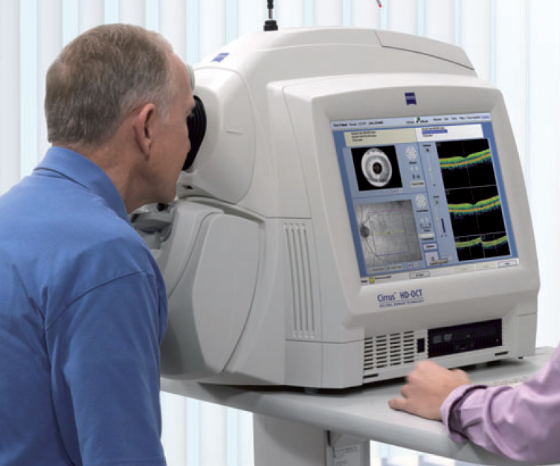
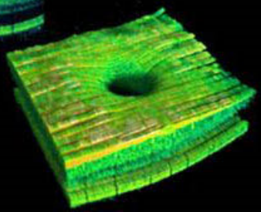
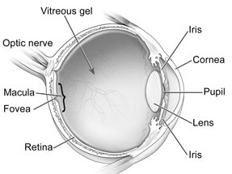
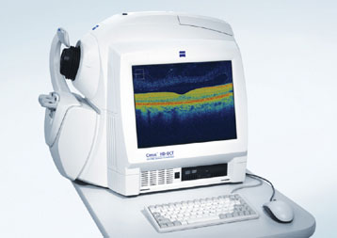

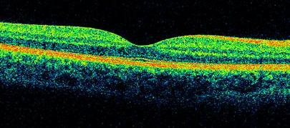
OCT Imaging in Ophthalmology
OCT (Optical Coherence Tomography)
  Non-contact, non-invasive 3D imaging
  Becoming as standard of care since 1991
Working principle:
  Emit lights into the eye; measure reflectivity of the tissues within a target cube
  Rendering the measurements for visualizing inner-structures
x
z
y
x
y
z
OCT volume
x
z
OCT slice

Slide 3
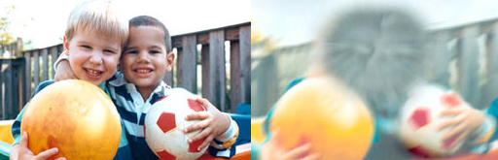
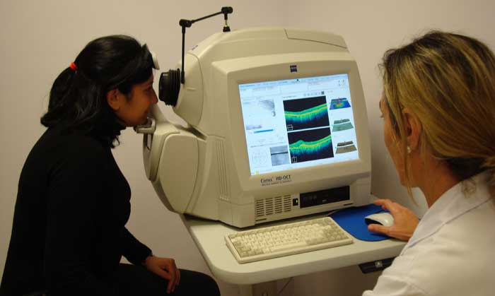
Motivation for Automated Pathology Diagnosis
Protect vision, need regular and large-scale screening;
require CAD tool to improve efficiency
Ophthalmologists have no access to radiologists;
CAD tool can help alleviate burden
In U.S., 30% of 75 yr. olds suffer
gradual loss of central vision (AMD)
regular screening help
detect early pathology
H
Radiologists
Ophthalmologists

Slide 4
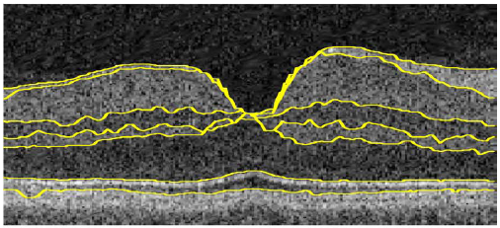
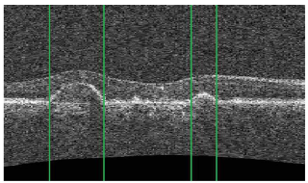
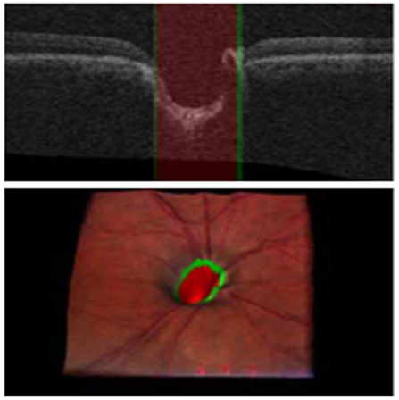
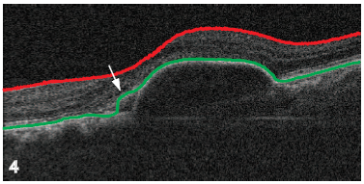
Prior Work in Analyzing Ocular OCT
Most Prior work focused on segmentation tasks
  Intra-retinal layer segmentation
Fluid-filled column segmentation
  Optic disc segmentation
[Garvin MK, et.al, TMI’08]
[G. Quellec , TMI’10]
[Lee K, et.al, TMI’10]
  Top and bottom layer segmentation
[Tapio, et.al, Opt Express’09]

Slide 5

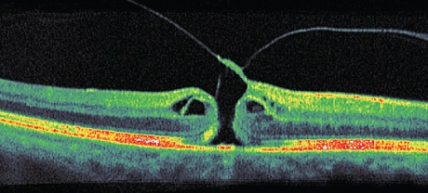
Our Goal: Automated Pathology Diagnosis
No prior work on computer-aided
diagnosis of macular pathology
Our goal: given the foveal slice from a 3D macular scan, automatically determine the presence of normal macula (NM) and three pathologies (MH, ME, AMD)
  All pathologies can coexist
Macular Scan
Foveal Slice
Presence
Normal macula (NM)? NO
Macular hole (MH)? YES
Macular edema (ME)? YES
Age-related degeneration (AMD)? NO
Auto
Diagnosis

Slide 6
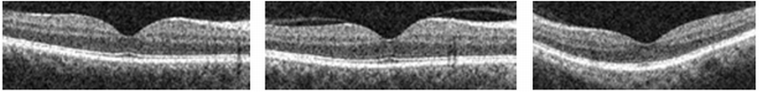
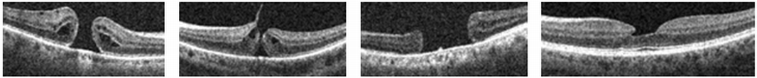
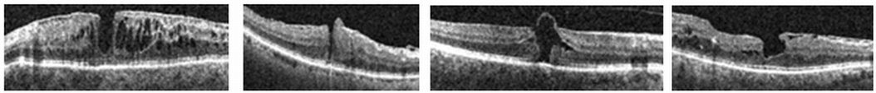
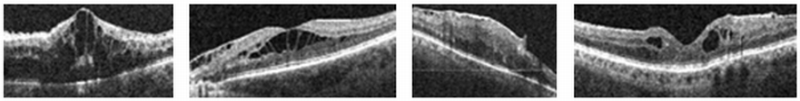
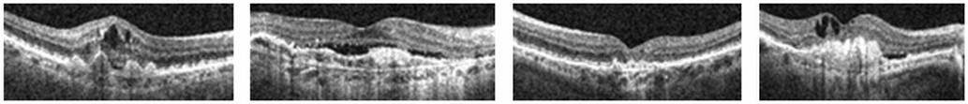
Examples of Normal Macula and Macular Pathology
High variations within each pathology!
NM
Normal Macula: a smooth depression arount the center, no abornomal tissues embedded
MH
Macular Hole: a full or partial (pseudo) hole arount the center
ME
Macular Edema: retinal thickening or fluid accumulation (black blobs)
AMD
Age-related Macular Degeneration: irregular shape of the bottom retinal layer

Slide 7
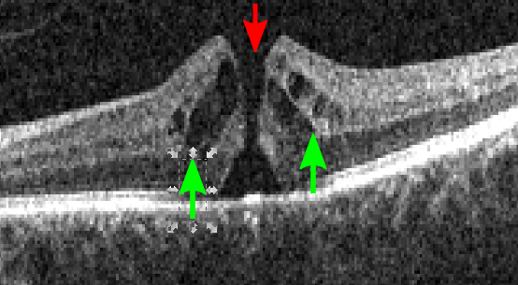
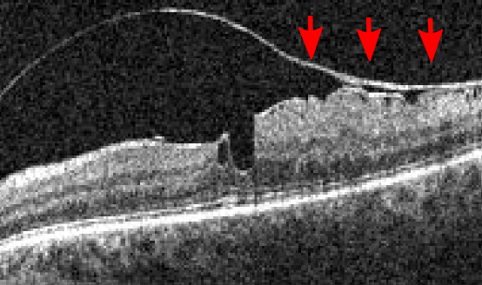
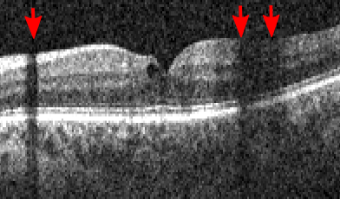
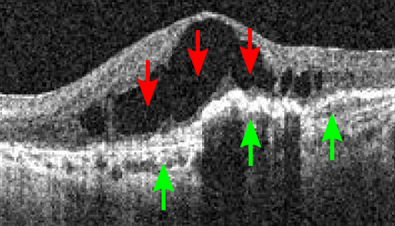

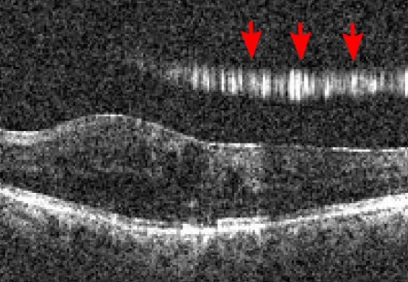
Challenges in Analyzing Ocular OCT
1. Multiple pathologies coexist
2. proliferated/deformed tissues
cover top layer/hole
3. Shadowing effects
by blood vessels/opaque media
MH+ME
ME+AMD
Handcrafting high-level rules is unlikely to generalize well
We use low-level features and data-driven approach for robust analysis

Slide 8
Overview of Our Learning-based Approach
Training
FovealSlice
Output:
Large
OCT Scan Set
Labeled
Foveal-Slice Set
SVM
Classifier
Training
Feature
Extraction
NM classifier
MH classifier
ME classifier
AMD classifier
NM | NO
ME | YES
MH | NO
AMD | YES
Patho.
+
-
Testing
Output:
Automated Diagnosis:
Input:
Feature
Extraction
Patho.
Presence
Classification
NM | NO
ME | YES
MH | YES
AMD | NO
Foveal
Slice

Slide 9
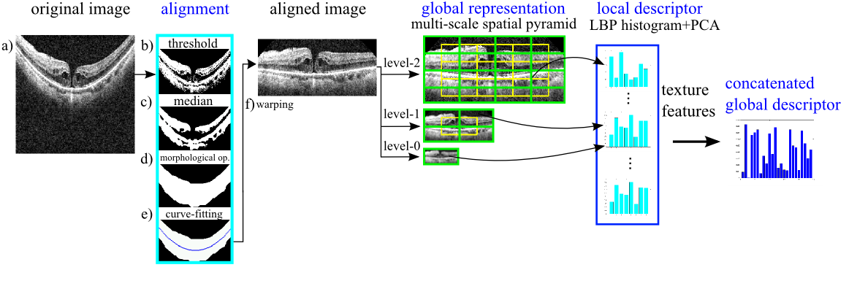
Overview of Algorithm
Feature Extraction
Classifier Training
Foveal Slice
Pre-
processing
Image
Representation
Descriptor
Generation
Classification
present
+
-
+
-
absent
+
-
+
-
-

Slide 10
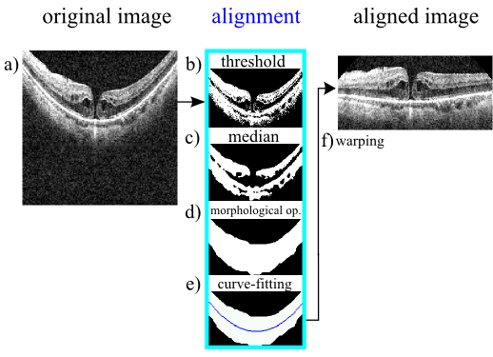
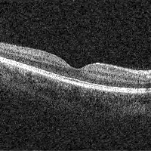

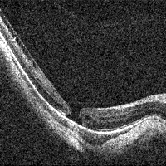

Preprocessing: Retina Alignment (1/2)
alignment
Classifier Training
Foveal Slice
Pre-
processing
Image
Representation
Descriptor
Generation
Classification
Purpose : reduce the appearance variations across scans
original image
aligned image
Align
remove curvature
and centering
Large variations in
positions, curvatures
Align
Align

Slide 11
Preprocessing: Retina Alignment (2/2)
alignment
Classifier Training
Foveal Slice
Pre-
processing
Image
Representation
Descriptor
Generation
Classification
Alignment process: find the retinal area, then curve-fit and warp
the retina to be roughly horizontal

Slide 12


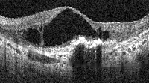
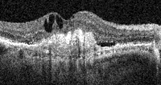
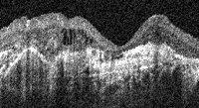
Image Representation
Classifier Training
Foveal Slice
Pre-
processing
Image
Representation
Descriptor
Generation
Classification
Good representation for ocular OCT should consider:
1.Spatial Location
2.Global Context
3.Multiple Scales
Pathology locality
Overall appearance
for correct interpretation
Small and large-scale changes
ME+AMD
ME+AMD

Slide 13
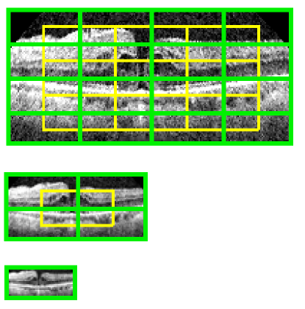

Image Representation:
Multi-Scale Spatial Pyramid (MSSP)
MSSP
Classifier Training
Foveal Slice
Pre-
processing
Image
Representation
Descriptor
Generation
Classification
1.Spatial Location
2.Global Context
3.Multiple Scales
  Multi-Scale Spatial Pyramid (MSSP) :
  preserve spatial organization of local features at multiple scales and spatial granularities
[Wu & Rehg, CVPR’08]
3-level MSSP
Finer spatial resolution
  Global descriptor:
  Concatenate local features
  in a fixed order
Level-2
Level-1
Coarser spatial resolution
Level-0

Slide 14
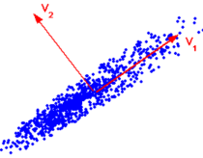
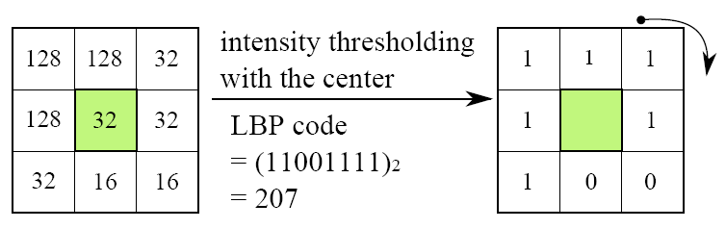
Local Descriptors: LBPpca
LBPpca
Classifier Training
Foveal Slice
Pre-
processing
Image
Representation
Descriptor
Generation
Classification
Suppress pixel noise
Encode micro-structures
Dimension reduction
Intensity
Quantization
Local Binary Pattern
Histogram
PCA
LBPpca
[Wu and Rehg, CVPR’08]
256 bins
32 dim.

Slide 15
Review of Algorithm
Feature Extraction
Alignment
Multi-Scale Spatial Pyramid
LBPpca
Classifier Training
Foveal Slice
Pre-
processing
Image
Representation
Descriptor
Generation
Classification

Slide 16
Classifier Training:
Support Vector Machine
SVM
Feature Extraction
Classifier Training
Foveal Slice
Pre-
processing
Image
Representation
Descriptor
Generation
Classification
Training:
present
+
Non-linear SVM
with RBF kernel,
probability output
-
absent
+
-
-
+
+
-
-
Testing:
sensitivity
ROC curve
1
SVM
Classifier
Probability
Decision Threshold t
present ?
YES/NO
1 - specificity
1

Slide 17
Dataset and Experiments
OCT dataset
  We collected 326 macular OCT scans from 136 subjects
  Ground truth: foveal slices and labels from one ophthalmologist
Experiment design
  10-fold cross-validation at subject level
  Area under ROC curve (AUC) as metric
Experiment result
  AUC: 0.991, 0.962, 0.894, 0.888 for NM, ME, MH, AMD
Validation: 3 sets of experiments for LBPpca, MSSP
Statistics | NM | ME | MH | AMD
# scans | 67 | 205 | 81 | 103
# subjects | 57 | 87 | 34 | 36
ROC curve
1
sensitivity
AUC
1 - specificity
1

Slide 18


Validation of LBPpca (1/2)
Performance comparison to other LBP-based methods:
  LBP (dim:256)
  Uniform LBP histogram (LBPu2) (dim:59):
  model distribution of patterns with infrequent bitwise changes!
  [Ojala, TPAMI’01, T. Ahonen, TPAMI’06, A. Oliver, MICCAI’07’]
Uniform patterns
For AMD,
LBPpca > LBPu2
(AMD: 0.888 vs. 0.867)
PCA preserves irregular shapes
of AMD better!
LBPpca, LBPu2 >> LBP
(0.93x vs. 0.81)
AUC | NM | ME | MH | AMD | Average
LBPpca (32) | 0.987 | 0.962 | 0.894 | 0.888 | 0.933
LBPu2 (59) | 0.991 | 0.965 | 0.901 | 0.867 | 0.931
LBP (256) | 0.931 | 0.845 | 0.774 | 0.693 | 0.811

Slide 19
Validation of LBPpca (2/2)
Performance comparison to other popular local descriptors:
For MH, AMD,
LBPpca >> the others
texture cues encoded by LBP are
relatively more effective!
AUC | NM | ME | MH | AMD | Average
LBP pca (32) | 0.987 | 0.962 | 0.894 | 0.888 | 0.933
Mean + std (2) | 0.965 | 0.951 | 0.714 | 0.784 | 0.854
Intensity histogram (32) | 0.970 | 0.963 | 0.826 | 0.824 | 0.895
Orientation histogram (32) | 0.983 | 0.958 | 0.845 | 0.857 | 0.911

Slide 20
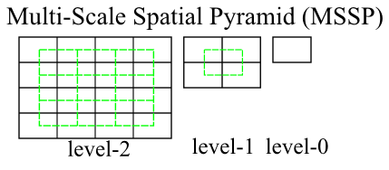
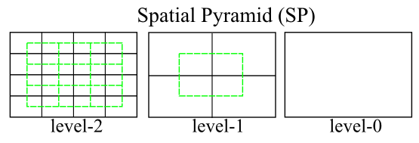
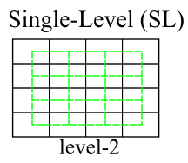
Validation of MSSP (1/2)
Compare MSSP to other spatial representations (SP, SL)
[Wu & Rehg, CVPR’08]
Multiple scales
Multiple spatial granularity
  [S. Lazebnik, CVPR’06]
Single scale
Multiple spatial granularities
[T. Ahonen, TPAMI’06]
[A. Oliver, MICCAI’07]
Single scale
Single spatial granularity

Slide 21
Validation of MSSP (2/2)
Performance comparison to “Spatial pyramid (SP)” and “Single level (SL)”
For AMD,
MSSP >> SP and SL
(0.888 vs. 0.84x)
Multi-scale modeling
is beneficial!
AUC | NM | ME | MH | AMD | Average
MSSP | 0.987 | 0.962 | 0.894 | 0.888 | 0.933
SP | 0.984 | 0.960 | 0.895 | 0.849 | 0.922
SL | 0.987 | 0.961 | 0.893 | 0.843 | 0.921

Slide 22
Conclusion
Addressed a novel problem
  Automated macular pathology diagnosis in OCT images
Developed an effective learning-based approach
  A large labeled OCT dataset of 326 scans
  Promising result: 0.991, 0.962, 0.894, 0.888 for NM, ME, MH, AMD
  Multi-scale global feature representation with LBPpca can effectively encodes the geometry and texture of the retina
Future work
  Exploring shape with texture features for better performance

Slide 23
Thank You!

Slide 24
Reference
Prior work in analyzing ocular OCT images
  M.K. Garvin, et. al, “Intraretinal layer segmentation of macular optical coherence tomography images using optimal 3-D graph search”, TMI 2008
  S.M. Tapio Fabritius, et.al, “Automated segmentation of the macula by optical coherence tomography”, Opt Express 2009
  G. Quellec, “Three-dimensional analysis of retinal layer texture: Identification of fluid-filled regions in SD-OCT of the macula”, TMI 2010
Local binary patterns (LBP)
  T. Ojala, et. al, “Multiresolution gray-scale and rotation invariant texture classification with local binary patterns”, TPAMI 2002
LBP applications
  T. Ahonen, et. al, “Face description with local binary patterns: Application to face recognition”, TPAMI 2006
  A. Oliver, et. al, “False positive reduction in mammographic mass detection using local binary patterns”, MICCAI 2007
  L. Sorensen, et. al, “Texture classification in lung CT using local binary patterns” , MICCAI 2008
Spatial pyramid
  S. Lazebnik, et. al, “Beyond bags of features: Spatial pyramid matching for recognizing natural scene categories”, CVPR 2006
Multi-scale spatial pyramid (MSSP), LBP+PCA
  J. Wu, J. M. Rehg, “Where am I: Place instance and category recognition using spatial PACT”, CVPR 2008

Slide 25
Backup Slides

Slide 26


Local Descriptor:
Alternative: uniform LBP
Uniform LBP (LBPu2)
[Ojala, TPAMI’01]
Separate to uniform and non-uniform patterns
all patterns (256)
uniform (58)
non-uniform (198)
LBPu2: retain distribution of uniform patterns only, since they are majority in pixel counts (>90%) [Ojala, TPAMI’01]
  Used often in literature [T. Ahonen, TPAMI’06, A. Oliver, MICCAI’07]
59 bins
256 bins
bin selection
& merging
58 uni. + 1 non-uni.
Notes:
And we are also aware another method for dimension reduction of LBP histogram.
, called uniform LBP, denoted as LBP u2, proposed by Ojala.
This method separates all patterns to two groups, one group called uniform, which contains patterns with less than 2 bitwise transitions; and all the other patterns are called non-uniform, which contain more frequent bit changes.
LBPu2 means that we retain the distribution of uniform pattern only, and the argument is that:
uniform patterns is usually in majority in pixel counts (>90%) when compute in texture images.
All the occurrentces of non-uniform patterns are merged into just 1 bin. Overall it will result in 59 bins.
This method is used more often in literature.

Slide 27
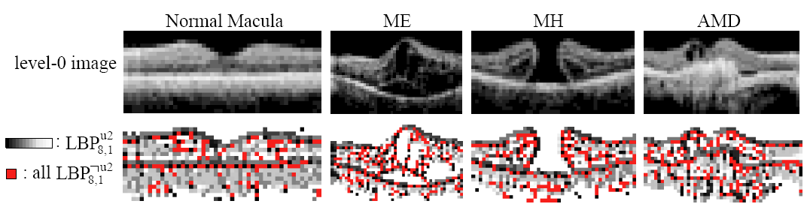
Local Descriptor:
Non-Uniform Patterns Can be Important
We argue that LBPpca is better than LBPu2 when frequent intensity changes are important (e.g. AMD)!
Visualization : non-uniform patterns reside mostly at edge contours
(likely important features!)
Uniform
All non-uniform

Slide 28
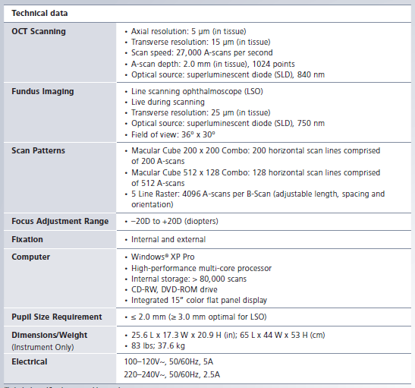
Zeiss Cirrus HD-OCT Machine

