Slide 1
CS 4803 / 7643: Deep Learning
Topics:
Regularization
Neural Networks
Dhruv Batra
Georgia Tech

Slide 2
Administrativia
PS1/HW1 out
Due: 09/09, 11:59pm
Asks about topics being covered now
Caveat: one more (extra credit) problem to be added
Please please please please start early
More details next class

Slide 3
Recap from last time

Slide 4
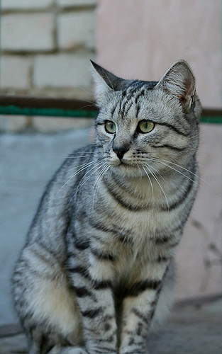
Parametric Approach: Linear Classifier
3072x1
f(x,W) = Wx + b
10x1
Image
10x1
10x3072
f(x,W)
10 numbers giving class scores
Array of 32x32x3 numbers
(3072 numbers total)
W
parameters
or weights
Slide Credit: Fei-Fei Li, Justin Johnson, Serena Yeung, CS 231n

Slide 5
Example with an image with 4 pixels, and 3 classes (cat/dog/ship)
Stretch pixels into column
56
231
24
2
56 | 231
24 | 2
Input image
Slide Credit: Fei-Fei Li, Justin Johnson, Serena Yeung, CS 231n

Slide 6
Example with an image with 4 pixels, and 3 classes (cat/dog/ship)
Stretch pixels into column
56
231
24
2
0.2 | -0.5 | 0.1 | 2.0
1.5 | 1.3 | 2.1 | 0.0
0 | 0.25 | 0.2 | -0.3
1.1
3.2
-1.2
-96.8
437.9
61.95
Cat score
56 | 231
24 | 2
+
=
Dog score
Ship score
Input image
W
b
Slide Credit: Fei-Fei Li, Justin Johnson, Serena Yeung, CS 231n

Slide 7
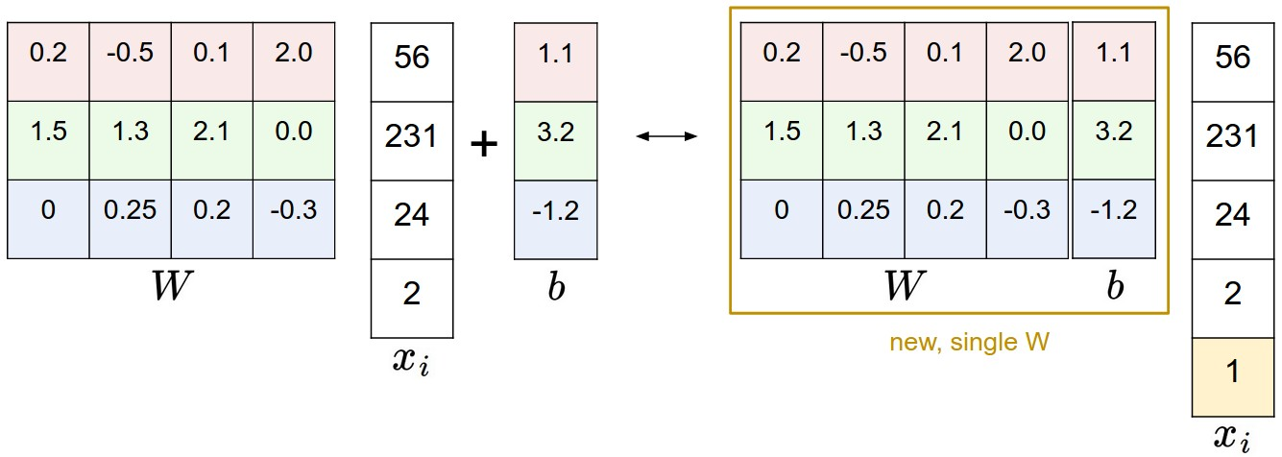
Image Credit: Andrej Karpathy, CS231n

Slide 8
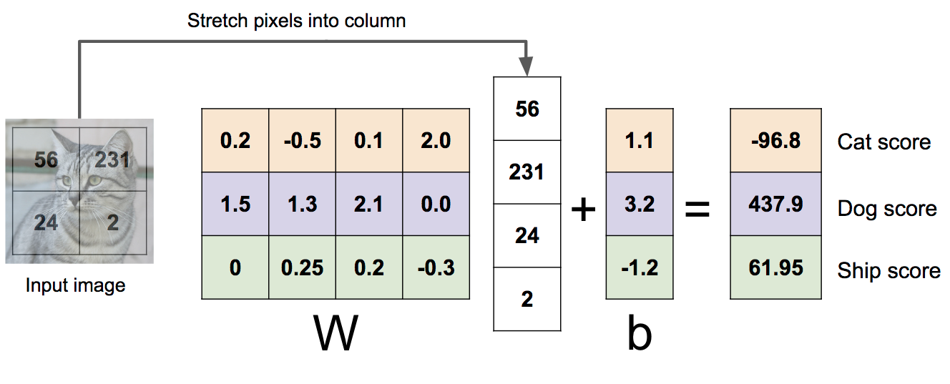

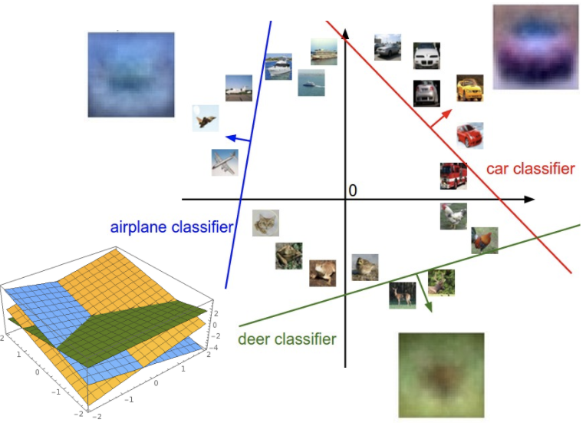
Linear Classifier: Three Viewpoints
Algebraic Viewpoint
Visual Viewpoint
Geometric Viewpoint
f(x,W) = Wx
One template per class
Hyperplanes cutting up space
Slide Credit: Fei-Fei Li, Justin Johnson, Serena Yeung, CS 231n

Slide 9
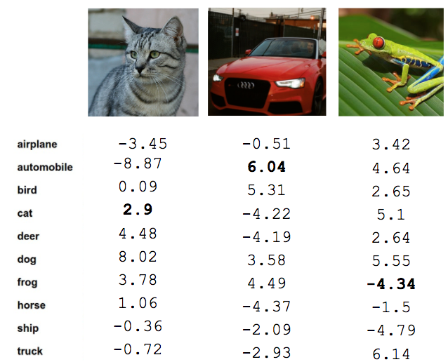
Recall from last time: Linear Classifier
TODO:
Define a loss function that quantifies our unhappiness with the scores across the training data.
Come up with a way of efficiently finding the parameters that minimize the loss function. (optimization)
Cat image by Nikita is licensed under CC-BY 2.0; Car image is CC0 1.0 public domain; Frog image is in the public domain
Slide Credit: Fei-Fei Li, Justin Johnson, Serena Yeung, CS 231n

Slide 10


Softmax vs. SVM
Slide Credit: Fei-Fei Li, Justin Johnson, Serena Yeung, CS 231n

Slide 11


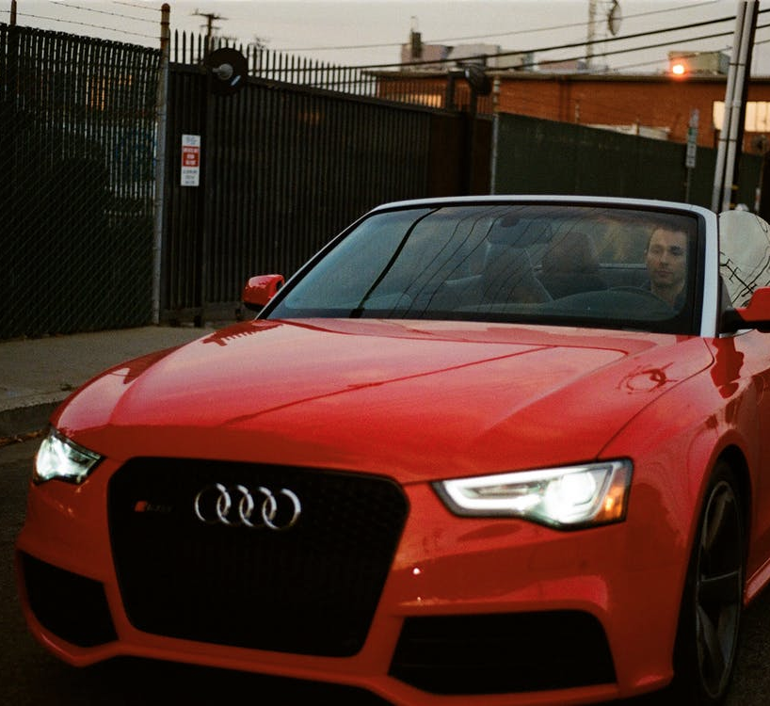
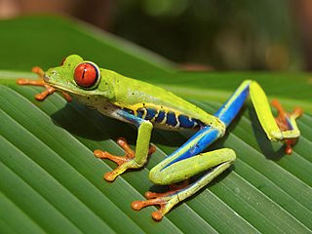




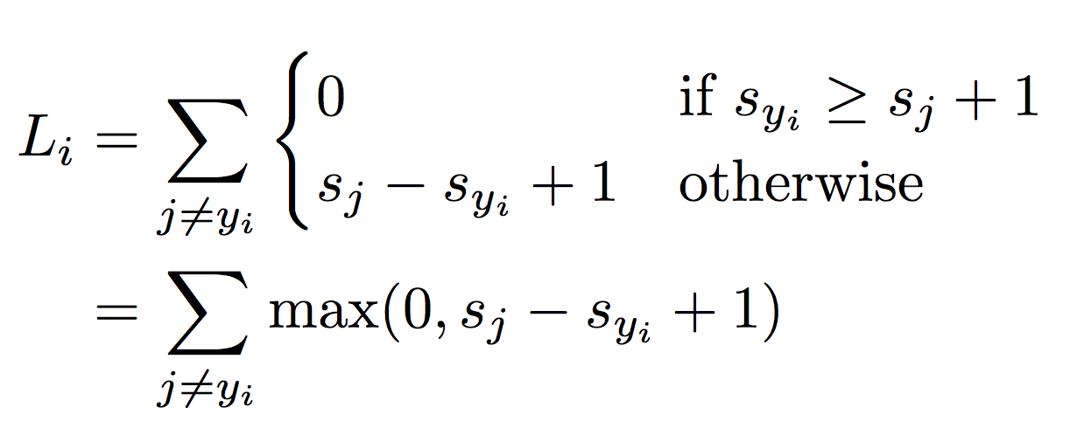

Suppose: 3 training examples, 3 classes.
With some W the scores are:
Multiclass SVM loss:
Given an example
where is the image and
where is the (integer) label,
and using the shorthand for the scores vector:
the SVM loss has the form:
“Hinge loss”
cat
3.2
1.3
2.2
car
5.1
4.9
2.5
frog
-1.7
2.0
-3.1
Slide Credit: Fei-Fei Li, Justin Johnson, Serena Yeung, CS 231n

Slide 12
Softmax vs. SVM
Slide Credit: Fei-Fei Li, Justin Johnson, Serena Yeung, CS 231n

Slide 13


Softmax Classifier (Multinomial Logistic Regression)
Want to interpret raw classifier scores as probabilities
Softmax Function
cat
3.2
car
5.1
frog
-1.7
Slide Credit: Fei-Fei Li, Justin Johnson, Serena Yeung, CS 231n

Slide 14
Softmax Classifier (Multinomial Logistic Regression)
Want to interpret raw classifier scores as probabilities
Softmax Function
Probabilities must be >= 0
cat
3.2
24.5
exp
car
5.1
164.0
frog
-1.7
0.18
unnormalized probabilities
Slide Credit: Fei-Fei Li, Justin Johnson, Serena Yeung, CS 231n

Slide 15
Softmax Classifier (Multinomial Logistic Regression)
Want to interpret raw classifier scores as probabilities
Softmax Function
Probabilities must be >= 0
Probabilities must sum to 1
cat
3.2
24.5
0.13
exp
normalize
car
5.1
164.0
0.87
frog
-1.7
0.18
0.00
unnormalized probabilities
probabilities
Slide Credit: Fei-Fei Li, Justin Johnson, Serena Yeung, CS 231n

Slide 16
Softmax Classifier (Multinomial Logistic Regression)
Want to interpret raw classifier scores as probabilities
Softmax Function
Probabilities must be >= 0
Probabilities must sum to 1
cat
3.2
24.5
0.13
exp
normalize
car
5.1
164.0
0.87
frog
-1.7
0.18
0.00
Unnormalized log-probabilities / logits
unnormalized probabilities
probabilities
Slide Credit: Fei-Fei Li, Justin Johnson, Serena Yeung, CS 231n

Slide 17

Softmax Classifier (Multinomial Logistic Regression)
Want to interpret raw classifier scores as probabilities
Softmax Function
Probabilities must be >= 0
Probabilities must sum to 1
cat
3.2
24.5
0.13
L_{i} = -log(0.13)
= 2.04
exp
normalize
car
5.1
164.0
0.87
frog
-1.7
0.18
0.00
Unnormalized log-probabilities / logits
unnormalized probabilities
probabilities
Slide Credit: Fei-Fei Li, Justin Johnson, Serena Yeung, CS 231n

Slide 18
Softmax Classifier (Multinomial Logistic Regression)
Want to interpret raw classifier scores as probabilities
Softmax Function
Probabilities must be >= 0
Probabilities must sum to 1
cat
3.2
24.5
0.13
L_{i} = -log(0.13)
= 2.04
exp
normalize
car
5.1
164.0
0.87
-1.7
0.18
0.00
Maximum Likelihood Estimation
Choose probabilities to maximize the likelihood of the observed data
frog
Unnormalized log-probabilities / logits
unnormalized probabilities
probabilities
Slide Credit: Fei-Fei Li, Justin Johnson, Serena Yeung, CS 231n

Slide 19
Softmax Classifier (Multinomial Logistic Regression)
Want to interpret raw classifier scores as probabilities
Softmax Function
Probabilities must be >= 0
Probabilities must sum to 1
cat
3.2
24.5
0.13
compare
1.00
exp
normalize
car
5.1
164.0
0.87
0.00
frog
-1.7
0.18
0.00
0.00
Unnormalized log-probabilities / logits
unnormalized probabilities
probabilities
Correct
probs
Slide Credit: Fei-Fei Li, Justin Johnson, Serena Yeung, CS 231n

Slide 20
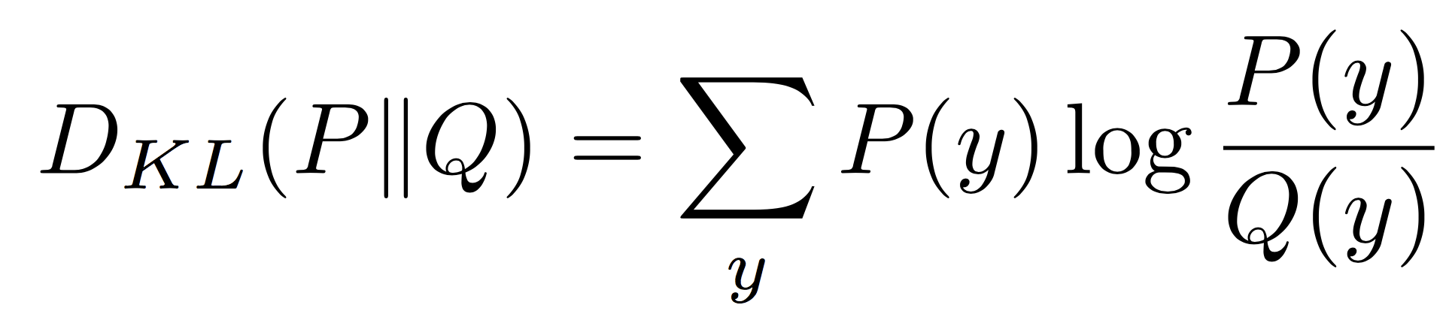
Softmax Classifier (Multinomial Logistic Regression)
Want to interpret raw classifier scores as probabilities
Softmax Function
Probabilities must be >= 0
Probabilities must sum to 1
cat
3.2
24.5
0.13
compare
1.00
exp
normalize
Kullback–Leibler divergence
car
5.1
164.0
0.87
0.00
frog
-1.7
0.18
0.00
0.00
Unnormalized log-probabilities / logits
unnormalized probabilities
probabilities
Correct
probs
Slide Credit: Fei-Fei Li, Justin Johnson, Serena Yeung, CS 231n
Notes:
Mention that this is useful for cases where you might have some target probability distribution instead of just one correct class, due to uncertainty in the model; also mention distillation

Slide 21
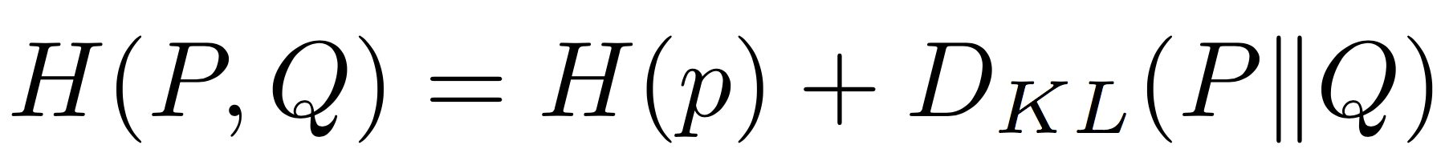
Softmax Classifier (Multinomial Logistic Regression)
Want to interpret raw classifier scores as probabilities
Softmax Function
Probabilities must be >= 0
Probabilities must sum to 1
cat
3.2
24.5
0.13
compare
1.00
exp
normalize
car
5.1
164.0
0.87
Cross Entropy
0.00
frog
-1.7
0.18
0.00
0.00
Unnormalized log-probabilities / logits
unnormalized probabilities
probabilities
Correct
probs
Slide Credit: Fei-Fei Li, Justin Johnson, Serena Yeung, CS 231n
Notes:
Mention that this is useful for cases where you might have some target probability distribution instead of just one correct class, due to uncertainty in the model; also mention distillation

Slide 22
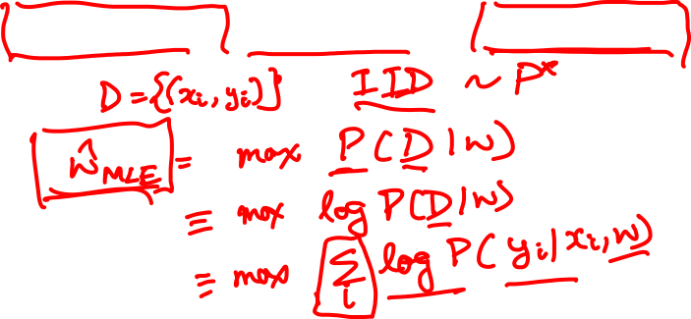
Log-Likelihood / KL-Divergence / Cross-Entropy

Slide 23
Plan for Today
Regularization
Neural Networks

Slide 24
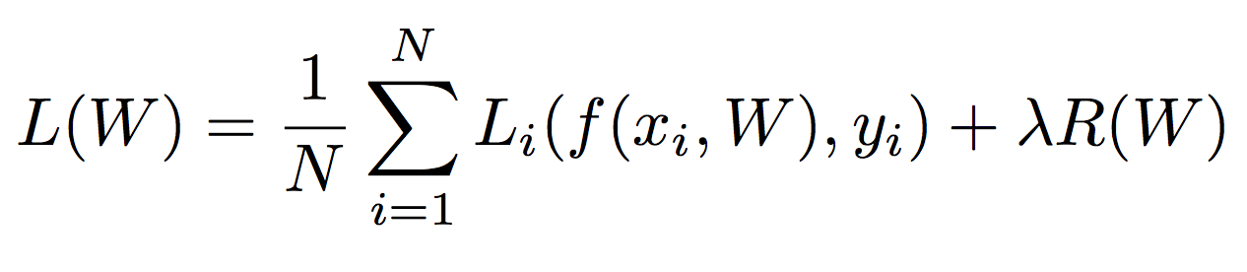
Regularization
Data loss: Model predictions should match training data
Slide Credit: Fei-Fei Li, Justin Johnson, Serena Yeung, CS 231n

Slide 25
Regularization
Data loss: Model predictions should match training data
Regularization: Prevent the model from doing too well on training data
Slide Credit: Fei-Fei Li, Justin Johnson, Serena Yeung, CS 231n

Slide 26

Regularization
= regularization strength
(hyperparameter)
Data loss: Model predictions should match training data
Regularization: Prevent the model from doing too well on training data
Slide Credit: Fei-Fei Li, Justin Johnson, Serena Yeung, CS 231n

Slide 27
Regularization Intuition in Polynomial Regression
y
x
Slide Credit: Fei-Fei Li, Justin Johnson, Serena Yeung, CS 231n

Slide 28
Polynomial Regression
f
y
x
Slide Credit: Fei-Fei Li, Justin Johnson, Serena Yeung, CS 231n

Slide 29
Polynomial Regression

Slide 30
Polynomial Regression

Slide 31
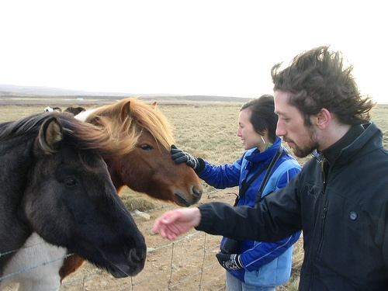
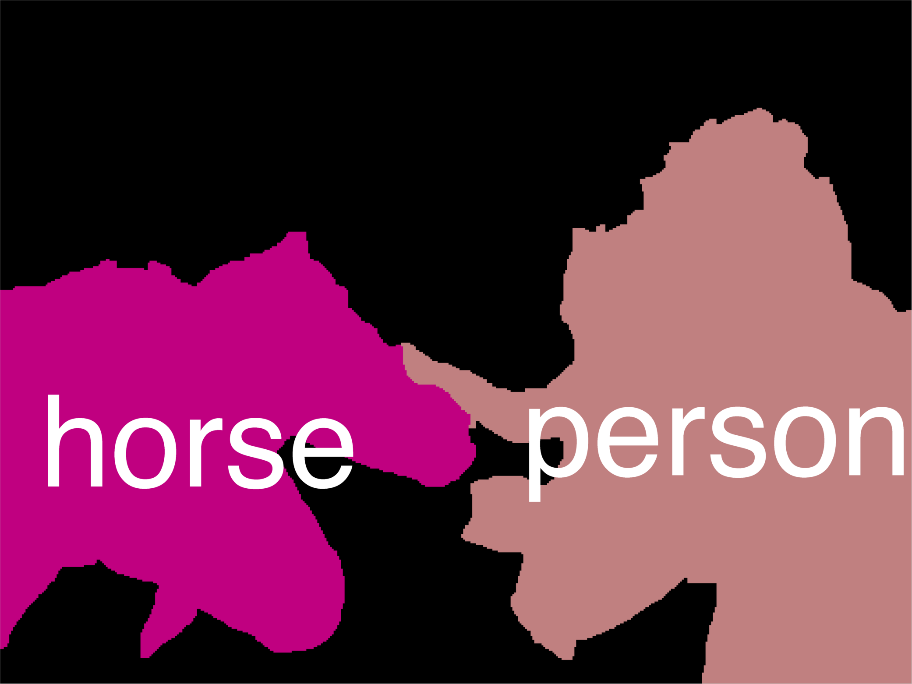
Error Decomposition
Reality
Multi-class Logistic Regression
Modeling Error
Softmax
FC HxWx3
Input
Estimation Error
Optimization Error = 0
model class

Slide 32
Polynomial Regression
Demo: https://arachnoid.com/polysolve/
You are a scientist studying runners.
You measure average speeds of the best runners at different ages.
Data: Age (years), Speed (mph)
10 6
15 9
20 11
25 12
29 13
40 11
50 10
60 9

Slide 33
Regularization: Prefer Simpler Models
f₁
f₂
y
x
Regularization pushes against fitting the data too well so we don’t fit noise in the data
Slide Credit: Fei-Fei Li, Justin Johnson, Serena Yeung, CS 231n

Slide 34
Regularization
= regularization strength
(hyperparameter)
Data loss: Model predictions should match training data
Regularization: Prevent the model from doing too well on training data
Slide Credit: Fei-Fei Li, Justin Johnson, Serena Yeung, CS 231n

Slide 35



Regularization
= regularization strength
(hyperparameter)
Data loss: Model predictions should match training data
Regularization: Prevent the model from doing too well on training data
Simple examples
L2 regularization:
L1 regularization:
Elastic net (L1 + L2):
Slide Credit: Fei-Fei Li, Justin Johnson, Serena Yeung, CS 231n

Slide 36
Regularization
= regularization strength
(hyperparameter)
Data loss: Model predictions should match training data
Regularization: Prevent the model from doing too well on training data
Simple examples
L2 regularization:
L1 regularization:
Elastic net (L1 + L2):
More complex:
Dropout
Batch normalization
Stochastic depth, fractional pooling, etc
Slide Credit: Fei-Fei Li, Justin Johnson, Serena Yeung, CS 231n

Slide 37
Regularization
= regularization strength
(hyperparameter)
Data loss: Model predictions should match training data
Regularization: Prevent the model from doing too well on training data
Why regularize?
Express preferences over weights
Make the model simple so it works on test data
Improve optimization by adding curvature
Slide Credit: Fei-Fei Li, Justin Johnson, Serena Yeung, CS 231n

Slide 38




Regularization: Expressing Preferences
L2 Regularization
Slide Credit: Fei-Fei Li, Justin Johnson, Serena Yeung, CS 231n

Slide 39
Regularization: Expressing Preferences
L2 Regularization
L2 regularization likes to “spread out” the weights
Slide Credit: Fei-Fei Li, Justin Johnson, Serena Yeung, CS 231n

Slide 40

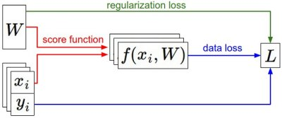

Recap
We have some dataset of (x,y)
We have a score function:
We have a loss function:
e.g.
Softmax
SVM
Full loss
Slide Credit: Fei-Fei Li, Justin Johnson, Serena Yeung, CS 231n

Slide 41
Recap
How do we find the best W?
We have some dataset of (x,y)
We have a score function:
We have a loss function:
e.g.
Softmax
SVM
Full loss
Slide Credit: Fei-Fei Li, Justin Johnson, Serena Yeung, CS 231n

Slide 42
Next: Neural Networks
Slide Credit: Fei-Fei Li, Justin Johnson, Serena Yeung, CS 231n

Slide 43
So far: Linear Classifiers
Class scores
f(x) = Wx

Slide 44
Hard cases for a linear classifier
Class 1:
First and third quadrants
Class 2:
Second and fourth quadrants
Class 1:
1 <= L2 norm <= 2
Class 2:
Everything else
Class 1:
Three modes
Class 2:
Everything else
Slide Credit: Fei-Fei Li, Justin Johnson, Serena Yeung, CS 231n

Slide 45
Aside: Image Features
f(x) = Wx
Class scores
Feature Representation
Slide Credit: Fei-Fei Li, Justin Johnson, Serena Yeung, CS 231n

Slide 46
Image Features: Motivation
y
x
Cannot separate red and blue points with linear classifier
Slide Credit: Fei-Fei Li, Justin Johnson, Serena Yeung, CS 231n

Slide 47
Image Features: Motivation
y
θ
f(x, y) = (r(x, y), θ(x, y))
x
r
Cannot separate red and blue points with linear classifier
After applying feature transform, points can be separated by linear classifier
Slide Credit: Fei-Fei Li, Justin Johnson, Serena Yeung, CS 231n

Slide 48

Example: Color Histogram
+1
Slide Credit: Fei-Fei Li, Justin Johnson, Serena Yeung, CS 231n

Slide 49

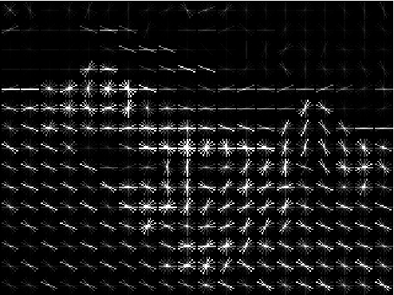
Example: Histogram of Oriented Gradients (HoG)
Divide image into 8x8 pixel regions
Within each region quantize edge direction into 9 bins
Example: 320x240 image gets divided into 40x30 bins; in each bin there are 9 numbers so feature vector has 30*40*9 = 10,800 numbers
Lowe, “Object recognition from local scale-invariant features”, ICCV 1999
Dalal and Triggs, "Histograms of oriented gradients for human detection," CVPR 2005
Slide Credit: Fei-Fei Li, Justin Johnson, Serena Yeung, CS 231n

Slide 50

Example: Bag of Words
Step 1: Build codebook
Cluster patches to form “codebook” of “visual words”
Extract random patches
Step 2: Encode images
Fei-Fei and Perona, “A bayesian hierarchical model for learning natural scene categories”, CVPR 2005
Slide Credit: Fei-Fei Li, Justin Johnson, Serena Yeung, CS 231n

Slide 51
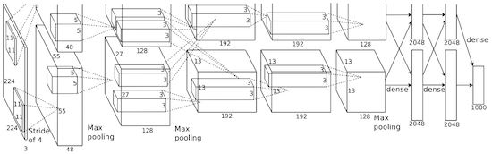
Image features vs Neural Nets
f
Feature Extraction
10 numbers giving scores for classes
training
Krizhevsky, Sutskever, and Hinton, “Imagenet classification with deep convolutional neural networks”, NIPS 2012.
Figure copyright Krizhevsky, Sutskever, and Hinton, 2012. Reproduced with permission.
10 numbers giving scores for classes
training
Slide Credit: Fei-Fei Li, Justin Johnson, Serena Yeung, CS 231n

Slide 52
Error Decomposition
Reality
Multi-class Logistic Regression
Modeling Error
Softmax
FC HxWx3
Input
Estimation Error
Optimization Error = 0
model class

Slide 53

Neural networks: without the brain stuff
(Before) Linear score function:
Slide Credit: Fei-Fei Li, Justin Johnson, Serena Yeung, CS 231n
Notes:
Have been using linear score function as running example of function to optimize

Slide 54

Neural networks: without the brain stuff
(Before) Linear score function:
(Now) 2-layer Neural Network
Slide Credit: Fei-Fei Li, Justin Johnson, Serena Yeung, CS 231n
Notes:
Instead of using single linear transformation, stack 2 together, get 2-layer network

Slide 55
Neural networks: without the brain stuff
(Before) Linear score function:
(Now) 2-layer Neural Network
x
h
W1
W2
s
3072
100
10
Slide Credit: Fei-Fei Li, Justin Johnson, Serena Yeung, CS 231n
Notes:
First have W1*x, then nonlinear function, then second linear layer
More broadly speaking, NN are class of functions where simpler functions are stacked on top of each other in a hierarchical way to make up a more complex, nonlinear function. Have multiple stages of hierarchical computation.

Slide 56
Neural networks: without the brain stuff
(Before) Linear score function:
(Now) 2-layer Neural Network
x
h
W1
W2
s
3072
100
10
Slide Credit: Fei-Fei Li, Justin Johnson, Serena Yeung, CS 231n
Notes:
Biological inspirations to neurons in brain that we’ll discuss later
Looking at it mathematically first, one thing this can help solve, is if we look back to our linear score function, each row of W corresponded to a template
Problem that there can be only one template per class, can’t look for multiple modes
Now intermediate layers can represent anonymous templates that later get recombined
Intermediate layers anonymous templates that get recombined. solves mode problems

Slide 57
Neural networks: without the brain stuff
(Before) Linear score function:
(Now) 2-layer Neural Network
or 3-layer Neural Network
Slide Credit: Fei-Fei Li, Justin Johnson, Serena Yeung, CS 231n
Notes:
Can stack more of these layers to get deeper networks, where the term deep NN comes from

Slide 58
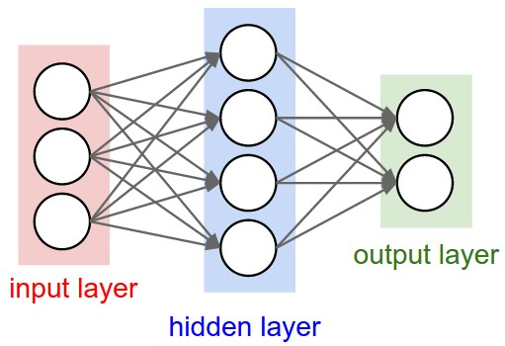
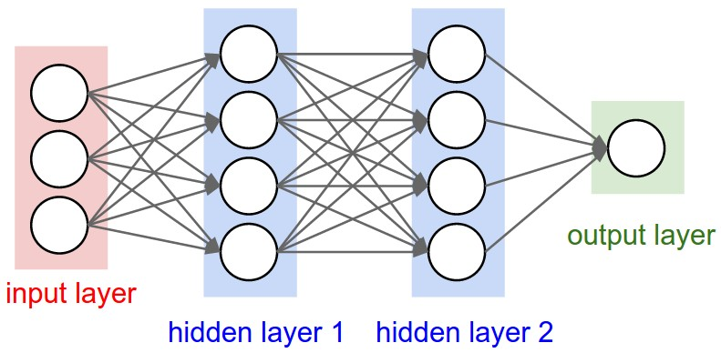
Multilayer Networks
Cascaded “neurons”
The output from one layer is the input to the next
Each layer has its own sets of weights
Image Credit: Andrej Karpathy, CS231n

Slide 59
Neural networks: Architectures
“3-layer Neural Net”, or
“2-hidden-layer Neural Net”
“2-layer Neural Net”, or
“1-hidden-layer Neural Net”
“Fully-connected” layers
Slide Credit: Fei-Fei Li, Justin Johnson, Serena Yeung, CS 231n

Slide 60
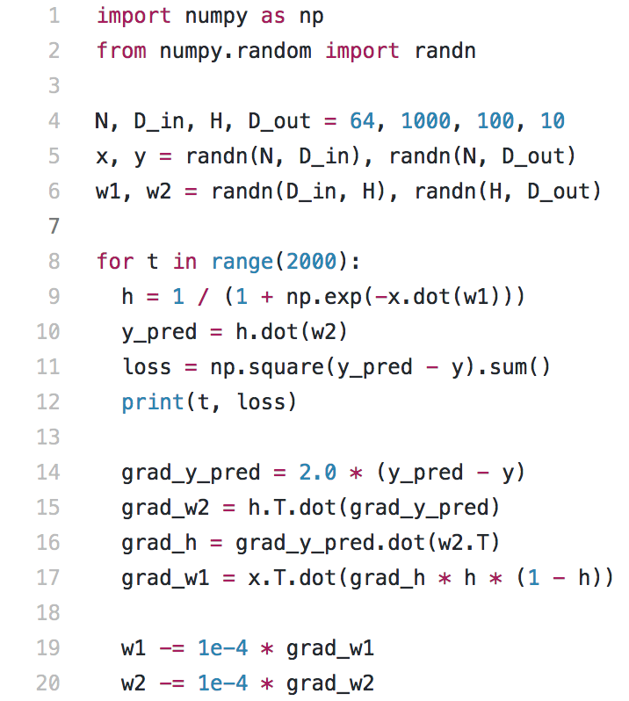
Full implementation of training a 2-layer Neural Network needs ~20 lines:
Slide Credit: Fei-Fei Li, Justin Johnson, Serena Yeung, CS 231n

Slide 61
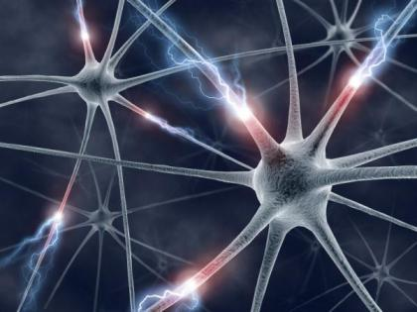
This image by Fotis Bobolas is licensed under CC-BY 2.0
Slide Credit: Fei-Fei Li, Justin Johnson, Serena Yeung, CS 231n
Notes:
Even though… still loosely inspired by brain, still interesting to understand where this comes from

Slide 62
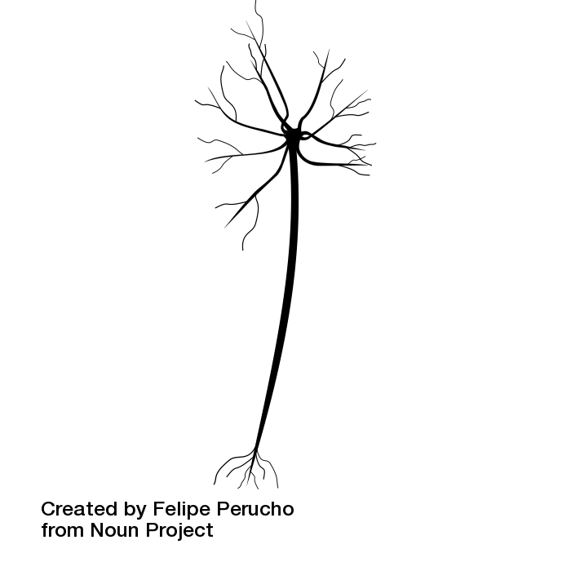
Impulses carried toward cell body
dendrite
presynaptic
terminal
axon
cell body
Impulses carried away from cell body
This image by Felipe Perucho
is licensed under CC-BY 3.0
Slide Credit: Fei-Fei Li, Justin Johnson, Serena Yeung, CS 231n

Slide 63
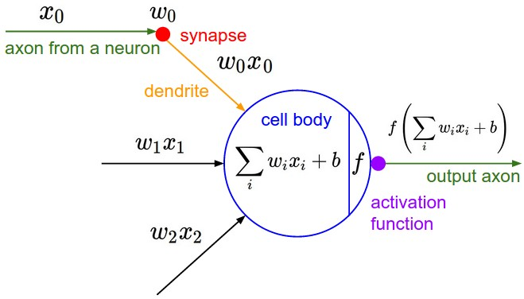
Impulses carried toward cell body
dendrite
presynaptic
terminal
axon
cell body
Impulses carried away from cell body
This image by Felipe Perucho
is licensed under CC-BY 3.0
Slide Credit: Fei-Fei Li, Justin Johnson, Serena Yeung, CS 231n

Slide 64
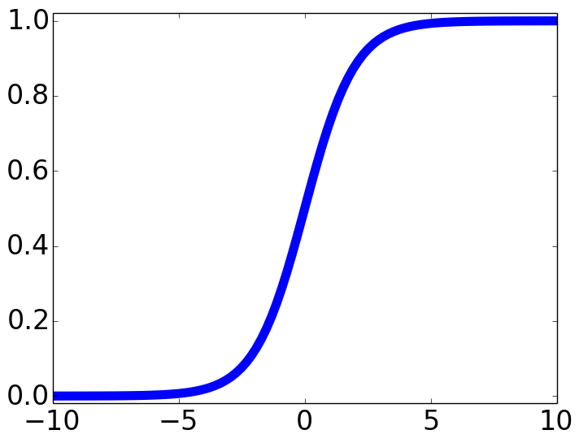

Impulses carried toward cell body
dendrite
presynaptic
terminal
axon
cell body
Impulses carried away from cell body
This image by Felipe Perucho
is licensed under CC-BY 3.0
sigmoid activation function
Slide Credit: Fei-Fei Li, Justin Johnson, Serena Yeung, CS 231n

Slide 65
Be very careful with your brain analogies!
Biological Neurons:
Many different types
Dendrites can perform complex non-linear computations
Synapses are not a single weight but a complex non-linear dynamical system
Rate code may not be adequate
[Dendritic Computation. London and Hausser]
Slide Credit: Fei-Fei Li, Justin Johnson, Serena Yeung, CS 231n

Slide 66
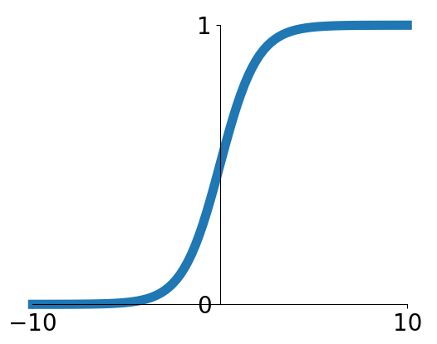
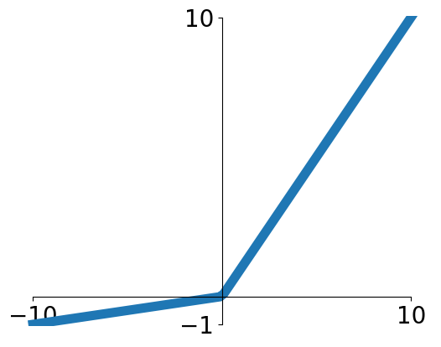


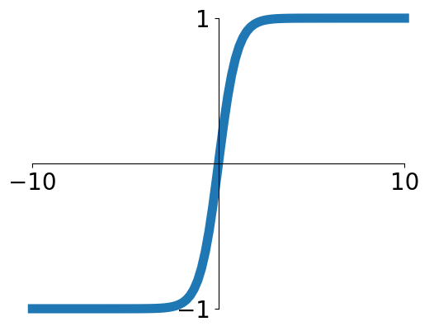


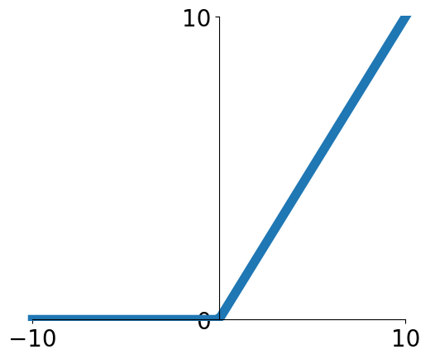
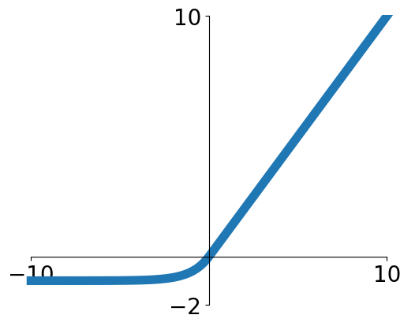

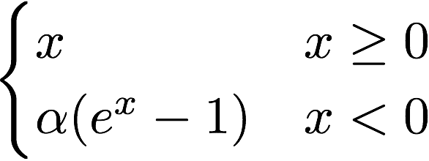
Activation functions
Sigmoid
Leaky ReLU
tanh
Maxout
ReLU
ELU
Slide Credit: Fei-Fei Li, Justin Johnson, Serena Yeung, CS 231n

Slide 67
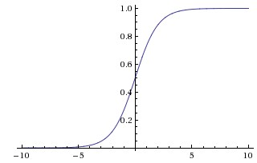
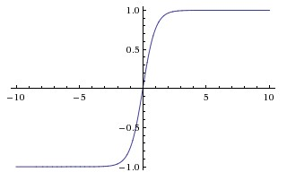
Activation Functions
sigmoid vs tanh

Slide 68
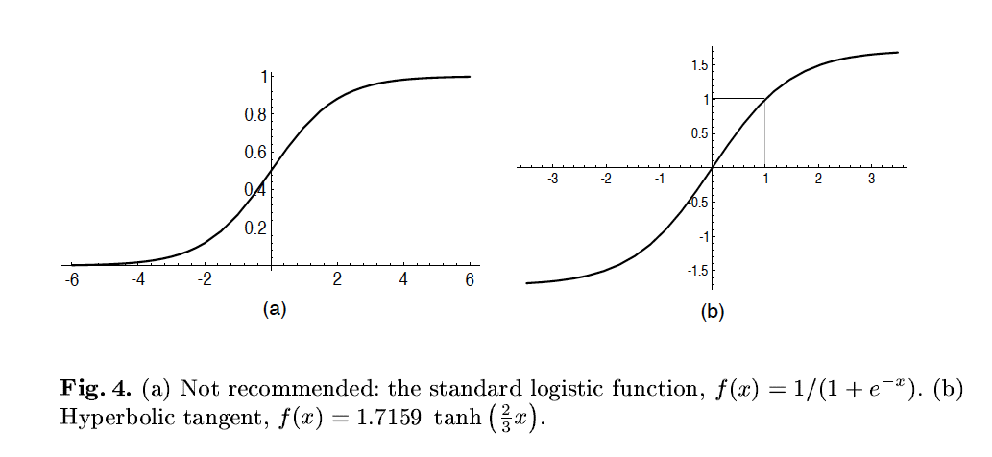
A quick note
Image Credit: LeCun et al. ‘98

Slide 69
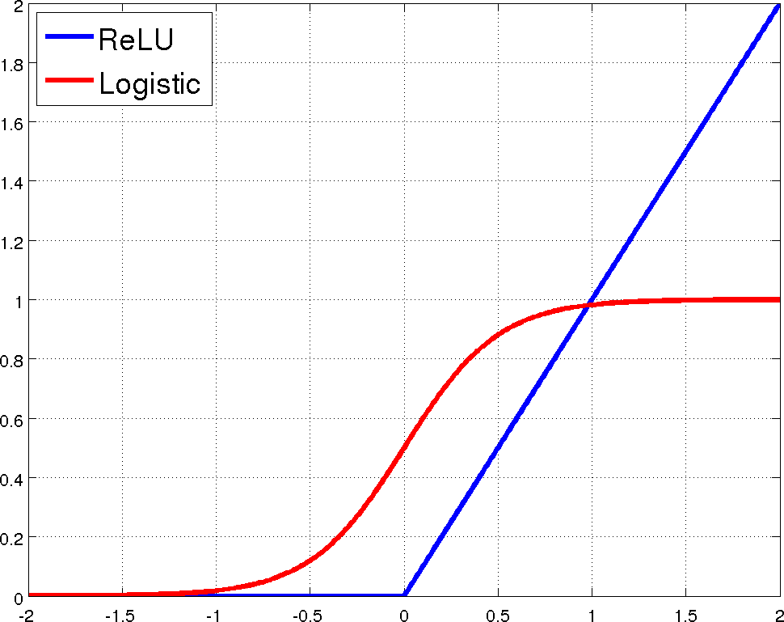
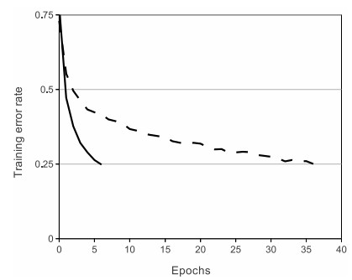
Rectified Linear Units (ReLU)
[Krizhevsky et al., NIPS12]

Slide 70
Demo Time
https://playground.tensorflow.org

Slide 71
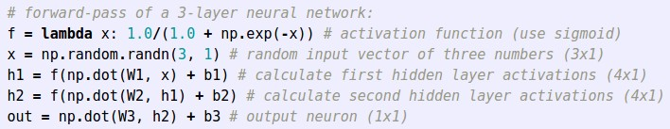
Example feed-forward computation of a neural network
Slide Credit: Fei-Fei Li, Justin Johnson, Serena Yeung, CS 231n

