Slide 1
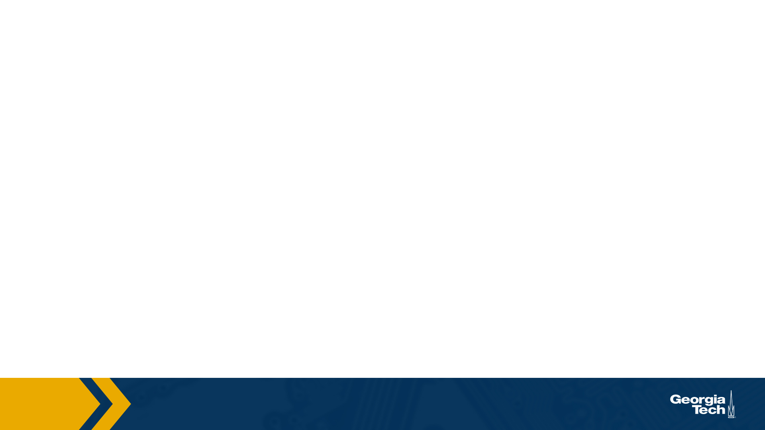
CS 4803 / 7643
Deep Learning, Fall 2020
Reinforcement Learning: Module 3/3
Presented by Nirbhay Modhe

Slide 2
Previous Lecture
MDPs: Value function, optimal quantities, algorithms for solving MDPs
RL: No rewards and transitions (RL), function approximation (deep RL).
Today
RL Algorithms
  Overview, types of RL algorithms
  Deep-Q Learning: A value based RL algorithm
  Policy gradients: A policy-based RL algorithm
Recap & Overview

Slide 3
Recursive Bellman expansion (from definition of Q)
(Expected) return from t = 0
(Reward at t = 0) + gamma * (Return from expected state at t=1)
Revisit: Deriving Optimality Equations

Slide 4
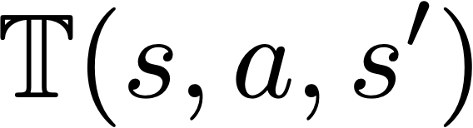
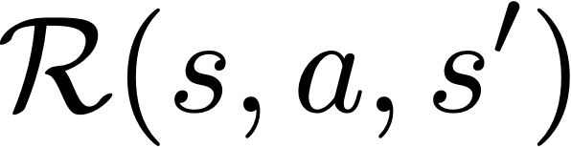
RL setting:
  unknown, how actions affect the environment
  unknown, what/when are the good actions?
Deep RL setting:
  Large or continuous state space
  Use deep neural networks to learn state representations
Recap: Learning Based Methods

Slide 5
Value-based RL
  (Deep) Q-Learning, approximating with a deep Q-network (DQN)
Policy-based RL
  Directly approximate optimal policy with a parametrized policy
Model-based RL
  Approximate transition function and reward function
  Plan by looking ahead in the (approx.) future!
Broad Types of RL Algorithms

Slide 6

Deep
Q-Learning

Slide 7
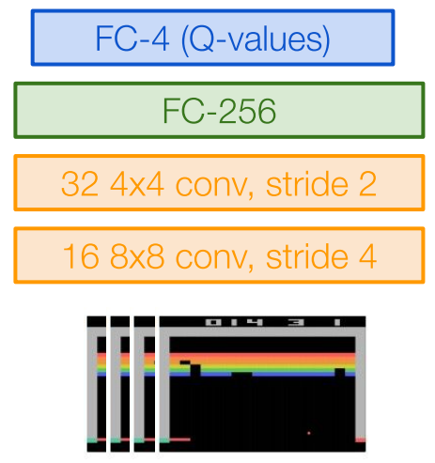
Intuition: Learn a parametrized Q-function from data
Q-Learning with linear function approximators
Deep Q-Learning: Fit a deep Q-Network
  Works well in practice
  Q-Network can take RGB images
Image Credits: Fei-Fei Li, Justin Johnson,
Serena Yeung, CS 231n
Deep Q-Learning

Slide 8
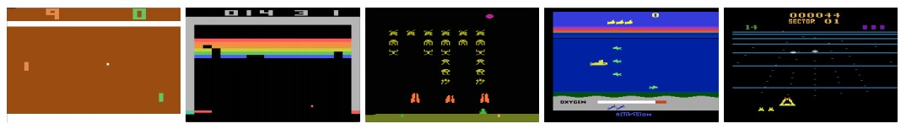
Atari Games
Objective: Complete the game with the highest score
State: Raw pixel inputs of the game state
Action: Game controls e.g. Left, Right, Up, Down
Reward: Score increase/decrease at each time step
Figures copyright Volodymyr Mnih et al., 2013. Reproduced with permission.
Slide Credit: Fei-Fei Li, Justin Johnson, Serena Yeung, CS 231n
Case study: Playing Atari Games

Slide 9
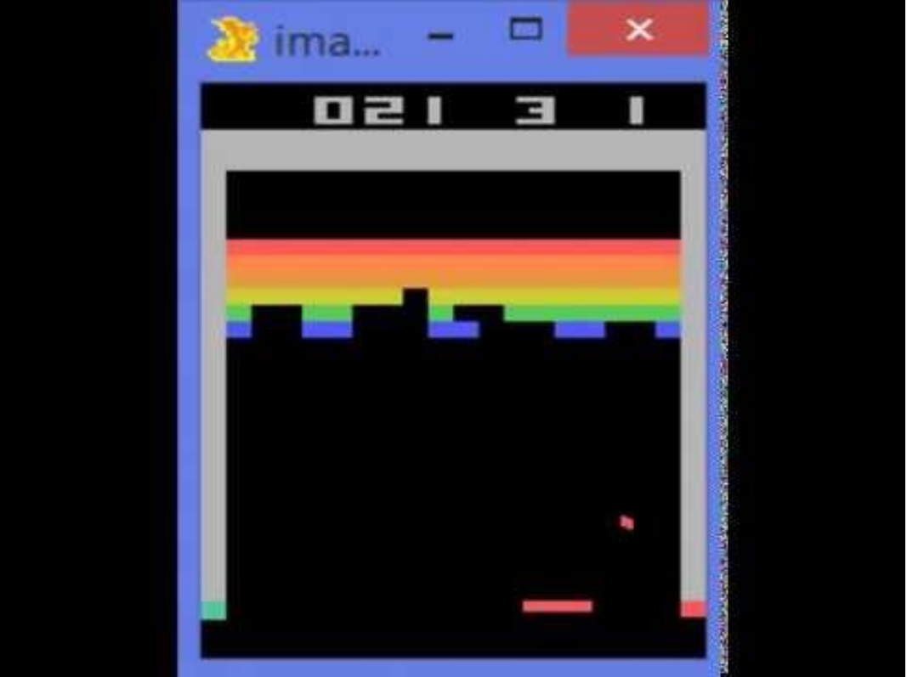
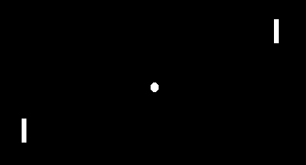
Atari Games
https://www.youtube.com/watch?v=V1eYniJ0Rnk
Slide Credit: Fei-Fei Li, Justin Johnson, Serena Yeung, CS 231n
Case study: Playing Atari Games

Slide 10
Assume we have collected a dataset:
We want a Q-function that satisfies bellman optimality (Q-value)
Loss for a single data point:
Predicted Q-Value
Target Q-Value
Deep Q-Learning

Slide 11
Minibatch of
Forward pass:
Compute loss:
Backward pass:
State
Q-Network
Q-Values per action
Q-Network
State
Deep Q-Learning

Slide 12
In practice, for stability:
  Freeze and update parameters
  Set at regular intervals
Deep Q-Learning

Slide 13
Assuming a fixed dataset, the MSE Loss can be optimized
  This is known as the Fitted Q-Iteration algorithm
However…
How to gather experience or “data”?
This is why RL is hard
Deep Q-Learning

Slide 14
Environment
Data
Train
Update
Challenge 1: Exploration vs Exploitation
Challenge 2: Non iid, highly correlated data
How to gather experience?

Slide 15
What should be?
  Greedy? -> Local minimas, no exploration
An exploration strategy:
Exploration Problem

Slide 16
Samples are correlated => high variance gradients => inefficient learning
Current Q-network parameters determines next training samples => can lead to bad feedback loops
  e.g. if maximizing action is to move right, training samples will be dominated by samples going right, may fall into local minima
R=10 |  |  |  | R=1
Correlated Data Problem

Slide 17
Correlated data: addressed by using experience replay
  A replay buffer stores transitions
  Continually update replay buffer as game (experience) episodes are played, older samples discarded
  Train Q-network on random minibatches of transitions from the replay memory, instead of consecutive samples
Larger the buffer, lower the correlation
Experience Replay

Slide 18
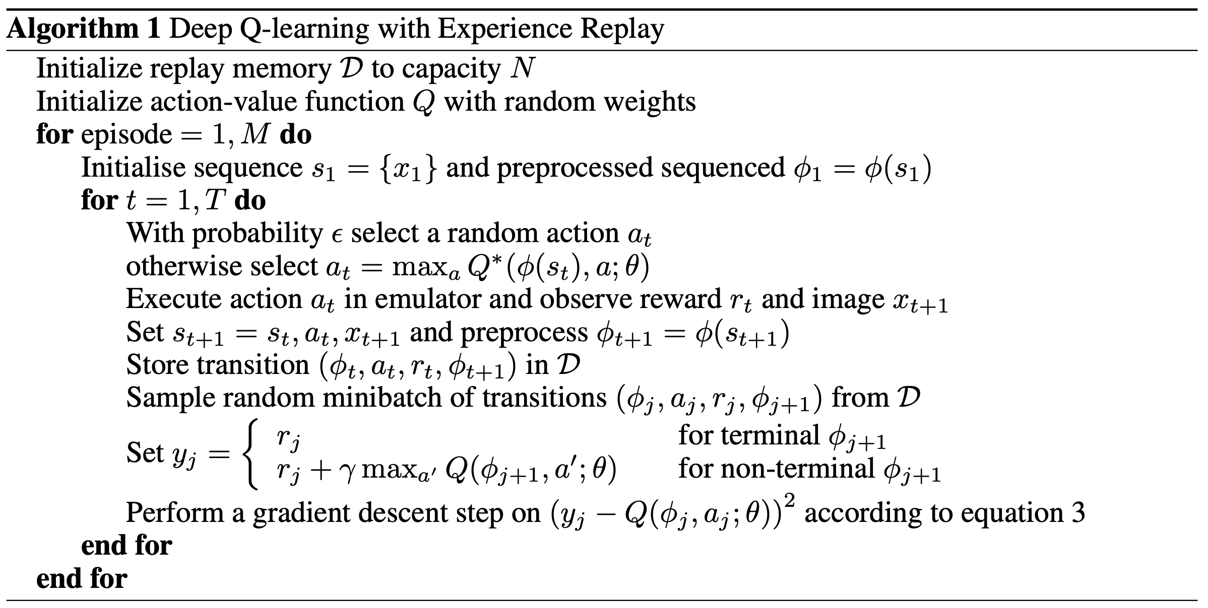
Experience Replay
Epsilon-greedy
Q Update
Source: Mnih, Volodymyr, et al. "Playing atari with deep reinforcement learning."
Deep Q-Learning Algorithm

Slide 19
Policy Gradients, Actor-Critic

Slide 20
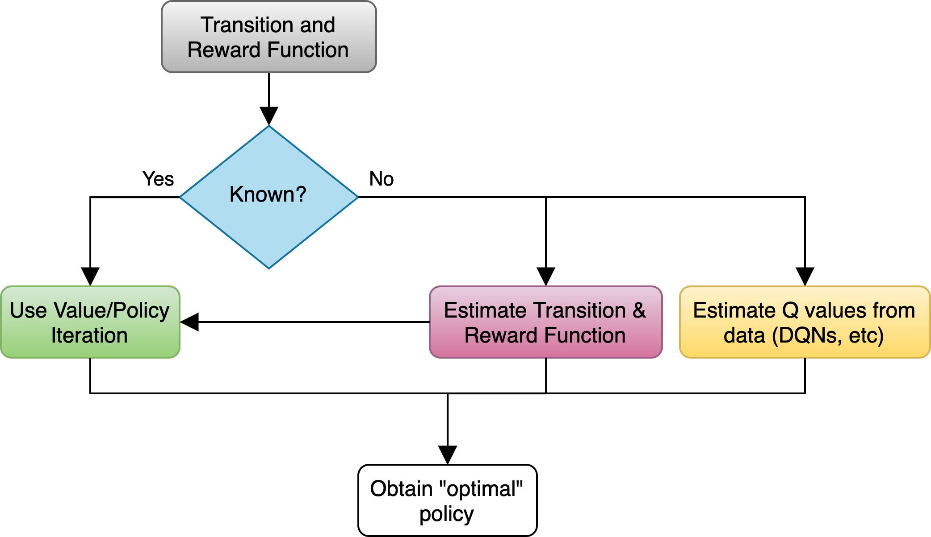
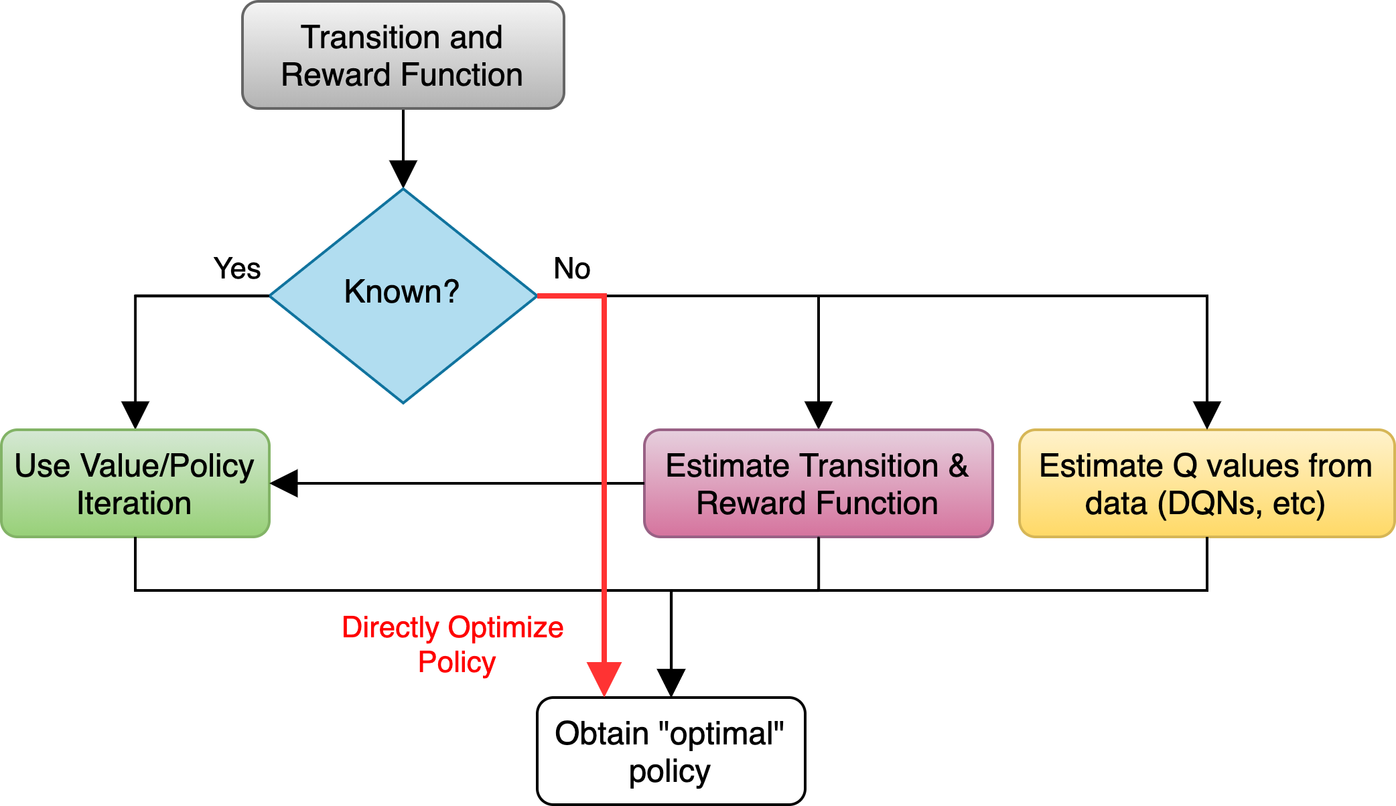
Overview

Slide 21
Class of policies defined by parameters
  Eg: can be parameters of linear transformation, deep network, etc.
Want to maximize:
In other words,
Parametrized Policy

Slide 22
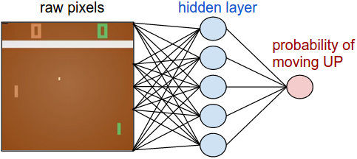
Pong from Pixels

Slide 23
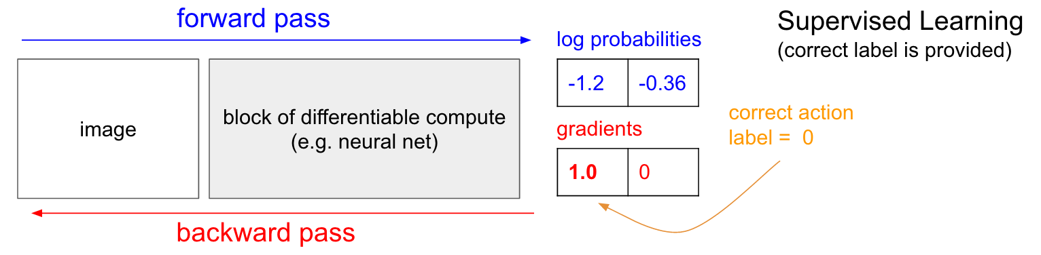
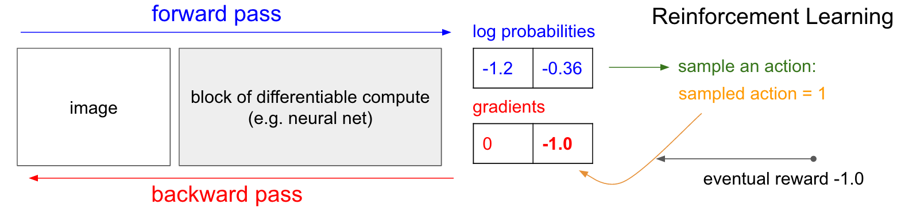
Image Source: http://karpathy.github.io/2016/05/31/rl/
Policy Gradient: Loss Function

Slide 24
Slightly re-writing the notation
Let denote a trajectory
Gathering Data/Experience

Slide 25
How to gather data?
  We already have a policy:
  Sample N trajectories by acting according to
Gathering Data/Experience

Slide 26
Sample trajectories by acting according to
Compute policy gradient as
Update policy parameters:
Run the policy and sample trajectories
Compute policy gradient
Update policy
Slide credit: Sergey Levine
The REINFORCE Algorithm

Slide 27
Expectation as integral
Exchange integral and gradient
Deriving The Policy Gradient

Slide 28
Doesn’t depend on
Transition probabilities!
Deriving The Policy Gradient

Slide 29
Sample trajectories by acting according to
Compute policy gradient as
Update policy parameters:
Run the policy and sample trajectories
Compute policy gradient
Update policy
Slide credit: Sergey Levine
The REINFORCE Algorithm

Slide 30
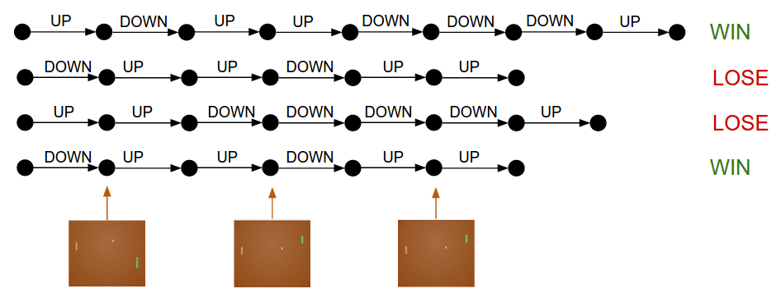
Slide credit: Dhruv Batra
Drawbacks of Policy Gradients

Slide 31
Credit assignment is hard!
  Which specific action led to increase in reward
  Suffers from high variance, leading to unstable training
How to reduce the variance?
  Subtract an action independent baseline from the reward
  Why does it work?
  What is the best choice of b?
Homework
Drawbacks of Policy Gradients

Slide 32
REINFORCE, use raw reward values
Actor-critic, use Q-values (learnt from data)
Advantage actor-critic, use Q minus V values (i.e. Advantage)
Policy Gradient Variants

