Slide 1

CS 4803 / 7643
Deep Learning, Fall 2020
Reinforcement Learning: Module 2/3
Presented by Nirbhay Modhe

Slide 2
Previous Lecture
RL: Definitions, interaction API, tasks/challenges
MDPs: Theoretical framework underlying RL, solving MDPs
Today
Policy (continued): How an agents acts at states
Value function (Utility): How good is a particular state or state-action pair?
Algorithms for solving MDPs (Value Iteration)
Departure from known rewards and transitions: Reinforcement Learning (RL), Deep RL
Recap & Overview

Slide 3
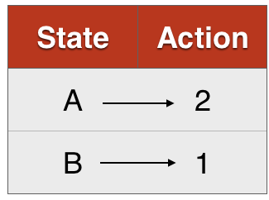
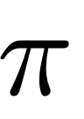
Markov Decision Processes (MDPs)
  States, Actions, Reward dist., Transition dist., Discount factor (gamma)
Policy:
  Mapping from states to actions (deterministic)
  Distribution of actions given states (stochastic)
MDP
Deterministic
Stochastic
Recap: MDPs, Policy

Slide 4
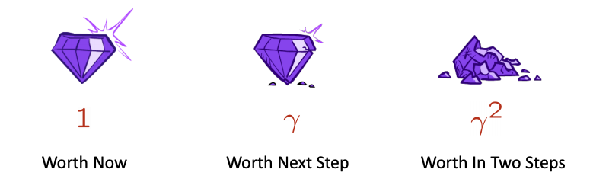

Markov Decision Processes (MDPs)
  States, Actions, Reward dist., Transition dist., Discount factor (gamma)
Policy:
  Mapping from states to actions (deterministic)
  Distribution of actions given states (stochastic)
What is a good policy?
  Maximize discounted sum of future rewards
    Discount factor:
MDP
Recap: MDPs, Policy

Slide 5
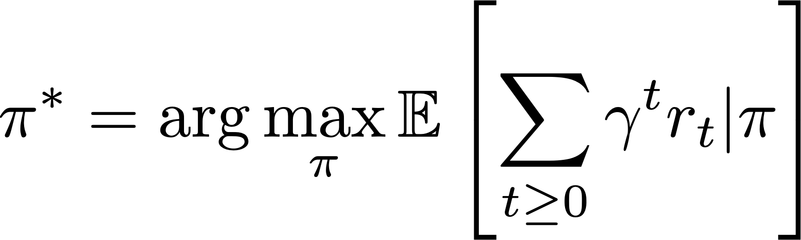
Formally, the optimal policy is defined as:
discounted sum of future rewards
Solving MDPs: Optimal policy

Slide 6
Formally, the optimal policy is defined as:
discounted sum of future rewards
Expectation over initial state, actions from policy, next states from transition distribution
Solving MDPs: Optimal policy

Slide 7
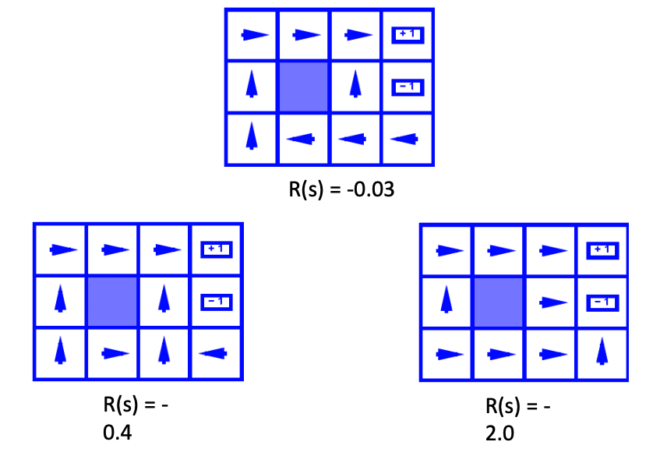
Some optimal policies for three different grid world MDPs (gamma=0.99)
  Varying reward for non-absorbing states (states other than +1/-1)
R(s) = -0.03
R(s) = -0.4
R(s) = -2.0
Image Credit: Byron Boots, CS 7641
Optimal policy examples

Slide 8
For example, with an MDP with 5 states as shown, starting at the middle cell:
Actions: (Right, Left)
Deterministic transitions
What is the optimal policy for:
R=10 |  |  |  | R=1
Slides adapted from: Byron Boots, CS 7641
Discounting future rewards

Slide 9
A value function is a prediction of discounted sum of future reward
State value function / V-function /
  How good is this state?
  Am I likely to win/lose the game from this state?
State-Action value function / Q-function /
  How good is this state-action pair?
  In this state, what is the impact of this action on my future?
Value Function

Slide 10
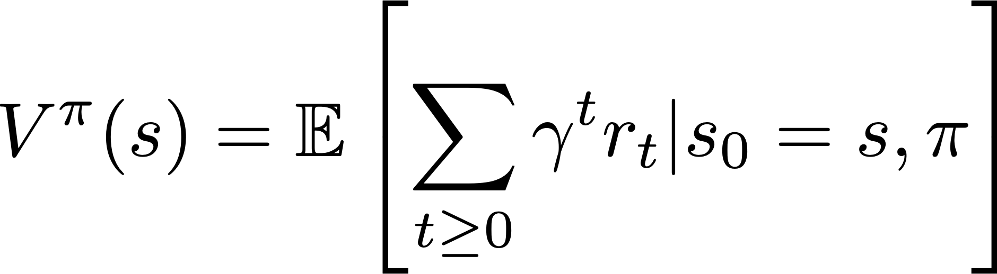
For a policy that produces a trajectory sample
The V-function of the policy at state s, is the expected cumulative reward from state s:
Value Function

Slide 11
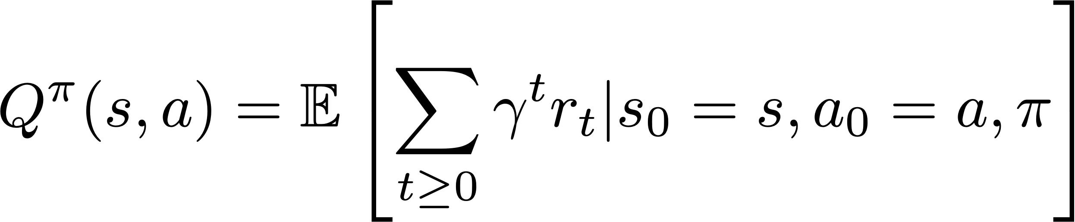
For a policy that produces a trajectory sample
The Q-function of the policy at state s and action a, is the expected cumulative reward upon taking action a in state s (and following policy thereafter):
Action-Value Function

Slide 12
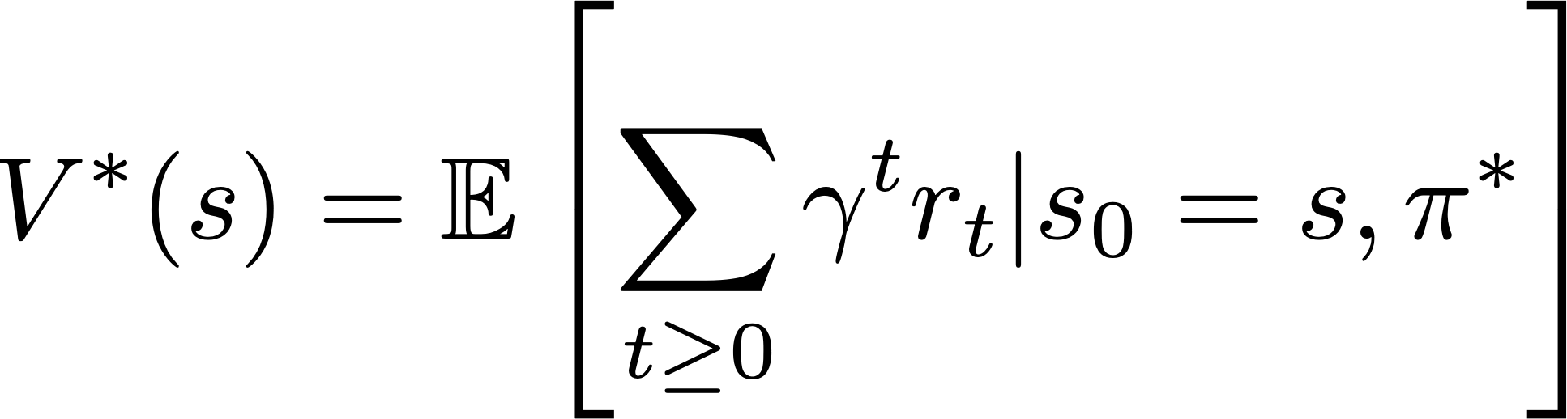
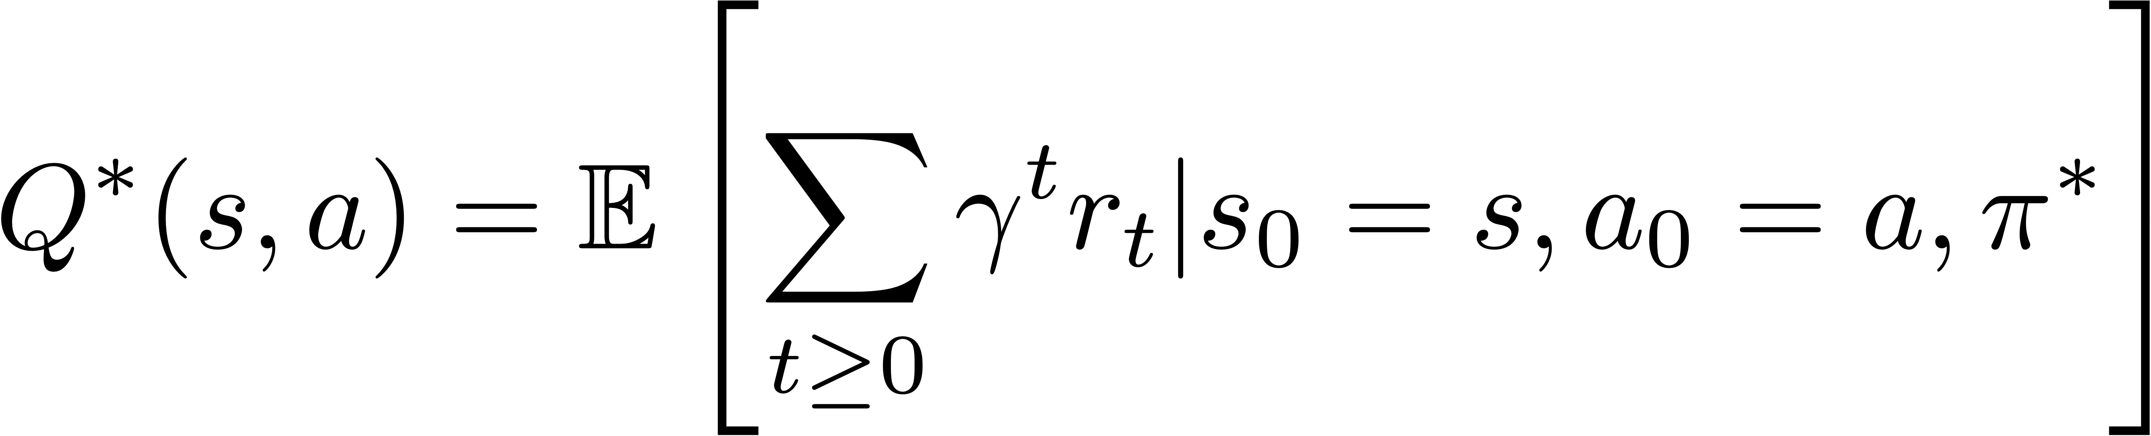
The V and Q functions corresponding to the optimal policy
Optimal V & Q functions

Slide 13
Recursive Bellman expansion (from definition of Q)
(Expected) return from t = 0
(Reward at t = 0) + (Return for expected state at t=1)
Bellman Optimality Equations

Slide 14
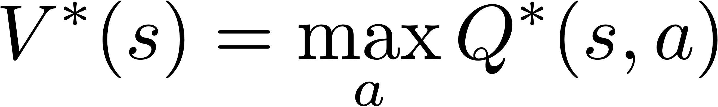
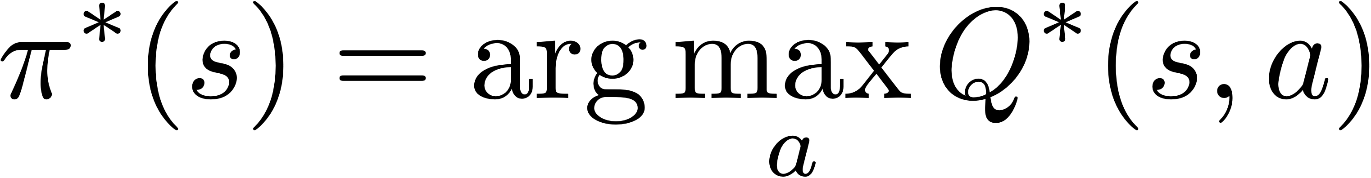
Equations relating optimal quantities
Recursive Bellman optimality equation
Bellman Optimality Equations

Slide 15
Based on the bellman optimality equation
Algorithm
Initialize values of all states
While not converged:
  For each state:
Repeat until convergence (no change in values)
Homework
Time complexity per iteration
Value Iteration

Slide 16
Value Iteration Update:
Q-Iteration Update:
The algorithm is same as value iteration, but it loops over actions as well as states
Q-Iteration

Slide 17
Policy iteration: Start with arbitrary and refine it.
Involves repeating two steps:
  Policy Evaluation: Compute (similar to Value Iteration)
  Policy Refinement: Greedily change actions as per
Why do policy iteration?
  often converges to much sooner than to
Policy Iteration

Slide 18
For Value Iteration:
3x4 Grid world?
Chess/Go?
Atari Games with integer image pixel values [0, 255] of size 16x16 as state?
Time complexity per iteration
State Spaces & Time Complexity

Slide 19
Value Iteration
  Bellman update to state value estimates
Q-Value Iteration
  Bellman update to (state, action) value estimates
Policy Iteration
  Policy evaluation + refinement
Summary: MDP Algorithms

Slide 20

Reinforcement Learning, Deep RL

Slide 21
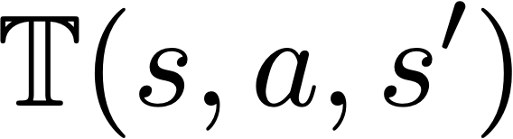
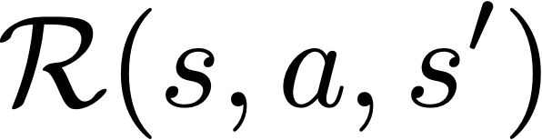
Recall RL assumptions:
  unknown, how actions affect the environment.
  unknown, what/when are the good actions?
But, we can learn by trial and error.
  Gather experience (data) by performing actions.
  Approximate unknown quantities from data.
Reinforcement Learning
Learning Based Methods: RL

Slide 22
Old Dynamic Programming Demo
  https://cs.stanford.edu/people/karpathy/reinforcejs/gridworld_dp.html
RL Demo
  https://cs.stanford.edu/people/karpathy/reinforcejs/gridworld_td.html
Learning Based Methods: RL

Slide 23
In addition to not knowing the environment, sometimes the state space is too large.
Recall: Value iteration not scalable (chess, RGB images as state space, etc)
Solution: Deep Learning! … more precisely, function approximation.
  Use deep neural networks to learn state representations
  Useful for continuous action spaces as well
Deep Reinforcement Learning
Learning Based Methods: Deep RL

Slide 24
Value-based RL
  (Deep) Q-Learning, approximating with a deep Q-network
Policy-based RL
  Directly approximate optimal policy with a parametrized policy
Model-based RL
  Approximate transition function and reward function
  Plan by looking ahead in the (approx.) future!
Homework
RL: Algorithm Categories

Slide 25
Deep
Q-Learning

Slide 26
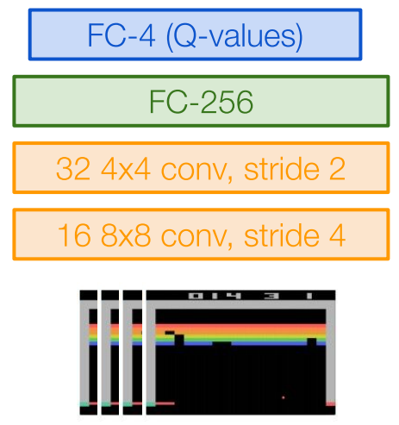
Q-Learning with linear function approximators
  Has some theoretical guarantees
Deep Q-Learning: Fit a deep Q-Network
  Works well in practice
  Q-Network can take RGB images
Image Credits: Fei-Fei Li, Justin Johnson,
Serena Yeung, CS 231n
Deep Q-Learning

Slide 27
Assume we have collected a dataset:
We want a Q-function that satisfies bellman optimality (Q-value)
Loss for a single data point:
Predicted Q-Value
Target Q-Value
Deep Q-Learning

Slide 28
Minibatch of
Forward pass:
Compute loss:
Backward pass:
State
Q-Network
Q-Values per action
Q-Network
State
Deep Q-Learning

Slide 29
In practice, for stability:
  Freeze and update parameters
  Set at regular intervals
Deep Q-Learning

Slide 30
How to gather experience?
This is why RL is hard
Deep Q-Learning

Slide 31
Environment
Data
Train
Update
Challenge 1: Exploration vs Exploitation
Challenge 2: Non iid, highly correlated data
How to gather experience?

Slide 32
What should be?
  Greedy? -> Local minimas, no exploration
An exploration strategy:
Exploration Problem

Slide 33
Samples are correlated => high variance gradients => inefficient learning
Current Q-network parameters determines next training samples => can lead to bad feedback loops
  e.g. if maximizing action is to move right, training samples will be dominated by samples going right, may fall into local minima
R=10 |  |  |  | R=1
Correlated Data Problem

Slide 34
Correlated data: addressed by using experience replay
  A replay buffer stores transitions
  Continually update replay buffer as game (experience) episodes are played, older samples discarded
  Train Q-network on random minibatches of transitions from the replay memory, instead of consecutive samples
Larger the buffer, lower the correlation
Experience Replay

Slide 35
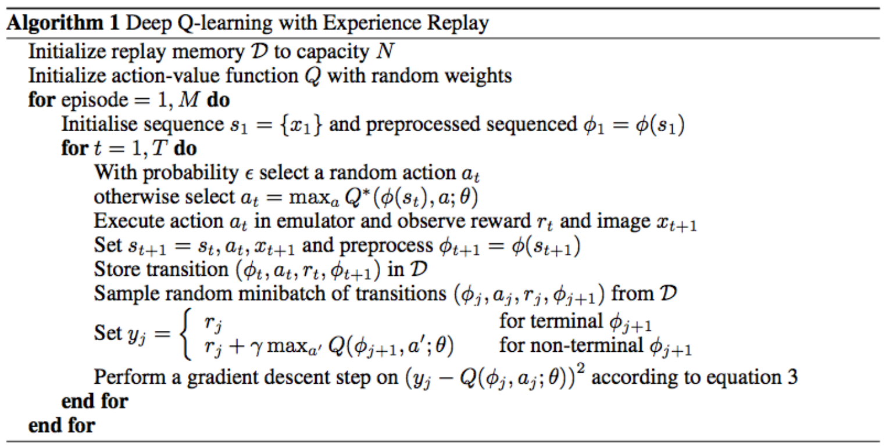
Experience Replay
Epsilon-greedy
Q Update
Deep Q-Learning Algorithm

Slide 36
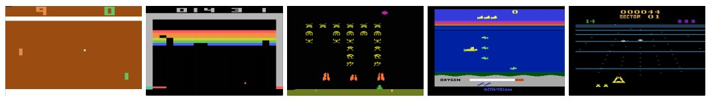
Atari Games
Objective: Complete the game with the highest score
State: Raw pixel inputs of the game state
Action: Game controls e.g. Left, Right, Up, Down
Reward: Score increase/decrease at each time step
Figures copyright Volodymyr Mnih et al., 2013. Reproduced with permission.
Slide Credit: Fei-Fei Li, Justin Johnson, Serena Yeung, CS 231n
Case study: Playing Atari Games

Slide 37
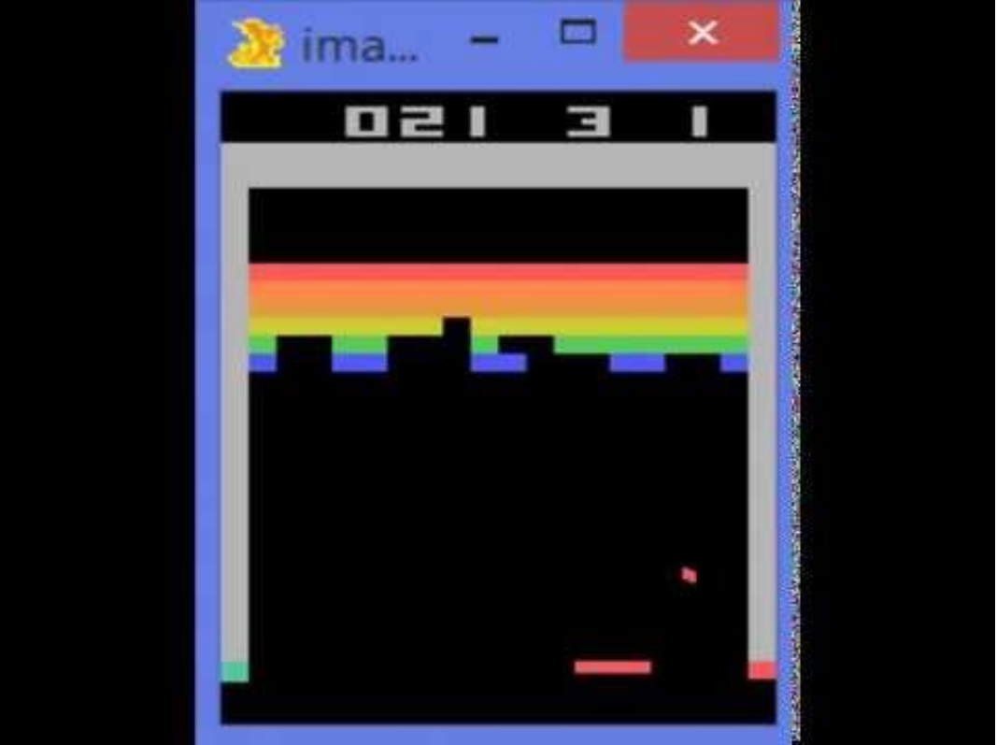
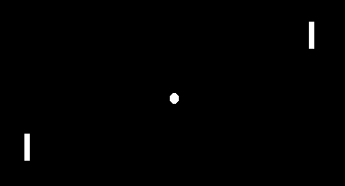
Atari Games
https://www.youtube.com/watch?v=V1eYniJ0Rnk
Slide Credit: Fei-Fei Li, Justin Johnson, Serena Yeung, CS 231n
Case study: Playing Atari Games

Slide 38
In today’s class, we looked at
Dynamic Programming
  Value, Q-Value Iteration
  Policy Iteration
Reinforcement Learning (RL)
  The challenges of (deep) learning based methods
  Value-based RL algorithms
    Deep Q-Learning
Next class:
Policy-based RL algorithms (policy gradients)
Summary

