Slide 1
CS 4803 / 7643: Deep Learning
Topics:
Convolutional Neural Networks
Stride, padding
Pooling layers
Fully-connected layers as convolutions
Dhruv Batra
Georgia Tech

Slide 2
Administrativia
HW2 Reminder
Due: 09/23, 11:59pm
https://evalai.cloudcv.org/web/challenges/challenge-page/684/leaderboard/1853
Project Teams
https://gtvault-my.sharepoint.com/:x:/g/personal/dbatra8_gatech_edu/EY4_65XOzWtOkXSSz2WgpoUBY8ux2gY9PsRzR6KnglIFEQ?e=4tnKWI
Project Title
1-3 sentence project summary TL;DR
Team member names

Slide 3
Recap from last time

Slide 4
Convolutional Neural Networks
(without the brain stuff)
Slide Credit: Fei-Fei Li, Justin Johnson, Serena Yeung, CS 231n

Slide 5
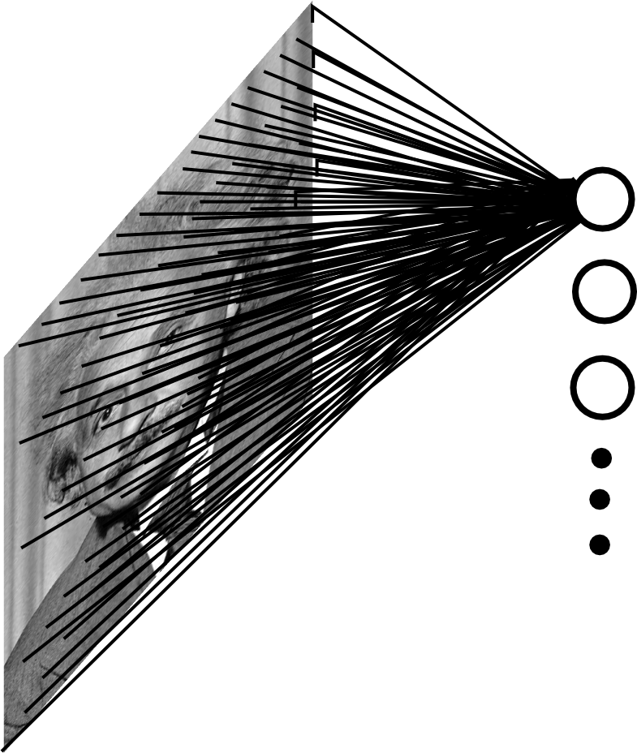
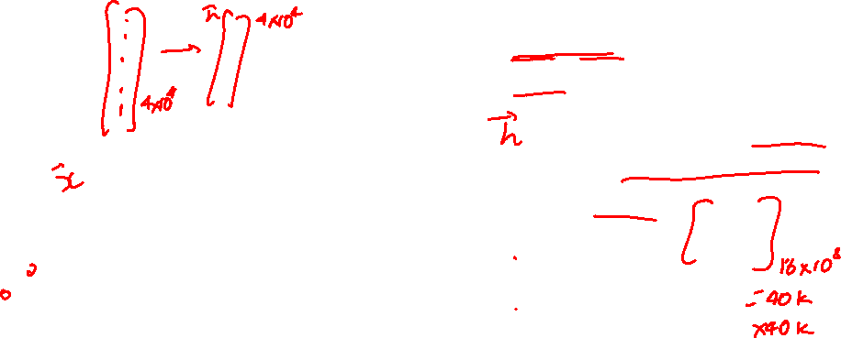
Fully Connected Layer
Example: 200x200 image
40K hidden units
Q: what is the number of parameters in this FC layer? A: 1.6B
Slide Credit: Marc'Aurelio Ranzato

Slide 6
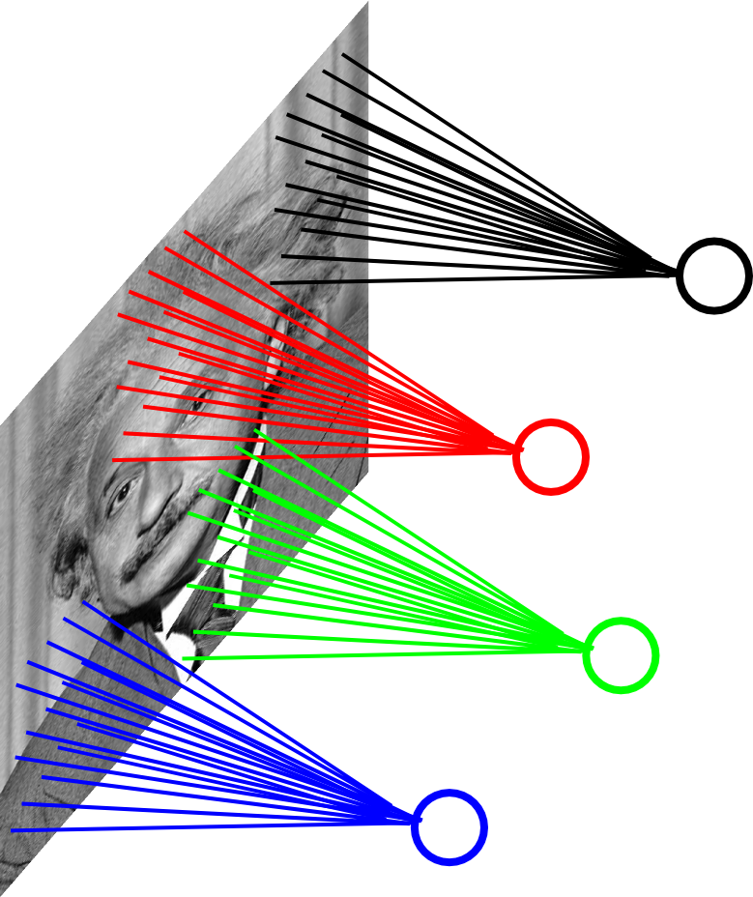
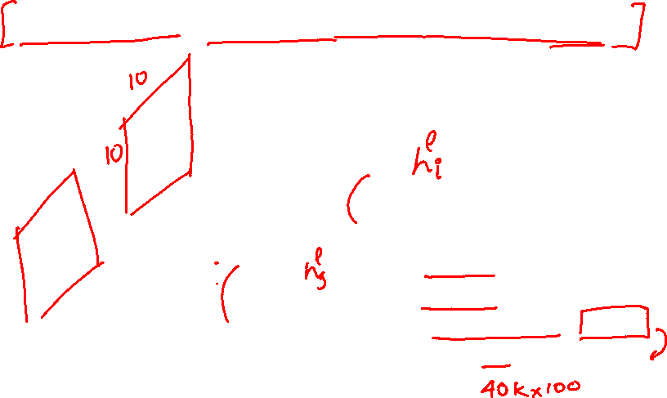
Assumption 1: Locally Connected Layer
Example: 200x200 image
40K hidden units
Connection size: 10x10
4M parameters
Note: This parameterization is good when input image is registered (e.g., face recognition).
Slide Credit: Marc'Aurelio Ranzato

Slide 7
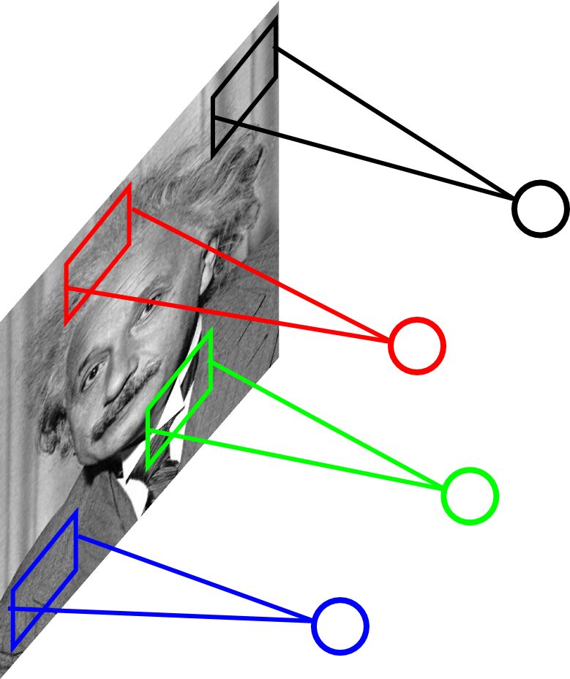
Assumption 2: Stationarity / Parameter Sharing
STATIONARITY? Statistics similar at all locations
Slide Credit: Marc'Aurelio Ranzato

Slide 8
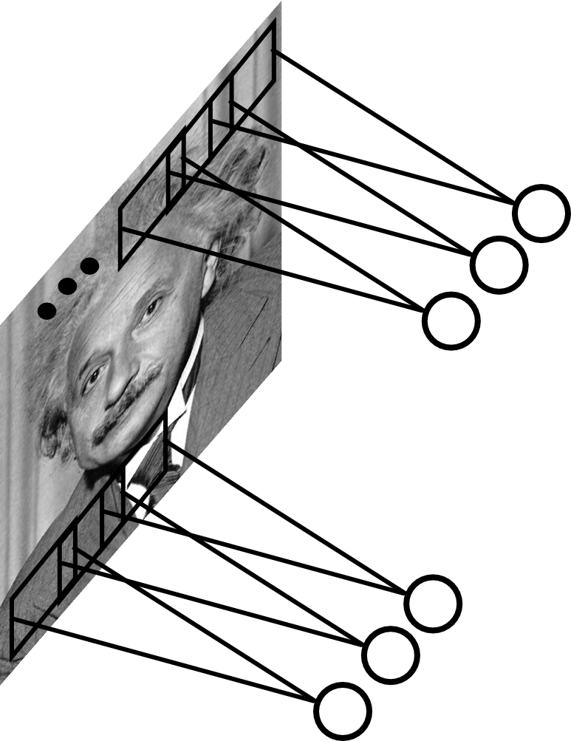
Convolutional Layer
Share the same parameters across different locations (assuming input is stationary):
Convolutions with learned kernels
Slide Credit: Marc'Aurelio Ranzato

Slide 9
Convolutions!

Slide 10
Convolutions for programmers

Slide 11
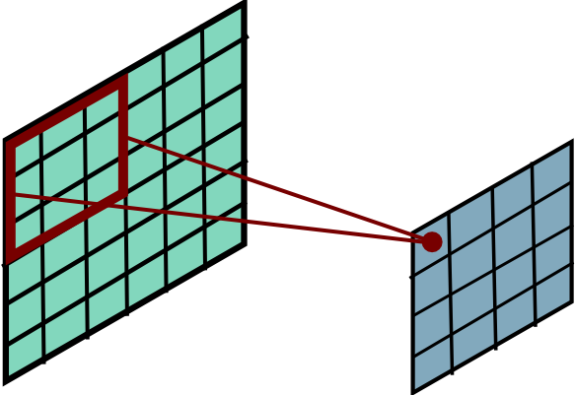
Convolution
Slide Credit: Marc'Aurelio Ranzato

Slide 12
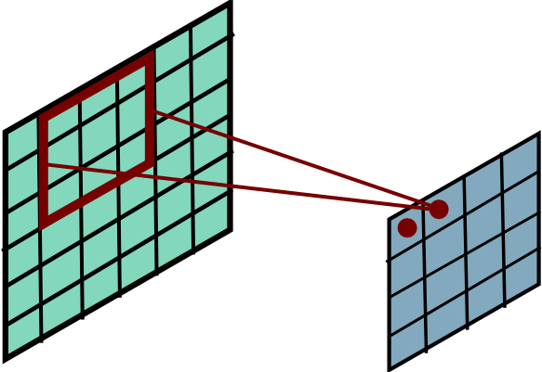
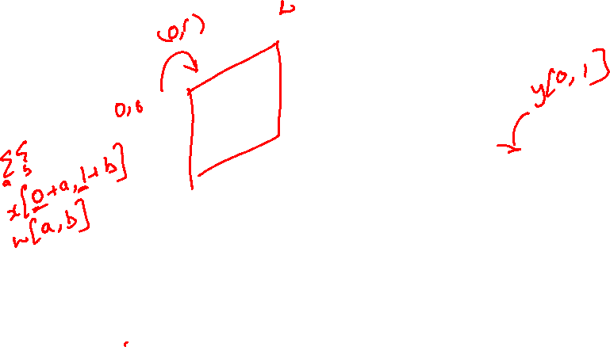
Convolutional Layer
Slide Credit: Marc'Aurelio Ranzato

Slide 13
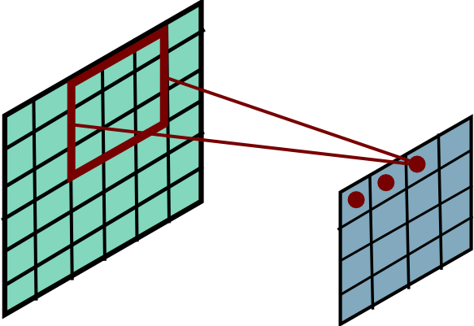
Convolution
Slide Credit: Marc'Aurelio Ranzato

Slide 14
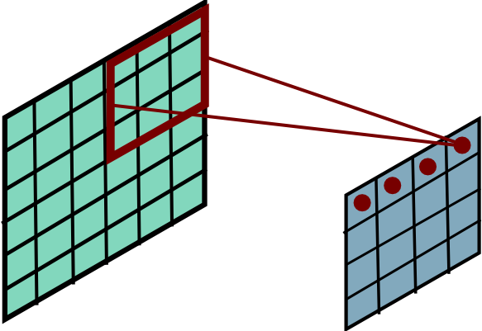
Convolution
Slide Credit: Marc'Aurelio Ranzato

Slide 15
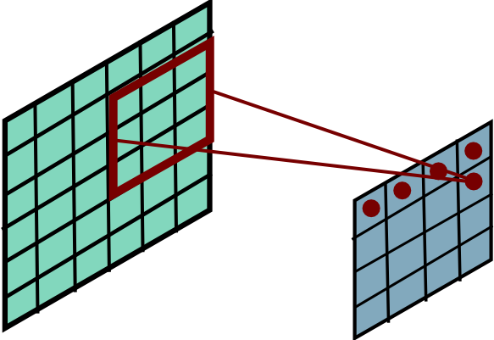
Convolution
Slide Credit: Marc'Aurelio Ranzato

Slide 16
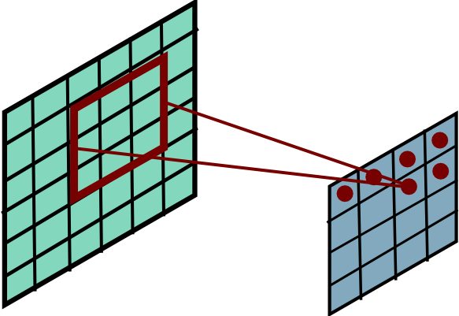
Convolution
Slide Credit: Marc'Aurelio Ranzato

Slide 17
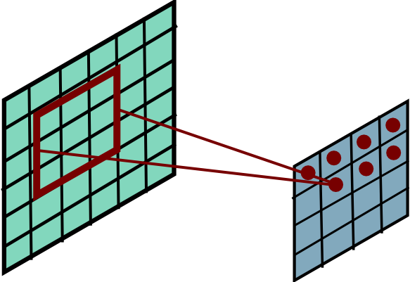
Convolution
Slide Credit: Marc'Aurelio Ranzato

Slide 18
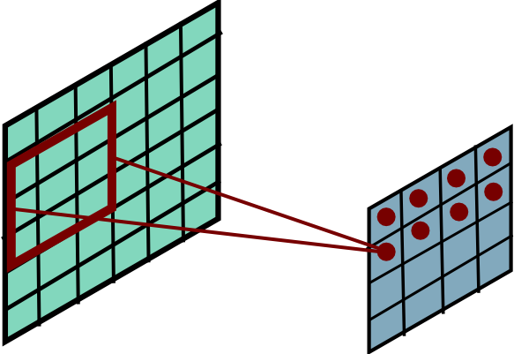
Convolution
Slide Credit: Marc'Aurelio Ranzato

Slide 19
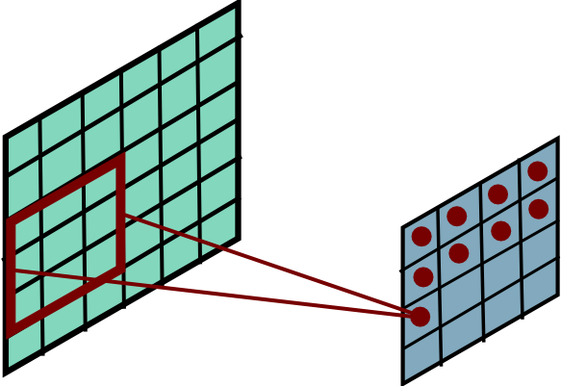
Convolution
Slide Credit: Marc'Aurelio Ranzato

Slide 20
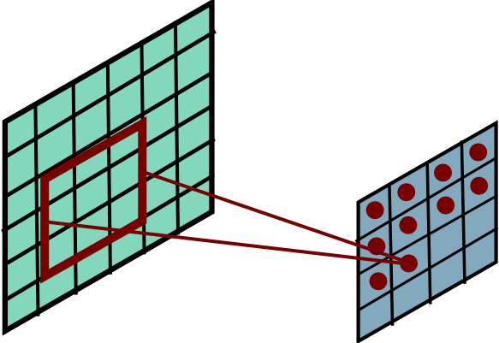
Convolution
Slide Credit: Marc'Aurelio Ranzato

Slide 21
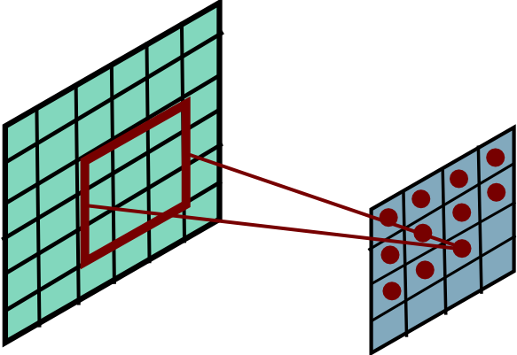
Convolution
Slide Credit: Marc'Aurelio Ranzato

Slide 22
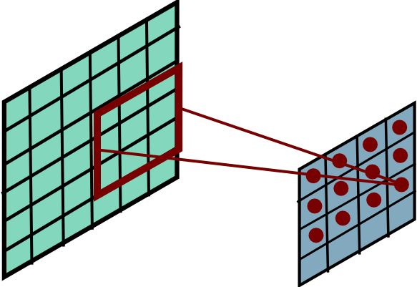
Convolution
Slide Credit: Marc'Aurelio Ranzato

Slide 23
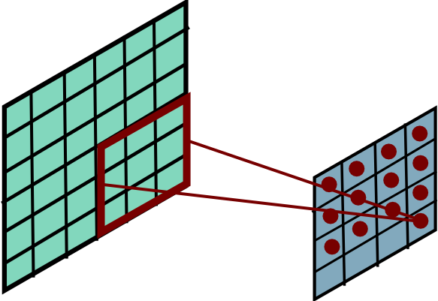
Convolution
Slide Credit: Marc'Aurelio Ranzato

Slide 24
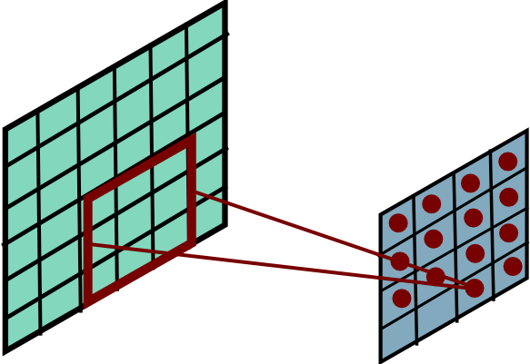
Convolution
Slide Credit: Marc'Aurelio Ranzato

Slide 25
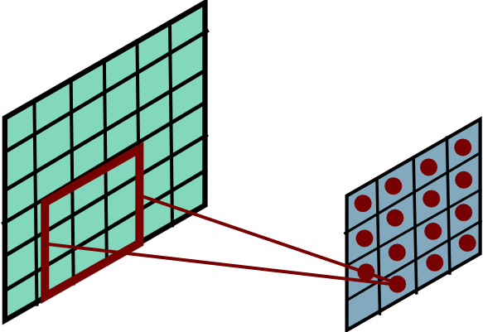
Convolution
Slide Credit: Marc'Aurelio Ranzato

Slide 26
Plan for Today
Convolutional Neural Networks
Features learned by CNN layers
Stride, padding
1x1 convolutions
Pooling layers
Fully-connected layers as convolutions

Slide 27
FC vs Conv Layer

Slide 28
FC vs Conv Layer

Slide 29
Convolution Layer
32x32x3 image
32
height
32
width
3
depth
Slide Credit: Fei-Fei Li, Justin Johnson, Serena Yeung, CS 231n
Notes:
Preserve spatial structure of input

Slide 30
Convolution Layer
32x32x3 image
5x5x3 filter
32
Convolve the filter with the image
i.e. “slide over the image spatially, computing dot products”
32
3
Slide Credit: Fei-Fei Li, Justin Johnson, Serena Yeung, CS 231n

Slide 31
Convolution Layer
Filters always extend the full depth of the input volume
32x32x3 image
5x5x3 filter
32
Convolve the filter with the image
i.e. “slide over the image spatially, computing dot products”
32
3
Slide Credit: Fei-Fei Li, Justin Johnson, Serena Yeung, CS 231n

Slide 32


Convolution Layer
32x32x3 image
5x5x3 filter
32
1 number:
the result of taking a dot product between the filter and a small 5x5x3 chunk of the image
(i.e. 5*5*3 = 75-dimensional dot product + bias)
32
3
Slide Credit: Fei-Fei Li, Justin Johnson, Serena Yeung, CS 231n

Slide 33
Convolution Layer
activation map
32x32x3 image
5x5x3 filter
32
28
convolve (slide) over all spatial locations
32
28
3
1
Slide Credit: Fei-Fei Li, Justin Johnson, Serena Yeung, CS 231n

Slide 34
consider a second, green filter
Convolution Layer
32x32x3 image
5x5x3 filter
activation maps
32
28
convolve (slide) over all spatial locations
32
28
3
1
Slide Credit: Fei-Fei Li, Justin Johnson, Serena Yeung, CS 231n

Slide 35
For example, if we had 6 5x5 filters, we’ll get 6 separate activation maps:
activation maps
32
28
Convolution Layer
32
28
3
6
We stack these up to get a “new image” of size 28x28x6!
Slide Credit: Fei-Fei Li, Justin Johnson, Serena Yeung, CS 231n

Slide 36
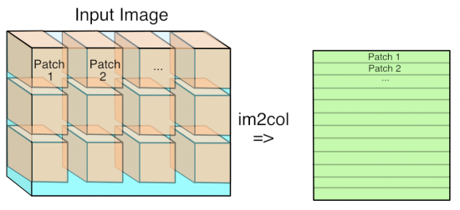
Im2Col
Figure Credit: https://petewarden.com/2015/04/20/why-gemm-is-at-the-heart-of-deep-learning/

Slide 37
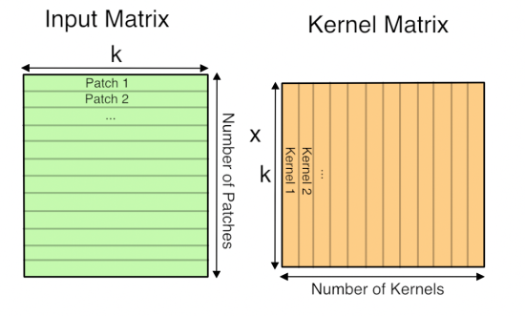
GEMM
Figure Credit: https://petewarden.com/2015/04/20/why-gemm-is-at-the-heart-of-deep-learning/

Slide 38
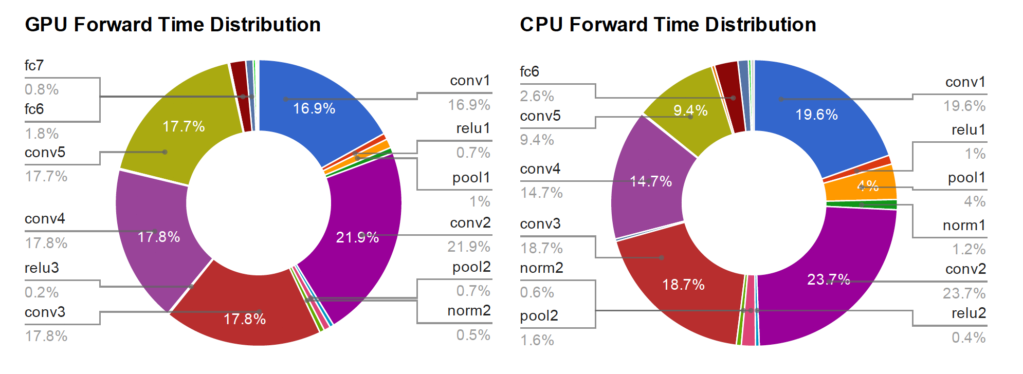
Time Distribution of AlexNet
Figure Credit: Yangqing Jia, PhD Thesis

Slide 39
Preview: ConvNet is a sequence of Convolution Layers, interspersed with activation functions
32
28
CONV,
ReLU
e.g. 6 5x5x3 filters
32
28
3
6
Slide Credit: Fei-Fei Li, Justin Johnson, Serena Yeung, CS 231n

Slide 40
Preview: ConvNet is a sequence of Convolutional Layers, interspersed with activation functions
32
28
24
….
CONV,
ReLU
e.g. 6 5x5x3 filters
CONV,
ReLU
e.g. 10 5x5x6 filters
CONV,
ReLU
32
28
24
3
6
10
Slide Credit: Fei-Fei Li, Justin Johnson, Serena Yeung, CS 231n

Slide 41
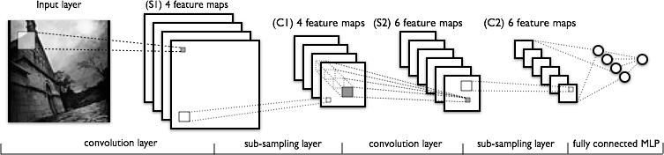
Convolutional Neural Networks
Image Credit: Yann LeCun, Kevin Murphy

Slide 42
Convolutional Neural Networks
a
Image Credit: Yann LeCun, Kevin Murphy

Slide 43
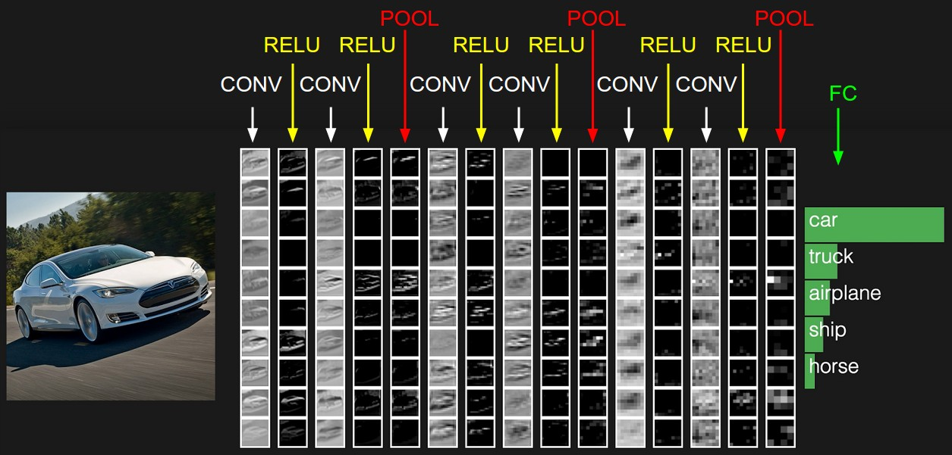
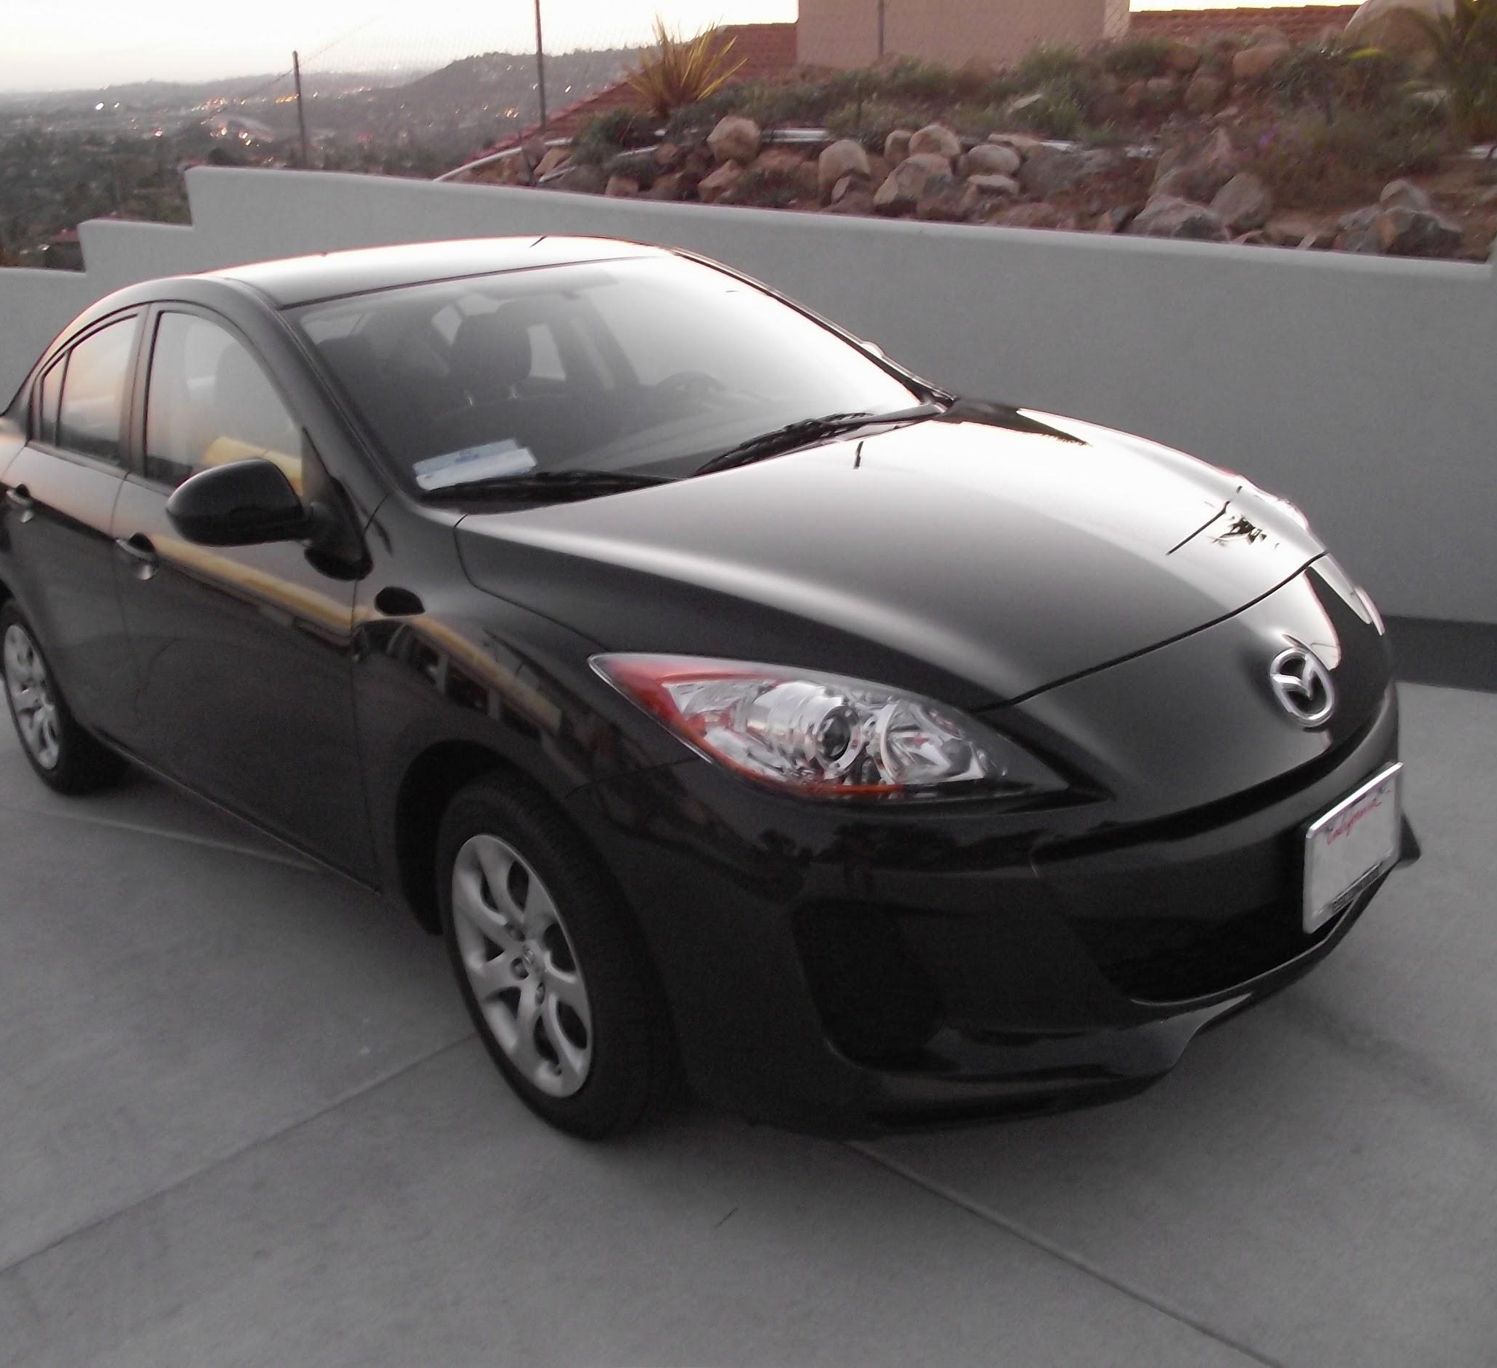
preview:
Slide Credit: Fei-Fei Li, Justin Johnson, Serena Yeung, CS 231n
Notes:
Convnet is stack of layers
Look at how an image progresses through the network, and sizes of output after each layer
Car image is photo taken by Lane McIntosh, permission to use.

Slide 44
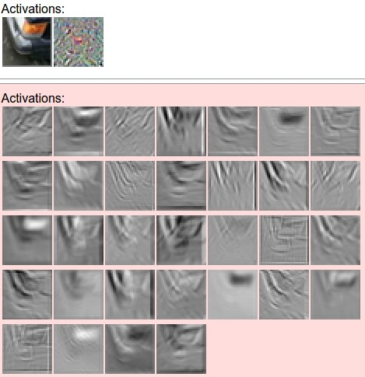
one filter =>
one activation map
example 5x5 filters
(32 total)
Figure copyright Andrej Karpathy.
Slide Credit: Fei-Fei Li, Justin Johnson, Serena Yeung, CS 231n
Notes:
Here have examples of activation maps produced by each filter
Each filter is slid over input to layer to produce an activation map
Because of sliding, call convolutional
Conv with neg. of filter (cross correlation)

Slide 45
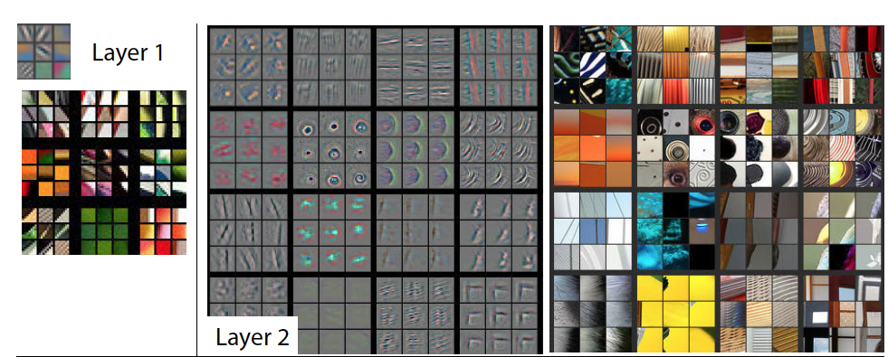
Visualizing Learned Filters
Figure Credit: [Zeiler & Fergus ECCV14]

Slide 46
Visualizing Learned Filters
Figure Credit: [Zeiler & Fergus ECCV14]

Slide 47
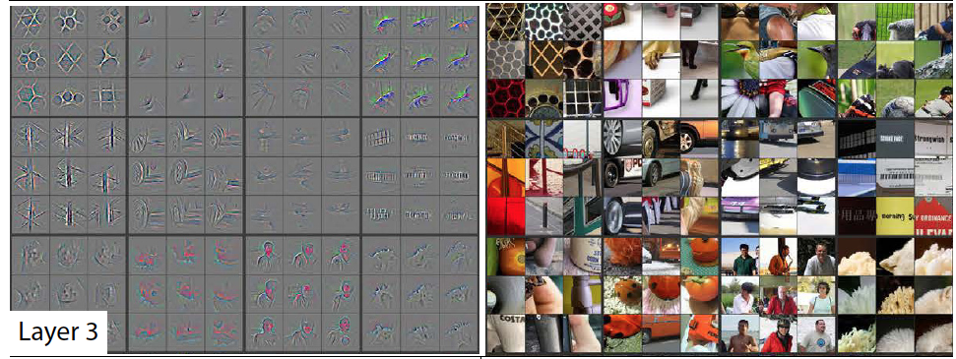
Visualizing Learned Filters
Figure Credit: [Zeiler & Fergus ECCV14]

Slide 48
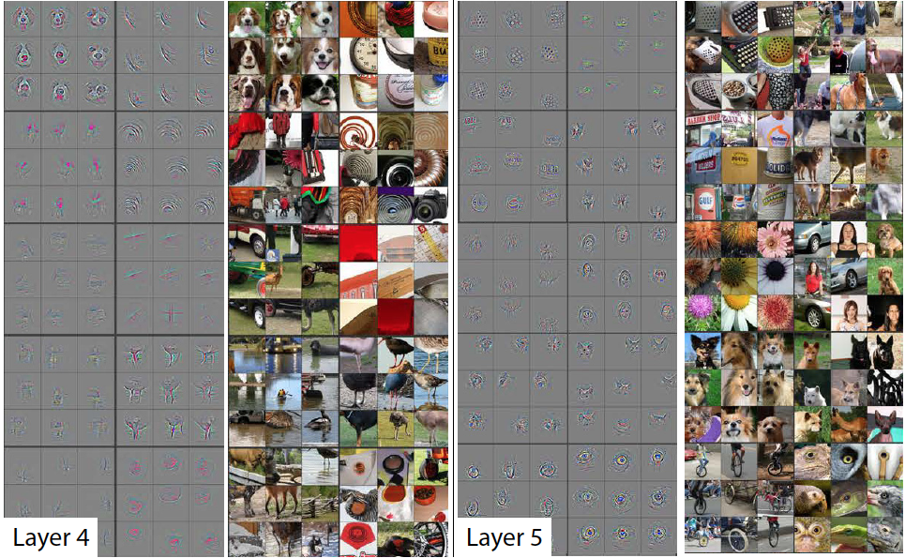
Visualizing Learned Filters
Figure Credit: [Zeiler & Fergus ECCV14]

Slide 49
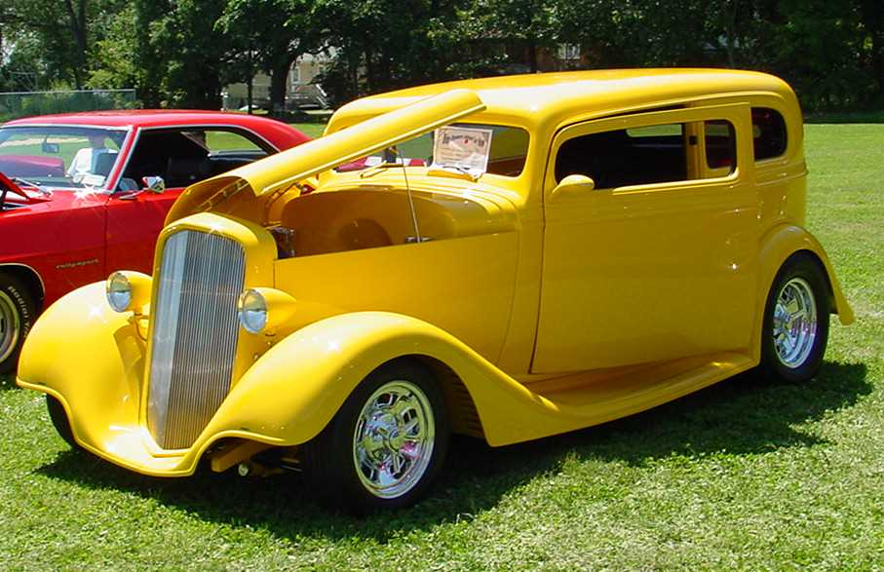
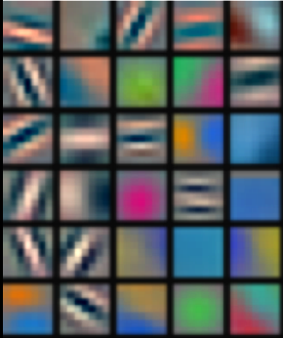
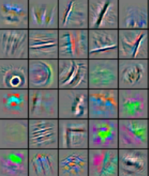
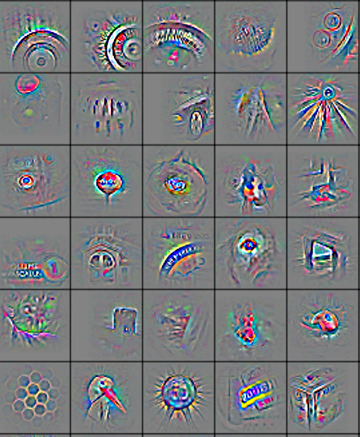
We can learn image features now!
Low-Level Feature
Mid-Level Feature
High-Level Feature
Linear Classifier
“car”
Feature visualization of convolutional net trained on ImageNet from [Zeiler & Fergus 2013]
Slide Credit: Marc'Aurelio Ranzato, Yann LeCun

Slide 50
Plan for Today
Convolutional Neural Networks
Features learned by CNN layers
Stride, padding
1x1 convolutions
Pooling layers
Fully-connected layers as convolutions

Slide 51
A closer look at spatial dimensions:
activation map
32x32x3 image
5x5x3 filter
32
28
convolve (slide) over all spatial locations
32
28
3
1
Slide Credit: Fei-Fei Li, Justin Johnson, Serena Yeung, CS 231n

Slide 52
A closer look at spatial dimensions:
7
7x7 input (spatially)
assume 3x3 filter
7
Slide Credit: Fei-Fei Li, Justin Johnson, Serena Yeung, CS 231n

Slide 53
A closer look at spatial dimensions:
7
7x7 input (spatially)
assume 3x3 filter
7
Slide Credit: Fei-Fei Li, Justin Johnson, Serena Yeung, CS 231n

Slide 54
A closer look at spatial dimensions:
7
7x7 input (spatially)
assume 3x3 filter
7
Slide Credit: Fei-Fei Li, Justin Johnson, Serena Yeung, CS 231n

Slide 55
A closer look at spatial dimensions:
7
7x7 input (spatially)
assume 3x3 filter
7
Slide Credit: Fei-Fei Li, Justin Johnson, Serena Yeung, CS 231n

Slide 56
A closer look at spatial dimensions:
7
7x7 input (spatially)
assume 3x3 filter
=> 5x5 output
7
Slide Credit: Fei-Fei Li, Justin Johnson, Serena Yeung, CS 231n

Slide 57
A closer look at spatial dimensions:
7
7x7 input (spatially)
assume 3x3 filter
applied with stride 2
7
Slide Credit: Fei-Fei Li, Justin Johnson, Serena Yeung, CS 231n

Slide 58
A closer look at spatial dimensions:
7
7x7 input (spatially)
assume 3x3 filter
applied with stride 2
7
Slide Credit: Fei-Fei Li, Justin Johnson, Serena Yeung, CS 231n

Slide 59
A closer look at spatial dimensions:
7
7x7 input (spatially)
assume 3x3 filter
applied with stride 2
=> 3x3 output!
7
Slide Credit: Fei-Fei Li, Justin Johnson, Serena Yeung, CS 231n

Slide 60
A closer look at spatial dimensions:
7
7x7 input (spatially)
assume 3x3 filter
applied with stride 3?
7
Slide Credit: Fei-Fei Li, Justin Johnson, Serena Yeung, CS 231n

Slide 61
A closer look at spatial dimensions:
7
7x7 input (spatially)
assume 3x3 filter
applied with stride 3?
7
doesn’t fit!
cannot apply 3x3 filter on 7x7 input with stride 3.
Slide Credit: Fei-Fei Li, Justin Johnson, Serena Yeung, CS 231n

Slide 62
N
Output size:
(N - F) / stride + 1
e.g. N = 7, F = 3:
stride 1 => (7 - 3)/1 + 1 = 5
stride 2 => (7 - 3)/2 + 1 = 3
stride 3 => (7 - 3)/3 + 1 = 2.33 :\
F
F
N
Slide Credit: Fei-Fei Li, Justin Johnson, Serena Yeung, CS 231n

Slide 63
Remember back to…
E.g. 32x32 input convolved repeatedly with 5x5 filters shrinks volumes spatially!
(32 -> 28 -> 24 ...). Shrinking too fast is not good, doesn’t work well.
32
28
24
….
CONV,
ReLU
e.g. 6 5x5x3 filters
CONV,
ReLU
e.g. 10 5x5x6 filters
CONV,
ReLU
32
28
24
3
6
10
Slide Credit: Fei-Fei Li, Justin Johnson, Serena Yeung, CS 231n

Slide 64
In practice: Common to zero pad the border
0 | 0 | 0 | 0 | 0 | 0
0
0
0
0
e.g. input 7x7
3x3 filter, applied with stride 1
pad with 1 pixel border => what is the output?
(recall:)
(N - F) / stride + 1
Slide Credit: Fei-Fei Li, Justin Johnson, Serena Yeung, CS 231n

Slide 65
In practice: Common to zero pad the border
0 | 0 | 0 | 0 | 0 | 0
0
0
0
0
e.g. input 7x7
3x3 filter, applied with stride 1
pad with 1 pixel border => what is the output?
7x7 output!
Slide Credit: Fei-Fei Li, Justin Johnson, Serena Yeung, CS 231n

Slide 66
In practice: Common to zero pad the border
0 | 0 | 0 | 0 | 0 | 0
0
0
0
0
e.g. input 7x7
3x3 filter, applied with stride 1
pad with 1 pixel border => what is the output?
7x7 output!
in general, common to see CONV layers with stride 1, filters of size FxF, and zero-padding with (F-1)/2. (will preserve size spatially)
e.g. F = 3 => zero pad with 1
F = 5 => zero pad with 2
F = 7 => zero pad with 3
Slide Credit: Fei-Fei Li, Justin Johnson, Serena Yeung, CS 231n

Slide 67
Examples time:
Input volume: 32x32x3
10 5x5 filters with stride 1, pad 2
Output volume size: ?
Slide Credit: Fei-Fei Li, Justin Johnson, Serena Yeung, CS 231n
Notes:
(32+2*2-5)/1+1 = 32 spatially
(Input size + 2*padding - stride) / 1 + 1 for new spatial size
10 filters

Slide 68
Examples time:
Input volume: 32x32x3
10 5x5 filters with stride 1, pad 2
Output volume size:
(32+2*2-5)/1+1 = 32 spatially, so
32x32x10
Slide Credit: Fei-Fei Li, Justin Johnson, Serena Yeung, CS 231n

Slide 69
Examples time:
Input volume: 32x32x3
10 5x5 filters with stride 1, pad 2
Number of parameters in this layer?
Slide Credit: Fei-Fei Li, Justin Johnson, Serena Yeung, CS 231n
Notes:
each filter has 5*5*3 + 1 = 76 params
1 for bias

Slide 70
Examples time:
Input volume: 32x32x3
10 5x5 filters with stride 1, pad 2
Number of parameters in this layer?
each filter has 5*5*3 + 1 = 76 params (+1 for bias)
=> 76*10 = 760
Slide Credit: Fei-Fei Li, Justin Johnson, Serena Yeung, CS 231n

Slide 71
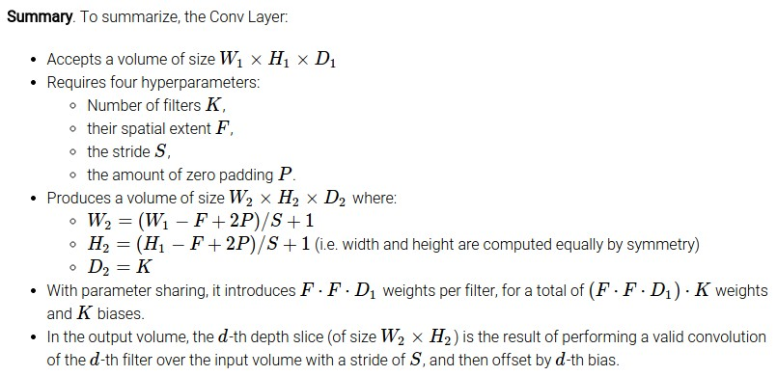
Slide Credit: Fei-Fei Li, Justin Johnson, Serena Yeung, CS 231n

Slide 72
Common settings:
K = (powers of 2, e.g. 32, 64, 128, 512)
F = 3, S = 1, P = 1
F = 5, S = 1, P = 2
F = 5, S = 2, P = ? (whatever fits)
F = 1, S = 1, P = 0
Slide Credit: Fei-Fei Li, Justin Johnson, Serena Yeung, CS 231n

Slide 73
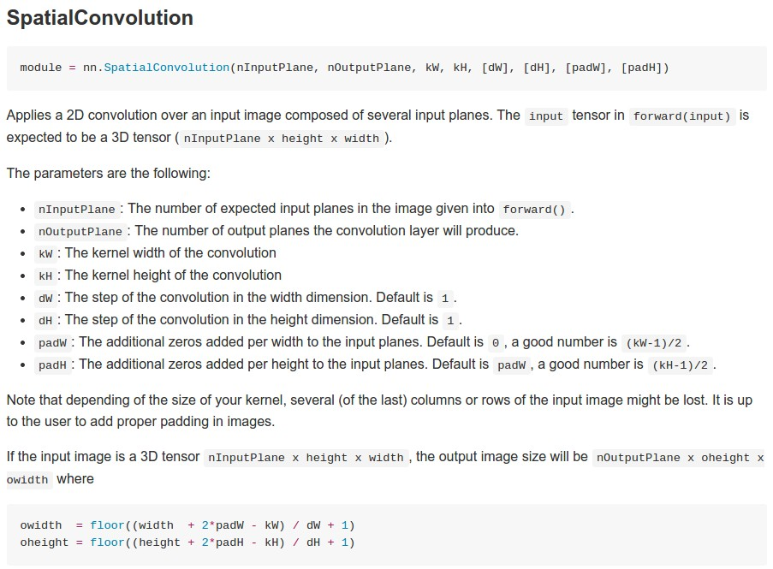
Example: CONV layer in Torch
Torch is licensed under BSD 3-clause.
Slide Credit: Fei-Fei Li, Justin Johnson, Serena Yeung, CS 231n

Slide 74
Plan for Today
Convolutional Neural Networks
Features learned by CNN layers
Stride, padding
1x1 convolutions
Pooling layers
Fully-connected layers as convolutions
Backprop in conv layers

Slide 75
Can we have 1x1 filters?

Slide 76
1x1 convolution layers make perfect sense
1x1 CONV
with 32 filters
56
56
(each filter has size 1x1x64, and performs a 64-dimensional dot product)
56
56
64
32
Slide Credit: Fei-Fei Li, Justin Johnson, Serena Yeung, CS 231n

Slide 77
Fully Connected Layer as 1x1 Conv
32x32x3 image -> stretch to 3072 x 1
input
activation
1
1
3072
10 x 3072
weights
10
1 number:
the result of taking a dot product between a row of W and the input (a 3072-dimensional dot product)
Slide Credit: Fei-Fei Li, Justin Johnson, Serena Yeung, CS 231n
Notes:
Preserve spatial structure of input

