Slide 1
CS 4803 / 7643: Deep Learning
Topics:
  Convolutional Neural Networks
    Pooling layers
    Fully-connected layers as convolutions
    Backprop in conv layers [Derived in notes]
    Toeplitz matrices and convolutions = matrix-mult
Dhruv Batra
Georgia Tech

Slide 2
Administrativia
HW2 Reminder
  Due: 09/23, 11:59pm
  https://evalai.cloudcv.org/web/challenges/challenge-page/684/leaderboard/1853
Project Teams
  https://gtvault-my.sharepoint.com/:x:/g/personal/dbatra8_gatech_edu/EY4_65XOzWtOkXSSz2WgpoUBY8ux2gY9PsRzR6KnglIFEQ?e=4tnKWI
  Project Title
  1-3 sentence project summary TL;DR
  Team member names

Slide 3
Recap from last time

Slide 4
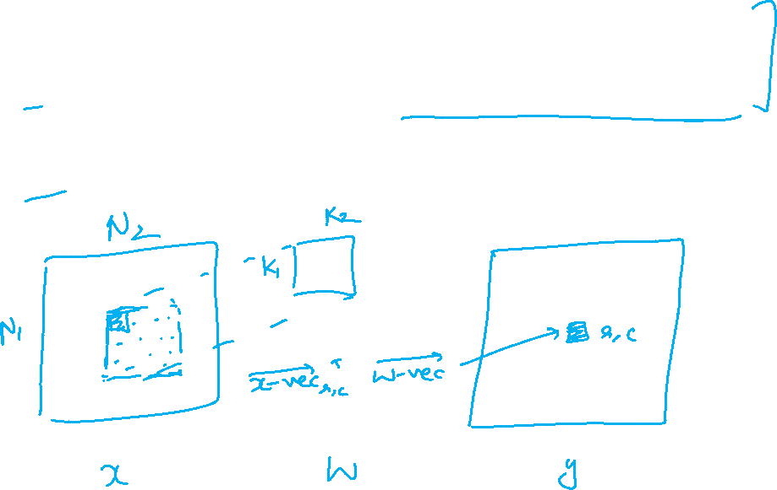
Convolutions for programmers

Slide 5
Convolution Layer
Filters always extend the full depth of the input volume
32x32x3 image
5x5x3 filter
32
Convolve the filter with the image
i.e. “slide over the image spatially, computing dot products”
32
3
Slide Credit: Fei-Fei Li, Justin Johnson, Serena Yeung, CS 231n

Slide 6


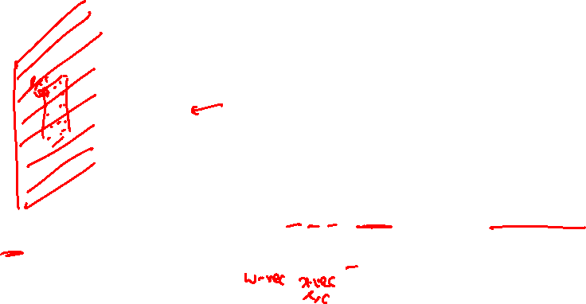
Convolution Layer
32x32x3 image
5x5x3 filter
32
1 number:
the result of taking a dot product between the filter and a small 5x5x3 chunk of the image
(i.e. 5*5*3 = 75-dimensional dot product + bias)
32
3
Slide Credit: Fei-Fei Li, Justin Johnson, Serena Yeung, CS 231n

Slide 7
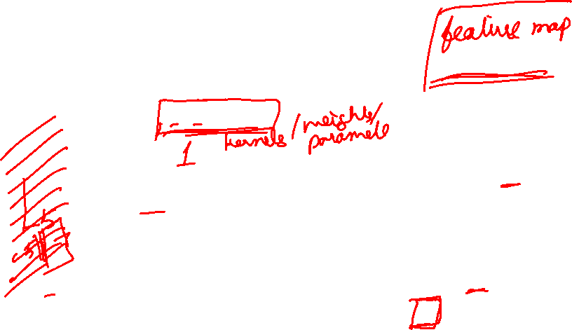
Convolution Layer
activation map
32x32x3 image
5x5x3 filter
32
28
convolve (slide) over all spatial locations
32
28
3
1
Slide Credit: Fei-Fei Li, Justin Johnson, Serena Yeung, CS 231n

Slide 8
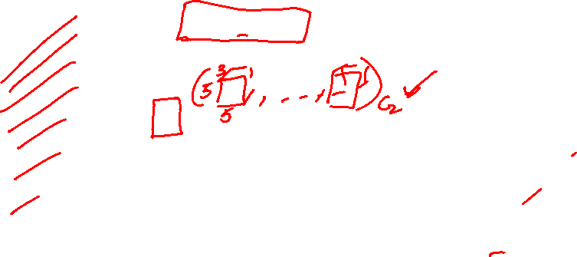
consider a second, green filter
Convolution Layer
32x32x3 image
5x5x3 filter
activation maps
32
28
convolve (slide) over all spatial locations
32
28
3
1
Slide Credit: Fei-Fei Li, Justin Johnson, Serena Yeung, CS 231n

Slide 9
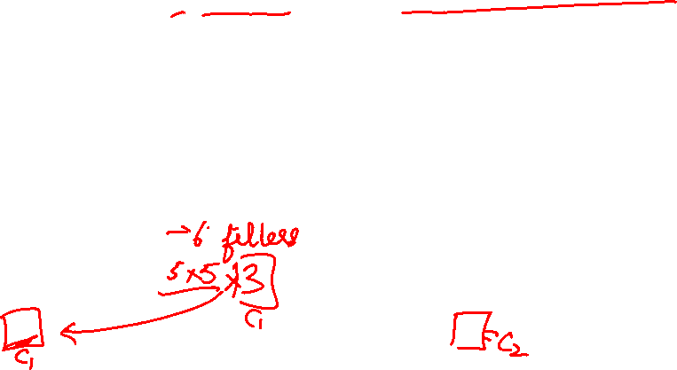
For example, if we had 6 5x5 filters, we’ll get 6 separate activation maps:
activation maps
32
28
Convolution Layer
32
28
3
6
We stack these up to get a “new image” of size 28x28x6!
Slide Credit: Fei-Fei Li, Justin Johnson, Serena Yeung, CS 231n

Slide 10
Plan for Today
Convolutional Neural Networks
  Stride, padding
  1x1 convolutions
  Backprop in conv layers [Derived in notes]
  Pooling layers
  Fully-connected layers as convolutions
  Toeplitz matrices and convolutions = matrix-mult

Slide 11
A closer look at spatial dimensions:
activation map
32x32x3 image
5x5x3 filter
32
28
convolve (slide) over all spatial locations
32
28
3
1
Slide Credit: Fei-Fei Li, Justin Johnson, Serena Yeung, CS 231n

Slide 12
A closer look at spatial dimensions:
7
7x7 input (spatially)
assume 3x3 filter
7
Slide Credit: Fei-Fei Li, Justin Johnson, Serena Yeung, CS 231n

Slide 13
A closer look at spatial dimensions:
7
7x7 input (spatially)
assume 3x3 filter
7
Slide Credit: Fei-Fei Li, Justin Johnson, Serena Yeung, CS 231n

Slide 14
A closer look at spatial dimensions:
7
7x7 input (spatially)
assume 3x3 filter
7
Slide Credit: Fei-Fei Li, Justin Johnson, Serena Yeung, CS 231n

Slide 15
A closer look at spatial dimensions:
7
7x7 input (spatially)
assume 3x3 filter
7
Slide Credit: Fei-Fei Li, Justin Johnson, Serena Yeung, CS 231n

Slide 16
A closer look at spatial dimensions:
7
7x7 input (spatially)
assume 3x3 filter
=> 5x5 output
7
Slide Credit: Fei-Fei Li, Justin Johnson, Serena Yeung, CS 231n

Slide 17
A closer look at spatial dimensions:
7
7x7 input (spatially)
assume 3x3 filter
applied with stride 2
7
Slide Credit: Fei-Fei Li, Justin Johnson, Serena Yeung, CS 231n

Slide 18
A closer look at spatial dimensions:
7
7x7 input (spatially)
assume 3x3 filter
applied with stride 2
7
Slide Credit: Fei-Fei Li, Justin Johnson, Serena Yeung, CS 231n

Slide 19
A closer look at spatial dimensions:
7
7x7 input (spatially)
assume 3x3 filter
applied with stride 2
=> 3x3 output!
7
Slide Credit: Fei-Fei Li, Justin Johnson, Serena Yeung, CS 231n

Slide 20
A closer look at spatial dimensions:
7
7x7 input (spatially)
assume 3x3 filter
applied with stride 3?
7
Slide Credit: Fei-Fei Li, Justin Johnson, Serena Yeung, CS 231n

Slide 21
A closer look at spatial dimensions:
7
7x7 input (spatially)
assume 3x3 filter
applied with stride 3?
7
doesn’t fit!
cannot apply 3x3 filter on 7x7 input with stride 3.
Slide Credit: Fei-Fei Li, Justin Johnson, Serena Yeung, CS 231n

Slide 22
N
Output size:
(N - F) / stride + 1
e.g. N = 7, F = 3:
stride 1 => (7 - 3)/1 + 1 = 5
stride 2 => (7 - 3)/2 + 1 = 3
stride 3 => (7 - 3)/3 + 1 = 2.33 :\
F
F
N
Slide Credit: Fei-Fei Li, Justin Johnson, Serena Yeung, CS 231n

Slide 23
Remember back to…
E.g. 32x32 input convolved repeatedly with 5x5 filters shrinks volumes spatially!
(32 -> 28 -> 24 ...). Shrinking too fast is not good, doesn’t work well.
32
28
24
….
CONV,
ReLU
e.g. 6 5x5x3 filters
CONV,
ReLU
e.g. 10 5x5x6 filters
CONV,
ReLU
32
28
24
3
6
10
Slide Credit: Fei-Fei Li, Justin Johnson, Serena Yeung, CS 231n

Slide 24
In practice: Common to zero pad the border
0 | 0 | 0 | 0 | 0 | 0
0
0
0
0
e.g. input 7x7
3x3 filter, applied with stride 1
pad with 1 pixel border => what is the output?
(recall:)
(N - F) / stride + 1
Slide Credit: Fei-Fei Li, Justin Johnson, Serena Yeung, CS 231n

Slide 25
In practice: Common to zero pad the border
0 | 0 | 0 | 0 | 0 | 0
0
0
0
0
e.g. input 7x7
3x3 filter, applied with stride 1
pad with 1 pixel border => what is the output?
7x7 output!
Slide Credit: Fei-Fei Li, Justin Johnson, Serena Yeung, CS 231n

Slide 26
In practice: Common to zero pad the border
0 | 0 | 0 | 0 | 0 | 0
0
0
0
0
e.g. input 7x7
3x3 filter, applied with stride 1
pad with 1 pixel border => what is the output?
7x7 output!
in general, common to see CONV layers with stride 1, filters of size FxF, and zero-padding with (F-1)/2. (will preserve size spatially)
e.g. F = 3 => zero pad with 1
F = 5 => zero pad with 2
F = 7 => zero pad with 3
Slide Credit: Fei-Fei Li, Justin Johnson, Serena Yeung, CS 231n

Slide 27
Examples time:
Input volume: 32x32x3
10 5x5 filters with stride 1, pad 2
Output volume size: ?
Slide Credit: Fei-Fei Li, Justin Johnson, Serena Yeung, CS 231n
Notes:
(32+2*2-5)/1+1 = 32 spatially
(Input size + 2*padding - stride) / 1 + 1 for new spatial size
10 filters

Slide 28
Examples time:
Input volume: 32x32x3
10 5x5 filters with stride 1, pad 2
Output volume size:
(32+2*2-5)/1+1 = 32 spatially, so
32x32x10
Slide Credit: Fei-Fei Li, Justin Johnson, Serena Yeung, CS 231n

Slide 29
Examples time:
Input volume: 32x32x3
10 5x5 filters with stride 1, pad 2
Number of parameters in this layer?
Slide Credit: Fei-Fei Li, Justin Johnson, Serena Yeung, CS 231n
Notes:
each filter has 5*5*3 + 1 = 76 params
1 for bias

Slide 30
Examples time:
Input volume: 32x32x3
10 5x5 filters with stride 1, pad 2
Number of parameters in this layer?
each filter has 5*5*3 + 1 = 76 params (+1 for bias)
=> 76*10 = 760
Slide Credit: Fei-Fei Li, Justin Johnson, Serena Yeung, CS 231n

Slide 31
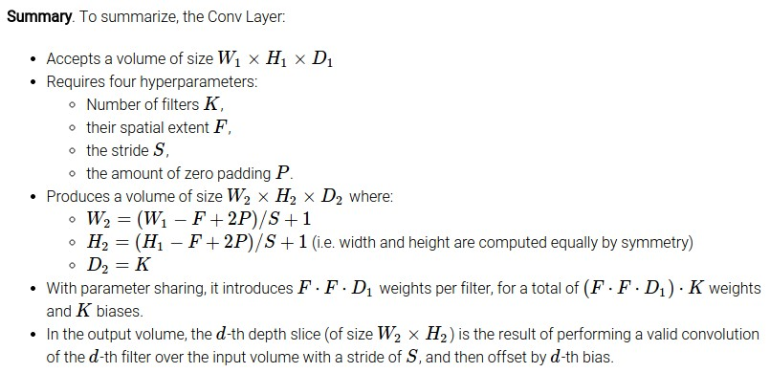
Slide Credit: Fei-Fei Li, Justin Johnson, Serena Yeung, CS 231n

Slide 32
Common settings:
K = (powers of 2, e.g. 32, 64, 128, 512)
F = 3, S = 1, P = 1
F = 5, S = 1, P = 2
F = 5, S = 2, P = ? (whatever fits)
F = 1, S = 1, P = 0
Slide Credit: Fei-Fei Li, Justin Johnson, Serena Yeung, CS 231n

Slide 33
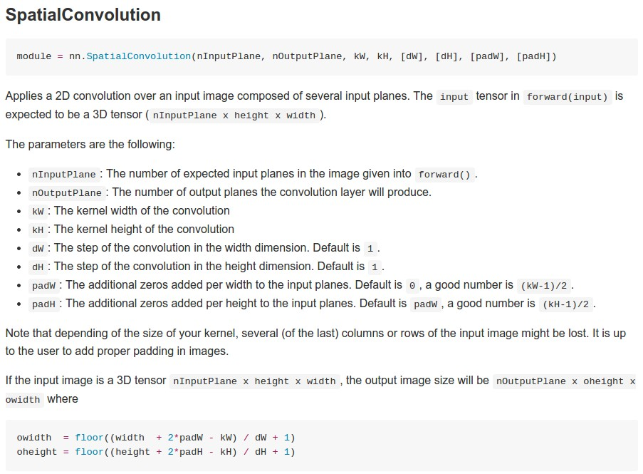
Example: CONV layer in Torch
Torch is licensed under BSD 3-clause.
Slide Credit: Fei-Fei Li, Justin Johnson, Serena Yeung, CS 231n

Slide 34
Plan for Today
Convolutional Neural Networks
  Stride, padding
  1x1 convolutions
  Backprop in conv layers [Derived in notes]
  Pooling layers
  Fully-connected layers as convolutions
  Toeplitz matrices and convolutions = matrix-mult

Slide 35
Can we have 1x1 filters?

Slide 36
1x1 convolution layers make perfect sense
1x1 CONV
with 32 filters
56
56
(each filter has size 1x1x64, and performs a 64-dimensional dot product)
56
56
64
32
Slide Credit: Fei-Fei Li, Justin Johnson, Serena Yeung, CS 231n

Slide 37
Fully Connected Layer as 1x1 Conv
32x32x3 image -> stretch to 3072 x 1
input
activation
1
1
3072
10 x 3072
weights
10
1 number:
the result of taking a dot product between a row of W and the input (a 3072-dimensional dot product)
Slide Credit: Fei-Fei Li, Justin Johnson, Serena Yeung, CS 231n
Notes:
Preserve spatial structure of input

Slide 38
Plan for Today
Convolutional Neural Networks
  Stride, padding
  1x1 convolutions
  Backprop in conv layers [Derived in notes]
  Pooling layers
  Fully-connected layers as convolutions
  Toeplitz matrices and convolutions = matrix-mult

Slide 39
Computational Graph
Any DAG of differentiable modules is allowed!
Slide Credit: Marc'Aurelio Ranzato

Slide 40
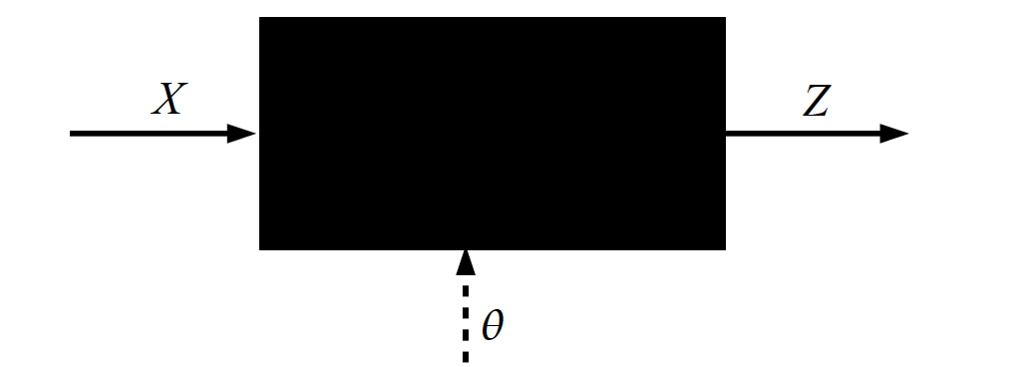
Key Computation: Forward-Prop
Slide Credit: Marc'Aurelio Ranzato, Yann LeCun

Slide 41
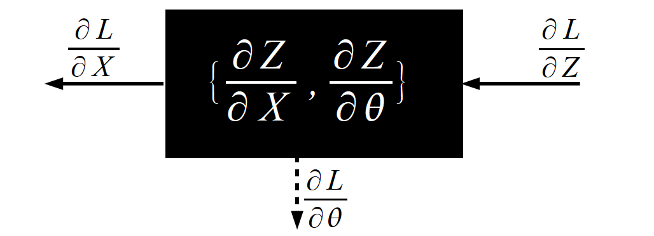
Key Computation: Back-Prop
Slide Credit: Marc'Aurelio Ranzato, Yann LeCun

Slide 42
Backprop in Convolutional Layers
Notes
  https://www.cc.gatech.edu/classes/AY2021/cs7643_fall/slides/L11_cnns_backprop_notes.pdf

Slide 43
Backprop in Convolutional Layers

Slide 44
Backprop in Convolutional Layers

Slide 45
Backprop in Convolutional Layers

Slide 46
Plan for Today
Convolutional Neural Networks
  Stride, padding
  1x1 convolutions
  Backprop in conv layers [Derived in notes]
  Pooling layers
  Fully-connected layers as convolutions
  Toeplitz matrices and convolutions = matrix-mult

Slide 47
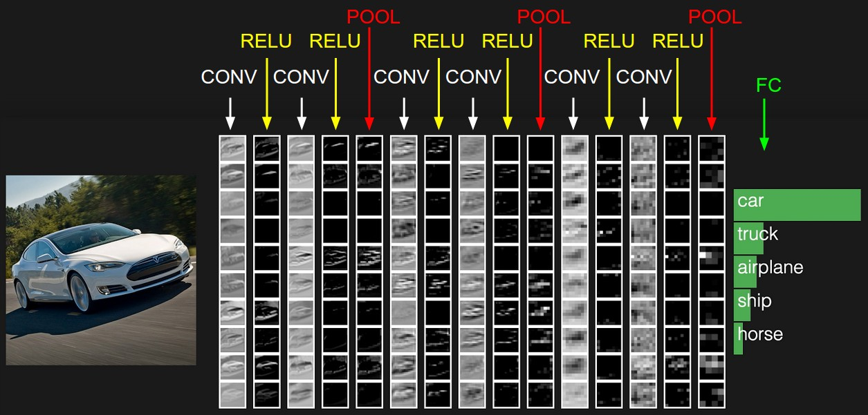
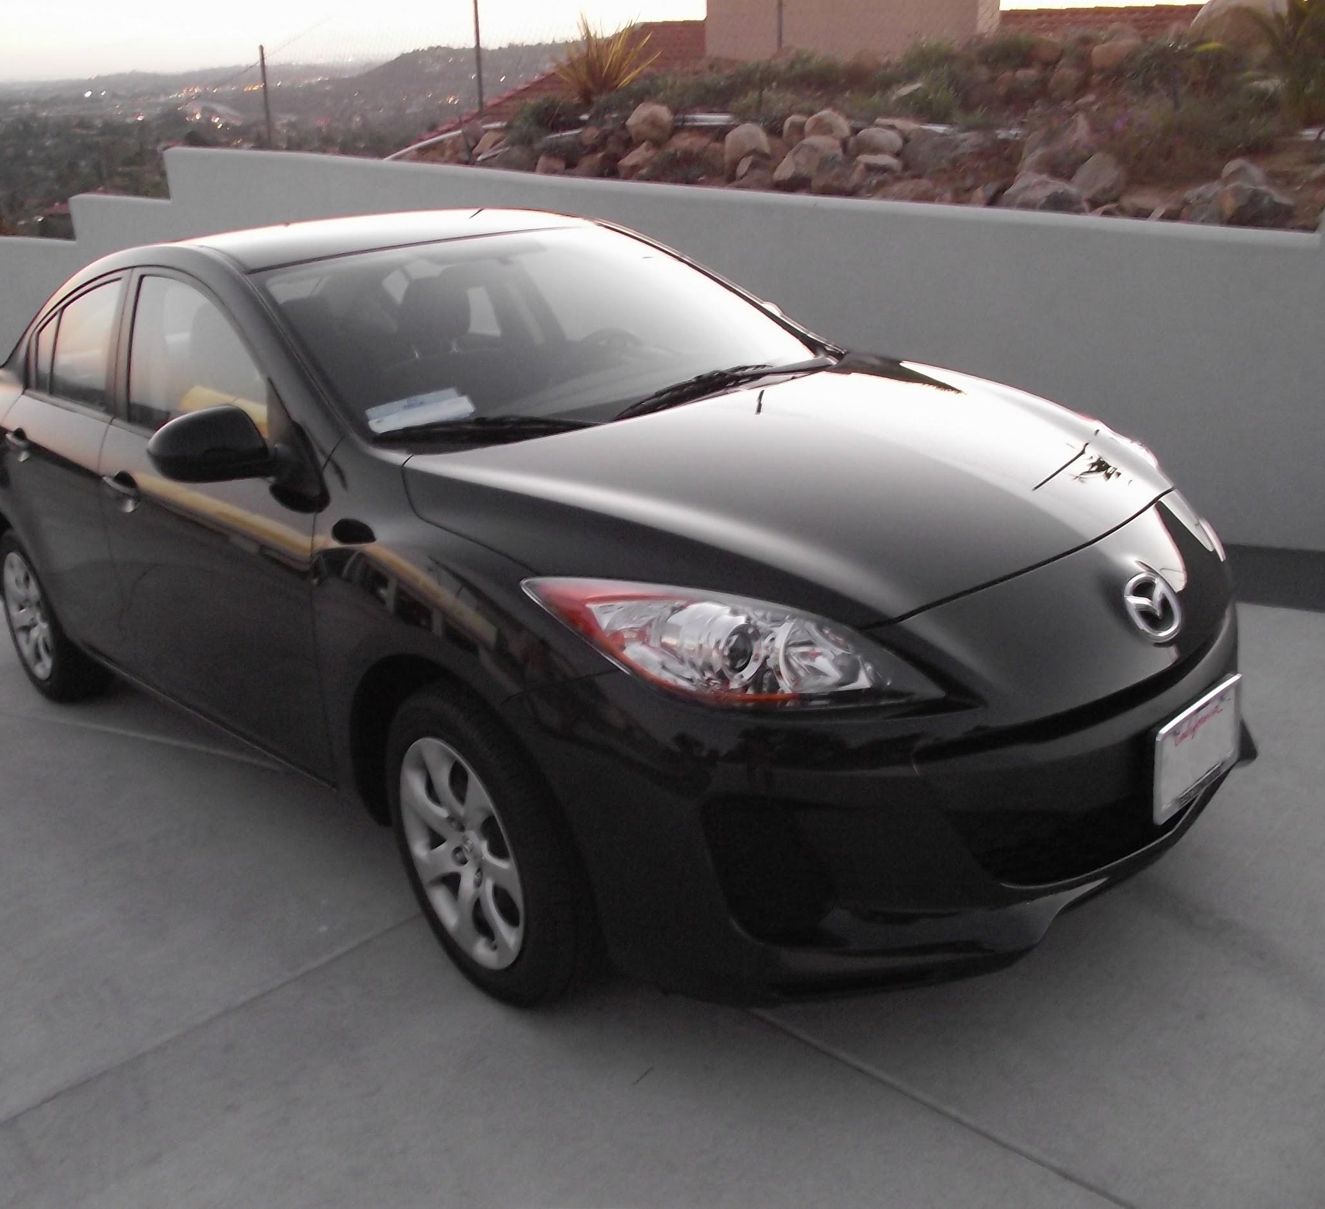
two more layers to go: POOL/FC
Slide Credit: Fei-Fei Li, Justin Johnson, Serena Yeung, CS 231n
Notes:
Car image is photo taken by Lane McIntosh, permission to use.

Slide 48
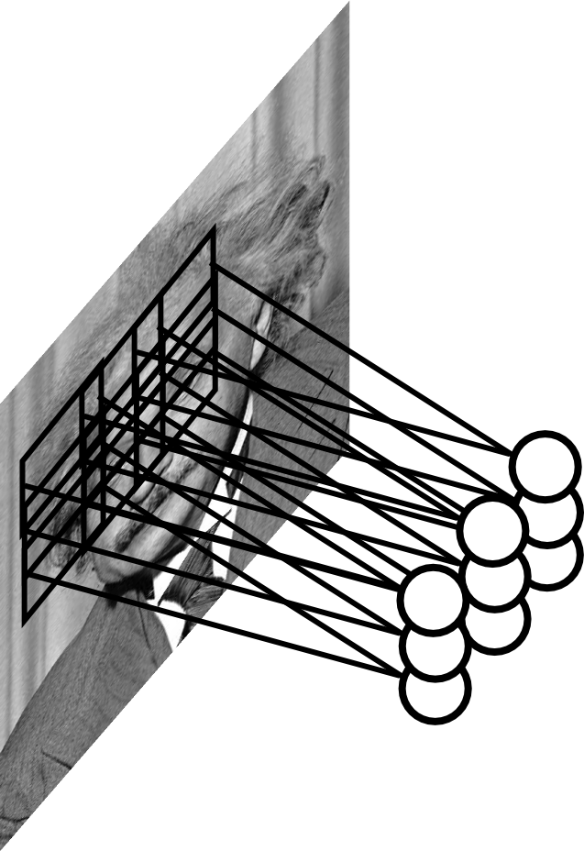
Pooling Layer
Let us assume filter is an “eye” detector.
Q.: how can we make the detection robust to the exact location of the eye?
Slide Credit: Marc'Aurelio Ranzato

Slide 49
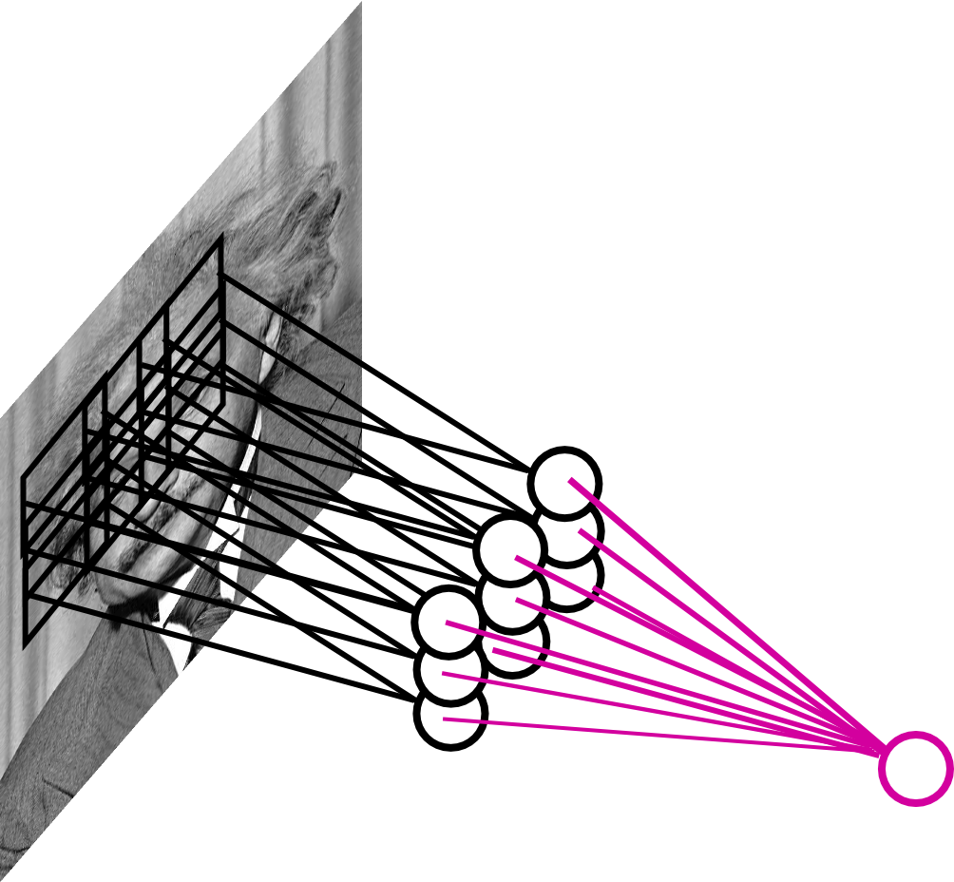
Pooling Layer
By “pooling” (e.g., taking max) filter
responses at different locations we gain robustness to the exact spatial location of features.
Slide Credit: Marc'Aurelio Ranzato

Slide 50
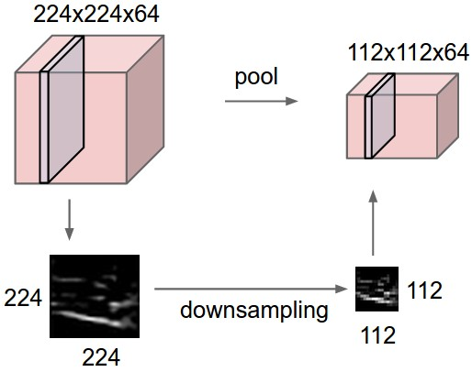
Pooling layer
makes the representations smaller and more manageable
operates over each activation map independently:
Slide Credit: Fei-Fei Li, Justin Johnson, Serena Yeung, CS 231n

Slide 51
MAX POOLING
Single depth slice
1 | 1 | 2 | 4
5 | 6 | 7 | 8
3 | 2 | 1 | 0
1 | 2 | 3 | 4
dim 1
max pool with 2x2 filters and stride 2
6 | 8
3 | 4
dim 2
Slide Credit: Fei-Fei Li, Justin Johnson, Serena Yeung, CS 231n

Slide 52
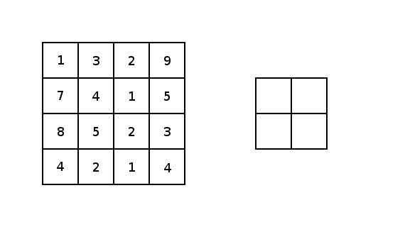
Image courtesy: Justin Francis.

Slide 53
Pooling Layer: Examples
Max-pooling:
Average-pooling:
L2-pooling:
Slide Credit: Marc'Aurelio Ranzato

Slide 54
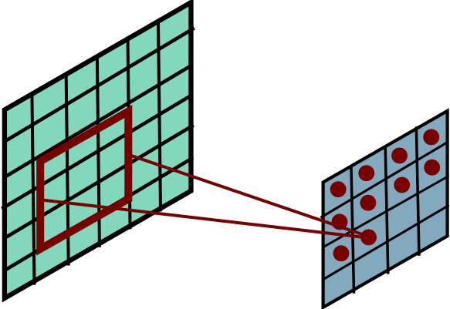
Receptive Field
Conv.
layer
Pool.
layer
Slide Credit: Marc'Aurelio Ranzato

Slide 55
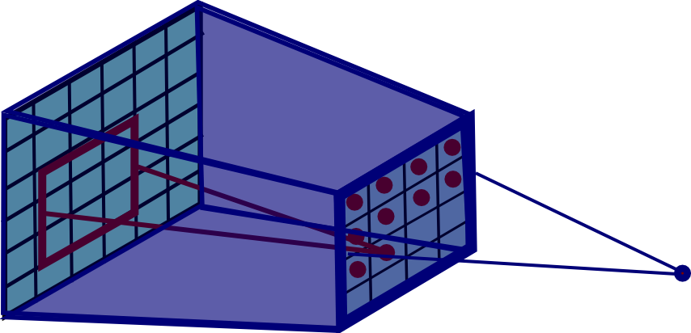
Pooling Layer: Receptive Field Size
Conv.
layer
Pool.
layer
Slide Credit: Marc'Aurelio Ranzato

Slide 56
Pooling Layer: Receptive Field Size
Conv.
layer
Pool.
layer
If convolutional filters are FxF and stride 1, and
pooling layer has pools of size PxP,
then each unit in the pooling layer depends upon a patch in h^{(l-1)} of size: (P+F-1)x(P+F-1)
Slide Credit: Marc'Aurelio Ranzato

Slide 57
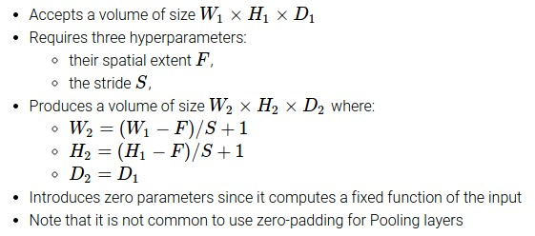
Slide Credit: Fei-Fei Li, Justin Johnson, Serena Yeung, CS 231n

Slide 58
Common settings:
F = 2, S = 2
F = 3, S = 2
Slide Credit: Fei-Fei Li, Justin Johnson, Serena Yeung, CS 231n

Slide 59
Fully Connected Layer (FC layer)
Contains neurons that connect to the entire input volume, as in ordinary Neural Networks
Slide Credit: Fei-Fei Li, Justin Johnson, Serena Yeung, CS 231n
Notes:
Car image is photo taken by Lane McIntosh, permission to use.

Slide 60

Convolutional Neural Networks
Image Credit: Yann LeCun, Kevin Murphy

Slide 61
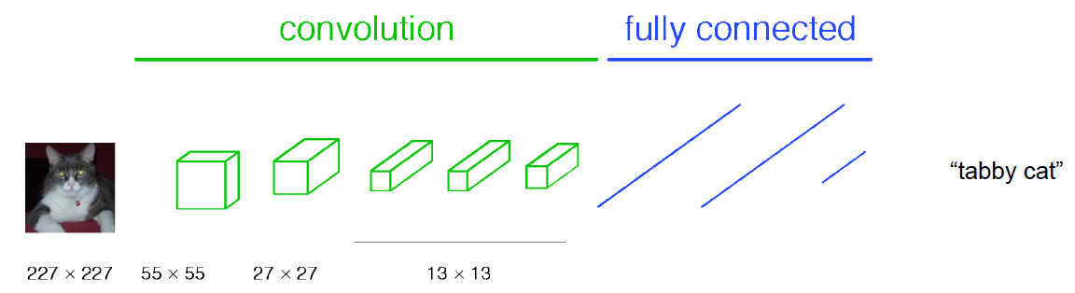
Classical View
Figure Credit: [Long, Shelhamer, Darrell CVPR15]

Slide 62
C₂ hidden units
NxNxC₁, N small
Fully conn. layer
Slide Credit: Marc'Aurelio Ranzato

Slide 63
Classical View
Figure Credit: [Long, Shelhamer, Darrell CVPR15]

Slide 64
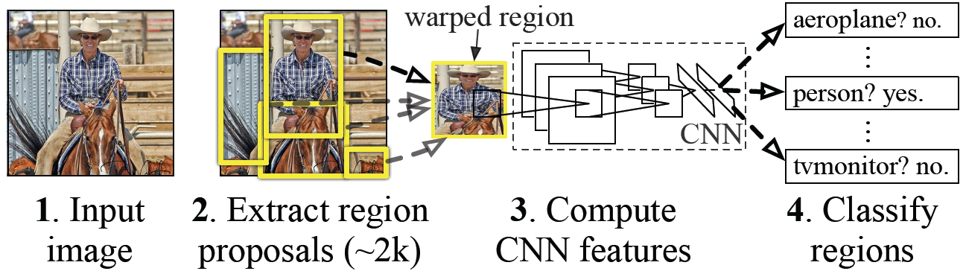
Classical View = Inefficient

Slide 65
Classical View
Figure Credit: [Long, Shelhamer, Darrell CVPR15]

Slide 66
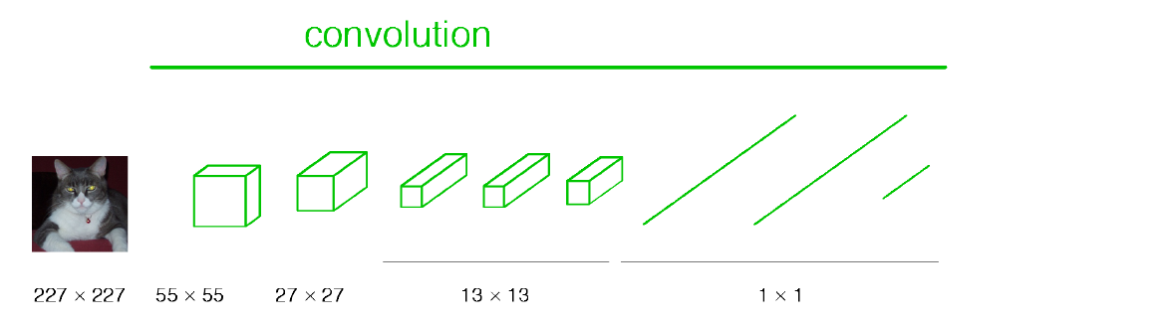
Re-interpretation
Just squint a little!
Figure Credit: [Long, Shelhamer, Darrell CVPR15]

Slide 67
C₂ hidden units /
1x1xC₂ feature maps
NxNxC₁, N small
Fully conn. layer /
Conv. layer (C₂ kernels of size NxNxC₁)
Slide Credit: Marc'Aurelio Ranzato

Slide 68
Re-interpretation
Just squint a little!
Figure Credit: [Long, Shelhamer, Darrell CVPR15]

Slide 69
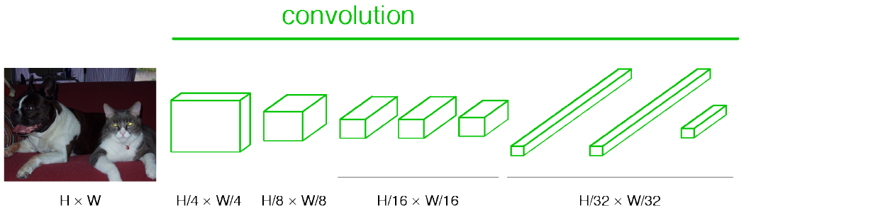
“Fully Convolutional” Networks
Can run on an image of any size!
Figure Credit: [Long, Shelhamer, Darrell CVPR15]

Slide 70
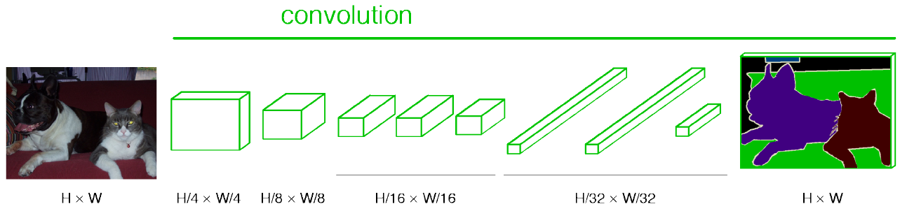
“Fully Convolutional” Networks
Up-sample to get segmentation maps
Figure Credit: [Long, Shelhamer, Darrell CVPR15]

Slide 71
Benefit of this thinking
Mathematically elegant
Efficiency
  Can run network on arbitrary image
  Without multiple crops

Slide 72
Plan for Today
Convolutional Neural Networks
  Stride, padding
  1x1 convolutions
  Backprop in conv layers [Derived in notes]
  Pooling layers
  Fully-connected layers as convolutions
  Toeplitz matrices and convolutions = matrix-mult

Slide 73
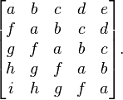
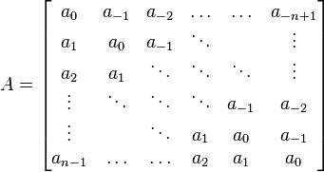
Toeplitz Matrix
Diagonals are constants
A_{ij} = a_{i-j}

Slide 74
Why do we care?
(Discrete) Convolution = Matrix Multiplication
  with Toeplitz Matrices
. . .

Slide 75
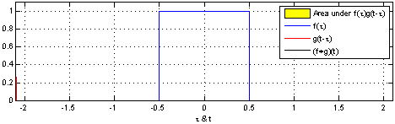
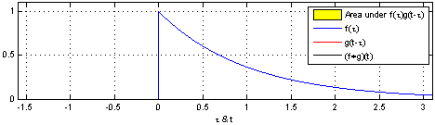
"Convolution of box signal with itself2" by Convolution_of_box_signal_with_itself.gif: Brian Ambergderivative work: Tinos (talk) - Convolution_of_box_signal_with_itself.gif. Licensed under CC BY-SA 3.0 via Commons - https://commons.wikimedia.org/wiki/File:Convolution_of_box_signal_with_itself2.gif#/media/File:Convolution_of_box_signal_with_itself2.gif

Slide 76
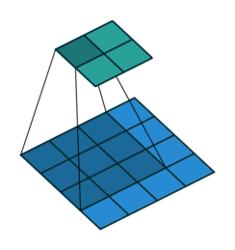
Figure Credit: Dumoulin and Visin, https://arxiv.org/pdf/1603.07285.pdf

