Slide 1
RNN-T Based ASR Systems
Mahaveer Jain, Facebook

Slide 2
Outline
Automatic Speech Recognition (ASR) Systems
Different Approaches For Building ASR Systems
RNN-T (Recurrent Neural Network Transducer) Based ASR Training And Decoding
Practical Considerations For deploying RNN-T ASR Systems in Production
Use pptx version if possible to see slides in Slide Show (Animation View) for best viewing as there are animations throughout

Slide 3

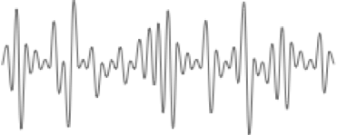
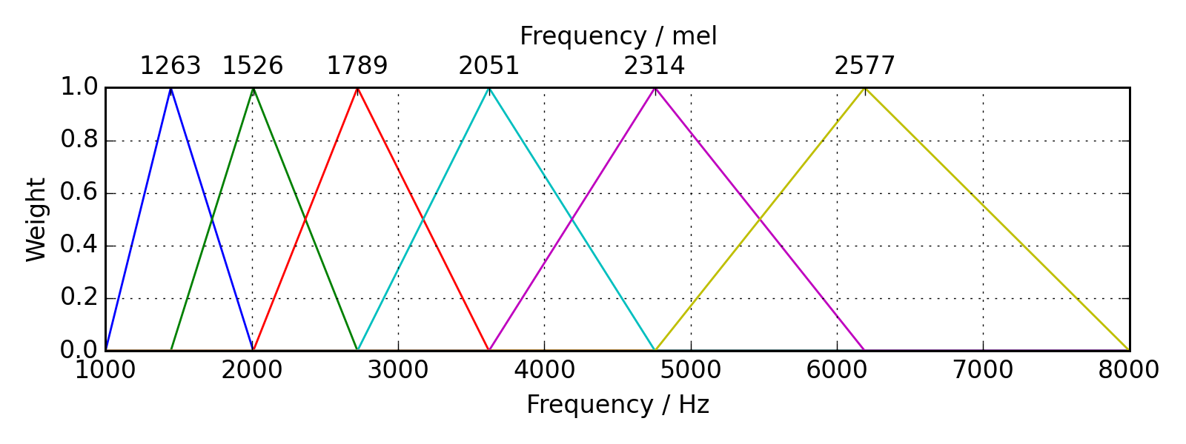
Automatic Speech Recognition
features
the cat sat
Audio
Transcript
Fourier Transform
Frequency Domain Representation
Audio
Overlapping Audio Frames
10ms
Mel Filters : Humans are better at
detecting differences in lower
frequencies than higher frequencies
Frame Shift
25ms
Frame Window
This filter bank image is taken from pyFilterBank documentation page http://siggigue.github.io/
Mel Features
Log
X₁
X₂
X₃
X₄
X₅
X₆
X₇
X_{T}
……
Audio
Audio Feature at frame 3
Notes:
Audio feature are 40 dimension vectors.

Slide 4
Automatic Speech Recognition: Modularized Vs Non Modularized
features
ASR
the cat sat
Modularized (Hybrid) ASR:
  Contains multiple modules
    Acoustic Model
    Language Model
    Pronunciation Model
Non Modularized (End2End) ASR:
  Single Neural Network
    Listen Attend and Spell (Chan et al., “Listen, Attend and Spell”)
    RNN-T (Graves et al., “Sequence transduction with recurrent neural networks”)
Audio
Transcript

Slide 5

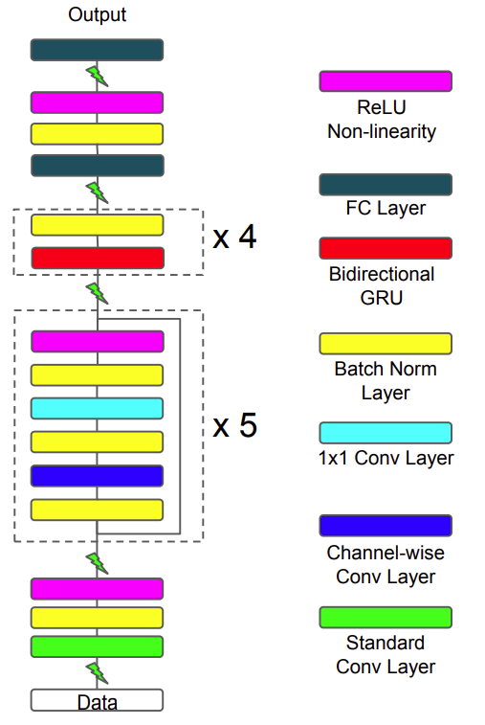


Automatic Speech Recognition : Modularized (Hybrid) ASR
features
acoustic
model
də kæt sæt
the cat sat
Sounds Units
phonemes
LSTMs
or variants
ConvNets
Thanks Ronan Collobert for the slide content
Zhou et al, 2017

Slide 6
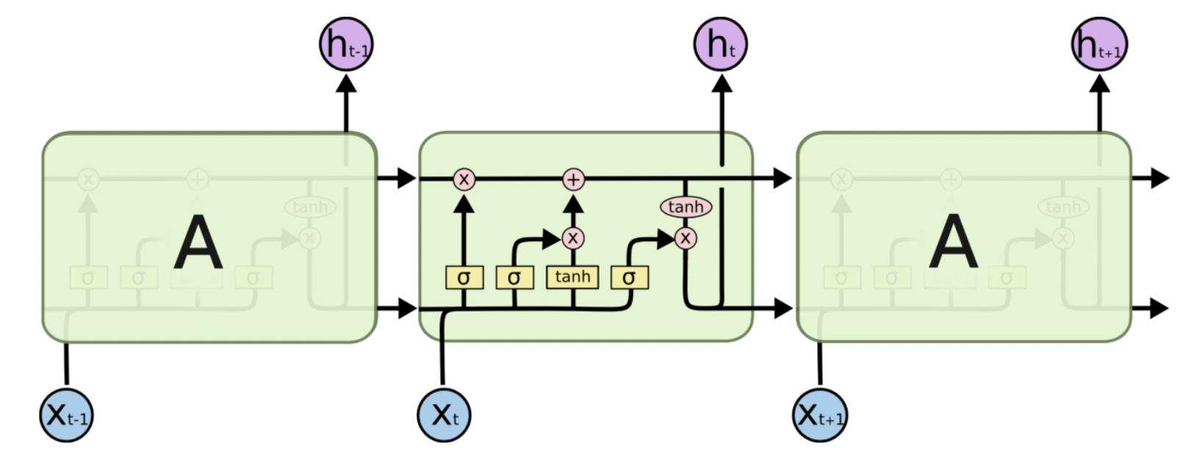
Acoustic Model: Training
LSTM image is taken from https://colah.github.io/posts/2015-08-Understanding-LSTMs/
Softmax Layer(Toy example: If we assume there are just three sound units(su1, su2, su3) in the language)
Acoustic model generates probability over sound units.
During training, convert True Transcript to corresponding sound units sequence (i.e: AND(an d))
Cross Entropy Loss
P_{Su1}¹
P_{Su2}¹
P_{Su3}¹
P_{Su1}²
P_{Su2}²
P_{Su3}²
P_{Su1}³
P_{Su2}³
P_{Su3}³
P_{Su1}⁴
P_{Su2}⁴
P_{Su3}⁴
P_{Su1}⁵
P_{Su2}⁵
P_{Su3}⁵
P_{Su1}⁶
P_{Su2}⁶
P_{Su3}⁶
P_{Su1}⁷
P_{Su2}⁷
P_{Su3}⁷
f₁
f₂
f₃
f₄
f₅
f₆
f₇
Example Acoustic Model (LSTM)
X₁
X₂
X₃
X₄
X₅
X₆
X₇
Audio
Audio Features
Frame wise True sound unit labels
from alignment model
su2
su2
su2
su1
su1
su1
su1
Notes:
Could be compressed

Slide 7
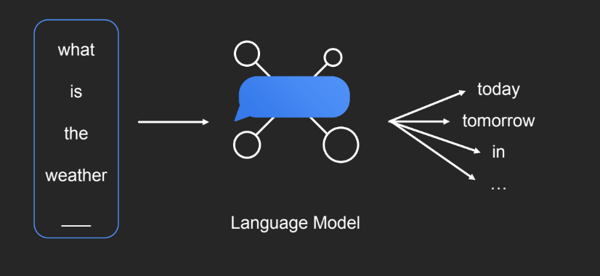
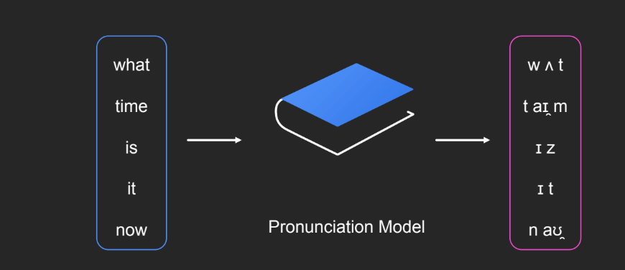
Automatic Speech Recognition: Modularized (Hybrid) ASR
Sounds Units
features
acoustic
model
decoder
the cat sat
language model
pronunciation
model
What is the probability of a specific next word given the history?
Pr_LM(“today”| [“what”, “is”, “the”, ”weather”])
How words are built from small sound units?
Thanks Ronan Collobert and Duc Le for the slide content

Slide 8
Automatic Speech Recognition: Modularized And Non Modularized ASR
Sounds Units
features
acoustic
model
decoder
the cat sat
language
model
pronunciation
model
Acoustic Only Training (Modularized ASR)
Non Modularized ASR training
How to train the system in a Non Modularized manner?
  Replace phonemes by letters and formulate ASR as Sequence to Sequence Problem
Thanks Ronan Collobert for the slide content

Slide 9
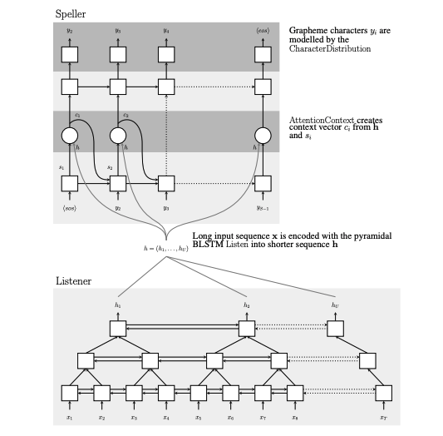
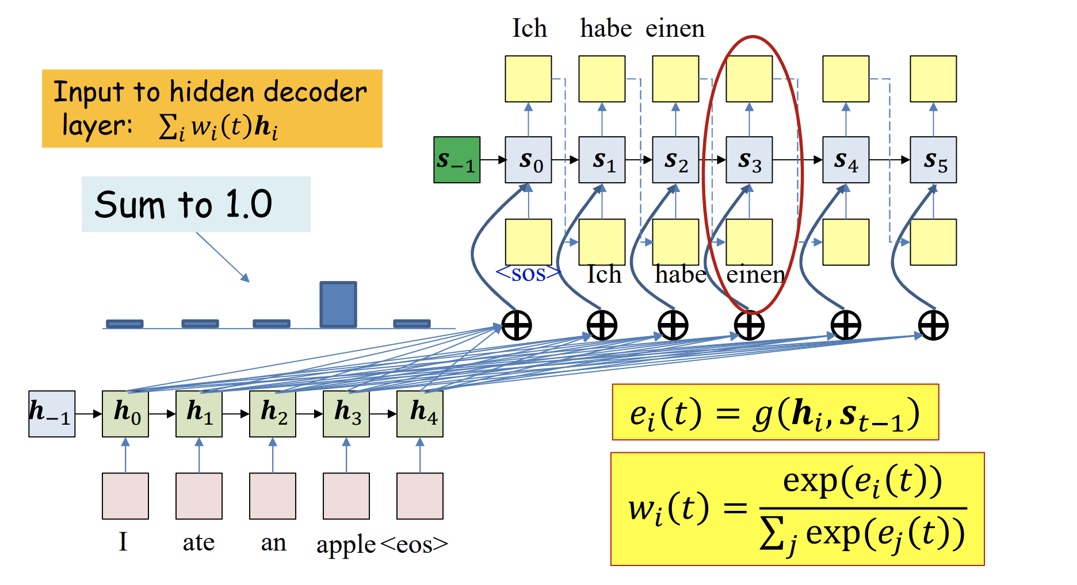
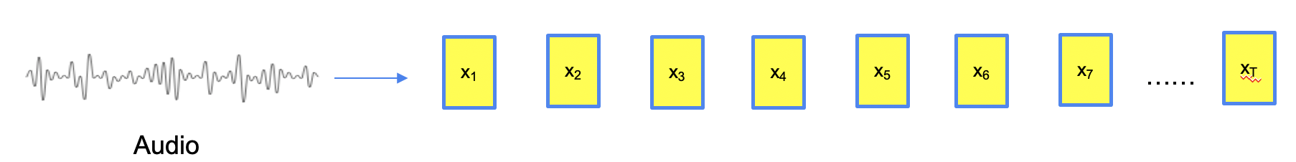
ASR And Machine Translation As Sequence To Sequence Problem
Machine Translation
Image from Bhiksha Raj’s lecture on attention models
LAS attends to all audio embeddings and uses text history produced so far to
generate probability distribution over output units
ASR
Image from Chan et al., “Listen, Attend and Spell”
Notes:
In MT, discrete input units get represented in continues features using embedding. in ASR, we already continues features
Input sequence much larger output sequence

Slide 10
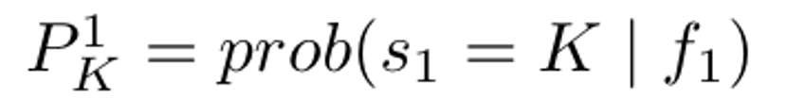


ASR As Sequence To Sequence Problem
Alignment not known during training
At each audio frame index, neural network generates probability of producing each output symbol. e. g. Probability of generating output symbol “k” at 1st frame.
#audio frames != # letters. We also don’t know which portion of audio was emitted when.
Long short-term memory (LSTM), B-LSTM (bi-directional LSTM) and, Transformer are some of the commonly used audio encoders.
P_{B}¹
P_{E}¹
P_{C}¹
…..
…
Pr$\left(k | t\right)→\text{P}\text{t}\text{k}$
Softmax
$$h^{t}$$
Linear Layer
$$f_{t}^{}$$
Audio Encoder
$$x_{t}$$

Slide 11
ASR As Sequence To Sequence Problem
Input Sequence: Audio frame features
Output Sequence : Words from True Transcript Text written as letters
Example Training Instance: Input Sequence : 7 audio frames and True Transcript Text: “BE”
At each audio frame index, network* generates probability of producing each output symbol. E. g. Probability of generating output symbol “K” at 1st frame.
#audio frames != # letters. We don’t know alignment i.e. which portion of audio aligns to what letter in true transcript.
Collapse continuous occurrences of same letter into one:
  First alignment choice (BBEEEEE -> BE)
  Second alignment choice (BBBEEEE -> BE)
  and so on…..
How to deal with repeated letters (as in word BEE) ? (next slide)
Softmax Layer (Toy example: If we assume there are just three letters in the language (B, E, C))
P_{B}¹
P_{E}¹
P_{C}¹
P_{B}²
P_{E}²
P_{C}²
P_{B}³
P_{E}³
P_{C}³
P_{B}⁴
P_{E}⁴
P_{C}⁴
P_{B}⁵
P_{E}⁵
P_{C}⁵
P_{B}⁶
P_{E}⁶
P_{C}⁶
P_{B}⁷
P_{E}⁷
P_{C}⁷
f₁
f₂
f₃
f₄
f₅
f₆
f₇
X₁
X₂
X₃
X₄
X₅
X₆
X₇
Audio
Audio Features
Neural Network (i.e. LSTM)
network* -> Softmax layer and neural network that produces f_{t}

Slide 12







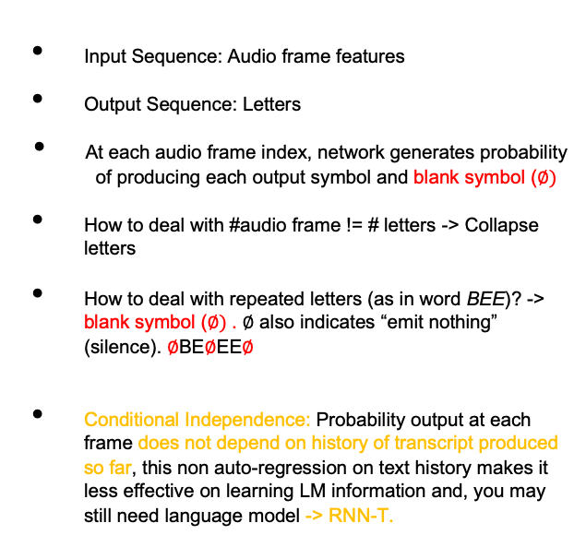
Connectionist Temporal Classification (CTC)
Softmax Layer
Input Sequence: Audio frame features
Output Sequence: Letters
At each audio frame index, network generates probability of producing each output symbol and blank symbol ($∅)$
How to deal with #audio frame != # letters -> Collapse letters
How to deal with repeated letters (as in word BEE)? -> blank symbol ($∅)$. $∅$ also indicates “emit nothing” (silence). $∅$BE$∅$EE$∅$
Conditional Independence: Probability output at each frame does not depend on history of transcript produced so far, this non auto-regression on text history makes it less effective on learning LM information and, you may still need language model -> RNN-T.
P$∅1$
P_{B}¹
P_{E}¹
P_{C}¹
P$∅2$
P_{B}²
P_{E}²
P_{C}²
P$∅3$
P_{B}³
P_{E}³
P_{C}³
P$∅4$
P_{B}⁴
P_{E}⁴
P_{C}⁴
P$∅5$
P_{B}⁵
P_{E}⁵
P_{C}⁵
P$∅6$
P_{B}⁶
P_{E}⁶
P_{C}⁶
P$∅7$
P_{B}⁷
P_{E}⁷
P_{C}⁷
f₁
f₂
f₃
f₄
f₅
f₆
f₇
X₁
X₂
X₃
X₄
X₅
X₆
X₇
Neural Network
A path to generate “BEE”
Audio Features

Slide 13

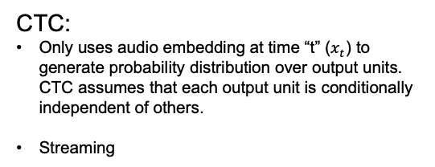
Conditional Independence Assumption
Pr$\left(k | t\right)→\text{P}\text{t}\text{k}$
Softmax
$$h^{t}$$
Linear Layer
$$f_{t}^{}$$
>
Audio Encoder
$$x_{t}$$
CTC:
Only uses audio embedding at time “t” ($x_{t}$) to generate probability distribution over output units. CTC assumes that each output unit is conditionally independent of others.
Streaming
LAS:
Attends to all audio embeddings and uses text history
produced so far to generate probability distribution over output units.

Slide 14



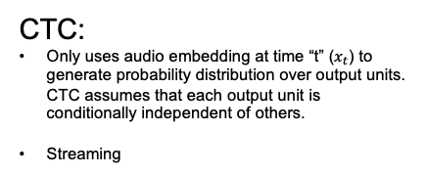

Conditional Independence Assumption
Pr$\left(k | t\right)→\text{P}\text{t}\text{k}$
Pr$\left(k | t,u\right)→\text{P}\text{k}\text{(}\text{t}\text{,}\text{u}\text{)}$
Softmax
Softmax
$$h^{t, u}$$
$$h^{t}$$
Linear Layer
Linear Layer
>
$$z^{t, u}$$
>
$$f_{t}^{}$$
Joiner
Audio Encoder
$$g_{u}^{}$$
$$f_{t}^{}$$
$$x_{t}$$
Text Predictor
Audio Encoder
CTC:
Only uses audio embedding at time “t” ($x_{t}$) to generate probability distribution over output units. CTC assumes that each output unit is conditionally independent of others.
Streaming
Text History: $y_{u−1}$
$$x_{t}$$
LAS:
Attends to all audio embeddings and uses text history
produced so far to generate probability distribution over output units.
RNN-T:
Uses both audio embedding at time “t” ($x_{t}$) and text history produced so far ($y_{u−1}$) to generate probability distribution over output units.
Streaming

Slide 15
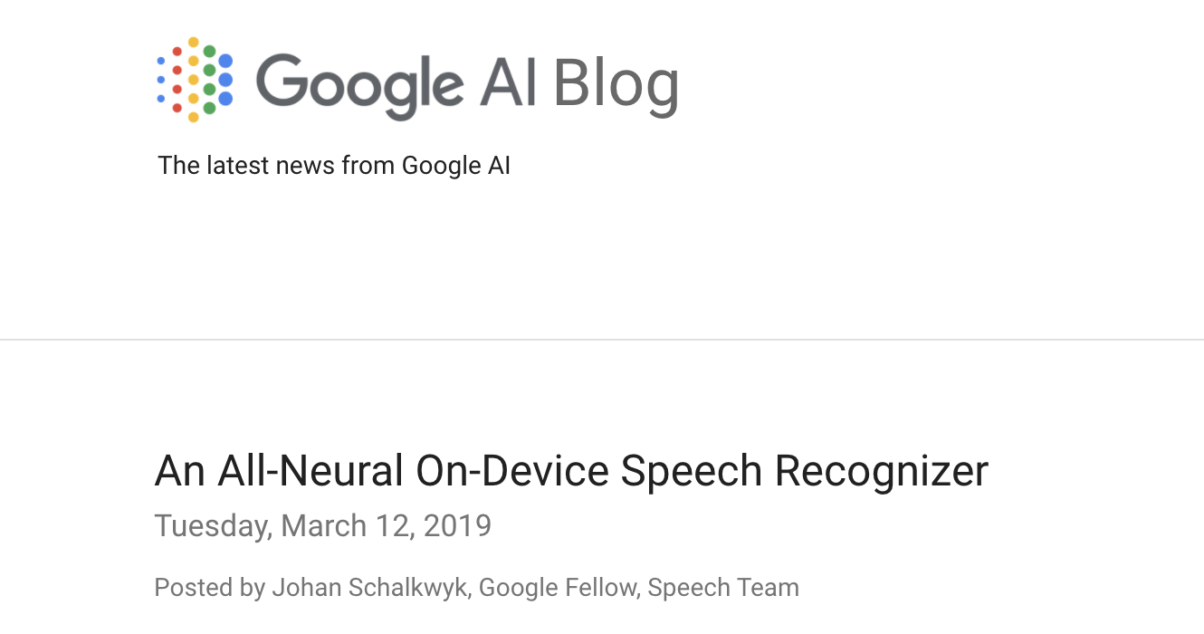
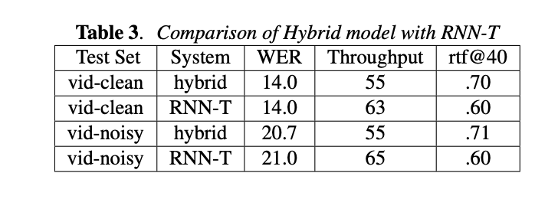
Why RNN-T ASR From Production Point Of View
  Single deployable non modularized neural model, all components of ASR in one model.
  Allows compact on-device streaming ASR. Does not need a decoder graph which can be large. Unlimited words in vocab. Standard on-device ASR choice across industry.
  Achieves comparable accuracy and compute with much smaller size model compared to modularized (hybrid) systems for production when training data is the same.
Image from https://ai.googleblog.com/2019/03/an-all-neural-on-device-speech.html
Image from Jain et al., “RNN-T For Latency Controlled ASR With Imoroved Beam Search”
Example Study

Slide 16
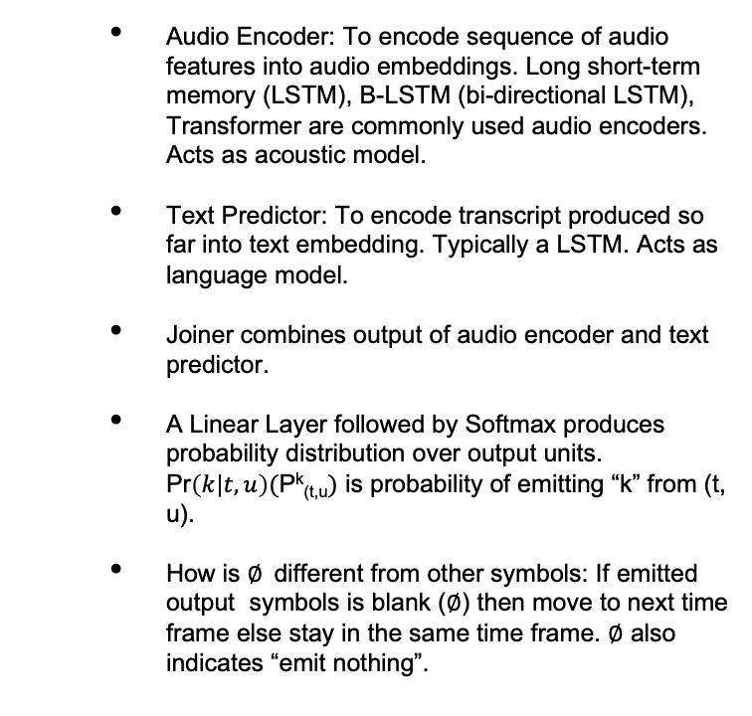

Components Of RNN-T ASR System
P^{E}_{(t,u)}
P^{B}_{(t,u)}
P^{C}_{t u)}
………..
…………..
…………
P $∅$_{(t,u)}
Audio Encoder: To encode sequence of audio features into audio embeddings. Long short-term memory (LSTM), B-LSTM (bi-directional LSTM), Transformer are commonly used audio encoders. Acts as acoustic model.
Text Predictor: To encode transcript produced so far into text embedding. Typically a LSTM. Acts as language model.
Joiner combines output of audio encoder and text predictor.
A Linear Layer followed by Softmax produces probability distribution over output units. Pr$\left(k | t,u\right)(\text{P}\text{k}\text{(}\text{t}\text{,}\text{u})$ is probability of emitting “k” from (t, u).
How is $∅$different from other symbols: If emitted output symbols is blank ($∅$) then move to next time frame else stay in the same time frame. $∅$ also indicates “emit nothing”.
Pr$\left(k | t,u\right)→\text{P}\text{k}\text{(}\text{t}\text{,}\text{u}\text{)}$
Softmax
$$h^{t, u}$$
Linear Layer
$$z^{t, u}$$
Joiner
$$g_{u}^{}$$
$$f_{t}^{}$$
Text Predictor
Audio Encoder
$$y_{u−1}$$
$$x_{t}$$
President Bara
Notes:
Auto regressive on text.

Slide 17
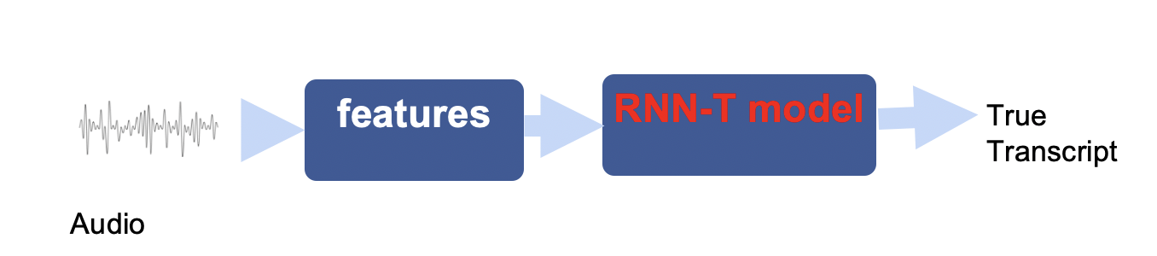
Training

Slide 18



Training Objective
  Training utterance:
  “Input Audio” -> “BEE” (transcript)
  #output units (u): 3
  BEE -> [[B], [E] ,[E]]
  #audio frames (t) : 4
  We don’t know alignment i.e. which portion of audio aligns to what output unit (A path taken in lattice)
  Training Objective
Graves et al., “Sequence transduction with recurrent neural networks”

Slide 19





An Alignment During Training
  Training utterance:
  “Input Audio” -> “BEE” (transcript)
  #output units (u): 3
  BEE -> [[B], [E] ,[E]]
  #audio frames (t) : 4
  <BOS>: Beginning of sentence
P^{E}_{(t,u)}
P^{B}_{(t,u)}
P^{C}_{t,u)}
P $∅$_{(t,u)}
0 1 2 3
Pr$(k|t,u)$
Softmax
u
$$h^{t, u}$$
_{h}
Linear Layer
$$z^{t, u}$$
P^{B}_{(1,0)}
Joiner
1 2 3 4
$$g_{u}^{}$$
$$f_{t}^{}$$
Probability of emitting “B” from (t=1, u =0)
t
Text Predictor
Audio Encoder
[<BOS> ]
$$x_{1}$$
Graves et al., “Sequence transduction with recurrent neural networks”

Slide 20
An Alignment During Training
  Training utterance:
  “Input Audio” -> “BEE” (transcript)
  #output units (u): 3
  BEE -> [[B], [E] ,[E]]
  #audio frames (t) : 4
  BOS: Beginning of sentence
P^{E}_{(t,u)}
P^{B}_{(t,u)}
P^{C}_{t,u)}
P $∅$_{(t,u)}
0 1 2 3
Pr$(k|t,u)$
Softmax
u
P^{E}_{(1,1)}
$$h^{t, u}$$
_{h}
Linear Layer
$$z^{t, u}$$
P^{B}_{(1,0)}
Joiner
1 2 3 4
$$g_{u}^{}$$
$$f_{t}^{}$$
Probability of emitting “B” from (t=1, u =0)
t
Text Predictor
Audio Encoder
[<BOS>, B ]
$$x_{1}$$
Graves et al., “Sequence transduction with recurrent neural networks”

Slide 21



An Alignment During Training
  Training utterance:
  “Input Audio” -> “BEE” (transcript)
  #output units (u): 3
  BEE -> [[B], [E] ,[E]]
  #audio frames (t) : 4
  BOS: Beginning of sentence
P^{E}_{(t,u)}
P^{B}_{(t,u)}
P^{C}_{t,u)}
Probability of emitting “$∅$” from (t=1, u =2)
P $∅$_{(t,u)}
0 1 2 3
Pr$(k|t,u)$
P $∅$_{(1,2)}
Softmax
u
P^{E}_{(1,1)}
$$h^{t, u}$$
_{h}
Linear Layer
$$z^{t, u}$$
P^{B}_{(1,0)}
Joiner
1 2 3 4
$$g_{u}^{}$$
$$f_{t}^{}$$
Probability of emitting “B” from (t=1, u =0)
t
Text Predictor
Audio Encoder
[<BOS> , B, E ]
$$x_{1}$$
Graves et al., “Sequence transduction with recurrent neural networks”

Slide 22


An Alignment During Training
  Training utterance:
  “Input Audio” -> “BEE” (transcript)
  #output units (u): 3
  BEE -> [[B], [E] ,[E]]
  #audio frames (t) : 4
  BOS: Beginning of sentence
P^{E}_{(t,u)}
P^{B}_{(t,u)}
P^{C}_{t,u)}
Probability of emitting “$∅$” from (t=1, u =2)
P $∅$_{(t,u)}
0 1 2 3
Pr$(k|t,u)$
P $∅$_{(2,2)}
P $∅$_{(1,2)}
Softmax
u
P^{E}_{(1,1)}
$$h^{t, u}$$
_{h}
Linear Layer
$$z^{t, u}$$
P^{B}_{(1,0)}
Joiner
1 2 3 4
$$g_{u}^{}$$
$$f_{t}^{}$$
Probability of emitting “B” from (t=1, u =0)
t
Text Predictor
Audio Encoder
[<BOS>, B, E ]
$$x_{2}$$
Graves et al., “Sequence transduction with recurrent neural networks”

Slide 23

An Alignment During Training
  Training utterance:
  “Input Audio” -> “BEE” (transcript)
  #output units (u): 3
  BEE -> [[B], [E] ,[E]]
  #audio frames (t) : 4
  BOS: Beginning of sentence
P^{E}_{(t,u)}
P^{B}_{(t,u)}
P^{C}_{t,u)}
Probability of emitting “$∅$” from (t=1, u =2)
P $∅$_{(t,u)}
0 1 2 3
Pr$(k|t,u)$
P^{E}_{(3,2)}
P $∅$_{(2,2)}
P $∅$_{(1,2)}
Softmax
u
P^{E}_{(1,1)}
$$h^{t, u}$$
_{h}
Linear Layer
$$z^{t, u}$$
P^{B}_{(1,0)}
Joiner
1 2 3 4
$$g_{u}^{}$$
$$f_{t}^{}$$
Probability of emitting “B” from (t=1, u =0)
t
Text Predictor
Audio Encoder
[<BOS>, B, E ]
$$x_{3}$$
Graves et al., “Sequence transduction with recurrent neural networks”

Slide 24

An Alignment During Training
  Training utterance:
  “Input Audio” -> “BEE” (transcript)
  #output units (u): 3
  BEE -> [[B], [E] ,[E]]
  #audio frames (t) : 4
  BOS: Beginning of sentence
P^{E}_{(t,u)}
P^{B}_{(t,u)}
P^{C}_{t,u)}
Probability of emitting “$∅$” from (t=1, u =2)
P $∅$_{(t,u)}
0 1 2 3
P $∅$_{(3,3)}
Pr$(k|t,u)$
P^{E}_{(3,2)}
P $∅$_{(2,2)}
P $∅$_{(1,2)}
Softmax
u
P^{E}_{(1,1)}
$$h^{t, u}$$
_{h}
Linear Layer
$$z^{t, u}$$
P^{B}_{(1,0)}
Joiner
1 2 3 4
$$g_{u}^{}$$
$$f_{t}^{}$$
Probability of emitting “B” from (t=1, u =0)
t
Text Predictor
Audio Encoder
[<BOS>, B, E, E ]
$$x_{3}$$
Graves et al., “Sequence transduction with recurrent neural networks”

Slide 25


An Alignment During Training
  Training utterance:
  “Input Audio” -> “BEE” (transcript)
  #output units (u): 3
  BEE -> [[B], [E] ,[E]]
  #audio frames (t) : 4
  BOS: Beginning of sentence
P^{E}_{(t,u)}
P^{B}_{(t,u)}
P^{C}_{t,u)}
Probability of emitting “$∅$” from (t=1, u =2)
P $∅$_{(t,u)}
0 1 2 3
P $∅$_{(3,3)}
P $∅$_{(4,3)}
Pr$(k|t,u)$
P^{E}_{(3,2)}
P $∅$_{(2,2)}
P $∅$_{(1,2)}
Softmax
u
P^{E}_{(1,1)}
$$h^{t, u}$$
_{h}
Linear Layer
$$z^{t, u}$$
P^{B}_{(1,0)}
Joiner
1 2 3 4
$$g_{u}^{}$$
$$f_{t}^{}$$
Probability of emitting “B” from (t=1, u =0)
t
Text Predictor
Audio Encoder
[<BOS>, B, E ]
$$x_{4}$$
Graves et al., “Sequence transduction with recurrent neural networks”

Slide 26
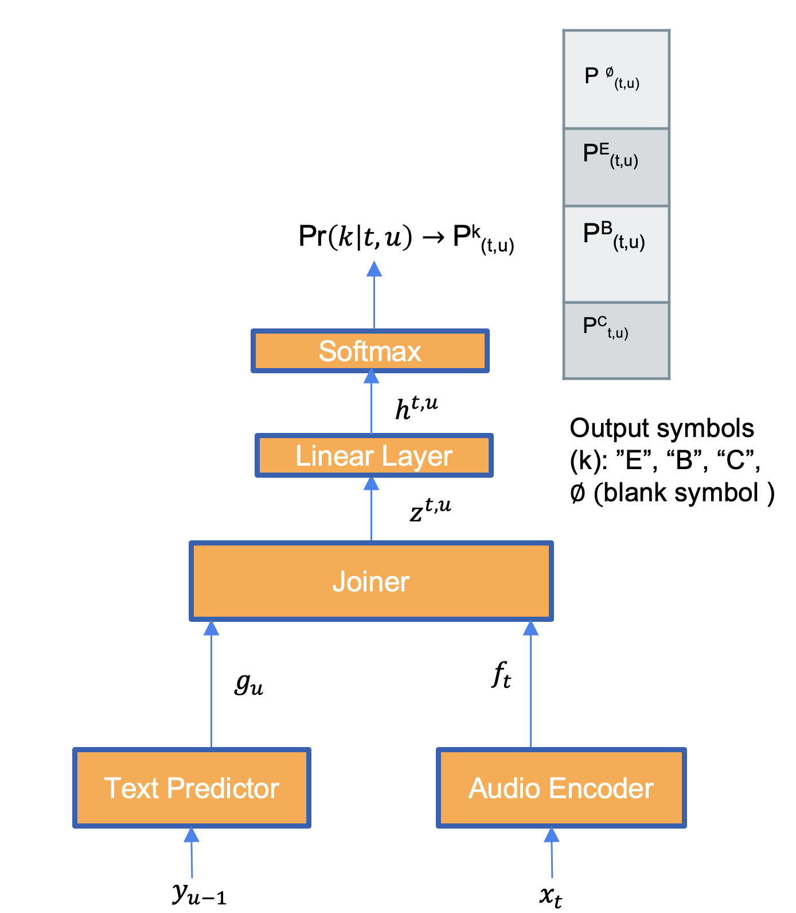
RNN-T Lattice And Training
  Training utterance:
  “Input Audio” -> “BEE” (transcript)
  #output units (u): 3
  BEE -> [[B], [E] ,[E]]
  #audio frames (t) : 4
  We don’t know alignment i.e.
  which portion of audio aligns to what
  output unit
  Probability of alignment is multiplication of probabilities assigned along the path of alignment
  Training
  Lattice contains all valid alignment paths(traversals). During training, we change (optimize) neural network parameters to maximize sum of probabilities of all alignment paths
  Computation is done efficiently through dynamic programming (slide 54 to 58)
0 1 2 3
P $∅$_{(4,3)}
P $∅$_{(3,3)}
P^{E}_{(3,2)}
E
u (text)
P $∅$_{(2,2)}
P $∅$_{(1,2)}
$$∅$$
P^{E}_{(1,1)}
E
P^{B}_{(1,0)}
B
$$∅$$
$$∅$$
Probability of emitting “B” from (t=1, u =0)
1 2 3 4
t (audio)
Graves et al., “Sequence transduction with recurrent neural networks”

Slide 27
Inference: Find a Transcript given an audio and Trained RNN-T model
Goal: Find candidate transcript of a given audio during test time.
Challenge: There are infinitely many alignments that can be assigned to a test audio.
features
RNN-T model
decoding
?
Audio
Transcript

Slide 28


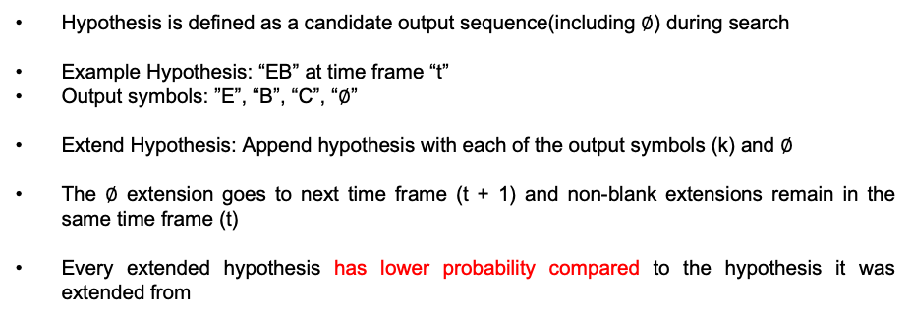






Operation: Extend Hypothesis
P^{E}_{(t,u)}
P^{B}_{(t,u)}
P^{C}_{t,u)}
P $∅$_{(t,u)}
Hypothesis is defined as a candidate output sequence(including $∅$) during search
Example Hypothesis: “EB” at time frame “t”
  Output symbols: ”E”, “B”, “C”, “$∅$”
Extend Hypothesis: Append hypothesis with each of the output symbols (k) and $∅$
The $∅$ extension goes to next time frame (t + 1) and non-blank extensions remain in the same time frame (t)
Every extended hypothesis has lower probability compared to the hypothesis it was extended from
Pr$(k|t,u)$
Softmax
$$h^{t, u}$$
Output symbols (k): ”E”, “B”, “C”, $∅ ($blank symbol )
_{h}
Linear Layer
$$z^{t, u}$$
Joiner
p
Time = t
EB
$$g_{u}^{}$$
$$f_{t}^{}$$
p * P^{E}_{(t, “BE”)}
Text Predictor
Audio Encoder
EB$∅$
EBE
EBB
EBC
Time = t + 1
[<BOS>, E, B]
$$x_{t}$$
p * P$∅$_{(t, “BE”)}
p * P^{B}_{(t, “BE”)}
p * P^{C}_{(t, “BE”)}

Slide 29
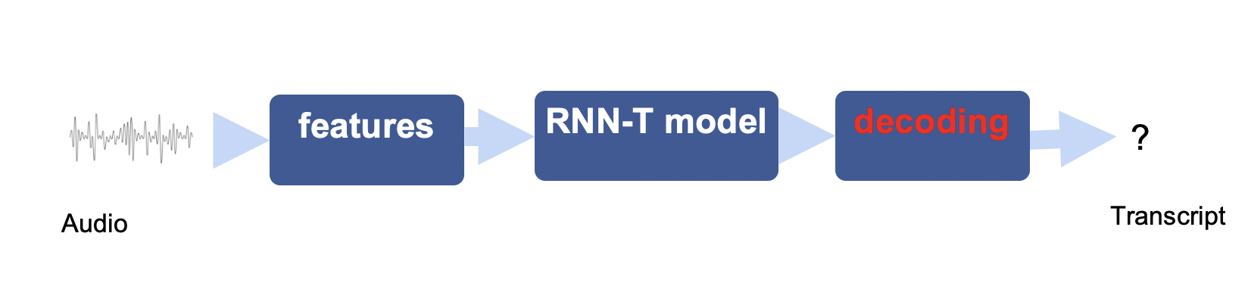
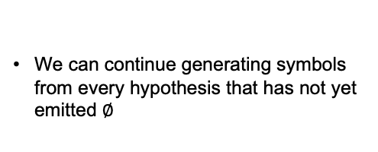
Subset Of Hypotheses At t = 1 During Decoding
We can continue generating symbols from every hypothesis that has not yet emitted $∅$
BOS
$$∅$$
B
E
C
t=1
B$∅$
BB
BE
BC
C$∅$
CB
CE
CC
BE$∅$
BEB
BEE
BEC
X₁
X₂
X₃
X₄
Audio
Notes:
Subset of valid sequence…

Slide 30
Greedy Decoding
Goal: Get a candidate final transcript by making local optimal choice at each distinct “t” and “u”

Slide 31
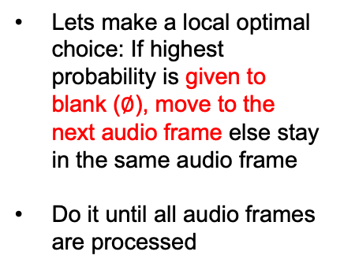
Greedy Decoding
k | probability
$$∅$$ | 0.4
E | 0.2
B | 0.3
C | 0.1
Pr$(k|t,u)$
Lets make a local optimal choice: If highest probability is given to blank ($∅$), move to the next audio frame else stay in the same audio frame
Do it until all audio frames are processed
Softmax
$$h^{t, u}$$
_{h}
Linear Layer
$$z^{t, u}$$
Joiner
t = 1
$$g_{u}^{}$$
$$f_{t}^{}$$
[$<BOS>,]$
Text Predictor
Audio Encoder
$$∅$$
E
B
C
[$<BOS>]$
$$x_{1}$$
X₁
X₂
X₃
X₄
Audio

Slide 32
Greedy Decoding
k | probability
$$∅$$ | 0.04
E | 0.04
B | 0.3
C | 0.01
Pr$(k|t,u)$
Lets make a local optimal choice: If highest probability is given to blank ($∅$), move to the next audio frame else stay in the same audio frame
Do it until all audio frames are processed
Softmax
$$h^{t, u}$$
_{h}
Linear Layer
$$z^{t, u}$$
Joiner
t = 2
$$g_{u}^{}$$
$$f_{t}^{}$$
[$<BOS>]$
Text Predictor
Audio Encoder
$$∅$$
E
B
C
[$<BOS>]$
$$x_{2}$$
X₁
X₂
X₃
X₄
Audio

Slide 33
Greedy Decoding
k | probability
$$∅$$ | 0.4
E | 0.1
B | 0.2
C | 0.3
Pr$(k|t,u)$
Lets make a local optimal choice: If highest probability is given to blank ($∅$), move to the next audio frame else stay in the same audio frame
Do it until all audio frames are processed
Softmax
$$h^{t, u}$$
_{h}
Linear Layer
$$z^{t, u}$$
Joiner
t = 2
$$g_{u}^{}$$
$$f_{t}^{}$$
[$<BOS>, B]$
Text Predictor
Audio Encoder
$$∅$$
E
B
C
[$<BOS>, B]$
$$x_{2}$$
X₁
X₂
X₃
X₄
Audio

Slide 34
Greedy Decoding
k | probability
$$∅$$ | 0.3
E | 0.35
B | 0.3
C | 0.15
Pr$(k|t,u)$
Lets make a local optimal choice: If highest probability is given to blank ($∅$), move to the next audio frame else stay in the same audio frame
Do it until all audio frames are processed
Softmax
$$h^{t, u}$$
_{h}
Linear Layer
$$z^{t, u}$$
Joiner
t = 3
$$g_{u}^{}$$
$$f_{t}^{}$$
[$<BOS>, B]$
Text Predictor
Audio Encoder
$$∅$$
E
E
C
[$<BOS>, B]$
$$x_{3}$$
X₁
X₂
X₃
X₄
Audio

Slide 35
Greedy Decoding
k | probability
$$∅$$ | 0.34
E | 0.26
B | 0.25
C | 0.25
Pr$(k|t,u)$
Lets make a local optimal choice: If highest probability is given to blank ($∅$), move to the next audio frame else stay in the same audio frame
Do it until all audio frames are processed
Softmax
$$h^{t, u}$$
_{h}
Linear Layer
$$z^{t, u}$$
Joiner
t = 3
$$g_{u}^{}$$
$$f_{t}^{}$$
[$<BOS>, B, E]$
Text Predictor
Audio Encoder
$$∅$$
E
B
C
[$<BOS>, B, E]$
$$x_{3}$$
X₁
X₂
X₃
X₄
Audio

Slide 36
Greedy Decoding
k | probability
$$∅$$ | 0.3
E | 0.4
B | 0.28
C | 0.02
Pr$(k|t,u)$
Lets make a local optimal choice: If highest probability is given to blank ($∅$), move to the next audio frame else stay in the same audio frame
Do it until all audio frames are processed
Softmax
$$h^{t, u}$$
_{h}
Linear Layer
$$z^{t, u}$$
Joiner
t = 4
$$g_{u}^{}$$
$$f_{t}^{}$$
[$<BOS>, B, E]$
Text Predictor
Audio Encoder
$$∅$$
E
B
C
[$<BOS>, B, E]$
$$x_{4}$$
X₁
X₂
X₃
X₄
Audio

Slide 37
Greedy Decoding
k | probability
$$∅$$ | 0.4
E | 0.25
B | 0.3
C | 0.05
Pr$(k|t,u)$
Lets make a local optimal choice: If highest probability is given to blank ($∅$), move to the next audio frame else stay in the same audio frame
Do it until all audio frames are processed
Softmax
$$h^{t, u}$$
_{h}
Linear Layer
$$z^{t, u}$$
Joiner
t = 4
$$g_{u}^{}$$
$$f_{t}^{}$$
[$<BOS>, B, E, E]$
Text Predictor
Audio Encoder
$$∅$$
E
B
C
[$<BOS>, B, E, E]$
$$x_{4}$$
X₁
X₂
X₃
X₄
Audio

Slide 38
Subset Of Hypotheses At t = 1 During Decoding
We can continue generating symbols from every hypothesis that has not yet emitted $∅$
BOS
$$∅$$
B
E
C
t=1
B$∅$
BB
BE
BC
C$∅$
CB
CE
CC
BE$∅$
BEB
BEE
BEC
X₁
X₂
X₃
X₄
Audio
Notes:
Subset of valid sequence…

Slide 39
Beam Search
We don’t want to stay in time frame “t” forever. But we do not know when to move to “t+1” as there are infinitely many candidates that can be explored in time frame “t”.
Goal: We would like to obtain n candidate hypotheses at time frame “t+1” before exiting to decode at “t” which would be better than all possible future extensions at “t”.
n is hyper parameter
Notes:
The process of doing this is easy to explain through an example so lets look at the example.

Slide 40

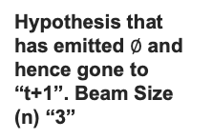
Beam Search: Expand the best hypothesis among candidate hypotheses
BOS
2nd extension candidate: Best hypothesis among “BB”, “BE”, “BC”, “E”, “C”
1st extension candidate: Best hypothesis among “B”, “E”, “C”
$$∅$$
B
E
C
B$∅$
C$∅$
$$∅$$
B$∅$
BB
BE
BC
C$∅$
CB
CE
CC
Hypothesis that has emitted $∅$ and hence gone to “t+1”. Beam Size (n) “3”
Is beam size (n) number of extensions enough? No.
X₁
X₂
X₃
X₄
Audio
Notes:
Having “n” hpos in next time frame is not enough. We will see in next slide, why?

Slide 41

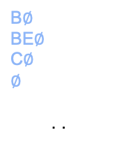
Beam Search: When to exit search at time frame t
Set B: Hypotheses that has emitted $∅$ from frame “t” and are now in “t+1”
Set A: Hypotheses that has not yet emitted $∅$ from frame “t” and so can continue emitting more symbols from “t"
n^{th} best hypothesis
from B
1st extension candidate from A: Best hypothesis among “B”, “E”, “C”
BOS
B$∅$
BE$∅$
C$∅$
$$∅$$
. .
2nd extension candidate from A: Best hypothesis among “BB”, “BE”, “BC”, “E”, “C”
$$∅$$
B
E
C
Hypothesis that has emitted $∅$ and hence gone to “t+1”. Beam Size (n) “3”
B$∅$
BB
BE
BC
C$∅$
CB
CE
CC
3rd extension candidate from A : Best hypothesis among “BB”, “BE”, “BC”, “CB”, “CE”, “CC”
Is the n^{th} best hypothesis in B better than the best hypothesis in A
BE$∅$
BEB
BEE
BEC
4th extension candidate from A : Best hypothesis among “BB”, “BEB”, “BEE”, “BEC”, “BC”, “CB”, “CE”, “CC”
yes
no
Recap: Every extended hypothesis has lower probability compared to hypothesis it was extended from.
Exit from t and move to t+ 1
Stay at t and expand more

Slide 42
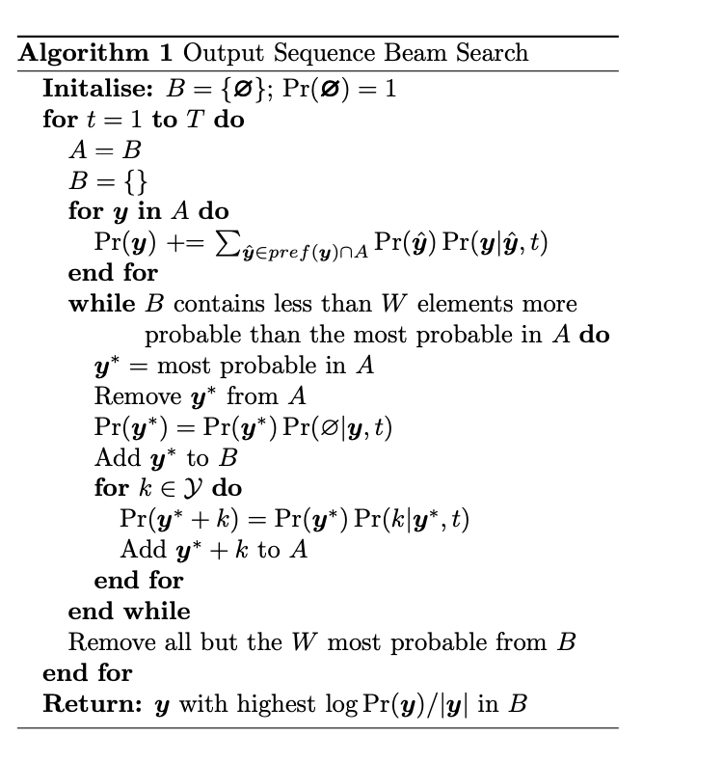
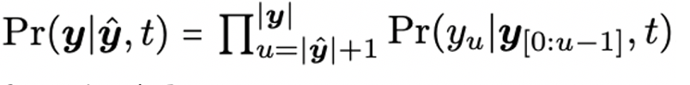

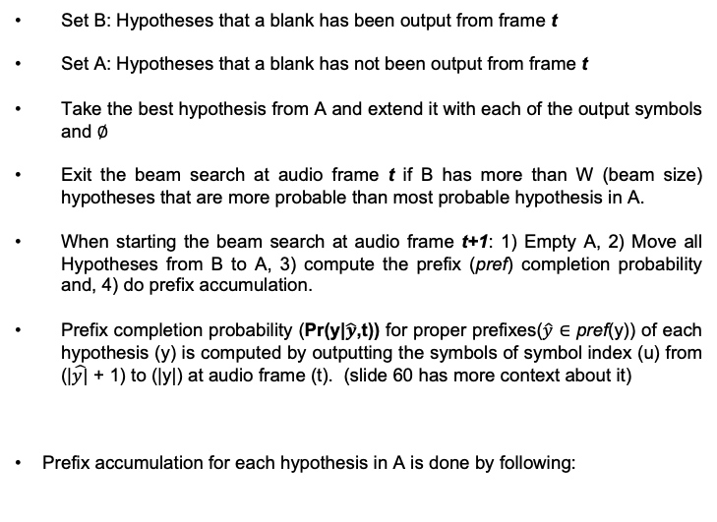
Beam Search: Algorithm
Set B: Hypotheses that a blank has been output from frame t
Set A: Hypotheses that a blank has not been output from frame t
Take the best hypothesis from A and extend it with each of the output symbols and $∅$
Exit the beam search at audio frame t if B has more than W (beam size) hypotheses that are more probable than most probable hypothesis in A.
When starting the beam search at audio frame t+1: 1) Empty A, 2) Move all Hypotheses from B to A, 3) compute the prefix (pref) completion probability and, 4) do prefix accumulation.
Prefix completion probability (Pr(y|$\hat{y}$,t)) for proper prefixes($\hat{y}$ ∈ pref(y)) of each hypothesis (y) is computed by outputting the symbols of symbol index (u) from (|$\hat{y|}$ + 1) to (|y|) at audio frame (t). (slide 60 has more context about it)
Prefix accumulation for each hypothesis in A is done by following:
Graves et al., “Sequence transduction with recurrent neural networks”

Slide 43
Practical Considerations

Slide 44
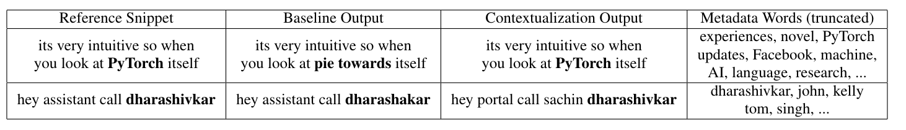
Utilizing Utterance Specific Context: Contextualization
Use utterance specific list of context words along with audio during RNN-T ASR training and/or inference
Improve recognition of rare words for ASR systems

Slide 45
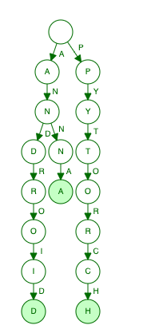
Utilizing Utterance Specific Context: Biasing Module
Train RNN-T model using: Utterance specific context words (Android, Anna, Pytorch) along with Audio, True Transcript
Biasing Module: Built using Trie (data structure) of all utterance specific context words. Trie is used to find what words from context list can be finished from last unfinished word in text history so far
Text history so far: Movies with An
Queries:
  Last unfinished word suffix: Android, Anna (Jain et al., “Contextual RNN-T For Open Domain ASR”)
  Zero suffix: Android, Anna, Pytorch (Le et al., “Contextualized Streaming End-to-End Speech Recognition with Trie-Based Deep Biasing and Shallow Fusion”)
Pr$(k|t,u)$
Softmax
$$h^{t, u}$$
_{h}
$$w_{1}$$
Linear Layer
BiasingModule (Trie)
$$b_{u}$$
$$z^{t, u}$$
$$w_{2}$$
Joiner
.
Android, Anna
.
Android, Anna, Pytorch
$$w_{N}$$
$$g_{u}^{}$$
$$f_{t}^{}$$
$Y_{u−1}$ (movies with An)
Text Predictor
Audio Encoder
.
$$y_{u−1}$$
Image from Jain et al., “Contextual RNN-T For Open Domain ASR”
$$x_{t}$$

Slide 46


Utilizing Utterance Specific Context: Attention Module
Train RNN-T model using: Utterance specific embeddings (i.e. embeddings of context words: Android, Anna, Pytorch) along with Audio, True Transcript (Jain et al., “Contextual RNN-T For Open Domain ASR”)
Embedding Extractor: Extracts embeddings of relevant context information. Here we are using embeddings of context words but we could use other embeddings such as visual embeddings.
Attention Module: Attends between contextual embeddings and output of RNN-T Text Predictor
Pr$(k|t,u)$
Softmax
$$h^{t, u}$$
$$h_{1}^{EE}$$
_{h}
Linear Layer
$$w_{1}$$
$${[c}_{u};g_{u}^{pred}]$$
$$z^{t, u}$$
$$h_{2}^{EE}$$
Joiner
$$w_{2}$$
AttModule
EE
.
.
$$f_{t}^{}$$
.
.
$g_{u}^{pred}$
$$h_{N}^{EE}$$
Text Predictor
Audio Encoder
$$w_{N}$$
$$y_{u−1}$$
Image from Jain et al., “Contextual RNN-T For Open Domain ASR”
$$x_{t}$$

Slide 47
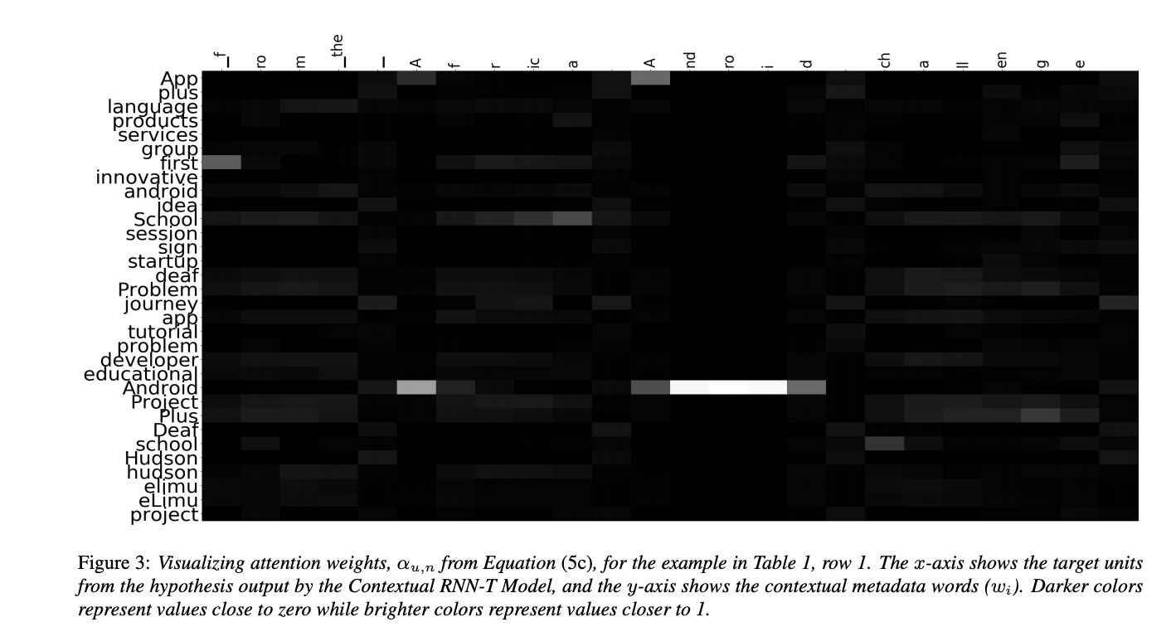
What Does Attention Module Learn?
Image from Jain et al., “Contextual RNN-T For Open Domain ASR”

Slide 48
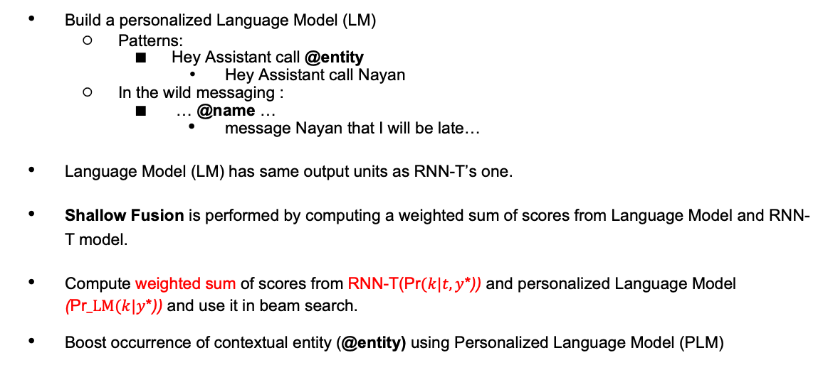
Utilizing Utterance Specific Context: Shallow Fusion
Personalized Language Model
Build a personalized Language Model (LM)
  Patterns:
    Hey Assistant call @entity
      Hey Assistant call Nayan
  In the wild messaging :
    … @name …
      message Nayan that I will be late…
Language Model (LM) has same output units as RNN-T’s one.
Shallow Fusion is performed by computing a weighted sum of scores from Language Model and RNN-T model.
Compute weighted sum of scores from RNN-T(Pr$(k|t, y$*)) and personalized Language Model (Pr$_LM(k|y$*)) and use it in beam search.
Boost occurrence of contextual entity (@entity) using Personalized Language Model (PLM)
Weighted Sum of Scores
Beam Search
RNN-T
Le et al., “Contextualized Streaming End-to-End Speech Recognition with Trie-Based Deep Biasing and Shallow Fusion”

Slide 49
Contextualization: Utilizing Large Text Only data with Shallow Fusion
Language models (LM) built with external text only data allows to model knowledge of the world into ASR system. Helpful when ASR training data is limited. Language model can estimate for example, Pr_LM(“m”| [“P”, “r”, “e”, ”s”, “I”, “d”, ”e”, ”n”, t”, “ “, “B”, ”a”, ”r”, ”a”, ”c”, ”k”, “ “,“O”, “b”, “a”]) from text LM only data.
Compute weighted sum of scores from RNN-T(Pr$(k|t, y$*)) and Language Model (Pr$_LM(k|y$*)) and use it in beam search
Language Model
Weighted Sum Of Scores
Beam Search
RNN-T

Slide 50
Choice Of Output Units For RNN-T ASR
RNN-T ASR produces probability distribution over output units.
Letters do not take co-occurrence into account.
Words
  Large number of output units.
  Out of vocabulary concern for unseen words in ASR training data.
Sentence Pieces
  Configurable number of output units.
  Combines co-occurring characters in single unit.
  Example:
    Hello World encoded as [[Hello] [▁Wor] [ld]]
  Number of output units larger than letters but less number of runs for text predictor network.
    If a phrase is of 11 letters but could be re-presented by 3 sentence pieces then we only need to run the text predictor network ~1/4th time.

Slide 51
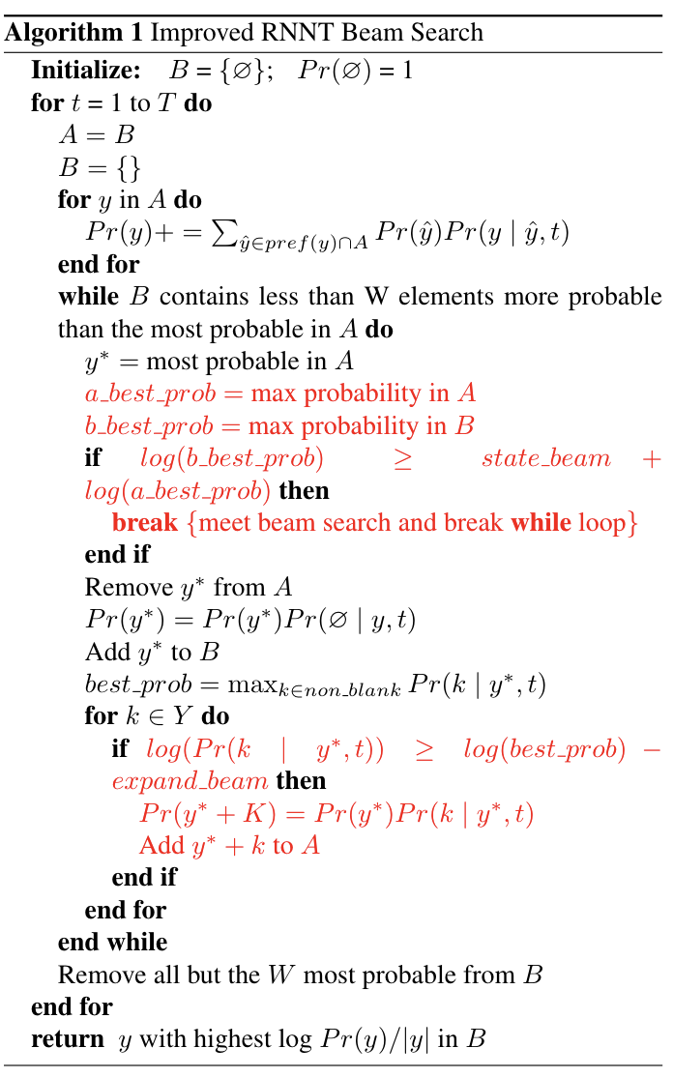
Optimization: Beam Search
Decoding
  Limit number of expanded hypothesizes that are added in A
  Expand best hypo from A only with the output symbols that are within expand_beam value of best expansion output symbol
  Additional Conditions for exiting beam search at audio frame t
  Exit if the best hypothesis in B is better by more than state_beam compared to best hypothesis in A
Jain et al., “RNN-T For Latency Controlled ASR With Imoroved Beam Search”

Slide 52
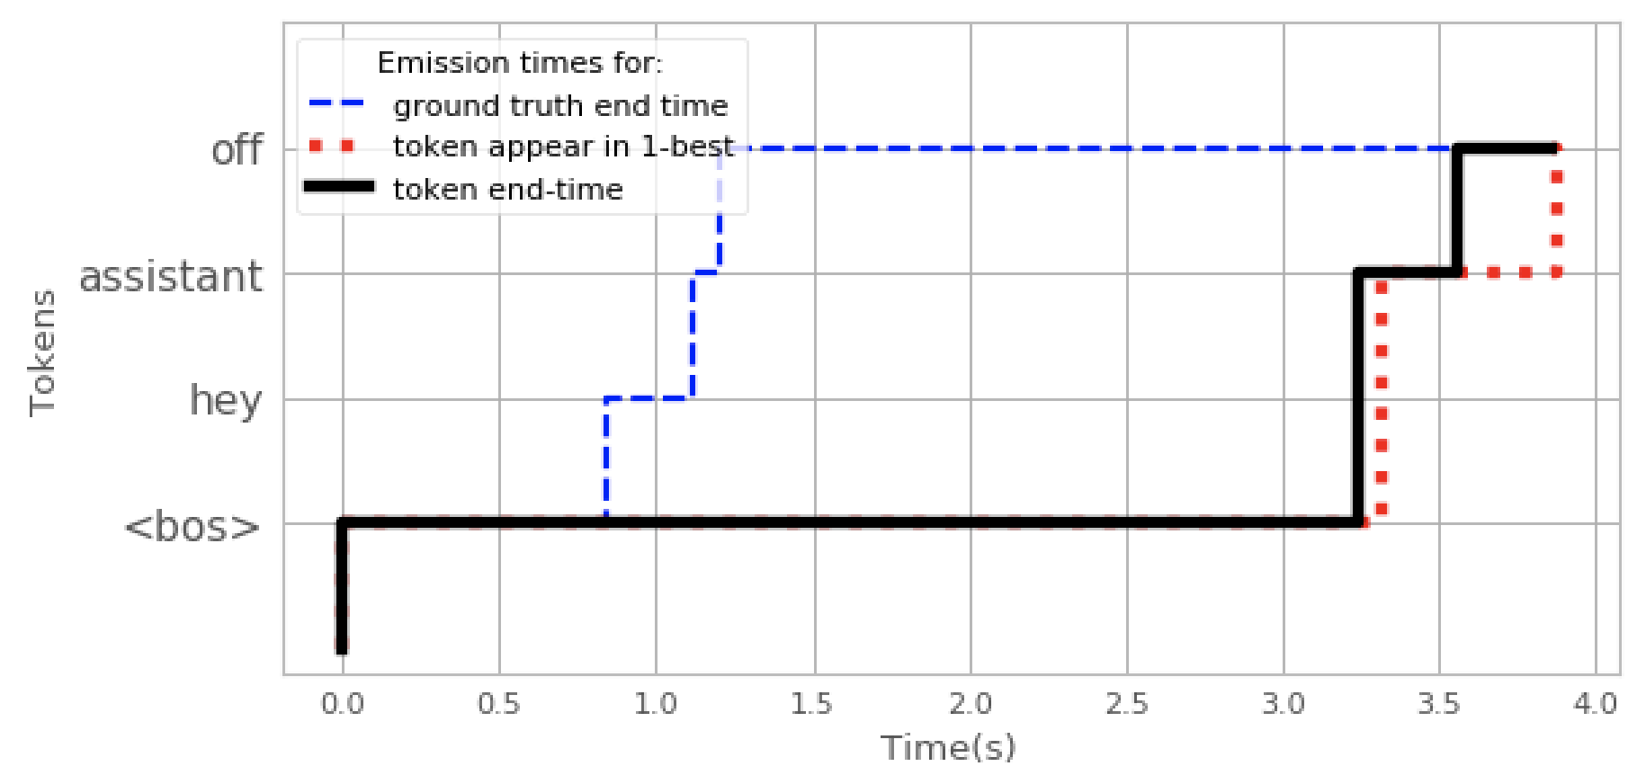
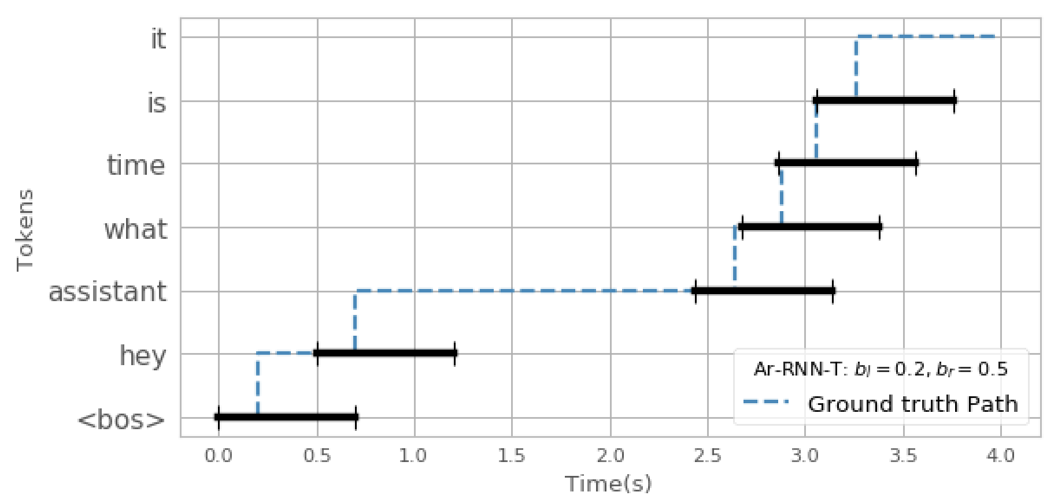
Improving Training Optimization And Emission Delays
Token Emission Delay Problem: During inference, tokens are emitted with considerable delay after they are spoken
Restrict alignment paths: Helps in token emission delay and improving training speed.
Mahadeokar et al. “Alignment Restricted Streaming Recurrent Neural Network Transducer”

Slide 53
More Details On Training RNN-T model

Slide 54
Training: Lattice With Complete Set Of Alignments
0 1 2 3
P $∅$_{(4,3)}
A naïve implementation is computationally heavy: Use dynamic programming to efficiently compute this.
P $∅$_{(3,3)}
P^{B}_{(3,2)}
u (text)
P $∅$_{(2,2)}
P $∅$_{(1,2)}
P^{E}_{(1,1)}
P^{B}_{(1,0)}
1 2 3 4
Probability of emitting “B” from (t=1, u =0)
t (audio)
Graves et al., “Sequence transduction with recurrent neural networks”

Slide 55
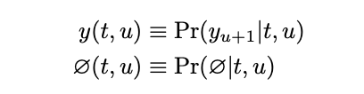
Training: Forward Variable (alpha)
y (t ,u) is probability of emitting next symbol (u + 1) in output sequence from (t, u)
0 1 2 3(U)
⍺(t, u) is probability of outputting [: u] symbols during [: t] frames
Pr$\left(k | t,u\right) a.k.a. \text{P}\text{k}\text{(}\text{t}\text{,}\text{u}\text{)}$
Softmax
⍺(1, 0) = 1
⍺(t, u) = ⍺(t-1, u) * $∅$(t-1, u) + ⍺(t, u-1) * y (t ,u-1)
$$h^{t, u}$$
Emitting $∅$ at t-1
_{h}
Linear Layer
⍺(t-1, u) * $∅$(t-1, u)
$$z^{t, u}$$
u
⍺(t, u-1) * y (t ,u-1)
Emitting non $∅$ at t
Joiner
$$g_{u}^{}$$
$$f_{t}^{}$$
Text Predictor
Audio Encoder
1 2 3 4(T)
$$y_{u−1}$$
$$x_{t}$$
t
Graves et al., “Sequence transduction with recurrent neural networks”

Slide 56
Training: Backward Variable (beta)
y (t ,u) is probability of emitting next symbol (u + 1) in output sequence from (t, u)
0 1 2 3(U)
Pr$(k|t,u)$
$∅$(3,3)
$∅$(4,3)
β(t, u+1) * y (t ,u)
Softmax
Emitted non $∅$ at t
β(t+1, u) * $∅$(t, u)
$$h^{t, u}$$
_{h}
Emitted $∅$ at t
Linear Layer
β(T, U) = $∅$ (T, U)
β(t, u) = β(t+1, u) * $∅$(t, u) + β(t, u+1) * y (t ,u)
$$z^{t, u}$$
Joiner
u
β(t, u) is probability of outputting [u+1: ] symbols during [t: ] frames.
$$g_{u}^{}$$
$$f_{t}^{}$$
Text Predictor
Audio Encoder
$$y_{u−1}$$
$$x_{t}$$
1 2 3 4(T)
t
Graves et al., “Sequence transduction with recurrent neural networks”

Slide 57
Training: ⍺(t, u) * β(t, u)
y (t ,u) is probability of emitting next symbol (u + 1) in output sequence from (t, u)
Pr$(k|t,u)$
0 1 2 3(U)
Softmax
β(t, u+1) * y (t ,u)
$$h^{t, u}$$
β(t+1, u) * $∅$(t, u)
_{h}
Linear Layer
⍺(t-1, u) * $∅$(t-1, u)
$$z^{t, u}$$
⍺(t, u-1) * y (t ,u-1)
α(t, u)β(t, u) is equal to the probability of emitting the complete output sequence if y_{u} is emitted during audio frame t.
For, given an input sequence x (length T) and a target sequence y* (length U)
  Pr(y*|x) = ∑ ⍺(t, u) * β (t ,u)
  (t,u): t+u = n , (for any n, 1 ≤ n ≤ U + T)
Joiner
$$g_{u}^{}$$
$$f_{t}^{}$$
Text Predictor
Audio Encoder
1 2 3 4(T)
$$y_{u−1}$$
$$x_{t}$$
t
Graves et al., “Sequence transduction with recurrent neural networks”

Slide 58

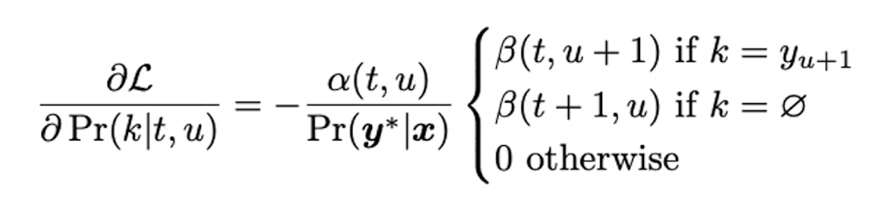
Training: Gradient Descent
y (t ,u) is probability of emitting next symbol (u + 1) in output sequence from (t, u)
For Target sequence $y$*
Pr$(k|t,u)$
  ⍺(t, u) = ⍺(t-1, u) * $∅$(t-1, u) + ⍺(t, u-1) * y (t ,u-1)
  β(t, u) = β(t+1, u) * $∅$(t, u) + β(t, u+1) * y (t ,u)
  Pr($y$*|x) = ∑ ⍺(t, u) * β (t ,u)
  (t,u): t+u = n (for any n, 1 ≤ n ≤ U + T)
Softmax
Back Propagation
$$h^{t, u}$$
Gradients
_{h}
Linear Layer
$$z^{t, u}$$
Joiner
$$g_{u}^{}$$
$$f_{t}^{}$$
Text Predictor
Audio Encoder
Image from Graves et al., “Sequence transduction with recurrent neural networks”
$$y_{u−1}$$
$$x_{t}$$
Graves et al., “Sequence transduction with recurrent neural networks”

Slide 59
Further Reading
      CTC: Graves et al., Connectionist Temporal Classification: Labelling Unsegmented Sequence Data with Recurrent Neural Networks
      RNN-T: Graves et al., Sequence Transduction with Recurrent Neural Networks
      On Device RNN-T ASR:
        He et al., Streaming end-to-end speech recognition for mobile devices
        Yuan et al., Optimizing speech recognition for the edge
      Improving RNN-T beam search
        Jain et al., RNN-T For Latency Controlled ASR With Imoroved Beam Search
      Contextualization:
        Jain et al., Contextual RNN-T For Open Domain ASR
        Le et al., “Contextualized Streaming End-to-End Speech Recognition with Trie-Based Deep Biasing and Shallow Fusion”
    RNN-T Variants:
        Variani et al., Hybrid Autoregressive Transducer (HAT)
        Tripathi et al., Monotonic RNN-T
      Comparing RNN-T with other ASR techniques
        Zhang et al., Benchmarking LF-MMI, CTC and RNN-T Criteria for Streaming ASR
        Jain et al., RNN-T For Latency Controlled ASR With Imoroved Beam Search
      Sentence Piece
        Kudo et al., A simple and language independent subword tokenizer and detokenizer for Neural Text Processing
      Good read on tries: https://medium.com/basecs/trying-to-understand-tries-3ec6bede0014 (Vaidehi Joshi)

Slide 60
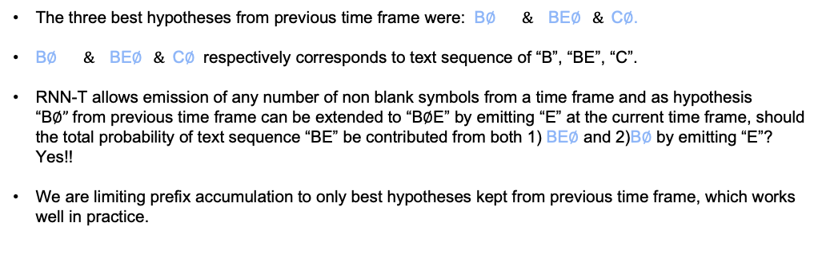
How To Deal With Hypotheses That Share Prefix
The three best hypotheses from previous time frame were: B$∅ \&$BE$∅ \&$C$∅$.
B$∅ \&$BE$∅ \&$C$∅$ respectively corresponds to text sequence of “B”, “BE”, “C”.
RNN-T allows emission of any number of non blank symbols from a time frame and as hypothesis “B$∅”$from previous time frame can be extended to “B$∅$E” by emitting “E” at the current time frame, should the total probability of text sequence “BE” be contributed from both 1) BE$∅$ and 2)B$∅$ by emitting “E”? Yes!!
We are limiting prefix accumulation to only best hypotheses kept from previous time frame, which works well in practice.
BOS
B
E
C
B$∅$
BE
C$∅$
BE$∅$
X₁
X₂
X₃
X₄
Audio

Slide 61
Thanks
Many thanks to Rohit Prabhavalkar, Mark Tygert, Michael Picheny, Nayan Singhal, Kritika Singh, Xiaohui Zhang, Duc Le, Yuan Shangguan, Paco Guzmán, Yatharth Saraf and Mike Seltzer for brainstorming with ideas to improve content of this presentation.

