Slide 1
CS 4803 / 7643: Deep Learning
Website: https://www.cc.gatech.edu/classes/AY2021/cs7643_fall/
Piazza: https://piazza.com/gatech/fall2020/cs48037643
Canvas: https://gatech.instructure.com/courses/137318 (4803)
https://gatech.instructure.com/courses/139054 (7643)
Gradescope: https://www.gradescope.com/courses/149503 (4803)
https://www.gradescope.com/courses/149504 (7643)
Dhruv Batra
School of Interactive Computing
Georgia Tech

Slide 2
Elephant in the room
This is weird.
Hope everyone is staying safe and healthy.
Let’s make the best of it.

Slide 3
Are you in the right place?
This is CS 4803(DL) / CS 7643
  “On campus” class
This is NOT CS 7643-O01
  Online class for OMSCS program

Slide 4
F20 Delivery Format
Remote
  No in-person interaction
  Lectures, office hours, HW/project submissions online
    No exam
Sync
  There is a scheduled “live” lecture time
  We will experiment with flipped classroom & pre-recorded lectures
Recording
  Lectures are recorded and available for viewing
  BUT BUT BUT we STRONGLY encourage you to attend the lectures
Remember: Content is free online.
  You are here for the interaction and the insight.

Slide 5

How to interact
Questions
  Q&A
    if one-off question
  Chat
    for back and forth
  Raise hand
    TA will elevate you to participant
  We’ll explicitly stop and take
  questions every 10 min
    But feel free to ask in between
BlueJeans Event
  ~10 sec lag

Slide 6
Outline
What is Deep Learning, the field, about?
  Highlight of some recent projects from my lab
What is this class about?
  What to expect?
  Logistics
FAQ

Slide 7
Outline
What is Deep Learning, the field, about?
  Highlight of some recent projects from my lab
What is this class about?
  What to expect?
  Logistics
FAQ

Slide 8
What are we here to discuss?
Some of the most exciting developments in
Machine Learning,
Vision, NLP, Speech, Robotics
& AI in general
in the last decade!

Slide 9
Demo time
vqa.cloudcv.org.
demo.visualdialog.org

Slide 10
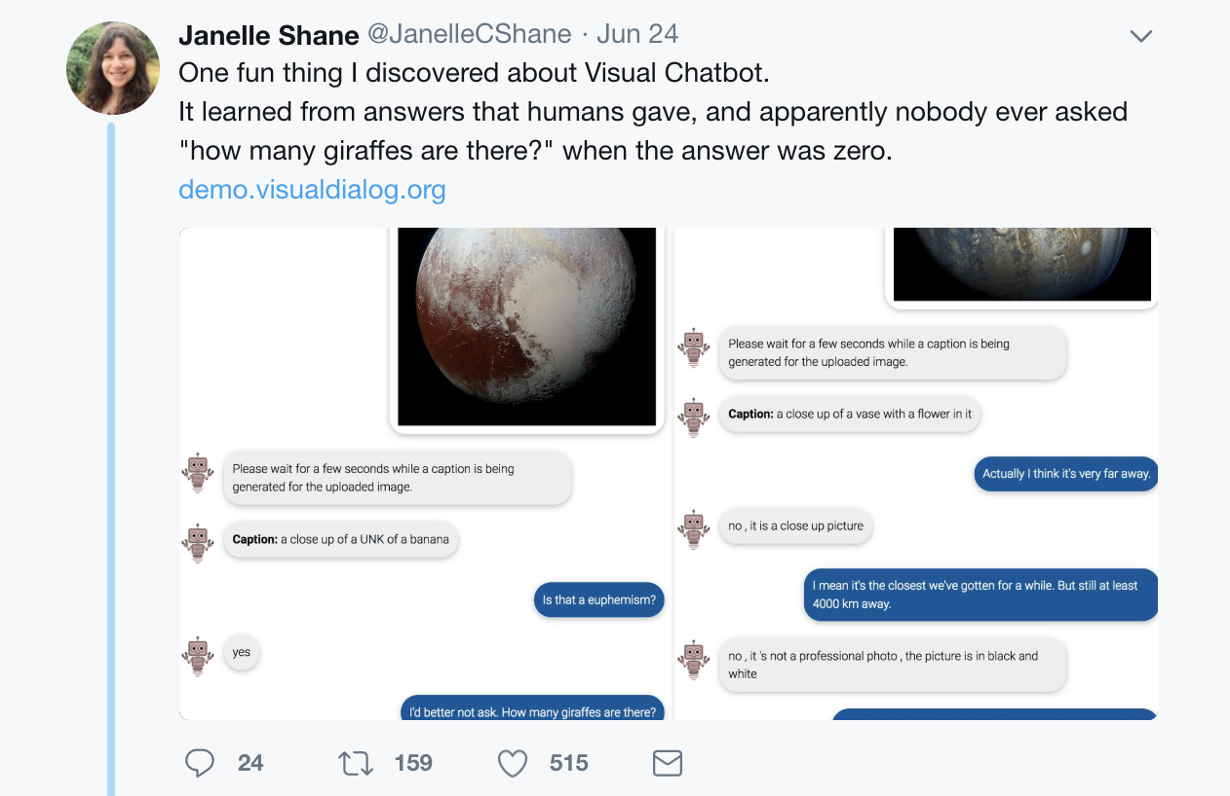

Slide 11
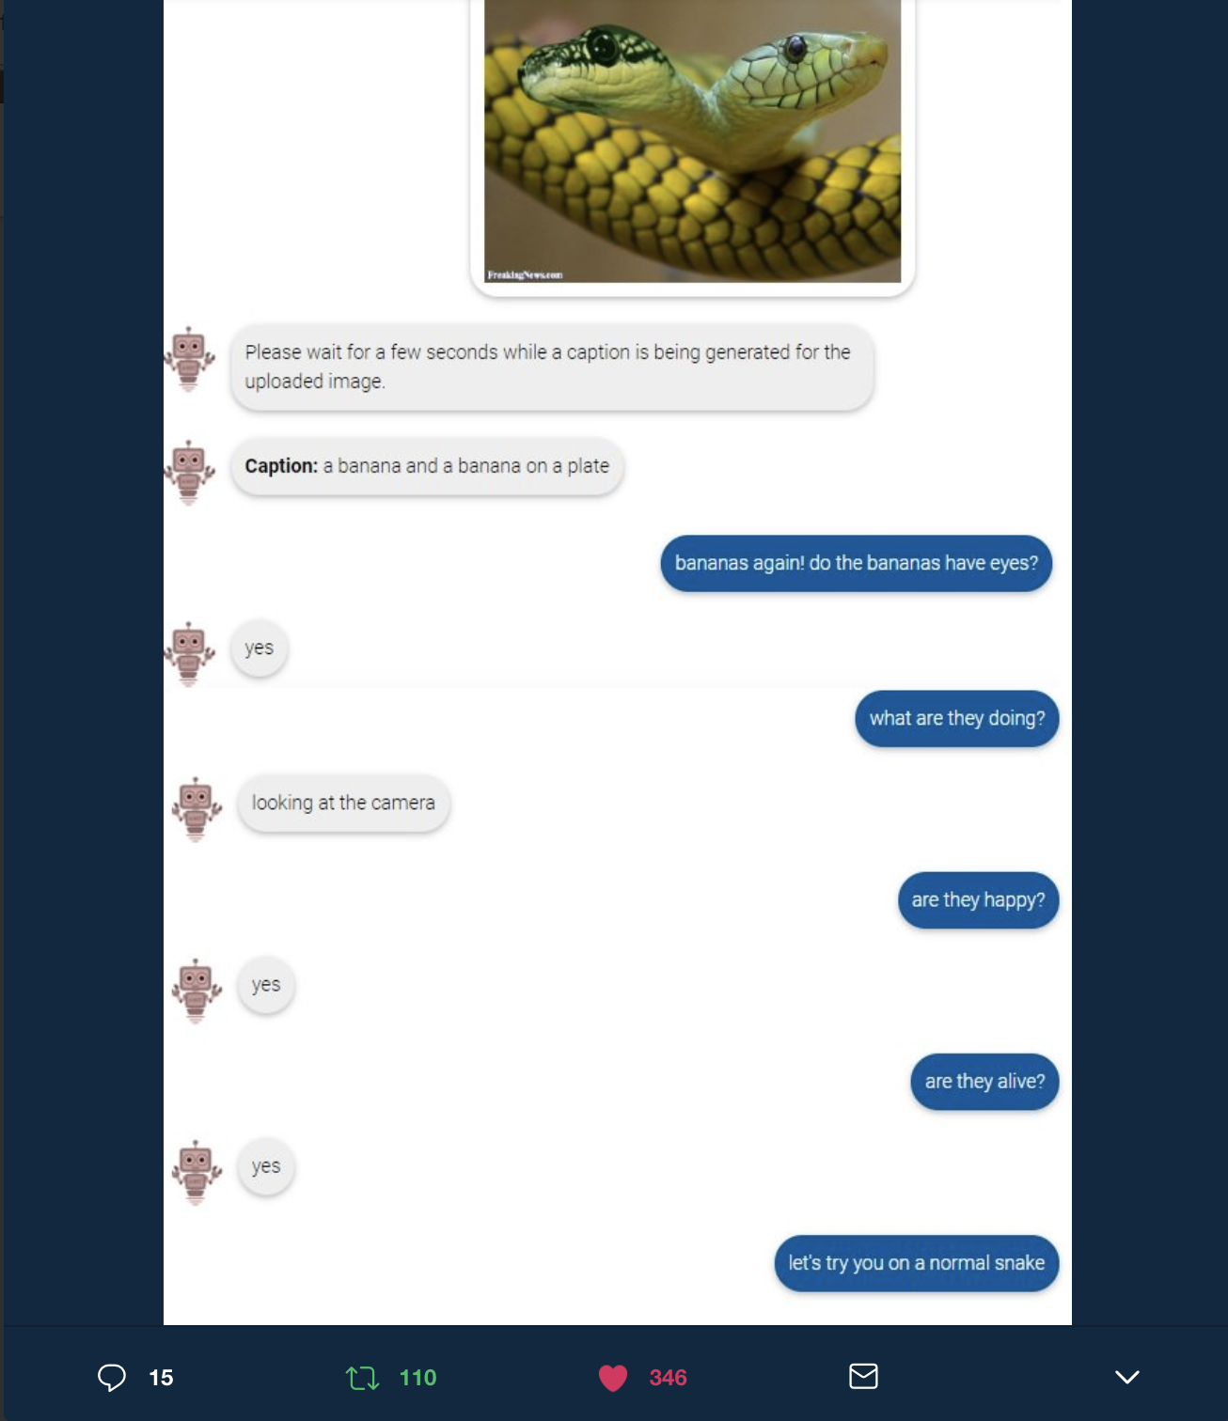

Slide 12
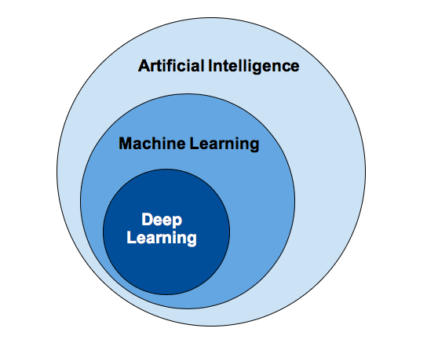
Concepts
Image Credit: https://www.sumologic.com/blog/machine-learning-deep-learning/

Slide 13
What is (general) intelligence?
Boring textbook answer
The ability to acquire and apply knowledge and skills
  Dictionary
My favorite
The ability to navigate in problem space
  Siddhartha Mukherjee, Columbia

Slide 14
What is artificial intelligence?
Boring textbook answer
Intelligence demonstrated by machines
  Wikipedia
My favorite
The science and engineering of making computers
behave in ways that, until recently, we thought
required human intelligence.
  Andrew Moore, CMU

Slide 15
What is machine learning?
My favorite
Study of algorithms that
improve their performance (P)
at some task (T)
with experience (E)
  Tom Mitchell, CMU

Slide 16
So what is Deep (Machine) Learning?
Representation Learning
Neural Networks
Deep Unsupervised/Reinforcement/Structured/
<insert-qualifier-here>
Learning
Simply: Deep Learning

Slide 17
So what is Deep (Machine) Learning?
A few different ideas:
(Hierarchical) Compositionality
  Cascade of non-linear transformations
  Multiple layers of representations
End-to-End Learning
  Learning (goal-driven) representations
  Learning to feature extraction
Distributed Representations
  No single neuron “encodes” everything
  Groups of neurons work together

Slide 18
Hierarchical Compositionality
VISION
pixels
edge
texton
motif
part
object
SPEECH
sample
spectral band
formant
motif
phone
word
NLP
character
word
NP/VP/..
clause
sentence
story
Slide Credit: Marc'Aurelio Ranzato, Yann LeCun

Slide 19
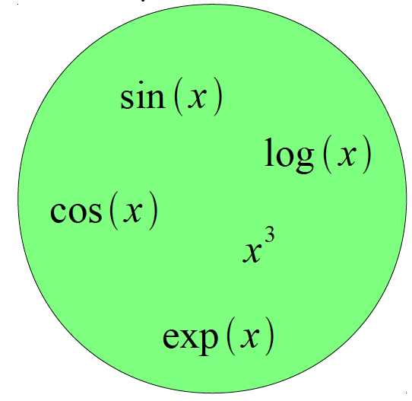
Building A Complicated Function
Given a library of simple functions
Compose into a
complicate function
Slide Credit: Marc'Aurelio Ranzato, Yann LeCun

Slide 20
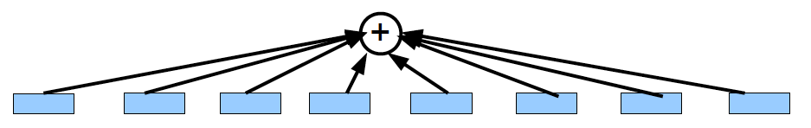
Building A Complicated Function
Given a library of simple functions
Idea 1: Linear Combinations
Boosting
Kernels
…
Compose into a
complicate function
Slide Credit: Marc'Aurelio Ranzato, Yann LeCun

Slide 21
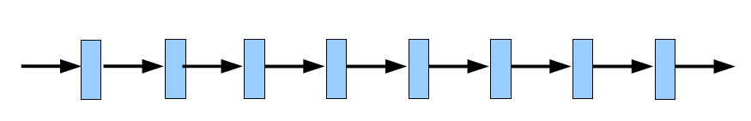
Building A Complicated Function
Given a library of simple functions
Idea 2: Compositions
Deep Learning
Grammar models
Scattering transforms…
Compose into a
complicate function
Slide Credit: Marc'Aurelio Ranzato, Yann LeCun

Slide 22
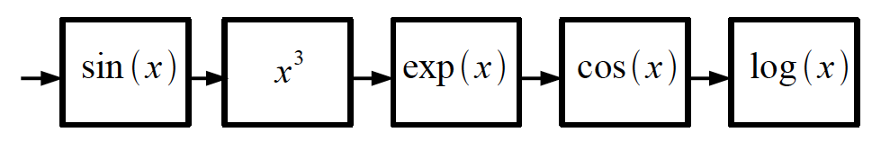
Building A Complicated Function
Given a library of simple functions
Idea 2: Compositions
Deep Learning
Grammar models
Scattering transforms…
Compose into a
complicate function
Slide Credit: Marc'Aurelio Ranzato, Yann LeCun

Slide 23
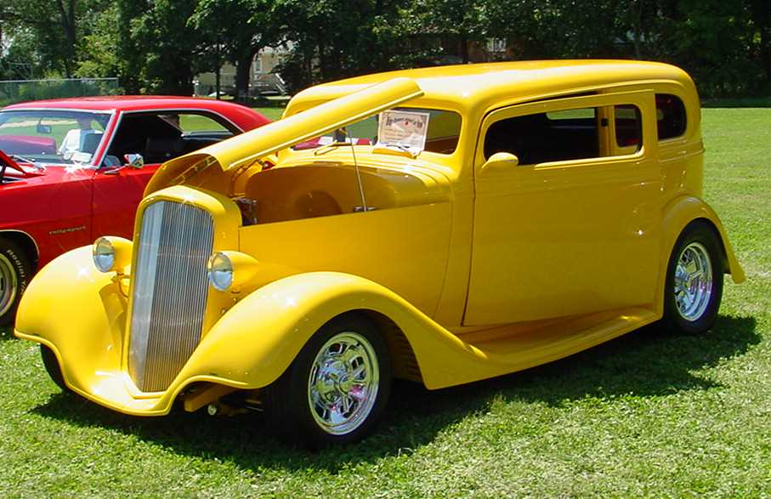
Deep Learning = Hierarchical Compositionality
“car”
Slide Credit: Marc'Aurelio Ranzato, Yann LeCun

Slide 24
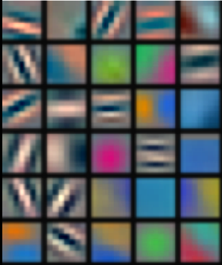
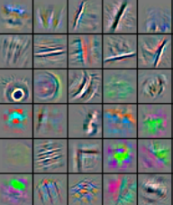
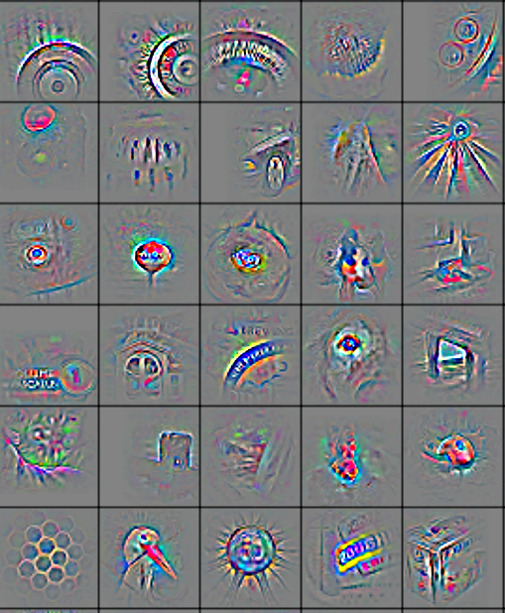
Deep Learning = Hierarchical Compositionality
Low-Level
Feature
Mid-Level
Feature
High-Level
Feature
Trainable
Classifier
“car”
Feature visualization of convolutional net trained on ImageNet from [Zeiler & Fergus 2013]
Slide Credit: Marc'Aurelio Ranzato, Yann LeCun

Slide 25
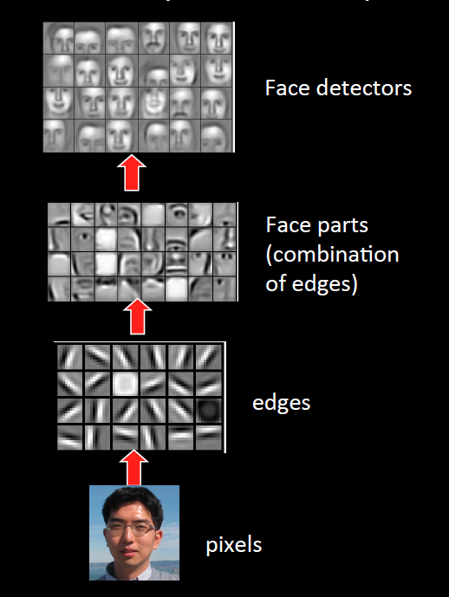
Sparse DBNs
[Lee et al. ICML ‘09]
Figure courtesy: Quoc Le

Slide 26
So what is Deep (Machine) Learning?
A few different ideas:
(Hierarchical) Compositionality
  Cascade of non-linear transformations
  Multiple layers of representations
End-to-End Learning
  Learning (goal-driven) representations
  Learning to feature extraction
Distributed Representations
  No single neuron “encodes” everything
  Groups of neurons work together

Slide 27
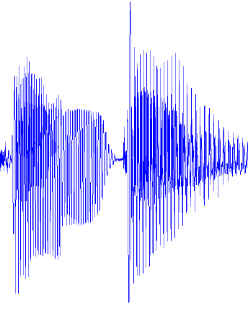
Traditional Machine Learning
VISION
hand-crafted
features
SIFT/HOG
your favorite
classifier
“car”
fixed
learned
SPEECH
hand-crafted
features
MFCC
your favorite
classifier
\ˈd ē p\
fixed
learned
NLP
hand-crafted
features
Bag-of-words
your favorite
classifier
This burrito place
is yummy and fun!
“+”
fixed
learned
Slide Credit: Marc'Aurelio Ranzato, Yann LeCun

Slide 28
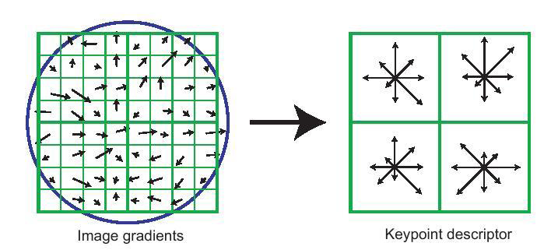
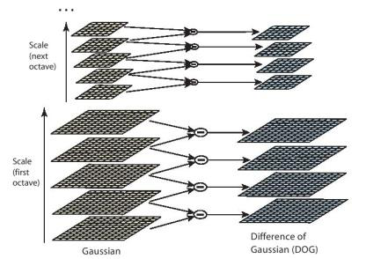
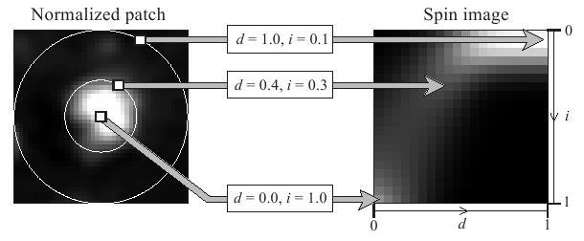
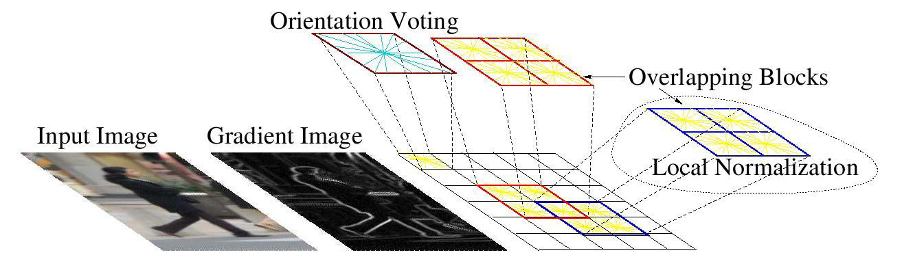
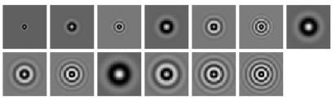
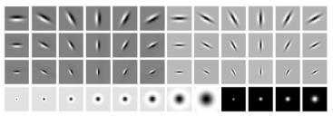
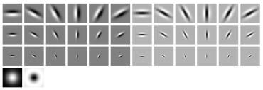
Feature Engineering
SIFT
Spin Images
HoG
Textons
and many many more….

Slide 29
Traditional Machine Learning (more accurately)
“Learned”
VISION
SIFT/HOG
K-Means/
pooling
classifier
“car”
fixed
unsupervised
supervised
SPEECH
MFCC
Mixture of
Gaussians
classifier
\ˈd ē p\
fixed
unsupervised
supervised
NLP
Parse Tree
Syntactic
n-grams
classifier
This burrito place
is yummy and fun!
“+”
fixed
unsupervised
supervised
Slide Credit: Marc'Aurelio Ranzato, Yann LeCun

Slide 30
Deep Learning = End-to-End Learning
“Learned”
VISION
SIFT/HOG
K-Means/
pooling
classifier
“car”
fixed
unsupervised
supervised
SPEECH
MFCC
Mixture of
Gaussians
classifier
\ˈd ē p\
fixed
unsupervised
supervised
NLP
Parse Tree
Syntactic
n-grams
classifier
This burrito place
is yummy and fun!
“+”
fixed
unsupervised
supervised
Slide Credit: Marc'Aurelio Ranzato, Yann LeCun

Slide 31
“Shallow” vs Deep Learning
“Shallow” models
Deep models
hand-crafted
Feature Extractor
“Simple” Trainable
Classifier
fixed
learned
Trainable
Feature-Transform /
Classifier
Trainable
Feature-Transform /
Classifier
Trainable
Feature-Transform /
Classifier
Learned Internal Representations
Slide Credit: Marc'Aurelio Ranzato, Yann LeCun

Slide 32
So what is Deep (Machine) Learning?
A few different ideas:
(Hierarchical) Compositionality
  Cascade of non-linear transformations
  Multiple layers of representations
End-to-End Learning
  Learning (goal-driven) representations
  Learning to feature extraction
Distributed Representations
  No single neuron “encodes” everything
  Groups of neurons work together

Slide 33
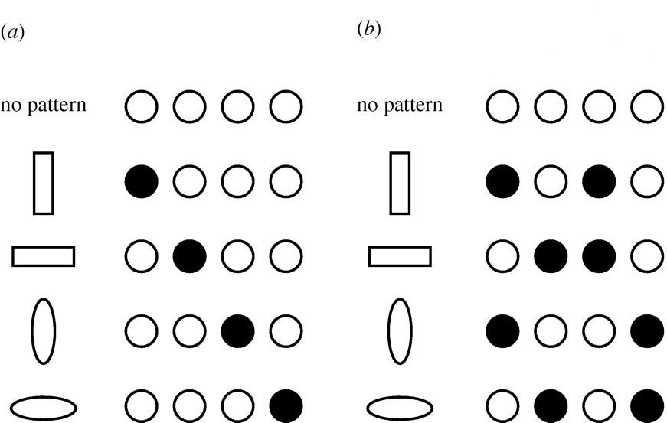
Distributed Representations Toy Example
Local vs Distributed
Slide Credit: Moontae Lee

Slide 34
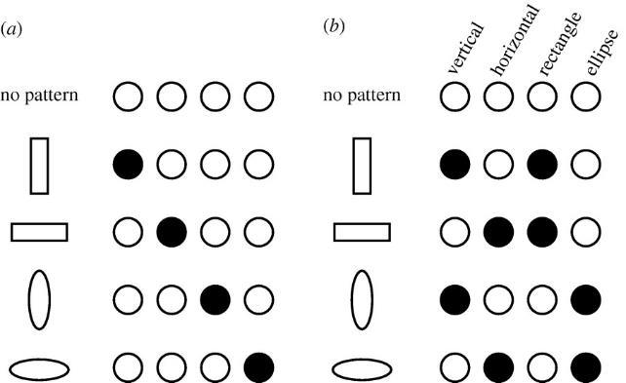
Distributed Representations Toy Example
Can we interpret each dimension?
Slide Credit: Moontae Lee

Slide 35
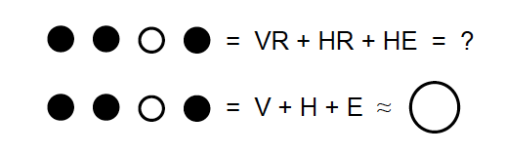
Power of distributed representations!
Local
Distributed
Slide Credit: Moontae Lee

Slide 36
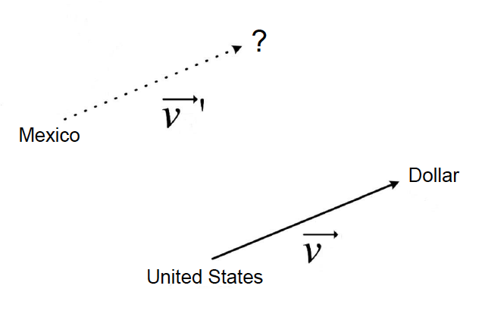
Power of distributed representations!
United States:Dollar :: Mexico:?
Slide Credit: Moontae Lee

Slide 37
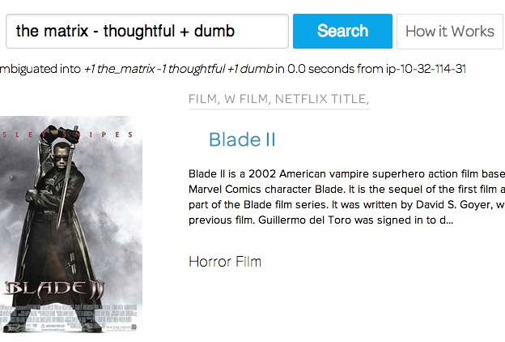
ThisPlusThat.me
Image Credit:
http://insightdatascience.com/blog/thisplusthat_a_search_engine_that_lets_you_add_words_as_vectors.html

Slide 38
So what is Deep (Machine) Learning?
A few different ideas:
(Hierarchical) Compositionality
  Cascade of non-linear transformations
  Multiple layers of representations
End-to-End Learning
  Learning (goal-driven) representations
  Learning to feature extraction
Distributed Representations
  No single neuron “encodes” everything
  Groups of neurons work together

Slide 39
Benefits of Deep/Representation Learning
(Usually) Better Performance
  Caveats: given enough data, similar train-test distributions, non-adversarial evaluation, etc, etc.
New domains without “experts”
  RGBD/Lidar
  Multi-spectral data
  Gene-expression data
  Unclear how to hand-engineer

Slide 40
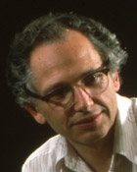
“Expert” intuitions can be misleading
“Every time I fire a linguist, the performance of our speech recognition system goes up”
  Fred Jelinik, IBM ’98
“Because gradient descent is better than you”
  Yann LeCun, CVPR ‘13

Slide 41
Benefits of Deep/Representation Learning
Modularity!
Plug and play architectures!

Slide 42
Differentiable Computation Graph
Any DAG of differentialble modules is allowed!
Slide Credit: Marc'Aurelio Ranzato

Slide 43
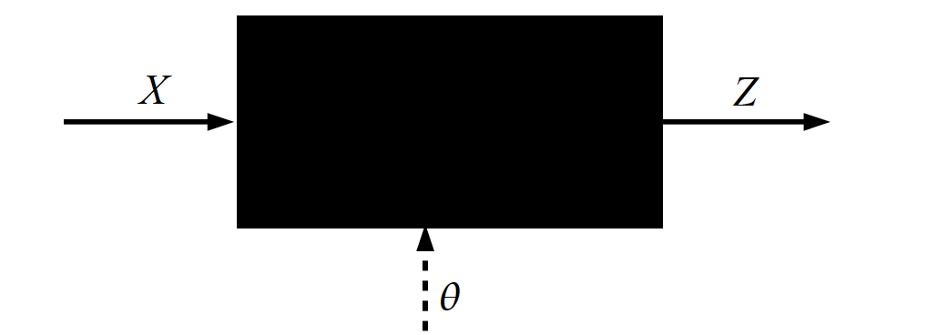
Key Computation: Forward-Prop
Slide Credit: Marc'Aurelio Ranzato, Yann LeCun

Slide 44
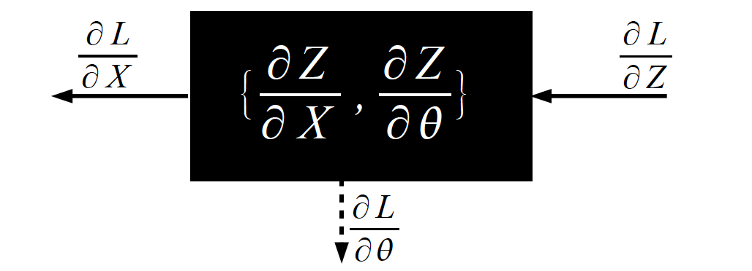
Key Computation: Back-Prop
Slide Credit: Marc'Aurelio Ranzato, Yann LeCun

Slide 45
Differentiable Computation Graph
Any DAG of differentialble modules is allowed!
Slide Credit: Marc'Aurelio Ranzato

Slide 46
Problems with Deep Learning
Problem#1: Lack of a formal understanding
  Non-Convex! Non-Convex! Non-Convex!
    Depth>=3: most losses non-convex in parameters
  Worse still, existing intuitions from classical statistical learning theory don’t seem to carry over.
  Theoretically, we are stumbling in the dark here
Standard response #1
  “Yes, but this just means there’s new theory to be constructed”
  “All interesting learning problems are non-convex”
    For example, human learning
      Order matters → wave hands → non-convexity
Standard response #2
  “Yes, but it often works!”

Slide 47
Problems with Deep Learning
Problem#2: Lack of interpretability
  Hard to track down what’s failing
  Pipeline systems have “oracle” performances at each step
  In end-to-end systems, it’s hard to know why things are not working

Slide 48
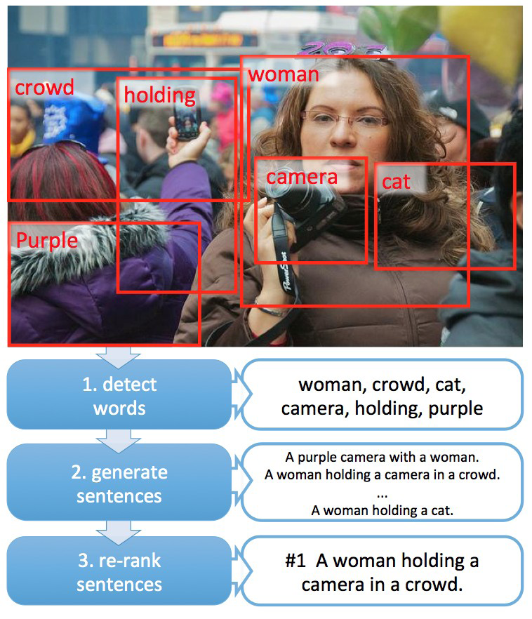
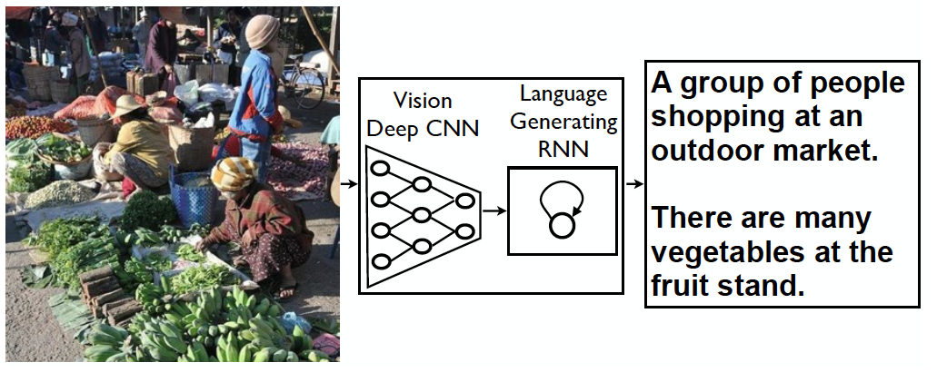
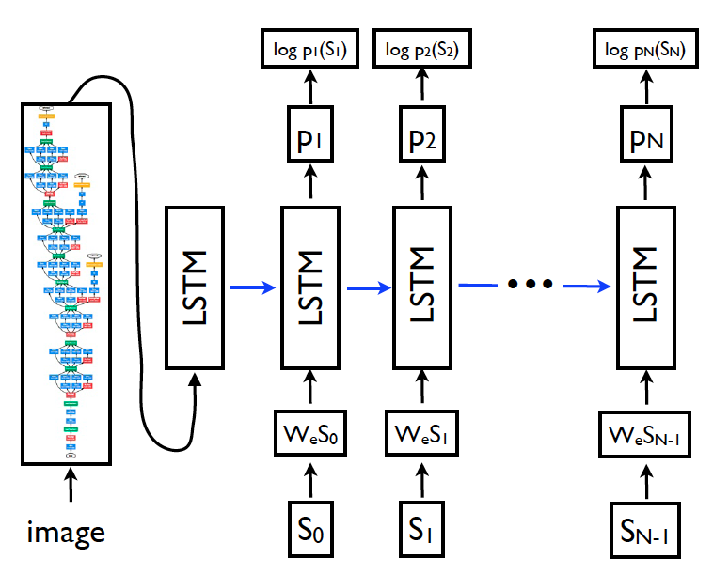
Problems with Deep Learning
Problem#2: Lack of interpretability
[Fang et al. CVPR15]
[Vinyals et al. CVPR15]
Pipeline
End-to-End

Slide 49
Problems with Deep Learning
Problem#2: Lack of interpretability
  Hard to track down what’s failing
  Pipeline systems have “oracle” performances at each step
  In end-to-end systems, it’s hard to know why things are not working
Standard response #1
  Tricks of the trade: visualize features, add losses at different layers, pre-train to avoid degenerate initializations…
  “We’re working on it”
Standard response #2
  “Yes, but it often works!”

Slide 50
Problems with Deep Learning
Problem#3: Lack of easy reproducibility
  Direct consequence of stochasticity & non-convexity
    different initializations → different local minima
Standard response #1
  It’s getting much better
  Standard toolkits/libraries/frameworks now available
  PyTorch, TensorFlow, MxNet…
Standard response #2
  “Yes, but it often works!”

Slide 51
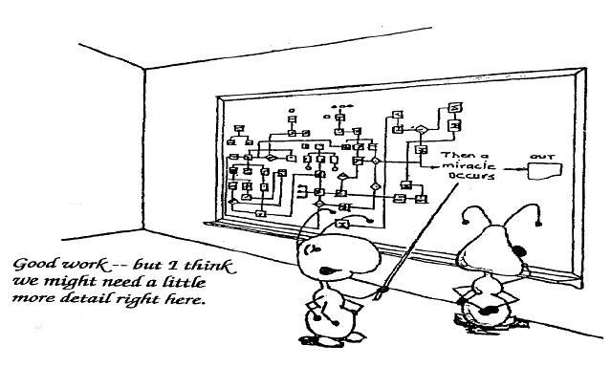
Yes it works, but how?

Slide 52
Outline
What is Deep Learning, the field, about?
  Highlight of some recent projects from my lab
What is this class about?
  What to expect?
  Logistics
FAQ

Slide 53
Outline
What is Deep Learning, the field, about?
  Highlight of some recent projects from my lab
What is this class about?
  What to expect?
  Logistics
FAQ

Slide 54
What is this class about?
Introduction to Deep Learning
Goal:
  After finishing this class, you should be ready to get started on your first DL research project.
    CNNs
    RNNs
    Deep Reinforcement Learning
    Generative Models (VAEs, GANs)
Target Audience:
  Senior undergrads, MS-ML, and new PhD students

Slide 55
What this class is NOT
NOT the target audience:
  Advanced grad-students already working in ML/DL areas
  People looking to understand latest and greatest cutting-edge research (e.g. GANs, AlphaGo, etc)
  Undergraduate/Masters students looking to graduate
  with a DL class on their resume.
NOT the goal:
  Teaching a toolkit. “Intro to TensorFlow/PyTorch”
  Intro to Machine Learning

Slide 56
Caveat
This is an ADVANCED Machine Learning class
  This should NOT be your first introduction to ML
  You will need a formal class; not just self-reading/coursera
  If you took CS 7641/ISYE 6740/CSE 6740 @GT,
  you’re in the right place
  If you took an equivalent class elsewhere, see list of topics taught in CS 7641 to be sure.

Slide 57
Prerequisites
Intro Machine Learning
  Classifiers, regressors, loss functions, MLE, MAP
Linear Algebra
  Matrix multiplication, eigenvalues, positive semi-definiteness…
Calculus
  Multi-variate gradients, hessians, jacobians…

Slide 58
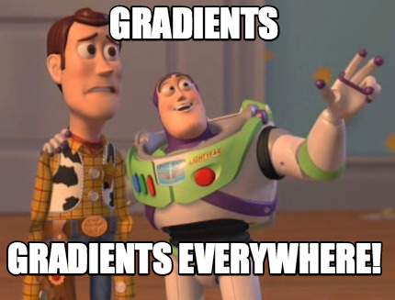
Prerequisites
Intro Machine Learning
  Classifiers, regressors, loss functions, MLE, MAP
Linear Algebra
  Matrix multiplication, eigenvalues, positive semi-definiteness…
Calculus
  Multi-variate gradients, hessians, jacobians…

Slide 59
Prerequisites
Intro Machine Learning
  Classifiers, regressors, loss functions, MLE, MAP
Linear Algebra
  Matrix multiplication, eigenvalues, positive semi-definiteness…
Calculus
  Multi-variate gradients, hessians, jacobians…
Programming!
  Homeworks will require Python!
  Libraries/Frameworks: PyTorch
  HW0+5 (pure python), HW1 (python + PyTorch),
  HW2+3+4 (PyTorch)
  Your language of choice for project

Slide 60
Course Information
Instructor: Dhruv Batra
  dbatra@gatech
  Location: 219 CCB

Slide 61
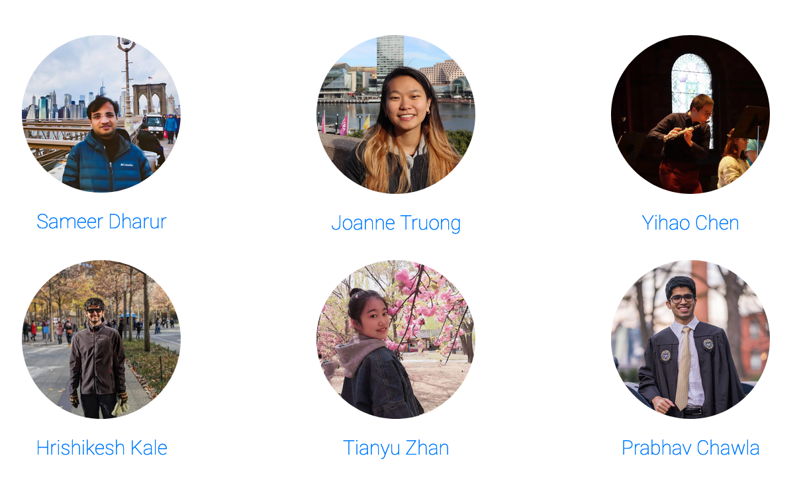

TAs

Slide 62
Organization & Deliverables
4 problem-sets+homeworks (80%)
  Need to submit only 4 out of 5 homeworks
  Mix of theory (PS) and implementation (HW)
  First one goes out next week
    Start early, Start early, Start early, Start early, Start early, Start early, Start early, Start early, Start early, Start early
Final project (20%)
  Projects done in groups of 3-4
(Bonus) Class Participation (5%)
  Contribute to class discussions on Piazza
  Ask questions, answer questions

Slide 63
Plenty of “buffer” built in
“Free” Late Days
  7 late days for the semester
    Can use for HWs
    Can NOT use for project related deadlines
    Can NOT use for PS0
  After free late days are used up:
    25% penalty for each late day
Only need to submit 4 out of 5 homeworks

Slide 64
PS0
Out today; due Aug 20
  Available on class webpage + Canvas
Grading
  Not counted towards your final grade, but required
  <=75% means that you might not be prepared for the class
Topics
  PS: probability, calculus, convexity, proving things

Slide 65
Project
Goal
  Chance to try Deep Learning
  Encouraged to apply to your research (computer vision, NLP, robotics,…)
  Must be done this semester.
  Can combine with other classes
    get permission from both instructors; delineate different parts
  Extra credit for shooting for a publication
Main categories
  Application/Survey
    Compare a bunch of existing algorithms on a new application domain of your interest
  Formulation/Development
    Formulate a new model or algorithm for a new or old problem
  Theory
    Theoretically analyze an existing algorithm

Slide 66
Computing
Major bottleneck
  GPUs
Options
  Your own / group / advisor’s resources
  Google Colab
    jupyter-notebook + free GPU instance

Slide 67
4803 vs 7643
Level differentiation
HWs
  Extra credit questions for 4803 students, necessary for 7643
Project
  Higher expectations from 7643

Slide 68
Outline
What is Deep Learning, the field, about?
  Highlight of some recent projects from my lab
What is this class about?
  What to expect?
  Logistics
FAQ

Slide 69
Waitlist / Audit / Sit in
Waitlist
  Class is full. Size will not increase further.
  Do PS0. Come to first few classes.
  Hope people drop.
“I need this class to graduate”
  Talk to your degree program advisor. They control the process of making sure you have options to graduate on time.
Audit or Pass/Fail
  No. We will give preference to people taking class for credit.
Sitting in
  Welcome to. Talk to instructor.

Slide 70
What is the re-grading policy?
Homework assignments
  Within 1 week of receiving grades: see the TAs
This is an advanced grad class.
  The goal is understanding the material and making progress towards our research.

Slide 71
What is the collaboration policy?
Collaboration
  Only on HWs and project (not allowed in HW0).
  You may discuss the questions
  Each student writes their own answers
  Write on your homework anyone with whom you collaborate
  Each student must write their own code for the programming part
Zero tolerance on plagiarism
  Neither ethical nor in your best interest
  Always credit your sources
  Don’t cheat. We will find out.

Slide 72
How do I get in touch?
Primary means of communication -- Piazza
  No direct emails to Instructor unless private information
  Instructor/TAs can provide answers to everyone on forum
  Class participation credit for answering questions!
  No posting answers. We will monitor.
Staff Mailing List
  f20-cs4803-cs7643-staff@googlegroups.com

Slide 73
Research
“Can I work with your group for funding/credits/neither?”
  I am not taking new advising duties.
  If you can find one of my students to supervise you,
  I am happy to sign off on the paperwork.
  Your responsibility to approach them and ask.
  It will help if you know what they are working on.

Slide 74
Todo
PS0
  Due: Aug 20 11:59pm

Slide 75
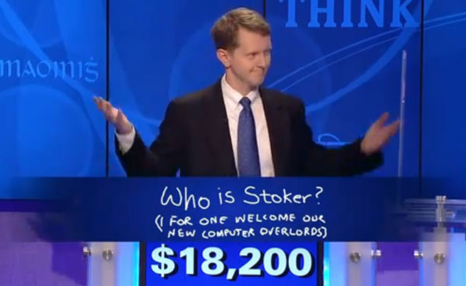
Welcome

