Slide 1
CS 4803 / 7643: Deep Learning
Topics:
  Unsupervised Learning
  Generative Models
Michael Cogswell
(subbing for Dhruv Batra)
Georgia Tech
Notes:
Supervised -> RL (evaluative feedback) -> Unsupervised
TODO: how does unsupervised related to generative??

Slide 2
Overview
Unsupervised Learning
  Comparison to Supervised and Reinforcement Learning
  Review of K-Means
e.g., Generative Models
  Varieties
  PixelRNN and PixelCNN
Slide Credit: Fei-Fei Li, Justin Johnson, Serena Yeung, CS 231n
Notes:
Unsupervised learning problem
Generative models, type of unsupervised learning
3 types of generative models
PixelRNN and PixelCNN, type of fully visible belief networks

Slide 3
Supervised vs Reinforcement vs Unsupervised Learning
Supervised Learning
Given: (x, y)
x is data, y is label
Goal: Learn a function to map x → y
Examples: Classification, regression, object detection, semantic segmentation, image captioning, etc.
Slide Credit: Fei-Fei Li, Justin Johnson, Serena Yeung, CS 231n
Notes:
In this class so far, have talked about a lot of sup. Learning problems
Data x, y is a label, and label can take many different forms

Slide 4
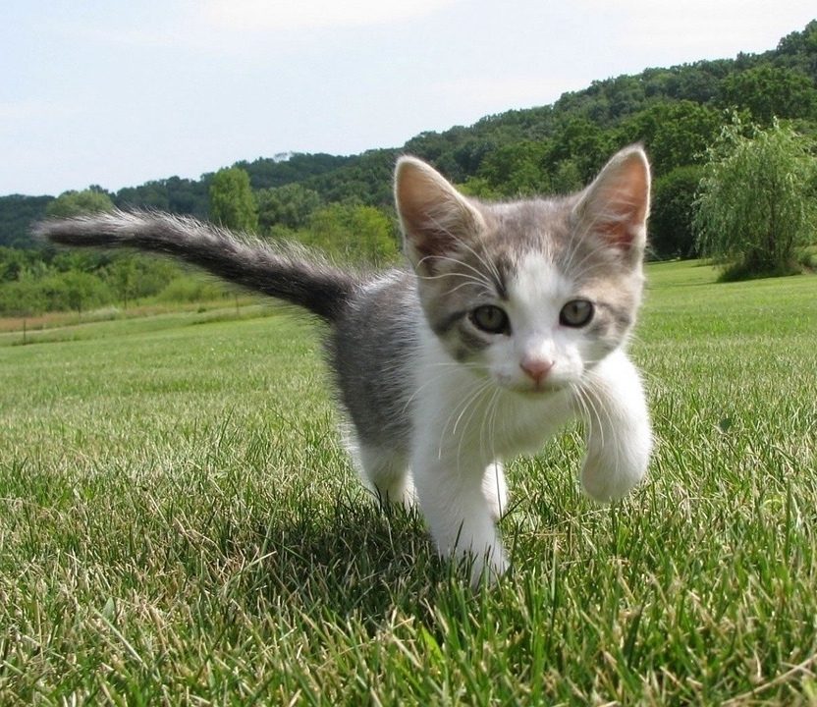
Supervised vs Reinforcement vs Unsupervised Learning
Supervised Learning
Given: (x, y)
x is data, y is label
Goal: Learn a function to map x → y
Examples: Classification, regression, object detection, semantic segmentation, image captioning, etc.
Cat
Classification
This image is CC0 public domain
Slide Credit: Fei-Fei Li, Justin Johnson, Serena Yeung, CS 231n
Notes:
Label is category

Slide 5
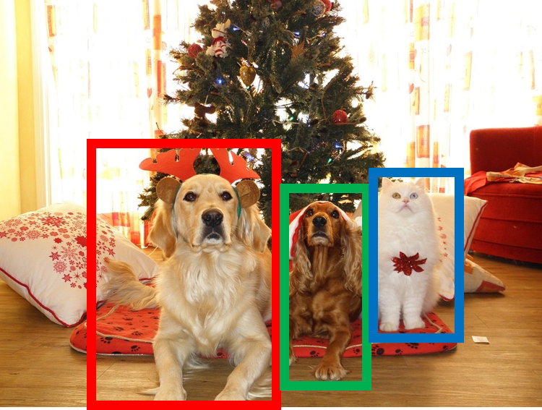
Supervised vs Reinforcement vs Unsupervised Learning
Supervised Learning
Given: (x, y)
x is data, y is label
Goal: Learn a function to map x → y
Examples: Classification, regression, object detection, semantic segmentation, image captioning, etc.
DOG, DOG, CAT
Object Detection
This image is CC0 public domain
Slide Credit: Fei-Fei Li, Justin Johnson, Serena Yeung, CS 231n

Slide 6
Supervised vs Reinforcement vs Unsupervised Learning
Supervised Learning
Given: (x, y)
x is data, y is label
Goal: Learn a function to map x → y
Examples: Classification, regression, object detection, semantic segmentation, image captioning, etc.
GRASS, CAT, TREE, SKY
Semantic Segmentation
Slide Credit: Fei-Fei Li, Justin Johnson, Serena Yeung, CS 231n

Slide 7

Supervised vs Reinforcement vs Unsupervised Learning
Supervised Learning
Given: (x, y)
x is data, y is label
Goal: Learn a function to map x → y
Examples: Classification, regression, object detection, semantic segmentation, image captioning, etc.
A cat sitting on a suitcase on the floor
Image captioning
Caption generated using neuraltalk2
Image is CC0 Public domain.
Slide Credit: Fei-Fei Li, Justin Johnson, Serena Yeung, CS 231n

Slide 8
Supervised vs Reinforcement vs Unsupervised Learning
Reinforcement Learning
Given: (e, r)
Environment e, Reward function r (evaluative feedback)
Goal: Maximize expected reward
Examples: Robotic control, video games, board games, etc.
Slide Credit: Fei-Fei Li, Justin Johnson, Serena Yeung, CS 231n
Notes:
Unsupervised learning is a type of learning where we have unlabeled training data, and we want to learn some underlying hidden structure of the data

Slide 9
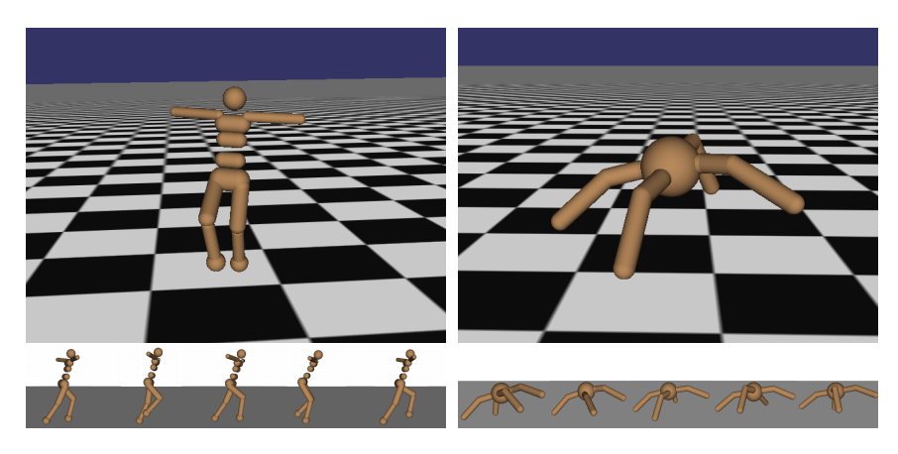
Supervised vs Reinforcement vs Unsupervised Learning
Reinforcement Learning
Given: (e, r)
Environment e, Reward function r (evaluative feedback)
Goal: Maximize expected reward
Examples: Robotic control, video games, board games, etc.
Robotic Locomotion
Slide Credit: Fei-Fei Li, Justin Johnson, Serena Yeung, CS 231n
Notes:
Unsupervised learning is a type of learning where we have unlabeled training data, and we want to learn some underlying hidden structure of the data

Slide 10
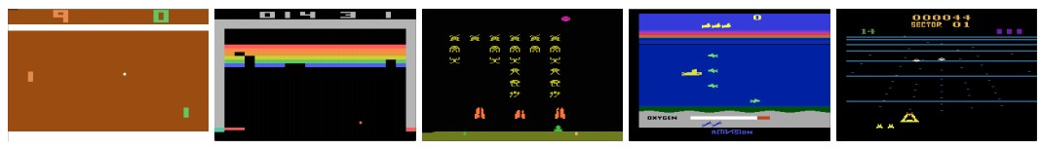
Supervised vs Reinforcement vs Unsupervised Learning
Reinforcement Learning
Given: (e, r)
Environment e, Reward function r (evaluative feedback)
Goal: Maximize expected reward
Examples: Robotic control, video games, board games, etc.
Atari Games
Slide Credit: Fei-Fei Li, Justin Johnson, Serena Yeung, CS 231n
Notes:
Unsupervised learning is a type of learning where we have unlabeled training data, and we want to learn some underlying hidden structure of the data

Slide 11
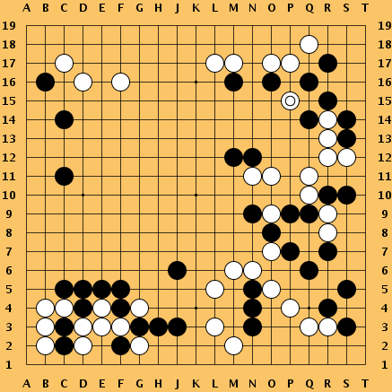
Supervised vs Reinforcement vs Unsupervised Learning
Reinforcement Learning
Given: (e, r)
Environment e, Reward function r (evaluative feedback)
Goal: Maximize expected reward
Examples: Robotic control, video games, board games, etc.
Go
Slide Credit: Fei-Fei Li, Justin Johnson, Serena Yeung, CS 231n
Notes:
Unsupervised learning is a type of learning where we have unlabeled training data, and we want to learn some underlying hidden structure of the data

Slide 12
Supervised vs Reinforcement vs Unsupervised Learning
Unsupervised Learning
Given: Data x
Just data, no labels!
Goal: Learn some underlying hidden structure of the data
Examples: Clustering, dimensionality reduction, feature learning, density estimation, etc.
Slide Credit: Fei-Fei Li, Justin Johnson, Serena Yeung, CS 231n
Notes:
Unsupervised learning is a type of learning where we have unlabeled training data, and we want to learn some underlying hidden structure of the data

Slide 13
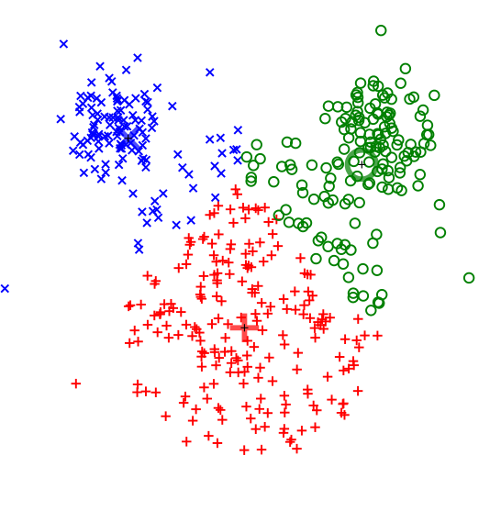
Supervised vs Reinforcement vs Unsupervised Learning
Unsupervised Learning
Given: Data x
Just data, no labels!
Goal: Learn some underlying hidden structure of the data
Examples: Clustering, dimensionality reduction, feature learning, density estimation, etc.
K-means clustering
This image is CC0 public domain
Slide Credit: Fei-Fei Li, Justin Johnson, Serena Yeung, CS 231n
Notes:
Clustering - find groups within the data that are similar through some metric

Slide 14
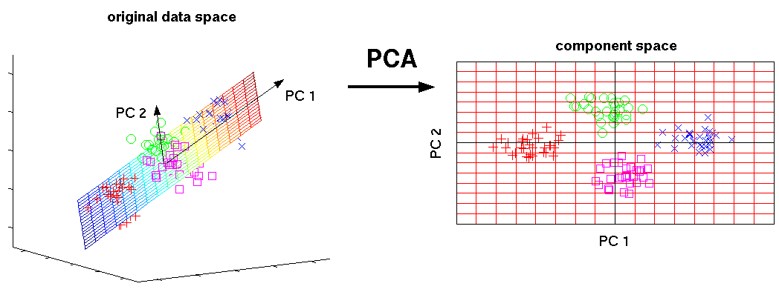
Supervised vs Reinforcement vs Unsupervised Learning
Unsupervised Learning
Given: Data x
Just data, no labels!
Goal: Learn some underlying hidden structure of the data
Examples: Clustering, dimensionality reduction, feature learning, density estimation, etc.
3-d
2-d
Principal Component Analysis
(Dimensionality reduction)
This image from Matthias Scholz is CC0 public domain
Slide Credit: Fei-Fei Li, Justin Johnson, Serena Yeung, CS 231n
Notes:
Find axes along which the data has most variation, this is part of the underlying structure of the data
Use this to reduce the dimensionality of the data such that the data has significant variation among each remaining dimension
Here is an example, take 3d data, finding 2 axes of variatiation and reducing dimensionality to 2d

Slide 15
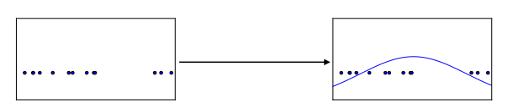
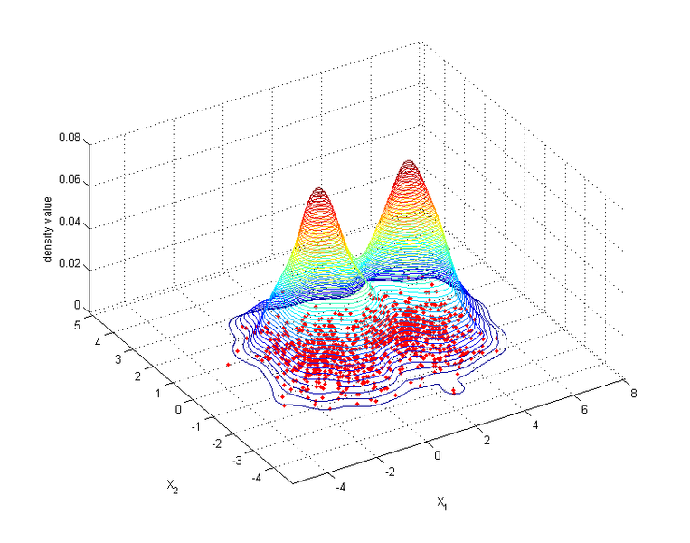
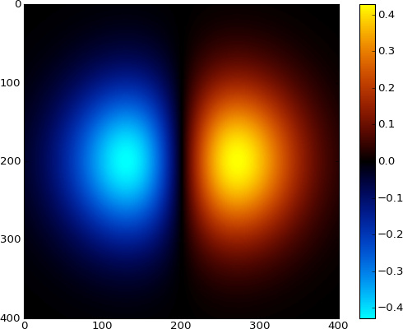
Supervised vs Reinforcement vs Unsupervised Learning
Unsupervised Learning
Given: Data x
Just data, no labels!
Goal: Learn some underlying hidden structure of the data
Examples: Clustering, dimensionality reduction, feature learning, density estimation, etc.
Figure copyright Ian Goodfellow, 2016. Reproduced with permission.
1-d density estimation
2-d density estimation
2-d density images left and right are CC0 public domain
Slide Credit: Fei-Fei Li, Justin Johnson, Serena Yeung, CS 231n
Notes:
Finally, another example is density estimation, which is estimating the underlying distribution of your data.
For example, in top example, have points in 1-d, and we can try to fit a gaussian to the density
In the bottom example, have 2d data. Again trying to estimate the density, and we model the density to be higher where more points are concentrated

Slide 16
Tasks
Supervised Learning
x
Classification
y
Discrete
x
Regression
y
Continuous
Unsupervised Learning
x
Clustering
c
Discrete
x
Dimensionality
Reduction
z
Continuous
x
Density
Estimation
p(x)
On simplex

Slide 17
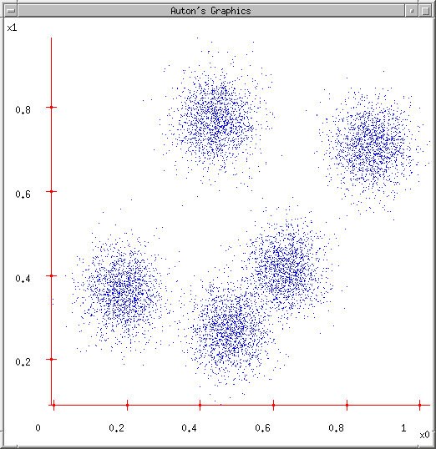
Some Data
Slide Credit: Carlos Guestrin

Slide 18
K-means
Ask user how many clusters they’d like. (e.g. k=5)
Slide Credit: Carlos Guestrin

Slide 19
K-means
Ask user how many clusters they’d like. (e.g. k=5)
Randomly guess k cluster Center locations
Slide Credit: Carlos Guestrin

Slide 20
K-means
Ask user how many clusters they’d like. (e.g. k=5)
Randomly guess k cluster Center locations
Each datapoint finds out which Center it’s closest to.
Slide Credit: Carlos Guestrin

Slide 21
K-means
Ask user how many clusters they’d like. (e.g. k=5)
Randomly guess k cluster Center locations
Each datapoint finds out which Center it’s closest to.
Each Center finds the centroid of the points it owns…
Slide Credit: Carlos Guestrin

Slide 22
K-means
Ask user how many clusters they’d like. (e.g. k=5)
Randomly guess k cluster Center locations
Each datapoint finds out which Center it’s closest to.
Each Center finds the centroid of the points it owns…
…and jumps there
…Repeat until terminated!
Slide Credit: Carlos Guestrin

Slide 23
K-means
Demo
  http://stanford.edu/class/ee103/visualizations/kmeans/kmeans.html

Slide 24
K-means
Randomly initialize k centers
  μ⁽⁰⁾ = μ₁⁽⁰⁾,…, μ_{k}⁽⁰⁾
Assign:
  Assign each point i∈{1,…n} to nearest center:
Recenter:
  μ_{j} becomes centroid of its points
Slide Credit: Carlos Guestrin

Slide 25
What is K-means optimizing?
Objective F(μ,C): function of centers μ and point allocations C:
  1-of-k encoding
Optimal K-means:
  min_{μ}min_{a} F(μ,a)
Notes:
How did we come up with F: I don’t know
How do we know F is minimized: Break it down into the expectation and maximization steps.
Clearly the max step (updating C; min in this case) is optimal since each term in the sum is minimized w.r.t. C.
The expectation step (updating mu) minimizes F as seen by taking derivative and setting to 0

Slide 26
Coordinate descent algorithms
Want: min_{a} min_{b} F(a,b)
Coordinate descent:
  fix a, minimize b
  fix b, minimize a
  repeat
Converges!!!
  if F is bounded
  to a (often good) local optimum
K-means is a coordinate descent algorithm!
Slide Credit: Carlos Guestrin

Slide 27
K-means as Co-ordinate Descent
Optimize objective function:
Alternate between
  Fix μ, optimize a (i.e. C)
  Fix a (i.e. C), optimize μ
Slide Credit: Carlos Guestrin

Slide 28
Supervised vs Unsupervised Learning
Supervised Learning
Given: (x, y)
x is data, y is label
Goal: Learn a function to map x -> y
Examples: Classification, regression, object detection, semantic segmentation, image captioning, etc.
Reinforcement Learning
Given: (e, r)
Environment e, Reward function r (evaluative feedback)
Goal: Maximize expected reward
Examples: Robotic control, video games, board games, etc.
Unsupervised Learning
Given: Data x
Just data, no labels!
Goal: Learn some underlying hidden structure of the data
Examples: Clustering, dimensionality reduction, feature learning, density estimation, etc.
Slide Credit: Fei-Fei Li, Justin Johnson, Serena Yeung, CS 231n
Notes:
To summarize differences, sup uses labeled data to learn a function mapping from x to y
Unsup uses no labels, tries to learn some underlying hidden structure of the data, whether grouping, axes of variation, underlying density

Slide 29
Supervised vs Unsupervised Learning
Supervised Learning
Given: (x, y)
x is data, y is label
Goal: Learn a function to map x -> y
Examples: Classification, regression, object detection, semantic segmentation, image captioning, etc.
Reinforcement Learning
Given: (e, r)
Environment e, Reward function r (evaluative feedback)
Goal: Maximize expected reward
Examples: Robotic control, video games, board games, etc.
Unsupervised Learning
Given: Data x
Just data, no labels!
Goal: Learn some underlying hidden structure of the data
Examples: Clustering, dimensionality reduction, feature learning, density estimation, etc.
Training data is cheap
Holy grail: Solve unsupervised learning
=> understand structure of visual world
Slide Credit: Fei-Fei Li, Justin Johnson, Serena Yeung, CS 231n
Notes:
To summarize differences, sup uses labeled data to learn a function mapping from x to y
Unsup uses no labels, tries to learn some underlying hidden structure of the data, whether grouping, axes of variation, underlying density

Slide 30






Generative Models
Given training data, generate new samples from same distribution
Training data ~ p_{data}(x)
Generated samples ~ p_{model}(x)
Want to learn p_{model}(x) similar to p_{data}(x)
Slide Credit: Fei-Fei Li, Justin Johnson, Serena Yeung, CS 231n
Notes:
Today we’ll focus on generative models, a class of models for unsupervised learning that given training data, tries to generate new samples from the same distribution

Slide 31
Generative Classification vs Discriminative Classification vs
Density Estimation
Generative Classification
  Model p(x, y); estimate p(x|y) and p(y)
  Use Bayes Rule to predict y
  E.g Naïve Bayes
Discriminative Classification (not a Generative Model)
  Estimate p(y|x) directly
  E.g. Logistic Regression
Density Estimation
  Model p(x)
  E.g. VAEs
Notes:
We’ve seen this pop up before… e.g., in NB, which was different because…

Slide 32
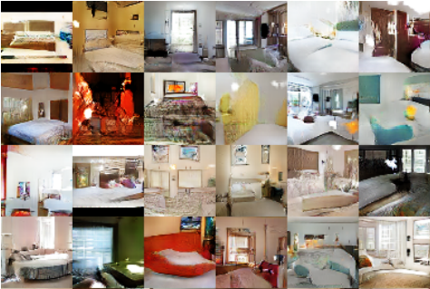
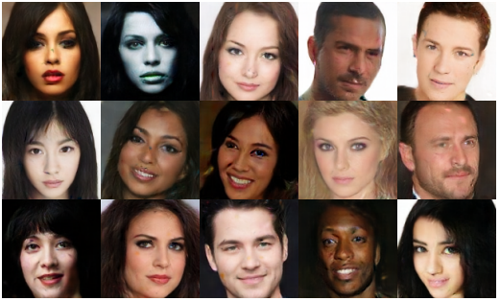
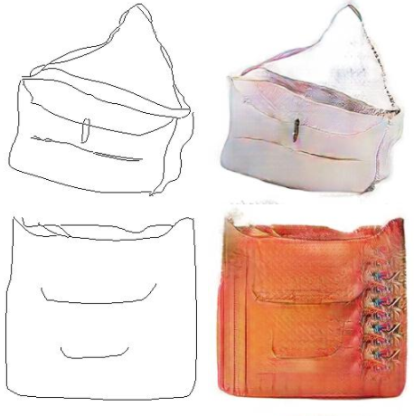
Why Generative Models?
Realistic samples for artwork, super-resolution, colorization, etc.
Generative models of time-series data can be used for simulation and planning (model based reinforcement learning!)
Training generative models can also enable inference of latent representations that can be useful as general features
FIgures from L-R are copyright: (1) Alec Radford et al. 2016; (2) David Berthelot et al. 2017; Phillip Isola et al. 2017. Reproduced with authors permission.
Slide Credit: Fei-Fei Li, Justin Johnson, Serena Yeung, CS 231n

Slide 33
Generative Models
Given training data, generate new samples from same distribution
Training data ~ p_{data}(x)
Generated samples ~ p_{model}(x)
Want to learn p_{model}(x) similar to p_{data}(x)
Addresses density estimation, a core problem in unsupervised learning
Several flavors:
Explicit density estimation: explicitly define and solve for p_{model}(x)
Implicit density estimation: learn model that can sample from p_{model}(x) w/o explicitly defining it
Slide Credit: Fei-Fei Li, Justin Johnson, Serena Yeung, CS 231n
Notes:
Addresses the problem of density estimation, which is a core problem in unsup learning

Slide 34
Taxonomy of Generative Models
Direct
GAN
Generative models
Explicit density
Implicit density
Tractable density
Approximate density
Markov Chain
Fully Visible Belief Nets
NADE
MADE
PixelRNN/CNN
Change of variables models (nonlinear ICA)
GSN
Variational
Markov Chain
Variational Autoencoder
Boltzmann Machine
Figure copyright and adapted from Ian Goodfellow, Tutorial on Generative Adversarial Networks, 2017.
Slide Credit: Fei-Fei Li, Justin Johnson, Serena Yeung, CS 231n
Notes:
If we look at types of generative models, can be organized into this taxonomy, where 2 major branches are, as mentioned earlier, explicit density models that explicitly define and solve for the underlying density function, and implicit density models that represent the underlying distribution implicitly through its samples

Slide 35
Taxonomy of Generative Models
Direct
We will discuss 3 most popular types of generative models
GAN
Generative models
Explicit density
Implicit density
Tractable density
Approximate density
Markov Chain
Fully Visible Belief Nets
NADE
MADE
PixelRNN/CNN
Change of variables models (nonlinear ICA)
GSN
Variational
Markov Chain
Variational Autoencoder
Boltzmann Machine
Figure copyright and adapted from Ian Goodfellow, Tutorial on Generative Adversarial Networks, 2017.
Slide Credit: Fei-Fei Li, Justin Johnson, Serena Yeung, CS 231n
Notes:
Refer to goodfellow tutorial which has a good overview of this
Today discuss 3 most popular types of generative models

Slide 36
PixelRNN and PixelCNN

Slide 37

Fully Visible Belief Network
Explicit density model
Use chain rule to decompose likelihood of an image x into product of 1-d distributions:
Likelihood of image x
Probability of i’th pixel value given all previous pixels
Then maximize likelihood of training data
Slide Credit: Fei-Fei Li, Justin Johnson, Serena Yeung, CS 231n
Notes:
Pielrnn and cnn type of fully visible belief network

Slide 38
Fully Visible Belief Network
Explicit density model
Use chain rule to decompose likelihood of an image x into product of 1-d distributions:
Likelihood of image x
Probability of i’th pixel value given all previous pixels
Then maximize likelihood of training data
Complex distribution over pixel values => Express using a neural network!
Slide Credit: Fei-Fei Li, Justin Johnson, Serena Yeung, CS 231n

Slide 39
Fully Visible Belief Network
Explicit density model
Use chain rule to decompose likelihood of an image x into product of 1-d distributions:
Will need to define ordering of “previous pixels”
Likelihood of image x
Probability of i’th pixel value given all previous pixels
Then maximize likelihood of training data
Complex distribution over pixel values => Express using a neural network!
Slide Credit: Fei-Fei Li, Justin Johnson, Serena Yeung, CS 231n

Slide 40
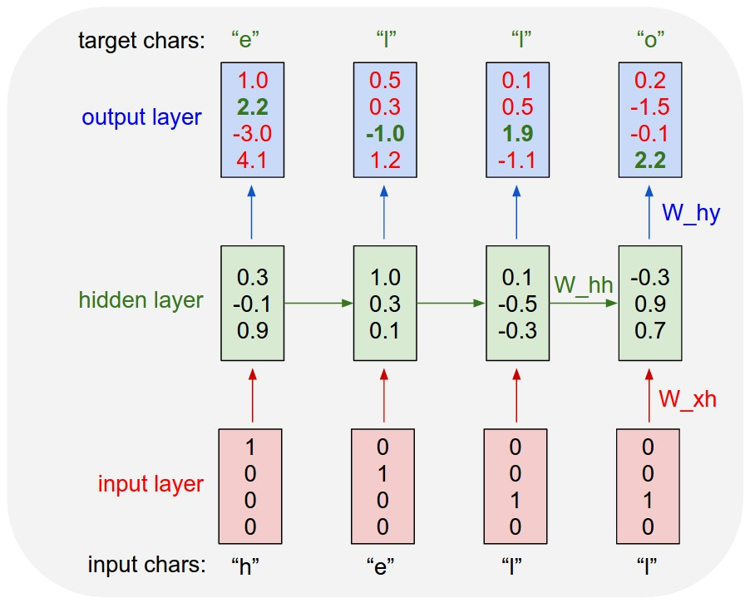
Example: Character-level
Language Model
Vocabulary:
[h,e,l,o]
Example training
sequence:
“hello”
Slide Credit: Fei-Fei Li, Justin Johnson, Serena Yeung, CS 231n

Slide 41
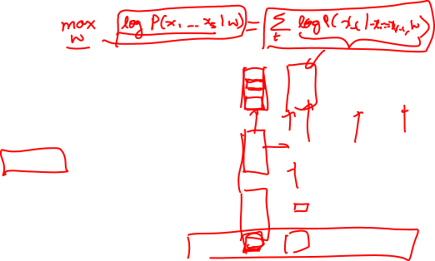
Example: Character-level
Language Model
Vocabulary:
[h,e,l,o]
Example training
sequence:
“hello”
Slide Credit: Fei-Fei Li, Justin Johnson, Serena Yeung, CS 231n

Slide 42
PixelRNN [van der Oord et al. 2016]
Generate image pixels starting from corner
Dependency on previous pixels modeled using an RNN (LSTM)
Slide Credit: Fei-Fei Li, Justin Johnson, Serena Yeung, CS 231n

Slide 43
PixelRNN [van der Oord et al. 2016]
Generate image pixels starting from corner
Dependency on previous pixels modeled using an RNN (LSTM)
Slide Credit: Fei-Fei Li, Justin Johnson, Serena Yeung, CS 231n

Slide 44
PixelRNN [van der Oord et al. 2016]
Generate image pixels starting from corner
Dependency on previous pixels modeled using an RNN (LSTM)
Slide Credit: Fei-Fei Li, Justin Johnson, Serena Yeung, CS 231n

Slide 45
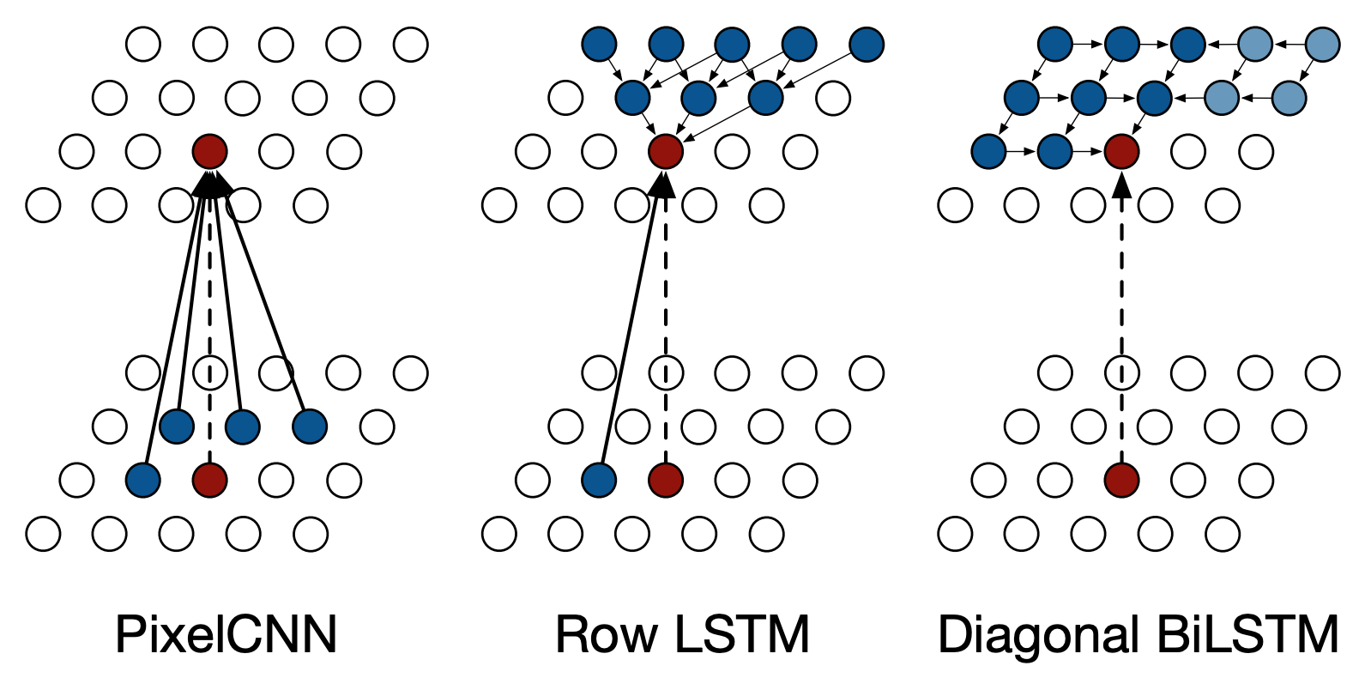
PixelRNN [van der Oord et al. 2016]
Slide Credit: Fei-Fei Li, Justin Johnson, Serena Yeung, CS 231n

Slide 46
Test Time: Sample / Argmax / Beam Search
Example: Character-level
Language Model
Sampling
Vocabulary:
[h,e,l,o]
At test-time sample characters one at a time, feed back to model
“e”
“l”
“l”
“o”
Sample
.03
.13
.00
.84
.25
.20
.05
.50
.11
.17
.68
.03
.11
.02.08
.79
Softmax
Slide Credit: Fei-Fei Li, Justin Johnson, Serena Yeung, CS 231n

Slide 47
Test Time: Sample / Argmax / Beam Search
Example: Character-level
Language Model
Sampling
Vocabulary:
[h,e,l,o]
At test-time sample characters one at a time, feed back to model
“e”
“l”
“l”
“o”
Sample
.03
.13
.00
.84
.25
.20
.05
.50
.11
.17
.68
.03
.11
.02.08
.79
Softmax
Slide Credit: Fei-Fei Li, Justin Johnson, Serena Yeung, CS 231n

Slide 48
Test Time: Sample / Argmax / Beam Search
Example: Character-level
Language Model
Sampling
Vocabulary:
[h,e,l,o]
At test-time sample characters one at a time, feed back to model
“e”
“l”
“l”
“o”
Sample
.03
.13
.00
.84
.25
.20
.05
.50
.11
.17
.68
.03
.11
.02.08
.79
Softmax
Slide Credit: Fei-Fei Li, Justin Johnson, Serena Yeung, CS 231n

Slide 49
Test Time: Sample / Argmax / Beam Search
Example: Character-level
Language Model
Sampling
Vocabulary:
[h,e,l,o]
At test-time sample characters one at a time, feed back to model
“e”
“l”
“l”
“o”
Sample
.03
.13
.00
.84
.25
.20
.05
.50
.11
.17
.68
.03
.11
.02.08
.79
Softmax
Slide Credit: Fei-Fei Li, Justin Johnson, Serena Yeung, CS 231n

Slide 50
PixelRNN [van der Oord et al. 2016]
Generate image pixels starting from corner
Dependency on previous pixels modeled using an RNN (LSTM)
Drawback: sequential generation is slow!
Slide Credit: Fei-Fei Li, Justin Johnson, Serena Yeung, CS 231n

Slide 51
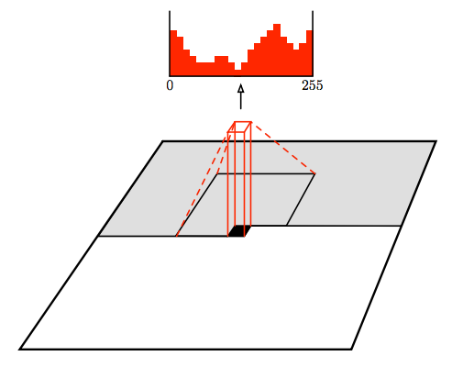
PixelCNN [van der Oord et al. 2016]
Still generate image pixels starting from corner
Dependency on previous pixels now modeled using a CNN over context region
Figure copyright van der Oord et al., 2016. Reproduced with permission.
Slide Credit: Fei-Fei Li, Justin Johnson, Serena Yeung, CS 231n
Notes:
Improves in efficiency over pixelrnn

Slide 53
Masked Convolutions
Apply masks so that a pixel does not see
“future” pixels

Slide 54
PixelCNN [van der Oord et al. 2016]
Still generate image pixels starting from corner
Dependency on previous pixels now modeled using a CNN over context region
Training: maximize likelihood of training images
Softmax loss at each pixel
Figure copyright van der Oord et al., 2016. Reproduced with permission.
Slide Credit: Fei-Fei Li, Justin Johnson, Serena Yeung, CS 231n

Slide 55
PixelCNN [van der Oord et al. 2016]
Still generate image pixels starting from corner
Dependency on previous pixels now modeled using a CNN over context region
Training: maximize likelihood of training images
Softmax loss at each pixel
Training is faster than PixelRNN
(can parallelize convolutions since context region values known from training images)
Generation must still proceed sequentially
=> still slow
Figure copyright van der Oord et al., 2016. Reproduced with permission.
Slide Credit: Fei-Fei Li, Justin Johnson, Serena Yeung, CS 231n

Slide 56
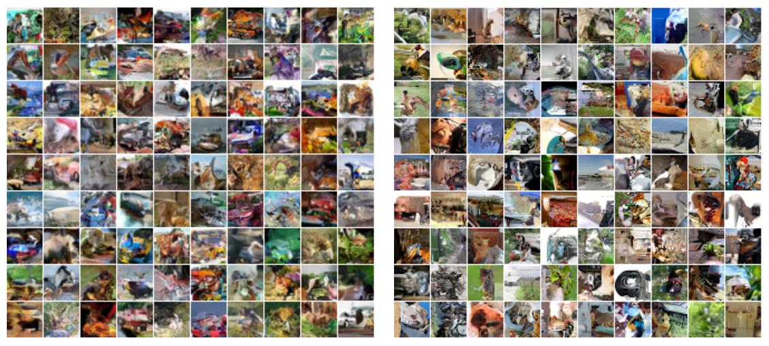
Generation Samples (PixelRNN)
Figures copyright Aaron van der Oord et al., 2016. Reproduced with permission.
32x32 CIFAR-10
32x32 ImageNet
Slide Credit: Fei-Fei Li, Justin Johnson, Serena Yeung, CS 231n
Notes:
Samples generated from Diagonal BiLSTM version of PixelRNN (the one covered in these slides)

Slide 57
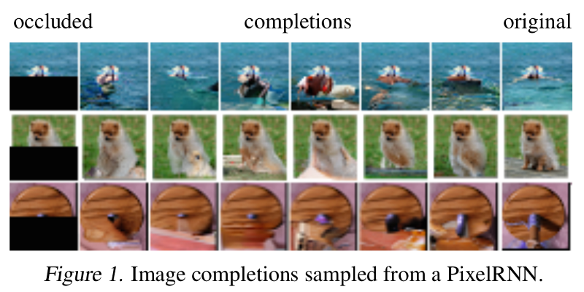
Image Completion

Slide 58
Results from generating sounds
https://deepmind.com/blog/wavenet-generative-model-raw-audio/

Slide 59
PixelRNN and PixelCNN
Improving PixelCNN performance
Gated convolutional layers
Short-cut connections
Discretized logistic loss
Multi-scale
Training tricks
Etc…
See
Van der Oord et al. NIPS 2016
Salimans et al. 2017 (PixelCNN++)
Pros:
Can explicitly compute likelihood p(x)
Explicit likelihood of training data gives good evaluation metric
Good samples
Con:
Sequential generation => slow
Slide Credit: Fei-Fei Li, Justin Johnson, Serena Yeung, CS 231n
Notes:
When is it not computationally tractable?

Slide 60
Conclusion
Unsupervised Learning
  Comparison to Supervised and Reinforcement Learning
  Review of K-Means
e.g., Generative Models
  Varieties
  PixelRNN and PixelCNN
Slide Credit: Fei-Fei Li, Justin Johnson, Serena Yeung, CS 231n
Notes:
Unsupervised learning problem
Generative models, type of unsupervised learning
3 types of generative models
PixelRNN and PixelCNN, type of fully visible belief networks

Slide 61
The End

