Slide 1

CS 4803 / 7643: Deep Learning
Lecture 6: Training Neural Networks Part I
Topics:
Activation functions
Initialization
Dropout
Batch Norm
Babysitting learning
Hyper-parameter search
Peter Anderson
Georgia Tech
www.panderson.me

Slide 2
Administrative
No class next week
09/11, 09/13

Slide 3



Where we are now...
Computational graphs
x
*
s (scores)
hinge loss
+
L
W
R
Slide Credit: Fei-Fei Li, Justin Johnson, Serena Yeung, CS 231n
Notes:
Talked about how to express any function in terms of a computational graph
Help us use backprop to obtain analytic gradient for complex functions

Slide 4



Where we are now...
Neural Networks
Linear score function:
2-layer Neural Network
x
h
W1
W2
s
3072
100
10
Slide Credit: Fei-Fei Li, Justin Johnson, Serena Yeung, CS 231n
Notes:
Talked more explicitly about neural networks, type of graph where have linear layers stacked with nonlinearities in between

Slide 5
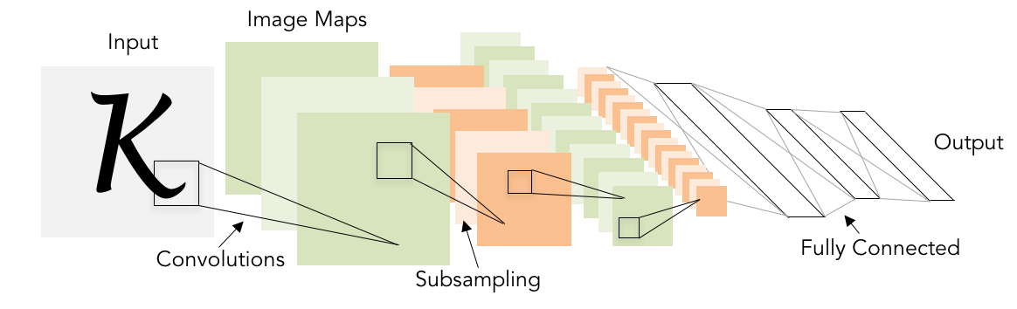
Not yet introduced...
Convolutional Neural Networks
Illustration of LeCun et al. 1998 from CS231n 2017 Lecture 1
Slide Credit: Fei-Fei Li, Justin Johnson, Serena Yeung, CS 231n
Notes:
Talked last lecture about CNNs, particular type of network using convolutional layers that preserve spatial structure throughout hierarchy of network
Illustration of LeCun et al. 1998 from CS231n 2017 Lecture 1

Slide 6

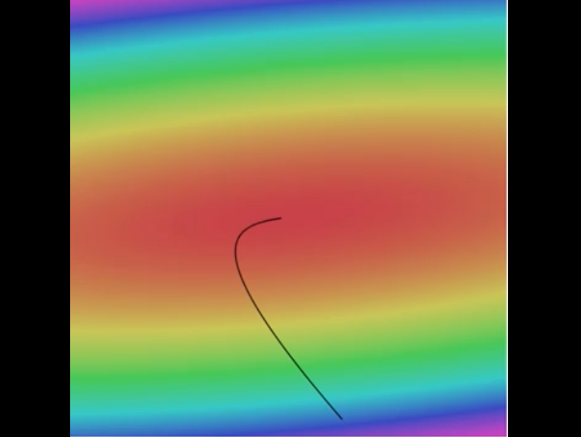

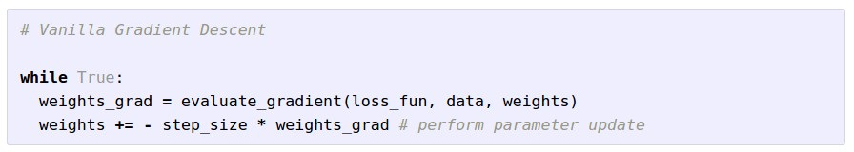
Where we are now...
Learning network parameters through optimization
Landscape image is CC0 1.0 public domain
Walking man image is CC0 1.0 public domain
Slide Credit: Fei-Fei Li, Justin Johnson, Serena Yeung, CS 231n
Notes:
Given these NNs and CNNs which we can express as computational graphs, and backprop technique for computing gradient, saw that we can learn network parameters by using optimization which we talked about earlier
Want to get to point in loss landscape that produces low loss, by taking steps in direction of neg. gradient

Slide 7
Where we are now...
Mini-batch SGD
Loop:
Sample a batch of data
Forward prop it through the graph (network), get loss
Backprop to calculate the gradients
Update the parameters using the gradient
Slide Credit: Fei-Fei Li, Justin Johnson, Serena Yeung, CS 231n
Notes:
The whole process we call mini-batch stochastic gradient descent
Steps are ...

Slide 8
Next: Training Neural Networks
Notes:
For next couple lectures, talk about details involved in training NNs

Slide 9
Overview
One time setup
activation functions, preprocessing, weight initialization, regularization, gradient checking
Training dynamics
babysitting the learning process,
parameter updates, hyperparameter optimization
Evaluation
model ensembles
Slide Credit: Fei-Fei Li, Justin Johnson, Serena Yeung, CS 231n
Notes:
How to set up NN at beginning
Training dynamics
evaluation

Slide 10
Part 1
Activation Functions
Data Preprocessing
Weight Initialization
Batch Normalization
Babysitting the Learning Process
Hyperparameter Optimization
Slide Credit: Fei-Fei Li, Justin Johnson, Serena Yeung, CS 231n
Notes:
Today in first part

Slide 11
Activation Functions

Slide 12
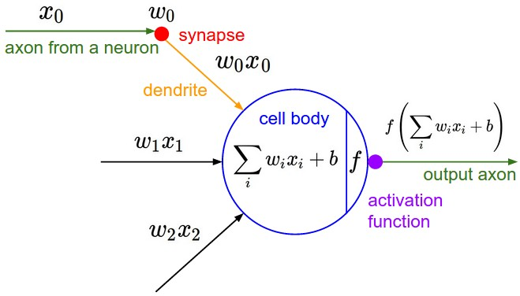
Activation Functions
Slide Credit: Fei-Fei Li, Justin Johnson, Serena Yeung, CS 231n
Notes:
Saw that at any particular layer have data coming in, multiply by weights in FC or conv layer, then pass through an activation function, or nonlinearity

Slide 13
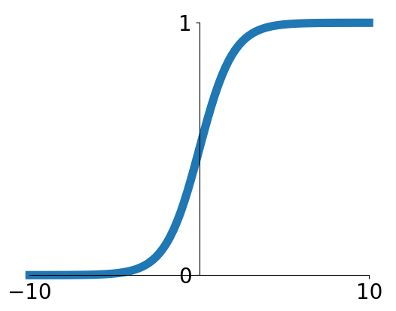
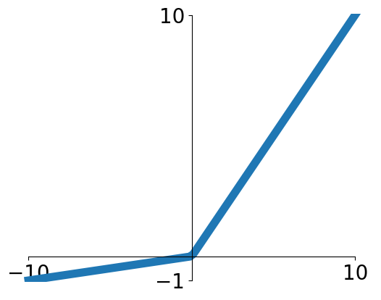


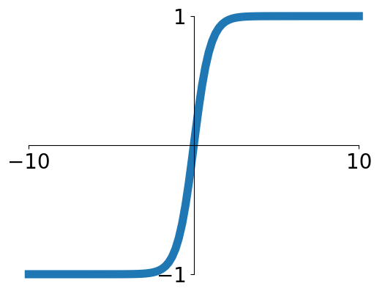


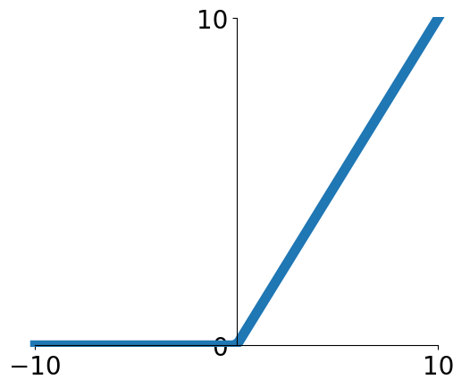
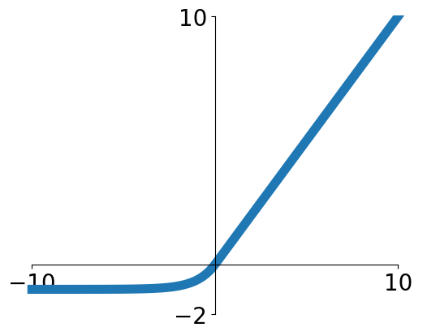

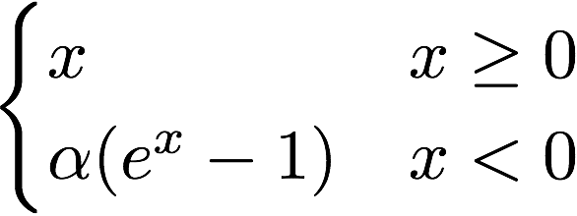
Activation Functions
Sigmoid
Leaky ReLU
tanh
Maxout
ReLU
ELU
Slide Credit: Fei-Fei Li, Justin Johnson, Serena Yeung, CS 231n
Notes:
Saw examples of nonlinearities, or activation functions
Sigmoid, relu, …
Today talk about different choices for activation functions and trade-offs between them

Slide 14

Activation Functions
Squashes numbers to range [0,1]
Historically popular since they have nice interpretation as a saturating “firing rate” of a neuron
Sigmoid
Slide Credit: Fei-Fei Li, Justin Johnson, Serena Yeung, CS 231n
Notes:
Sigmoid -- seen before, most comfortable with
Function is
Takes input, elementwise squashes
If high positive functions, near 1
Negative, near 0
Near 0 have Linear regime
Historically popular since have nice interpretation
Talk later about other nonlinearities like relu that in practice turn out to be more biologically plausible. But this does have an interpretation you could make

Slide 15
Activation Functions
Squashes numbers to range [0,1]
Historically popular since they have nice interpretation as a saturating “firing rate” of a neuron
3 problems:
Saturated neurons “kill” the gradients
Sigmoid
Slide Credit: Fei-Fei Li, Justin Johnson, Serena Yeung, CS 231n
Notes:
Look at more carefully, several problems
Saturated neurons can kill of gradient. What exactly does this mean

Slide 16
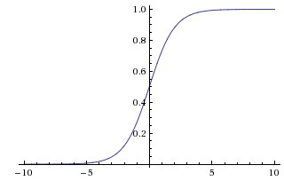

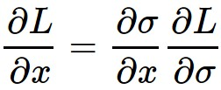

sigmoid
gate
x
What happens when x = -10?
What happens when x = 0?
What happens when x = 10?
Slide Credit: Fei-Fei Li, Justin Johnson, Serena Yeung, CS 231n
Notes:
If we look at a sigmoid gate, a node. Input x, sigmoid output.
What does the gradient flow look like coming back. Upstream coming back, multiply, chain, ...
Look at local gradient
Very negative region, gradient is 0, chain any upstream gradient coming down, multiply by something near 0
After chain rule, very small gradient is passed back, kills gradient flow
Ds / dx very small (0) in saturating regimes (x=-10, x=0), where x is very positive or negative

Slide 17
Activation Functions
Squashes numbers to range [0,1]
Historically popular since they have nice interpretation as a saturating “firing rate” of a neuron
3 problems:
Saturated neurons “kill” the gradients
Sigmoid outputs are not zero-centered
Sigmoid
Slide Credit: Fei-Fei Li, Justin Johnson, Serena Yeung, CS 231n
Notes:
2nd problem.
Consider why this a problem.

Slide 18
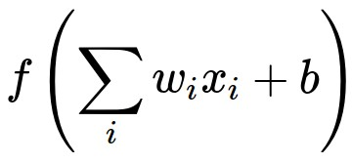
Consider what happens when the input to a neuron (x)
is always positive:
What can we say about the gradients on w?
Slide Credit: Fei-Fei Li, Justin Johnson, Serena Yeung, CS 231n
Notes:
Consider what happens...
Xs positive, multiplied by weights w, pass through activation
What can we say about gradients on w

Slide 19
Consider what happens when the input to a neuron is always positive...
allowed gradient update directions
zig zag path
allowed gradient update directions
hypothetical optimal w vector
What can we say about the gradients on w?
Always all positive or all negative :(
(this is also why you want zero-mean data!)
Slide Credit: Fei-Fei Li, Justin Johnson, Serena Yeung, CS 231n
Notes:
All positive or all negative.
Upstream gradient dL/df is pos or neg, arbitrary gradient
Local gradient for gradients on W is df/dw = x
If x is always positive, gradients on w will be the sign of the upstream gradient
Gradients on W since either all pos or neg, will always move in the same direction.
**When doing parameter update will either increase all elements of W by positive amounts, or all negative amounts
Inefficient gradient updates. E.g. example with 2d w. Only 2 directions (quadrants) in which you’re allowed to take gradient update
In case where hypothetical optimal w is the blue vector, we’re starting off at a point beginning of red, can’t directly take an update in this direction
Have to take a sequence of gradient updates
Why also we want zero-mean data (x) to have positive and negative values
Why bad?
For a given input pattern, weights can only increase or decrease all at once in an update

Slide 20
Activation Functions
Squashes numbers to range [0,1]
Historically popular since they have nice interpretation as a saturating “firing rate” of a neuron
3 problems:
Saturated neurons “kill” the gradients
Sigmoid outputs are not zero-centered
exp() is a bit compute expensive
Sigmoid
Slide Credit: Fei-Fei Li, Justin Johnson, Serena Yeung, CS 231n
Notes:
Talked about 2 main problems
Saturated gradients can kill gradient if too positive or negative
Not zero-centered, inefficient gradient update
Third problem have exponential funciton. A little computational expensive, but in big picture not main problem. Have convolutions and dot products.
Exp expensive, but convolutions, dot products main computational bottleneck

Slide 21
Activation Functions
Squashes numbers to range [-1,1]
zero centered (nice)
still kills gradients when saturated :(
tanh(x)
[LeCun et al., 1991]
Slide Credit: Fei-Fei Li, Justin Johnson, Serena Yeung, CS 231n
Notes:
2nd activation function, tanh.
Looks similar, but now squashed to…
Now zero centered, avoids 2nd problem
Still kills gradients

Slide 22
Activation Functions
Computes f(x) = max(0,x)
Does not saturate (in +region)
Very computationally efficient
Converges much faster than sigmoid/tanh in practice (e.g. 6x)
Actually more biologically plausible than sigmoid
ReLU
(Rectified Linear Unit)
[Krizhevsky et al., 2012]
Slide Credit: Fei-Fei Li, Justin Johnson, Serena Yeung, CS 231n
Notes:
Now relu, saw in last lecture
If positive, passed through
If look at previous problems of sigmoid, does not saturate for half region.
Very computationally efficient. Relu simple max (no exponential)
In practice converges much faster
Actually turns out to be more biologically plausible if look at what inputs look like and what outputs look like in neuroscience experiments, this is closer approximation
Started to be used a lot starting 2012 with alexnet

Slide 23
Activation Functions
Computes f(x) = max(0,x)
Does not saturate (in +region)
Very computationally efficient
Converges much faster than sigmoid/tanh in practice (e.g. 6x)
Actually more biologically plausible than sigmoid
Not zero-centered output
ReLU
(Rectified Linear Unit)
Slide Credit: Fei-Fei Li, Justin Johnson, Serena Yeung, CS 231n
Notes:
Problem not zero-centered anymore. Tanh had fixed, now have again.
No saturation in positive half, but problem in negative half
When x < 0, no gradient flow

Slide 24
Activation Functions
Computes f(x) = max(0,x)
Does not saturate (in +region)
Very computationally efficient
Converges much faster than sigmoid/tanh in practice (e.g. 6x)
Actually more biologically plausible than sigmoid
Not zero-centered output
An annoyance:
hint: what is the gradient when x < 0?
ReLU
(Rectified Linear Unit)
Slide Credit: Fei-Fei Li, Justin Johnson, Serena Yeung, CS 231n
Notes:
Problem not zero-centered anymore. Tanh had fixed, now have again.
No saturation in positive half, but problem in negative half
When x < 0, no gradient flow

Slide 25

ReLU
gate
x
What happens when x = -10?
What happens when x = 0?
What happens when x = 10?
Slide Credit: Fei-Fei Li, Justin Johnson, Serena Yeung, CS 231n
Notes:
Thinking a little more precisely
-10, then 10
At 0 is undefined, in practice define gradient at kink to be 0
Killing gradient in half the regime
Define gradient at kink to be 0

Slide 26
DATA CLOUD
active ReLU
dead ReLU
will never activate
=> never update
Slide Credit: Fei-Fei Li, Justin Johnson, Serena Yeung, CS 231n
Notes:
Get a phenomenon of dead relus when in bad part of regime
When look at data cloud, look at where relus can fall.
Each of these is plane that defines relus, where it activates. Can fall off data cloud where never activates.
Separating hyperplane
Can look at this as coming from several potential reasons
Can be from bad initialization (weights that happen to be off the data cloud). Never get a data input that causes it to activate, never good gradient flow coming back.
More commonly happens when your learning rate is too high (making big updates), the w jumps, gets knocked off the data manifold
In practice, if freeze trained network and pass data through, as much as 10-20% of network is dead relus.
Problem, but in practice most networks do have these problems, and is research problem but still doing ok for training networks.

Slide 27
DATA CLOUD
active ReLU
=> people like to initialize ReLU neurons with slightly positive biases (e.g. 0.01)
dead ReLU
will never activate
=> never update
Slide Credit: Fei-Fei Li, Justin Johnson, Serena Yeung, CS 231n
Notes:
People like to initialize ReLu neurons with slightly positive biases to increase likelihood of being active at initialization and get updates (as opposed to never getting an update)
Biases towards more relus firing at beginning
Some say it helps, some say it doesn’t
Generally people don’t always use this, initialize with 0 biases still

Slide 28

Activation Functions
[Mass et al., 2013]
[He et al., 2015]
Does not saturate
Computationally efficient
Converges much faster than sigmoid/tanh in practice! (e.g. 6x)
will not “die”.
Leaky ReLU
Slide Credit: Fei-Fei Li, Justin Johnson, Serena Yeung, CS 231n
Notes:
Look at some modifications of relus that have come out since then
Leaky relu. Instead of being flat in negative regime, have slight negative slow
Does not have problem of saturating neuron killing gradient flow

Slide 29

Activation Functions
[Mass et al., 2013]
[He et al., 2015]
Does not saturate
Computationally efficient
Converges much faster than sigmoid/tanh in practice! (e.g. 6x)
will not “die”.
Parametric Rectifier (PReLU)
Leaky ReLU
backprop into \alpha
(parameter)
Slide Credit: Fei-Fei Li, Justin Johnson, Serena Yeung, CS 231n
Notes:
Like leaky relu with sloped region in negative regime, but slope in negative regime now learned. More flexibility
Learn alpha

Slide 30

Activation Functions
[Clevert et al., 2015]
Exponential Linear Units (ELU)
All benefits of ReLU
Closer to zero mean outputs
Negative saturation regime compared with Leaky ReLU adds some robustness to noise
Computation requires exp()
Slide Credit: Fei-Fei Li, Justin Johnson, Serena Yeung, CS 231n
Notes:
Still closer to zero mean outputs
But saturation in negative regime means that only “activated” units have variation, and “deactivated” units have all the same value. More robust to noise, since focuses modeling on positive regime, and we care much more about degree of activation, presence of features, rather than absence of them in negative regime
Models non-informative deactivation state
Saturation means a small derivative which decreases the variation and the information that is propagated to the next layer
Noise-robust deactivation state
In between ReLU (closer to zero mean outputs in comparison) and Leaky ReLU
The saturation decreases the variation of the units if deactivated, so the precise deactivation argument is less relevant. Such an activation function can code the degree of presence of particular phenomena in the input, but does not quantitatively model the degree of their absence. Therefore, such an activation function is more robust to noise.
Consequently, dependencies between coding units are much easier to model and much easier to interpret since only activated code units carry much information.
Alpha a hyperparameter

Slide 31

Maxout “Neuron”
Does not have the basic form of dot product -> nonlinearity
Generalizes ReLU and Leaky ReLU
Linear Regime! Does not saturate! Does not die!
[Goodfellow et al., 2013]
Problem: doubles the number of parameters/neuron :(
Slide Credit: Fei-Fei Li, Justin Johnson, Serena Yeung, CS 231n
Notes:
Looks a little difference, doesn’t have same form of dot product with nonlinearity over it
Wx + b, then second set of weights w2 x + b
Max of these 2 functions, generalizes relu and leaky relu
Gives us: linear regime, doesn’t saturate, doesn’t die

Slide 32
TLDR: In practice:
Use ReLU. Be careful with your learning rates
Try out Leaky ReLU / Maxout / ELU
Try out tanh but don’t expect much
Don’t use sigmoid
Slide Credit: Fei-Fei Li, Justin Johnson, Serena Yeung, CS 231n
Notes:
Good general rule of thumb is to use relu. Most standard one that generally works well.

Slide 33
Data Preprocessing
Slide Credit: Fei-Fei Li, Justin Johnson, Serena Yeung, CS 231n
Notes:
Talked about activation function, part of designing network
Now want to train network.
Generally always want to preprocess data

Slide 34
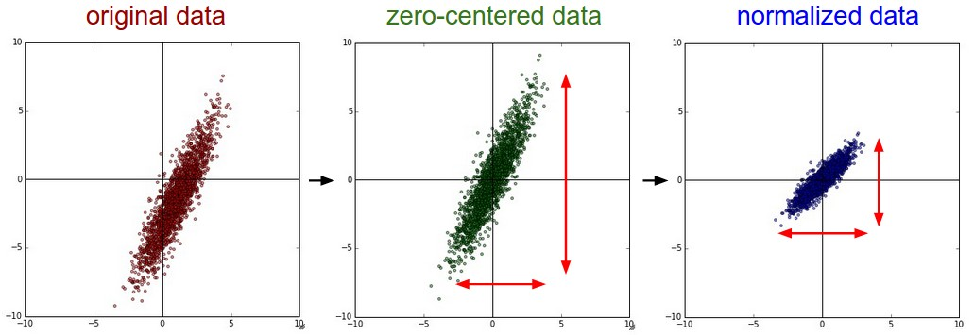


Step 1: Preprocess the data
(Assume X [NxD] is data matrix, each example in a row)
Slide Credit: Fei-Fei Li, Justin Johnson, Serena Yeung, CS 231n
Notes:
Typical preprocessing in ML is zero-mean, normalize to unit variance
Why do we want to do this

Slide 35
Remember: Consider what happens when the input to a neuron is always positive...
allowed gradient update directions
zig zag path
allowed gradient update directions
hypothetical optimal w vector
What can we say about the gradients on w?
Always all positive or all negative :(
(this is also why you want zero-mean data!)
Slide Credit: Fei-Fei Li, Justin Johnson, Serena Yeung, CS 231n
Notes:
For zero-centering, talked about when all inputs are positives, gradients on weights all positive, get suboptimal optimization
In general, even if not all pos or all negative, any sort of bias still causes problems, inefficient optimization
If data is shifted, all positive or with a bias, then gradients are also shifted
If all positive or negative gradients, inefficient optimization

Slide 36
Step 1: Preprocess the data
(Assume X [NxD] is data matrix, each example in a row)
Slide Credit: Fei-Fei Li, Justin Johnson, Serena Yeung, CS 231n
Notes:
Normalize the data typically in ML problems so all features are in the same range and contribute equally
In practice for images, zero-centering is common but don’t need to normalize since pixel values at each location typically already have relatively comparable distribution
Compared to other ML features
(also want to learn weights of same scale, e.g. L2 regularization assumes this)

Slide 37
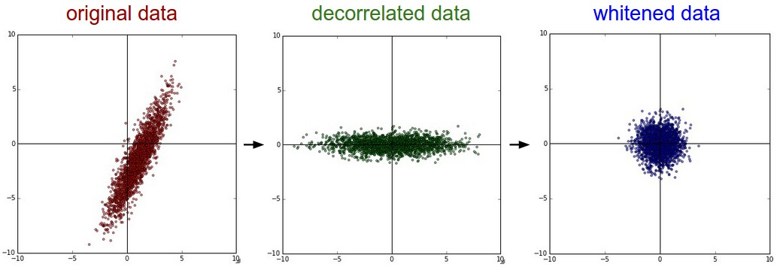
Step 1: Preprocess the data
In practice, you may also see PCA and Whitening of the data
(data has diagonal covariance matrix)
(covariance matrix is the identity matrix)
Slide Credit: Fei-Fei Li, Justin Johnson, Serena Yeung, CS 231n
Notes:
In ML, sometimes people also do PCA to decorrelate the data or whiten
Not common with images, don’t really want to project onto lower dimensional space, typically just want to apply convnets spatially over the original image
Compress correlated dimensions into lower dimension

Slide 38
TLDR: In practice for Images: center only
e.g. consider CIFAR-10 example with [32,32,3] images
Subtract the mean image (e.g. AlexNet)
(mean image = [32,32,3] array)
Subtract per-channel mean (e.g. VGGNet)
(mean along each channel = 3 numbers)
Not common to normalize variance, to do PCA or whitening
Slide Credit: Fei-Fei Li, Justin Johnson, Serena Yeung, CS 231n
Notes:
To summarize, for images, often just zero-mean the images
Subtract mean image
Or even simpler, subtract per-channel mean (similar across all pixels in practice, found unnecessary)

Slide 39
Weight Initialization

Slide 40
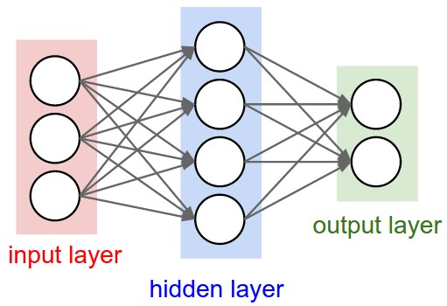
Q: what happens when W=constant init is used?
Slide Credit: Fei-Fei Li, Justin Johnson, Serena Yeung, CS 231n
Notes:
Have weights that we want to learn
Need to initialize them with some values, and then perform gradient updates from there
Question: what happens...
All neurons will output the same thing, go through same operations, get same gradient.
All update in the same way, get all neurons the same. But want neurons to learn different things No symmetry breaking
Connected at end to different classes? ...

Slide 41
First idea: Small random numbers
(gaussian with zero mean and 1e-2 standard deviation)
Slide Credit: Fei-Fei Li, Justin Johnson, Serena Yeung, CS 231n
Notes:
First idea to try to improve upon this

Slide 42
First idea: Small random numbers
(gaussian with zero mean and 1e-2 standard deviation)
Works ~okay for small networks, but problems with deeper networks.
Slide Credit: Fei-Fei Li, Justin Johnson, Serena Yeung, CS 231n
Notes:
Does work ok for small networks, but problems with deeper networks

Slide 43
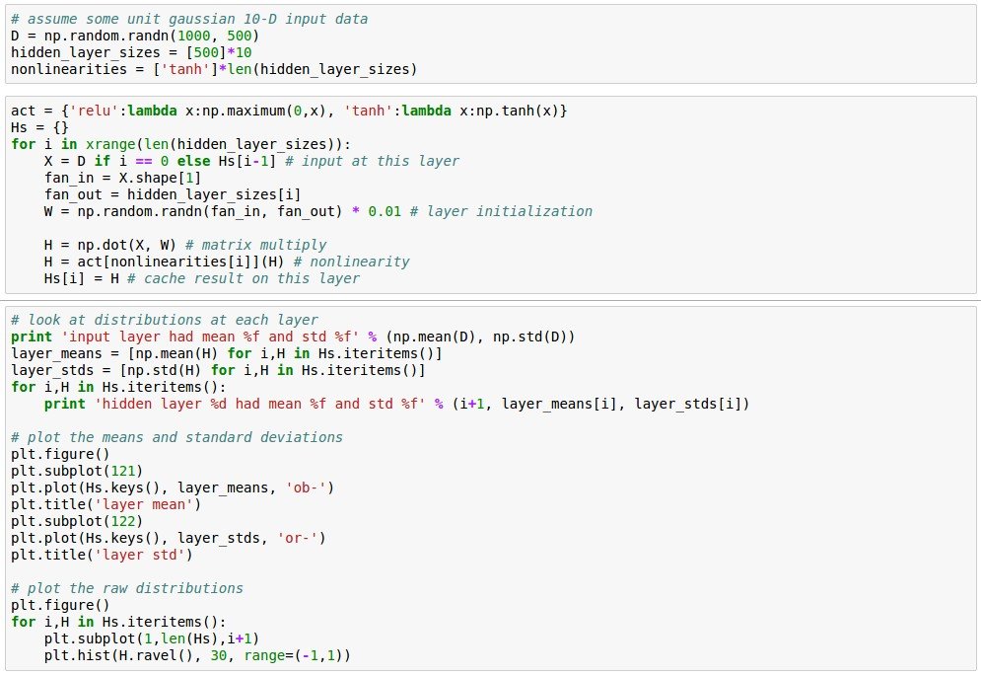
Lets look at some activation statistics
E.g. 10-layer net with 500 neurons on each layer, using tanh non-linearities, and initializing as described in last slide.
Slide Credit: Fei-Fei Li, Justin Johnson, Serena Yeung, CS 231n
Notes:
Look at why this is the case
Experiment where take a deeper network, 10 layer net w/ 500 neurons on each layer, initialize with small random numbers
Pass data through network, at each layer look at statistics of activations at that layer
Initialize random data
Initialize deep network, 10 layers with 500 neurons on each layer and tanh nonlinearity
Pass data through network, store hidden layer activations, look at their distributions

Slide 44
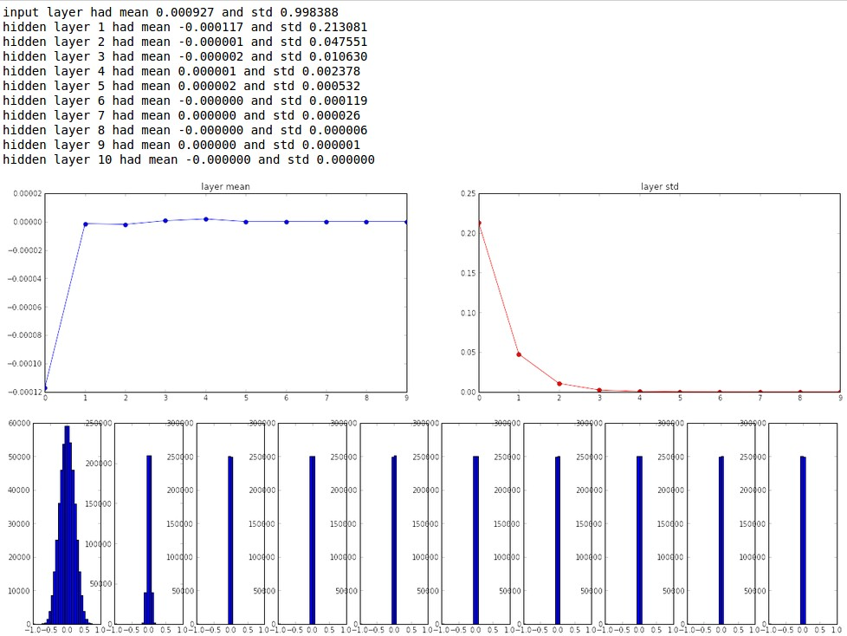
Slide Credit: Fei-Fei Li, Justin Johnson, Serena Yeung, CS 231n
Notes:
Mean stays ~ 0, std deviation collapses to 0 (keep multiplying by our W, gaussian with zeo mean and 1e-2 standard deviation)
At first layer still have reasonable looking gaussian

Slide 45
All activations become zero!
Q: think about the backward pass. What do the gradients look like?
Hint: think about backward pass for a W*X gate.
Slide Credit: Fei-Fei Li, Justin Johnson, Serena Yeung, CS 231n
Notes:
Activations become zero
Now think about backward pass, what do gradients look like?
Input values X small at each layer. dL / dW = dL * X is small. Weights not updating
Also, as chain backwards, gradient flowing back into each layer is gradient on inputs (dL * W) * W, etc. has same phenomenon as going forward, collapsing to zero
Magnitude of gradient goes down

Slide 46
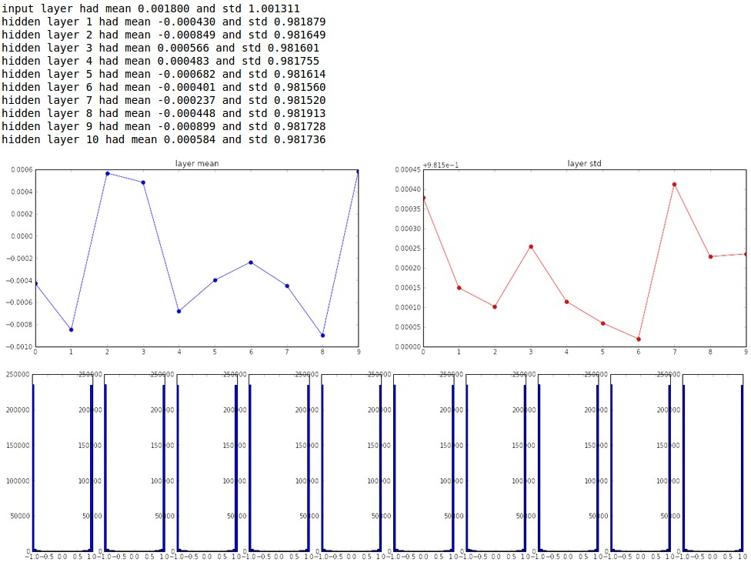
Almost all neurons completely saturated, either -1 and 1. Gradients will be all zero.
*1.0 instead of *0.01
Slide Credit: Fei-Fei Li, Justin Johnson, Serena Yeung, CS 231n
Notes:
What if we try to solve problem by making weights big
Now try different value, 1 instead of 0.01
Go to the other extreme, all neurons are saturated, either -1 or 1
Because weights are large
Gradients will be all zero

Slide 47
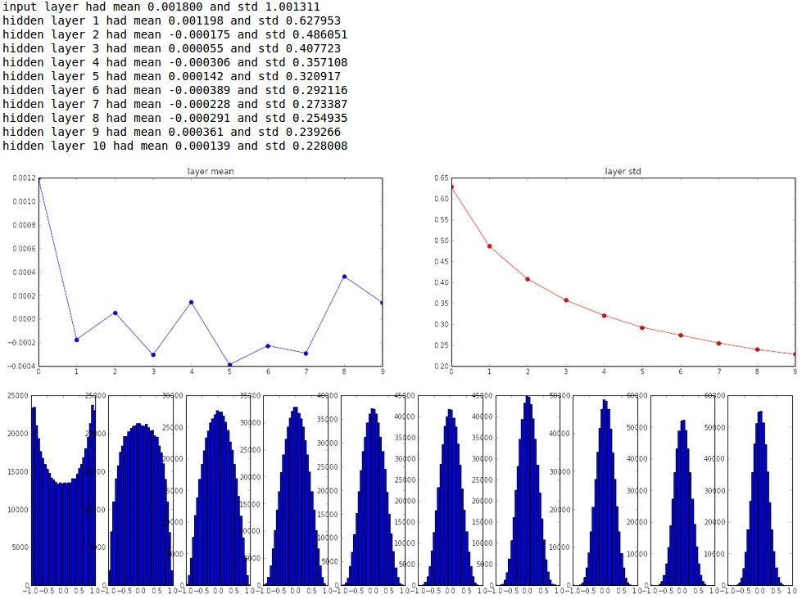
“Xavier initialization”
[Glorot et al., 2010]
Reasonable initialization.
(Mathematical derivation assumes linear activations)
Slide Credit: Fei-Fei Li, Justin Johnson, Serena Yeung, CS 231n
Notes:
Hard to get weight initialization right. When too small, they all collapse, when too large, they saturate.
Work in trying to figure out proper way to initialize weights.
One good rule of thumb is xavier initialization.
Sample from distribution, then scale by sqrt number of inputs
Fan-in # of inputs, fan-out # of outputs
If want variance of input same as variance of output (see notes for derivation), get formula
If small number of inputs, need larger weights to get the same larger variance at output
If many inputs, want smaller weights to get the same spread
If have unit gaussian data as input, and want neuron to have variance of one, initialize this way.
Assumes linear activations, e.g. in active region of tanhs

Slide 48
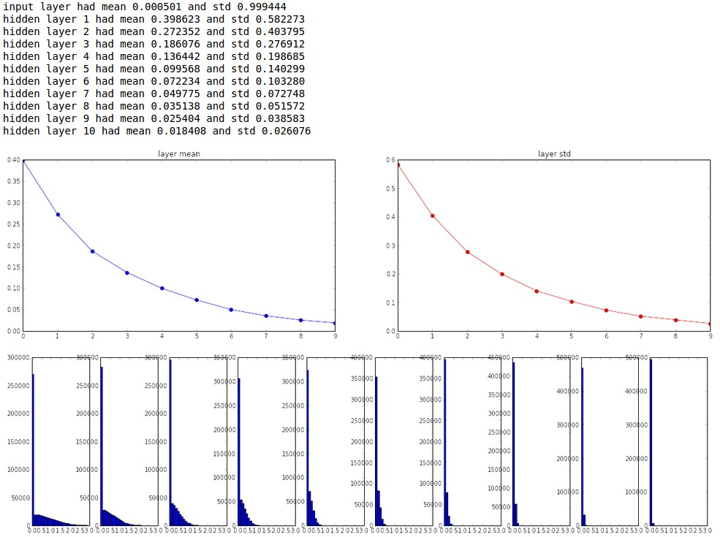
but when using the ReLU nonlinearity it breaks.
Slide Credit: Fei-Fei Li, Justin Johnson, Serena Yeung, CS 231n
Notes:
Problem is that breaks with ReLU
ReLU kills half the units, sets half to zero. So halves your variance.
If make same assumptions as derivations earlier, won’t get the right variance coming out
Distribution starts collapsing, more and more peaked towards zero, more and more units deactivated.

Slide 49
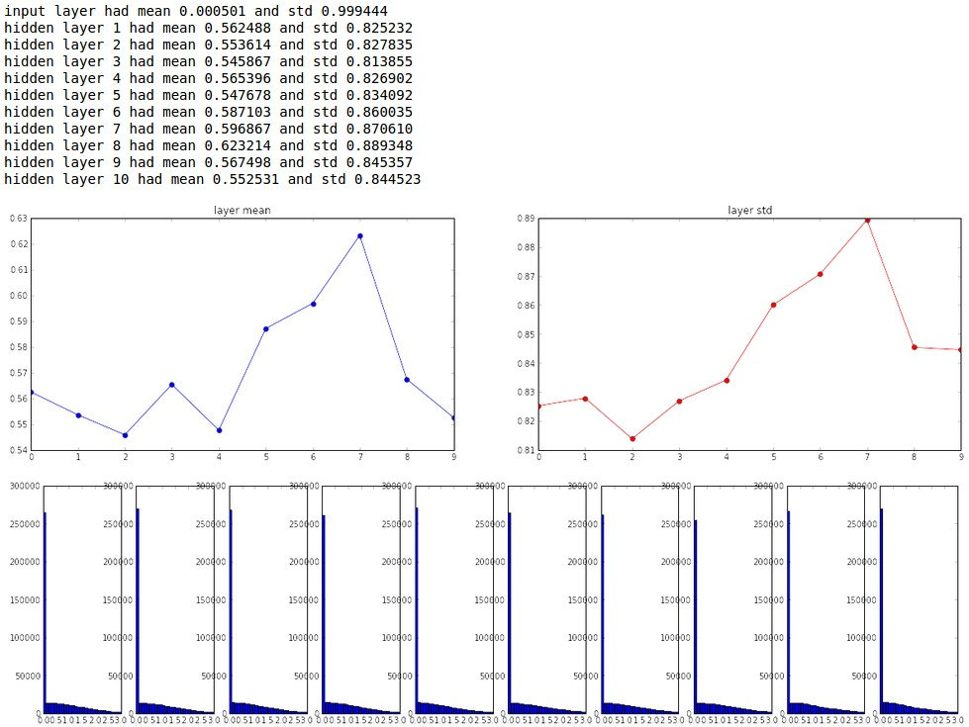
He et al., 2015
(note additional 2/)
Slide Credit: Fei-Fei Li, Justin Johnson, Serena Yeung, CS 231n
Notes:
Account for it with an extra /2, prevents the factor of 2 compounding together
Equivalent input has half # of inputs

Slide 50
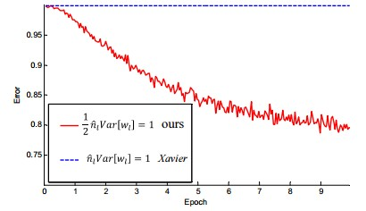
He et al., 2015
(note additional 2/)
Slide Credit: Fei-Fei Li, Justin Johnson, Serena Yeung, CS 231n
Notes:
Factor of 2 makes a big difference
Initialization important!
In practice these little things, paying attention to how weights are, make a big difference
Difference between network training at all vs nothing happening

Slide 51
Proper initialization is an active area of research…
Understanding the difficulty of training deep feedforward neural networks
by Glorot and Bengio, 2010
Exact solutions to the nonlinear dynamics of learning in deep linear neural networks by Saxe et al, 2013
Random walk initialization for training very deep feedforward networks by Sussillo and Abbott, 2014
Delving deep into rectifiers: Surpassing human-level performance on ImageNet classification by He et al., 2015
Data-dependent Initializations of Convolutional Neural Networks by Krähenbühl et al., 2015
All you need is a good init, Mishkin and Matas, 2015
…
Slide Credit: Fei-Fei Li, Justin Johnson, Serena Yeung, CS 231n
Notes:
Proper initialization still an active area of research
Good general rule of thumb: use xavier initialization to start with, think about other methods
Data-driven techniques

Slide 52
Batch Normalization
Notes:
Related idea to keep activations in the unit gaussian range we want

Slide 53

Batch Normalization
[Ioffe and Szegedy, 2015]
“you want zero-mean unit-variance activations? just make them so.”
consider a batch of activations at some layer. To make each dimension zero-mean unit-variance, apply:
this is a vanilla differentiable function...
Notes:
If want zero mean unit variance, can do it empirically.
Take mean of current batch and variance, and normalize by this
Weight initializations happen before training, start in good place and try to preserve
Now explicitly try to enforce this at every iteration of training
Just a differentiable function, sequence of computational operations that can do backprop through
Before, set weight at the start of training to get it into a good spot to have unit gaussians at every layer
Now, explicitly make that happen functionally as we train and make forward passes through the network

Slide 54
Batch Normalization
[Ioffe and Szegedy, 2015]
“you want zero-mean unit-variance activations? just make them so.”
1. compute the empirical mean and variance independently for each dimension.
X
N
2. Normalize
D
Slide Credit: Fei-Fei Li, Justin Johnson, Serena Yeung, CS 231n
Notes:
If N training examples, compute empirical mean and variance independently for each dimension
This is a differentiable function

Slide 55
Batch Normalization
[Ioffe and Szegedy, 2015]
FC
Usually inserted after Fully Connected or Convolutional layers, and before nonlinearity.
BN
tanh
FC
BN
tanh
...
Slide Credit: Fei-Fei Li, Justin Johnson, Serena Yeung, CS 231n
Notes:
Usually inserted after FC or conv layers, we saw that multiplying by W, which we did over and over again, can have bad scaling effect with each one, undoes this
Since scaling each activation, can apply the same way to either FC or conv. Difference with conv is that we’ll normalize not only across all training examples in the batch, but also spatial locations, since we want to obey the convolutional property. Want nearby locations normalized the same way. One mean and std for each activation map, across all batch examples, refer to paper.
Going to implement in next homework, all details explained clearly in paper.
Useful technique that will use a lot in practice.

Slide 56
Batch Normalization
[Ioffe and Szegedy, 2015]
FC
Usually inserted after Fully Connected or Convolutional layers, and before nonlinearity.
BN
tanh
FC
BN
Problem: do we necessarily want a zero-mean unit-variance input?
tanh
...
Slide Credit: Fei-Fei Li, Justin Johnson, Serena Yeung, CS 231n
Notes:
Not clear you necessarily want unit gaussian input to tanh layer
Would constrain to the linear regime of the nonlinearity
Trying to say not have any saturation, but maybe a little is good
Want to control how much saturation.

Slide 57



Batch Normalization
[Ioffe and Szegedy, 2015]
Normalize:
Note, the network can learn:
And then allow the network to squash
the range if it wants to:
to recover the identity mapping.
Slide Credit: Fei-Fei Li, Justin Johnson, Serena Yeung, CS 231n
Notes:
The way we address this when doing BN is have normalization operation, but then have additional squashing and scaling operation
Scale by gamma, shift by b
Can recover identity (gamma to be variance, b to be mean)
Have ability to achieve tanh more or less saturated, to learn to be effective in training?

Slide 58
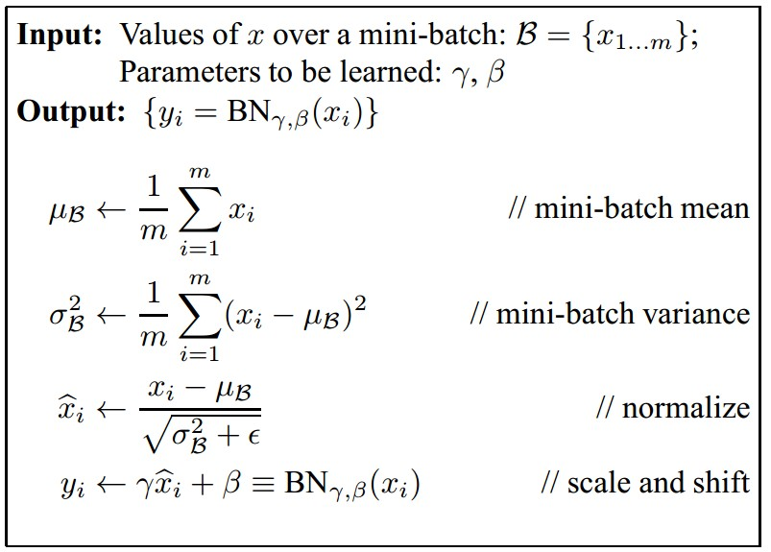
Batch Normalization
[Ioffe and Szegedy, 2015]
Improves gradient flow through the network
Allows higher learning rates
Reduces the strong dependence on initialization
Acts as a form of regularization in a funny way, and slightly reduces the need for dropout, maybe
Slide Credit: Fei-Fei Li, Justin Johnson, Serena Yeung, CS 231n
Notes:
steps
Improves gradient flow
More robust, works for more range of learning rate, different kinds of initalization
Regularization: Output of layer function of both x as well as other examples in batch happens to be sampled in.
no longer produces deterministic values for a given training example. Tying inputs in a batch together
Because no longer deterministic, jitters representation of x a bit, gives some sort of regularization effect

Slide 59
Batch Normalization
[Ioffe and Szegedy, 2015]
Note: at test time BatchNorm layer functions differently:
The mean/std are not computed based on the batch. Instead, a single fixed empirical mean of activations during training is used.
(e.g. can be estimated during training with running averages)
Slide Credit: Fei-Fei Li, Justin Johnson, Serena Yeung, CS 231n
Notes:
At test time, take mean and variance from training data, don’t re-compute.
Just estimate at training time e.g. using running averages, and then use at test time

Slide 60
Babysitting the Learning Process
Notes:
Have defined network architecture
Talk about how do we monitor training, and adjust hyperparameters as we go to get good learning results

Slide 61
Step 1: Preprocess the data
(Assume X [NxD] is data matrix, each example in a row)
Slide Credit: Fei-Fei Li, Justin Johnson, Serena Yeung, CS 231n
Notes:
First do preprocessing

Slide 62
Step 2: Choose the architecture:
say we start with one hidden layer of 50 neurons:
50 hidden neurons
output layer
10 output neurons, one per class
CIFAR-10 images, 3072 numbers
input layer
hidden layer
Slide Credit: Fei-Fei Li, Justin Johnson, Serena Yeung, CS 231n
Notes:
Then choose architecture
Here we have...

Slide 63
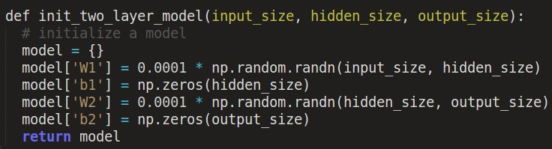

Double check that the loss is reasonable:
disable regularization
loss ~2.3.
“correct” for
10 classes
returns the loss and the gradient for all parameters
Slide Credit: Fei-Fei Li, Justin Johnson, Serena Yeung, CS 231n
Notes:
First thing is initialize network, do a forward pass through it, and make sure loss is reasonable
Talked about this several lectures ago, know what loss should be when network hasn’t learned anything yet, have small weights, should be diffuse probabilities
Disabled regularization
Softmax classifier neg. log likelihood -log (1/10)
Network hasn’t learned anything yet, have small weights, should be diffuse probabilities

Slide 64

Double check that the loss is reasonable:
crank up regularization
loss went up, good. (sanity check)
Slide Credit: Fei-Fei Li, Justin Johnson, Serena Yeung, CS 231n
Notes:
Increase regularization, loss should go up

Slide 65
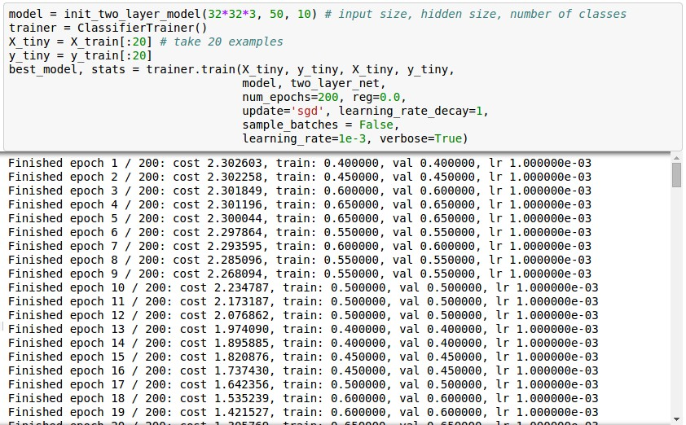
Lets try to train now…
Tip: Make sure that you can overfit very small portion of the training data
The above code:
take the first 20 examples from CIFAR-10
turn off regularization (reg = 0.0)
use simple vanilla ‘sgd’
Slide Credit: Fei-Fei Li, Justin Johnson, Serena Yeung, CS 231n
Notes:
Now can start training
Start with very small amount of data, should be able to overfit and get very good training loss
In this case...

Slide 66
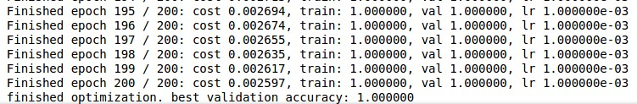
Lets try to train now…
Tip: Make sure that you can overfit very small portion of the training data
Very small loss,
train accuracy 1.00,
nice!
Slide Credit: Fei-Fei Li, Justin Johnson, Serena Yeung, CS 231n
Notes:
See how loss is changing, compute loss at each epoch, want to see it go to 0
Training accuracy goes to 1, makes sense

Slide 67
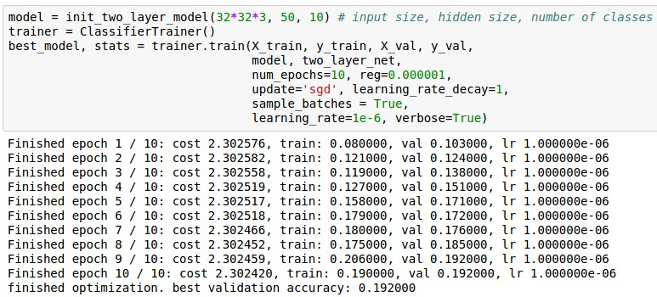
Lets try to train now…
Start with small regularization and find learning rate that makes the loss go down.
Slide Credit: Fei-Fei Li, Justin Johnson, Serena Yeung, CS 231n
Notes:
Now can really start training to train
Take full training data
Start with small regularization and find learning rate that makes the loss go down
Learning rate one of most important hyperparameters, something you want to adjust first

Slide 68
Lets try to train now…
Start with small regularization and find learning rate that makes the loss go down.
Loss barely changing
Slide Credit: Fei-Fei Li, Justin Johnson, Serena Yeung, CS 231n
Notes:
Loss barely changed, why?

Slide 69
Lets try to train now…
Start with small regularization and find learning rate that makes the loss go down.
loss not going down:
learning rate too low
Loss barely changing: Learning rate is probably too low
Slide Credit: Fei-Fei Li, Justin Johnson, Serena Yeung, CS 231n
Notes:
, probably learning rate too small
LR too small, gradient updates not big enough

Slide 70
Lets try to train now…
Start with small regularization and find learning rate that makes the loss go down.
loss not going down:
learning rate too low
Loss barely changing: Learning rate is probably too low
Notice train/val accuracy goes to 20% though, what’s up with that? (remember this is softmax)
Slide Credit: Fei-Fei Li, Justin Johnson, Serena Yeung, CS 231n
Notes:
Notice train/val accuracy goes up...
Probabilities still diffuse, loss still similar, but shift slightly in right direction, accuracies goes up when taking maxes

Slide 71
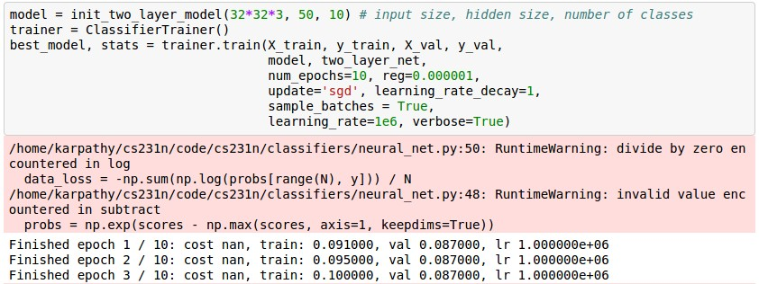
Lets try to train now…
Start with small regularization and find learning rate that makes the loss go down.
loss not going down:
learning rate too low
Now let’s try learning rate 1e6.
Slide Credit: Fei-Fei Li, Justin Johnson, Serena Yeung, CS 231n
Notes:
Try another LR, jump in other extreme
1e6

Slide 72
Lets try to train now…
Start with small regularization and find learning rate that makes the loss go down.
loss not going down:
learning rate too low
loss exploding:
learning rate too high
cost: NaN almost always means high learning rate...
Slide Credit: Fei-Fei Li, Justin Johnson, Serena Yeung, CS 231n
Notes:
Get NaNs: cost exploded, LR was too high

Slide 73
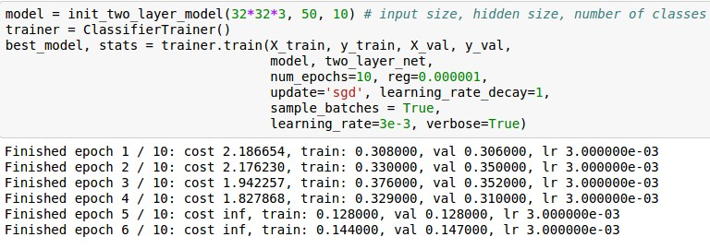
Lets try to train now…
Start with small regularization and find learning rate that makes the loss go down.
loss not going down:
learning rate too low
loss exploding:
learning rate too high
3e-3 is still too high. Cost explodes….
=> Rough range for learning rate we should be cross-validating is somewhere [1e-3 … 1e-5]
Slide Credit: Fei-Fei Li, Justin Johnson, Serena Yeung, CS 231n
Notes:
Adjust learning rate again
3e-3 still too high
Rough range

Slide 74
Hyperparameter Optimization
Notes:
How do we pick these hyperparameters, pick best values, do hyperparameter optimization

Slide 75
Cross-validation strategy
coarse -> fine cross-validation in stages
First stage: only a few epochs to get rough idea of what params work
Second stage: longer running time, finer search
… (repeat as necessary)
Tip for detecting explosions in the solver:
If the cost is ever > 3 * original cost, break out early
Slide Credit: Fei-Fei Li, Justin Johnson, Serena Yeung, CS 231n
Notes:
Strategy that we’ll use to pick any hyperparameter is cross-validation
Train on training set, evaluate on a validation set, how well did this HP do, have done on assignment
Do in stages
First a coarse stage, pick values pretty spread out apart, learn from only a few epochs
Second stage
Tip for detecting explosions like NaNs

Slide 76
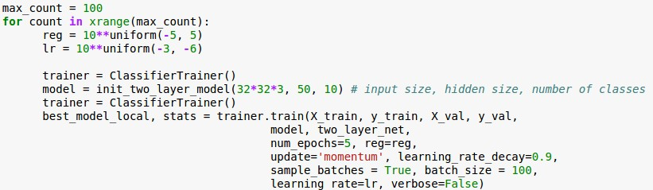
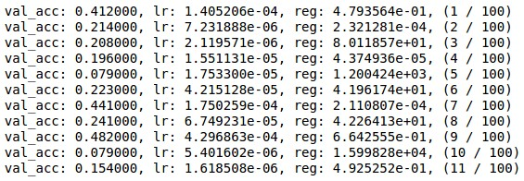
For example: run coarse search for 5 epochs
note it’s best to optimize in log space!
nice
Slide Credit: Fei-Fei Li, Justin Johnson, Serena Yeung, CS 231n
Notes:
ExL coarse search for 5 epochs, see all val accuracies, red are regions we want to explore in more detail
Best to sample in Log space, bc learning rate is multiplying gradient update
Learning rate has multiplicative effects on learning dynamics, makes sense to consider range of learning rates that are multiplicated or divided by some value instead of uniformly sampled
Dealing with orders of magnitude
multiplies your gradient (so if you have fixed addition of 0.01, has huge effect if lr is 0.001, but almost no effect if it’s 10)
More natural to consider a range of learning rates multiplied or divided by some value
Don’t want to sample in region from 0.01 to 100, most samples will be in a bad region
Deal with orders of magnitude

Slide 77

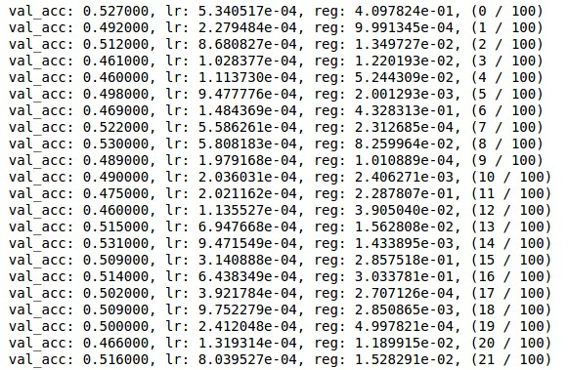
Now run finer search...
adjust range
53% - relatively good for a 2-layer neural net with 50 hidden neurons.
Slide Credit: Fei-Fei Li, Justin Johnson, Serena Yeung, CS 231n
Notes:
Getting a relatively good accuracy, headed in right direction

Slide 78
Now run finer search...
adjust range
53% - relatively good for a 2-layer neural net with 50 hidden neurons.
But this best cross-validation result is worrying. Why?
Slide Credit: Fei-Fei Li, Justin Johnson, Serena Yeung, CS 231n
Notes:
Problem: Good learning rates at edge of range
Reg more in ok part of range, e-1

Slide 79
Random Search for Hyper-Parameter Optimization
Bergstra and Bengio, 2012
Random Search vs. Grid Search
Grid Layout
Random Layout
Unimportant Parameter
Unimportant Parameter
Important Parameter
Important Parameter
Illustration of Bergstra et al., 2012 by Shayne Longpre, copyright CS231n 2017
Slide Credit: Fei-Fei Li, Justin Johnson, Serena Yeung, CS 231n
Notes:
Can sample hyperparameters using grid search, fixed set of values from each hyperparameter, sample in grid manner
In practice actually better to sample from a random layout. Random value in a range, get right side
Reason: If the function is really much more a function of one variable than another
Usually True, usually have low effective dimensionality, some variables are more important than others
Grid search will waste trials in the search dimensions that are not important
Random will get much more samples of different values of the important variable, more useful signal overall
random points are slightly less evenly distributed in the original space, but far more evenly distributed in the subspaces.
A grid with sufficient granularity to optimizing hyper-parameters for all data sets must consequently be inefficient for each individual data set because of the curse of dimensionality: the number of wasted grid search trials is exponential in the number of search dimensions that turn out to be irrelevant for a particular data set. In contrast, random search thrives on low effective dimensionality. Random search has the same efficiency in the relevant subspace as if it had been used to search only the relevant dimensions.

Slide 80

Hyperparameters to play with:
network architecture
learning rate, its decay schedule, update type
regularization (L2/Dropout strength)
neural networks practitioner
music = loss function
This image by Paolo Guereta is licensed under CC-BY 2.0
Slide Credit: Fei-Fei Li, Justin Johnson, Serena Yeung, CS 231n
Notes:
All hyperparameters to play with
Have talked about some of these, will talk about others in the next lecture
If tuning knobs of turntable where you’re a NN practitioner. Output is loss, want to tune knobs to get output that you want. An art.

Slide 81
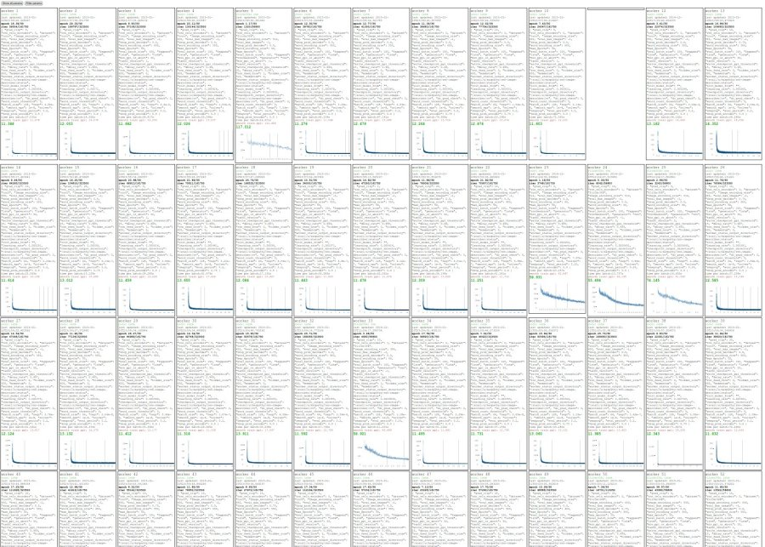
Cross-validation “command center”
Slide Credit: Fei-Fei Li, Justin Johnson, Serena Yeung, CS 231n
Notes:
In practice will do a lot of CV, hyperparameter search
Ppl will run over tons of hyperparameters and monitor

Slide 82
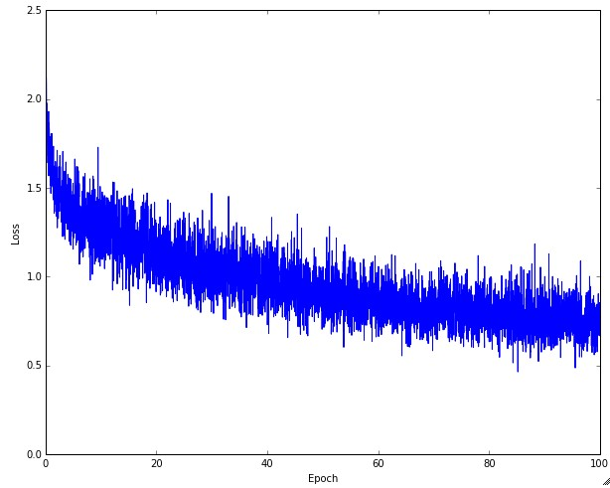
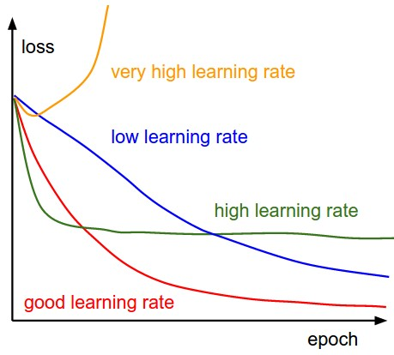
Monitor and visualize the loss curve
Slide Credit: Fei-Fei Li, Justin Johnson, Serena Yeung, CS 231n
Notes:
As monitoring loss curves will get a sense for which LRs are good and bad
Drop then plateau also not ideal, Too large jumps, not able to settle well into local optimum

Slide 83
Loss
Bad initialization a prime suspect
time
Slide Credit: Fei-Fei Li, Justin Johnson, Serena Yeung, CS 231n
Notes:
Flat then train all of a sudden

Slide 84
Loss
time
Slide Credit: Fei-Fei Li, Justin Johnson, Serena Yeung, CS 231n
Notes:
Flat then train all of a sudden, potential reason can be bad initialization
Gradients not really flowing too well in the beginning, nothing’s really learning, then at some point just adjusts in the right way such that it tips over and things start training

Slide 85
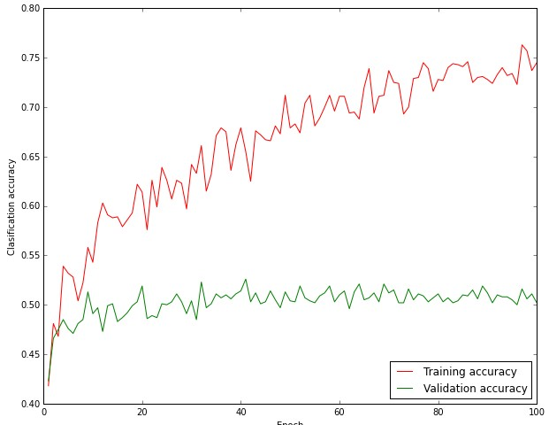
Monitor and visualize the accuracy:
big gap = overfitting
=> increase regularization strength?
no gap
=> increase model capacity?
Slide Credit: Fei-Fei Li, Justin Johnson, Serena Yeung, CS 231n
Notes:
Lot of experience that you’ll acquire over time
Will want to monitor and visualize accuracy
If big gap, may have overfitting =>
If no gap, may want to increase model capacity, haven’t overfit yet, can increase more

Slide 86
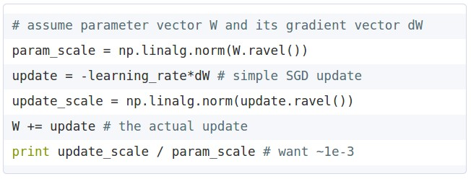
Track the ratio of weight updates / weight magnitudes:
ratio between the updates and values: ~ 0.0002 / 0.02 = 0.01 (about okay)
want this to be somewhere around 0.001 or so
Slide Credit: Fei-Fei Li, Justin Johnson, Serena Yeung, CS 231n
Notes:
Want to track ratio
Take norm of parameters to get a sense for how large they are
Also take norm of update size
Want ratio to be ~1e-3. Lot of variance in this range, don’t have to be exactly on this, but don’t want updates to be too large compared to value or too small. To dominate or have no effect
Can help debug what might be a problem

Slide 87
Summary
We looked in detail at:
Activation Functions (use ReLU)
Data Preprocessing (images: subtract mean)
Weight Initialization (use Xavier/He init)
Batch Normalization (use)
Babysitting the Learning process
Hyperparameter Optimization
(random sample hyperparams, in log space when appropriate)
TLDRs
Slide Credit: Fei-Fei Li, Justin Johnson, Serena Yeung, CS 231n
Notes:
Takeaways for each

Slide 88
Next time:
Training Neural Networks, Part 2
Parameter update schemes
Learning rate schedules
Gradient checking
Regularization (Dropout etc.)
Evaluation (Ensembles etc.)
Transfer learning / fine-tuning

