Slide 1
CS 4803 / 7643: Deep Learning
Topics:
  Variational Auto-Encoders (VAEs)
  Key Ideas
    AEs, Variational Inference
Dhruv Batra
Georgia Tech

Slide 2
Administrativia
HW3 out
  Due: 11/06, 11:55pm
Final project
  No poster session
  Webpage submission
    Details out soon

Slide 3
Recap from last time

Slide 4
Overview
Unsupervised Learning
Generative Models
  PixelRNN and PixelCNN
  Variational Autoencoders (VAE)
  Generative Adversarial Networks (GAN)
Slide Credit: Fei-Fei Li, Justin Johnson, Serena Yeung, CS 231n
Notes:
Unsupervised learning problem
Generative models, type of unsupervised learning
3 types of generative models
PixelRNN and PixelCNN, type of fully visible belief networks

Slide 5
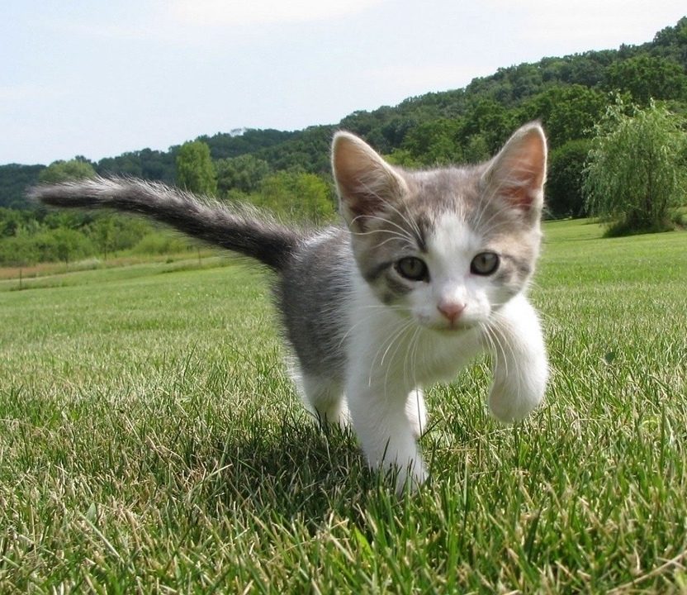

So far… Supervised Learning
Data: (x, y)
x is data, y is label
Goal: Learn a function to map x -> y
Examples: Classification, regression, object detection, semantic segmentation, image captioning, etc.
Cat
Classification
This image is CC0 public domain
Slide Credit: Fei-Fei Li, Justin Johnson, Serena Yeung, CS 231n
Notes:
So far talked about SL
Type of problem where have Data X, Labels Y, goals is to learn a function mapping from x to y

Slide 6
Supervised vs Unsupervised Learning
Unsupervised Learning
Data: x
Just data, no labels!
Goal: Learn some underlying hidden structure of the data
Examples: Clustering, dimensionality reduction, feature learning, density estimation, etc.
Slide Credit: Fei-Fei Li, Justin Johnson, Serena Yeung, CS 231n
Notes:
Unsupervised learning is a type of learning where we have unlabeled training data, and we want to learn some underlying hidden structure of the data

Slide 7
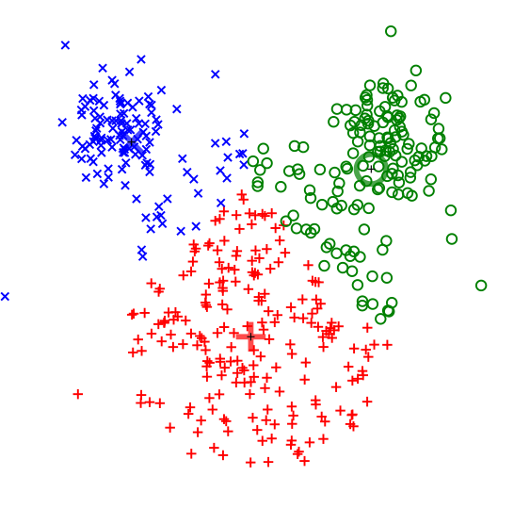
Supervised vs Unsupervised Learning
Unsupervised Learning
Data: x
Just data, no labels!
Goal: Learn some underlying hidden structure of the data
Examples: Clustering, dimensionality reduction, feature learning, density estimation, etc.
K-means clustering
This image is CC0 public domain
Slide Credit: Fei-Fei Li, Justin Johnson, Serena Yeung, CS 231n
Notes:
Clustering - find groups within the data that are similar through some metric

Slide 8
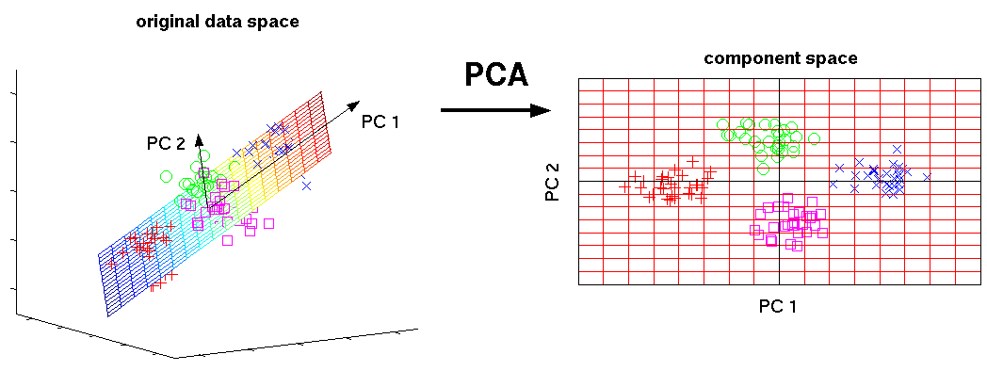
Supervised vs Unsupervised Learning
Unsupervised Learning
Data: x
Just data, no labels!
Goal: Learn some underlying hidden structure of the data
Examples: Clustering, dimensionality reduction, feature learning, density estimation, etc.
3-d
2-d
Principal Component Analysis
(Dimensionality reduction)
This image from Matthias Scholz is CC0 public domain
Slide Credit: Fei-Fei Li, Justin Johnson, Serena Yeung, CS 231n
Notes:
Find axes along which the data has most variation, this is part of the underlying structure of the data
Use this to reduce the dimensionality of the data such that the data has significant variation among each remaining dimension
Here is an example, take 3d data, finding 2 axes of variatiation and reducing dimensionality to 2d

Slide 9
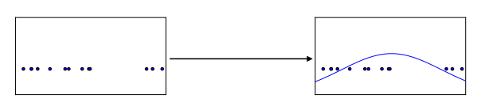
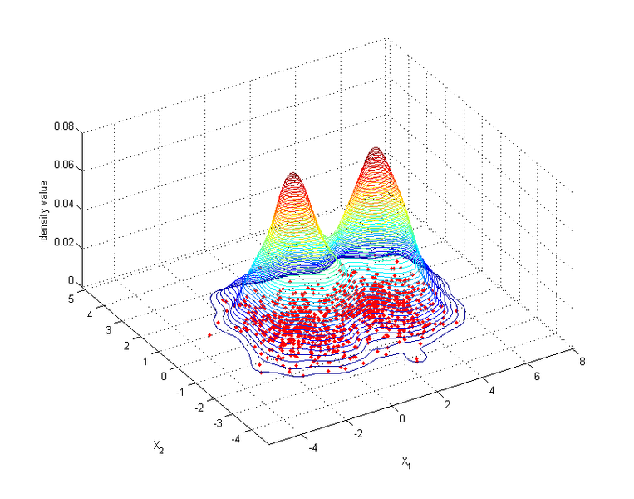
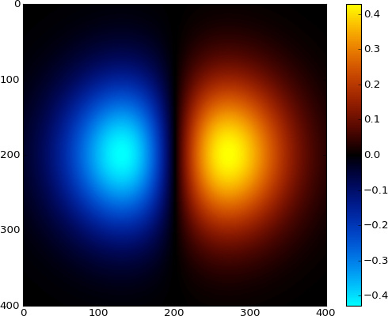
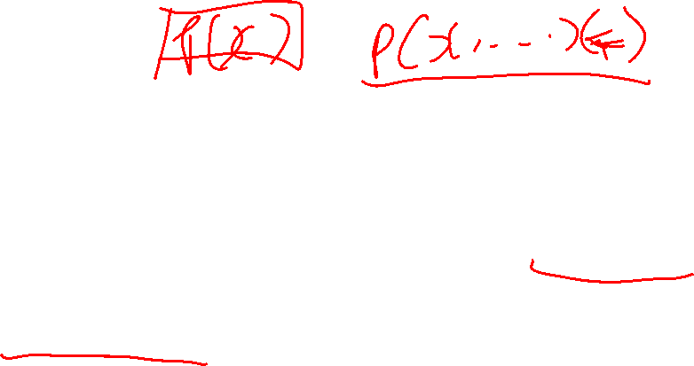
Supervised vs Unsupervised Learning
Unsupervised Learning
Data: x
Just data, no labels!
Goal: Learn some underlying hidden structure of the data
Examples: Clustering, dimensionality reduction, feature learning, density estimation, etc.
Figure copyright Ian Goodfellow, 2016. Reproduced with permission.
1-d density estimation
2-d density estimation
2-d density images left and right are CC0 public domain
Slide Credit: Fei-Fei Li, Justin Johnson, Serena Yeung, CS 231n
Notes:
Finally, another example is density estimation, which is estimating the underlying distribution of your data.
For example, in top example, have points in 1-d, and we can try to fit a gaussian to the density
In the bottom example, have 2d data. Again trying to estimate the density, and we model the density to be higher where more points are concentrated

Slide 10
Tasks
Supervised Learning
x
Classification
y
Discrete
x
Regression
y
Continuous
Unsupervised Learning
x
Clustering
c
Discrete
x
Dimensionality
Reduction
z
Continuous
x
Density
Estimation
p(x)
On simplex

Slide 11
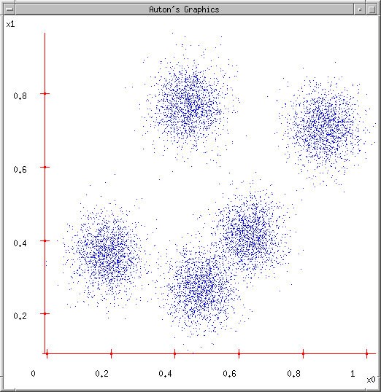
Some Data
Slide Credit: Carlos Guestrin

Slide 12
K-means
Ask user how many clusters they’d like. (e.g. k=5)
Slide Credit: Carlos Guestrin

Slide 13
K-means
Ask user how many clusters they’d like. (e.g. k=5)
Randomly guess k cluster Center locations
Slide Credit: Carlos Guestrin

Slide 14
K-means
Ask user how many clusters they’d like. (e.g. k=5)
Randomly guess k cluster Center locations
Each datapoint finds out which Center it’s closest to. (Thus each Center “owns” a set of datapoints)
Slide Credit: Carlos Guestrin

Slide 15
K-means
Ask user how many clusters they’d like. (e.g. k=5)
Randomly guess k cluster Center locations
Each datapoint finds out which Center it’s closest to.
Each Center finds the centroid of the points it owns
Slide Credit: Carlos Guestrin

Slide 16
K-means
Ask user how many clusters they’d like. (e.g. k=5)
Randomly guess k cluster Center locations
Each datapoint finds out which Center it’s closest to.
Each Center finds the centroid of the points it owns…
…and jumps there
…Repeat until terminated!
Slide Credit: Carlos Guestrin

Slide 17
K-means
Randomly initialize k centers
  μ⁽⁰⁾ = μ₁⁽⁰⁾,…, μ_{k}⁽⁰⁾
Assign:
  Assign each point i∈{1,…n} to nearest center:
Recenter:
  μ_{j} becomes centroid of its points
Slide Credit: Carlos Guestrin

Slide 18
What is K-means optimizing?
Objective F(μ,C): function of centers μ and point allocations C:
  1-of-k encoding
Optimal K-means:
  min_{μ}min_{a} F(μ,a)

Slide 19
K-means as Co-ordinate Descent
Optimize objective function:
Fix μ, optimize a (or C)
Slide Credit: Carlos Guestrin

Slide 20
K-means as Co-ordinate Descent
Optimize objective function:
Fix a (or C), optimize μ
Slide Credit: Carlos Guestrin

Slide 21






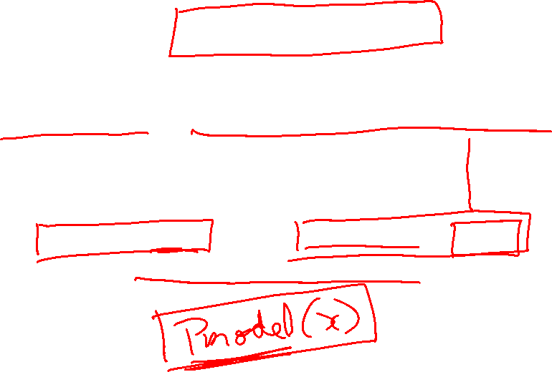
Generative Models
Given training data, generate new samples from same distribution
Training data ~ p_{data}(x)
Generated samples ~ p_{model}(x)
Want to learn p_{model}(x) similar to p_{data}(x)
Slide Credit: Fei-Fei Li, Justin Johnson, Serena Yeung, CS 231n
Notes:
Today we’ll focus on generative models, a class of models for unsupervised learning that given training data, tries to generate new samples from the same distribution

Slide 22
Taxonomy of Generative Models
Direct
GAN
Generative models
Explicit density
Implicit density
Tractable density
Approximate density
Markov Chain
Fully Visible Belief Nets
NADE
MADE
PixelRNN/CNN
Change of variables models (nonlinear ICA)
GSN
Variational
Markov Chain
Variational Autoencoder
Boltzmann Machine
Figure copyright and adapted from Ian Goodfellow, Tutorial on Generative Adversarial Networks, 2017.
Slide Credit: Fei-Fei Li, Justin Johnson, Serena Yeung, CS 231n
Notes:
If we look at types of generative models, can be organized into this taxonomy, where 2 major branches are, as mentioned earlier, explicit density models that explicitly define and solve for the underlying density function, and implicit density models that represent the underlying distribution implicitly through its samples

Slide 23
Taxonomy of Generative Models
Direct
We will discuss 3 most popular types of generative models
GAN
Generative models
Explicit density
Implicit density
Tractable density
Approximate density
Markov Chain
Fully Visible Belief Nets
NADE
MADE
PixelRNN/CNN
Change of variables models (nonlinear ICA)
GSN
Variational
Markov Chain
Variational Autoencoder
Boltzmann Machine
Figure copyright and adapted from Ian Goodfellow, Tutorial on Generative Adversarial Networks, 2017.
Slide Credit: Fei-Fei Li, Justin Johnson, Serena Yeung, CS 231n
Notes:
Refer to goodfellow tutorial which has a good overview of this
Today discuss 3 most popular types of generative models

Slide 24
PixelRNN and PixelCNN

Slide 25

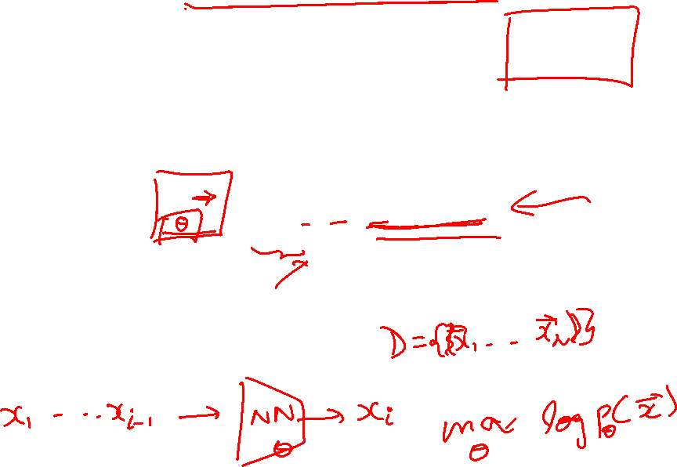
Fully Observable Model
Explicit density model
Use chain rule to decompose likelihood of an image x into product of 1-d distributions:
Likelihood of image x
Probability of i’th pixel value given all previous pixels
Then maximize likelihood of training data
Slide Credit: Fei-Fei Li, Justin Johnson, Serena Yeung, CS 231n
Notes:
Pielrnn and cnn type of fully visible belief network

Slide 26
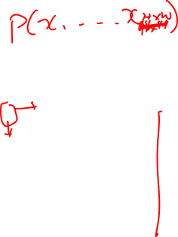
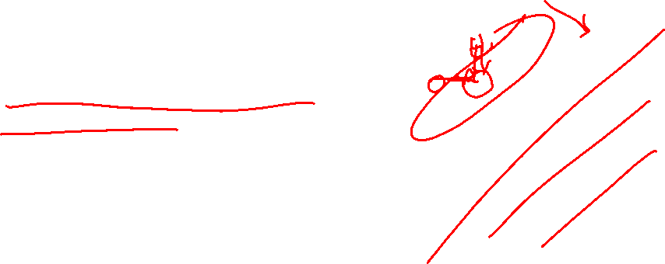
PixelRNN [van der Oord et al. 2016]
Generate image pixels starting from corner
Dependency on previous pixels modeled using an RNN (LSTM)
Slide Credit: Fei-Fei Li, Justin Johnson, Serena Yeung, CS 231n

Slide 27
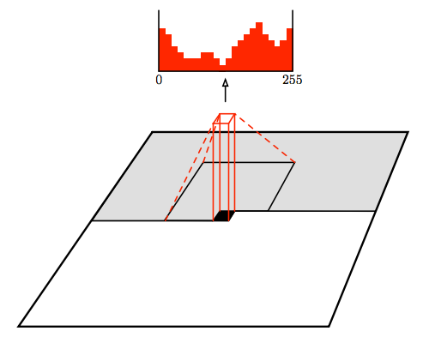
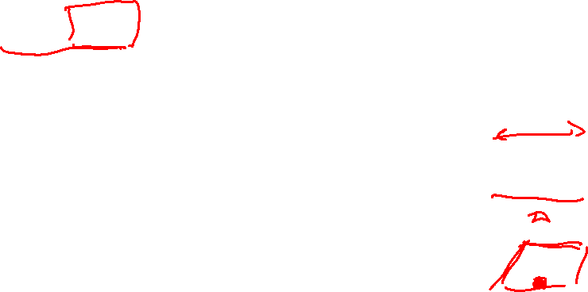
PixelCNN [van der Oord et al. 2016]
Still generate image pixels starting from corner
Dependency on previous pixels now modeled using a CNN over context region
Figure copyright van der Oord et al., 2016. Reproduced with permission.
Slide Credit: Fei-Fei Li, Justin Johnson, Serena Yeung, CS 231n
Notes:
Improves in efficiency over pixelrnn

Slide 28
Variational Autoencoders (VAE)

Slide 29
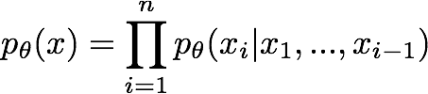
So far...
PixelCNNs define tractable density function, optimize likelihood of training data:
Slide Credit: Fei-Fei Li, Justin Johnson, Serena Yeung, CS 231n

Slide 30

So far...
PixelCNNs define tractable density function, optimize likelihood of training data:
VAEs define intractable density function with latent z:
Cannot optimize directly, derive and optimize lower bound on likelihood instead
Slide Credit: Fei-Fei Li, Justin Johnson, Serena Yeung, CS 231n

Slide 31
GMM
Figure Credit: Kevin Murphy

Slide 32
Gaussian Mixture Model

Slide 33
Gaussian Mixture Model

Slide 34
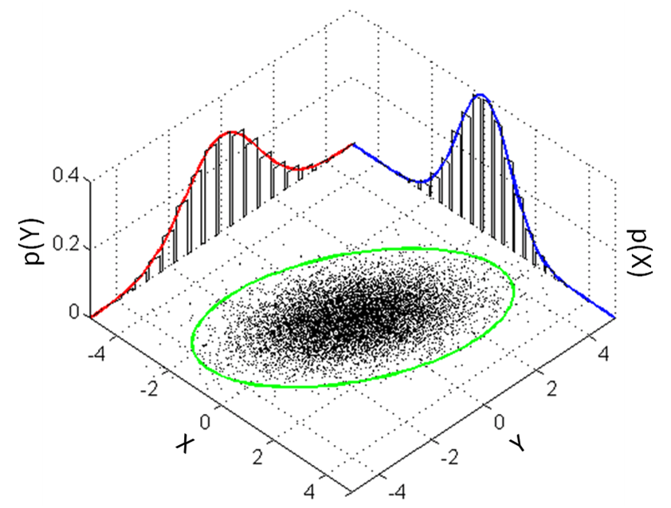
Recall Multi-variate Gaussians

Slide 35
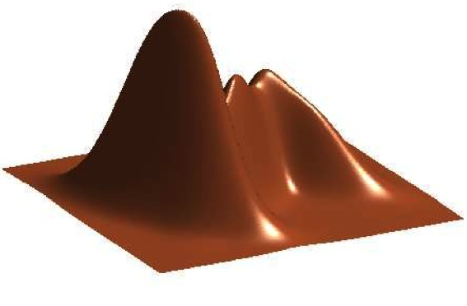
GMM
Figure Credit: Kevin Murphy

Slide 36
K-means vs GMM
K-Means
  http://stanford.edu/class/ee103/visualizations/kmeans/kmeans.html
GMM
  https://lukapopijac.github.io/gaussian-mixture-model/

Slide 37
Hidden Data Causes Problems #1
Fully Observed (Log) Likelihood factorizes
Marginal (Log) Likelihood doesn’t factorize
All parameters coupled!

Slide 39
Hidden Data Causes Problems #2
Identifiability
Figure Credit: Kevin Murphy

Slide 40
Hidden Data Causes Problems #3
Likelihood has singularities if one Gaussian “collapses”

Slide 42
Variational Auto Encoders
VAEs are a combination of the following ideas:
Auto Encoders
Variational Approximation
  Variational Lower Bound / ELBO
Amortized Inference Neural Networks
“Reparameterization” Trick

Slide 43
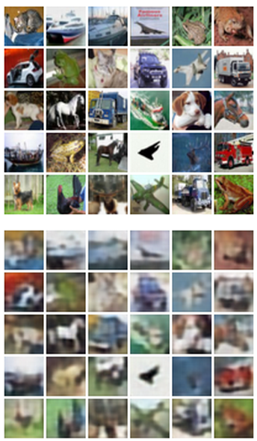
Autoencoders
Unsupervised approach for learning a lower-dimensional feature representation from unlabeled training data
Features
Encoder
Input data
Slide Credit: Fei-Fei Li, Justin Johnson, Serena Yeung, CS 231n
Notes:
Generative model with latent variables to maximize training data
What is unsupervised learning? Learning feature representations with unsupervised objectives, vs. learning generative models for data, etc…
Explicit density estimation (PixelCNN) vs. Autoencoder vs. VAE vs. GANs. Compare and contrast. In particular, VAE vs. GAN. What are advantages of VAE? Are Autoencoders still used? In what context? Or why not?
What is current research, pros / cons of each?

Slide 44
Autoencoders
Unsupervised approach for learning a lower-dimensional feature representation from unlabeled training data
Originally: Linear + nonlinearity (sigmoid)
Later: Deep, fully-connected
Later: ReLU CNN
Features
Encoder
Input data
Slide Credit: Fei-Fei Li, Justin Johnson, Serena Yeung, CS 231n

Slide 45
Autoencoders
Unsupervised approach for learning a lower-dimensional feature representation from unlabeled training data
z usually smaller than x
(dimensionality reduction)
Originally: Linear + nonlinearity (sigmoid)
Later: Deep, fully-connected
Later: ReLU CNN
Q: Why dimensionality reduction?
Features
Encoder
Input data
Slide Credit: Fei-Fei Li, Justin Johnson, Serena Yeung, CS 231n

Slide 46
Autoencoders
Unsupervised approach for learning a lower-dimensional feature representation from unlabeled training data
z usually smaller than x
(dimensionality reduction)
Originally: Linear + nonlinearity (sigmoid)
Later: Deep, fully-connected
Later: ReLU CNN
Q: Why dimensionality reduction?
A: Want features to capture meaningful factors of variation in data
Features
Encoder
Input data
Slide Credit: Fei-Fei Li, Justin Johnson, Serena Yeung, CS 231n

Slide 47
Autoencoders
How to learn this feature representation?
Features
Encoder
Input data
Slide Credit: Fei-Fei Li, Justin Johnson, Serena Yeung, CS 231n

Slide 48
Autoencoders
How to learn this feature representation?
Train such that features can be used to reconstruct original data
“Autoencoding” - encoding itself
Reconstructed input data
Decoder
Features
Encoder
Input data
Slide Credit: Fei-Fei Li, Justin Johnson, Serena Yeung, CS 231n

Slide 49
Autoencoders
How to learn this feature representation?
Train such that features can be used to reconstruct original data
“Autoencoding” - encoding itself
Originally: Linear + nonlinearity (sigmoid)
Later: Deep, fully-connected
Later: ReLU CNN (upconv)
Reconstructed input data
Decoder
Features
Encoder
Input data
Slide Credit: Fei-Fei Li, Justin Johnson, Serena Yeung, CS 231n

Slide 50
Autoencoders
Reconstructed data
How to learn this feature representation?
Train such that features can be used to reconstruct original data
“Autoencoding” - encoding itself
Reconstructed input data
Encoder: 4-layer conv
Decoder: 4-layer upconv
Decoder
Input data
Features
Encoder
Input data
Slide Credit: Fei-Fei Li, Justin Johnson, Serena Yeung, CS 231n

Slide 51

Autoencoders
Reconstructed data
Train such that features can be used to reconstruct original data
L2 Loss function:
Reconstructed input data
Encoder: 4-layer conv
Decoder: 4-layer upconv
Decoder
Input data
Features
Encoder
Input data
Slide Credit: Fei-Fei Li, Justin Johnson, Serena Yeung, CS 231n

Slide 52
Autoencoders
Reconstructed data
Train such that features can be used to reconstruct original data
Doesn’t use labels!
L2 Loss function:
Reconstructed input data
Encoder: 4-layer conv
Decoder: 4-layer upconv
Decoder
Input data
Features
Encoder
Input data
Slide Credit: Fei-Fei Li, Justin Johnson, Serena Yeung, CS 231n

Slide 53
Autoencoders
Demo
  https://cs.stanford.edu/people/karpathy/convnetjs/demo/autoencoder.html

Slide 54
Autoencoders
Reconstructed input data
Decoder
Features
After training,
throw away decoder
Encoder
Input data
Slide Credit: Fei-Fei Li, Justin Johnson, Serena Yeung, CS 231n

Slide 55
Autoencoders
Loss function (Softmax, etc)
bird
plane
dog
deer
truck
Predicted Label
Train for final task (sometimes with small data)
Classifier
Fine-tune
encoder
jointly with
classifier
Encoder can be used to initialize a supervised model
Features
Encoder
Input data
Slide Credit: Fei-Fei Li, Justin Johnson, Serena Yeung, CS 231n

Slide 56
Autoencoders
Autoencoders can reconstruct data, and can learn features to initialize a supervised model
Features capture factors of variation in training data. Can we generate new images from an autoencoder?
Reconstructed input data
Decoder
Features
Encoder
Input data
Slide Credit: Fei-Fei Li, Justin Johnson, Serena Yeung, CS 231n

Slide 57
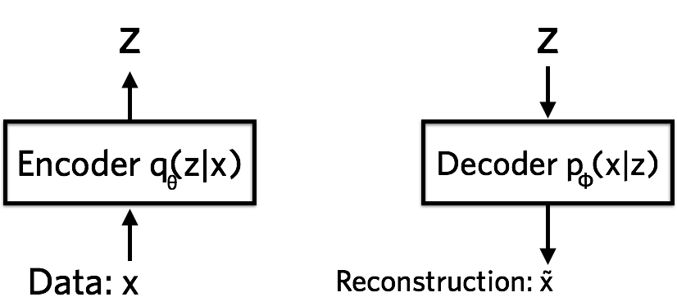


Variational Autoencoders
Probabilistic spin on autoencoders - will let us sample from the model to generate data!
$$qφ\left(z | x\right)$$
$$pθ\left(x | z\right)$$
Image Credit: https://jaan.io/what-is-variational-autoencoder-vae-tutorial/

Slide 58
Variational Auto Encoders
VAEs are a combination of the following ideas:
Auto Encoders
Variational Approximation
  Variational Lower Bound / ELBO
Amortized Inference Neural Networks
“Reparameterization” Trick

Slide 59
Key problem
P(z|x)

Slide 60
What is Variational Inference?
A class of methods for
  approximate inference, parameter learning
  and approximating integrals basically..
Key idea
  Reality is complex
  Instead of performing approximate computation in something complex,
  Can we perform exact computation in something “simple”?
  Just need to make sure the simple thing is “close” to the complex thing.

Slide 61
Intuition

Slide 62
KL divergence:
Distance between distributions
Given two distributions p and q KL divergence:
D(p||q) = 0 iff p=q
Not symmetric – p determines where difference is important
Slide Credit: Carlos Guestrin

Slide 63
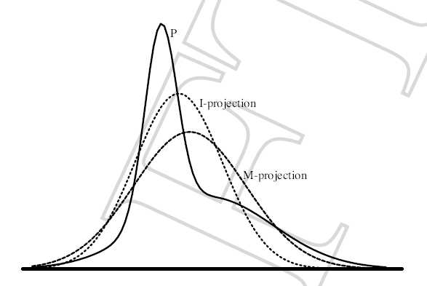
Find simple approximate distribution
Suppose p is intractable posterior
Want to find simple q that approximates p
KL divergence not symmetric
D(p||q)
  true distribution p defines support of diff.
  the “correct” direction
  will be intractable to compute
D(q||p)
  approximate distribution defines support
  tends to give overconfident results
  will be tractable
Slide Credit: Carlos Guestrin

Slide 64
Example 1
p = 2D Gaussian with arbitrary co-variance
q = 2D Gaussian with diagonal co-variance
argmin_q KL (p || q)
argmin_q KL (q || p)
p = Green; q = Red

Slide 65
Example 2
p = Mixture of Two Gaussians
q = Single Gaussian
argmin_q KL (p || q)
argmin_q KL (q || p)
p = Blue; q = Red

