Slide 1
CS 4803 / 7643: Deep Learning
Topics:
Convolutional Neural Networks
Transposed convolutions
Visualizing CNNs
Dhruv Batra
Georgia Tech

Slide 2
Administrativia
HW0 Grades Released
Regard request windows closes 11:59pm 10/16.
HW1 Challenge Final Analysis
https://docs.google.com/spreadsheets/d/1taAu_5AQSiDMtwIY59wTijkd-2Y95nswmv0JnH0eYRI/edit#gid=1468043323
Coming soon.
HW2 Released
Due: 10/18, 11:55pm
https://www.cc.gatech.edu/classes/AY2019/cs7643_fall/assets/hw2.pdf

Slide 3
Recap from last time

Slide 4
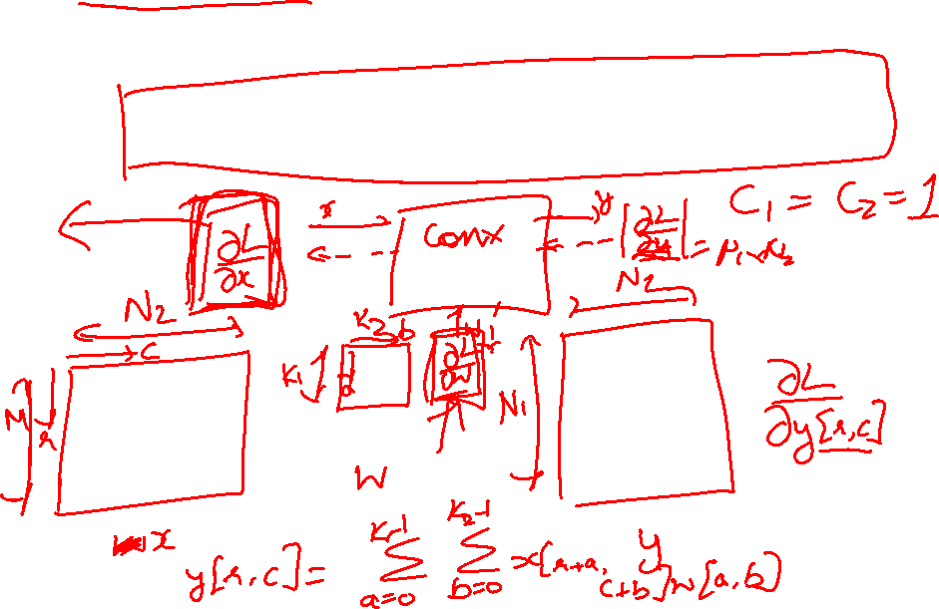
Backprop in Convolutional Layers
Notes
https://www.cc.gatech.edu/classes/AY2018/cs7643_fall/slides/L6_cnns_backprop_notes.pdf

Slide 5
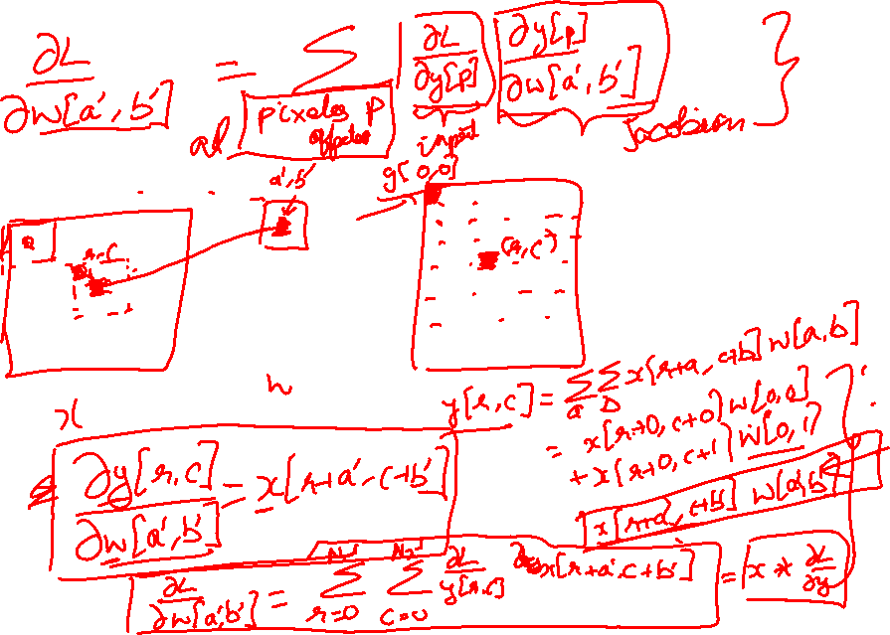
Backprop in Convolutional Layers

Slide 6
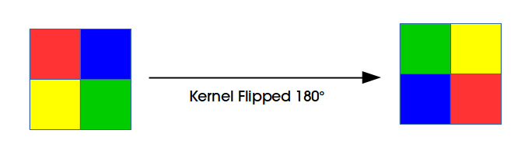
Backprop in Convolutional Layers

Slide 7
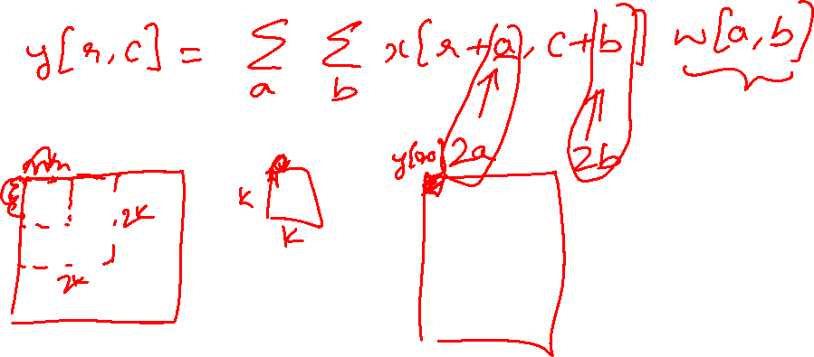
Dilated Convolutions

Slide 8
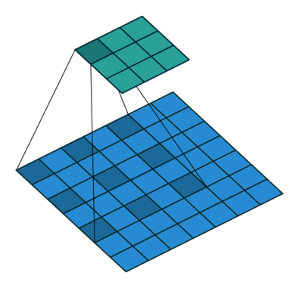
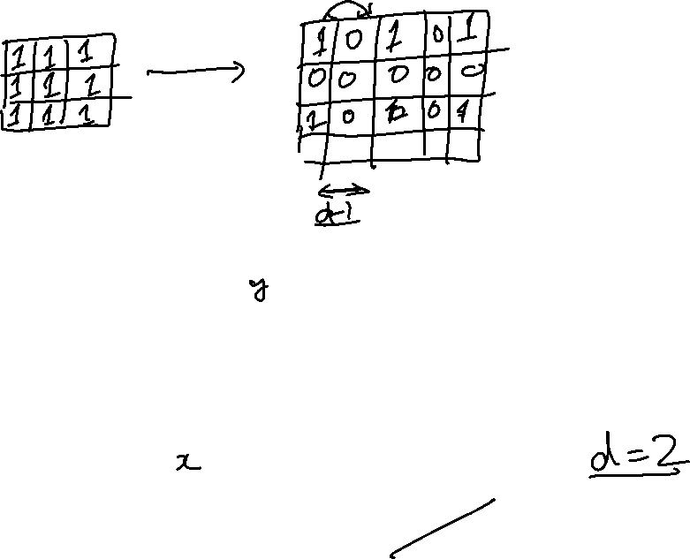
Dilated Convolutions
Figure Credit: Dumoulin and Visin, https://arxiv.org/pdf/1603.07285.pdf

Slide 9
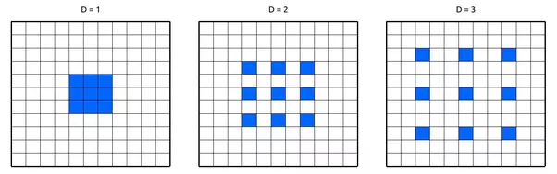
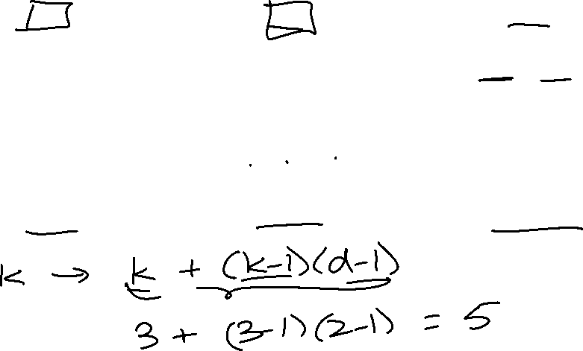

Slide 10

(recall:)
(N - k) / stride + 1
Figure Credit: Dumoulin and Visin, https://arxiv.org/pdf/1603.07285.pdf

Slide 11
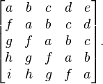
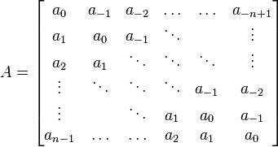
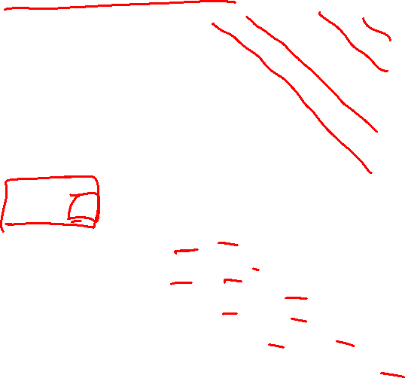
Toeplitz Matrix
Diagonals are constants
A_{ij} = a_{i-j}

Slide 12
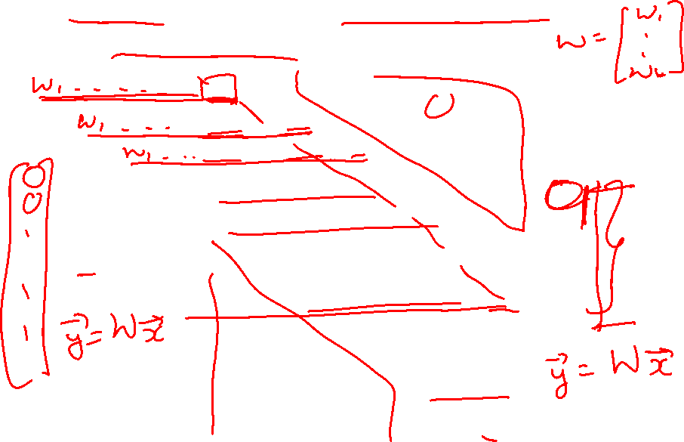
Why do we care?
(Discrete) Convolution = Matrix Multiplication
with Toeplitz Matrices

Slide 13
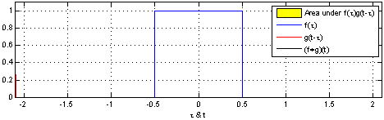
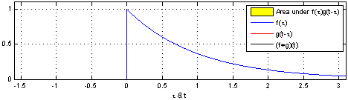
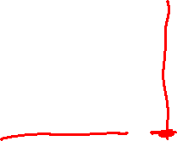
"Convolution of box signal with itself2" by Convolution_of_box_signal_with_itself.gif: Brian Ambergderivative work: Tinos (talk) - Convolution_of_box_signal_with_itself.gif. Licensed under CC BY-SA 3.0 via Commons - https://commons.wikimedia.org/wiki/File:Convolution_of_box_signal_with_itself2.gif#/media/File:Convolution_of_box_signal_with_itself2.gif

Slide 14
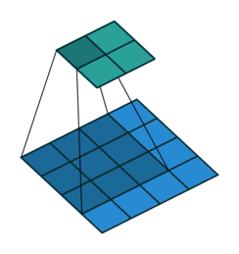
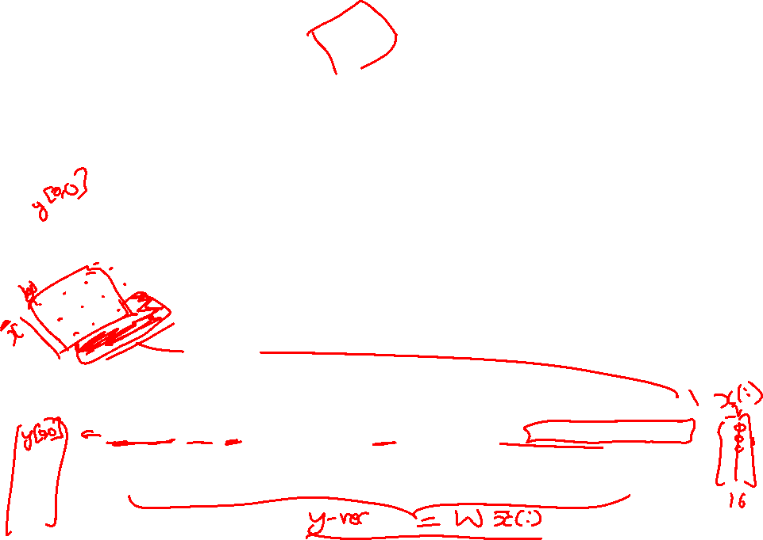
Figure Credit: Dumoulin and Visin, https://arxiv.org/pdf/1603.07285.pdf

Slide 15
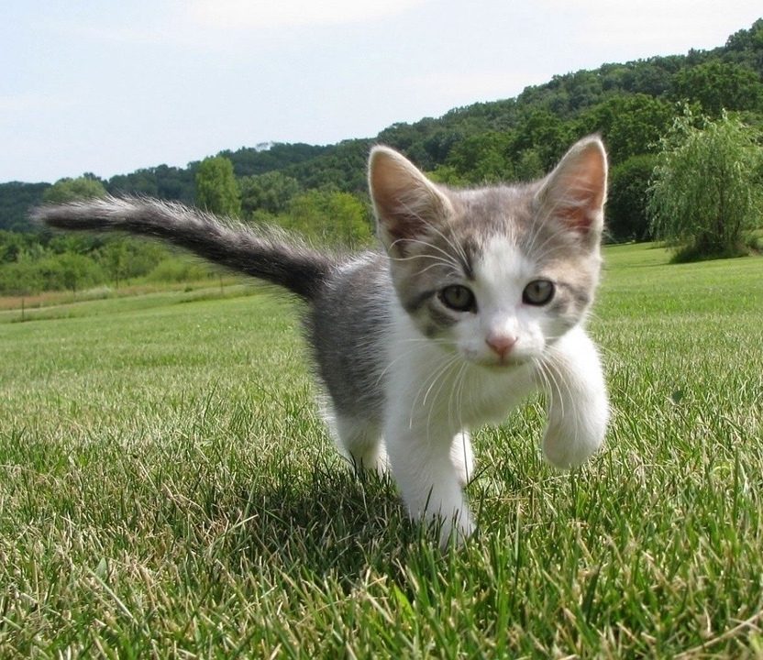
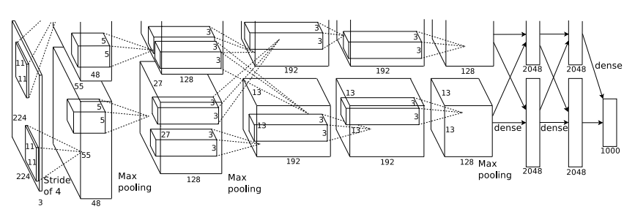
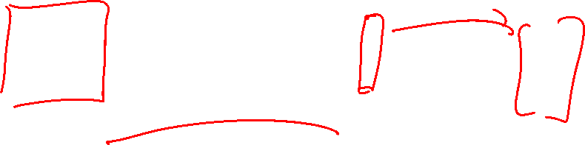
So far: Image Classification
Class Scores
Cat: 0.9
Dog: 0.05
Car: 0.01
...
Fully-Connected:
4096 to 1000
This image is CC0 public domain
Figure copyright Alex Krizhevsky, Ilya Sutskever, and Geoffrey Hinton, 2012. Reproduced with permission.
Vector:
4096
Slide Credit: Fei-Fei Li, Justin Johnson, Serena Yeung, CS 231n

Slide 16
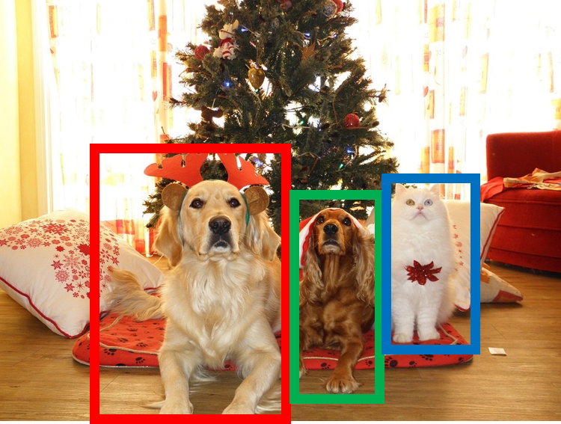
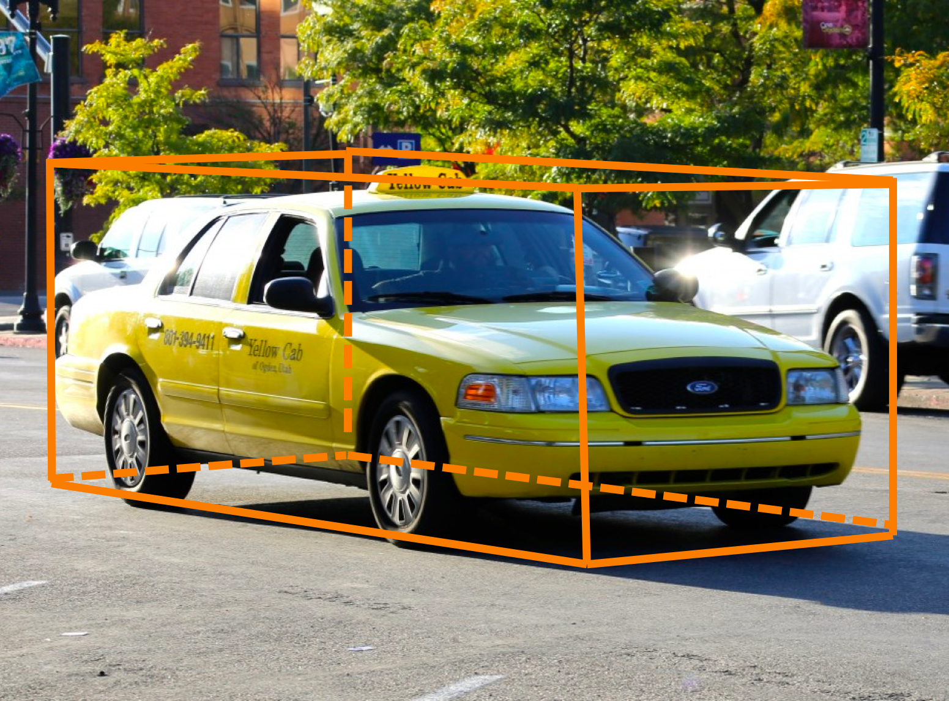
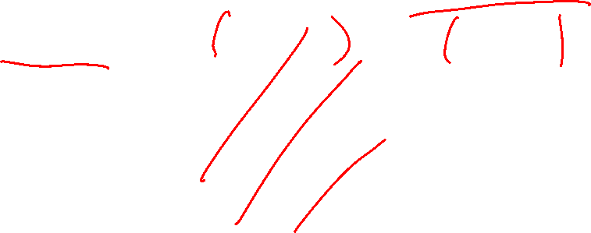
Other Computer Vision Tasks
Semantic Segmentation
2D Object Detection
3D Object Detection
GRASS, CAT, TREE, SKY
DOG, DOG, CAT
Car
Object categories +
2D bounding boxes
Object categories +
3D bounding boxes
No objects, just pixels
This image is CC0 public domain
Slide Credit: Fei-Fei Li, Justin Johnson, Serena Yeung, CS 231n

Slide 17
Semantic Segmentation
Semantic Segmentation
2D Object Detection
3D Object Detection
GRASS, CAT, TREE, SKY
DOG, DOG, CAT
Car
Object categories +
2D bounding boxes
Object categories +
3D bounding boxes
No objects, just pixels
This image is CC0 public domain
Notes:
Given this cute cat picture, the image classification task would be looking at this picture and ouput a single label cat

Slide 18
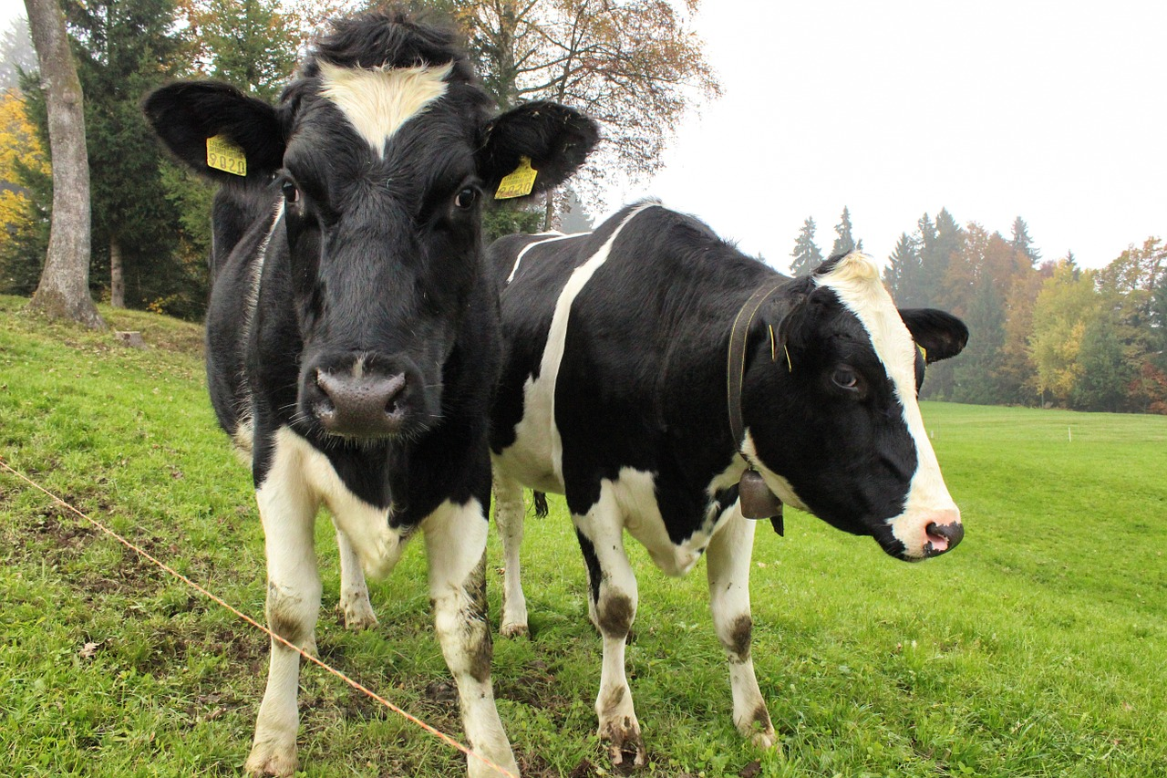
Semantic Segmentation Idea: Sliding Window
Extract patch
Classify center pixel with CNN
Full image
Cow
Cow
Grass
Problem: Very inefficient! Not reusing shared features between overlapping patches
Farabet et al, “Learning Hierarchical Features for Scene Labeling,” TPAMI 2013
Pinheiro and Collobert, “Recurrent Convolutional Neural Networks for Scene Labeling”, ICML 2014
Slide Credit: Fei-Fei Li, Justin Johnson, Serena Yeung, CS 231n

Slide 19
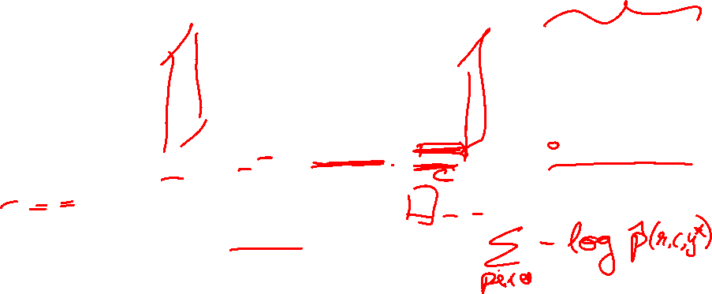
Semantic Segmentation Idea: Fully Convolutional
Design a network as a bunch of convolutional layers to make predictions for pixels all at once!
Conv
Conv
Conv
Conv
argmax
Input:
3 x H x W
Predictions:
H x W
Scores:
C x H x W
Convolutions:
D x H x W
Slide Credit: Fei-Fei Li, Justin Johnson, Serena Yeung, CS 231n

Slide 20
Semantic Segmentation Idea: Fully Convolutional
Design a network as a bunch of convolutional layers to make predictions for pixels all at once!
Conv
Conv
Conv
Conv
argmax
Input:
3 x H x W
Predictions:
H x W
Scores:
C x H x W
Problem: convolutions at original image resolution will be very expensive ...
Convolutions:
D x H x W
Slide Credit: Fei-Fei Li, Justin Johnson, Serena Yeung, CS 231n

Slide 21
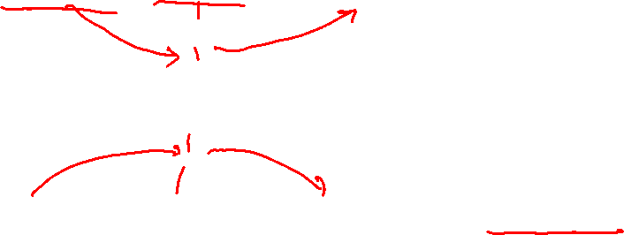
Semantic Segmentation Idea: Fully Convolutional
Design network as a bunch of convolutional layers, with downsampling and upsampling inside the network!
Med-res:
D₂ x H/4 x W/4
Med-res:
D₂ x H/4 x W/4
Low-res:
D₃ x H/4 x W/4
Input:
3 x H x W
High-res:
D₁ x H/2 x W/2
High-res:
D₁ x H/2 x W/2
Predictions:
H x W
Long, Shelhamer, and Darrell, “Fully Convolutional Networks for Semantic Segmentation”, CVPR 2015 Noh et al, “Learning Deconvolution Network for Semantic Segmentation”, ICCV 2015
Slide Credit: Fei-Fei Li, Justin Johnson, Serena Yeung, CS 231n

Slide 22

Semantic Segmentation Idea: Fully Convolutional
Downsampling:
Pooling, strided convolution
Design network as a bunch of convolutional layers, with downsampling and upsampling inside the network!
Upsampling:
???
Med-res:
D₂ x H/4 x W/4
Med-res:
D₂ x H/4 x W/4
Low-res:
D₃ x H/4 x W/4
Input:
3 x H x W
High-res:
D₁ x H/2 x W/2
High-res:
D₁ x H/2 x W/2
Predictions:
H x W
Long, Shelhamer, and Darrell, “Fully Convolutional Networks for Semantic Segmentation”, CVPR 2015 Noh et al, “Learning Deconvolution Network for Semantic Segmentation”, ICCV 2015
Slide Credit: Fei-Fei Li, Justin Johnson, Serena Yeung, CS 231n

Slide 23
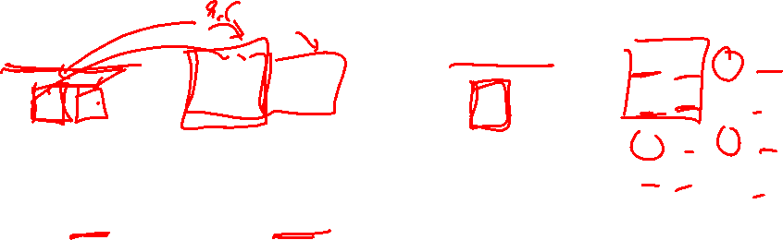
In-Network upsampling: “Unpooling”
Nearest Neighbor
“Bed of Nails”
1 | 0 | 2 | 0
0 | 0 | 0 | 0
3 | 0 | 4 | 0
0 | 0 | 0 | 0
1 | 1 | 2 | 2
1 | 1 | 2 | 2
3 | 3 | 4 | 4
3 | 3 | 4 | 4
1 | 2
3 | 4
1 | 2
3 | 4
Input: 2 x 2
Output: 4 x 4
Input: 2 x 2
Output: 4 x 4
Slide Credit: Fei-Fei Li, Justin Johnson, Serena Yeung, CS 231n

Slide 24
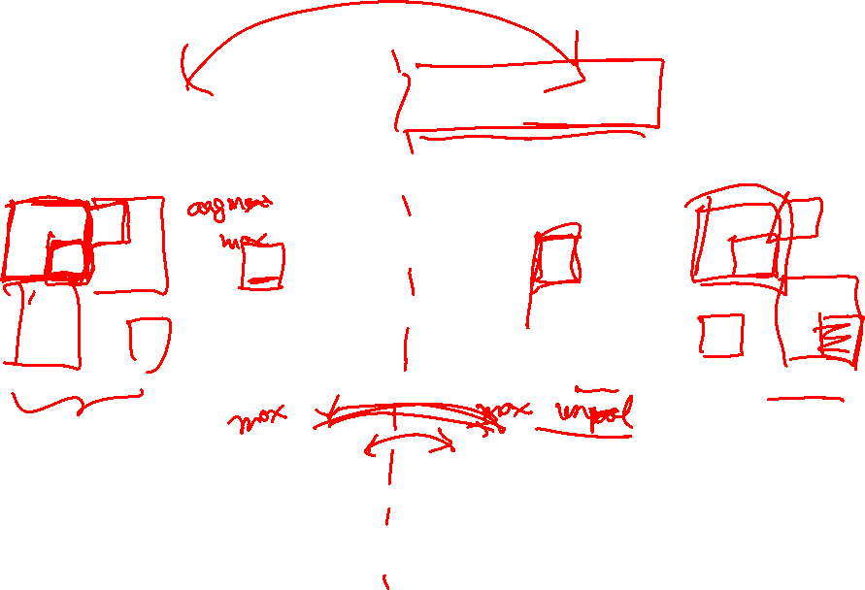
In-Network upsampling: “Max Unpooling”
Max Pooling
Remember which element was max!
Max Unpooling
Use positions from pooling layer
1 | 2 | 6 | 3
3 | 5 | 2 | 1
1 | 2 | 2 | 1
7 | 3 | 4 | 8
0 | 0 | 2 | 0
0 | 1 | 0 | 0
0 | 0 | 0 | 0
3 | 0 | 0 | 4
5 | 6
7 | 8
…
1 | 2
3 | 4
Rest of the network
Input: 4 x 4
Output: 2 x 2
Input: 2 x 2
Output: 4 x 4
Corresponding pairs of downsampling and upsampling layers
Slide Credit: Fei-Fei Li, Justin Johnson, Serena Yeung, CS 231n

Slide 25
Plan for Today
Convolutional Neural Networks
Transposed convolutions
Visualizing CNNs

Slide 26
Transposed Convolutions
Deconvolution (bad)
Upconvolution
Fractionally strided convolution
Backward strided convolution

Slide 27
Learnable Upsampling: Transpose Convolution
Recall:Typical 3 x 3 convolution, stride 1 pad 1
Input: 4 x 4
Output: 4 x 4
Slide Credit: Fei-Fei Li, Justin Johnson, Serena Yeung, CS 231n

Slide 28
Learnable Upsampling: Transpose Convolution
Recall: Normal 3 x 3 convolution, stride 1 pad 1
Dot product between filter and input
Input: 4 x 4
Output: 4 x 4
Slide Credit: Fei-Fei Li, Justin Johnson, Serena Yeung, CS 231n

Slide 29
Learnable Upsampling: Transpose Convolution
Recall: Normal 3 x 3 convolution, stride 1 pad 1
Dot product between filter and input
Input: 4 x 4
Output: 4 x 4
Slide Credit: Fei-Fei Li, Justin Johnson, Serena Yeung, CS 231n

Slide 30
Learnable Upsampling: Transpose Convolution
Recall: Normal 3 x 3 convolution, stride 2 pad 1
Input: 4 x 4
Output: 2 x 2
Slide Credit: Fei-Fei Li, Justin Johnson, Serena Yeung, CS 231n

Slide 31
Learnable Upsampling: Transpose Convolution
Recall: Normal 3 x 3 convolution, stride 2 pad 1
Dot product between filter and input
Input: 4 x 4
Output: 2 x 2
Slide Credit: Fei-Fei Li, Justin Johnson, Serena Yeung, CS 231n

Slide 32
Learnable Upsampling: Transpose Convolution
Recall: Normal 3 x 3 convolution, stride 2 pad 1
Filter moves 2 pixels in the input for every one pixel in the output
Stride gives ratio between movement in input and output
Dot product between filter and input
Input: 4 x 4
Output: 2 x 2
Slide Credit: Fei-Fei Li, Justin Johnson, Serena Yeung, CS 231n

Slide 33
Learnable Upsampling: Transpose Convolution
3 x 3 transpose convolution, stride 2 pad 1
Input: 2 x 2
Output: 4 x 4
Slide Credit: Fei-Fei Li, Justin Johnson, Serena Yeung, CS 231n

Slide 34
Learnable Upsampling: Transpose Convolution
3 x 3 transpose convolution, stride 2 pad 1
Input gives weight for filter
Input: 2 x 2
Output: 4 x 4
Slide Credit: Fei-Fei Li, Justin Johnson, Serena Yeung, CS 231n

Slide 35
Learnable Upsampling: Transpose Convolution
3 x 3 transpose convolution, stride 2 pad 1
Sum where output overlaps
Filter moves 2 pixels in the output for every one pixel in the input
Stride gives ratio between movement in output and input
Input gives weight for filter
Input: 2 x 2
Output: 4 x 4
Slide Credit: Fei-Fei Li, Justin Johnson, Serena Yeung, CS 231n

Slide 36
Learnable Upsampling: Transpose Convolution
3 x 3 transpose convolution, stride 2 pad 1
Sum where output overlaps
Other names:
-Deconvolution (bad)
-Upconvolution
-Fractionally strided convolution
-Backward strided convolution
Filter moves 2 pixels in the output for every one pixel in the input
Stride gives ratio between movement in output and input
Input gives weight for filter
Input: 2 x 2
Output: 4 x 4
Slide Credit: Fei-Fei Li, Justin Johnson, Serena Yeung, CS 231n

Slide 37
Transpose Convolution: 1D Example
Output
Input
Filter
ax
ay
az + bx
by
bz
Output contains copies of the filter weighted by the input, summing at where at overlaps in the output
Need to crop one pixel from output to make output exactly 2x input
x
y
z
a
b
Slide Credit: Fei-Fei Li, Justin Johnson, Serena Yeung, CS 231n

Slide 38
Transposed Convolution
https://distill.pub/2016/deconv-checkerboard/

Slide 39
Semantic Segmentation Idea: Fully Convolutional
Downsampling:
Pooling, strided convolution
Design network as a bunch of convolutional layers, with downsampling and upsampling inside the network!
Upsampling:
Unpooling or strided transpose convolution
Med-res:
D₂ x H/4 x W/4
Med-res:
D₂ x H/4 x W/4
Low-res:
D₃ x H/4 x W/4
Input:
3 x H x W
High-res:
D₁ x H/2 x W/2
High-res:
D₁ x H/2 x W/2
Predictions:
H x W
Long, Shelhamer, and Darrell, “Fully Convolutional Networks for Semantic Segmentation”, CVPR 2015 Noh et al, “Learning Deconvolution Network for Semantic Segmentation”, ICCV 2015
Slide Credit: Fei-Fei Li, Justin Johnson, Serena Yeung, CS 231n

Slide 40
In-Network upsampling: “Unpooling”
Nearest Neighbor
“Bed of Nails”
1 | 0 | 2 | 0
0 | 0 | 0 | 0
3 | 0 | 4 | 0
0 | 0 | 0 | 0
1 | 1 | 2 | 2
1 | 1 | 2 | 2
3 | 3 | 4 | 4
3 | 3 | 4 | 4
1 | 2
3 | 4
1 | 2
3 | 4
Input: 2 x 2
Output: 4 x 4
Input: 2 x 2
Output: 4 x 4
Slide Credit: Fei-Fei Li, Justin Johnson, Serena Yeung, CS 231n

Slide 41
Why this operation?

Slide 42
What is deconvolution?
(Non-blind) Deconvolution

Slide 43
What is deconvolution?
(Non-blind) Deconvolution

Slide 44
What does “deconvolution” have to do with “transposed convolution”?

Slide 46

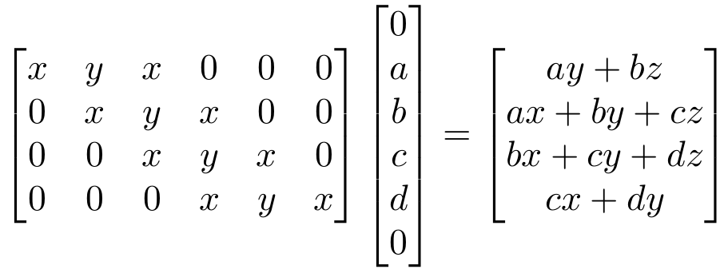
“transposed convolution” is a convolution!
We can express convolution in terms of a matrix multiplication
Example: 1D conv, kernel size=3, stride=1, padding=1
Slide Credit: Fei-Fei Li, Justin Johnson, Serena Yeung, CS 231n

Slide 47

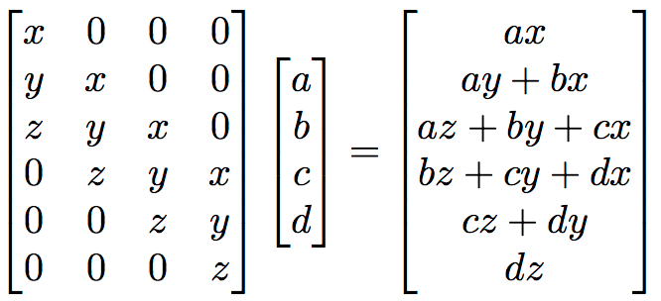
“transposed convolution” is a convolution!
We can express convolution in terms of a matrix multiplication
Convolution transpose multiplies by the transpose of the same matrix:
Example: 1D conv, kernel size=3, stride=1, padding=1
Slide Credit: Fei-Fei Li, Justin Johnson, Serena Yeung, CS 231n

Slide 48
“transposed convolution” is a convolution!
We can express convolution in terms of a matrix multiplication
Convolution transpose multiplies by the transpose of the same matrix:
Example: 1D conv, kernel size=3, stride=1, padding=1
When stride=1, convolution transpose is just a regular convolution (with different padding rules)
Slide Credit: Fei-Fei Li, Justin Johnson, Serena Yeung, CS 231n

Slide 49
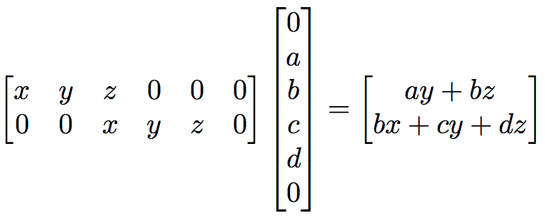
But not always
We can express convolution in terms of a matrix multiplication
Example: 1D conv, kernel size=3, stride=2, padding=1
Slide Credit: Fei-Fei Li, Justin Johnson, Serena Yeung, CS 231n

Slide 50
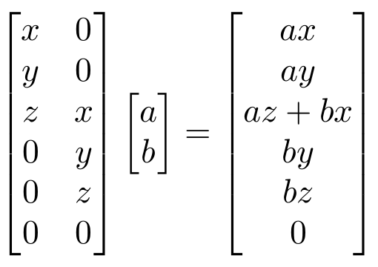
But not always
We can express convolution in terms of a matrix multiplication
Convolution transpose multiplies by the transpose of the same matrix:
Example: 1D conv, kernel size=3, stride=2, padding=1
When stride>1, convolution transpose is no longer a normal convolution!
Slide Credit: Fei-Fei Li, Justin Johnson, Serena Yeung, CS 231n

Slide 51
Plan for Today
Convolutional Neural Networks
Transposed convolutions
Visualizing CNNs

Slide 52
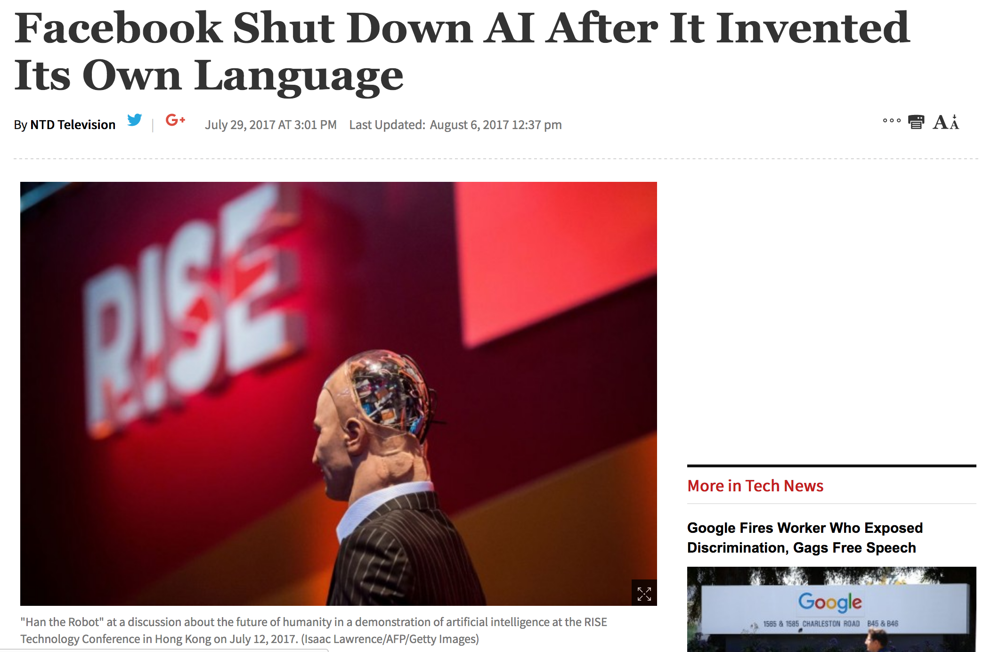
Story from Summer 2017…

Slide 53
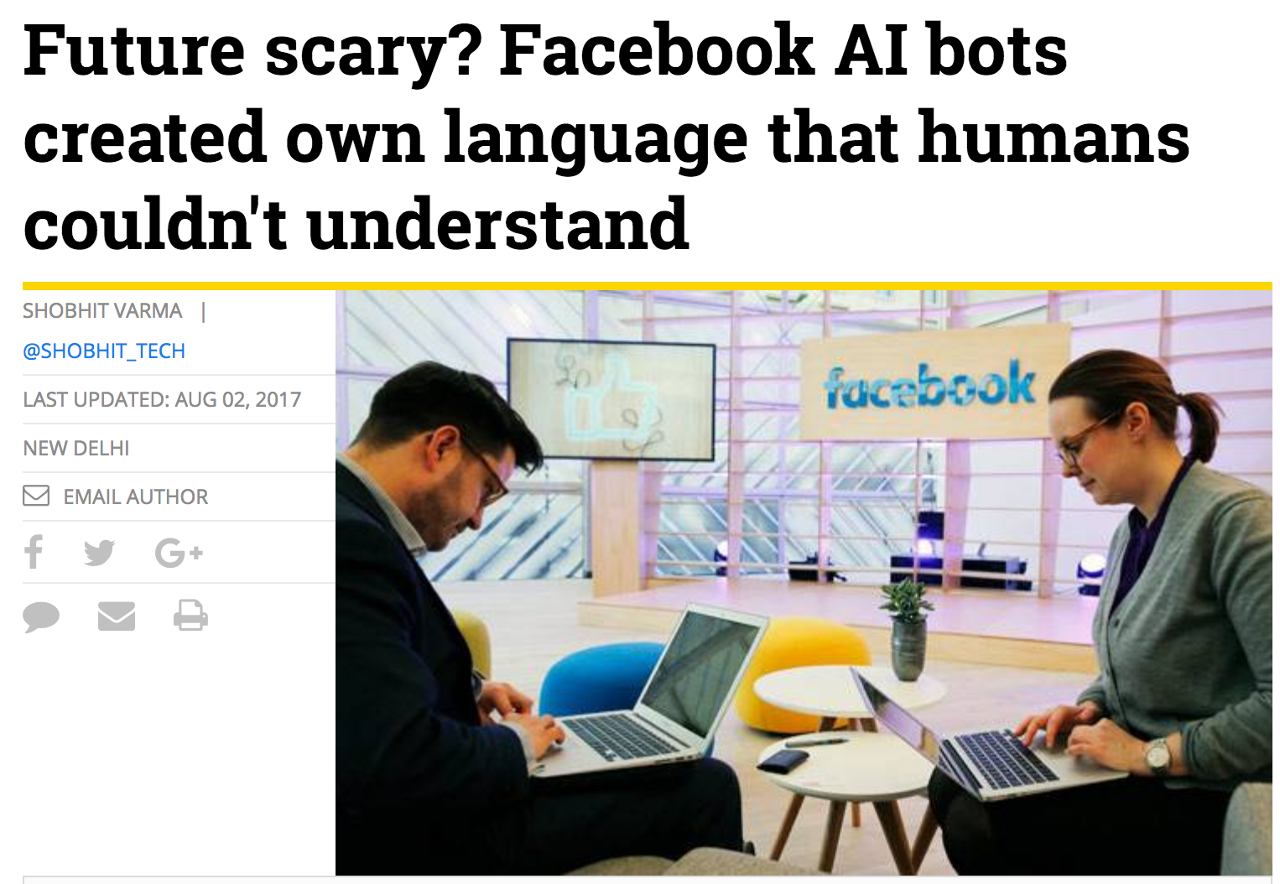

Slide 54
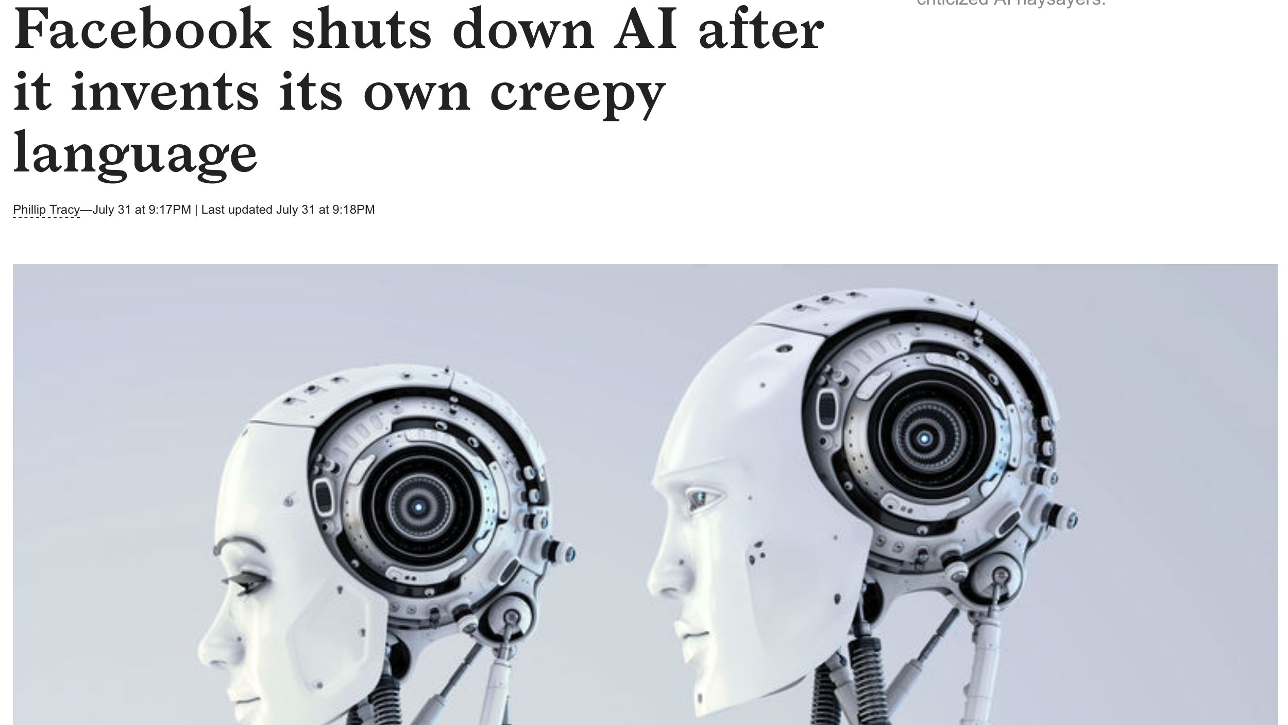
Story from last week…

Slide 55
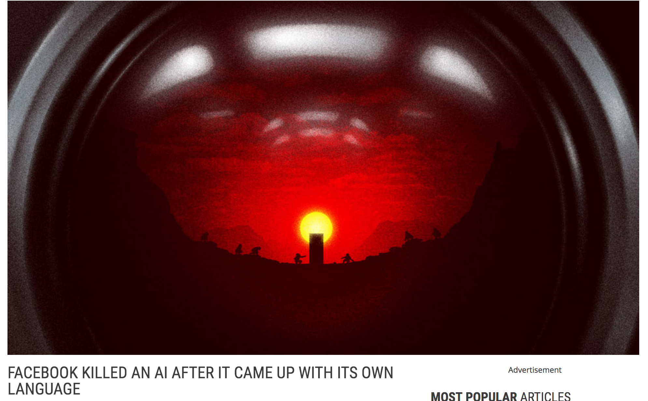
Story from last week…

Slide 56
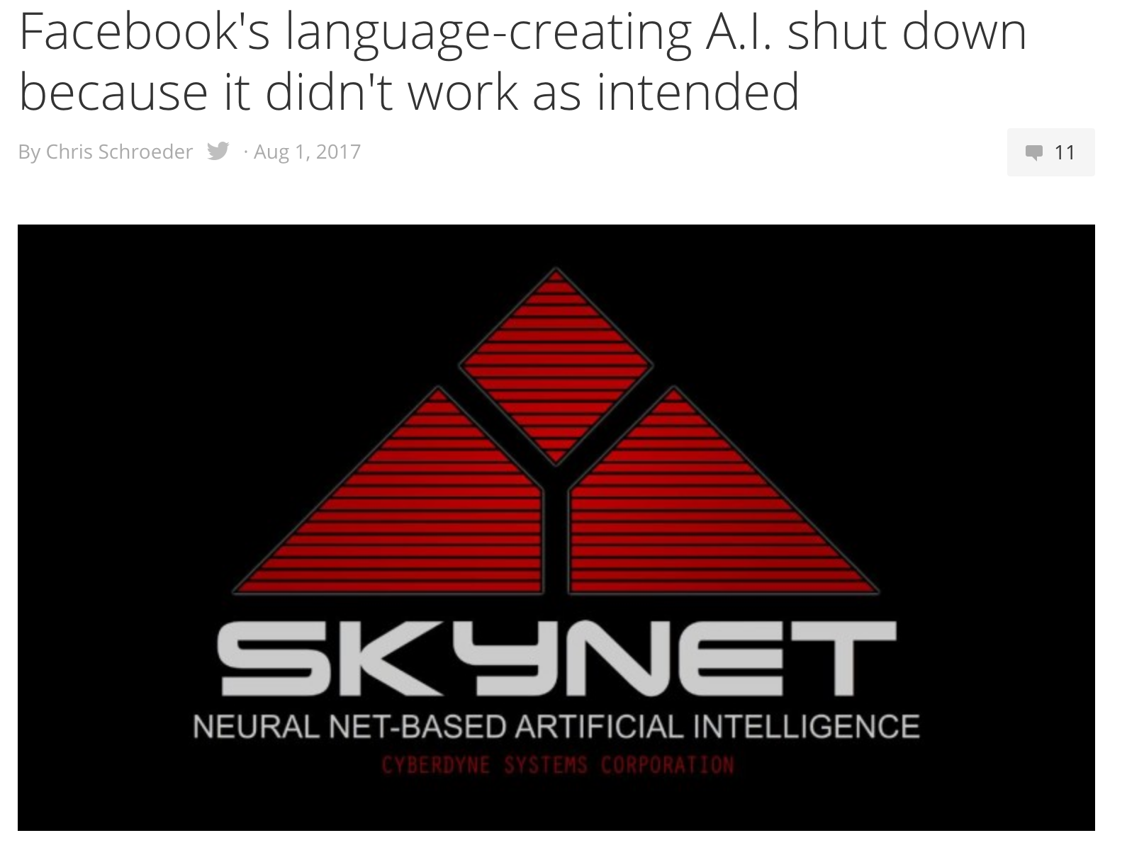
Story from last week…

Slide 57
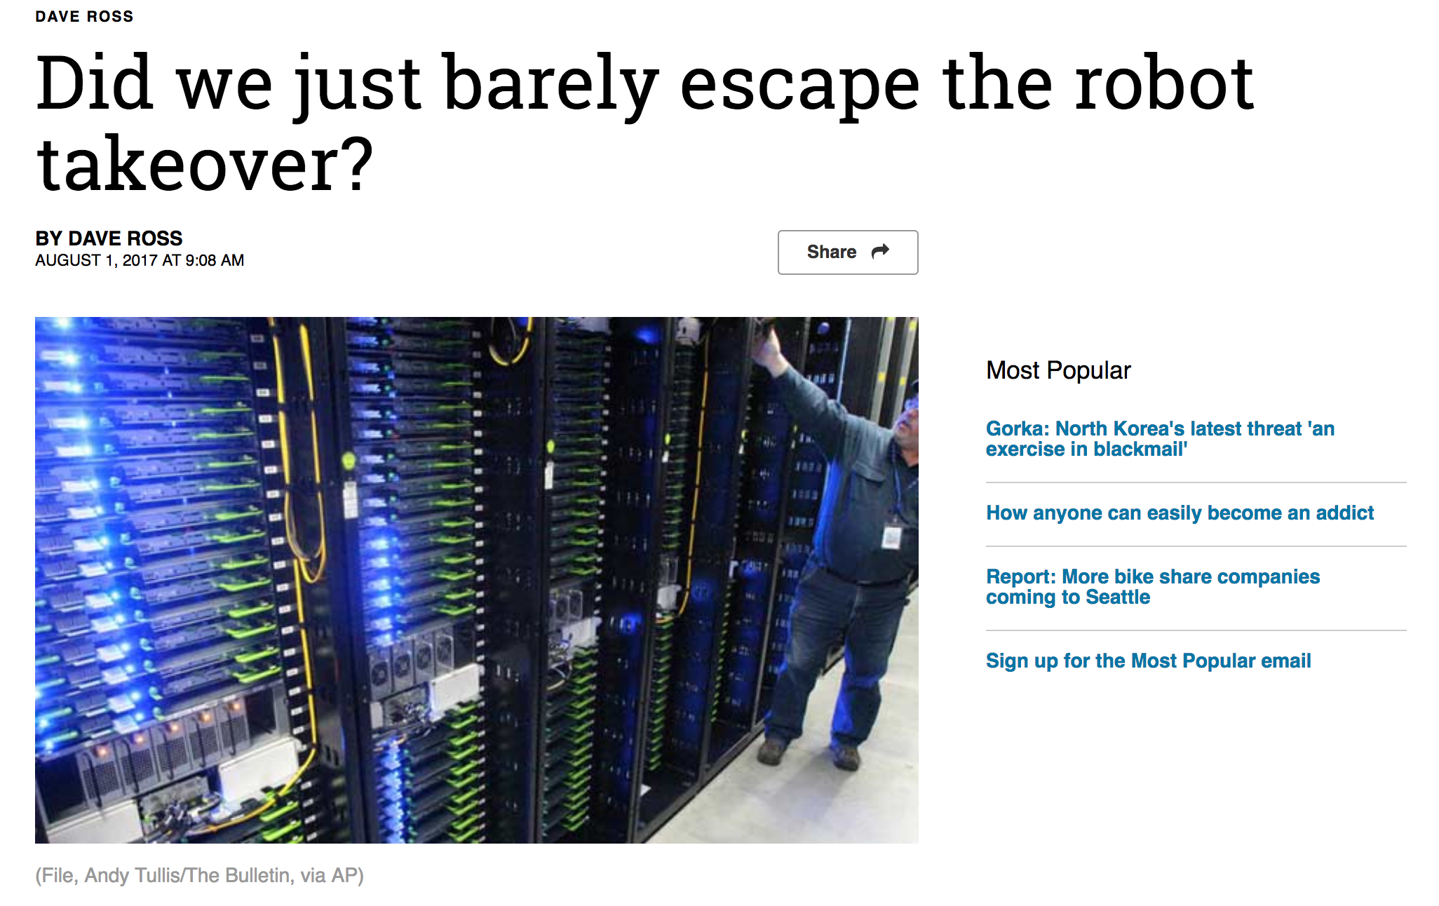
Story from last week…

Slide 58
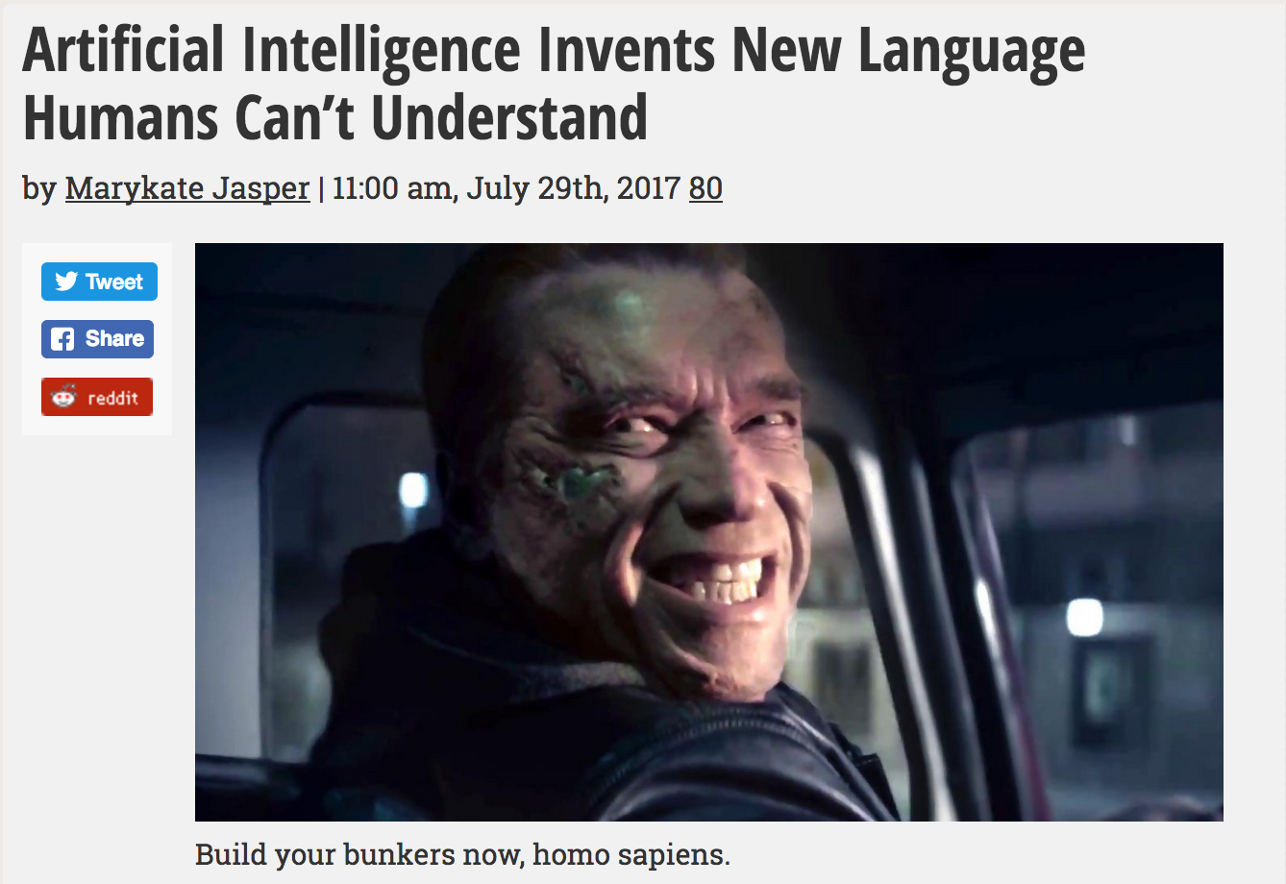
Story from last week…

Slide 59
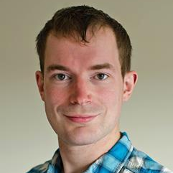

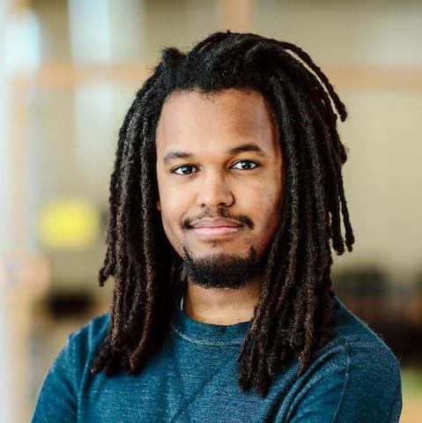
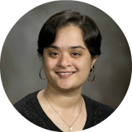
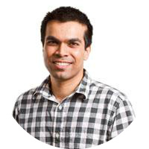
Deal or No Deal? End-to-End Learning for Negotiation Dialogues [EMNLP ‘17]
Mike Lewis (FAIR)
Denis Yarats (FAIR)
Yann Dauphin (FAIR)
Devi Parikh (Georgia Tech / FAIR)
Dhruv Batra (Georgia Tech / FAIR)

Slide 60



Object Division Task
Agents shown same set of object but different values for each
Asked to agree how to divide objects between them
2 points each
1 point each
5 points each
Slide Credit: Mike Lewis

Slide 61
Multi-Issue Bargaining
I’d like the ball and hats
I need the hats, you can have the ball
Ok, if I get both books?
Ok, deal
Slide Credit: Mike Lewis

Slide 62
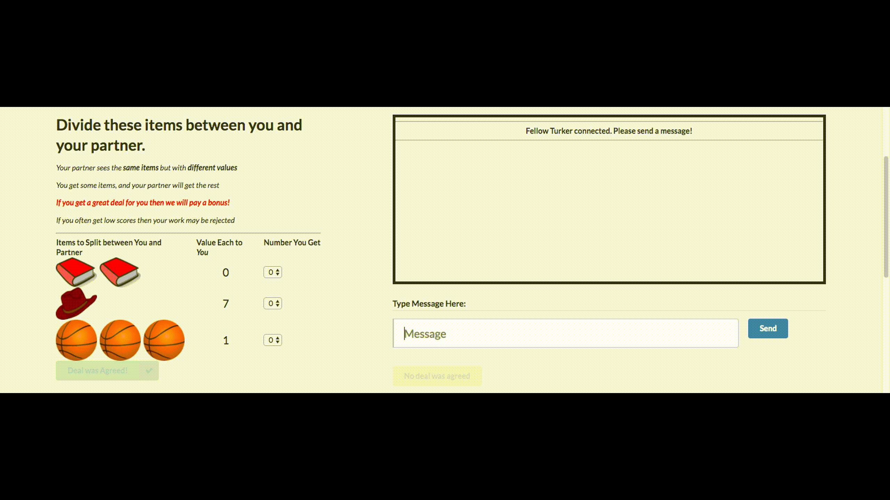
Data Collection on AMT
Slide Credit: Mike Lewis

Slide 63
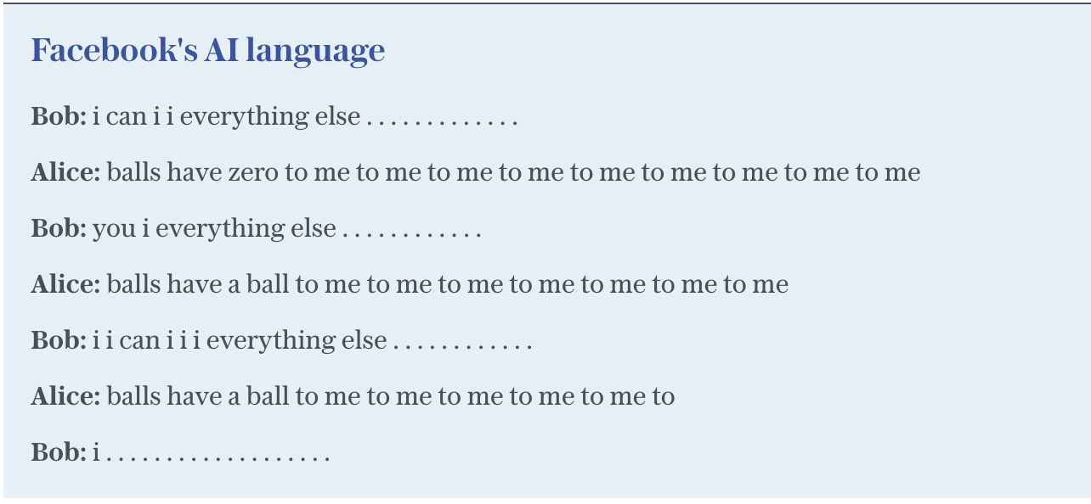
What happened?
Results …show that the simple LIKELIHOOD model produces the most human-like responses, and the alternative training and decoding strategies cause a divergence from human language.

Slide 64
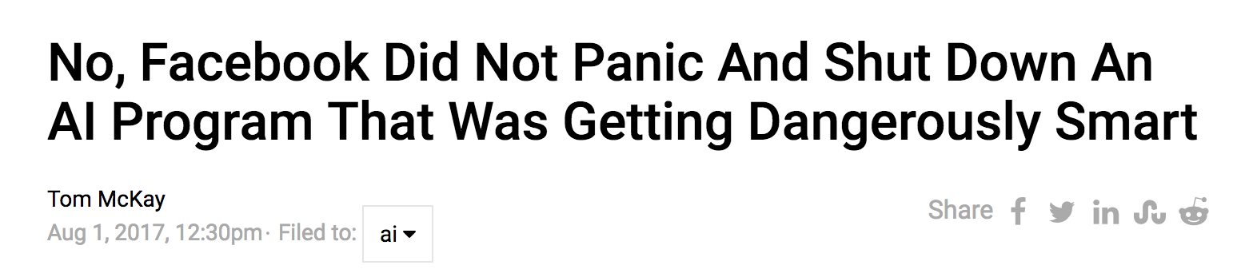
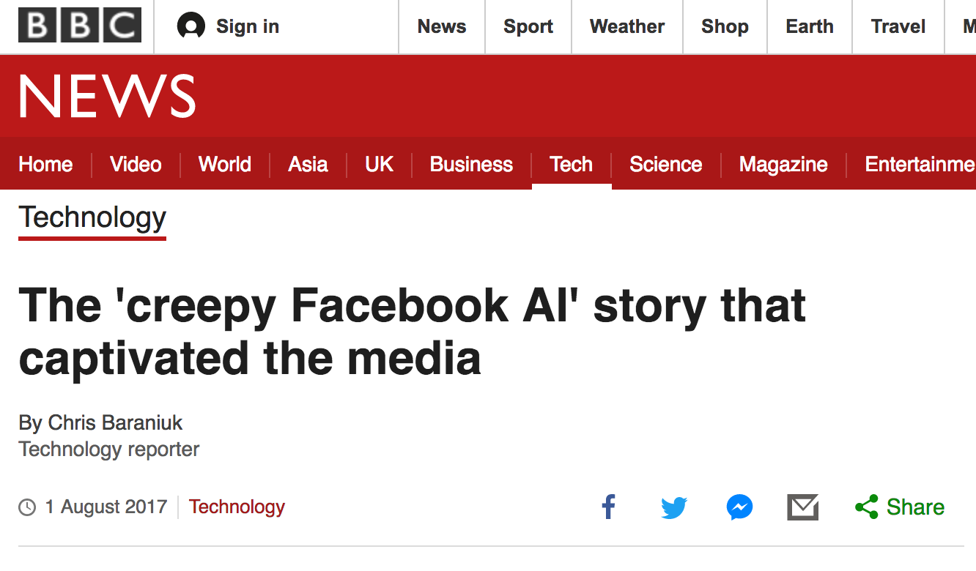
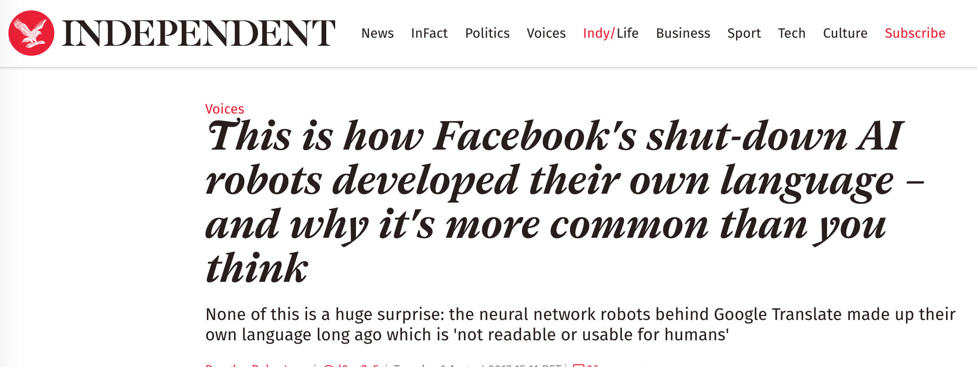

Slide 65

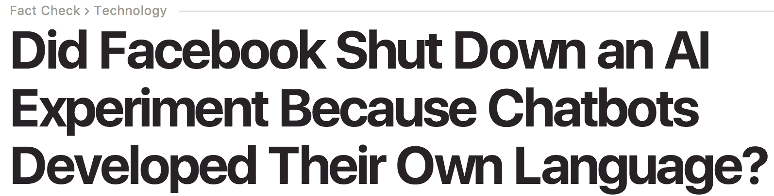
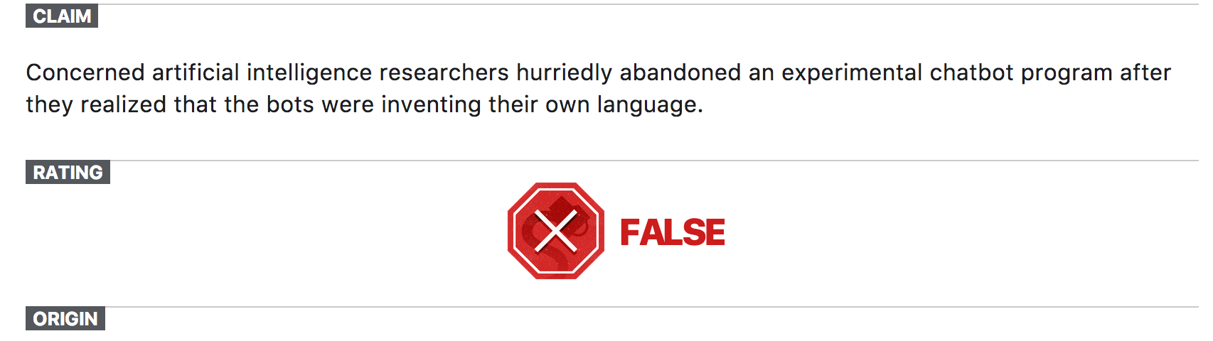

Slide 66

#ShutDownTheAI

Slide 67
Takeaway for us
People don’t trust what they don’t understand

Slide 68


Stories from last year…

Slide 69

Stories from last year…

Slide 70

Stories from last year…
AlphaGo vs Lee Sedol, Match 4, Move 78

Slide 71


Stories from last year…
AlphaGo vs Lee Sedol, Match 4, Press Conference

Slide 72

…Story from 1980s
Tanks vs No-Tanks, or Sunny vs Cloudy?

Slide 73
Explainable AI
Why does an intelligent system do what it does?

Slide 74

Explainable AI
a data subject has the right to “an explanation of the decision reached after [algorithmic] assessment.”
[Goodman & Flaxman, ICML Workshop on Human Interpretability, 2016]

Slide 75


DARPA XAI

Slide 76
Explainable AI
Why does an intelligent system do what it does?
Justification from Test Data
What evidence in test data supports this prediction?
Justification from Training Data
What training data/annotations support these predictions?
Explaining a prediction
Explaining a model

Slide 77





Explaining/Trusting a Prediction
Why?

Slide 78


Explaining/Trusting a Model
Should I put this into production?
Usually related to trusting most predictions
Slide Credit: Marco Ribeiro, Sameer Singh

Slide 79
What do we do today for trust?
Slide Credit: Marco Ribeiro, Sameer Singh

Slide 80

1. Use simple/interpretable models
Can be great, but usually at the cost of:
Accuracy
Flexibility
Speed
Slide Credit: Marco Ribeiro, Sameer Singh

Slide 81


2. Dark Magic
“Trust me” / Gut Feeling
"I looked at a few examples and it seems to work”
"I've done this before"
“Trust me child”
“I know how the brain works”

Slide 82
Explainable AI
When AI is weaker than humans
Transparency = finding error modes
Goal = improving machines
When AI is at par with humans
Transparency = providing rationales
Goal = building trust with humans
When AI is stronger than humans
Transparency = explaining a complicated function
Goal = teaching humans

Slide 83


Slide 84
Machines Teaching Humans
Park Yeong-hun, who was recently defeated by Lee Sedol in the Maxim Cup semifinal match said:
"Sedol surprised people by copying the moves of AlphaGo in the Ing Cup….
It appears he has learned something from the five matches against AlphaGo,
and his game of go, which was strong to begin with, seems stronger because of that."

Slide 85
Explainable AI: Visual Explanations
Where does an intelligent system “look” to make its predictions?

