Slide 1

CS 4803 / 7643: Deep Learning
Lecture 10: Training Neural Networks Part II
Topics:
More normalization
Fancier optimization
Regularization
Transfer Learning
Peter Anderson
Georgia Tech
www.panderson.me

Slide 2
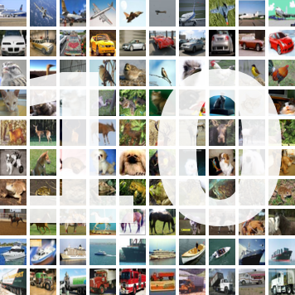
Administrative
HW1 due Oct 2
Allow time for the last question – CIFAR 10 network:
Outperform baseline: 100% credit for sub-question
Outperform TA’s: Extra credit!

Slide 3
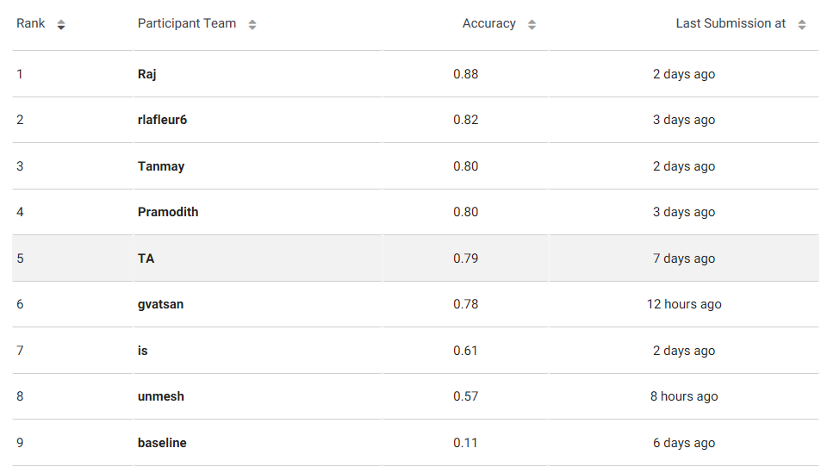
Current leaderboard for HW1

Slide 4
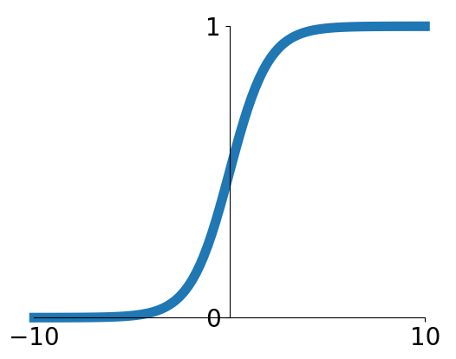
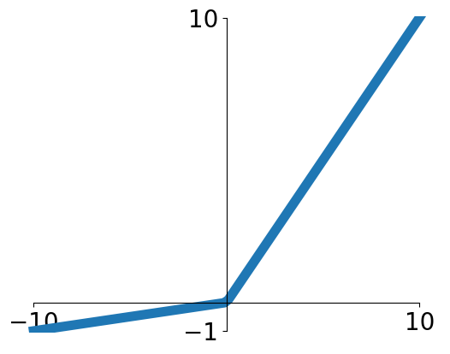


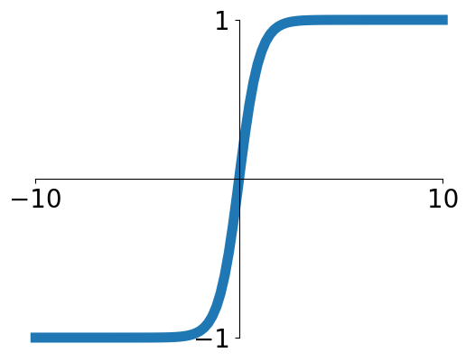


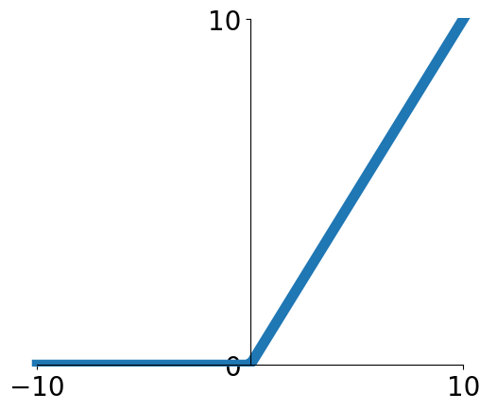
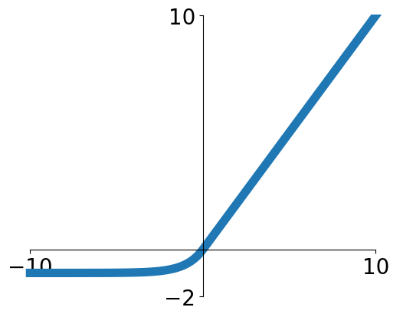

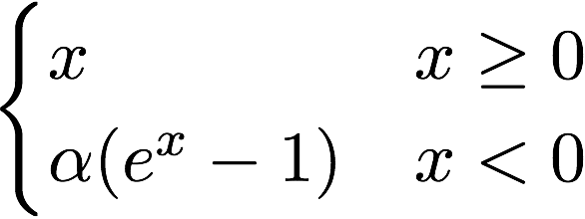
Previously: Activation Functions
Sigmoid
Leaky ReLU
tanh
Maxout
ReLU
ELU
Slide Credit: Fei-Fei Li, Justin Johnson, Serena Yeung, CS 231n

Slide 5
Previously: Activation Functions
Sigmoid
Leaky ReLU
tanh
Maxout
ReLU
ELU
Good default choice
Slide Credit: Fei-Fei Li, Justin Johnson, Serena Yeung, CS 231n

Slide 6
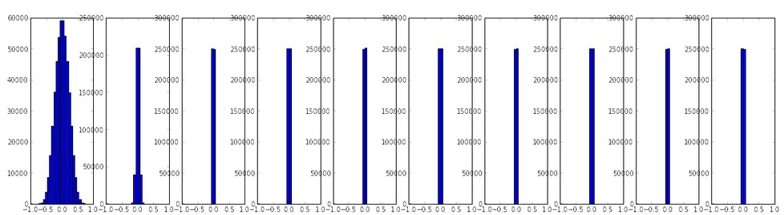
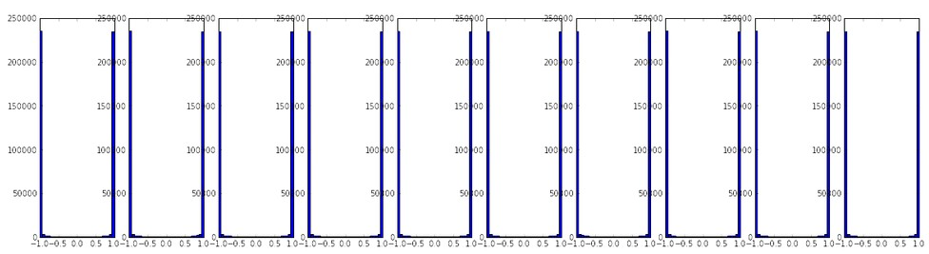
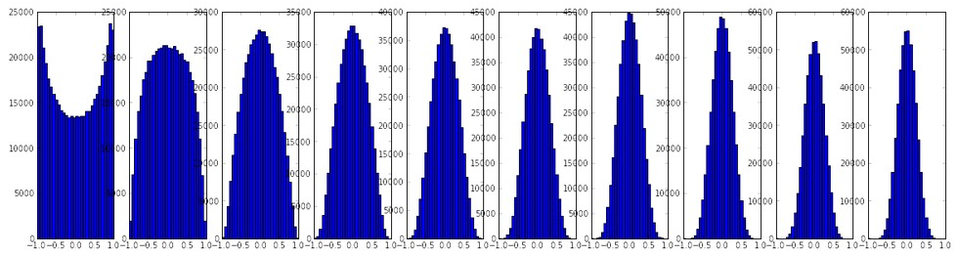
Previously: Weight Initialization
Initialization too small:
Activations go to zero, gradients also zero,
No learning
Initialization too big:
Activations saturate (for tanh),
Gradients zero, no learning
Initialization just right:
Nice distribution of activations at all layers,
Learning proceeds nicely
Slide Credit: Fei-Fei Li, Justin Johnson, Serena Yeung, CS 231n

Slide 7
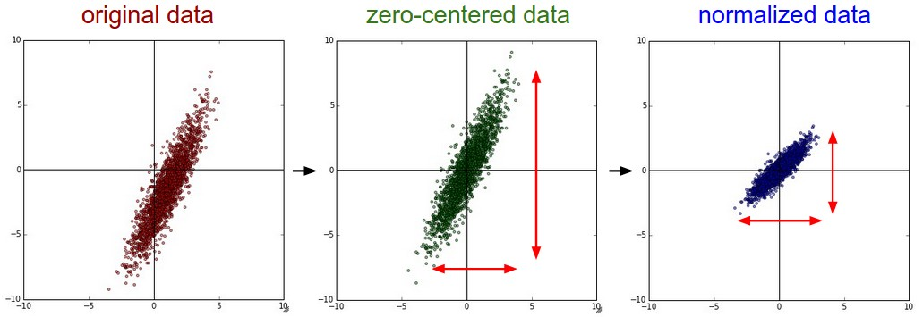
Previously: Data Preprocessing
Slide Credit: Fei-Fei Li, Justin Johnson, Serena Yeung, CS 231n

Slide 8
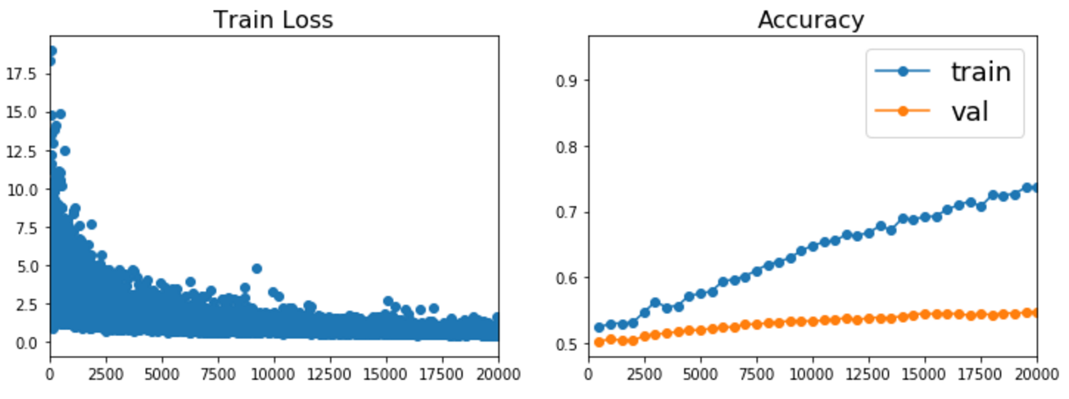
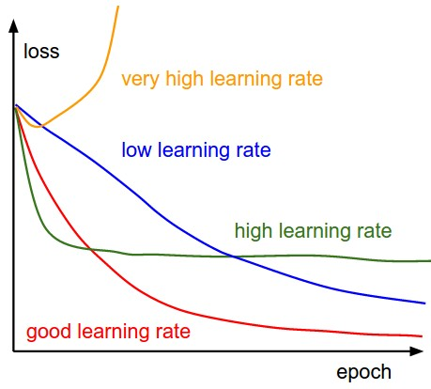
Previously: Babysitting Learning
Slide Credit: Fei-Fei Li, Justin Johnson, Serena Yeung, CS 231n

Slide 9
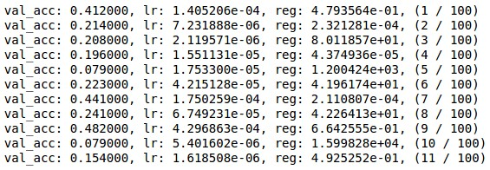
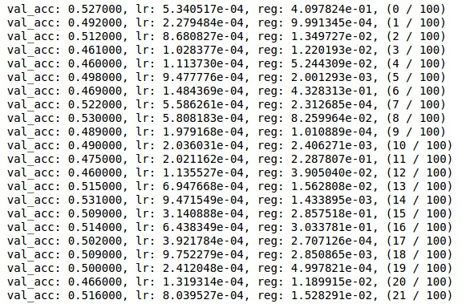
Previously: Hyperparameter Search
Coarse to fine search
Grid Layout
Random Layout
Unimportant Parameter
Unimportant Parameter
Important Parameter
Important Parameter
Slide Credit: Fei-Fei Li, Justin Johnson, Serena Yeung, CS 231n

Slide 10
Today
More normalization
Fancier optimization
Regularization
Transfer Learning
Slide Credit: Fei-Fei Li, Justin Johnson, Serena Yeung, CS 231n

Slide 11

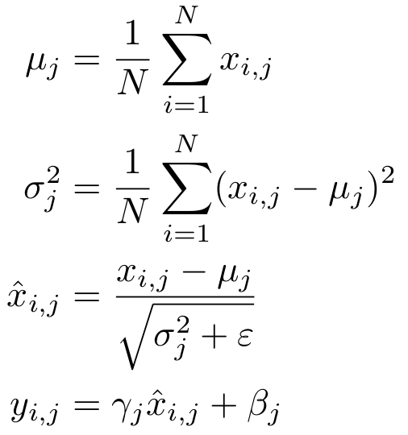

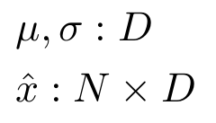

Previously: Batch Normalization
Input:
Learnable params:
Intermediates:
Output:
Slide Credit: Fei-Fei Li, Justin Johnson, Serena Yeung, CS 231n

Slide 12
Estimate mean and variance from minibatch;
Can’t do this at test-time
Previously: Batch Normalization
Input:
Learnable params:
Intermediates:
Output:
Slide Credit: Fei-Fei Li, Justin Johnson, Serena Yeung, CS 231n

Slide 13
Batch Normalization: Test Time
Input:
(Running) average of values seen during training
Learnable params:
(Running) average of values seen during training
Intermediates:
Output:
Slide Credit: Fei-Fei Li, Justin Johnson, Serena Yeung, CS 231n

Slide 14
Batch Normalization for ConvNets
Batch Normalization for
convolutional networks
(Spatial Batchnorm, BatchNorm2D)
Batch Normalization for fully-connected networks
x: N × D
𝞵,𝝈: 1 × D
ɣ,β: 1 × D
y = ɣ(x-𝞵)/𝝈+β
x: N×C×H×W
𝞵,𝝈: 1×C×1×1
ɣ,β: 1×C×1×1
y = ɣ(x-𝞵)/𝝈+β
Normalize
Normalize
Slide Credit: Fei-Fei Li, Justin Johnson, Serena Yeung, CS 231n

Slide 15
Layer Normalization
Layer Normalization for fully-connected networks
Same behavior at train and test!
Can be used in recurrent networks
Batch Normalization for fully-connected networks
x: N × D
𝞵,𝝈: 1 × D
ɣ,β: 1 × D
y = ɣ(x-𝞵)/𝝈+β
x: N × D
𝞵,𝝈: N × 1
ɣ,β: 1 × D
y = ɣ(x-𝞵)/𝝈+β
Normalize
Normalize
Ba, Kiros, and Hinton, “Layer Normalization”, arXiv 2016
Slide Credit: Fei-Fei Li, Justin Johnson, Serena Yeung, CS 231n

Slide 16
Instance Normalization
Batch Normalization for convolutional networks
Instance Normalization for convolutional networks
Same behavior at train / test!
x: N×C×H×W
𝞵,𝝈: 1×C×1×1
ɣ,β: 1×C×1×1
y = ɣ(x-𝞵)/𝝈+β
x: N×C×H×W
𝞵,𝝈: N×C×1×1
ɣ,β: 1×C×1×1
y = ɣ(x-𝞵)/𝝈+β
Normalize
Normalize
Ulyanov et al, Improved Texture Networks: Maximizing Quality and Diversity in Feed-forward Stylization and Texture Synthesis, CVPR 2017
Slide Credit: Fei-Fei Li, Justin Johnson, Serena Yeung, CS 231n

Slide 17
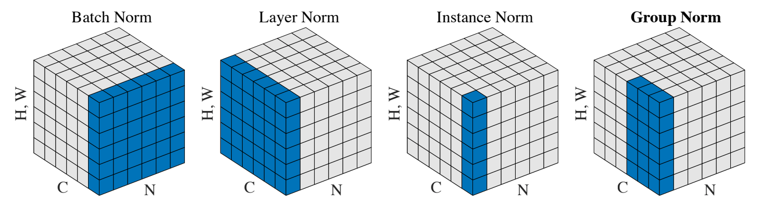
Comparison of Normalization Layers
Wu and He, “Group Normalization”, arXiv 2018
Slide Credit: Fei-Fei Li, Justin Johnson, Serena Yeung, CS 231n

Slide 18
Group Normalization
Wu and He, “Group Normalization”, arXiv 2018
Slide Credit: Fei-Fei Li, Justin Johnson, Serena Yeung, CS 231n

Slide 19
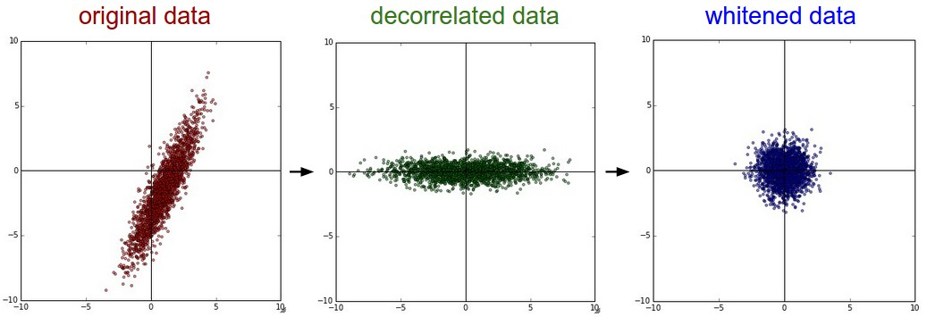
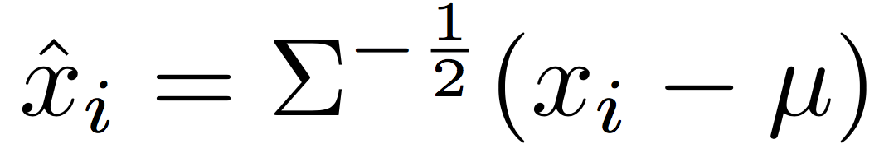
Decorrelated Batch Normalization
Batch Normalization
Decorrelated Batch Normalization
BatchNorm normalizes the data, but cannot correct for correlations among the input features
DBN whitens the data using the full covariance matrix of the minibatch; this corrects for correlations
Huang et al, “Decorrelated Batch Normalization”, arXiv 2018 (Appeared 4/23/2018)
Slide Credit: Fei-Fei Li, Justin Johnson, Serena Yeung, CS 231n

Slide 20

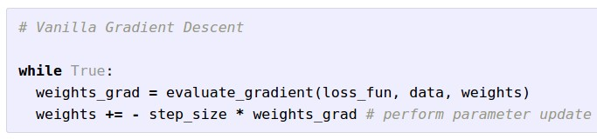
Optimization
W_2
W_1
Slide Credit: Fei-Fei Li, Justin Johnson, Serena Yeung, CS 231n

Slide 21
Optimization: Problems with SGD (1)
What if loss changes quickly in one direction and slowly in another?
What does gradient descent do?
Loss function has high condition number: ratio of largest to smallest singular value of the Hessian matrix is large
Slide Credit: Fei-Fei Li, Justin Johnson, Serena Yeung, CS 231n

Slide 22
Optimization: Problems with SGD (1)
What if loss changes quickly in one direction and slowly in another?
What does gradient descent do?
Very slow progress along shallow dimension, jitter along steep direction
Loss function has high condition number: ratio of largest to smallest singular value of the Hessian matrix is large
Slide Credit: Fei-Fei Li, Justin Johnson, Serena Yeung, CS 231n

Slide 23
Optimization: Problems with SGD (2)
What if the loss function has a local minima or saddle point?
Slide Credit: Fei-Fei Li, Justin Johnson, Serena Yeung, CS 231n

Slide 24
Optimization: Problems with SGD (2)
What if the loss function has a local minima or saddle point?
Zero gradient, gradient descent gets stuck
Slide Credit: Fei-Fei Li, Justin Johnson, Serena Yeung, CS 231n

Slide 25
Optimization: Problems with SGD (2)
What if the loss function has a local minima or saddle point?
Saddle points much more common in high dimension
Dauphin et al, “Identifying and attacking the saddle point problem in high-dimensional non-convex optimization”, NIPS 2014
Slide Credit: Fei-Fei Li, Justin Johnson, Serena Yeung, CS 231n

Slide 26
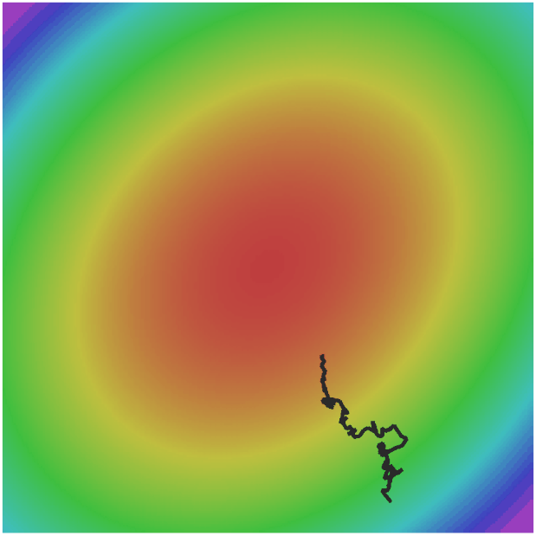
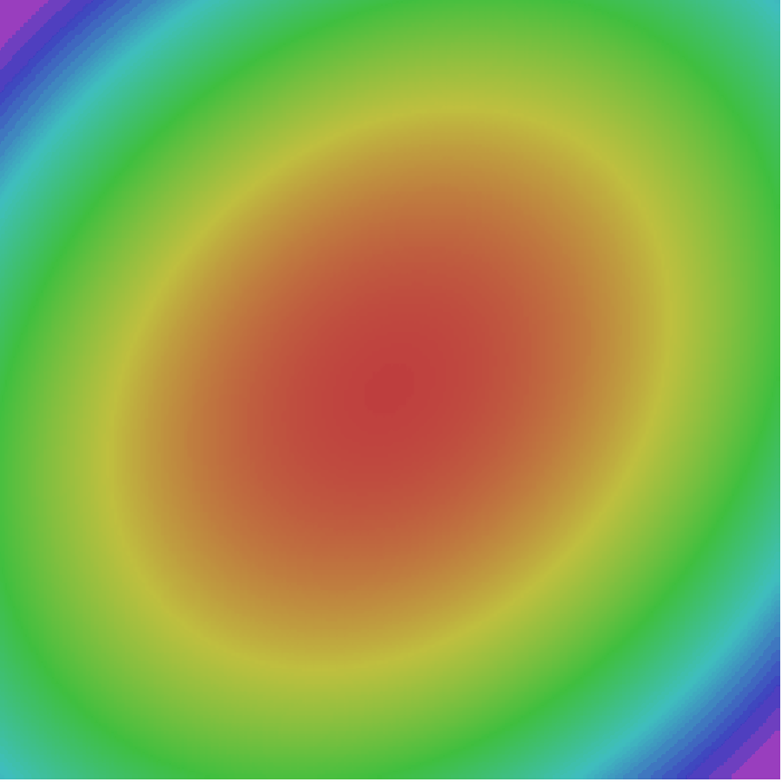
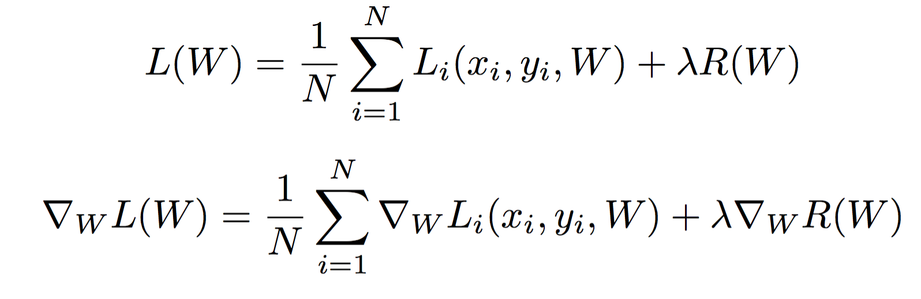
Optimization: Problems with SGD (3)
Our gradients come from minibatches so they can be noisy!
Slide Credit: Fei-Fei Li, Justin Johnson, Serena Yeung, CS 231n

Slide 27
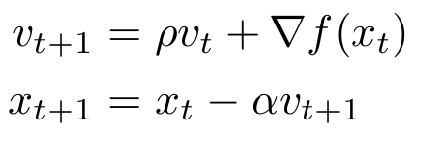

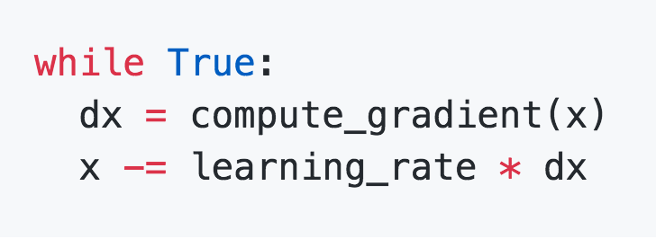
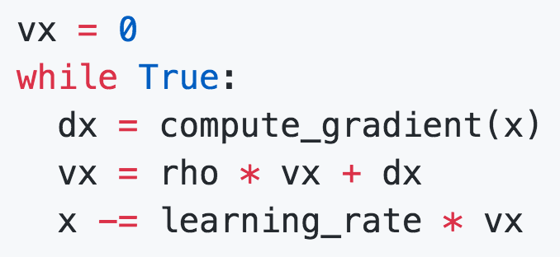
SGD + Momentum
SGD
SGD+Momentum
Build up “velocity” as a running mean of gradients
Rho gives “friction”; typically rho=0.9 or 0.99
Sutskever et al, “On the importance of initialization and momentum in deep learning”, ICML 2013
Slide Credit: Fei-Fei Li, Justin Johnson, Serena Yeung, CS 231n

Slide 28
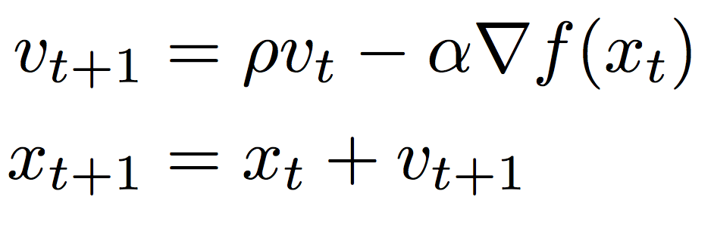
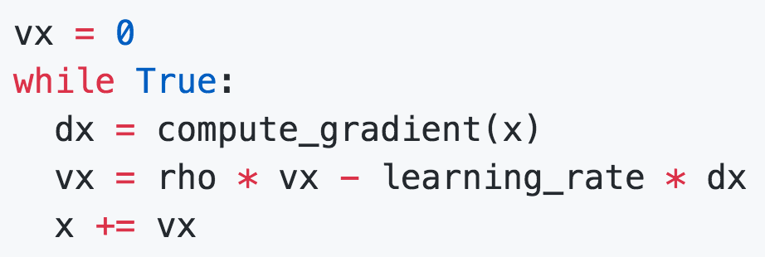
SGD + Momentum
SGD+Momentum
SGD+Momentum
You may see SGD+Momentum formulated different ways, but they are equivalent - give same sequence of x
Sutskever et al, “On the importance of initialization and momentum in deep learning”, ICML 2013
Slide Credit: Fei-Fei Li, Justin Johnson, Serena Yeung, CS 231n

Slide 29
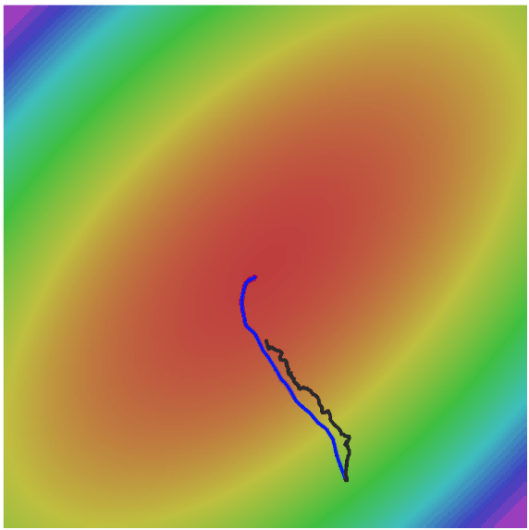
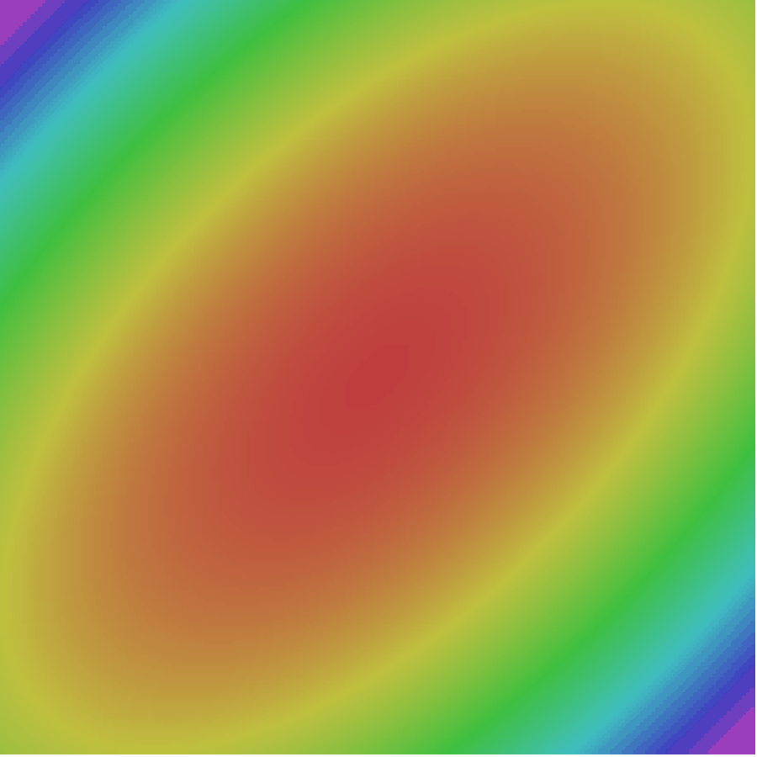
SGD + Momentum
Gradient Noise
Local Minima
Saddle points
Poor Conditioning
SGD
SGD+Momentum
Slide Credit: Fei-Fei Li, Justin Johnson, Serena Yeung, CS 231n

Slide 30
SGD+Momentum
Momentum update:
Velocity
actual step
Gradient
Combine gradient at current point with velocity to get step used to update weights
Nesterov, “A method of solving a convex programming problem with convergence rate O(1/k^2)”, 1983
Nesterov, “Introductory lectures on convex optimization: a basic course”, 2004
Sutskever et al, “On the importance of initialization and momentum in deep learning”, ICML 2013
Slide Credit: Fei-Fei Li, Justin Johnson, Serena Yeung, CS 231n

Slide 31
Nesterov Momentum
Momentum update:
Nesterov Momentum
Gradient
Velocity
Velocity
actual step
actual step
Gradient
Combine gradient at current point with velocity to get step used to update weights
“Look ahead” to the point where updating using velocity would take us; compute gradient there and mix it with velocity to get actual update direction
Nesterov, “A method of solving a convex programming problem with convergence rate O(1/k^2)”, 1983
Nesterov, “Introductory lectures on convex optimization: a basic course”, 2004
Sutskever et al, “On the importance of initialization and momentum in deep learning”, ICML 2013
Slide Credit: Fei-Fei Li, Justin Johnson, Serena Yeung, CS 231n

Slide 32
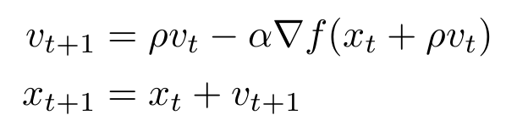
Nesterov Momentum
Gradient
Velocity
actual step
“Look ahead” to the point where updating using velocity would take us; compute gradient there and mix it with velocity to get actual update direction
Slide Credit: Fei-Fei Li, Justin Johnson, Serena Yeung, CS 231n

Slide 33

Nesterov Momentum
Annoying, usually we want
update in terms of
Gradient
Velocity
actual step
“Look ahead” to the point where updating using velocity would take us; compute gradient there and mix it with velocity to get actual update direction
Slide Credit: Fei-Fei Li, Justin Johnson, Serena Yeung, CS 231n

Slide 34

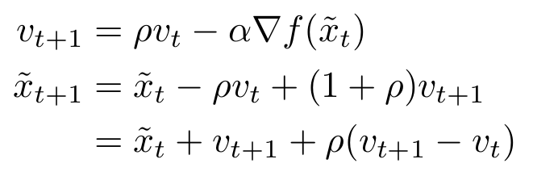
Nesterov Momentum
Annoying, usually we want
update in terms of
Gradient
Velocity
Change of variables and rearrange:
actual step
“Look ahead” to the point where updating using velocity would take us; compute gradient there and mix it with velocity to get actual update direction
Slide Credit: Fei-Fei Li, Justin Johnson, Serena Yeung, CS 231n

Slide 35
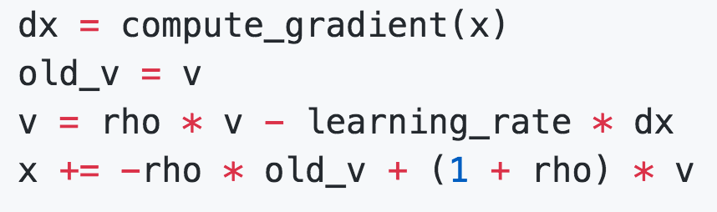
Nesterov Momentum
Annoying, usually we want
update in terms of
Change of variables and rearrange:
Slide Credit: Fei-Fei Li, Justin Johnson, Serena Yeung, CS 231n

Slide 36
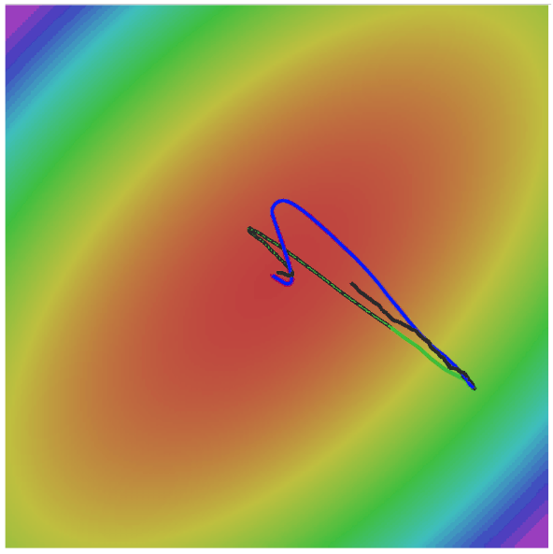
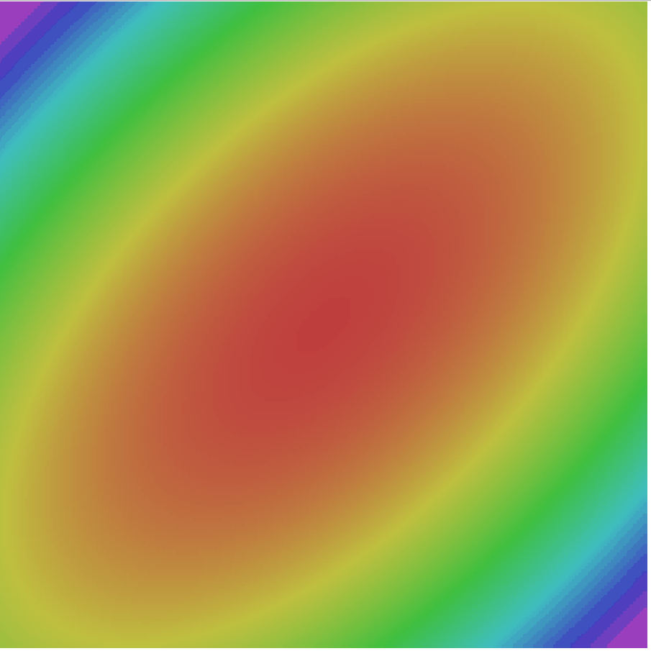
Nesterov Momentum
SGD
SGD+Momentum
Nesterov
Slide Credit: Fei-Fei Li, Justin Johnson, Serena Yeung, CS 231n

Slide 37
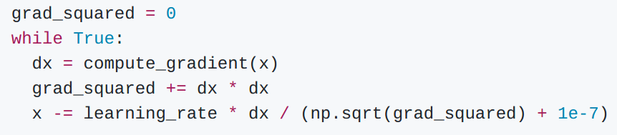
AdaGrad
Added element-wise scaling of the gradient based on the historical sum of squares in each dimension
“Per-parameter learning rates”
or “adaptive learning rates”
Duchi et al, “Adaptive subgradient methods for online learning and stochastic optimization”, JMLR 2011
Slide Credit: Fei-Fei Li, Justin Johnson, Serena Yeung, CS 231n

Slide 38
AdaGrad
Q: What happens with AdaGrad?
Slide Credit: Fei-Fei Li, Justin Johnson, Serena Yeung, CS 231n

Slide 39
AdaGrad
Q: What happens with AdaGrad?
Progress along “steep” directions is damped; progress along “flat” directions is accelerated
Slide Credit: Fei-Fei Li, Justin Johnson, Serena Yeung, CS 231n

Slide 40
AdaGrad
Q2: What happens to the step size over long time?
Slide Credit: Fei-Fei Li, Justin Johnson, Serena Yeung, CS 231n

Slide 41
AdaGrad
Q2: What happens to the step size over long time?
Decays to zero
Slide Credit: Fei-Fei Li, Justin Johnson, Serena Yeung, CS 231n

Slide 42
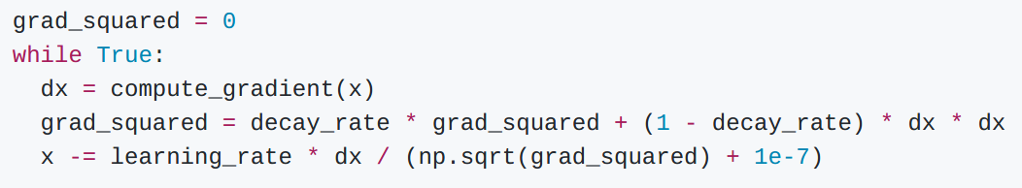
RMSProp
AdaGrad
RMSProp
Tieleman and Hinton, 2012
Slide Credit: Fei-Fei Li, Justin Johnson, Serena Yeung, CS 231n

Slide 43
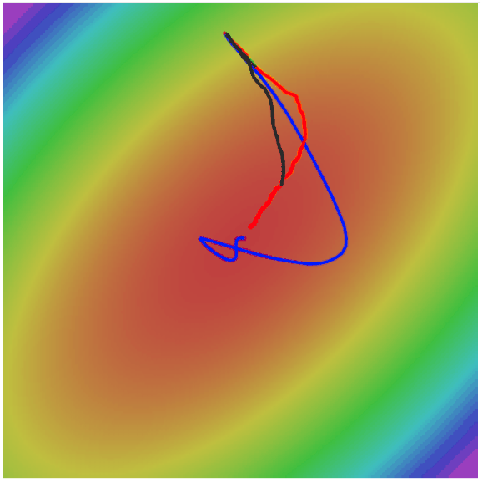
RMSProp
SGD
SGD+Momentum
RMSProp
Slide Credit: Fei-Fei Li, Justin Johnson, Serena Yeung, CS 231n

Slide 44
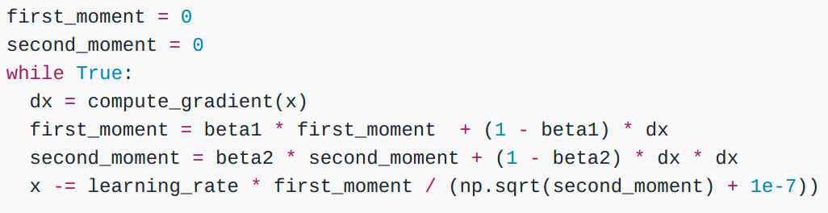
Adam (almost)
Kingma and Ba, “Adam: A method for stochastic optimization”, ICLR 2015
Slide Credit: Fei-Fei Li, Justin Johnson, Serena Yeung, CS 231n

Slide 45
Adam (almost)
Momentum
AdaGrad / RMSProp
Sort of like RMSProp with momentum
Q: What happens at first timestep?
Kingma and Ba, “Adam: A method for stochastic optimization”, ICLR 2015
Slide Credit: Fei-Fei Li, Justin Johnson, Serena Yeung, CS 231n

Slide 46
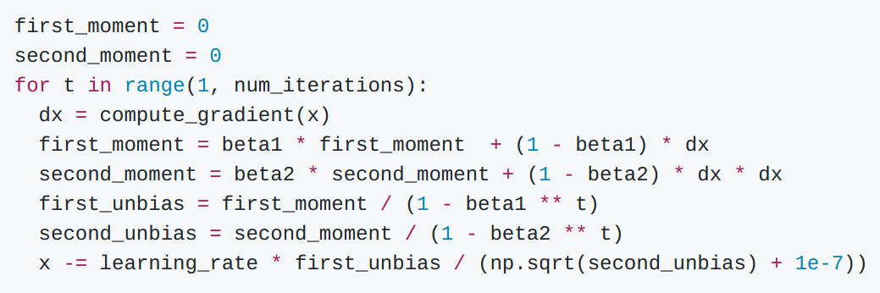
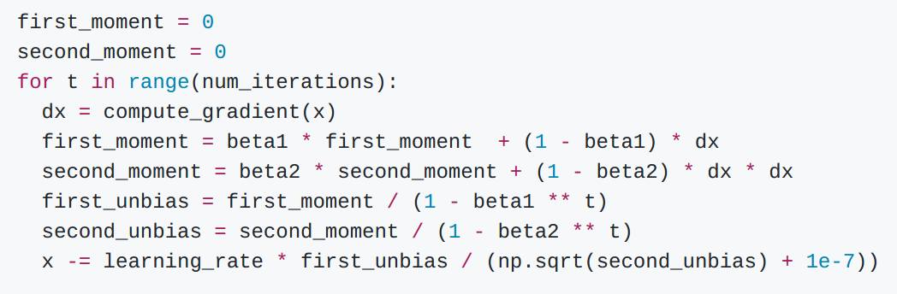
Adam (full form)
Momentum
Bias correction
AdaGrad / RMSProp
Bias correction for the fact that first and second moment estimates start at zero
Kingma and Ba, “Adam: A method for stochastic optimization”, ICLR 2015
Slide Credit: Fei-Fei Li, Justin Johnson, Serena Yeung, CS 231n

Slide 47
Adam (full form)
Momentum
Bias correction
AdaGrad / RMSProp
Bias correction for the fact that first and second moment estimates start at zero
Adam with beta1 = 0.9,
beta2 = 0.999, and learning_rate = 1e-3 or 5e-4
is a great starting point for many models!
Kingma and Ba, “Adam: A method for stochastic optimization”, ICLR 2015
Slide Credit: Fei-Fei Li, Justin Johnson, Serena Yeung, CS 231n

Slide 48
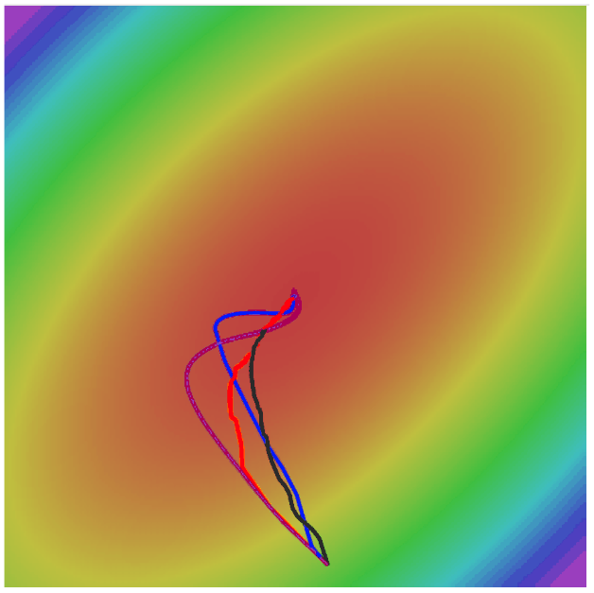
Adam
SGD
SGD+Momentum
RMSProp
Adam
Slide Credit: Fei-Fei Li, Justin Johnson, Serena Yeung, CS 231n

Slide 49
SGD, SGD+Momentum, Adagrad, RMSProp, Adam all have learning rate as a hyperparameter.
Q: Which one of these learning rates is best to use?
Slide Credit: Fei-Fei Li, Justin Johnson, Serena Yeung, CS 231n

Slide 50


SGD, SGD+Momentum, Adagrad, RMSProp, Adam all have learning rate as a hyperparameter.
=> Learning rate decay over time!
step decay:
e.g. decay learning rate by half every few epochs.
exponential decay:
1/t decay:
Slide Credit: Fei-Fei Li, Justin Johnson, Serena Yeung, CS 231n

Slide 51
SGD, SGD+Momentum, Adagrad, RMSProp, Adam all have learning rate as a hyperparameter.
Loss
Learning rate decay!
Epoch
Slide Credit: Fei-Fei Li, Justin Johnson, Serena Yeung, CS 231n

Slide 52
SGD, SGD+Momentum, Adagrad, RMSProp, Adam all have learning rate as a hyperparameter.
Loss
Learning rate decay!
More critical with SGD+Momentum,
less common with Adam
Epoch
Slide Credit: Fei-Fei Li, Justin Johnson, Serena Yeung, CS 231n

Slide 53
First-Order Optimization
Loss
w1
Slide Credit: Fei-Fei Li, Justin Johnson, Serena Yeung, CS 231n

Slide 54
First-Order Optimization
Use gradient form linear approximation
Step to minimize the approximation
Loss
w1
Slide Credit: Fei-Fei Li, Justin Johnson, Serena Yeung, CS 231n

Slide 55
Second-Order Optimization
Use gradient and Hessian to form quadratic approximation
Step to the minima of the approximation
Loss
w1
Slide Credit: Fei-Fei Li, Justin Johnson, Serena Yeung, CS 231n

Slide 56

Second-Order Optimization
second-order Taylor expansion:
Solving for the critical point we obtain the Newton parameter update:
Q: What is nice about this update?
Slide Credit: Fei-Fei Li, Justin Johnson, Serena Yeung, CS 231n

Slide 57
Second-Order Optimization
second-order Taylor expansion:
Solving for the critical point we obtain the Newton parameter update:
No hyperparameters!
No learning rate!
(Though you might use one in practice)
Q: What is nice about this update?
Slide Credit: Fei-Fei Li, Justin Johnson, Serena Yeung, CS 231n

Slide 58
Second-Order Optimization
second-order Taylor expansion:
Solving for the critical point we obtain the Newton parameter update:
Q2: Why is this bad for deep learning?
Slide Credit: Fei-Fei Li, Justin Johnson, Serena Yeung, CS 231n

Slide 59
Second-Order Optimization
second-order Taylor expansion:
Solving for the critical point we obtain the Newton parameter update:
Hessian has O(N^2) elements
Inverting takes O(N^3)
N = (Tens or Hundreds of) Millions
Q2: Why is this bad for deep learning?
Slide Credit: Fei-Fei Li, Justin Johnson, Serena Yeung, CS 231n

Slide 60
Second-Order Optimization
Quasi-Newton methods (BGFS most popular):
instead of inverting the Hessian (O(n^3)), approximate inverse Hessian with rank 1 updates over time (O(n^2) each).
L-BFGS (Limited memory BFGS):
Does not form/store the full inverse Hessian.
Slide Credit: Fei-Fei Li, Justin Johnson, Serena Yeung, CS 231n

Slide 61
L-BFGS
Usually works very well in full batch, deterministic mode
i.e. if you have a single, deterministic f(x) then L-BFGS will probably work very nicely
Does not transfer very well to mini-batch setting. Gives bad results. Adapting second-order methods to large-scale, stochastic setting is an active area of research.
Le et al, “On optimization methods for deep learning, ICML 2011”
Ba et al, “Distributed second-order optimization using Kronecker-factored approximations”, ICLR 2017
Slide Credit: Fei-Fei Li, Justin Johnson, Serena Yeung, CS 231n

Slide 62
In practice:
Adam is a good default choice in many cases
SGD+Momentum with learning rate decay often outperforms Adam by a bit, but requires more tuning
If you can afford to do full batch updates then try out L-BFGS (and don’t forget to disable all sources of noise)
Slide Credit: Fei-Fei Li, Justin Johnson, Serena Yeung, CS 231n

Slide 63
Beyond Training Error
Better optimization algorithms help reduce training loss
But we really care about error on new data - how to reduce the gap?
Slide Credit: Fei-Fei Li, Justin Johnson, Serena Yeung, CS 231n

Slide 64
Model Ensembles
Train multiple independent models
At test time average their results (Take average of predicted probability distributions, then choose argmax)
Enjoy 2% extra performance
Slide Credit: Fei-Fei Li, Justin Johnson, Serena Yeung, CS 231n

Slide 65
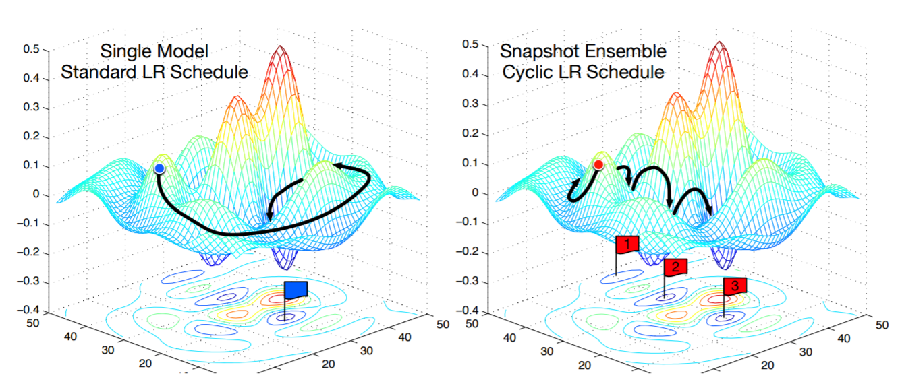
Model Ensembles: Tips and Tricks
Instead of training independent models, use multiple snapshots of a single model during training!
Loshchilov and Hutter, “SGDR: Stochastic gradient descent with restarts”, arXiv 2016
Huang et al, “Snapshot ensembles: train 1, get M for free”, ICLR 2017
Figures copyright Yixuan Li and Geoff Pleiss, 2017. Reproduced with permission.
Slide Credit: Fei-Fei Li, Justin Johnson, Serena Yeung, CS 231n

Slide 66
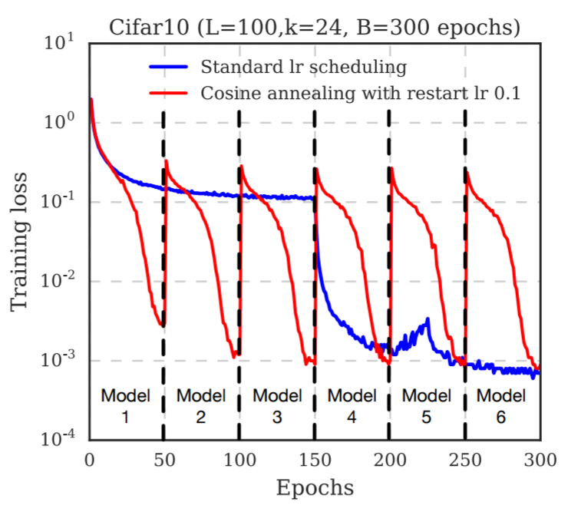
Model Ensembles: Tips and Tricks
Instead of training independent models, use multiple snapshots of a single model during training!
Loshchilov and Hutter, “SGDR: Stochastic gradient descent with restarts”, arXiv 2016
Huang et al, “Snapshot ensembles: train 1, get M for free”, ICLR 2017
Figures copyright Yixuan Li and Geoff Pleiss, 2017. Reproduced with permission.
Cyclic learning rate schedules can make this work even better!
Slide Credit: Fei-Fei Li, Justin Johnson, Serena Yeung, CS 231n

Slide 67
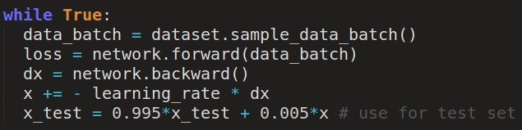
Model Ensembles: Tips and Tricks
Instead of using actual parameter vector, keep a moving average of the parameter vector and use that at test time (Polyak averaging)
Polyak and Juditsky, “Acceleration of stochastic approximation by averaging”, SIAM Journal on Control and Optimization, 1992.
Slide Credit: Fei-Fei Li, Justin Johnson, Serena Yeung, CS 231n

Slide 68
Early Stopping
Train
Val
Loss
Accuracy
Stop training here
Iteration
Iteration
Stop training the model when accuracy on the validation set decreases
Or train for a long time, but always keep track of the model snapshot that worked best on val
Slide Credit: Fei-Fei Li, Justin Johnson, Serena Yeung, CS 231n

Slide 69
How to improve single-model performance?
Regularization
Slide Credit: Fei-Fei Li, Justin Johnson, Serena Yeung, CS 231n

Slide 70



Regularization: Add term to loss
In common use:
L2 regularization
L1 regularization
Elastic net (L1 + L2)
(Weight decay)
Slide Credit: Fei-Fei Li, Justin Johnson, Serena Yeung, CS 231n

Slide 71
Regularization: Dropout
In each forward pass, randomly set some neurons to zero
Probability of dropping is a hyperparameter; 0.5 is common
Srivastava et al, “Dropout: A simple way to prevent neural networks from overfitting”, JMLR 2014
Slide Credit: Fei-Fei Li, Justin Johnson, Serena Yeung, CS 231n

Slide 72
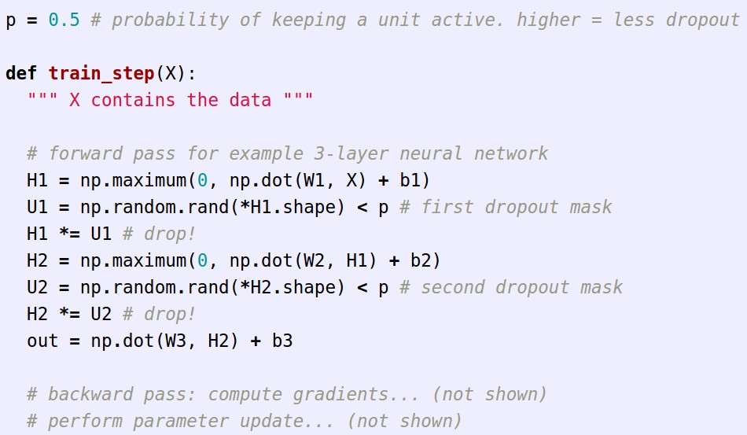
Regularization: Dropout
Example forward pass with a 3-layer network using dropout
Slide Credit: Fei-Fei Li, Justin Johnson, Serena Yeung, CS 231n

Slide 73
Regularization: Dropout
How can this possibly be a good idea?
Forces the network to have a redundant representation;
Prevents co-adaptation of features
has an ear
X
has a tail
is furry
X
cat
score
has claws
X
mischievous
look
Slide Credit: Fei-Fei Li, Justin Johnson, Serena Yeung, CS 231n

Slide 74
Regularization: Dropout
How can this possibly be a good idea?
Another interpretation:
Dropout is training a large ensemble of models (that share parameters).
Each binary mask is one model
An FC layer with 4096 units has
2⁴⁰⁹⁶ ~ 10¹²³³ possible masks!
Only ~ 10⁸² atoms in the universe...
Slide Credit: Fei-Fei Li, Justin Johnson, Serena Yeung, CS 231n

Slide 75

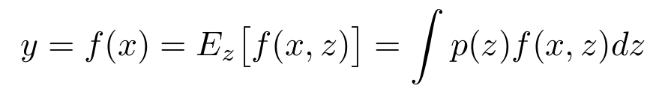
Dropout: Test time
Output
(label)
Input
(image)
Dropout makes our output random!
Random mask
Want to “average out” the randomness at test-time
But this integral seems hard …
Slide Credit: Fei-Fei Li, Justin Johnson, Serena Yeung, CS 231n

Slide 76
Dropout: Test time
Want to approximate the integral
Consider a single neuron.
a
w₁
w₂
x
y
Slide Credit: Fei-Fei Li, Justin Johnson, Serena Yeung, CS 231n

Slide 77

Dropout: Test time
Want to approximate the integral
Consider a single neuron.
At test time we have:
a
w₁
w₂
x
y
Slide Credit: Fei-Fei Li, Justin Johnson, Serena Yeung, CS 231n

Slide 78
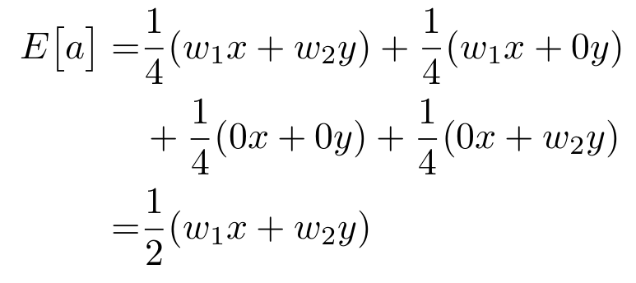
Dropout: Test time
Want to approximate the integral
Consider a single neuron.
At test time we have:
During training we have:
a
w₁
w₂
x
y
Slide Credit: Fei-Fei Li, Justin Johnson, Serena Yeung, CS 231n

Slide 79
Dropout: Test time
Want to approximate the integral
Consider a single neuron.
At test time we have:
During training we have:
a
w₁
w₂
x
y
At test time, multiply by dropout probability
Note: Here, dropout probability means the probability of keeping an activation – sometimes people define this as the opposite…
Slide Credit: Fei-Fei Li, Justin Johnson, Serena Yeung, CS 231n

Slide 80

Dropout: Test time
At test time all neurons are active always
=> We must scale the activations so that for each neuron:
output at test time = expected output at training time
Slide Credit: Fei-Fei Li, Justin Johnson, Serena Yeung, CS 231n

Slide 81

Dropout Summary
drop in forward pass
scale at test time
Slide Credit: Fei-Fei Li, Justin Johnson, Serena Yeung, CS 231n

Slide 82

Alternative: “Inverted dropout”
test time is unchanged!
Slide Credit: Fei-Fei Li, Justin Johnson, Serena Yeung, CS 231n

Slide 83
Regularization: A common pattern
Training: Add some kind of randomness
Testing: Average out randomness (sometimes approximate)
Slide Credit: Fei-Fei Li, Justin Johnson, Serena Yeung, CS 231n

Slide 84
Regularization: A common pattern
Training: Add some kind of randomness
Example: Batch Normalization
Training: Normalize using stats from random minibatches
Testing: Use fixed stats to normalize
Testing: Average out randomness (sometimes approximate)
Slide Credit: Fei-Fei Li, Justin Johnson, Serena Yeung, CS 231n

Slide 85

Regularization: Data Augmentation
“cat”
Load image and label
Compute
loss
CNN
This image by Nikita is licensed under CC-BY 2.0
Slide Credit: Fei-Fei Li, Justin Johnson, Serena Yeung, CS 231n

Slide 86

Regularization: Data Augmentation
“cat”
Load image and label
Compute
loss
CNN
Transform image
Slide Credit: Fei-Fei Li, Justin Johnson, Serena Yeung, CS 231n

Slide 87
Data Augmentation
Horizontal Flips
Slide Credit: Fei-Fei Li, Justin Johnson, Serena Yeung, CS 231n

Slide 88
Data Augmentation
Random crops and scales
Training: sample random crops / scales ResNet:
Pick random L in range [256, 480]
Resize training image, short side = L
Sample random 224 x 224 patch
Slide Credit: Fei-Fei Li, Justin Johnson, Serena Yeung, CS 231n

Slide 89
Data Augmentation
Random crops and scales
Training: sample random crops / scales ResNet:
Pick random L in range [256, 480]
Resize training image, short side = L
Sample random 224 x 224 patch
Testing: average a fixed set of crops
ResNet:
Resize image at 5 scales: {224, 256, 384, 480, 640}
For each size, use 10 224 x 224 crops: 4 corners + center, + flips
Slide Credit: Fei-Fei Li, Justin Johnson, Serena Yeung, CS 231n

Slide 90

Data Augmentation
Color Jitter
Simple: Randomize contrast and brightness
Slide Credit: Fei-Fei Li, Justin Johnson, Serena Yeung, CS 231n

Slide 91
Data Augmentation
Color Jitter
More Complex:
Apply PCA to all [R, G, B] pixels in training set
Sample a “color offset” along principal component directions
Add offset to all pixels of a training image
Simple: Randomize contrast and brightness
(As seen in [Krizhevsky et al. 2012], ResNet, etc)
Slide Credit: Fei-Fei Li, Justin Johnson, Serena Yeung, CS 231n

Slide 92
Data Augmentation
Get creative for your problem!
Random mix/combinations of :
translation
rotation
stretching
shearing,
lens distortions, … (go crazy)
Slide Credit: Fei-Fei Li, Justin Johnson, Serena Yeung, CS 231n

Slide 93
Regularization: A common pattern
Training: Add random noise
Testing: Marginalize over the noise
Examples:
Dropout
Batch Normalization
Data Augmentation
Slide Credit: Fei-Fei Li, Justin Johnson, Serena Yeung, CS 231n

Slide 94
Regularization: A common pattern
Training: Add random noise
Testing: Marginalize over the noise
Examples:
Dropout
Batch Normalization
Data Augmentation
DropConnect
Wan et al, “Regularization of Neural Networks using DropConnect”, ICML 2013
Slide Credit: Fei-Fei Li, Justin Johnson, Serena Yeung, CS 231n

Slide 95

Regularization: A common pattern
Training: Add random noise
Testing: Marginalize over the noise
Examples:
Dropout
Batch Normalization
Data Augmentation
DropConnect
Fractional Max Pooling
Graham, “Fractional Max Pooling”, arXiv 2014
Slide Credit: Fei-Fei Li, Justin Johnson, Serena Yeung, CS 231n

Slide 96
Regularization: A common pattern
Training: Add random noise
Testing: Marginalize over the noise
Examples:
Dropout
Batch Normalization
Data Augmentation
DropConnect
Fractional Max Pooling
Stochastic Depth
Huang et al, “Deep Networks with Stochastic Depth”, ECCV 2016
Slide Credit: Fei-Fei Li, Justin Johnson, Serena Yeung, CS 231n

Slide 97
Transfer Learning
“You need a lot of a data if you want to train/use CNNs”
Slide Credit: Fei-Fei Li, Justin Johnson, Serena Yeung, CS 231n

Slide 98
Transfer Learning
“You need a lot of a data if you want to train/use CNNs”
BUSTED
Slide Credit: Fei-Fei Li, Justin Johnson, Serena Yeung, CS 231n

Slide 99
Donahue et al, “DeCAF: A Deep Convolutional Activation Feature for Generic Visual Recognition”, ICML 2014
Razavian et al, “CNN Features Off-the-Shelf: An Astounding Baseline for Recognition”, CVPR Workshops 2014
Transfer Learning with CNNs
1. Train on Imagenet
FC-1000
FC-4096
FC-4096
MaxPool
Conv-512
Conv-512
MaxPool
Conv-512
Conv-512
MaxPool
Conv-256
Conv-256
MaxPool
Conv-128
Conv-128
MaxPool
Conv-64
Conv-64
Image
Slide Credit: Fei-Fei Li, Justin Johnson, Serena Yeung, CS 231n

Slide 100
Donahue et al, “DeCAF: A Deep Convolutional Activation Feature for Generic Visual Recognition”, ICML 2014
Razavian et al, “CNN Features Off-the-Shelf: An Astounding Baseline for Recognition”, CVPR Workshops 2014
Transfer Learning with CNNs
1. Train on Imagenet
2. Small Dataset (C classes)
FC-1000
FC-C
Reinitialize this and train
FC-4096
FC-4096
FC-4096
FC-4096
MaxPool
MaxPool
Conv-512
Conv-512
Conv-512
Conv-512
MaxPool
MaxPool
Conv-512
Conv-512
Conv-512
Conv-512
Freeze these
MaxPool
MaxPool
Conv-256
Conv-256
Conv-256
Conv-256
MaxPool
MaxPool
Conv-128
Conv-128
Conv-128
Conv-128
MaxPool
MaxPool
Conv-64
Conv-64
Conv-64
Conv-64
Image
Image
Slide Credit: Fei-Fei Li, Justin Johnson, Serena Yeung, CS 231n

Slide 101
Donahue et al, “DeCAF: A Deep Convolutional Activation Feature for Generic Visual Recognition”, ICML 2014
Razavian et al, “CNN Features Off-the-Shelf: An Astounding Baseline for Recognition”, CVPR Workshops 2014
Transfer Learning with CNNs
1. Train on Imagenet
2. Small Dataset (C classes)
3. Bigger dataset
FC-1000
FC-C
Reinitialize this and train
FC-C
Train these
FC-4096
FC-4096
FC-4096
FC-4096
FC-4096
FC-4096
MaxPool
MaxPool
MaxPool
With bigger dataset, train more layers
Conv-512
Conv-512
Conv-512
Conv-512
Conv-512
Conv-512
MaxPool
MaxPool
MaxPool
Conv-512
Conv-512
Conv-512
Conv-512
Conv-512
Freeze these
Conv-512
MaxPool
MaxPool
MaxPool
Fine-tune these
Conv-256
Conv-256
Conv-256
Conv-256
Conv-256
Conv-256
MaxPool
MaxPool
MaxPool
Lower learning rate when finetuning; 1/10 of original LR is good starting point
Conv-128
Conv-128
Conv-128
Conv-128
Conv-128
Conv-128
MaxPool
MaxPool
MaxPool
Conv-64
Conv-64
Conv-64
Conv-64
Conv-64
Conv-64
Image
Image
Image
Slide Credit: Fei-Fei Li, Justin Johnson, Serena Yeung, CS 231n

Slide 102
FC-1000
 | very similar dataset | very different dataset
very little data | ? | ?
quite a lot of data | ? | ?
FC-4096
FC-4096
MaxPool
Conv-512
Conv-512
More specific
MaxPool
Conv-512
Conv-512
MaxPool
Conv-256
More generic
Conv-256
MaxPool
Conv-128
Conv-128
MaxPool
Conv-64
Conv-64
Image
Slide Credit: Fei-Fei Li, Justin Johnson, Serena Yeung, CS 231n

Slide 103
FC-1000
 | very similar dataset | very different dataset
very little data | Use Linear Classifier on top layer | ?
quite a lot of data | Finetune a few layers | ?
FC-4096
FC-4096
MaxPool
Conv-512
Conv-512
More specific
MaxPool
Conv-512
Conv-512
MaxPool
Conv-256
More generic
Conv-256
MaxPool
Conv-128
Conv-128
MaxPool
Conv-64
Conv-64
Image
Slide Credit: Fei-Fei Li, Justin Johnson, Serena Yeung, CS 231n

Slide 104
FC-1000
 | very similar dataset | very different dataset
very little data | Use Linear Classifier on top layer | You’re in trouble… Try linear classifier from different stages
quite a lot of data | Finetune a few layers | Finetune a larger number of layers
FC-4096
FC-4096
MaxPool
Conv-512
Conv-512
More specific
MaxPool
Conv-512
Conv-512
MaxPool
Conv-256
More generic
Conv-256
MaxPool
Conv-128
Conv-128
MaxPool
Conv-64
Conv-64
Image
Slide Credit: Fei-Fei Li, Justin Johnson, Serena Yeung, CS 231n

Slide 105


Transfer learning with CNNs is pervasive…
(it’s the norm, not an exception)
Object Detection (Fast R-CNN)
Image Captioning: CNN + RNN
Girshick, “Fast R-CNN”, ICCV 2015
Figure copyright Ross Girshick, 2015. Reproduced with permission.
Karpathy and Fei-Fei, “Deep Visual-Semantic Alignments for Generating Image Descriptions”, CVPR 2015
Figure copyright IEEE, 2015. Reproduced for educational purposes.
Slide Credit: Fei-Fei Li, Justin Johnson, Serena Yeung, CS 231n

Slide 106
Transfer learning with CNNs is pervasive…
(it’s the norm, not an exception)
Object Detection (Fast R-CNN)
CNN pretrained on ImageNet
Image Captioning: CNN + RNN
Girshick, “Fast R-CNN”, ICCV 2015
Figure copyright Ross Girshick, 2015. Reproduced with permission.
Karpathy and Fei-Fei, “Deep Visual-Semantic Alignments for Generating Image Descriptions”, CVPR 2015
Figure copyright IEEE, 2015. Reproduced for educational purposes.
Slide Credit: Fei-Fei Li, Justin Johnson, Serena Yeung, CS 231n

Slide 107
Transfer learning with CNNs is pervasive…
(it’s the norm, not an exception)
Object Detection (Fast R-CNN)
CNN pretrained on ImageNet
Image Captioning: CNN + RNN
Word vectors pretrained with word2vec
Girshick, “Fast R-CNN”, ICCV 2015
Figure copyright Ross Girshick, 2015. Reproduced with permission.
Karpathy and Fei-Fei, “Deep Visual-Semantic Alignments for Generating Image Descriptions”, CVPR 2015
Figure copyright IEEE, 2015. Reproduced for educational purposes.
Slide Credit: Fei-Fei Li, Justin Johnson, Serena Yeung, CS 231n

Slide 108
Takeaway for your projects and beyond:
Have some dataset of interest but it has < ~1M images?
Find a very large dataset that has similar data, train a big ConvNet there
Transfer learn to your dataset
Deep learning frameworks provide a “Model Zoo” of pretrained models so you don’t need to train your own
Caffe: https://github.com/BVLC/caffe/wiki/Model-Zoo
TensorFlow: https://github.com/tensorflow/models
PyTorch: https://github.com/pytorch/vision
Slide Credit: Fei-Fei Li, Justin Johnson, Serena Yeung, CS 231n

Slide 109
Summary
Lots of Batch Normalization variants
Optimization
Momentum, RMSProp, Adam, etc
Regularization
Dropout, etc
Transfer learning
Use this for your projects!
Slide Credit: Fei-Fei Li, Justin Johnson, Serena Yeung, CS 231n

Slide 110
Next time: More on CNNs!

