Slide 1
CS 4803 / 7643: Deep Learning
Topics:
Convolutional Neural Networks
Pooling layers
Fully-connected layers as convolutions
Backprop in conv layers
Dhruv Batra
Georgia Tech

Slide 2
Administrativia
HW1 Reminder
Due: 10/02, 11:55pm
Project Idea: ICLR19 Reproducibility Challenge
https://reproducibility-challenge.github.io/iclr_2019/
https://docs.google.com/spreadsheets/d/1BipWLvvWb7Fu6OSDd-uOCF1Lr_4drKOCRVdhxm_eSHc/edit#gid=0

Slide 3
Recap from last time

Slide 4
Convolutional Neural Networks
(without the brain stuff)
Slide Credit: Fei-Fei Li, Justin Johnson, Serena Yeung, CS 231n

Slide 5
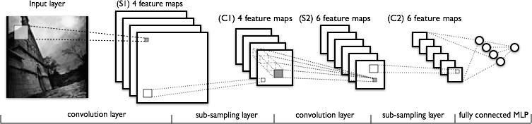
Convolutional Neural Networks
a
Image Credit: Yann LeCun, Kevin Murphy

Slide 6
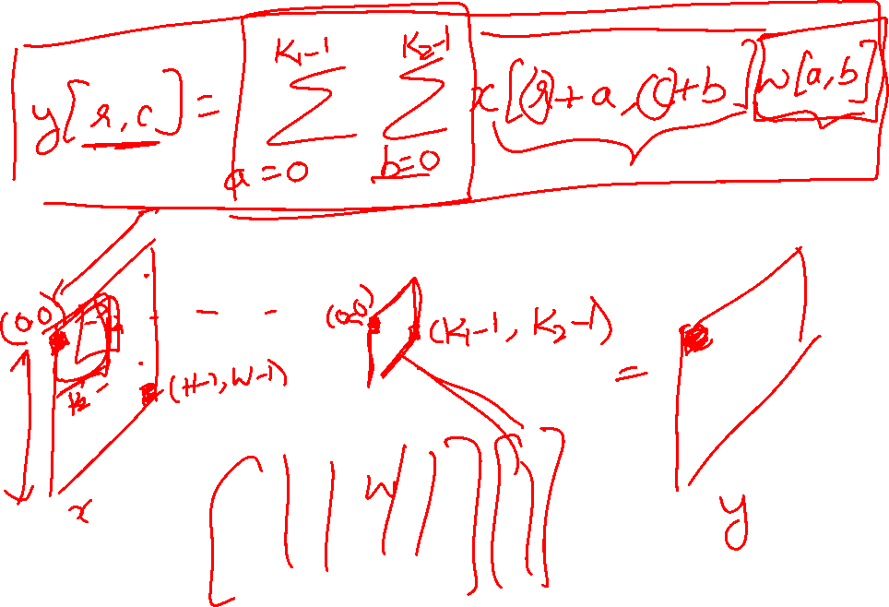
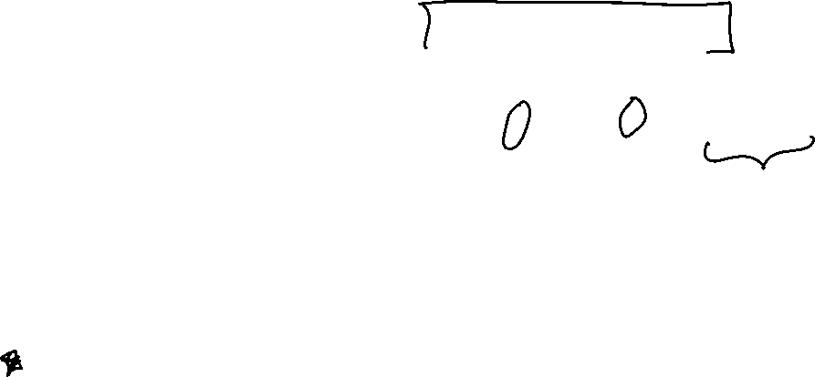
Convolutions for programmers

Slide 7
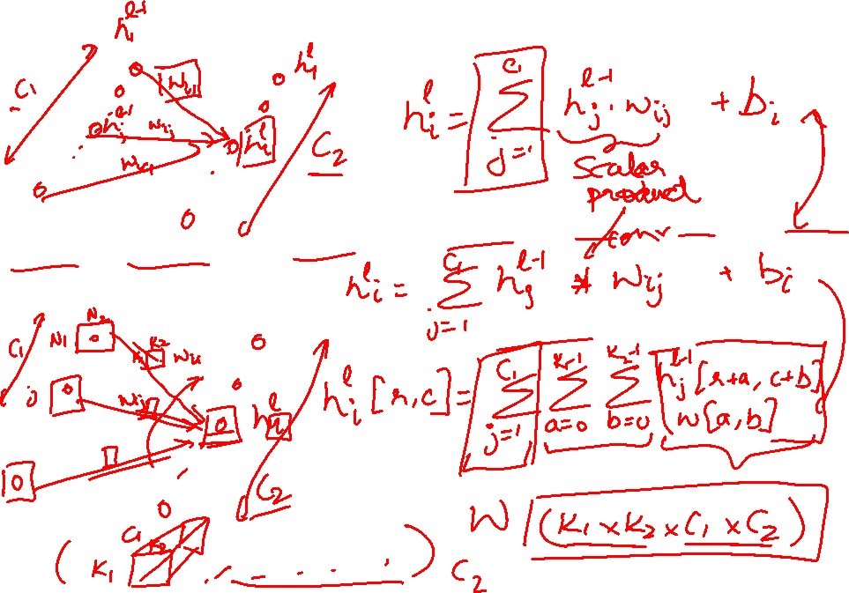
FC vs Conv Layer

Slide 8


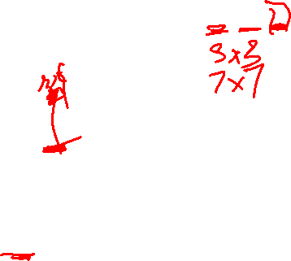
Convolution Layer
32x32x3 image
5x5x3 filter
32
1 number:
the result of taking a dot product between the filter and a small 5x5x3 chunk of the image
(i.e. 5*5*3 = 75-dimensional dot product + bias)
32
3
Slide Credit: Fei-Fei Li, Justin Johnson, Serena Yeung, CS 231n

Slide 9
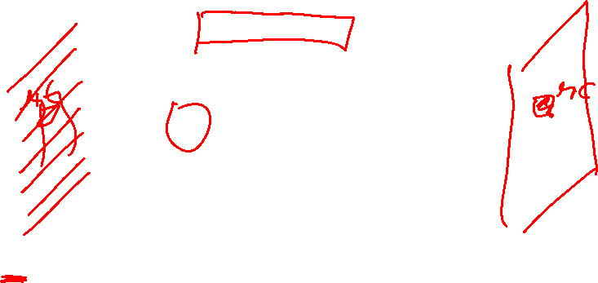
Convolution Layer
activation map
32x32x3 image
5x5x3 filter
32
28
convolve (slide) over all spatial locations
32
28
3
1
Slide Credit: Fei-Fei Li, Justin Johnson, Serena Yeung, CS 231n

Slide 10
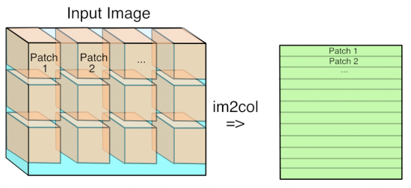
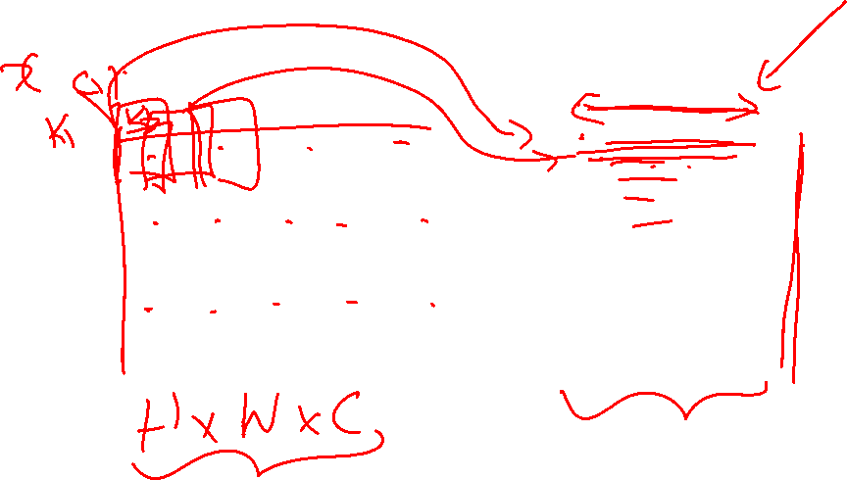
Im2Col
Figure Credit: https://petewarden.com/2015/04/20/why-gemm-is-at-the-heart-of-deep-learning/

Slide 11
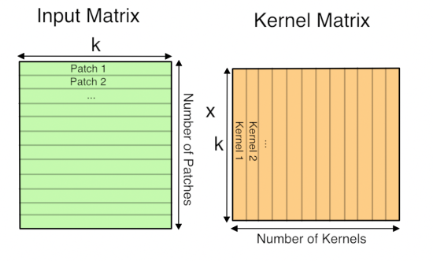
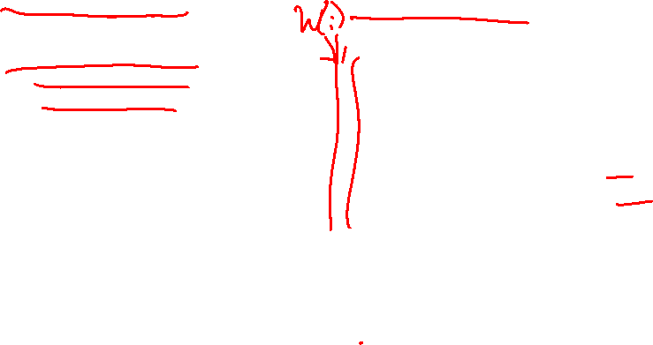
GEMM
Figure Credit: https://petewarden.com/2015/04/20/why-gemm-is-at-the-heart-of-deep-learning/

Slide 12
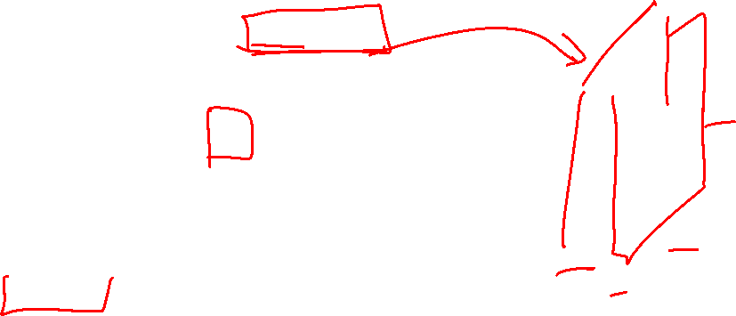
consider a second, green filter
Convolution Layer
32x32x3 image
5x5x3 filter
activation maps
32
28
convolve (slide) over all spatial locations
32
28
3
1
Slide Credit: Fei-Fei Li, Justin Johnson, Serena Yeung, CS 231n

Slide 13
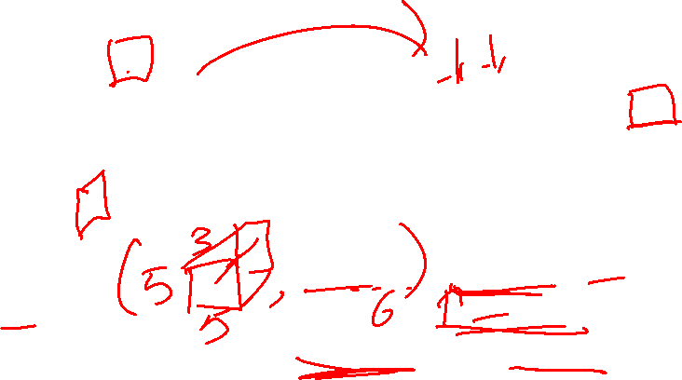
For example, if we had 6 5x5 filters, we’ll get 6 separate activation maps:
activation maps
32
28
Convolution Layer
32
28
3
6
We stack these up to get a “new image” of size 28x28x6!
Slide Credit: Fei-Fei Li, Justin Johnson, Serena Yeung, CS 231n

Slide 14
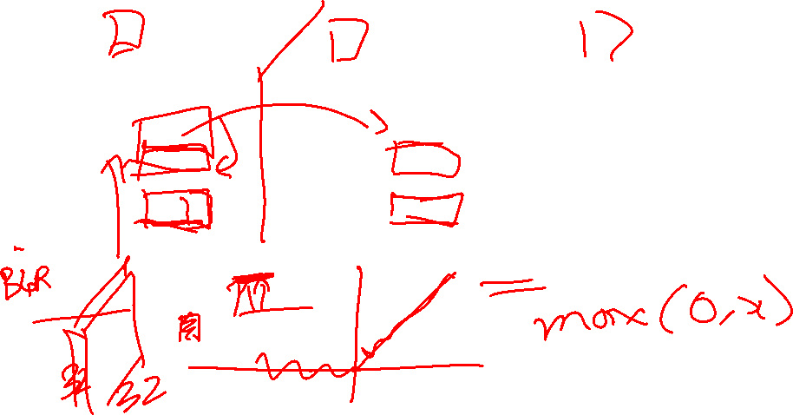
Preview: ConvNet is a sequence of Convolutional Layers, interspersed with activation functions
32
28
24
….
CONV,
ReLU
e.g. 6 5x5x3 filters
CONV,
ReLU
e.g. 10 5x5x6 filters
CONV,
ReLU
32
28
24
3
6
10
Slide Credit: Fei-Fei Li, Justin Johnson, Serena Yeung, CS 231n

Slide 15
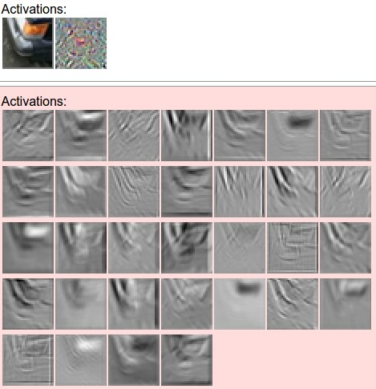
one filter =>
one activation map
example 5x5 filters
(32 total)
Figure copyright Andrej Karpathy.
Slide Credit: Fei-Fei Li, Justin Johnson, Serena Yeung, CS 231n
Notes:
Here have examples of activation maps produced by each filter
Each filter is slid over input to layer to produce an activation map
Because of sliding, call convolutional
Conv with neg. of filter (cross correlation)

Slide 16
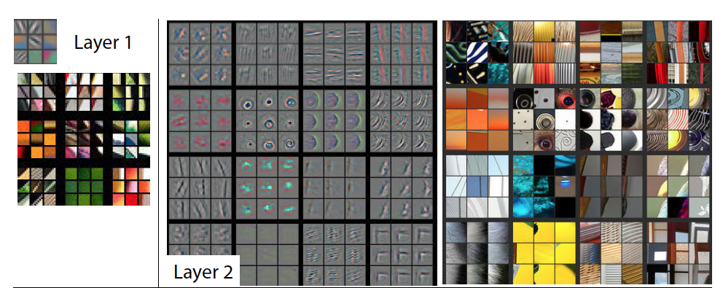
Visualizing Learned Filters
Figure Credit: [Zeiler & Fergus ECCV14]

Slide 17
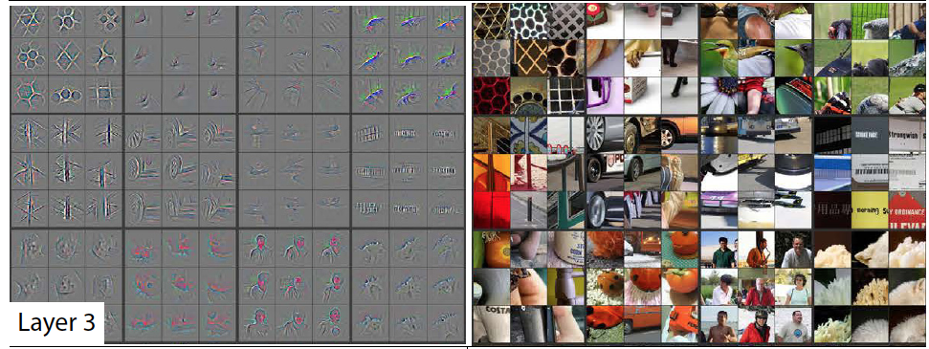
Visualizing Learned Filters
Figure Credit: [Zeiler & Fergus ECCV14]

Slide 18
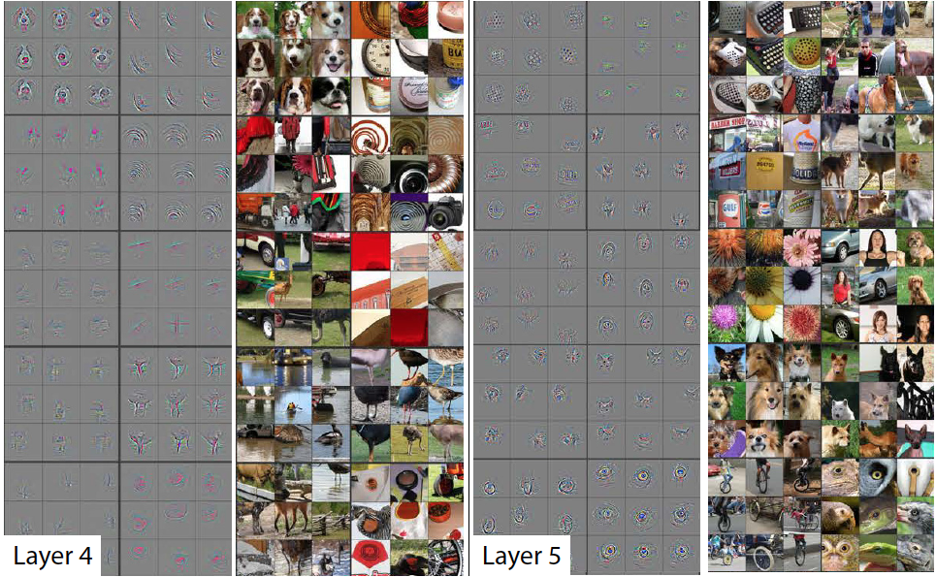
Visualizing Learned Filters
Figure Credit: [Zeiler & Fergus ECCV14]

Slide 19
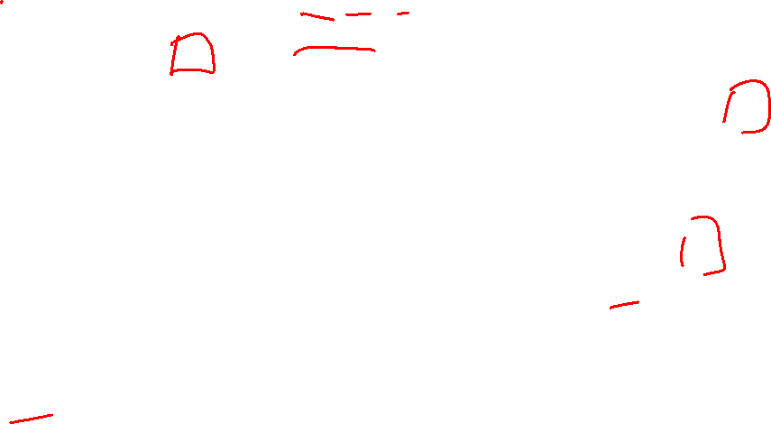
A closer look at spatial dimensions:
activation map
32x32x3 image
5x5x3 filter
32
28
convolve (slide) over all spatial locations
32
28
3
1
Slide Credit: Fei-Fei Li, Justin Johnson, Serena Yeung, CS 231n

Slide 20

A closer look at spatial dimensions:
7
7x7 input (spatially)
assume 3x3 filter
7
Slide Credit: Fei-Fei Li, Justin Johnson, Serena Yeung, CS 231n

Slide 21
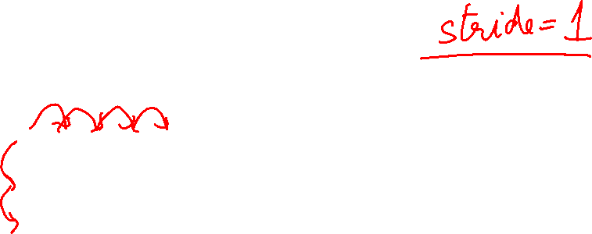
A closer look at spatial dimensions:
7
7x7 input (spatially)
assume 3x3 filter
7
Slide Credit: Fei-Fei Li, Justin Johnson, Serena Yeung, CS 231n

Slide 22
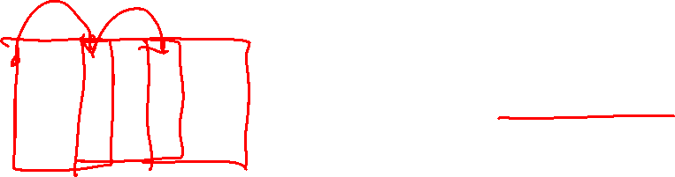
A closer look at spatial dimensions:
7
7x7 input (spatially)
assume 3x3 filter
applied with stride 2
7
Slide Credit: Fei-Fei Li, Justin Johnson, Serena Yeung, CS 231n

Slide 23
A closer look at spatial dimensions:
7
7x7 input (spatially)
assume 3x3 filter
applied with stride 2
7
Slide Credit: Fei-Fei Li, Justin Johnson, Serena Yeung, CS 231n

Slide 24
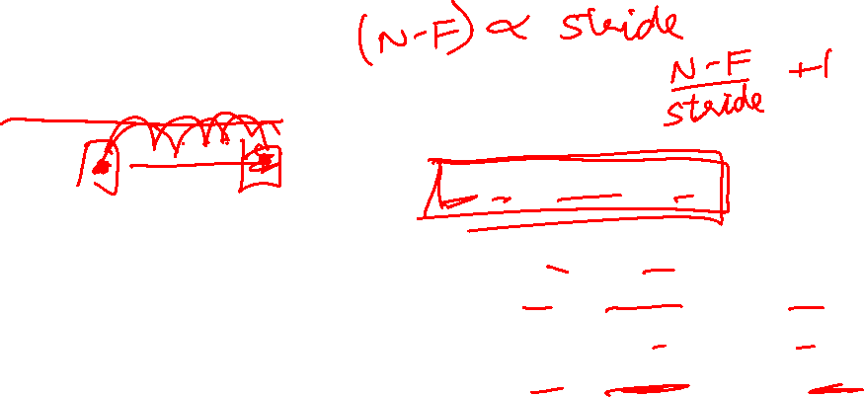
N
Output size:
(N - F) / stride + 1
e.g. N = 7, F = 3:
stride 1 => (7 - 3)/1 + 1 = 5
stride 2 => (7 - 3)/2 + 1 = 3
stride 3 => (7 - 3)/3 + 1 = 2.33 :\
F
F
N
Slide Credit: Fei-Fei Li, Justin Johnson, Serena Yeung, CS 231n

Slide 25
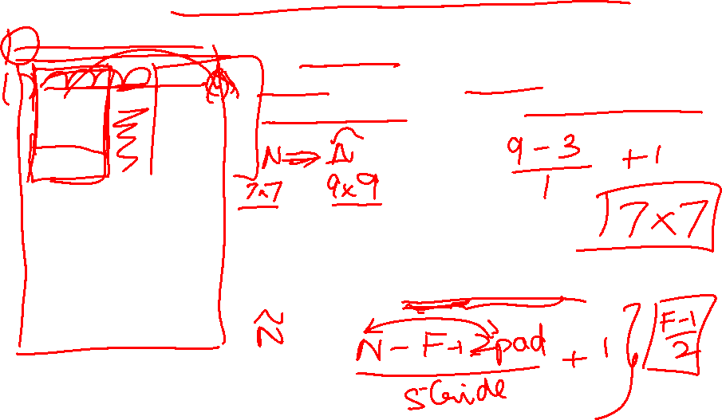
In practice: Common to zero pad the border
0 | 0 | 0 | 0 | 0 | 0
0
0
0
0
e.g. input 7x7
3x3 filter, applied with stride 1
pad with 1 pixel border => what is the output?
(recall:)
(N - F) / stride + 1
Slide Credit: Fei-Fei Li, Justin Johnson, Serena Yeung, CS 231n

Slide 26
In practice: Common to zero pad the border
0 | 0 | 0 | 0 | 0 | 0
0
0
0
0
e.g. input 7x7
3x3 filter, applied with stride 1
pad with 1 pixel border => what is the output?
7x7 output!
Slide Credit: Fei-Fei Li, Justin Johnson, Serena Yeung, CS 231n

Slide 27

In practice: Common to zero pad the border
0 | 0 | 0 | 0 | 0 | 0
0
0
0
0
e.g. input 7x7
3x3 filter, applied with stride 1
pad with 1 pixel border => what is the output?
7x7 output!
in general, common to see CONV layers with stride 1, filters of size FxF, and zero-padding with (F-1)/2. (will preserve size spatially)
e.g. F = 3 => zero pad with 1
F = 5 => zero pad with 2
F = 7 => zero pad with 3
Slide Credit: Fei-Fei Li, Justin Johnson, Serena Yeung, CS 231n

Slide 28
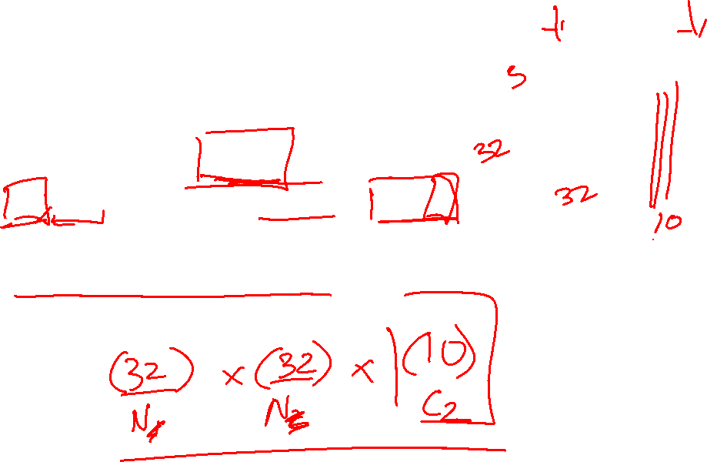
Examples time:
Input volume: 32x32x3
10 5x5 filters with stride 1, pad 2
Output volume size: ?
Slide Credit: Fei-Fei Li, Justin Johnson, Serena Yeung, CS 231n
Notes:
(32+2*2-5)/1+1 = 32 spatially
(Input size + 2*padding - stride) / 1 + 1 for new spatial size
10 filters

Slide 29
Examples time:
Input volume: 32x32x3
10 5x5 filters with stride 1, pad 2
Output volume size:
(32+2*2-5)/1+1 = 32 spatially, so
32x32x10
Slide Credit: Fei-Fei Li, Justin Johnson, Serena Yeung, CS 231n

Slide 30
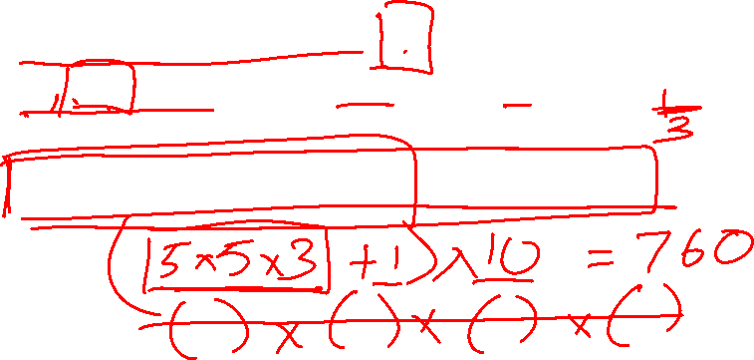
Examples time:
Input volume: 32x32x3
10 5x5 filters with stride 1, pad 2
Number of parameters in this layer?
Slide Credit: Fei-Fei Li, Justin Johnson, Serena Yeung, CS 231n
Notes:
each filter has 5*5*3 + 1 = 76 params
1 for bias

Slide 31
Examples time:
Input volume: 32x32x3
10 5x5 filters with stride 1, pad 2
Number of parameters in this layer?
each filter has 5*5*3 + 1 = 76 params (+1 for bias)
=> 76*10 = 760
Slide Credit: Fei-Fei Li, Justin Johnson, Serena Yeung, CS 231n

Slide 32
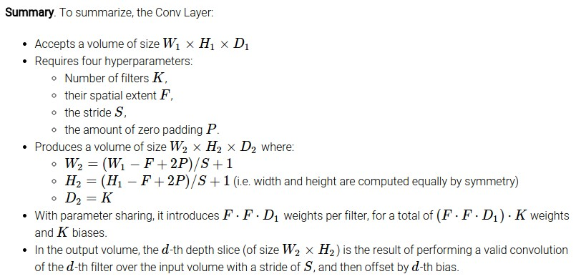
Slide Credit: Fei-Fei Li, Justin Johnson, Serena Yeung, CS 231n

Slide 33
Common settings:
K = (powers of 2, e.g. 32, 64, 128, 512)
F = 3, S = 1, P = 1
F = 5, S = 1, P = 2
F = 5, S = 2, P = ? (whatever fits)
F = 1, S = 1, P = 0
Slide Credit: Fei-Fei Li, Justin Johnson, Serena Yeung, CS 231n

Slide 34
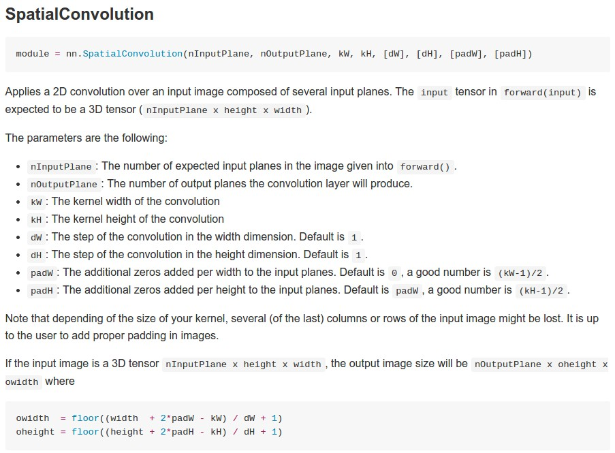
Example: CONV layer in Torch
Torch is licensed under BSD 3-clause.
Slide Credit: Fei-Fei Li, Justin Johnson, Serena Yeung, CS 231n

Slide 35
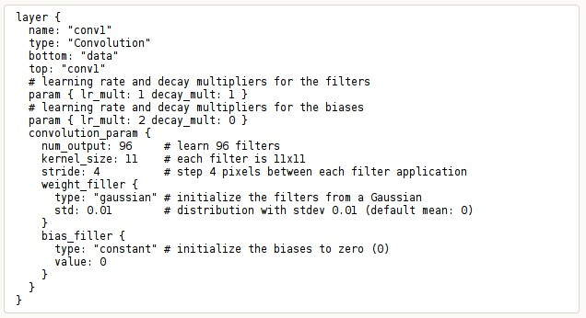
Example: CONV layer in Caffe
Caffe is licensed under BSD 2-Clause.
Slide Credit: Fei-Fei Li, Justin Johnson, Serena Yeung, CS 231n

Slide 36
Plan for Today
Convolutional Neural Networks
1x1 convolutions
Pooling layers
Fully-connected layers as convolutions
Backprop in conv layers
Toeplitz matrices and convolutions = matrix-mult
Dilated/a-trous convolutions

Slide 37
Can we have 1x1 filters?

Slide 38
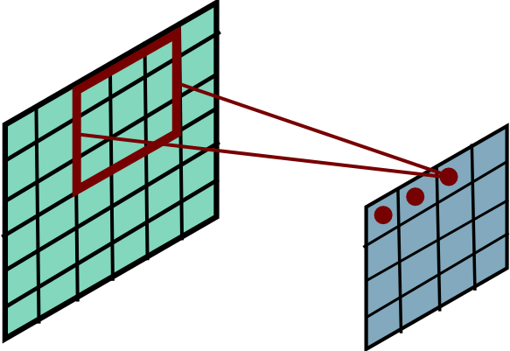
Convolutional Layer
Slide Credit: Marc'Aurelio Ranzato

Slide 39
(btw, 1x1 convolution layers make perfect sense)
1x1 CONV
with 32 filters
56
56
(each filter has size 1x1x64, and performs a 64-dimensional dot product)
56
56
64
32
Slide Credit: Fei-Fei Li, Justin Johnson, Serena Yeung, CS 231n

Slide 40
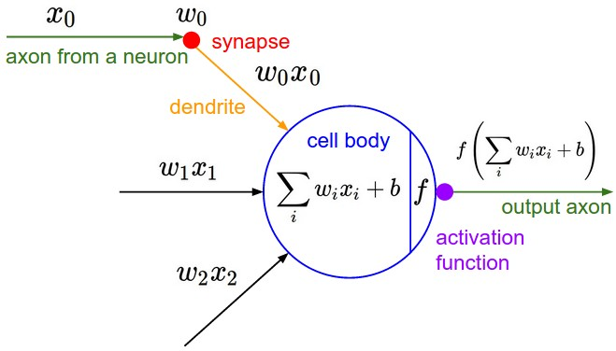
The brain/neuron view of CONV Layer
32
28
An activation map is a 28x28 sheet of neuron outputs:
Each is connected to a small region in the input
All of them share parameters
“5x5 filter” -> “5x5 receptive field for each neuron”
32
28
3
Slide Credit: Fei-Fei Li, Justin Johnson, Serena Yeung, CS 231n

Slide 41
Reminder: Fully Connected Layer
Each neuron looks at the full input volume
32x32x3 image -> stretch to 3072 x 1
input
activation
1
1
3072
10 x 3072
weights
10
1 number:
the result of taking a dot product between a row of W and the input (a 3072-dimensional dot product)
Slide Credit: Fei-Fei Li, Justin Johnson, Serena Yeung, CS 231n
Notes:
Preserve spatial structure of input

Slide 42
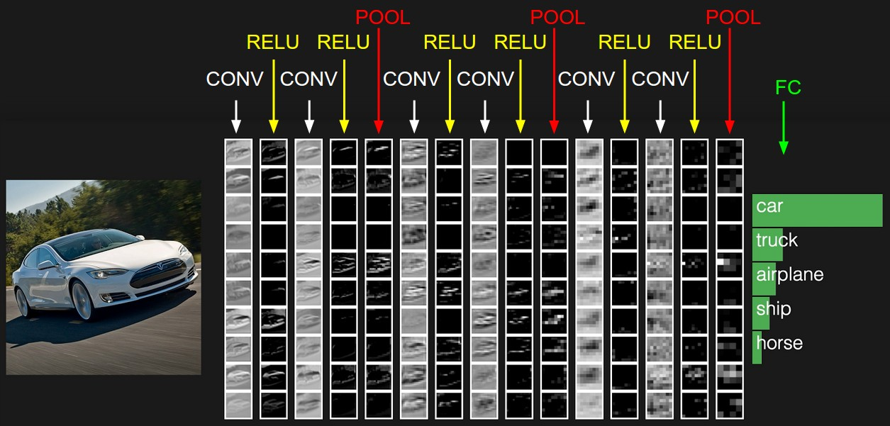
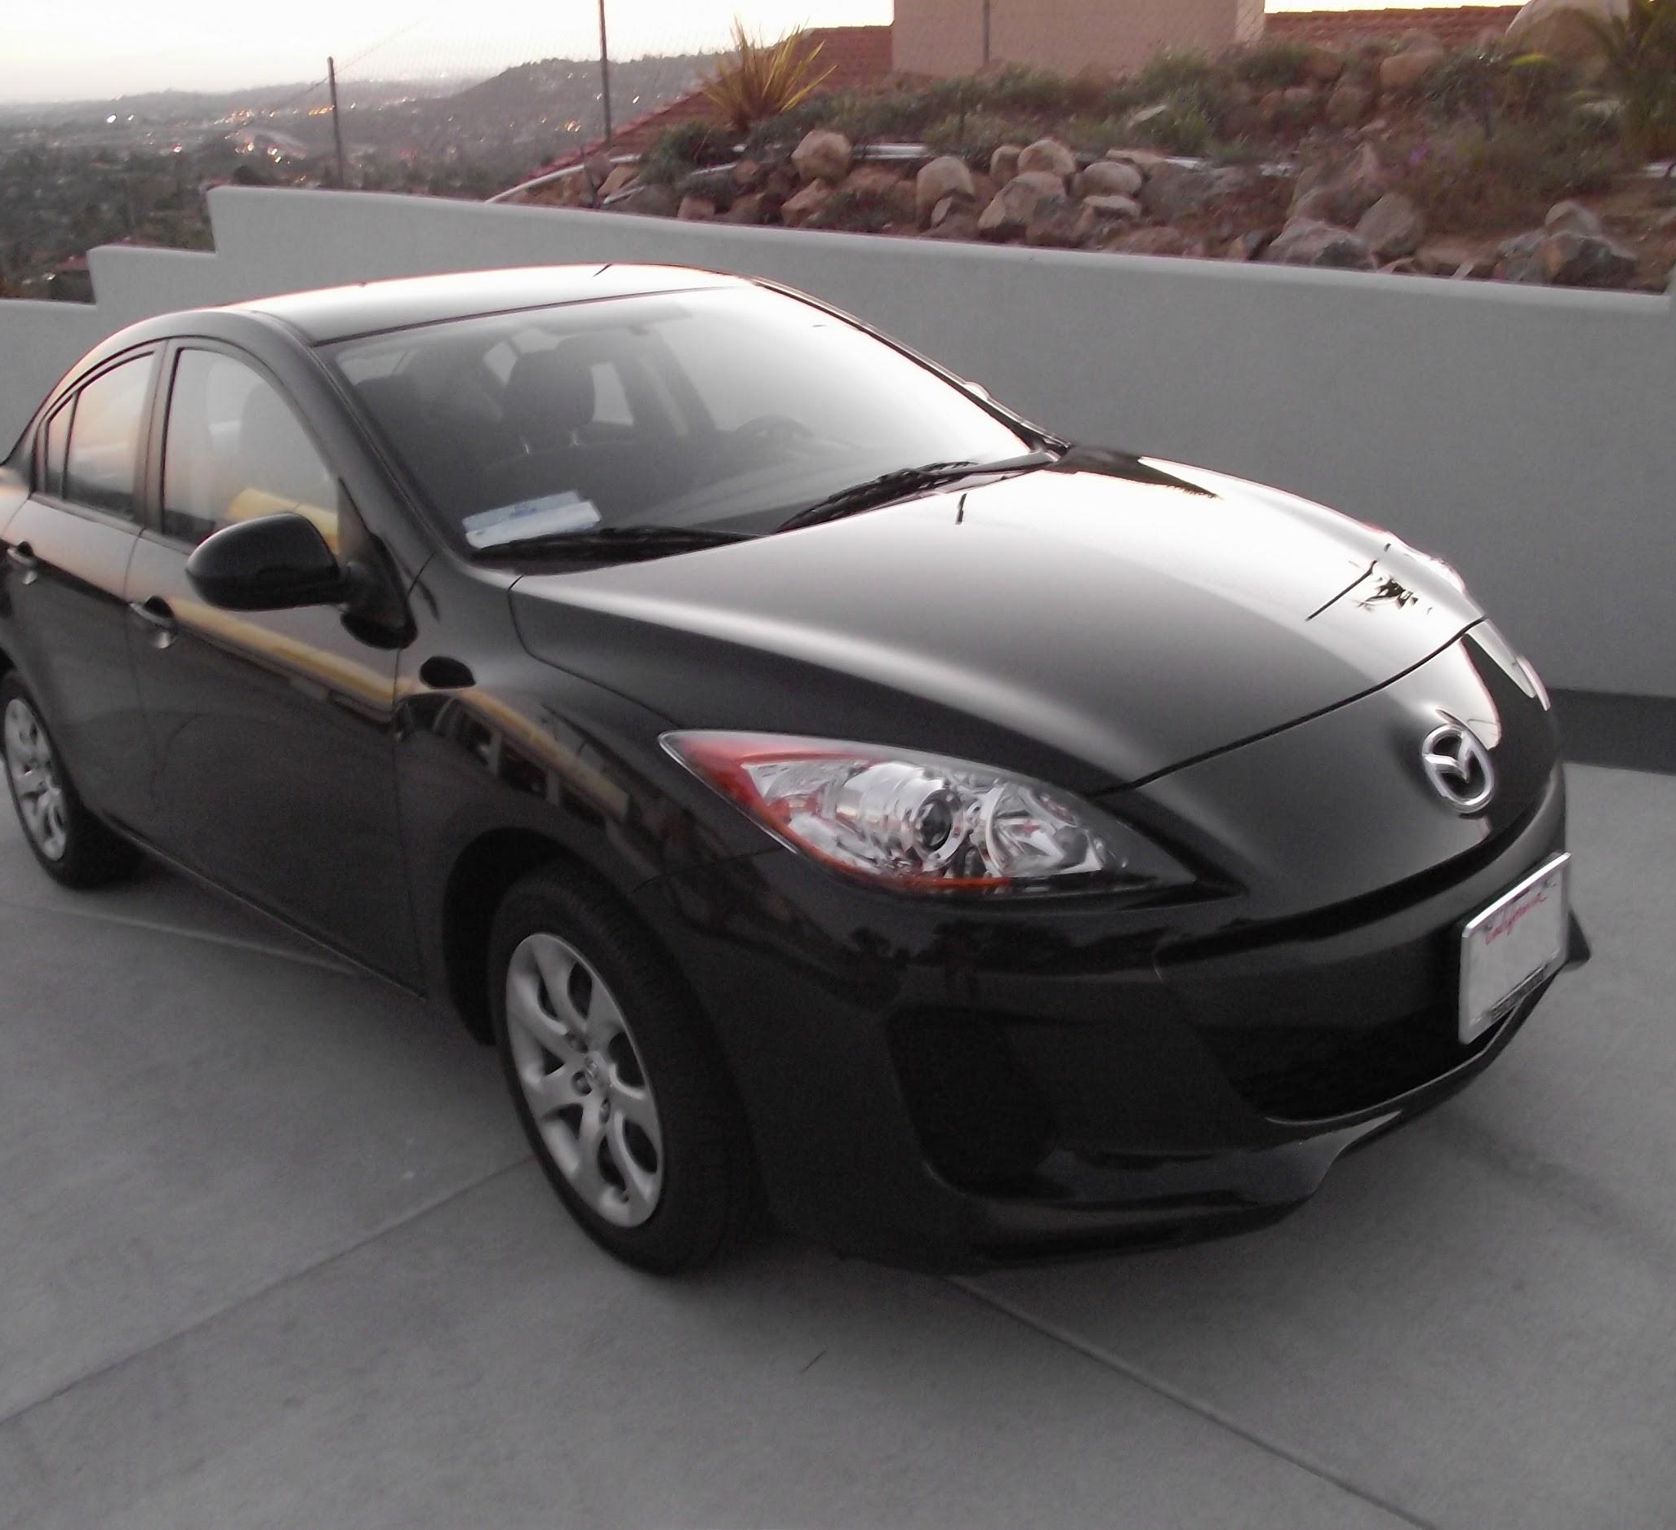
two more layers to go: POOL/FC
Slide Credit: Fei-Fei Li, Justin Johnson, Serena Yeung, CS 231n
Notes:
Car image is photo taken by Lane McIntosh, permission to use.

Slide 43
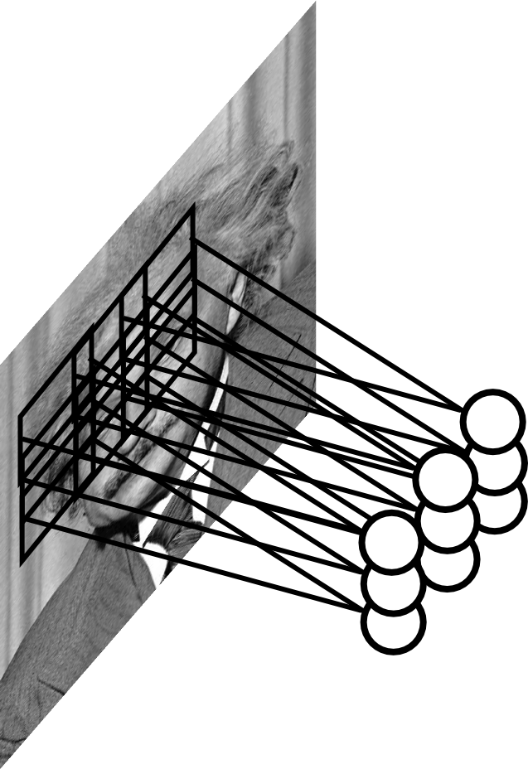
Pooling Layer
Let us assume filter is an “eye” detector.
Q.: how can we make the detection robust to the exact location of the eye?
Slide Credit: Marc'Aurelio Ranzato

Slide 44
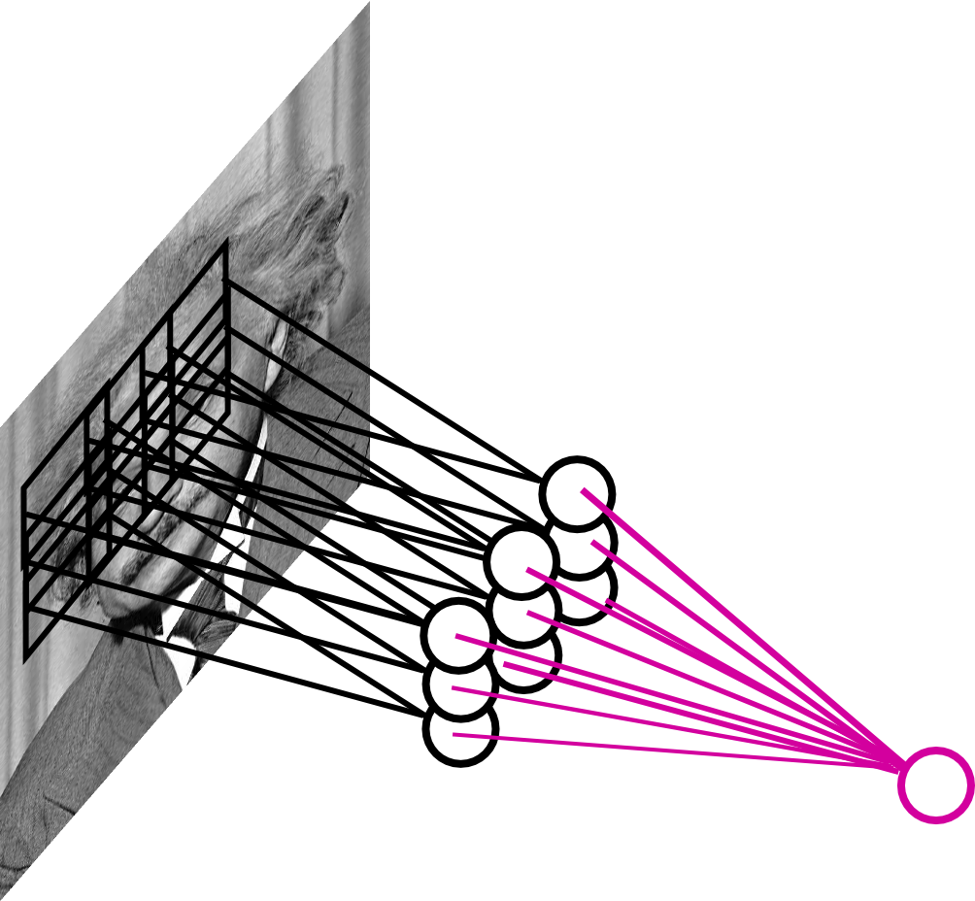
Pooling Layer
By “pooling” (e.g., taking max) filter
responses at different locations we gain robustness to the exact spatial location of features.
Slide Credit: Marc'Aurelio Ranzato

Slide 45
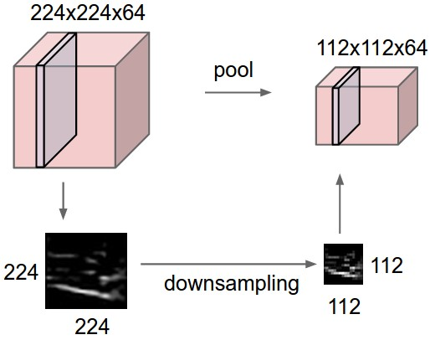
Pooling layer
makes the representations smaller and more manageable
operates over each activation map independently:
Slide Credit: Fei-Fei Li, Justin Johnson, Serena Yeung, CS 231n

Slide 46
MAX POOLING
Single depth slice
1 | 1 | 2 | 4
5 | 6 | 7 | 8
3 | 2 | 1 | 0
1 | 2 | 3 | 4
dim 1
max pool with 2x2 filters and stride 2
6 | 8
3 | 4
dim 2
Slide Credit: Fei-Fei Li, Justin Johnson, Serena Yeung, CS 231n

Slide 47
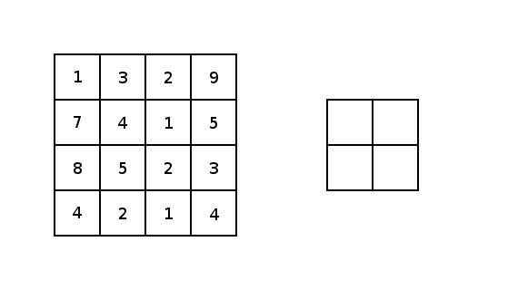
Image courtesy: Justin Francis.

Slide 48
Pooling Layer: Examples
Max-pooling:
Average-pooling:
L2-pooling:
Slide Credit: Marc'Aurelio Ranzato

Slide 49
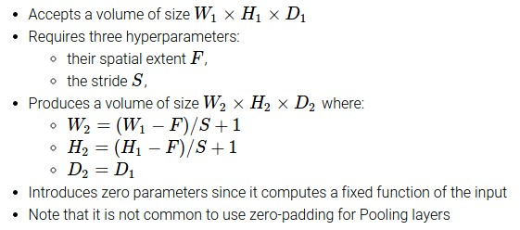
Slide Credit: Fei-Fei Li, Justin Johnson, Serena Yeung, CS 231n

Slide 50
Common settings:
F = 2, S = 2
F = 3, S = 2
Slide Credit: Fei-Fei Li, Justin Johnson, Serena Yeung, CS 231n

Slide 51
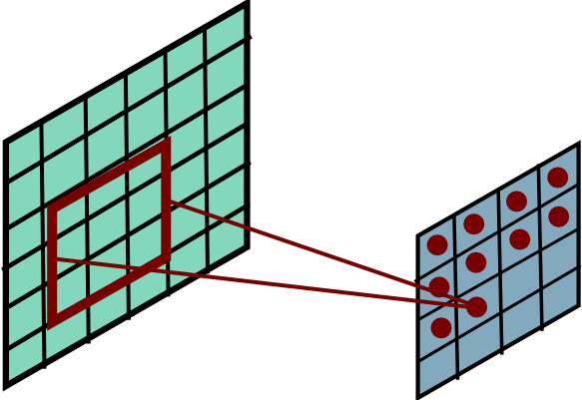
Pooling Layer: Receptive Field Size
Conv.
layer
Pool.
layer
If convolutional filters have size KxK and stride 1, and pooling layer has pools of size PxP, then each unit in the pooling layer depends upon a patch (at the input of the preceding conv. layer) of size: (P+K-1)x(P+K-1)
Slide Credit: Marc'Aurelio Ranzato

Slide 52
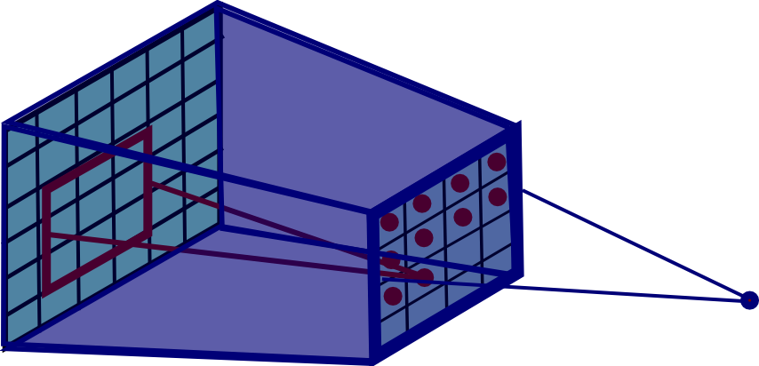
Pooling Layer: Receptive Field Size
Conv.
layer
Pool.
layer
If convolutional filters have size KxK and stride 1, and pooling layer has pools of size PxP, then each unit in the pooling layer depends upon a patch (at the input of the preceding conv. layer) of size: (P+K-1)x(P+K-1)
Slide Credit: Marc'Aurelio Ranzato

Slide 53
Plan for Today
Convolutional Neural Networks
1x1 convolutions
Pooling layers
Fully-connected layers as convolutions
Backprop in conv layers

Slide 54
Fully Connected Layer (FC layer)
Contains neurons that connect to the entire input volume, as in ordinary Neural Networks
Slide Credit: Fei-Fei Li, Justin Johnson, Serena Yeung, CS 231n
Notes:
Car image is photo taken by Lane McIntosh, permission to use.

Slide 55
Convolutional Nets
Example:
http://yann.lecun.com/exdb/lenet/index.html
Image Credit: Yann LeCun, Kevin Murphy

Slide 56
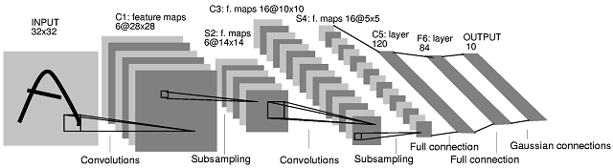
Note: After several stages of convolution-pooling, the spatial resolution is greatly reduced (usually to about 5x5) and the number of feature maps is large (several hundreds depending on the application).
It would not make sense to convolve again (there is no translation invariance and support is too small). Everything is vectorized and fed into several fully connected layers.
If the input of the fully connected layers is of size 5x5xN, the first fully connected layer can be seen as a conv. layer with 5x5 kernels.
The next fully connected layer can be seen as a conv. layer with 1x1 kernels.
Slide Credit: Marc'Aurelio Ranzato

Slide 57
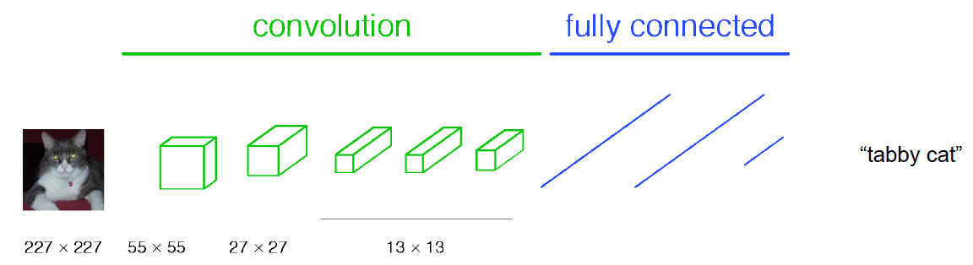
Classical View
Figure Credit: [Long, Shelhamer, Darrell CVPR15]

Slide 58
H hidden units
NxNxC, N small
Fully conn. layer
Slide Credit: Marc'Aurelio Ranzato

Slide 59
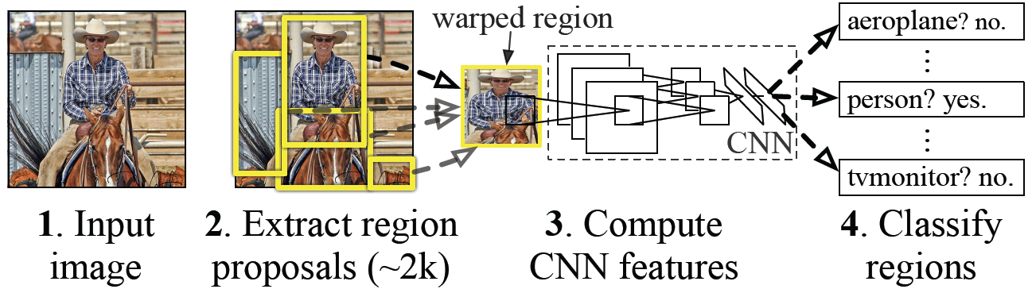
Classical View = Inefficient

Slide 60
Classical View
Figure Credit: [Long, Shelhamer, Darrell CVPR15]

Slide 61
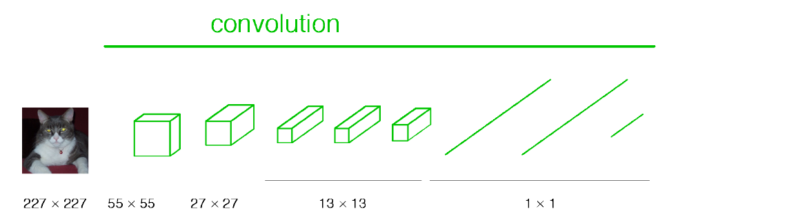
Re-interpretation
Just squint a little!
Figure Credit: [Long, Shelhamer, Darrell CVPR15]

Slide 62
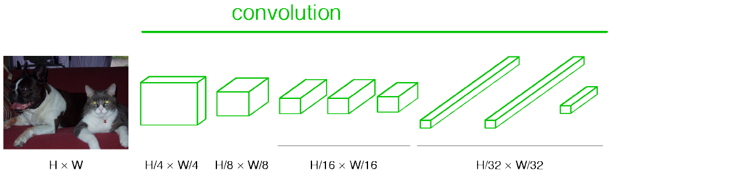
“Fully Convolutional” Networks
Can run on an image of any size!
Figure Credit: [Long, Shelhamer, Darrell CVPR15]

Slide 63
H hidden units /
1x1xH feature maps
NxNxC, N small
Fully conn. layer /
Conv. layer (H kernels of size NxNxC)
Slide Credit: Marc'Aurelio Ranzato

Slide 64
K hidden units /
1x1xK feature maps
H hidden units /
1x1xH feature maps
MxMxN, M small
Fully conn. layer /
Conv. layer (H kernels of size MxMxN)
Fully conn. layer /
Conv. layer (K kernels of size 1x1xH)
Slide Credit: Marc'Aurelio Ranzato

Slide 65
Viewing fully connected layers as convolutional layers enables efficient use of convnets on bigger images (no need to slide windows but unroll network over space as needed to re-use computation).
TRAINING TIME
Input
Image
CNN
TEST TIME
Input
Image
Input
Image
CNN
cols
rows
Slide Credit: Marc'Aurelio Ranzato

Slide 66
Viewing fully connected layers as convolutional layers enables efficient use of convnets on bigger images (no need to slide windows but unroll network over space as needed to re-use computation).
TRAINING TIME
Input
Image
CNN
TEST TIME
CNNs work on any image size!
Input
Image
CNN
cols
rows
Unrolling is order of magnitudes more eficient than sliding windows!
Slide Credit: Marc'Aurelio Ranzato

Slide 67
Training time
Fixed-size images
Figure Credit: [Long, Shelhamer, Darrell CVPR15]

Slide 68
Testing time
Can run on an image of any size!
Figure Credit: [Long, Shelhamer, Darrell CVPR15]

Slide 69
Benefit of this thinking
Mathematically elegant
Efficiency
Can run network on arbitrary image
Without multiple crops

Slide 70
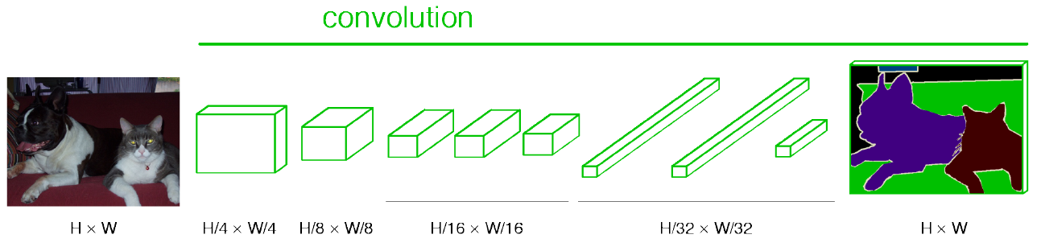
“Fully Convolutional” Networks
Up-sample to get segmentation maps
Figure Credit: [Long, Shelhamer, Darrell CVPR15]

Slide 71
Plan for Today
Convolutional Neural Networks
1x1 convolutions
Pooling layers
Fully-connected layers as convolutions
Backprop in conv layers

Slide 72
Jacobians of FC-Layer

Slide 73
Backprop in Convolutional Layers
Notes
https://www.cc.gatech.edu/classes/AY2018/cs7643_fall/slides/L6_cnns_backprop_notes.pdf

