Slide 1
CS 7643: Deep Learning
Topics:
Notation + Supervised Learning view
Linear Classifiers
Neural Networks
Modular Design
Dhruv Batra
Georgia Tech

Slide 2
Administrativia
Now that the dust has settled
Nearly everyone who submitted HW0 was added to class from waitlist
Canvas
Anybody not have access?
HW0
People who were on waitlist, your HW0 scores will be uploaded soon.
Remember, doesn’t count towards final grade.
Self-assessment tool.

Slide 3
Plan for Today
Notation + Supervised Learning view
Linear Classifiers
Neural Networks
Modular Design

Slide 4
Notation

Slide 5
Supervised Learning

Slide 6
Supervised Learning
Input: x (images, text, emails…)
Output: y (spam or non-spam…)
(Unknown) Target Function
f: X → Y (the “true” mapping / reality)
Data
(x₁,y₁), (x₂,y₂), …, (x_{N},y_{N})
Model / Hypothesis Class
h: X → Y
y = h(x) = sign(w^{T}x)
Learning = Search in hypothesis space
Find best h in model class.

Slide 7
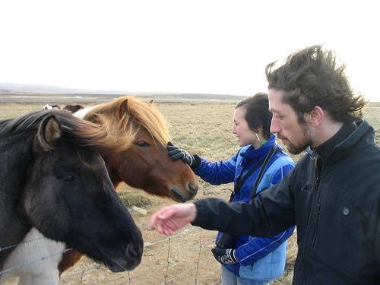
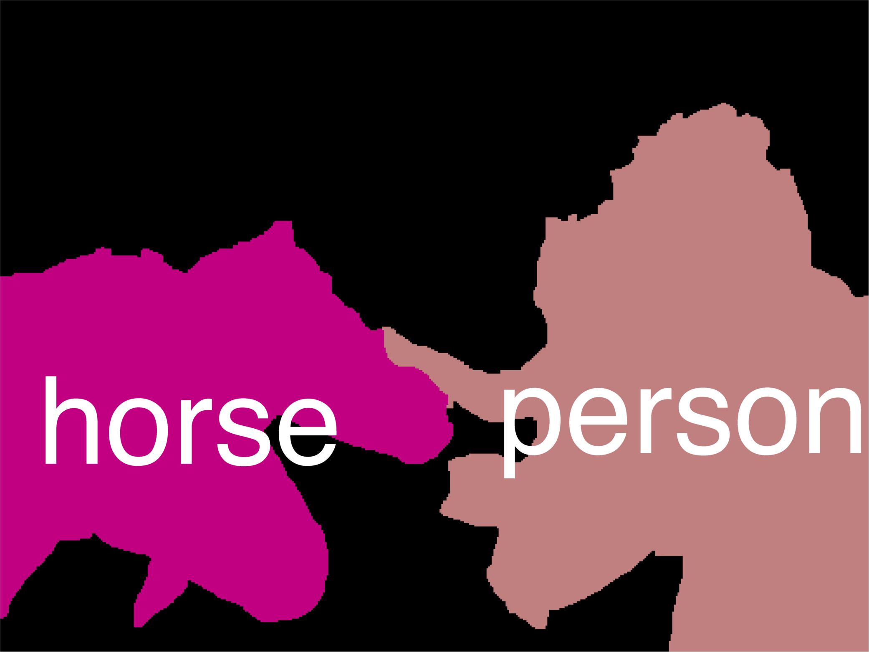
Error Decomposition
Reality

Slide 8
Error Decomposition
AlexNet
Softmax
Reality
FC 1000
FC 4096
FC 4096
Modeling Error
Pool
3x3 conv, 256
model class
3x3 conv, 384
Pool
3x3 conv, 384
Pool
Estimation Error
5x5 conv, 256
11x11 conv, 96
Input
Optimization Error

Slide 9
Error Decomposition
Reality
Multi-class Logistic Regression
Modeling Error
Softmax
FC HxWx3
Input
Estimation Error
Optimization Error = 0
model class

Slide 10
Error Decomposition
VGG19
Softmax
FC 1000
FC 4096
FC 4096
Pool
3x3 conv, 512
Reality
3x3 conv, 512
Modeling Error
3x3 conv, 512
model class
3x3 conv, 512
Pool
3x3 conv, 512
3x3 conv, 512
3x3 conv, 512
3x3 conv, 512
Estimation Error
Pool
3x3 conv, 256
3x3 conv, 256
Pool
3x3 conv, 128
3x3 conv, 128
Optimization Error
Pool
3x3 conv, 64
3x3 conv, 64
Input

Slide 11
Error Decomposition
Approximation/Modeling Error
You approximated reality with model
Estimation Error
You tried to learn model with finite data
Optimization Error
You were lazy and couldn’t/didn’t optimize to completion
Bayes Error
Reality just sucks

Slide 12
Linear Classification

Slide 13
Neural Network
Linear classifiers
This image is CC0 1.0 public domain
Slide Credit: Fei-Fei Li, Justin Johnson, Serena Yeung, CS 231n

Slide 14
Image Captioning
Image Credit: [Vinyals et al. CVPR15]

Slide 15
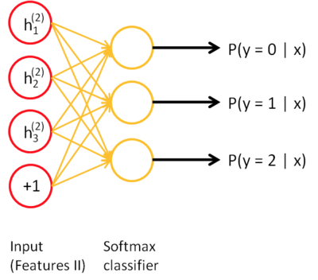
Visual Question Answering
Neural Network Softmax over top K answers
Embedding (VGGNet)
Image
4096-dim
Convolution Layer + Non-Linearity
Pooling Layer
Convolution Layer + Non-Linearity
Pooling Layer
Fully-Connected MLP
Question
Embedding (LSTM)
“How many horses are in this image?”

Slide 16
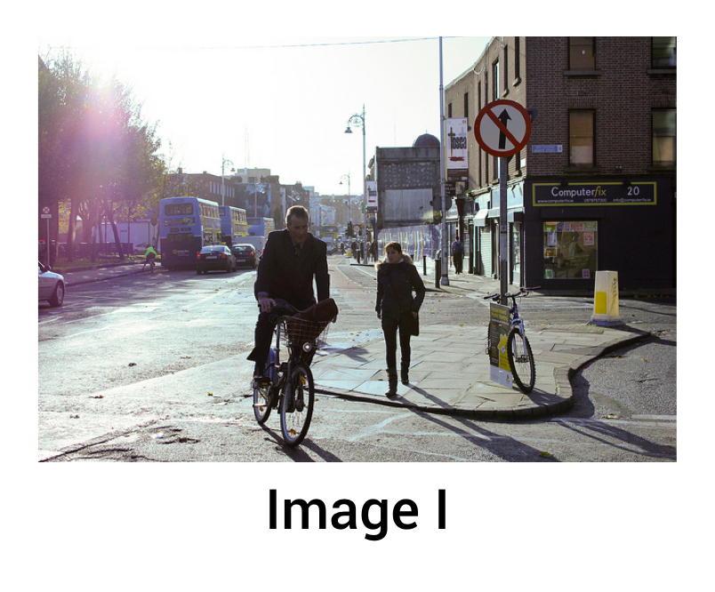
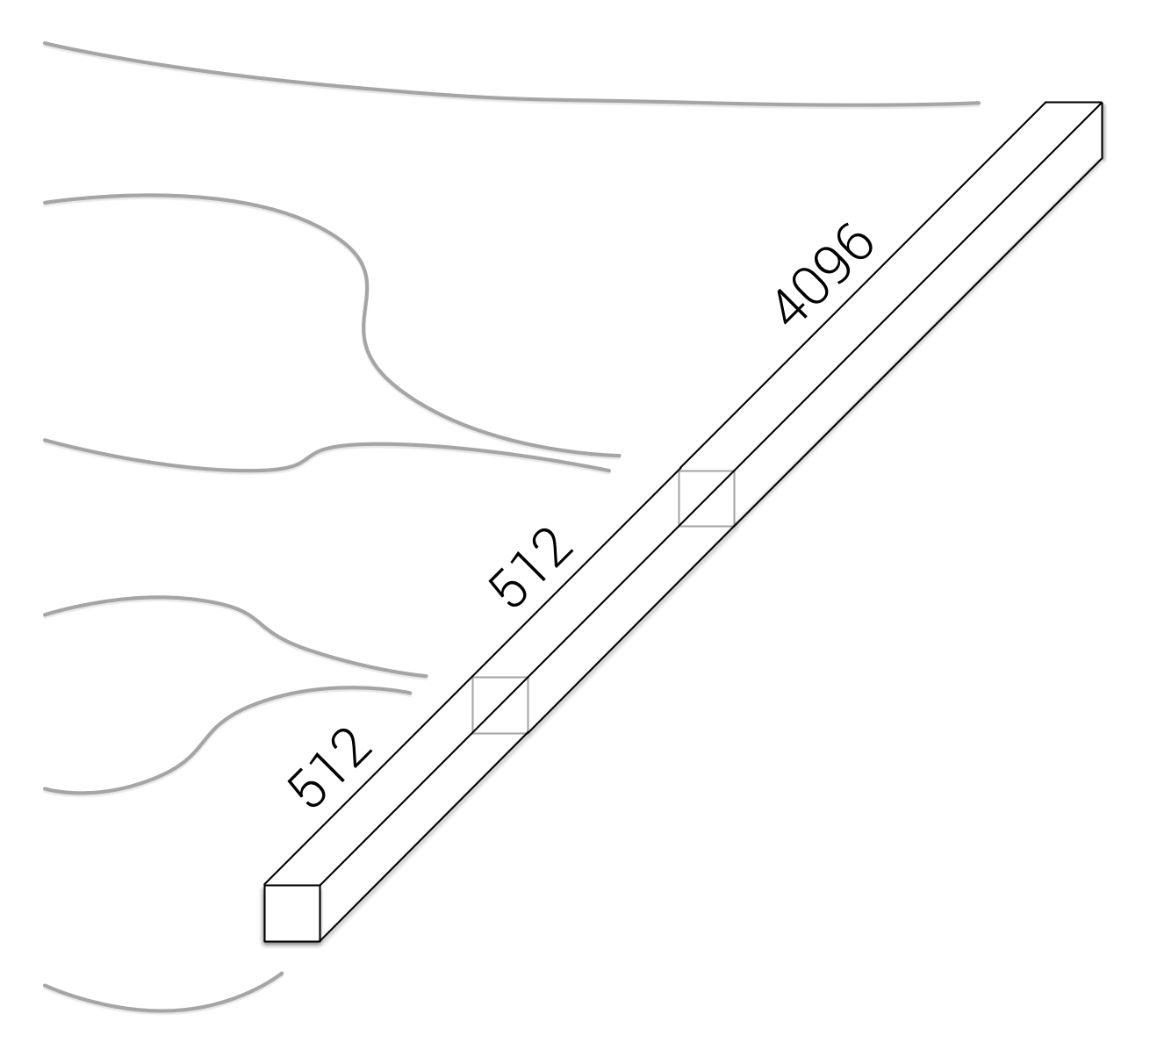
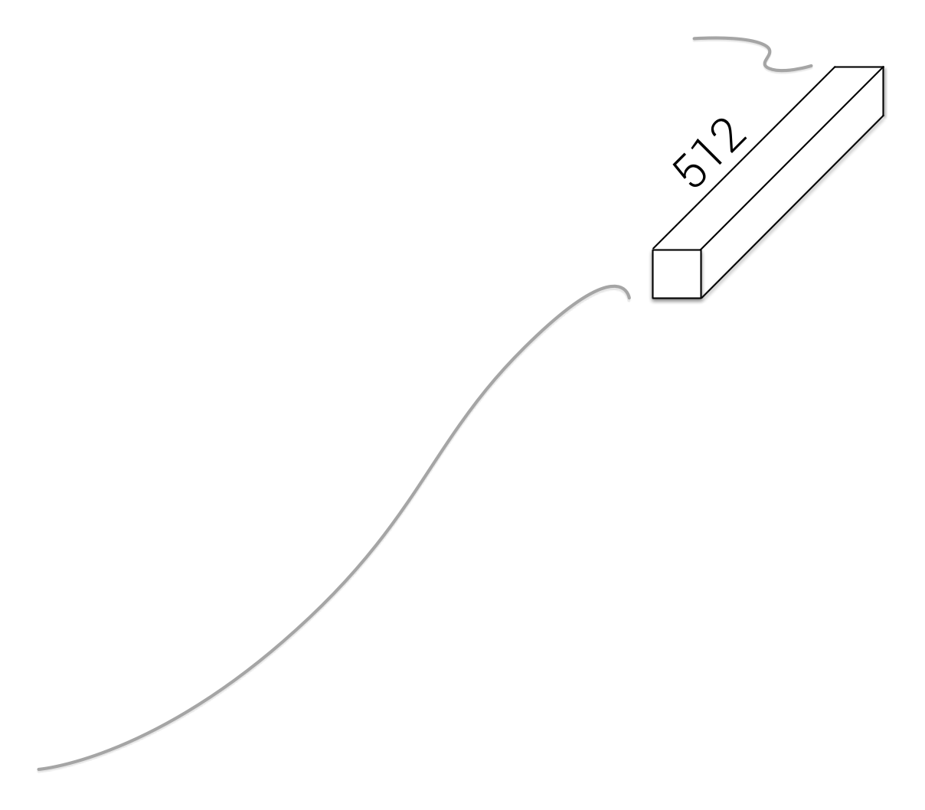
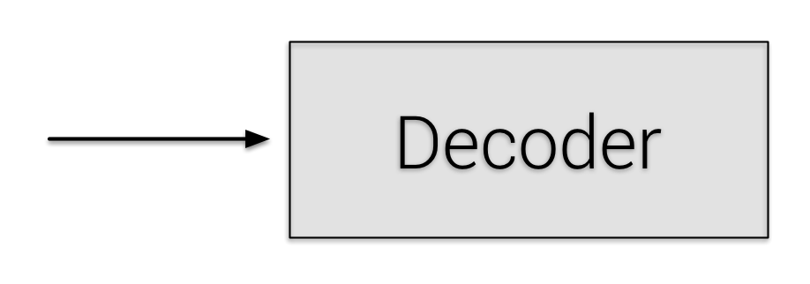
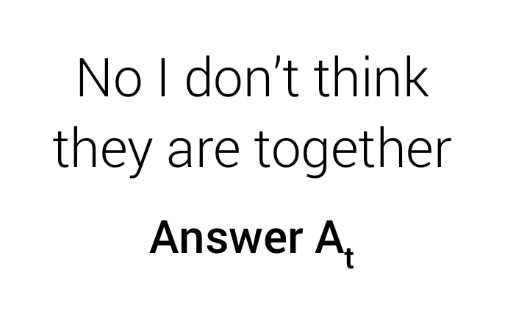
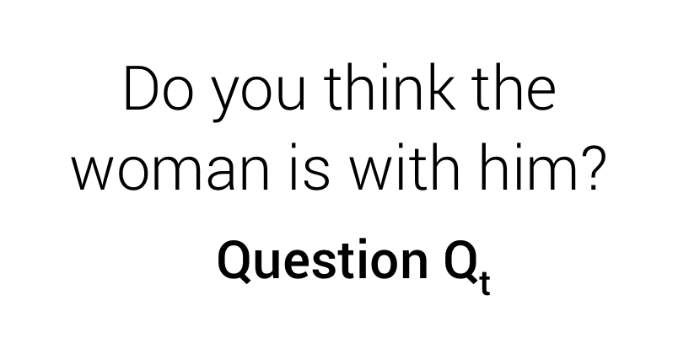
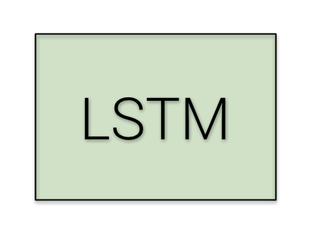
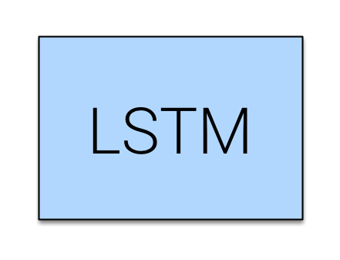
Visual Dialog
Late Fusion Encoder
Slide Credit: Abhishek Das

Slide 17
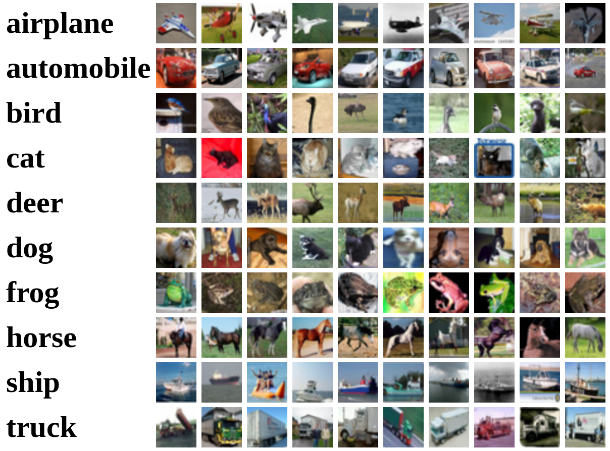
Recall CIFAR10
50,000 training images
each image is 32x32x3
10,000 test images.
Slide Credit: Fei-Fei Li, Justin Johnson, Serena Yeung, CS 231n

Slide 18
Parametric Approach
Image
f(x,W)
10 numbers giving class scores
Array of 32x32x3 numbers
(3072 numbers total)
W
parameters
or weights
Slide Credit: Fei-Fei Li, Justin Johnson, Serena Yeung, CS 231n

Slide 19
Parametric Approach: Linear Classifier
f(x,W) = Wx
Image
f(x,W)
10 numbers giving class scores
Array of 32x32x3 numbers
(3072 numbers total)
W
parameters
or weights
Slide Credit: Fei-Fei Li, Justin Johnson, Serena Yeung, CS 231n

Slide 20
Parametric Approach: Linear Classifier
3072x1
f(x,W) = Wx
Image
10x1
10x3072
f(x,W)
10 numbers giving class scores
Array of 32x32x3 numbers
(3072 numbers total)
W
parameters
or weights
Slide Credit: Fei-Fei Li, Justin Johnson, Serena Yeung, CS 231n

Slide 21
Parametric Approach: Linear Classifier
3072x1
f(x,W) = Wx + b
10x1
Image
10x1
10x3072
f(x,W)
10 numbers giving class scores
Array of 32x32x3 numbers
(3072 numbers total)
W
parameters
or weights
Slide Credit: Fei-Fei Li, Justin Johnson, Serena Yeung, CS 231n

Slide 22
Example with an image with 4 pixels, and 3 classes (cat/dog/ship)
Stretch pixels into column
56
231
24
2
0.2 | -0.5 | 0.1 | 2.0
1.5 | 1.3 | 2.1 | 0.0
0 | 0.25 | 0.2 | -0.3
1.1
3.2
-1.2
-96.8
437.9
61.95
Cat score
56 | 231
24 | 2
+
=
Dog score
Ship score
Input image
W
Slide Credit: Fei-Fei Li, Justin Johnson, Serena Yeung, CS 231n

Slide 23
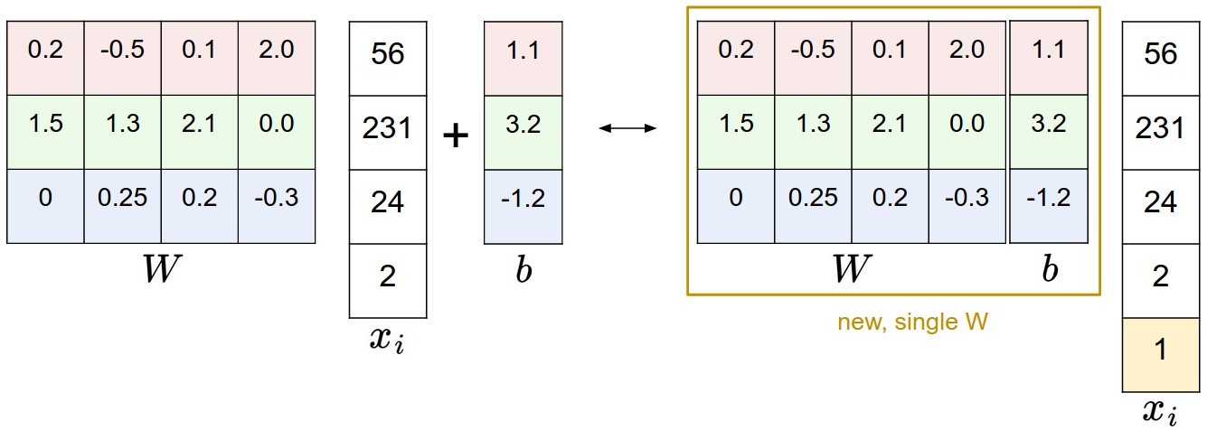
Image Credit: Andrej Karpathy, CS231n

Slide 24
Interpreting a Linear Classifier
f(x,W) = Wx + b
What is this thing doing?
Slide Credit: Fei-Fei Li, Justin Johnson, Serena Yeung, CS 231n

Slide 25
Interpreting a Linear Classifier
f(x,W) = Wx + b
Example trained weights of a linear classifier trained on CIFAR-10:
Slide Credit: Fei-Fei Li, Justin Johnson, Serena Yeung, CS 231n

Slide 26
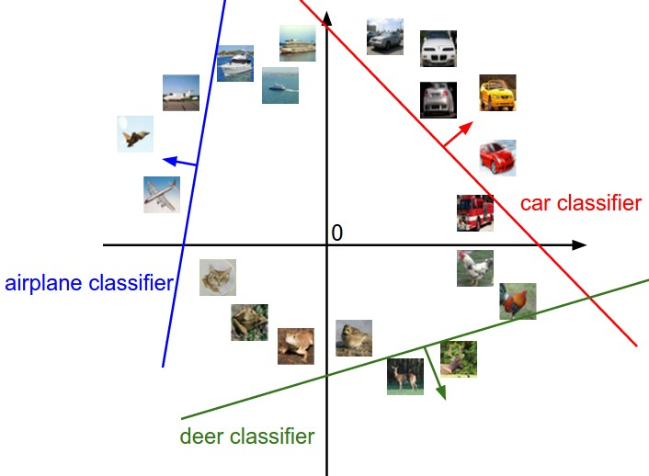
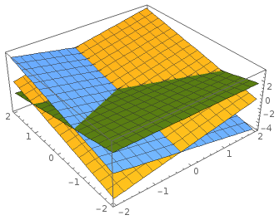
Interpreting a Linear Classifier
f(x,W) = Wx + b
Array of 32x32x3 numbers
(3072 numbers total)
Plot created using Wolfram Cloud
Cat image by Nikita is licensed under CC-BY 2.0
Slide Credit: Fei-Fei Li, Justin Johnson, Serena Yeung, CS 231n

Slide 27
Hard cases for a linear classifier
Class 1:
number of pixels > 0 odd
Class 2:
number of pixels > 0 even
Class 1:
1 <= L2 norm <= 2
Class 2:
Everything else
Class 1:
Three modes
Class 2:
Everything else
Slide Credit: Fei-Fei Li, Justin Johnson, Serena Yeung, CS 231n

Slide 28
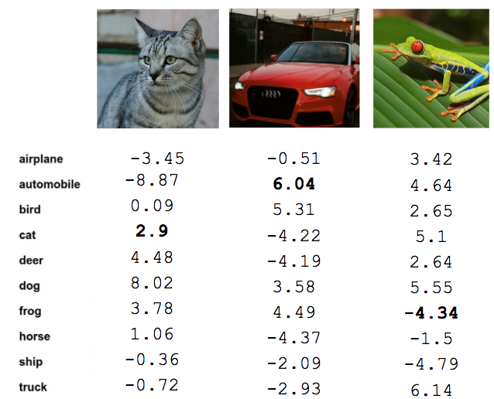
So far: Defined a (linear) score function
f(x,W) = Wx + b
Example class scores for 3 images for some W:
How can we tell whether this W is good or bad?
Cat image by Nikita is licensed under CC-BY 2.0; Car image is CC0 1.0 public domain; Frog image is in the public domain
Slide Credit: Fei-Fei Li, Justin Johnson, Serena Yeung, CS 231n

Slide 29
So far: Defined a (linear) score function
TODO:
Define a loss function that quantifies our unhappiness with the scores across the training data.
Come up with a way of efficiently finding the parameters that minimize the loss function. (optimization)
Cat image by Nikita is licensed under CC-BY 2.0; Car image is CC0 1.0 public domain; Frog image is in the public domain
Slide Credit: Fei-Fei Li, Justin Johnson, Serena Yeung, CS 231n

Slide 30
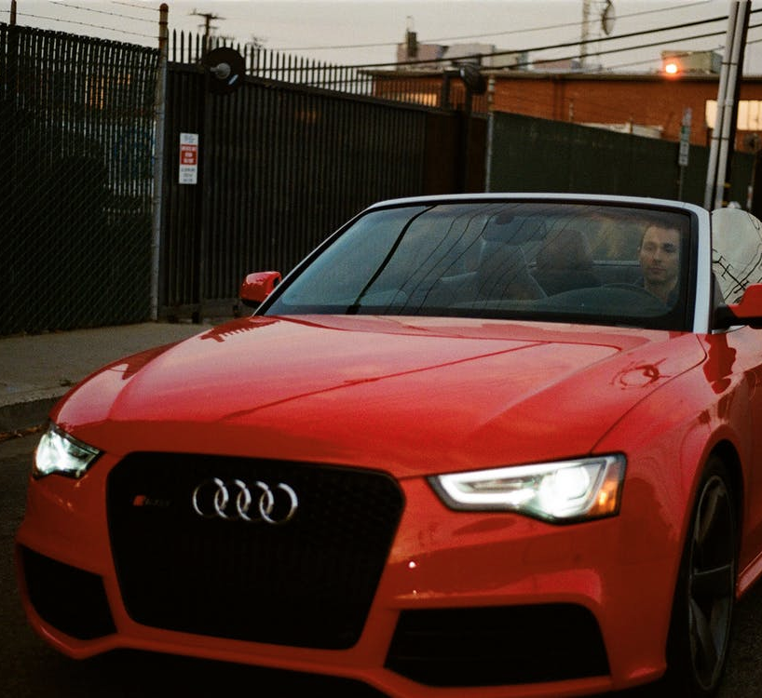
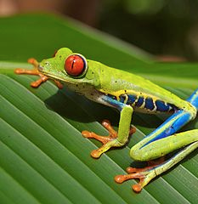
Suppose: 3 training examples, 3 classes.
With some W the scores are:
cat
3.2
1.3
2.2
car
5.1
4.9
2.5
frog
-1.7
2.0
-3.1
Slide Credit: Fei-Fei Li, Justin Johnson, Serena Yeung, CS 231n

Slide 31
Suppose: 3 training examples, 3 classes.
With some W the scores are:
A loss function tells how good our current classifier is
Given a dataset of examples
Where is image and
is (integer) label
Loss over the dataset is a sum of loss over examples:
cat
3.2
1.3
2.2
car
5.1
4.9
2.5
frog
-1.7
2.0
-3.1
Slide Credit: Fei-Fei Li, Justin Johnson, Serena Yeung, CS 231n

Slide 32
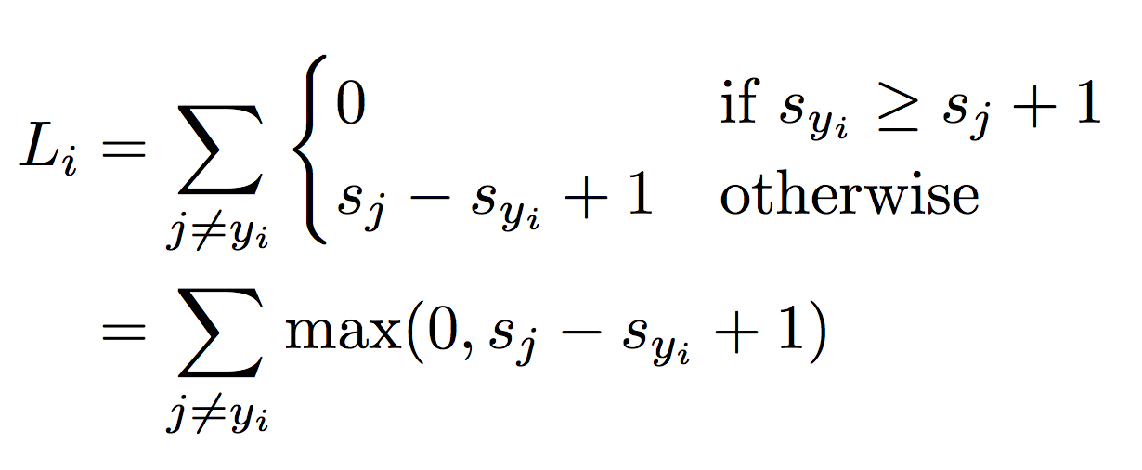
Suppose: 3 training examples, 3 classes.
With some W the scores are:
Multiclass SVM loss:
Given an example
where is the image and
where is the (integer) label,
and using the shorthand for the scores vector:
the SVM loss has the form:
cat
3.2
1.3
2.2
car
5.1
4.9
2.5
frog
-1.7
2.0
-3.1
Slide Credit: Fei-Fei Li, Justin Johnson, Serena Yeung, CS 231n

Slide 33
Suppose: 3 training examples, 3 classes.
With some W the scores are:
Multiclass SVM loss:
Given an example
where is the image and
where is the (integer) label,
and using the shorthand for the scores vector:
the SVM loss has the form:
“Hinge loss”
cat
3.2
1.3
2.2
car
5.1
4.9
2.5
frog
-1.7
2.0
-3.1
Slide Credit: Fei-Fei Li, Justin Johnson, Serena Yeung, CS 231n

Slide 34
Suppose: 3 training examples, 3 classes.
With some W the scores are:
Multiclass SVM loss:
Given an example
where is the image and
where is the (integer) label,
and using the shorthand for the scores vector:
the SVM loss has the form:
cat
3.2
1.3
2.2
car
5.1
4.9
2.5
frog
-1.7
2.0
-3.1
Slide Credit: Fei-Fei Li, Justin Johnson, Serena Yeung, CS 231n

Slide 35
Suppose: 3 training examples, 3 classes.
With some W the scores are:
Multiclass SVM loss:
Given an example
where is the image and
where is the (integer) label,
and using the shorthand for the scores vector:
the SVM loss has the form:
cat
3.2
1.3
2.2
car
5.1
4.9
2.5
= max(0, 5.1 - 3.2 + 1)
+max(0, -1.7 - 3.2 + 1)
= max(0, 2.9) + max(0, -3.9)
= 2.9 + 0
= 2.9
frog
-1.7
2.0
-3.1
Losses:
2.9
Slide Credit: Fei-Fei Li, Justin Johnson, Serena Yeung, CS 231n

Slide 36
Suppose: 3 training examples, 3 classes.
With some W the scores are:
Multiclass SVM loss:
Given an example
where is the image and
where is the (integer) label,
and using the shorthand for the scores vector:
the SVM loss has the form:
cat
3.2
1.3
2.2
car
5.1
4.9
2.5
= max(0, 1.3 - 4.9 + 1)
+max(0, 2.0 - 4.9 + 1)
= max(0, -2.6) + max(0, -1.9)
= 0 + 0
= 0
frog
-1.7
2.0
-3.1
Losses:
2.9
0
Slide Credit: Fei-Fei Li, Justin Johnson, Serena Yeung, CS 231n

Slide 37
Suppose: 3 training examples, 3 classes.
With some W the scores are:
Multiclass SVM loss:
Given an example
where is the image and
where is the (integer) label,
and using the shorthand for the scores vector:
the SVM loss has the form:
cat
3.2
1.3
2.2
car
5.1
4.9
2.5
= max(0, 2.2 - (-3.1) + 1)
+max(0, 2.5 - (-3.1) + 1)
= max(0, 6.3) + max(0, 6.6)
= 6.3 + 6.6
= 12.9
frog
-1.7
2.0
-3.1
Losses:
2.9
0
12.9
Slide Credit: Fei-Fei Li, Justin Johnson, Serena Yeung, CS 231n

Slide 38
Suppose: 3 training examples, 3 classes.
With some W the scores are:
Multiclass SVM loss:
Given an example
where is the image and
where is the (integer) label,
and using the shorthand for the scores vector:
the SVM loss has the form:
Loss over full dataset is average:
cat
3.2
1.3
2.2
car
5.1
4.9
2.5
frog
-1.7
2.0
-3.1
Losses:
2.9
0
12.9
L = (2.9 + 0 + 12.9)/3
= 5.27
Slide Credit: Fei-Fei Li, Justin Johnson, Serena Yeung, CS 231n

Slide 39
Suppose: 3 training examples, 3 classes.
With some W the scores are:
Multiclass SVM loss:
Given an example
where is the image and
where is the (integer) label,
and using the shorthand for the scores vector:
the SVM loss has the form:
“Hinge loss”
cat
3.2
1.3
2.2
car
5.1
4.9
2.5
frog
-1.7
2.0
-3.1
Slide Credit: Fei-Fei Li, Justin Johnson, Serena Yeung, CS 231n

Slide 40
Suppose: 3 training examples, 3 classes.
With some W the scores are:
Multiclass SVM loss:
Given an example
where is the image and
where is the (integer) label,
and using the shorthand for the scores vector:
the SVM loss has the form:
Q: What happens to loss if car image scores change a bit?
cat
3.2
1.3
2.2
car
5.1
4.9
2.5
frog
-1.7
2.0
-3.1
Losses:
2.9
0
12.9
Slide Credit: Fei-Fei Li, Justin Johnson, Serena Yeung, CS 231n

Slide 41
Suppose: 3 training examples, 3 classes.
With some W the scores are:
Multiclass SVM loss:
Given an example
where is the image and
where is the (integer) label,
and using the shorthand for the scores vector:
the SVM loss has the form:
Q2: what is the min/max possible loss?
cat
3.2
1.3
2.2
car
5.1
4.9
2.5
frog
-1.7
2.0
-3.1
Losses:
2.9
0
12.9
Slide Credit: Fei-Fei Li, Justin Johnson, Serena Yeung, CS 231n
Notes:
Min is 0, max is infinity

Slide 42
Suppose: 3 training examples, 3 classes.
With some W the scores are:
Multiclass SVM loss:
Given an example
where is the image and
where is the (integer) label,
and using the shorthand for the scores vector:
the SVM loss has the form:
Q3: At initialization W is small so all s ≈ 0.
What is the loss?
cat
3.2
1.3
2.2
car
5.1
4.9
2.5
frog
-1.7
2.0
-3.1
Losses:
2.9
0
12.9
Slide Credit: Fei-Fei Li, Justin Johnson, Serena Yeung, CS 231n
Notes:
Min is 0, max is infinity

Slide 43
Suppose: 3 training examples, 3 classes.
With some W the scores are:
Multiclass SVM loss:
Given an example
where is the image and
where is the (integer) label,
and using the shorthand for the scores vector:
the SVM loss has the form:
Q4: What if the sum was over all classes?
(including j = y_i)
cat
3.2
1.3
2.2
car
5.1
4.9
2.5
frog
-1.7
2.0
-3.1
Losses:
2.9
0
12.9
Slide Credit: Fei-Fei Li, Justin Johnson, Serena Yeung, CS 231n

Slide 44
Suppose: 3 training examples, 3 classes.
With some W the scores are:
Multiclass SVM loss:
Given an example
where is the image and
where is the (integer) label,
and using the shorthand for the scores vector:
the SVM loss has the form:
Q5: What if we used mean instead of sum?
cat
3.2
1.3
2.2
car
5.1
4.9
2.5
frog
-1.7
2.0
-3.1
Losses:
2.9
0
12.9
Slide Credit: Fei-Fei Li, Justin Johnson, Serena Yeung, CS 231n

Slide 45
Suppose: 3 training examples, 3 classes.
With some W the scores are:
Multiclass SVM loss:
Given an example
where is the image and
where is the (integer) label,
and using the shorthand for the scores vector:
the SVM loss has the form:
Q6: What if we used
cat
3.2
1.3
2.2
car
5.1
4.9
2.5
frog
-1.7
2.0
-3.1
Losses:
2.9
0
12.9
Slide Credit: Fei-Fei Li, Justin Johnson, Serena Yeung, CS 231n
Notes:
Minima could change

Slide 46
Multiclass SVM Loss: Example code
Slide Credit: Fei-Fei Li, Justin Johnson, Serena Yeung, CS 231n

Slide 47
E.g. Suppose that we found a W such that L = 0.
Is this W unique?
Slide Credit: Fei-Fei Li, Justin Johnson, Serena Yeung, CS 231n

Slide 48
E.g. Suppose that we found a W such that L = 0.
Is this W unique?
No! 2W is also has L = 0!
Slide Credit: Fei-Fei Li, Justin Johnson, Serena Yeung, CS 231n

Slide 49
Suppose: 3 training examples, 3 classes.
With some W the scores are:
Before:
= max(0, 1.3 - 4.9 + 1)
+max(0, 2.0 - 4.9 + 1)
= max(0, -2.6) + max(0, -1.9)
= 0 + 0
= 0
cat
3.2
1.3
2.2
With W twice as large:
car
5.1
4.9
2.5
= max(0, 2.6 - 9.8 + 1)
+max(0, 4.0 - 9.8 + 1)
= max(0, -6.2) + max(0, -4.8)
= 0 + 0
= 0
frog
-1.7
2.0
-3.1
Losses:
2.9
0
Slide Credit: Fei-Fei Li, Justin Johnson, Serena Yeung, CS 231n

Slide 50
Softmax Classifier (Multinomial Logistic Regression)
cat
3.2
car
5.1
frog
-1.7
Slide Credit: Fei-Fei Li, Justin Johnson, Serena Yeung, CS 231n

Slide 51
Softmax Classifier (Multinomial Logistic Regression)
scores = unnormalized log probabilities of the classes.
cat
3.2
car
5.1
frog
-1.7
Slide Credit: Fei-Fei Li, Justin Johnson, Serena Yeung, CS 231n

Slide 52
Softmax Classifier (Multinomial Logistic Regression)
scores = unnormalized log probabilities of the classes.
where
cat
3.2
car
5.1
frog
-1.7
Slide Credit: Fei-Fei Li, Justin Johnson, Serena Yeung, CS 231n

Slide 53
Softmax Classifier (Multinomial Logistic Regression)
scores = unnormalized log probabilities of the classes.
where
cat
3.2
Softmax function
car
5.1
frog
-1.7
Slide Credit: Fei-Fei Li, Justin Johnson, Serena Yeung, CS 231n

Slide 54
Why is softmax called softmax?

Slide 55
Softmax Classifier (Multinomial Logistic Regression)
scores = unnormalized log probabilities of the classes.
Want to maximize the log likelihood, or (for a loss function)
to minimize the negative log likelihood of the correct class:
where
cat
3.2
car
5.1
frog
-1.7
Slide Credit: Fei-Fei Li, Justin Johnson, Serena Yeung, CS 231n

Slide 56
Softmax Classifier (Multinomial Logistic Regression)
scores = unnormalized log probabilities of the classes.
Want to maximize the log likelihood, or (for a loss function)
to minimize the negative log likelihood of the correct class:
where
cat
3.2
car
5.1
frog
-1.7
in summary:
Slide Credit: Fei-Fei Li, Justin Johnson, Serena Yeung, CS 231n

Slide 57
Log-Likelihood / KL-Divergence / Cross-Entropy

Slide 58
Softmax Classifier (Multinomial Logistic Regression)
cat
3.2
car
5.1
frog
-1.7
unnormalized log probabilities
Slide Credit: Fei-Fei Li, Justin Johnson, Serena Yeung, CS 231n

Slide 59
Softmax Classifier (Multinomial Logistic Regression)
unnormalized probabilities
cat
3.2
24.5
exp
car
5.1
164.0
frog
-1.7
0.18
unnormalized log probabilities
Slide Credit: Fei-Fei Li, Justin Johnson, Serena Yeung, CS 231n

Slide 60
Softmax Classifier (Multinomial Logistic Regression)
unnormalized probabilities
cat
3.2
24.5
0.13
exp
normalize
car
5.1
164.0
0.87
frog
-1.7
0.18
0.00
unnormalized log probabilities
probabilities
Slide Credit: Fei-Fei Li, Justin Johnson, Serena Yeung, CS 231n

Slide 61
Softmax Classifier (Multinomial Logistic Regression)
unnormalized probabilities
cat
3.2
24.5
0.13
L_i = -log(0.13)
= 0.89
exp
normalize
car
5.1
164.0
0.87
frog
-1.7
0.18
0.00
unnormalized log probabilities
probabilities
Slide Credit: Fei-Fei Li, Justin Johnson, Serena Yeung, CS 231n

Slide 62
Softmax Classifier (Multinomial Logistic Regression)
Q: What is the min/max possible loss L_i?
unnormalized probabilities
cat
3.2
24.5
0.13
L_i = -log(0.13)
= 0.89
exp
normalize
car
5.1
164.0
0.87
frog
-1.7
0.18
0.00
unnormalized log probabilities
probabilities
Slide Credit: Fei-Fei Li, Justin Johnson, Serena Yeung, CS 231n

Slide 63
Softmax Classifier (Multinomial Logistic Regression)
Q2: Usually at initialization W is small so all s ≈ 0.
What is the loss?
unnormalized probabilities
cat
3.2
24.5
0.13
L_i = -log(0.13)
= 0.89
exp
normalize
car
5.1
164.0
0.87
frog
-1.7
0.18
0.00
unnormalized log probabilities
probabilities
Slide Credit: Fei-Fei Li, Justin Johnson, Serena Yeung, CS 231n
Notes:
log(C)

Slide 64
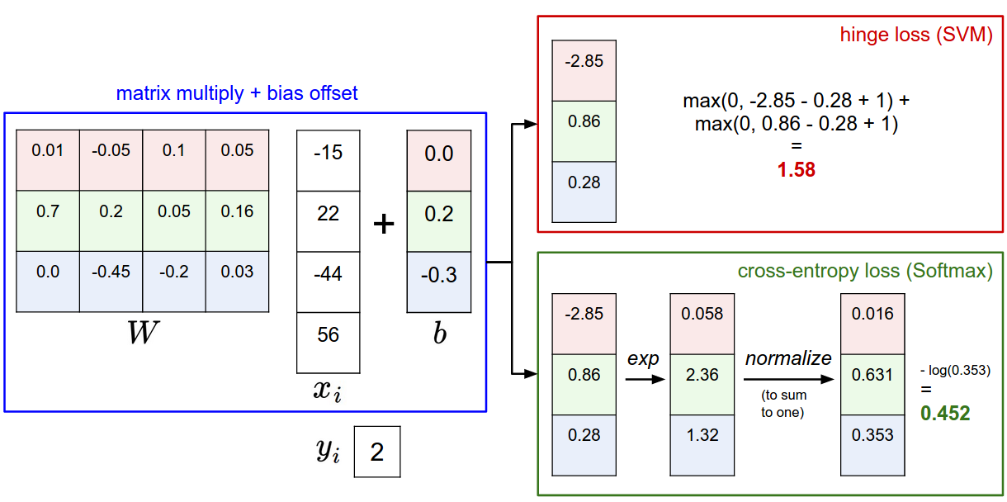
Slide Credit: Fei-Fei Li, Justin Johnson, Serena Yeung, CS 231n

Slide 65
Softmax vs. SVM
Slide Credit: Fei-Fei Li, Justin Johnson, Serena Yeung, CS 231n

Slide 66
Softmax vs. SVM
assume scores:
[10, -2, 3]
[10, 9, 9]
[10, -100, -100]
and
Q: Suppose I take a datapoint and I jiggle a bit (changing its score slightly). What happens to the loss in both cases?
Slide Credit: Fei-Fei Li, Justin Johnson, Serena Yeung, CS 231n

Slide 67
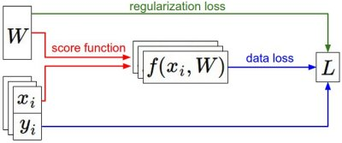
Recap
We have some dataset of (x,y)
We have a score function:
We have a loss function:
e.g.
Softmax
SVM
Full loss
Slide Credit: Fei-Fei Li, Justin Johnson, Serena Yeung, CS 231n

Slide 68
Recap
How do we find the best W?
We have some dataset of (x,y)
We have a score function:
We have a loss function:
e.g.
Softmax
SVM
Full loss
Slide Credit: Fei-Fei Li, Justin Johnson, Serena Yeung, CS 231n

