Slide 1
COCO dataset and
Deeper Deep Architectures

Slide 2

Tsung-Yi Lin
Cornell Tech
Notes:
I am very

Slide 3
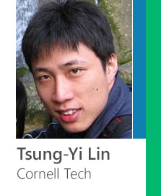

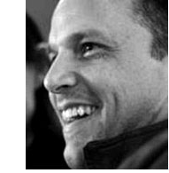
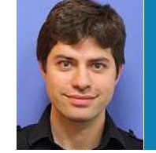


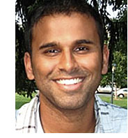
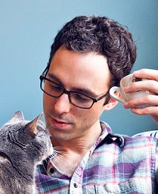

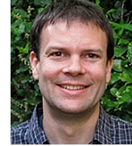
Tsung-Yi Lin
Michael Maire
Serge Belongie
Lubomir Bourdev
James Hays
TTI Chicago
Cornell Tech
Facebook
Brown University
Cornell Tech
Pietro Perona
Deva Ramanan
Ross Girshick
Piotr Dollar
Larry Zitnick
Caltech
UC Irvine
Microsoft Research
Microsoft Research
Microsoft Research
Notes:
I am happy to introduce the microsoft coco dataset today.
That is generously funded by Microsoft.
While it is funded by microsoft, I would like to stress (pause) this dataset is made by academics (pause) and made for academics (pause).
We would like to thank Microsoft for generously funding the dataset. Though the dataset is funded by company, it is made for academic and by academic. Here you might see some familiar faces from people behind COCO.

Slide 4



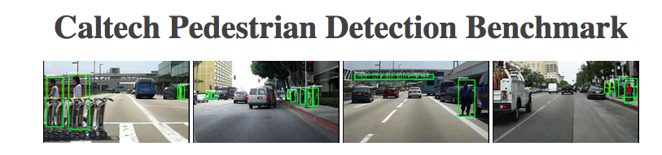
Why a new dataset?
Continue our field’s momentum:
Notes:
Why do we want to create a new dataset.
The short answer
In the past few years, our field has been driven by great dataset such as a,b,c,d, and so on.
We believe a new dataset would help us continue our progress
(especially in!!!!)
In the past few years, many researches have been inspired by datasets. For instances, Pascal VOC and ImageNet for object recognition, SUN database for scene understanding, and so on. All the progress are fantastic and we want to keep the field’s momentum especially in the direction of object detection.

Slide 5
Why a new dataset?
Continue our field’s momentum:
Detecting difficult instances (context)
Localizing instances accurately
Enabling new research directions
Notes:
This includes detecting
1. Detecti
2. Accurately localize objects.
3. Enable new research directions
We hope a new dataset can enable research in detecting difficult objects which can be small and require context for detection and localizing objects accurately.

Slide 6
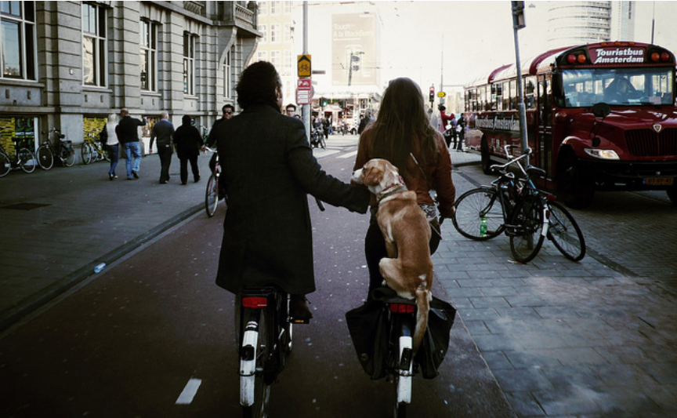
Notes:
We want to explore realistic and difficult detection scenarios such as the bikes in this image
This includes detecting
1. Detecti
2. Accurately localize objects.
3. Enable new research directions
We hope a new dataset can enable research in detecting difficult objects which can be small and require context for detection and localizing objects accurately.

Slide 7
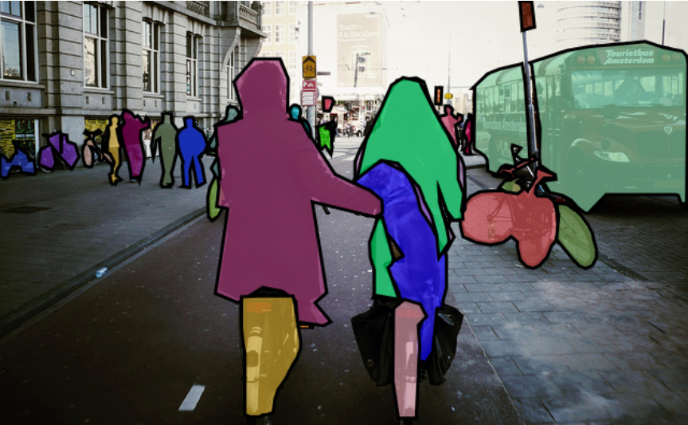
Notes:
As well as accurately localizing the instances.
As I will describe later we also want to enable new research directions.
This includes detecting
1. Detecti
2. Accurately localize objects.
3. Enable new research directions
We hope a new dataset can enable research in detecting difficult objects which can be small and require context for detection and localizing objects accurately.

Slide 8
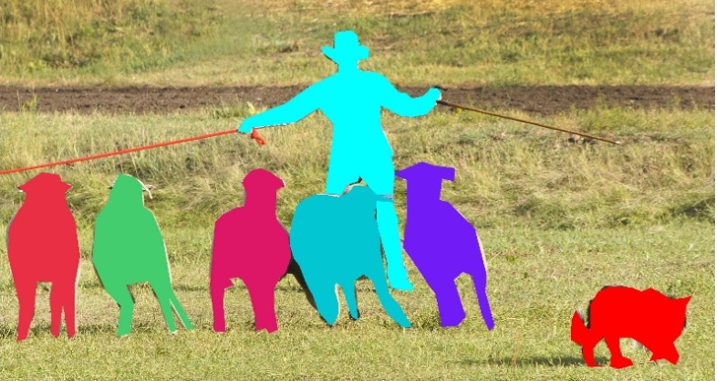
Instance segmentation
Non-iconic Images
Notes:
To achieve our goal, we believe there are two critical properties.
First, every individual object instance should be segmented.
And we believe images should be non-iconic.
Let me quickly describe what I mean by non-iconic images.

Slide 9
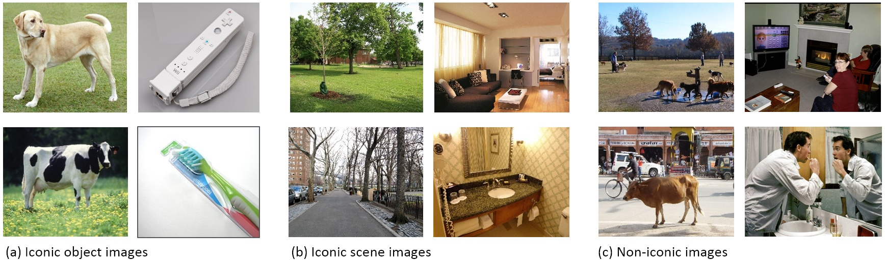
Iconic object images

Slide 10
Iconic scene images
Notes:
And you can also have iconic scene images.
Where generally, images are uncluttered and commonly lack of people.
Also, there are iconic scene images which zoom-out the focus from single object but don’t have much activities happen in them.

Slide 11
Non-iconic images
Notes:
Here shows REPRESENTATIVE non-iconic images from our dataset.
Each non-iconic image shows a realistic and cluttered scene with many object categories including people.
We believe by studying these realistic images and detail segmentation we can gain a better understanding of our visual world.

Slide 12
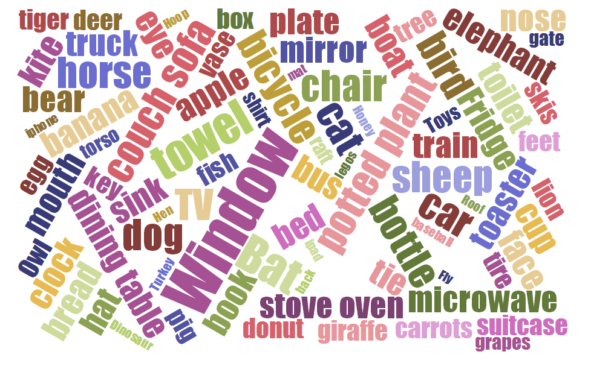
Notes:
One of our first decisions to make in creating the dataset is what object category to label.
There are …
…
So we want to start with common objects that cover our everyday life.
Everyone in our group thought they are expert in naming object categories.
But we found one group that are truly expert in naming simple categories.

Slide 13
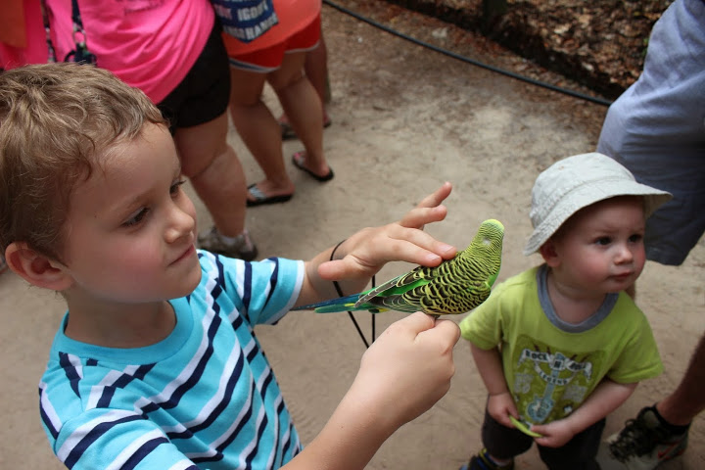
Bird!
Notes:
Kids. (pause)
We ask kids to name everything they see around them.
This gave us a great starting point.
We can just ask kid about “what are the objects you see in your everyday life.” to get a initial set of object categories.
You can imagine kids would run around in a house or point things in his book.
It turned out the categories candidate are quite satisfactory and we used them together with categories from existing dataset to generate the list of category candidates.

Slide 14
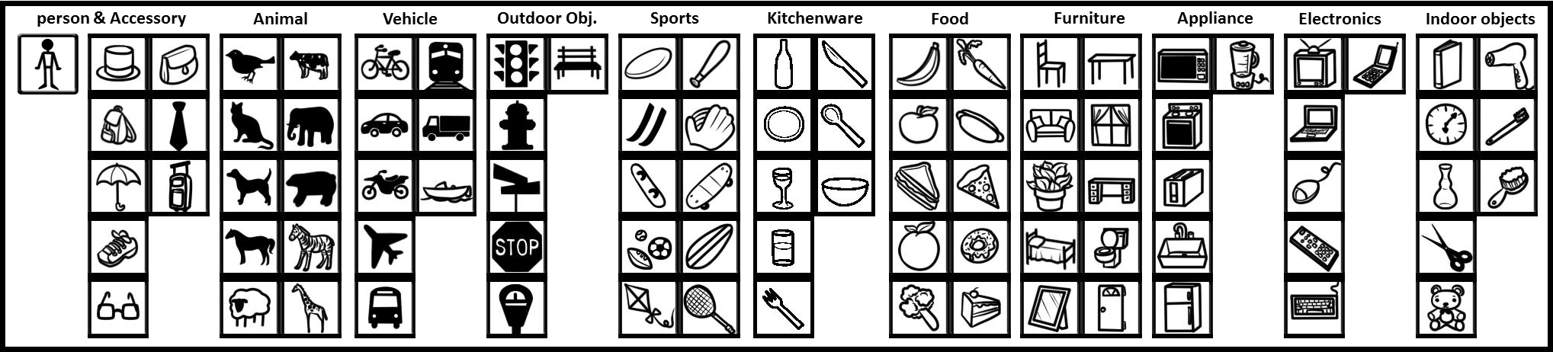
Object categories (things not stuff)
Notes:
And the members in COCO sat down and voted for their favorites based on how well the category is defined and how commonly it appears. Finally, we gathered a set of categories shown here which includes animal, vehicles, indoor outdoor objects etc. Basically, we want them to span the space of people’s everyday life. Also, all 20 PASCAL categories are included for the continuation and comparison of existing object detection research.

Slide 15
Object categories (things not stuff)
Notes:
And the members in COCO sat down and voted for their favorites based on how well the category is defined and how commonly it appears. And we also strive to balance number of categories in 11 supercatogry. Don’t worry, potted plant is included. We include all categories from PASCAL for continuation of existing object detection research.

Slide 16

330,000 images
(All creative commons)
Notes:
The second decision is where to find non-iconic images. get the non-iconic images for each category. We found Flickr in general has more non-iconic images and nicely provides licensing information. So we decide to only use images with creative common license from Flikcr. And in COCO, there are 330K images.
Existing datasets often contain “iconic image” like these images shown here. The iconic-image is not super interesting for object detection task. Because 1) the object location is obvious 2) it doesn’t contain contextual information like in the real world.
It’s important that COCO has biased of its image collection, though initially we hope it to be an unbiased dataset. However, we soon realized it is inevitable that every dataset has its own bias toward its goal. The mission of COCO is to provide a dataset for detecting objects in context. The context can be the interaction between objects or between object and scene.

Slide 17
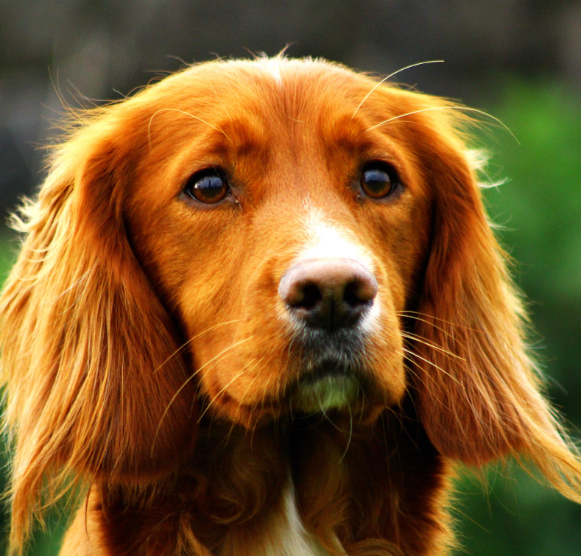
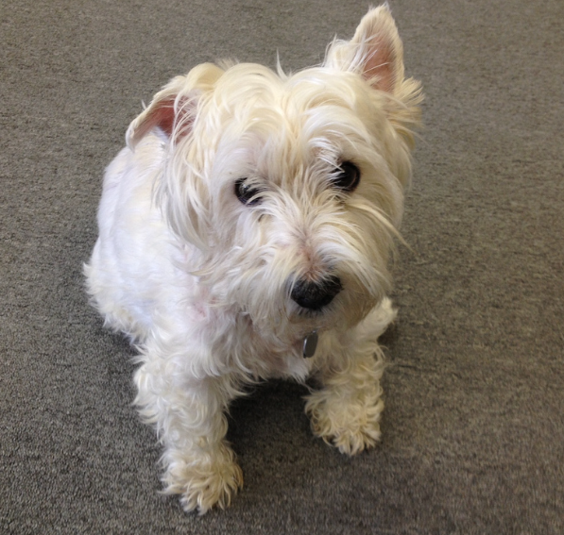
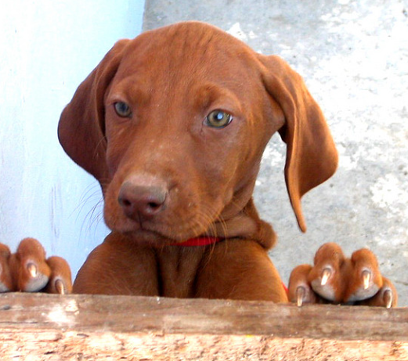
“Dog”
Notes:
However, even Flikcr has more non-iconic images. . It is still very likely to get iconic images, if one just query the database with single category

Slide 18
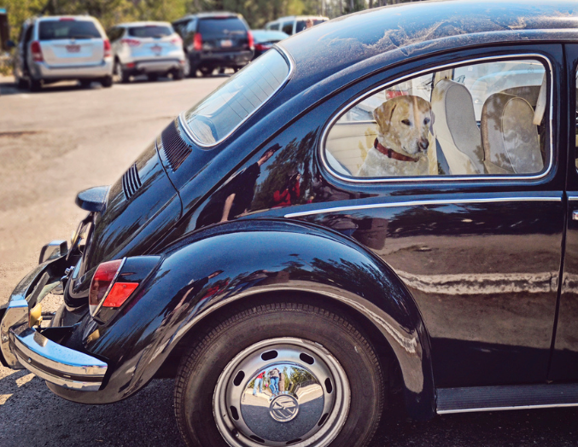
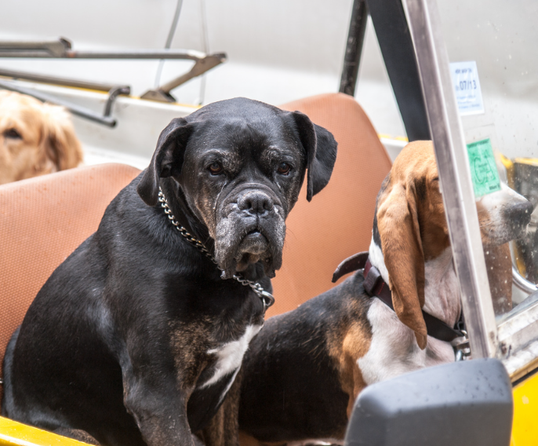
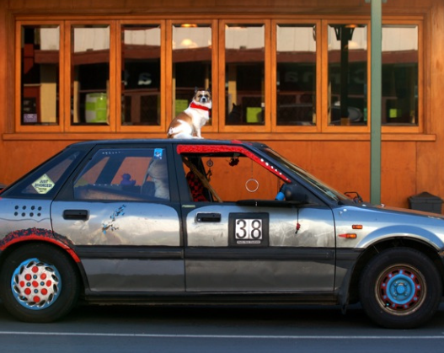
“Dog + Car”
Im2Text: Describing Images Using 1 Million Captioned Photographs, V. Ordonez, G. Kulkarni, T. L. Berg NIPS’11
Notes:
What if we instead search for a pair of categories such dog and car.
We found that results in many more non-iconic images which include interactions between multiple objects.
We create our dataset by query for pairs of object categories and combination of object and scene

Slide 19
Annotation pipeline
Notes:
Now we disscuss how go annotate images

Slide 20
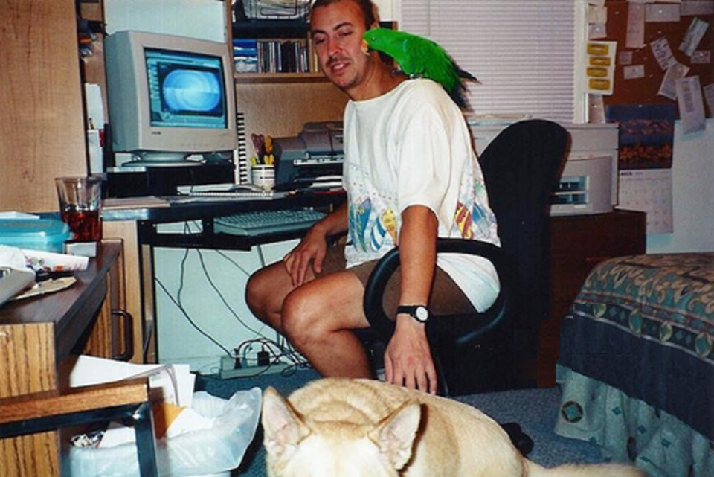
Notes:
Imagine looking to at image. And trying to find all common object 80 different types of objects and segment out each individual instance.
It is
Given the scale of COCO, we decide to perform crowd sourcing on Amazon Mturk platform.
The upside of using Mturk is the high throughput of annotations. We get 25k instance segmentation per day once the task ramped up.
However, not every worker at Mturk is willing to read instruction carefully and spend long time to generate quality work.
It is unrealistic to hope that a single worker can take all the heavy lifting in segmenting out everything in an image.

Slide 21
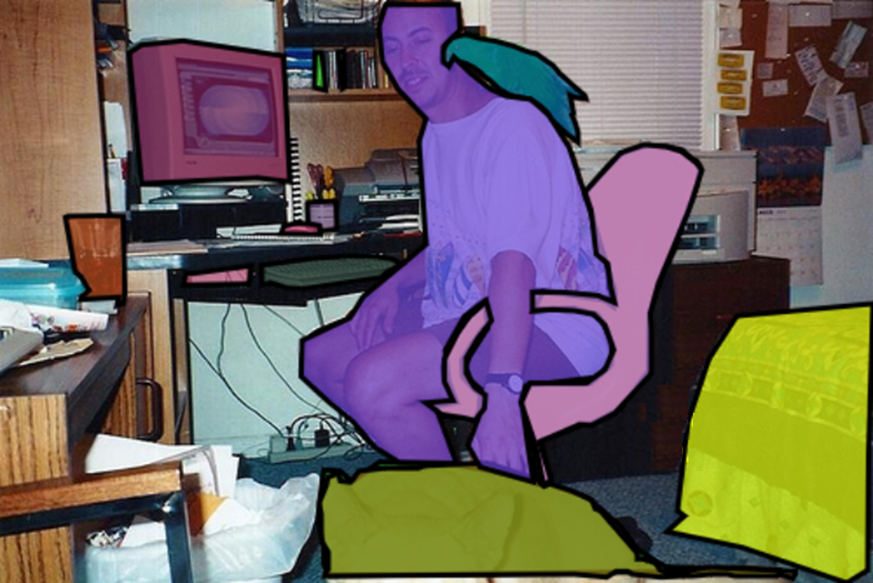
Notes:
Imagine looking to at image. And trying to find 80 different types of objects and segment out each individual instance.
It is
Given the scale of COCO, we decide to perform crowd sourcing on Amazon Mturk platform.
The upside of using Mturk is the high throughput of annotations. We get 25k instance segmentation per day once the task ramped up.
However, not every worker at Mturk is willing to read instruction carefully and spend long time to generate quality work.
It is unrealistic to hope that a single worker can take all the heavy lifting in segmenting out everything in an image.

Slide 22
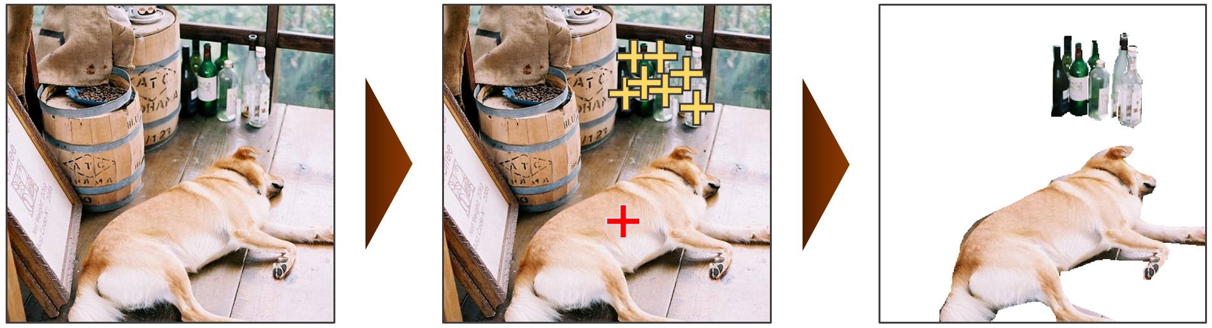
Divide and Conquer
1. Category Labeling
2. Instance spotting
3. Instance segmentation
dog, bottle
Notes:
We decide to divide and conquer the complex task by breaking it down into 3 stages. Each stage is simple and only focus on one visual task at a time. So it’s easy for worker to understand the tasks and do them quickly.

Slide 23
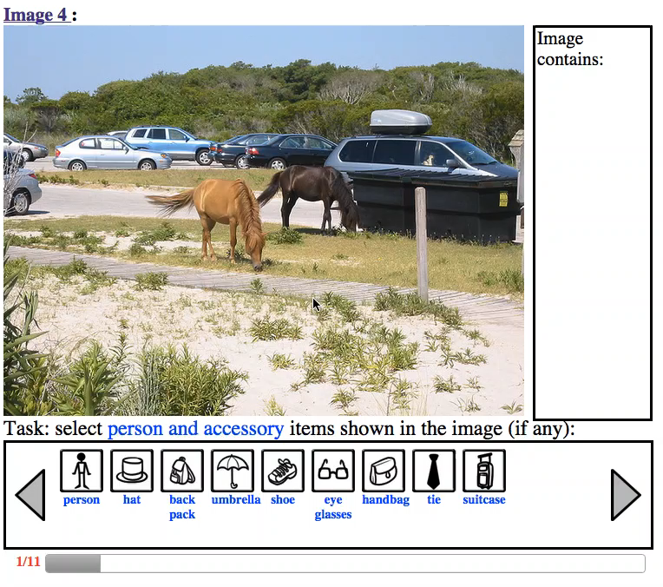
1. Category Labeling
Notes:
The first visual task is what categories are in the image. This is done by dragging single icon onto any instance of that objects. We use supercategory for grouping to make it easier to go over
Catgories are grouped into supercategory .
Critical, 8 workers to boost recall

Slide 24
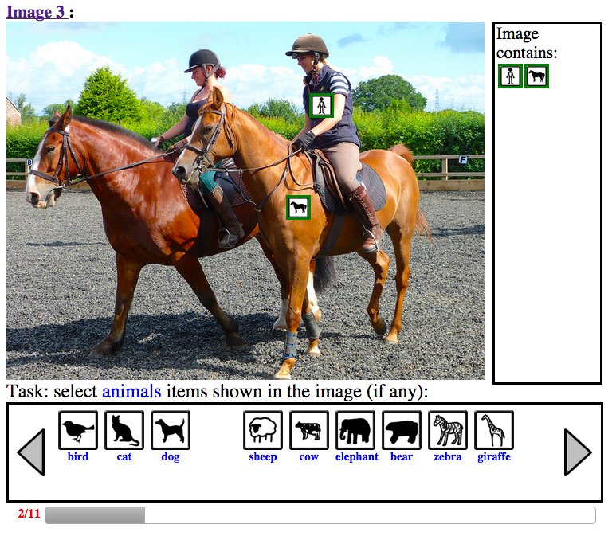
1. Category Labeling
Notes:
The first visual task is what categories are in the image. This is done by dragging single icon onto any instance of that objects. We use supercategory for grouping to make it easier to go over
Catgories are grouped into supercategory .
Critical, 8 workers to boost recall

Slide 25
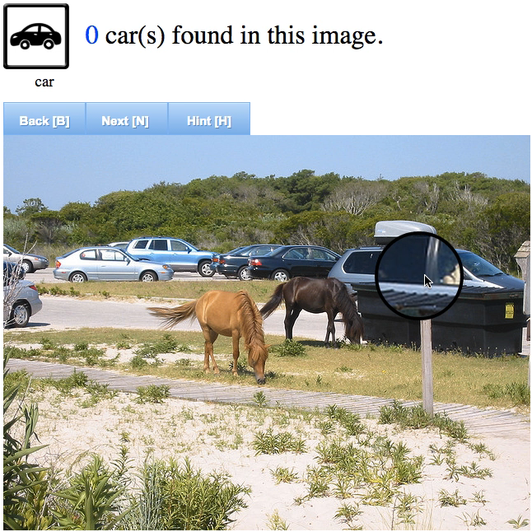
2. Instance Spotting
Notes:
For the next task, we find another worker to spot all the instances from the previously identified category. Again, 8 workers thing.

Slide 26
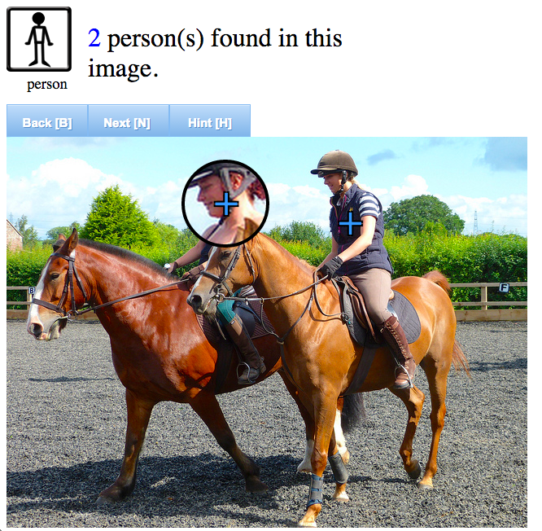
2. Instance Spotting
Notes:
For the next task, we find another worker to spot all the instances from the previously identified category. Again, 8 workers thing.

Slide 27
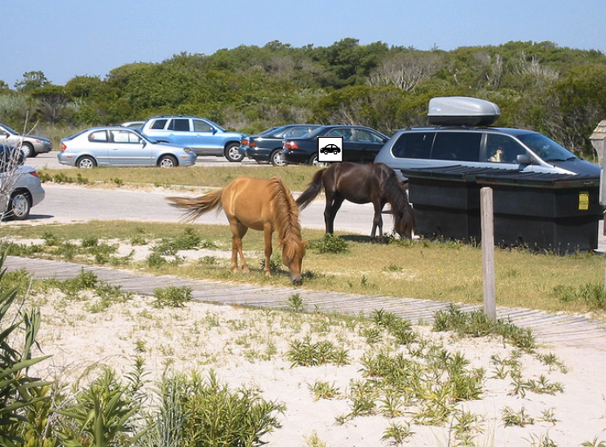
3. Instance Segmentation
http://opensurfaces.cs.cornell.edu/
Sean Bell, Paul Upchurch, Noah Snavely, Kavita Bala, Cornell University.
Notes:
And finally, for all instances that are identified, we segment out each instance one at a time.

Slide 28
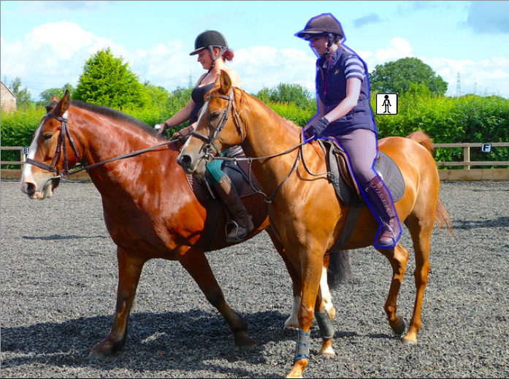
3. Instance Segmentation
http://opensurfaces.cs.cornell.edu/
Sean Bell, Paul Upchurch, Noah Snavely, Kavita Bala, Cornell University.
Notes:
And finally, for all instances that are identified, we segment out each instance one at a time.

Slide 29
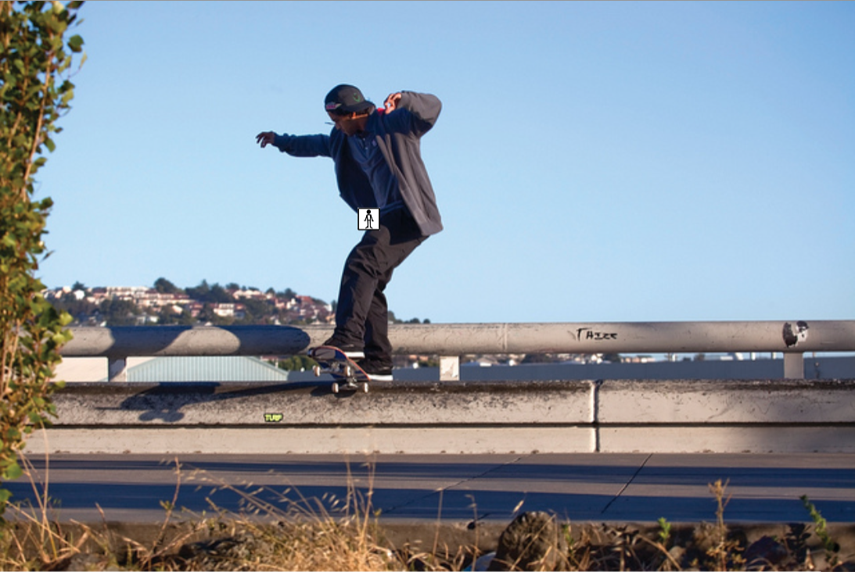

Slide 30
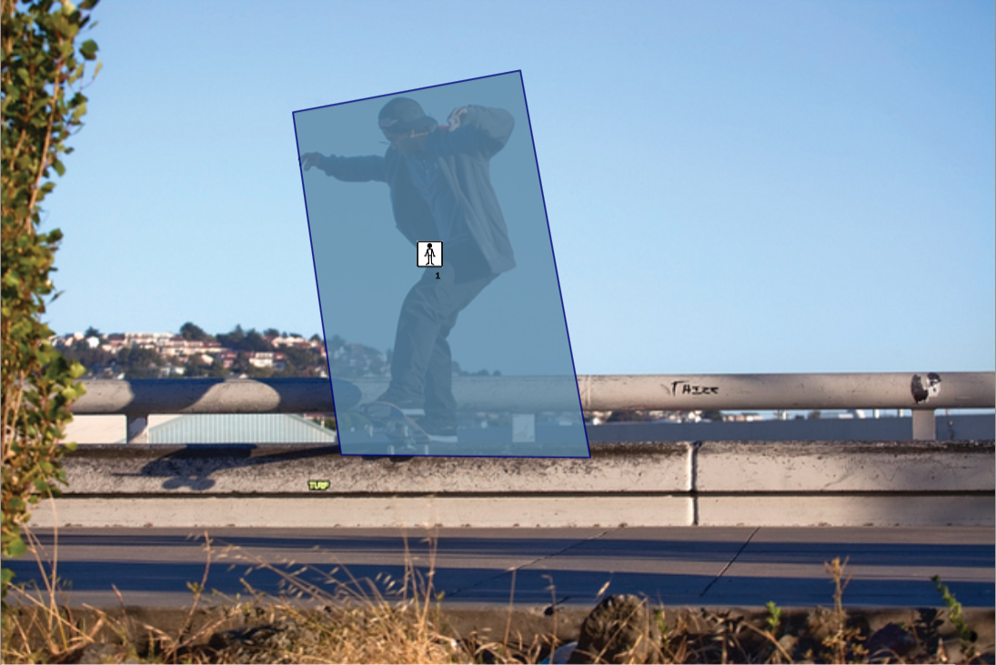
Notes:
If you just posed it on Mturk. This is what you would usaly get.

Slide 31
After training
Notes:
To improve the quality of segmentation, we introduce an additional training phase which workers needs to pass (click) it and do the actual annotation.

Slide 32
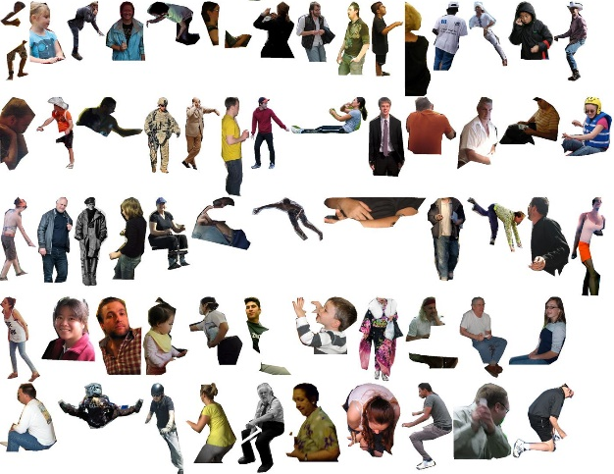
Notes:
We are surprised by the quality of Mturk workers can provide
Due to the cost of this task, we only have one worker to do the task. To ensure the quality, we pass all segmentations into a verifying task.

Slide 33
Properties

Slide 34
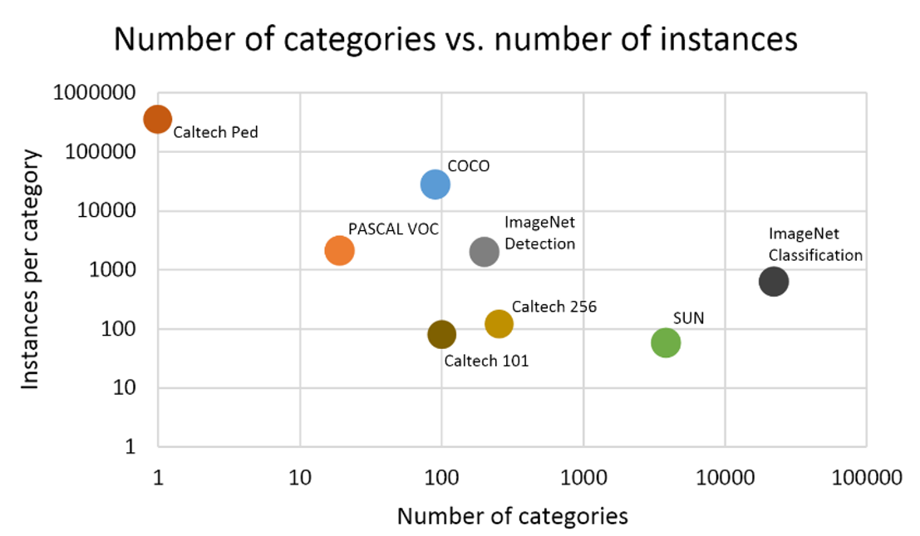
Notes:
It’s interesting to know how existing datasets balance the number of categories and instances. given the recent trend of using large amount of training data. Our goal is to collect at least 10k instances for common object categories. And also note COCO has instance segmentation.

Slide 35
Notes:
It’s interesting to know how existing datasets balance the number of categories and instances. given the recent trend of using large amount of training data. Our goal is to collect at least 10k instances for common object categories. And also note COCO has instance segmentation.

Slide 36
Segmentations
Notes:
It’s interesting to know how existing datasets balance the number of categories and instances. given the recent trend of using large amount of training data. Our goal is to collect at least 10k instances for common object categories. And also note COCO has instance segmentation.

Slide 37
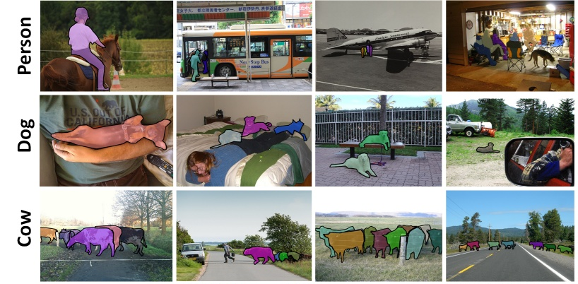
330,000 images
>2 million instances (700k people)
Every instance is segmented
7.7 instances per image (3.5 categories)
Notes:
Specifically,

Slide 38
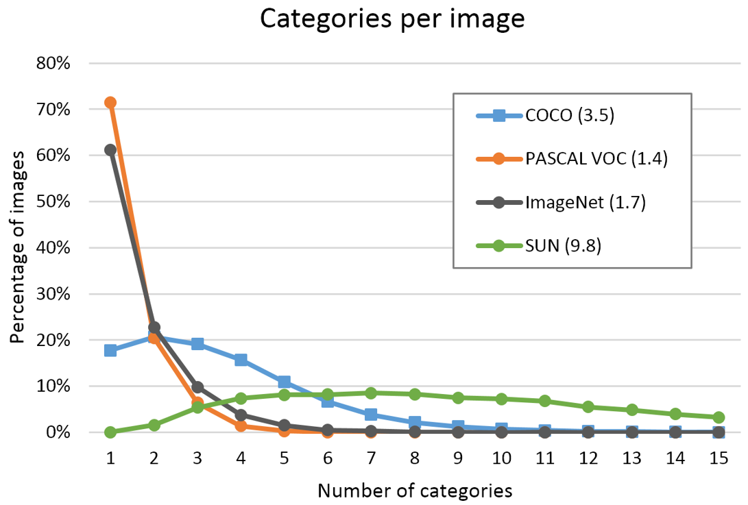
Notes:
It’s interesting to see how many categories in one image. In order to obtain contextual information, it’s necessary to have multiple objects per image. As you can see most of images in COCO have 2 to 5 with avg. 3.5 categories per image.
Here is a figure to show how much contextual information in an image by looking at how many categories appear per image. Almost every image in SUN database has 2+ categories. COCO has 80% of images that have 2 or more categories in an image. And ImageNet and PASCAL have less than 50% of images have multiple categories.

Slide 39
Detection Performance
( DPM V5 )
 | Person (mAP) | Average (mAP)
PASCAL VOC | 41.3 | 29.6
MS COCO | 17.5 | 16.9

Slide 40
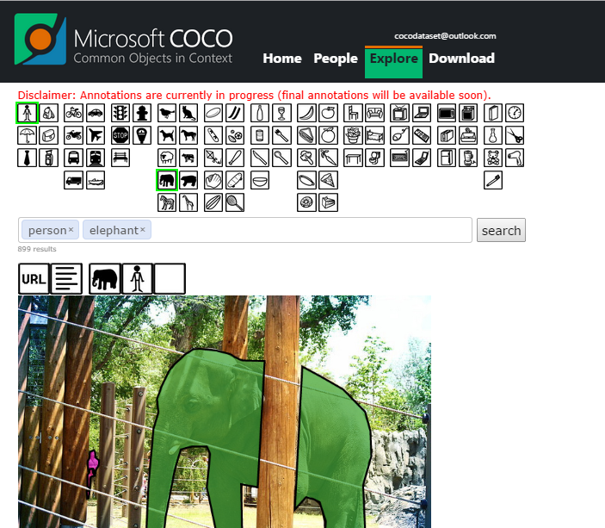
http://mscoco.org

Slide 41
Beyond detection
Notes:
One of things that is also exciting to us is by adding more types of annotations to the realistic images, it is possible to enable new research directions and applications.

Slide 42
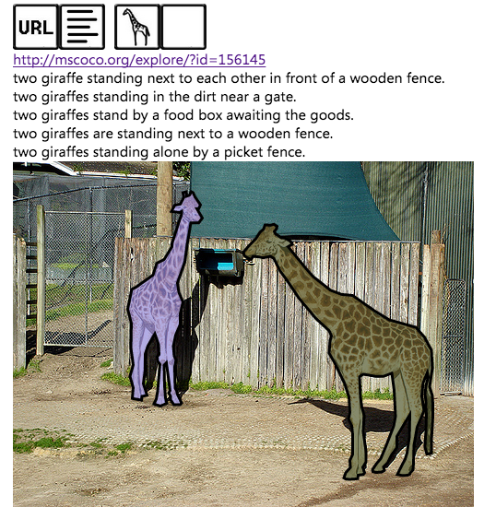
Beyond detection
Sentences
Collecting Image Annotations Using Amazon’s Mechanical Turk, C. Rashtchian, P. Young, M. Hodosh, J. Hockenmaier, NAACL HLT Workshop on Creating Speech and Language Data with Amazon’s Mechanical Turk, 2010

Slide 43
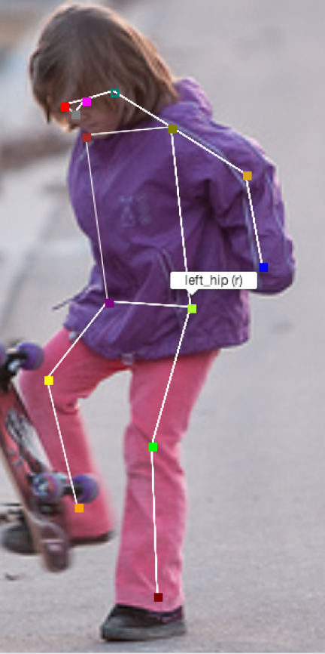
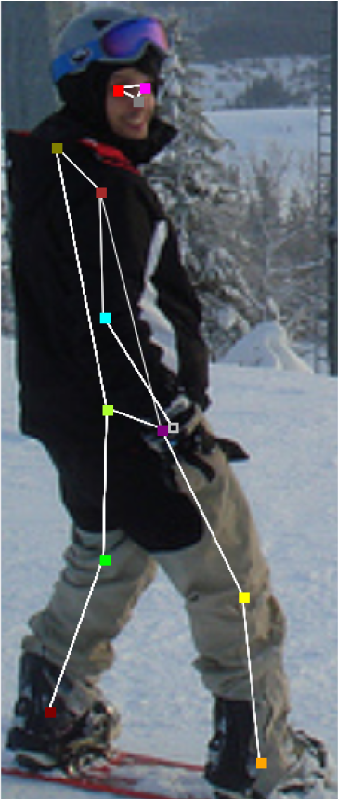
Beyond detection
Keypoints
(provided by Facebook)
Notes:
Thanks for the support provided by Facebook. We starts to label keypoints annotations for people. We are also debating weather to add keypoints to other categories please contact us if you have strong feeling on this.

Slide 44
How to use COCO

Slide 45
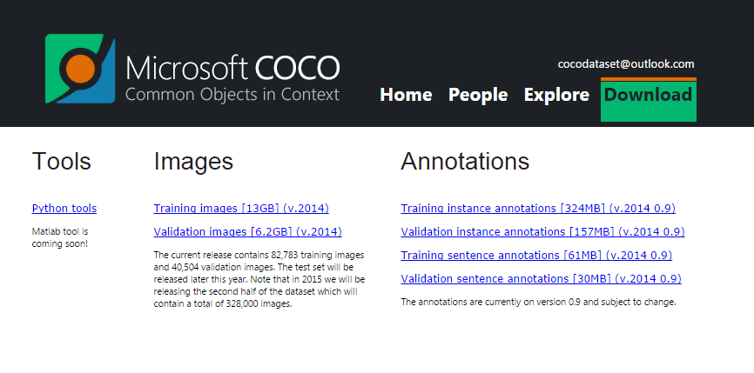
http://mscoco.org

Slide 46
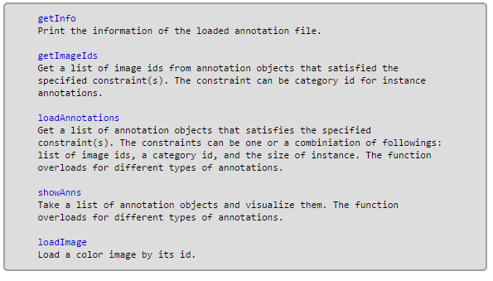
APIs
Python and MATLAB

Slide 47

MS COCO 2014 release
(half of COCO)
Over 77,000 worker hours (8+ years)
160k images
80 object categories (things not stuff)
1M+ instances (300k people)
Every instance segmented
5 sentences per image
Separate train and validation set
Notes:
We want to release first half of COCO dataset by the end of July

Slide 48
Going forward

Slide 49
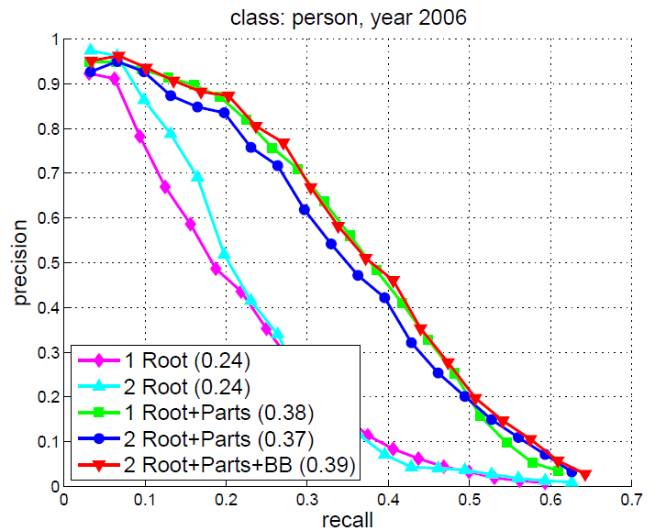
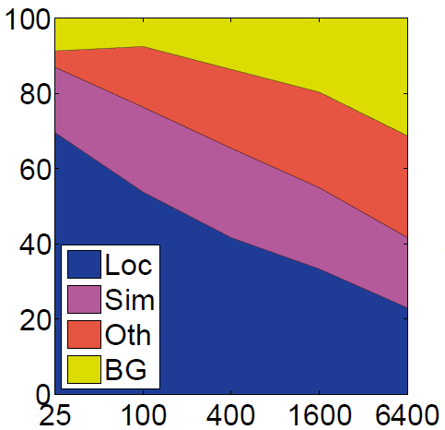
Algorithm Evaluation
Still debating…
The metric should be:
Simple
Relevant
Robust
Notes:
We want to release first half of COCO dataset by the end of July
metricS

Slide 50
MS COCO 2015
(full release)
Early 2015
80-100 object categories
330k images
2M+ instances (700k people)
Every instance segmented
5 sentences per image
Keypoint annotations
http://mscoco.org
Notes:
Mention 35,000 hours.
Which we will have 330 images labeled and keypoints annotations.

Slide 51
Visit mscoco.org
Thank you!
Tsung-Yi Lin
Michael Maire
Serge Belongie
Lubomir Bourdev
James Hays
Cornell Tech
TTI Chicago
Cornell Tech
Facebook
Brown University
Pietro Perona
Deva Ramanan
Ross Girshick
Piotr Dollar
Larry Zitnick
Caltech
UC Irvine
Microsoft Research
Microsoft Research
Microsoft Research
Notes:
This dataset is for entire community. We are very open to comments, suggestions please feel free to contact us. We are looking for feedback and thoughts. Thank you!

Slide 53
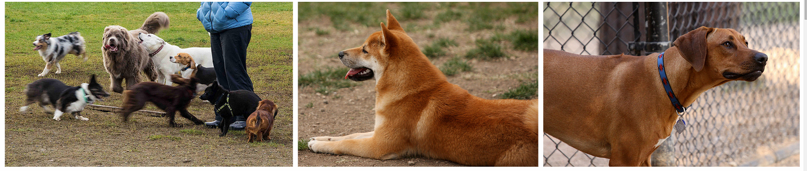
330,000 images
Flickr.com (All creative commons)
Search (category + category, category + scene):
“Dog + Park”
Notes:
Here is another examples that combine object and scene as query. These images show the object-scene contextual information.

Slide 54
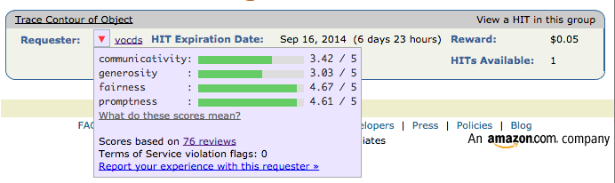
Turkopticon rating

Slide 55
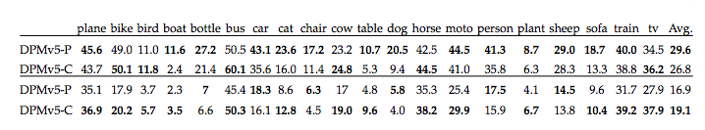
DPM performance

Slide 56
Beyond AlexNet

Slide 57
VERY DEEP CONVOLUTIONAL NETWORKS FOR LARGE-SCALE IMAGE RECOGNITION
Karen Simonyan & Andrew Zisserman 2015
These are the “VGG” networks.
Including what you use in Project 6

Slide 58
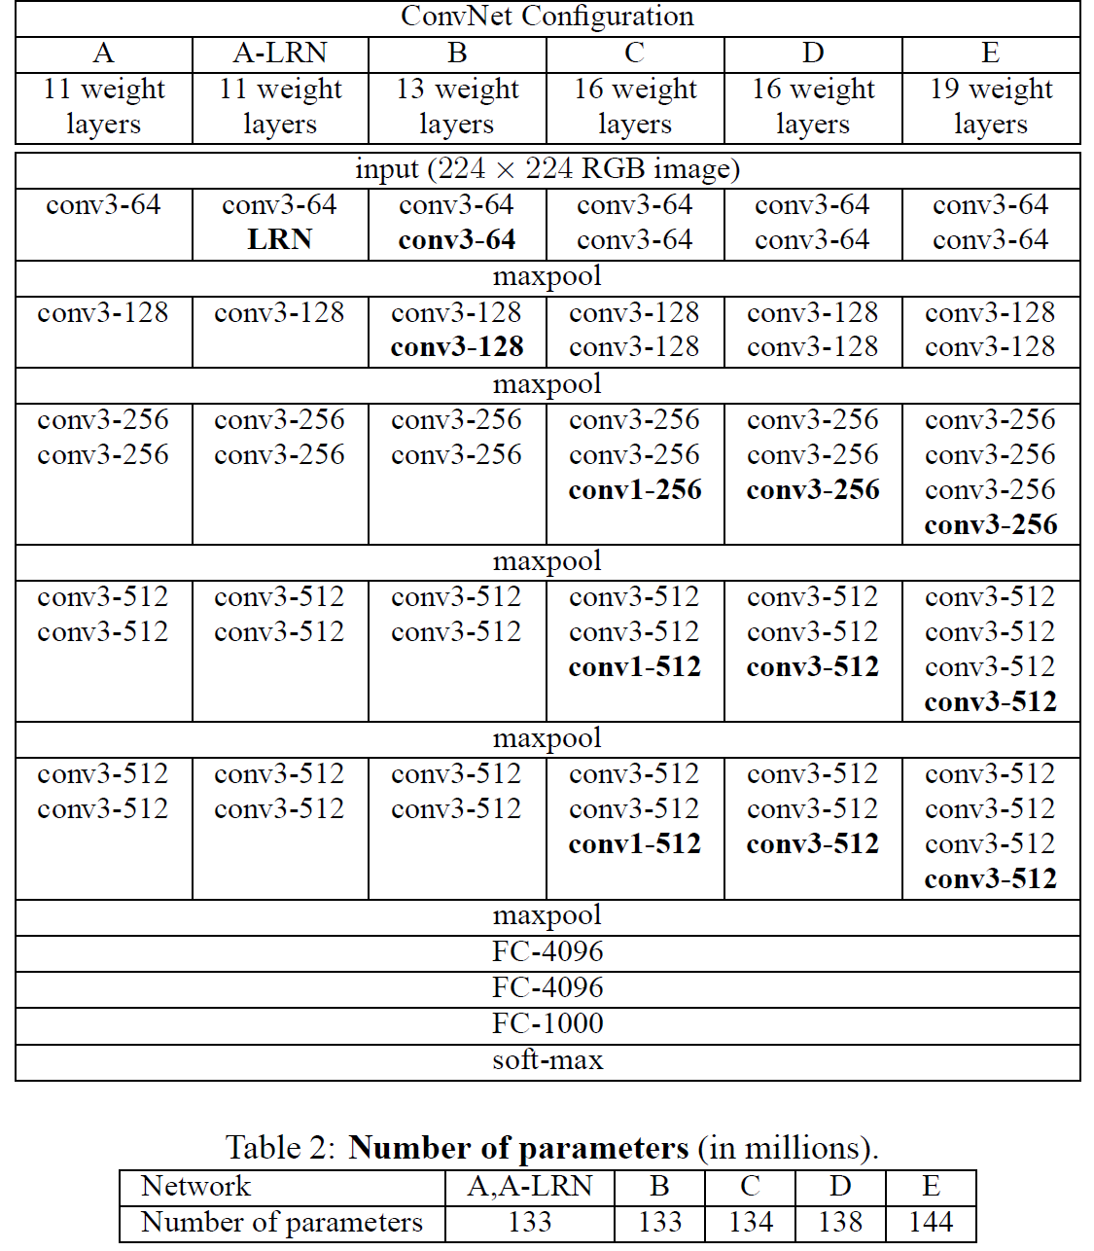
Notes:
Compared to Alex-Net – Deeper, smaller convolutions, more parameters

Slide 59
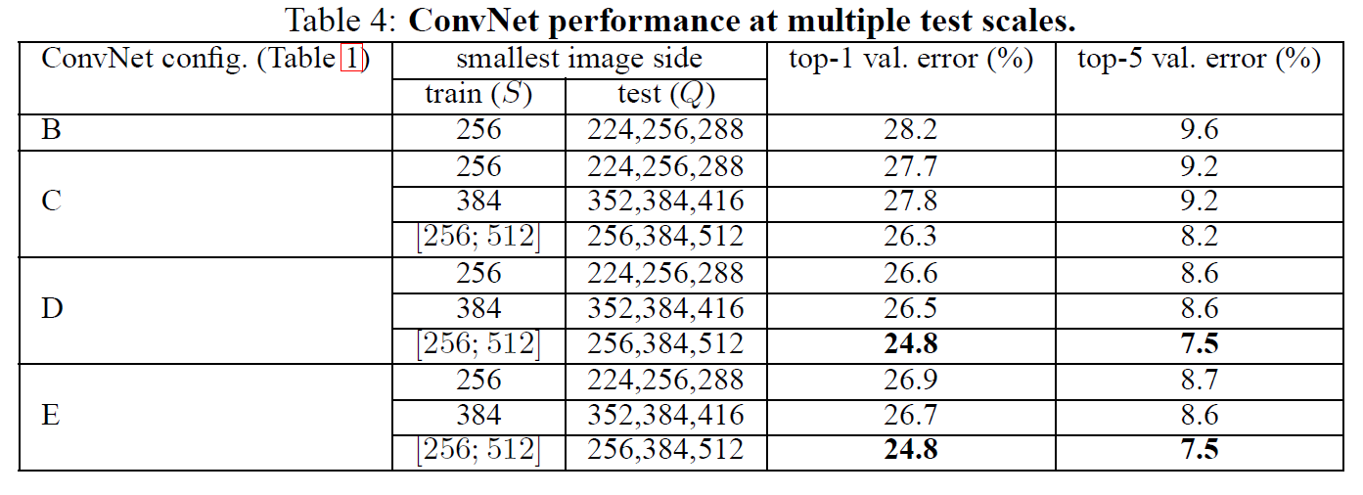
Notes:
Compared to Alex-Net – Deeper, smaller convolutions, more parameters

Slide 60
Going Deeper with Convolutions
Christian Szegedy, Wei Liu, Yangqing Jia, Pierre Sermanet, Scott Reed,
Dragomir Anguelov, Dumitru Erhan, Vincent Vanhoucke, Andrew Rabinovich
2015
This is the “Inception” architecture or “GoogLeNet”
*The architecture blocks are called “Inception” modules
and the collection of them into a particular net is “GoogLeNet”

Slide 61
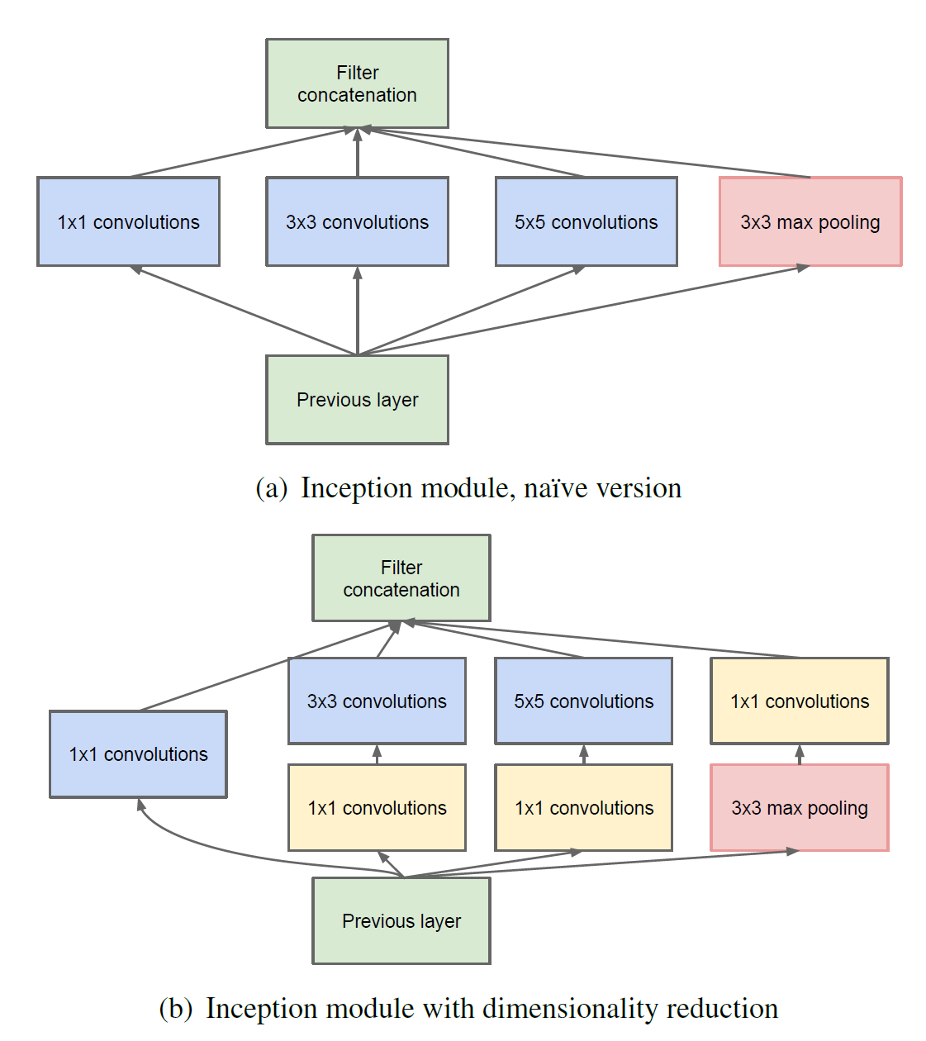

Slide 62
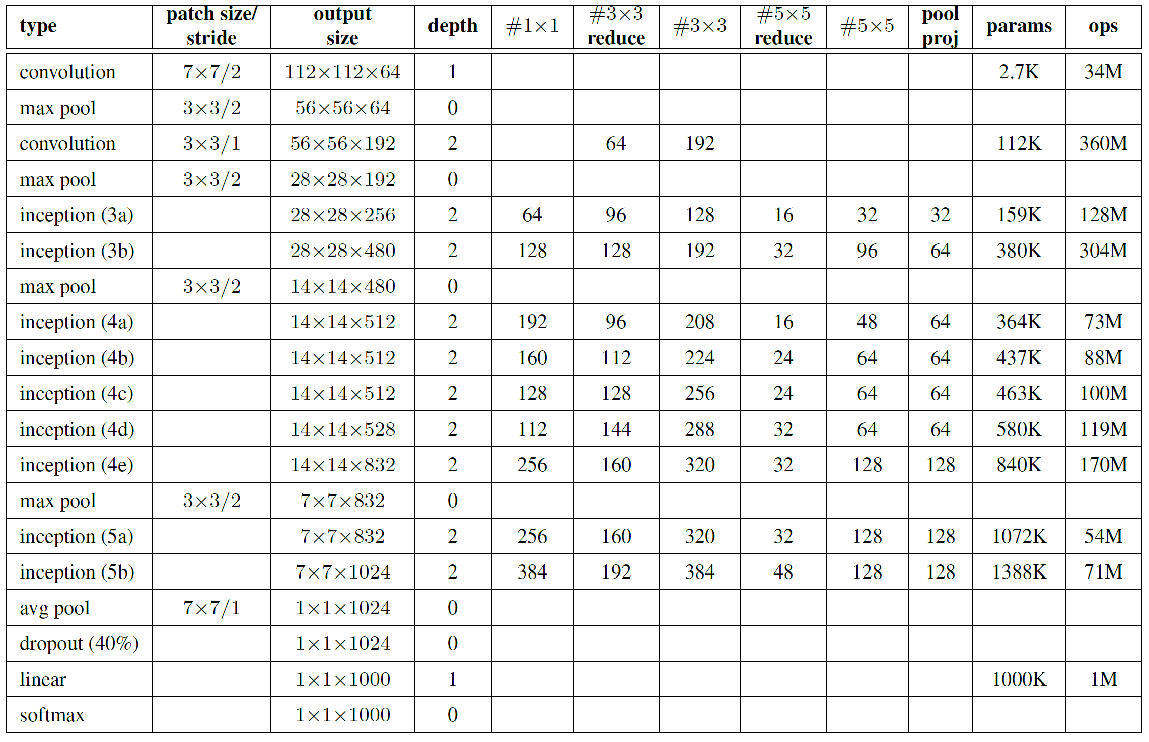
Only 6.8 million parameters. AlexNet ~60 million, VGG up to 138 million

Slide 63




Slide 64


Slide 65
Surely it would be ridiculous to go any deeper…
ResNet
See the following slides: http://kaiminghe.com/cvpr16resnet/cvpr2016_deep_residual_learning_kaiminghe.pdf

