Slide 1
Deep Geolocalization and Siamese Nets
Computer Vision
James Hays

Slide 2
Long, Shelhamer, and Darrell 2014

Slide 3
Long, Shelhamer, and Darrell 2014

Slide 4
PlaNet - Photo Geolocation with Convolutional Neural Networks
Tobias Weyand, Ilya Kostrikov, James Philbin
ECCV 2016

Slide 5
Discretization of Globe

Slide 6
Network and Training
Network Architecture: Inception with 97M parameters
26,263 “categories”
126 Million Web photos
2.5 months of training on 200 CPU cores

Slide 8
Notes:
Figure 7. The top-5 most confident images from the Flickr dataset for the S2 cells on the left, showing the diverse visual representation of places that PlaNet learns.

Slide 9
PlaNet vs im2gps (2008, 2009)
Notes:
Table 1. Comparison of PlaNet with Im2GPS. Percentages are the fraction of images from the Im2GPS test set that were localized within the given radius. (Numbers for the original Im2GPS are approximate as they were extracted from a plot in the paper.)
Table 3. Median localization error (km) by image category on the Im2GPS test set. Manmade Landmark are landmark buildings like the Eiffel Tower, Natural Landmark are geographical features like the Grand Canyon, City Scene and Natural Scene are photos taken in cities or in nature not showing any distinctive landmarks, and Animal are photos of individual animals.

Slide 10
Spatial support for decision
Notes:
Figure 10. Left: Input image, right: Heatmap of the probability of the correct class when sliding an occluding window over the image as in [53]. (a) Grand Canyon. Occluding the distinctive mountain formation makes the confidence in the correct location drop the most. (b) Norway. While the house in the foreground is fairly generic, the snowy mountain range on the left is the most important cue. (c) Shanghai. Confidence in the correct location increases if the palm trees in the foreground are covered since they are not common in Shanghai.

Slide 11
PlaNet vs Humans
Notes:
Figure 9. Top: GeoGuessr panorama, Bottom: Ground truth location (yellow), human guess (green), PlaNet guess (blue).

Slide 12
PlaNet vs Humans

Slide 13
PlaNet summary
Very fast Geolocalization method. Geolocalization by categorization.
Uses far more training data than previous work (im2gps)
There’s definitely still room for improvement

Slide 14
Learning Deep Representations For Ground-to-Aerial Geolocalization
Tsung-Yi Lin, Yin Cui, Serge Belongie, James Hays
CVPR 2015

Slide 15
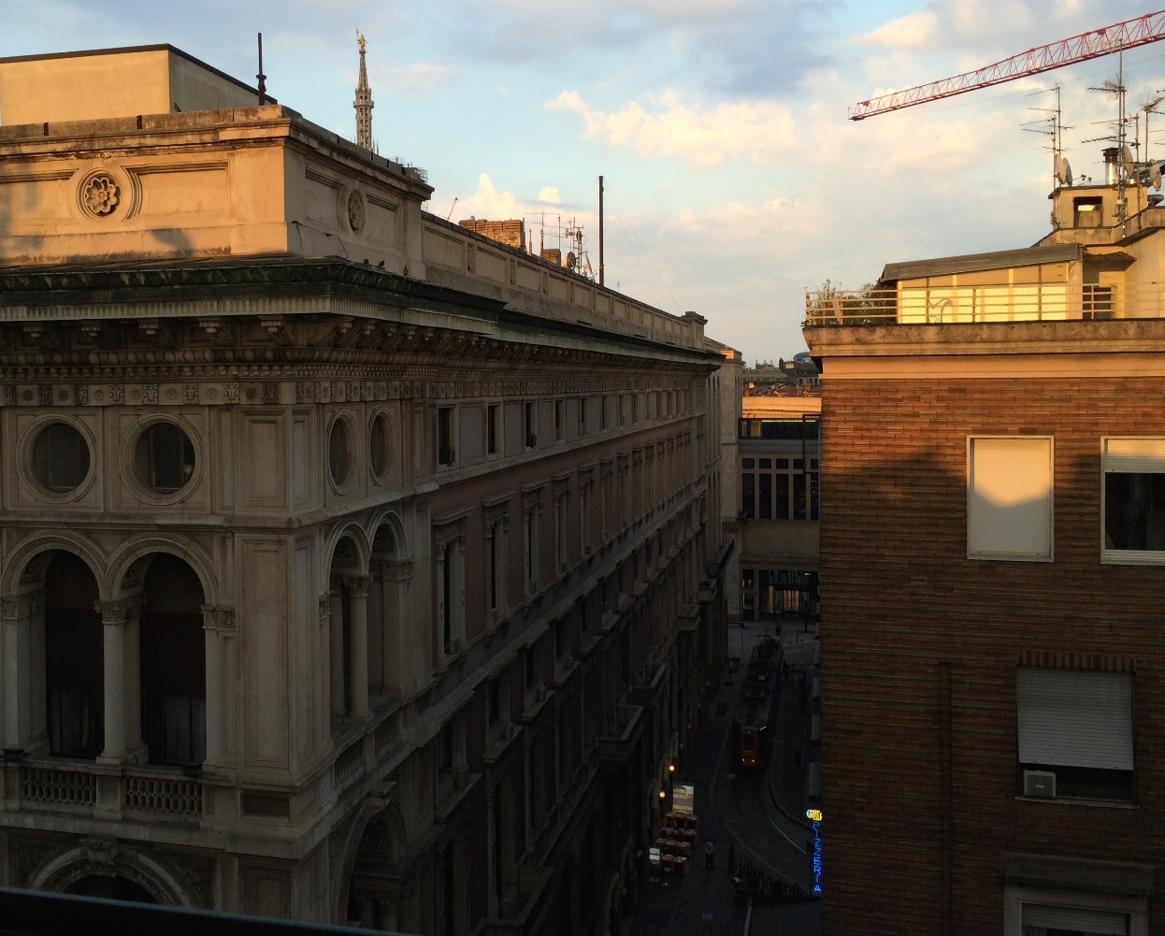
View From Your Window Contest
June 9, 2010 – Feb. 4, 2015
Where was the photo taken?
Notes:
Consider the picture here. Where do you think the picture was taken? (pause, pause, pause)
This photo was from the popular “view from your window” contest. A weekly fun competition that had been running almost for 5 years. In the contest, contenstents were asked to localize where the image was taken. And it can be anywhere on the earth.
You may recognize the building architecture is quite unique. The train running on the street is a clue. Or the blue sign reading “Pizzeria”. All these visual information can be great information to geolocalize the image.

Slide 16
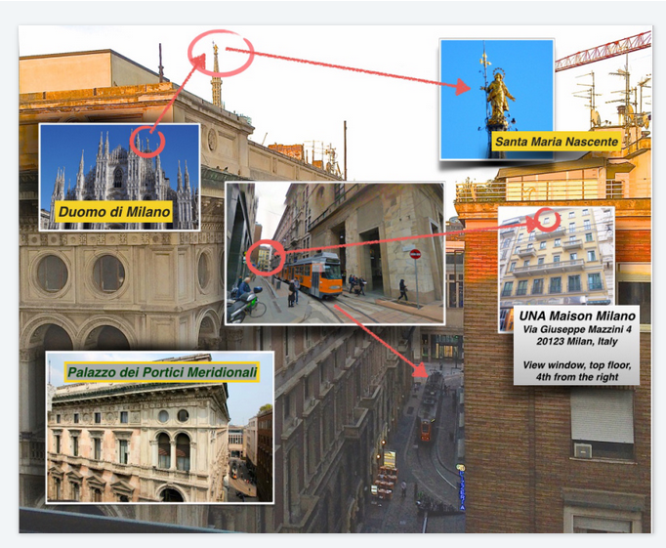
Ans:
Milano, Italy
Notes:
This is someone’s careful response to the contest. A diverse set of publicly available data sources were used to localize the image.
We can see there is a diversity of

Slide 17
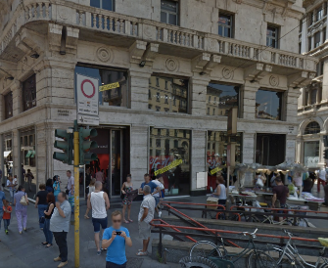
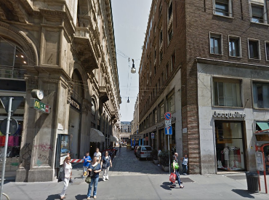
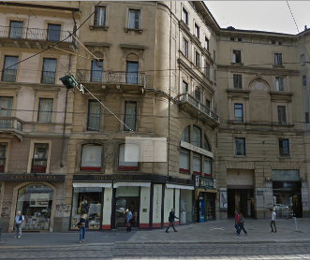
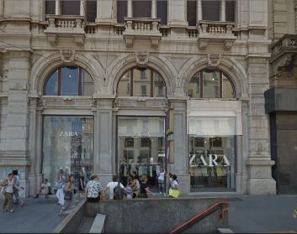
To Geolocalize a Photo
One can capture every corner on the earth
…
Notes:
One popular approach used to geolocalize an image is to match the query image to geo-referenced ground-level images (such as images provided by Google street-view).

Slide 18
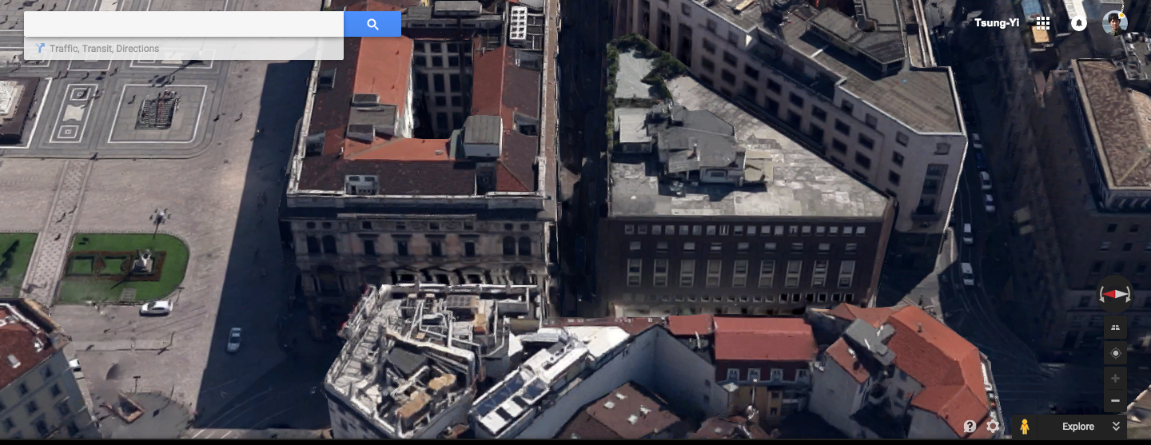
To Geolocalize a Photo
Notes:
As an alternative, another popular approach used in the “view from your window contest” is to localize the query images by matching it to the aerial imagery. Which has the advantage that can densely cover a large region.

Slide 19
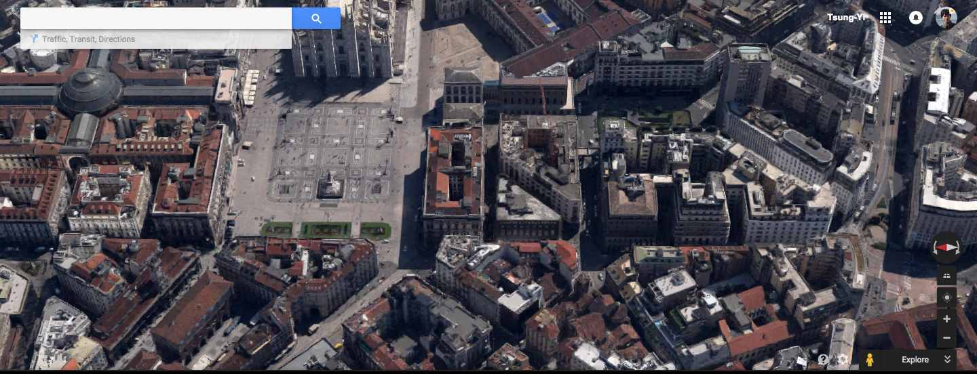

Slide 20
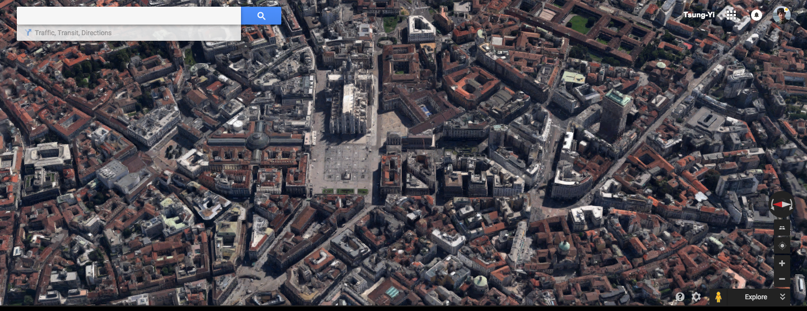

Slide 21
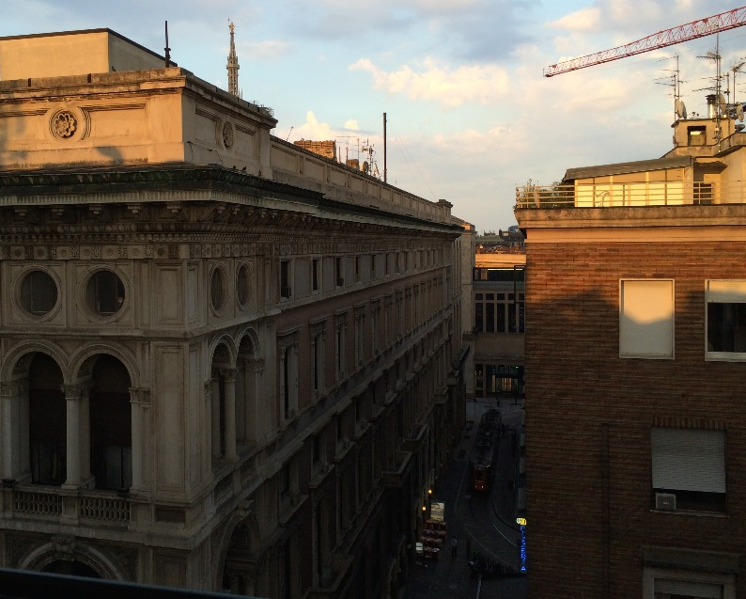
How To Match Ground-to-Aerial?
Shan et al., Accurate Geo-registration by Ground-to-Aerial Image Matching, 3DV’14
Bansal et al., Ultra-wide baseline façade matching for geo-localization, ECCV workshop’12
Notes:
We are particularly interested in matching ground-to-aerial images.
However, the images look quite different because of the illumination, occlusions, imaging device, time of day, moving objects like car, and so on… All these variations make the matching problem challenging.
A couple works from shan, bansal group tried to address that before.

Slide 22
Are these the same location?
Ground
Aerial
Notes:
To demonstrate the level of difficulty of ground-to-aerial geolocalization, we select four cross-view pairs. Some of them are from the same locations, some are not.
The top row shows the ground-level images and the bottom row shows the aerial images.
Guess which pairs are from the same location?

Slide 23
Are these the same location?
Ground
Aerial
Notes:
In this example, only center two pairs are from the same location. Which is quite challenging for human.

Slide 24
Why Don’t You Just…
Sparse Keypoint Matching + RANSAC
Notes:
Matching ground-to-aerial images is also quite challenging computationally.
The obviously thing to try would be SIFT + RANSAC but due to all variations mentioned in the previous slide. It doesn’t work
And this motivates us to learn a better feature representations with deep learning so that the ground and aerial images can be matched

Slide 25
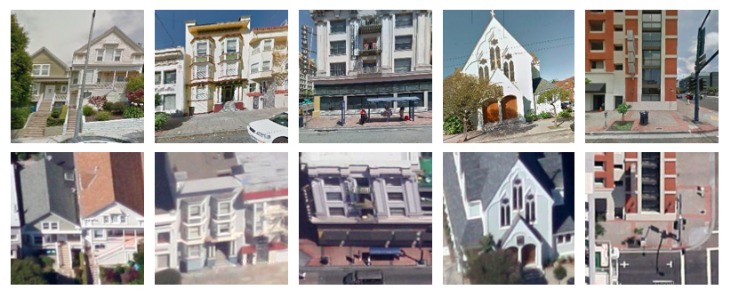
Cross-view Pairs
Ground
Aerial
Notes:
As with any approach using deep learning, we need significant amount of data to learn from.
In our case, we will be learning from corresponding ground-aerial pairs as shown in this slide.

Slide 26
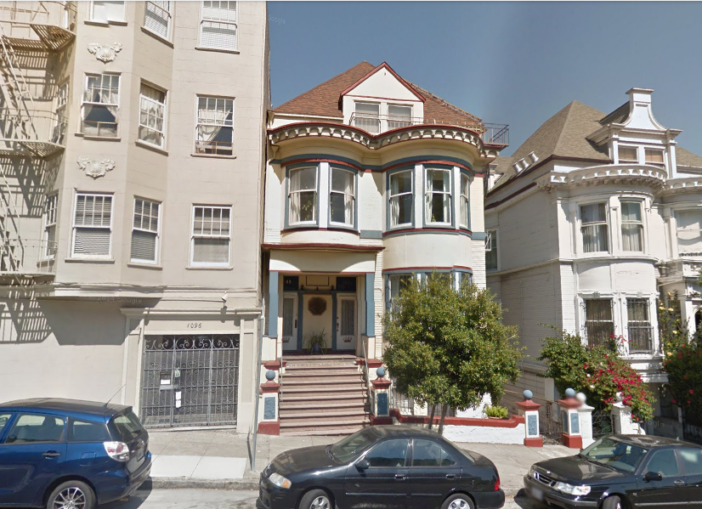
Street view Projection on
depth estimates
Heading Direction
GPS location
0°
Street-view car
Notes:
we collect these pairs by using information captured by google street-view car and aerial imagery.
Google provides the heading direction and gps location so we know the camera pose of each street view panorama image.

Slide 27
Street view Projection on
depth estimates
Heading Direction
GPS location
0°
Street-view car
Notes:
Google also provides rough depth estimates which we use to assign a dominant depth to each street-view crop.

Slide 28
Street view Projection on
depth estimates
45°
Heading Direction
GPS location
0°
Street-view car
Notes:
Together with known camera pose and depth estimates, we compute the homography to align the dominant plane of the street-view crop to aerial image crops.

Slide 29
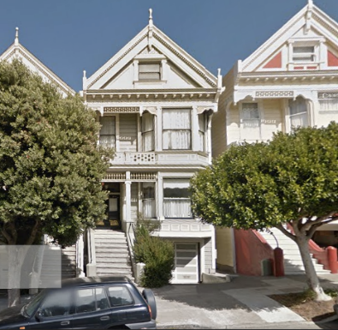
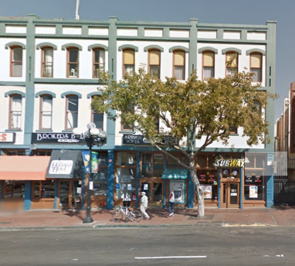
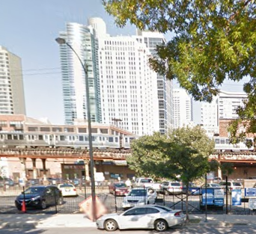
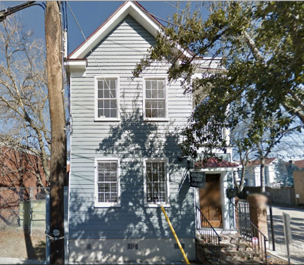
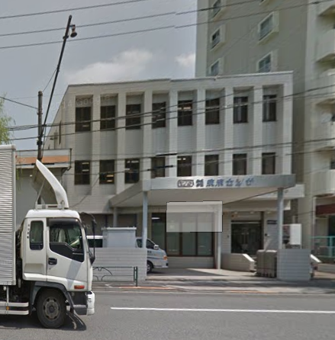
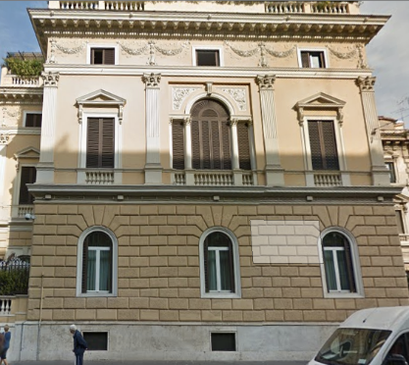
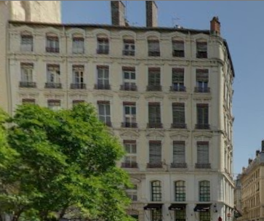
7 Cities: 78k Corresponding Pairs
San Francisco
San Diego
Chicago
Charleston
Tokyo
Rome
Lyon
Notes:
We use the process to generate a city scale cross-view image collection which we will use for training the deep learning model.

Slide 30
Place Verification
Same
OR
Different
Notes:
The particular task we are trying to optimize from the data is place verification. Given a pair of image, the model is going to decide if there are from the same location.

Slide 31
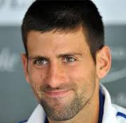
Face Verification
Same
OR
Different
Notes:
We draw heavy inspiration from the face verification literature. Where their task is to verify a pair of faces is from same person or different persons. Which is a very similar problem to place verification.

Slide 32
Face Verification
Chopra and Hadsell and LeCun, Learning a Similarity Metric Discriminatively, with Application to Face Verification (CVPR 2005)
Taigman, Yang, Ranzato, Wolf, DeepFace: Closing the Gap to Human-Level Performance in Face Verification (CVPR 2014)
Schroff, Kalenichenko, Philbin, FaceNet: A Unified Embedding for Face Recognition and Clustering (CVPR 2015)
Huang et al. Labeled Faces in the Wild: A Database for Studying Face Recognition in Unconstrained Environments
Notes:
There are rich literatures around face verification.

Slide 33
Face Verification
Chopra and Hadsell and LeCun, Learning a Similarity Metric Discriminatively, with Application to Face Verification (CVPR 2005)
Taigman, Yang, Ranzato, Wolf, DeepFace: Closing the Gap to Human-Level Performance in Face Verification (CVPR 2014)
Schroff, Kalenichenko, Philbin, FaceNet: A Unified Embedding for Face Recognition and Clustering (CVPR 2015)
Huang et al. Labeled Faces in the Wild: A Database for Studying Face Recognition in Unconstrained Environments
Notes:
And our work is in particularly inspired by the siamese network architeture that was proposed by chopra et al.

Slide 34
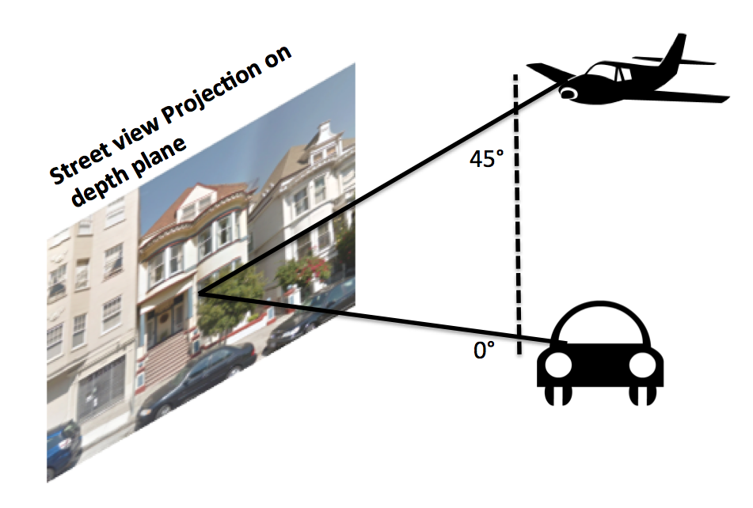
Deep Face
Notes:
Face verification work

Slide 35
“Siamese” ConvNet for Ground-to-Aerial Matching
Notes:
The siamese network consists of two networks that have identical architecture, here labeled as A and B.
And we use the alex net architecture without fc8 layer..
The network can embed input images onto an embedding space.

Slide 36
“Siamese” ConvNet for Ground-to-Aerial Matching
Notes:
In the training stage, the network takes a pair of data as input.
Given a pair of images form the same location, which we called it a positive pair, the learning process will try to pull the images from the same location together in the embedding space.

Slide 37
“Siamese” ConvNet for Ground-to-Aerial Matching
Notes:
Given a pair of images that are from different location, which we called it negative pairs, the learning process will push the images from different locations away

Slide 38
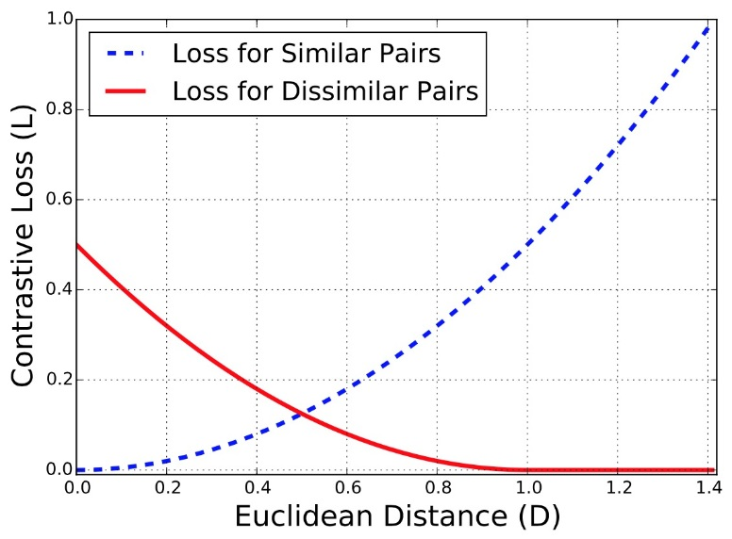
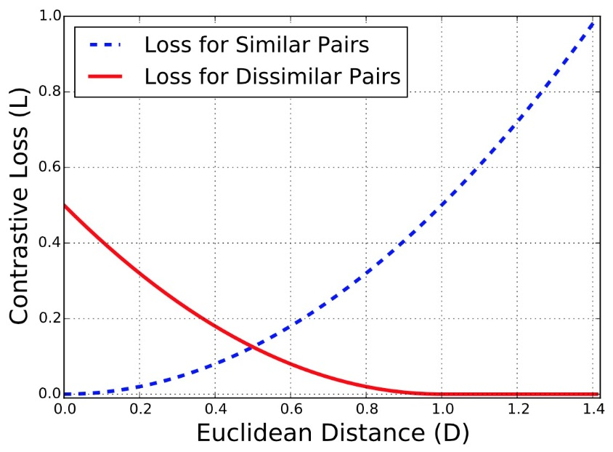
Contrastive Loss
red: similar pairs
blue: dissimilar pairs
2
2
Hadsell, Chopra, Yann LeCun,
Dimensionality Reduction by Learning an Invariant Mapping,
CVPR06
Notes:
Specifically, we use contrastive loss, which tries to pull positive pairs to have pair distance 0 and push the negative pair away such that it has pair distance larger than margin m.

Slide 39
Pair Distance Distribution
Green: positive pairs
Red: negative pairs
Margin
ImageNet-CNN Model
Where-CNN Model
50k iterations
Notes:
To demonstrate the value of our siamese network, first let’s look at the distribution of distances between positive and negative pairs if we simply use the off the shelf alexnet trained on imagenet. You can see that the positive pairs aren’t really closer together than the negative pairs.
We use the average pair distance from this experiment to set the margin for our siamese network and after 50k learning iterations we have a new embedding with the pair distances on the right.
And now there are many positive pairs that have smaller distance compared to the negative pairs.

Slide 40
Quantitative Evaluation (AP)
Random: 5% (1:20 pos. to neg. pairs)
HoG2x2 (BoW): 7.9%
Places-CNN: 10.2%
ImageNet-CNN: 11.3%
Where-CNN (ours): 41.9%
Notes:
Here shows the quantitative results measured by average precision on the verification task
If we randomly assign matched and unmatched to the test pairs, the ap is 5%.

Slide 41
Share The Same Parameters?
For face verification A and B share parameters
For ground-aerial image pairs, should A, B share parameters?
Notes:
In the face verification literature, A and B share the same network architecture as well as the parameters.
The reason is the input face data is from the same domain.

Slide 42
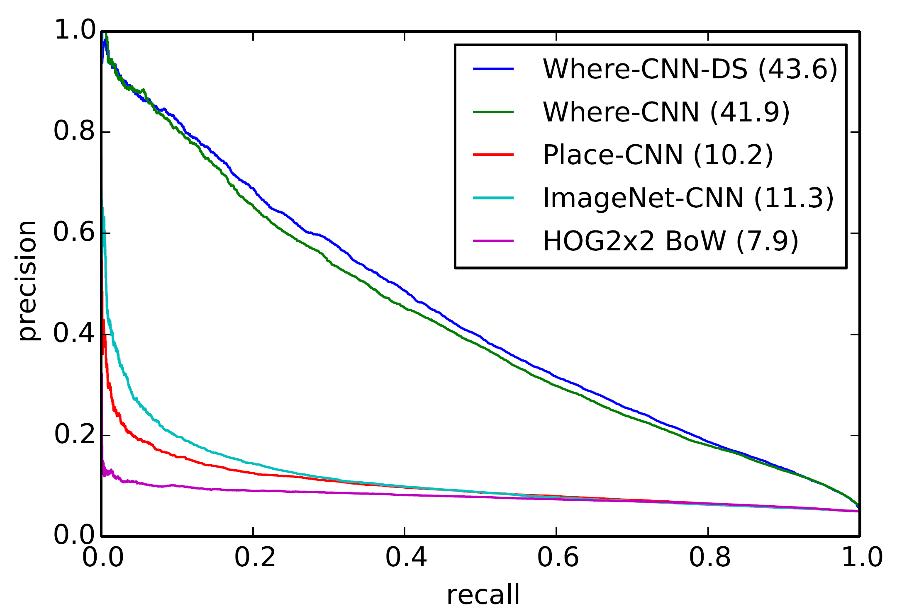
Quantitative Evaluation
Notes:
We train this domain specific network, and to our surprise, it only gave us 2% AP improvement.

Slide 43
Notes:
Let’s take a look at the matching pairs that have small distance in the learned feature embedding. The figure shows the positive pairs that are correctly verified by the network with high confidence.

Slide 44
Notes:
And here shows the negative pairs that are mistaken by the network as matching pairs.

Slide 45
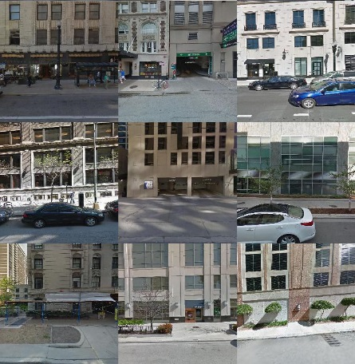
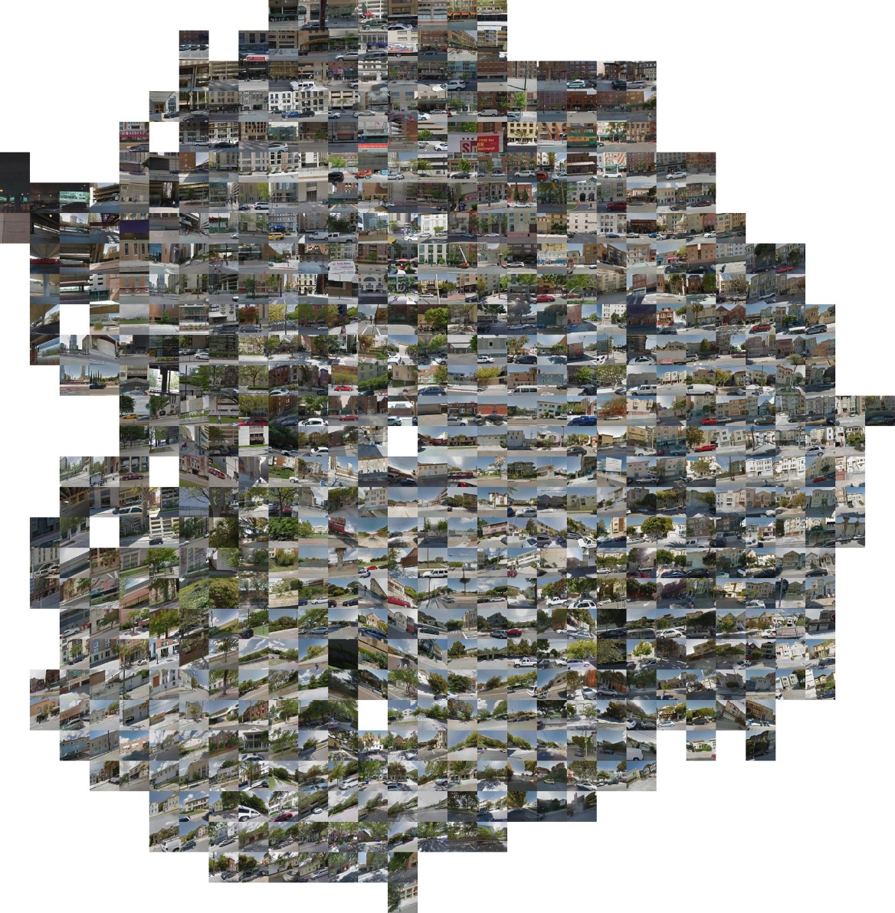
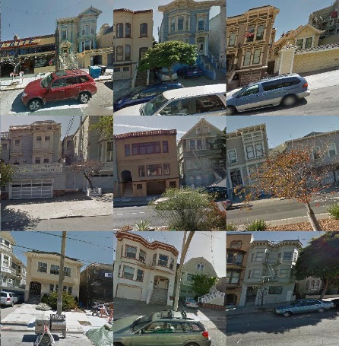
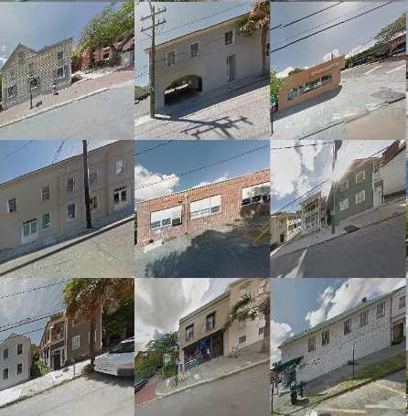
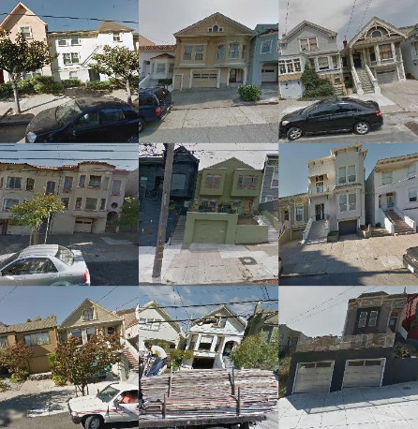
Notes:
Here we visualize the embedding of ground-level image using t-SNE. As you can see, the images with similar architecures are grouped together. (pause, pause, pause)

Slide 46
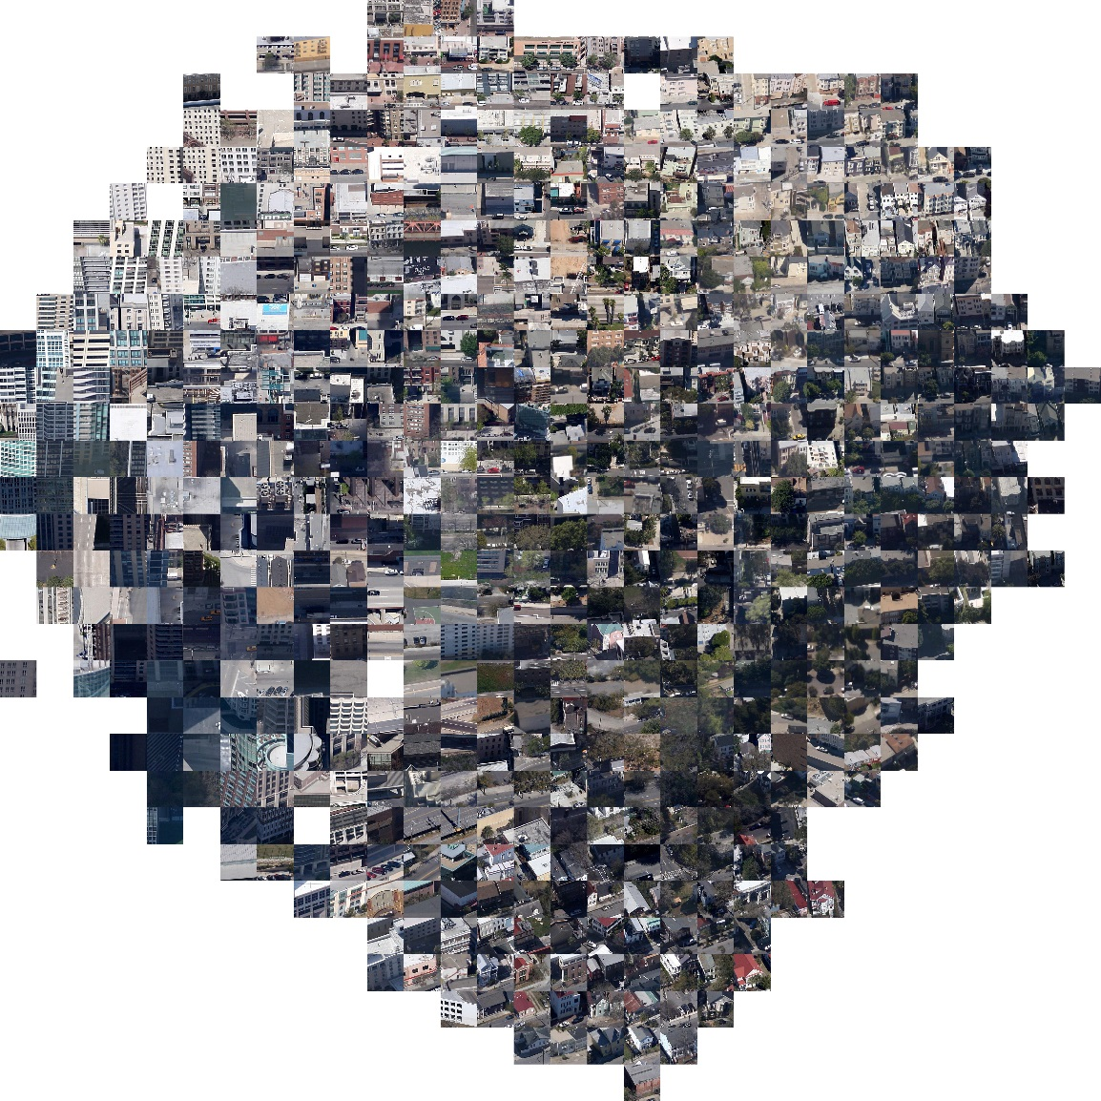
Notes:
we also visualize the embedding of aerial images. Similarly, the network seems to generate embedding that can group simiilar architectures from the aerial view. And what is really interesting is to visualize aerial and street-view image at the same time.

Slide 47
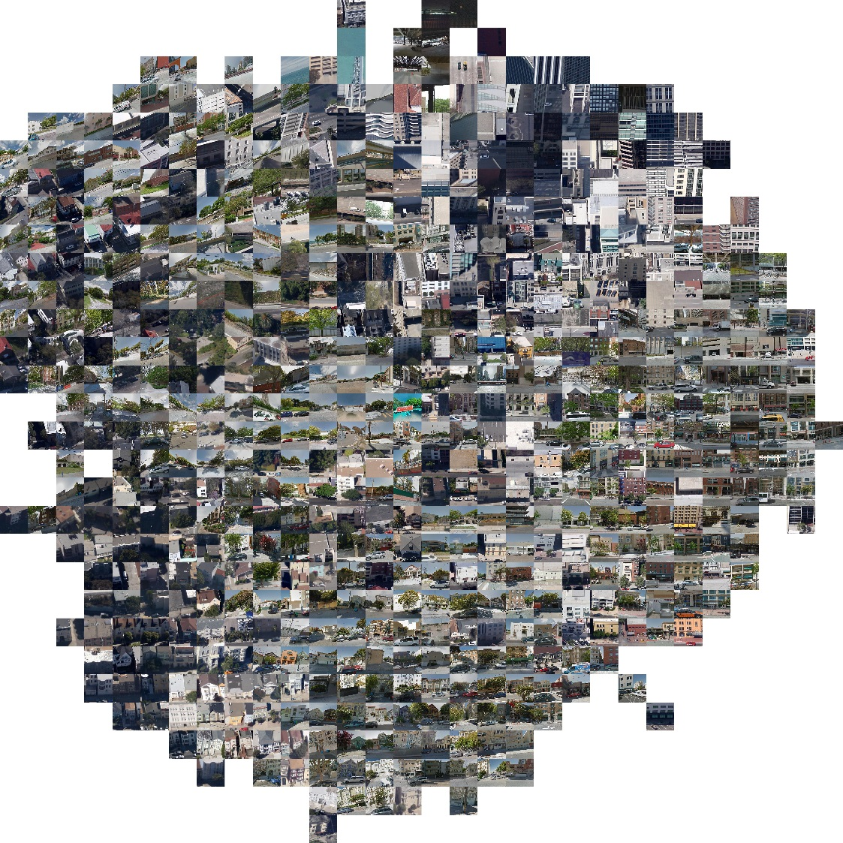
Notes:
From this embedding you can see cross-view pairs that share the similar architecures got grouped together.

Slide 48
Strongest Activations of Particular Units
Notes:
After looking at the overview of feature embedding.
Here we study the activation of each output unit.
We retrieved 9 images that have strongest activations to a particular unit in the output layer. A unit seems to be responsive to each architectural style, like office building and residential building, in our learned model.

Slide 49
Geolocalization
San Francisco
San Diego
Chicago
Charleston
Tokyo
Rome
Lyon
Notes:
We’ve been using the pair verification framework to learn how to match cross-view pairs. And here we apply learned model for city-scale geolocalization.

Slide 50
Notes:
We tested on various city and here are couple qualitative results.

Slide 51
Conclusions
Localize images without corresponding ground-level images
Create a large-scale training dataset from public data sources
Learning feature representations for matching cross-view images

