Slide 1
Deep Learning 3 Visualizing Network Internals & Fully Convolutional Networks
Computer Vision
James Hays
Many slides from CVPR 2014 Deep Learning Tutorial (Honglak Lee and Marc’Aurelio especially) and Rob Fergus
https://sites.google.com/site/deeplearningcvpr2014

Slide 2
Project 6 out today

Slide 3
Recap
Lecture 1 Neural Networks
Lecture 2 Convolutional Deep Neural Networks (e.g. AlexNet)

Slide 4
Traditional Recognition Approach
Features are not learned
feature representation (hand-crafted)
Learning Algorithm (e.g., SVM)
Input data (pixels)
Image
Low-level vision features
(edges, SIFT, HOG, etc.)
Object detection
/ classification

Slide 5
Computer vision features
SIFT
Spin image
Textons
HoG
and many others:
SURF, MSER, LBP, Color-SIFT, Color histogram, GLOH, …..

Slide 6
Motivation
Features are key to recent progress in recognition
Multitude of hand-designed features currently in use
Where next? Better classifiers? building better features?
Felzenszwalb, Girshick,
McAllester and Ramanan, PAMI 2007
Yan & Huang
(Winner of PASCAL 2010 classification competition)
Slide: R. Fergus

Slide 7
What Limits Current Performance?
Ablation studies on Deformable Parts Model
– Felzenszwalb, Girshick, McAllester, Ramanan, PAMI’10
Replace each part with humans (Amazon Turk):
Parikh & Zitnick, CVPR’10
Also removal of part deformations has small (<2%) effect.
– Are “Deformable Parts” necessary in the Deformable Parts Model?
Divvala, Hebert, Efros, ECCV 2012
Slide: R. Fergus

Slide 8
Mid-Level Representations
Mid-level cues
Continuation
Parallelism
Junctions
Corners
“Tokens” from Vision by D.Marr:
Object parts:
Difficult to hand-engineer → What about learning them?
Slide: R. Fergus

Slide 9
Learning Feature Hierarchy
Learn hierarchy
All the way from pixels → classifier
One layer extracts features from output of previous layer
Image/Video Pixels
Simple
Classifier
Layer 1
Layer 2
Layer 3
Train all layers jointly
Slide: R. Fergus

Slide 10
Learning Feature Hierarchy
1. Learn useful higher-level features from images
Feature representation
3rd layer “Objects”
Input data
2nd layer “Object parts”
1st layer “Edges”
Lee et al., ICML 2009; CACM 2011
Pixels
2. Fill in representation gap in recognition

Slide 11
Learning Feature Hierarchy
Better performance
Other domains (unclear how to hand engineer):
Kinect
Video
Multi spectral
Feature computation time
Dozens of features now regularly used [e.g., MKL]
Getting prohibitive for large datasets (10’s sec /image)
Slide: R. Fergus

Slide 12
Approaches to learning features
Supervised Learning
End-to-end learning of deep architectures (e.g., deep
neural networks) with back-propagation
Works well when the amounts of labels is large
Structure of the model is important (e.g.
convolutional structure)
Unsupervised Learning
Learn statistical structure or dependencies of the data from unlabeled data
Layer-wise training
Useful when the amount of labels is not large

Slide 13
Taxonomy of feature learning methods
Supervised
• T
Support Vector Machine
Deep Neural Net
Logistic Regression
Convolutional Neural Net
Perceptron
Recurrent Neural Net
Shallow
Deep
Denoising Autoencoder
Deep (stacked) Denoising Autoencoder*
Restricted Boltzmann machines*
Deep Belief Nets*
Sparse coding*
Deep Boltzmann machines*
Hierarchical Sparse Coding*
Unsupervised
* supervised version exists

Slide 14
Supervised Learning

Slide 15
Example: Convolutional Neural Networks
LeCun et al. 1989
Neural network with specialized connectivity structure
Slide: R. Fergus

Slide 16
Convolutional Neural Networks
Feed-forward:
Convolve input
Non-linearity (rectified linear)
Pooling (local max)
Supervised
Train convolutional filters by
back-propagating classification error
LeCun et al. 1998
Feature maps
Pooling
Non-linearity
Convolution
(Learned)
Input Image
Slide: R. Fergus

Slide 17
Components of Each Layer
Pixels /
Features
Filter with
Dictionary
(convolutional or tiled)
+ Non-linearity
Spatial/Feature (Sum or Max)
[Optional]
Normalization between feature responses
[Optional]
Output
Features
Slide: R. Fergus

Slide 18
Filtering
Convolutional
Dependencies are local
Translation equivariance
Tied filter weights (few params)
Stride 1,2,… (faster, less mem.)
.
.
.
Input
Feature Map
Slide: R. Fergus

Slide 19
Non-Linearity
Non-linearity
Per-element (independe
Tanh
Sigmoid: 1/(1+exp(-x))
Rectified linear
Simplifies backprop
Makes learning faster
Avoids saturation issues
→ Preferred option
nt)
Slide: R. Fergus

Slide 20
Pooling
Spatial Pooling
Non-overlapping / overlapping regions
Sum or max
Boureau et al. ICML’10 for theoretical analysis
Max
Sum
Slide: R. Fergus

Slide 21
Normalization
Contrast normalization (across feature maps)
Local mean = 0, local std. = 1, “Local” → 7x7 Gaussian
Equalizes the features maps
Feature Maps
After Contrast Normalization
Feature Maps
Slide: R. Fergus

Slide 22
Compare: SIFT Descriptor
Image Pixels
Apply
Gabor filters
Spatial pool (Sum)
Feature
Vector
Normalize to
unit length
Slide: R. Fergus

Slide 23
Visualizing Deep Networks
See slides here: http://places.csail.mit.edu/slide_iclr2015.pdf

Slide 24
Fully Convolutional Networks

Slide 31
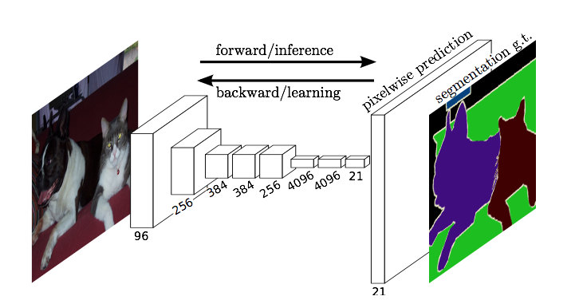
Fully Convolutional Networks for Semantic Segmentation
Jonathan Long* Evan Shelhamer* Trevor Darrell
UC Berkeley
Slides from Long, Shelhamer, and Darrell

Slide 32
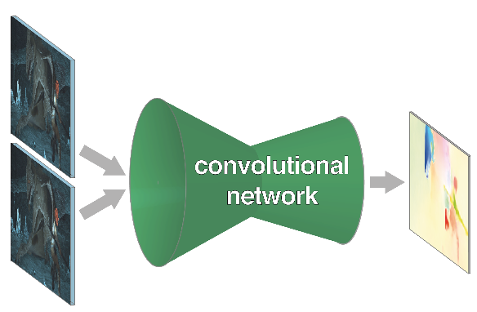
pixels in, pixels out
monocular depth estimation Eigen & Fergus 2015
semantic
segmentation
optical flow Fischer et al. 2015
boundary prediction Xie & Tu 2015
Notes:
these networks can not only do semantic segmentation, but many other pixelwise prediction tasks
these could likewise extend to video

Slide 33
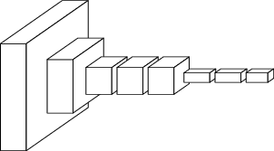
convnets perform classification
< 1 millisecond
“tabby cat”
1000-dim vector
end-to-end learning

Slide 34
R-CNN does detection
many seconds
R-CNN
“dog”
“cat”

Slide 35
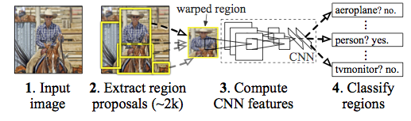
R-CNN
figure: Girshick et al.

Slide 36
~1/10 second
???
end-to-end learning

Slide 37
a classification network
“tabby cat”
Notes:
note omissions
“activations”
fixed size input, single label output
desire: efficient per-pixel output

Slide 38
becoming fully convolutional

Slide 39
becoming fully convolutional

Slide 40
upsampling output

Slide 41
end-to-end, pixels-to-pixels network

Slide 42
end-to-end, pixels-to-pixels network
upsampling
conv, pool,
nonlinearity
pixelwise output + loss

Slide 43
spectrum of deep features
combine where (local, shallow) with what (global, deep)
fuse features into deep jet
(cf. Hariharan et al. CVPR15 “hypercolumn”)

Slide 44
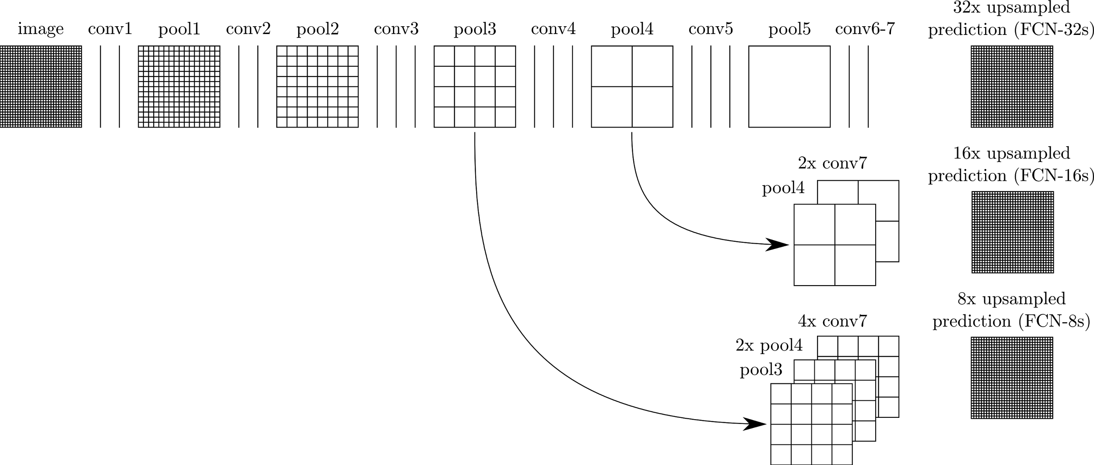
skip layers
interp + sum
skip to fuse layers!
interp + sum
end-to-end, joint learning
of semantics and location
dense output

Slide 45
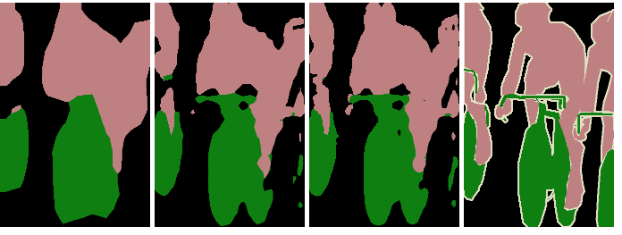
skip layer refinement
input image
stride 32
stride 16
stride 8
ground truth
no skips
1 skip
2 skips

Slide 46
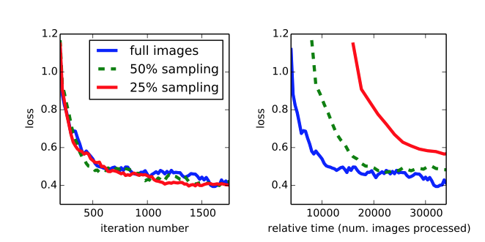
training + testing
train full image at a time without patch sampling
reshape network to take input of any size
forward time is ~100ms for 500 x 500 x 21 output

Slide 47
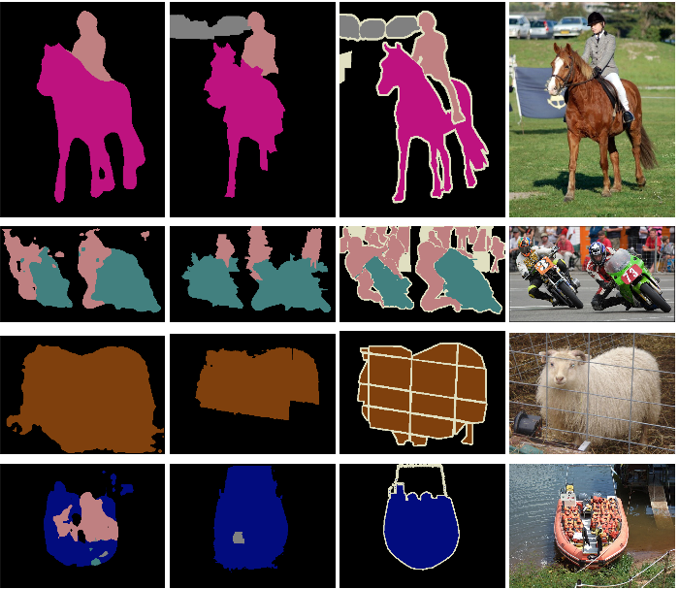
results
FCN
SDS*
Truth
Input
Relative to prior state-of-the-art SDS:
30% relative improvement for mean IoU
286× faster
*Simultaneous Detection and Segmentation Hariharan et al. ECCV14
Notes:
+ NYUD net for multi-modal input and SIFT Flow net for multi-task output

