Slide 1
Deep Learning 2 Neural Net Basics
Computer Vision
James Hays
Many slides by Marc’Aurelio Ranzato

Slide 78
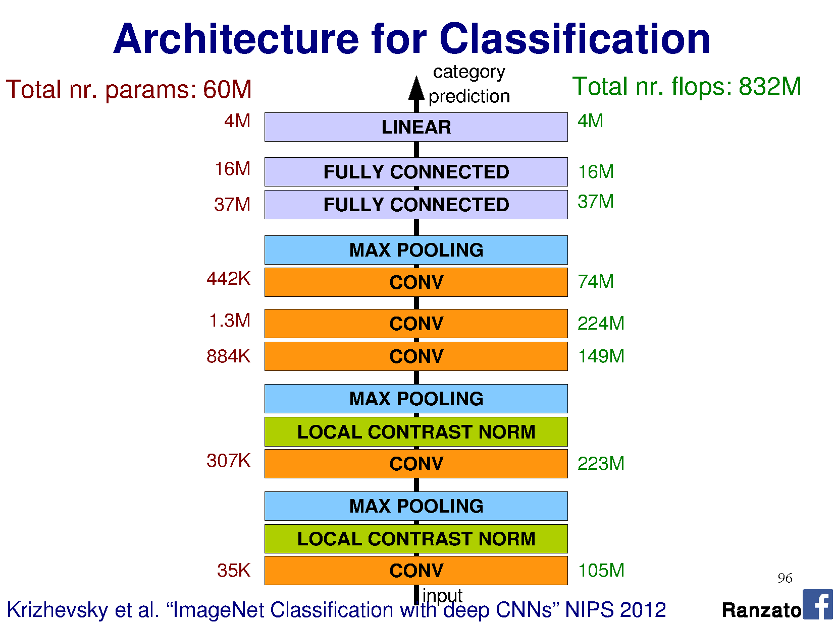

Slide 81
