Slide 1
Boundaries and Sketches
Szeliski 4.2
Computer Vision
James Hays
Many slides from Michael Maire, Jitendra Malek

Slide 2
Today’s lecture
Segmentation vs Boundary Detection
Why boundaries / Grouping?
Recap: Canny Edge Detection
The Berkeley Segmentation Data Set
pB boundary detector ~2001
Sketch Tokens 2013
How do Humans Sketch Objects?

Slide 3
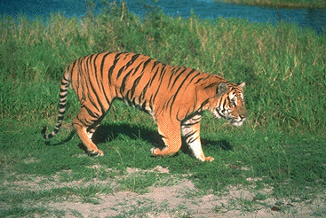
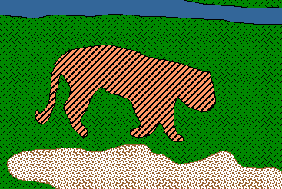
From Images to Objects
"I stand at the window and see a house, trees, sky. Theoretically I
might say there were 327 brightnesses and nuances of colour. Do
I have "327"? No. I have sky, house, and trees." --Max Wertheimer, 1923
Notes:
https://simple.wikipedia.org/wiki/Gestalt_psychology

Slide 4
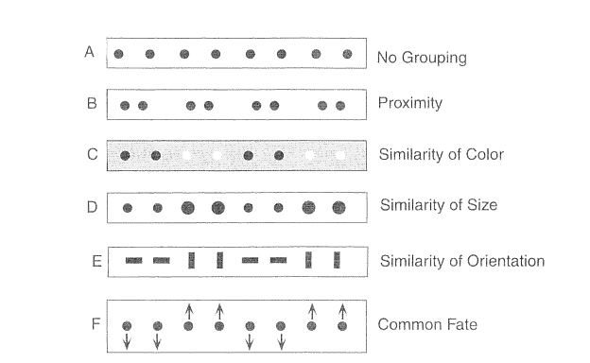
Grouping factors

Slide 5
Recap: Canny edge detector
This is probably the most widely used edge detector in computer vision
Theoretical model: step-edges corrupted by additive Gaussian noise
Canny has shown that the first derivative of the Gaussian closely approximates the operator that optimizes the product of signal-to-noise ratio and localization
J. Canny, A Computational Approach To Edge Detection, IEEE Trans. Pattern Analysis and Machine Intelligence, 8:679-714, 1986.
Source: L. Fei-Fei

Slide 6

Example
original image (Lena)

Slide 7
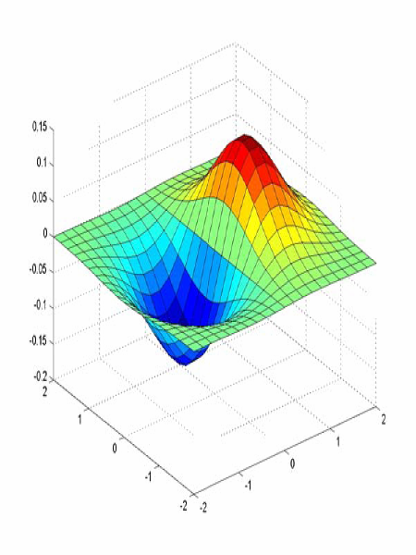
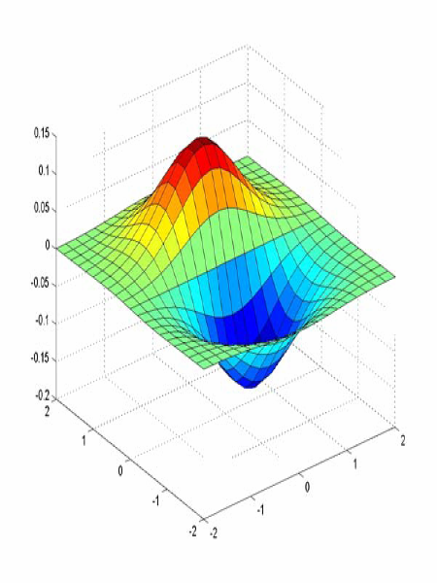
Derivative of Gaussian filter
x-direction
y-direction

Slide 8
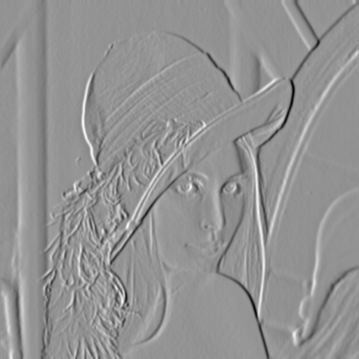
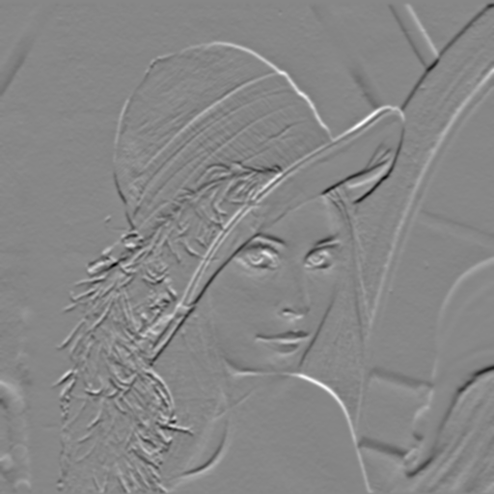

Compute Gradients (DoG)
X-Derivative of Gaussian
Y-Derivative of Gaussian
Gradient Magnitude

Slide 9
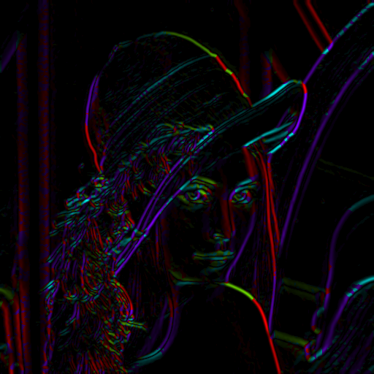
Get Orientation at Each Pixel
Threshold at minimum level
Get orientation
theta = atan2(gy, gx)

Slide 10


Non-maximum suppression for each orientation
At q, we have a maximum if the value is larger than those at both p and at r. Interpolate to get these values.
Source: D. Forsyth

Slide 11
Edge linking
Assume the marked point is an edge point. Then we construct the tangent to the edge curve (which is normal to the gradient at that point) and use this to predict the next points (here either r or s).
Source: D. Forsyth

Slide 12
Before Non-max Suppression

Slide 13
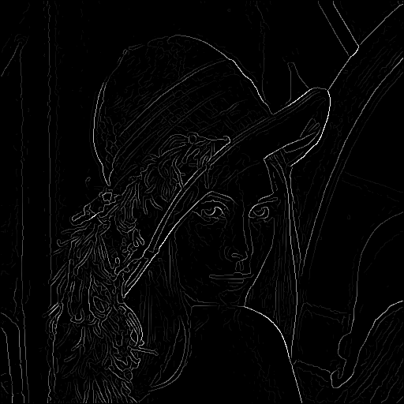
After non-max suppression

Slide 14
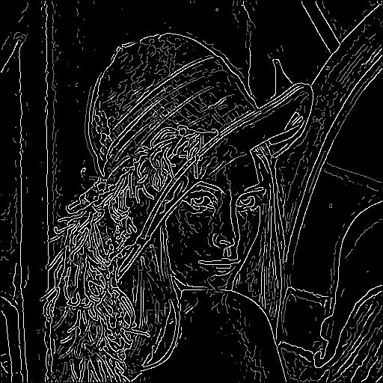
Hysteresis thresholding
Threshold at low/high levels to get weak/strong edge pixels
Do connected components, starting from strong edge pixels

Slide 15
Hysteresis thresholding
Check that maximum value of gradient value is sufficiently large
  drop-outs? use hysteresis
    use a high threshold to start edge curves and a low threshold to continue them.
Source: S. Seitz

Slide 16
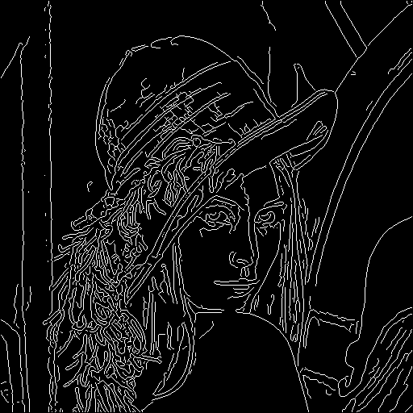
Final Canny Edges

Slide 17
Canny edge detector
Filter image with x, y derivatives of Gaussian
Find magnitude and orientation of gradient
Non-maximum suppression:
  Thin multi-pixel wide “ridges” down to single pixel width
Thresholding and linking (hysteresis):
  Define two thresholds: low and high
  Use the high threshold to start edge curves and the low threshold to continue them
MATLAB: edge(image, ‘canny’)
Source: D. Lowe, L. Fei-Fei

Slide 18
I made a new boundary detector!
How do I show that it is better than your boundary detector?

Slide 19
Berkeley Segmentation Data Set
David Martin, Charless Fowlkes,
Doron Tal, Jitendra Malik
UC Berkeley
{dmartin,fowlkes,doron,malik}@eecs.berkeley.edu

Slide 20
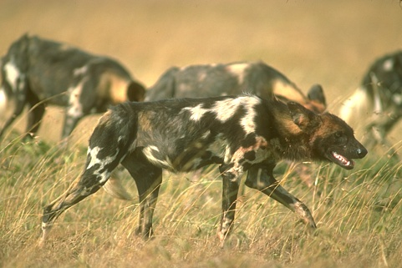
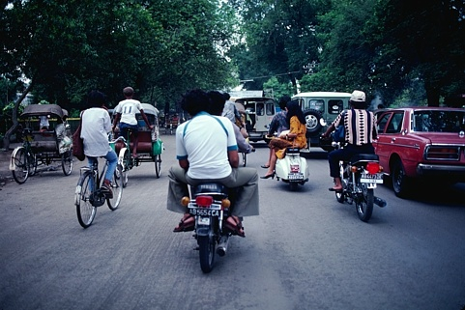
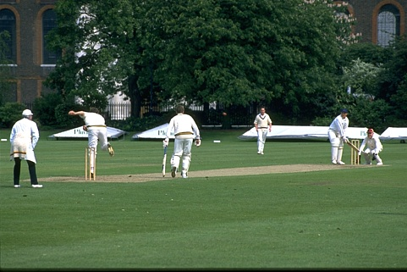
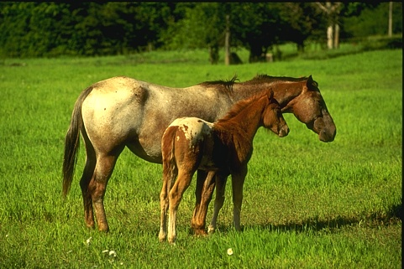
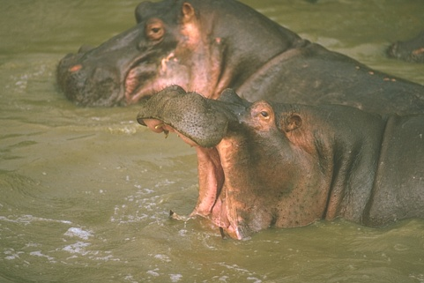
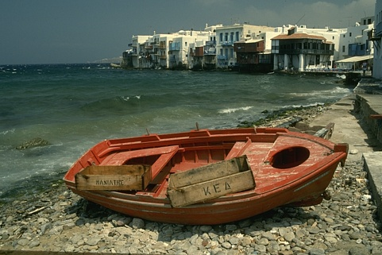
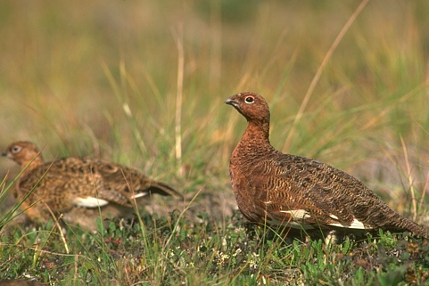
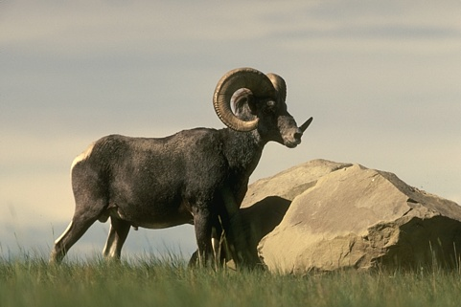
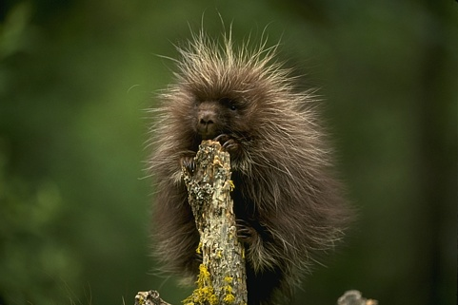
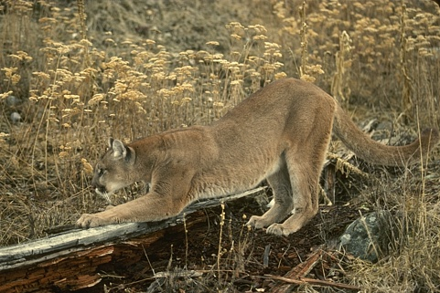

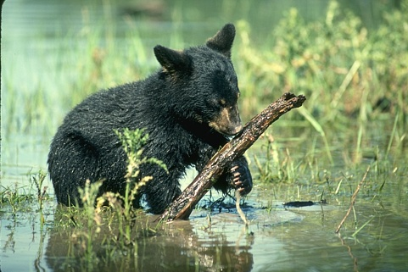
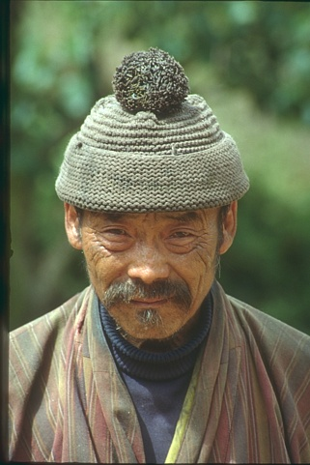
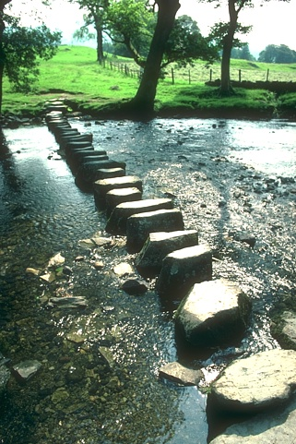
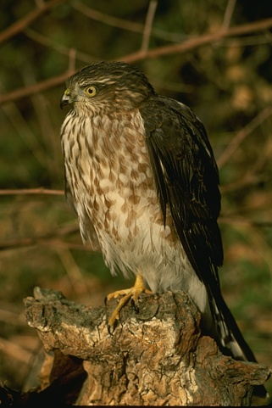
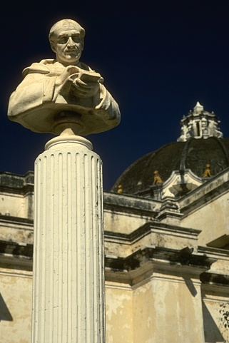
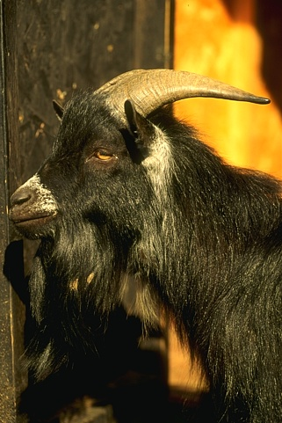
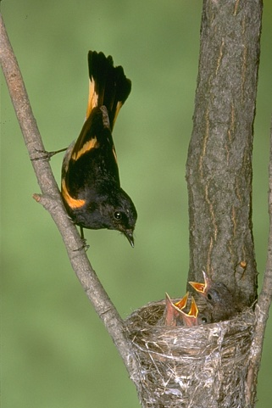

Slide 21
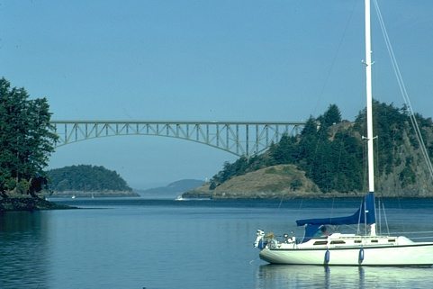
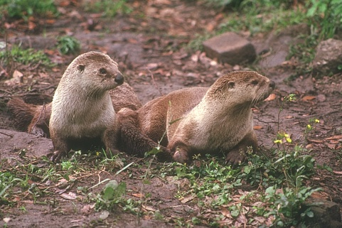
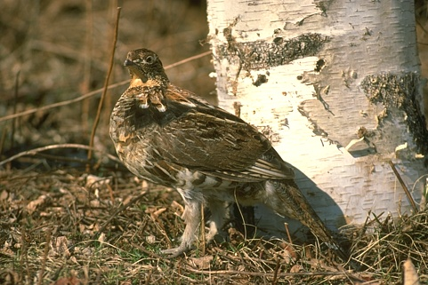
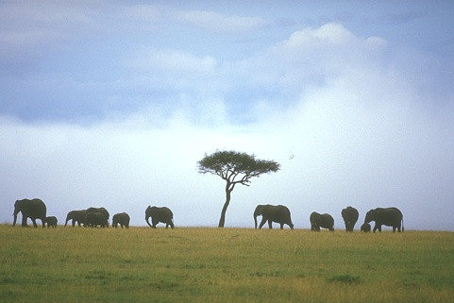
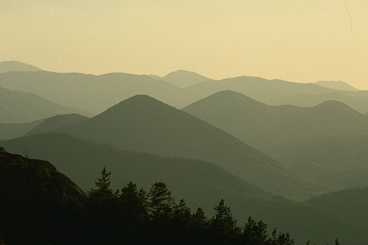
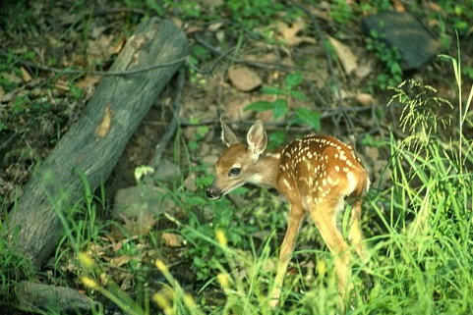
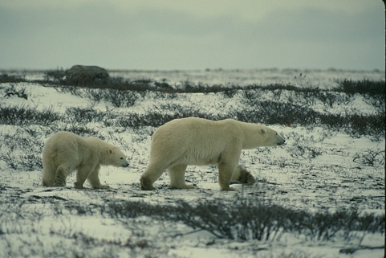
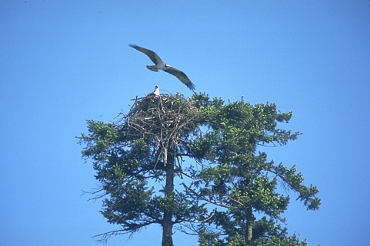
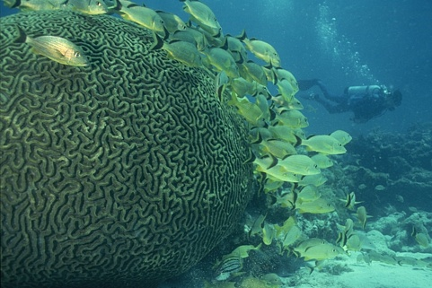
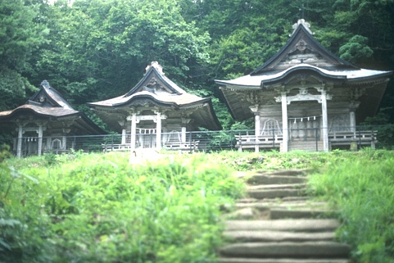
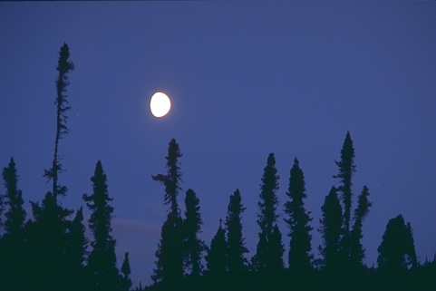

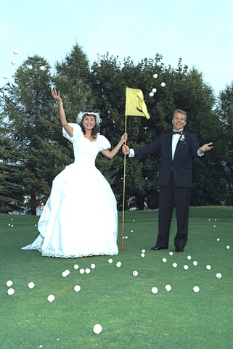
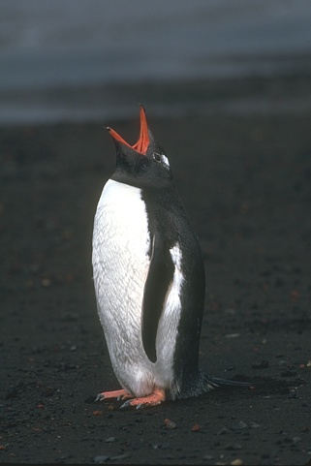
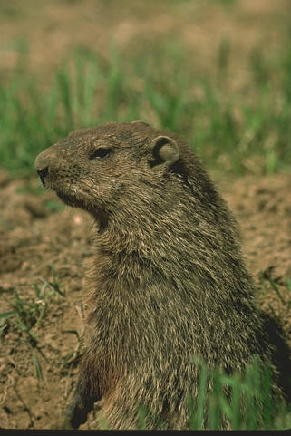
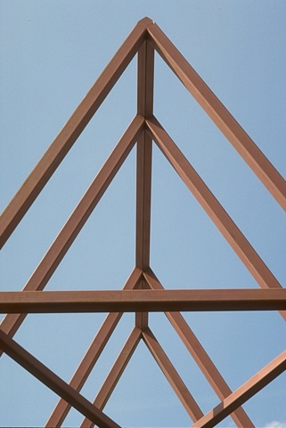
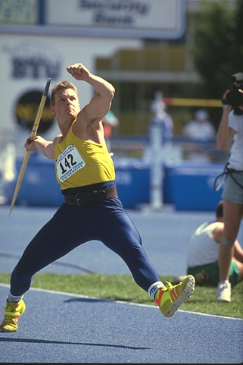
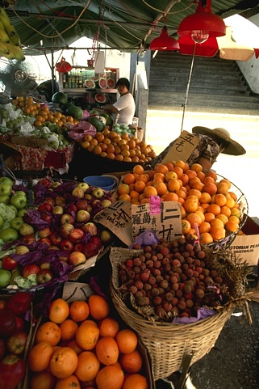

Slide 22
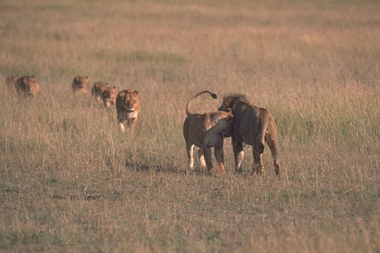
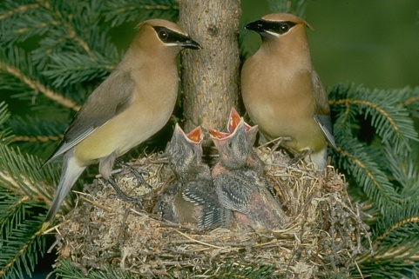
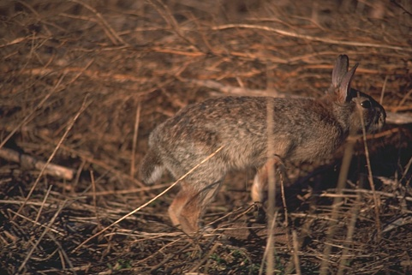
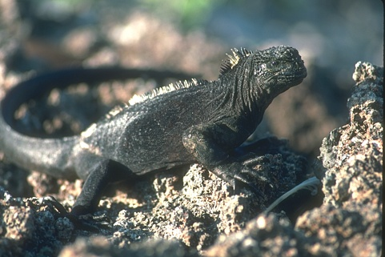
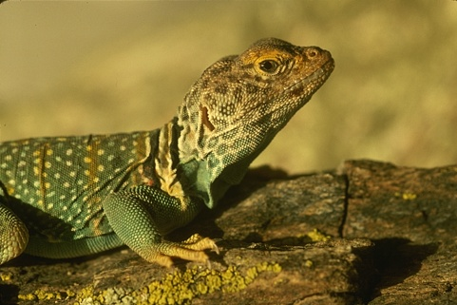














Slide 23
Protocol
You will be presented a photographic image. Divide the image into some number of segments, where the segments represent “things” or “parts of things” in the scene. The number of segments is up to you, as it depends on the image. Something between 2 and 30 is likely to be appropriate. It is important that all of the segments have approximately equal importance.
Custom segmentation tool
Subjects obtained from work-study program
(UC Berkeley undergraduates)

Slide 24

















Slide 25

















Slide 26




Segmentations are Consistent
A
Perceptual organization forms a tree:
Image
BG
L-bird
R-bird
B
C
grass
bush
far
beak
body
beak
body
eye
head
eye
head
Two segmentations are
consistent when they can be
explained by the same
segmentation tree (i.e. they
could be derived from a single
perceptual organization).
A,C are refinements of B
A,C are mutual refinements
A,B,C represent the same percept
  Attention accounts for differences

Slide 27

















Slide 28
Dataset Summary
30 subjects, age 19-23
  17 men, 13 women
  9 with artistic training
8 months
1,458 person hours
1,020 Corel images
11,595 Segmentations
  5,555 color, 5,554 gray, 486 inverted/negated

Slide 29
Gray, Color, InvNeg Datasets
Explore how various high/low-level cues affect the task of image segmentation by subjects
  Color = full color image
  Gray = luminance image
  InvNeg = inverted negative luminance image

Slide 30






Color
Gray
InvNeg

Slide 31


InvNeg

Slide 32




Color
Gray
InvNeg

Slide 33
Pb Detector

Slide 34


Dataflow
P_{b}
Image
Boundary Cues
Cue Combination
Brightness
Model
Color
Texture
Challenges: texture cue, cue combination
Goal: learn the posterior probability of a boundary
P_{b}(x,y,θ) from local information only

Slide 35



































Non-Boundaries
Boundaries
I
B
C
T

Slide 36
Brightness and Color Features
1976 CIE L*a*b* colorspace
Brightness Gradient BG(x,y,r,θ)
  χ² difference in L* distribution
Color Gradient CG(x,y,r,θ)
  χ² difference in a* and b*
  distributions
r
(x,y)
θ

Slide 37



Texture Feature
Texton
Map
Texture Gradient TG(x,y,r,θ)
  χ² difference of texton histograms
  Textons are vector-quantized filter outputs

Slide 38
Cue Combination Models
Classification Trees
  Top-down splits to maximize entropy, error bounded
Density Estimation
  Adaptive bins using k-means
Logistic Regression, 3 variants
  Linear and quadratic terms
  Confidence-rated generalization of AdaBoost (Schapire&Singer)
Hierarchical Mixtures of Experts (Jordan&Jacobs)
  Up to 8 experts, initialized top-down, fit with EM
Support Vector Machines (libsvm, Chang&Lin)
  Gaussian kernel, ν-parameterization
Range over bias, complexity, parametric/non-parametric

Slide 39
Computing Precision/Recall
Recall = Pr(signal|truth) = fraction of ground truth found by the signal
Precision = Pr(truth|signal) = fraction of signal that is correct
Always a trade-off between the two
Standard measures in information retrieval (van Rijsbergen XX)
ROC from standard signal detection the wrong approach
Strategy
Detector output (Pb) is a soft boundary map
Compute precision/recall curve:
  Threshold Pb at many points t in [0,1]
  Recall = Pr(Pb>t|seg=1)
  Precision = Pr(seg=1|Pb>t)

Slide 40

Classifier
Comparison
Goal
More
Noise
More
Signal

Slide 41
ROC vs. Precision/Recall
Truth
 | P | N
P | TP | FP
N | FN | TN
Signal
ROC Curve
Hit Rate = TP / (TP+FN) =
False Alarm Rate = FP / (FP+TN) =
PR Curve
Precision = TP / (TP+FP) =
Recall = TP / (TP+FN) =
/
/
/
/

Slide 42
Cue Calibration
All free parameters optimized on training data
All algorithmic alternatives evaluated by experiment
Brightness Gradient
  Scale, bin/kernel sizes for KDE
Color Gradient
  Scale, bin/kernel sizes for KDE, joint vs. marginals
Texture Gradient
  Filter bank: scale, multiscale?
  Histogram comparison: L¹, L², L∞, χ², EMD
  Number of textons, Image-specific vs. universal textons
Localization parameters for each cue

Slide 43

Calibration Example: Number of
Textons
for the Texture Gradient

Slide 44

Calibration Example #2: Image-Specific
vs.
Universal Textons

Slide 45











Boundary Localization
Non-Boundaries
Boundaries
TG
TG
(1) Fit cylindrical parabolas to raw oriented signal to get local shape: (Savitsky-Golay)
(2) Localize peaks:

Slide 46






Dataflow
P_{b}
Image
Optimized Cues
Cue Combination
Brightness
Model
Color
Texture
Benchmark
Human Segmentations

Slide 47
Classifier
Comparison

Slide 48

Cue Combinations

Slide 49
Alternate Approaches
Canny Detector
  Canny 1986
  MATLAB implementation
  With and without hysteresis
Second Moment Matrix
  Nitzberg/Mumford/Shiota 1993
  cf. Förstner and Harris corner detectors
  Used by Konishi et al. 1999 in learning framework
  Logistic model trained on full eigenspectrum

Slide 50










P_{b} Images
Image
Canny
2MM
Us
Human

Slide 51






P_{b} Images II
Image
Canny
2MM
Us
Human

Slide 52










P_{b} Images II
Image
Canny
2MM
Us
Human

Slide 53

Two Decades of Boundary Detection

Slide 54


Slide 55


Slide 56
Findings
A simple linear model is sufficient for cue combination
  All cues weighted approximately equally in logistic
Proper texture edge model is not optional for complex natural images
  Texture suppression is not sufficient!
Significant improvement over state-of-the-art in boundary detection
  P_{b}(x,y,θ) useful for higher-level processing
Empirical approach critical for both cue calibration and cue combination

Slide 57
Sketch Tokens: A Learned Mid-level
Representation for Contour and Object Detection
Joseph Lim, C Lawrence Zitnick, Piotr Dollar
CVPR 2013

Slide 58


Slide 59


Slide 60
Image Features – 21350 dimensions!
35x35 patches centered at every pixel
35x35 “channels” of many types:
  Color (3 channels)
  Gradients (3 unoriented + 8 oriented channels)
    Sigma = 0, T heta = 0, pi/2, pi, 3pi/2
    Sigma = 1.5, Theta = 0, pi/2, pi, 3pi/2
    Sigma = 5
  Self Similarity
    5x5 maps of self similarity within the above channels for a particular anchor point.

Slide 61

Self-similarity features
Self-similarity features: The L1 distance from the anchor cell (yellow box) to the other 5 x 5 cells are shown for color and gradient magnitude channels. The original patch is shown to the left.

Slide 62
Learning
Random Forest Classifiers, one for each sketch token + background, trained 1-vs-all
Advantages:
  Fast at test time, especially for a non-linear classifier.
  Don’t have to explicitly compute independent descriptors for every patch. Just look up what the decision tree wants to know at each branch.

Slide 63

Learning
Frequency of example features being selected by the random forest: (first row) color channels, (second row) gradient magnitude channels, (third row) selected orientation channels.

Slide 64

Detections of individual sketch tokens

Slide 65
Detections of individual sketch tokens

Slide 66
Combining sketch token detections
Simply add the probability of all non-background sketch tokens
Free parameter: number of sketch tokens
  k = 1 works poorly*, k = 16 and above work OK.
*Actually, the entire sketch clustering idea might not be important.

Slide 67

Input Image Ground Truth Sketch Tokens

Slide 68

Evaluation on BSDS

Slide 69

Evaluation on BSDS

Slide 70
Summary
Distinct from previous work, cluster the human annotations to discover the mid-level structures that you want to detect.
Train a classifier for every sketch token.
Is as accurate as any other method while being 200 times faster and using no global information.

Slide 71
How Do Humans Sketch Objects?
Mathias Eitz, James Hays, and Marc Alexa. Siggraph 2012

Slide 72


Sketches Are Important
20,000 years ago (Lascaux, France)
Notes:
So why is this an important problem? Sketching has been used since tens of thousands of years and on this slide we show two examples from a cave in Lascaux in France. The sketch on the left depicts a horse and the sketch on the right an antilope. Researchers hypothesize that those drawings possibly depict animals successfully hunted.
Terminology: petroglyph = rock engraving

Slide 73

Notes:
Chauvet Cave
30k to 32k years ago
Written language only appeared 5k years ago

Slide 74


Slide 75


Sketches Are Important
Today
Notes:
Even today sketching, is an immensely popular task. For example a recently highly popular pictionary-style mobile game is DrawSomething. It got 20 million downloads within the first five weeks of ist release.

Slide 76
Sketches Are Important
Despite decades of Computer Graphics research:
Sketching is the only method for most people to render visual content
Notes:
To summarize, I have a bit of a provocative statement here for us as computer graphics researchers. Despite decades of computer graphics research, sketching is probably the only method for most people to render visual content. As such, we believe that it is extremely important to understand how humans sketch objects and possibly transfer this knowledge to achieve computational sketch recognition.

Slide 77




Prior Work: Domain-specific Recognition
[LaViola and Zeleznik 2004]
[Sezgin and Davis 2008]
[Rebelo et al. 2009]
[Ouyang and Davis 2011]

Slide 78

Prior Work: Sketch-based image retrieval
PhotoSketcher. Eitz, Richter, Hildebrand, Boubekeur, and Alexa. CGA 2011.
Sketch2Photo. Chen, Cheng, Tan, Shamir, Hu. Siggraph Asia 2009

Slide 79

Prior Work: ShadowDraw
Lee, Zitnick, Cohen, SIGGRAPH 2011

Slide 80

Prior Work: ShadowDraw

Slide 81

Prior Work: ShadowDraw

Slide 82

Our work
Notes:
So this is our system, users sketch an object, for example a bicycle and our system interactively recognized correct category.

Slide 83
How Do Humans Sketch Objects?
Need many example sketches from a variety of humans
We used amazon Mechanical Turk
“Please sketch an image that is clearly recognizable to other humans as belonging to the following category: airplane”

Slide 84


How Do Humans Sketch Objects?
Mechanical Turk Instructions

Slide 85


How Do Humans Sketch Objects?
Mechanical Turk Instructions

Slide 86
How Do Humans Sketch Objects?
20,000 sketches in 250 categories
  1,350 unique participants, 741 hours drawing time
Notes:
As a result of this experiment on Mechanical Turk, we got a dataset of 20.000 sketches in 250 categories. We had a total of 1.350 unique participants which spent a total of 741 hours drawing the sketches.
(CLICK->next slide)

Slide 87
Human Sketch Recognition
73% overall human recognition accuracy
Notes:
We found that the overall average human recognition accuracy is 73%.
On this slide, I will show you the 16 categories with overall highest human recognition accuracy. All 80 sketches depicting t-shirts have been correctly classified. Here are several more examples.

Slide 88
Human Sketch Recognition
category
confusing categories
category
confusing categories
Notes:
We found that the overall average human recognition accuracy is 73%.
On this slide, I will show you the 16 categories with overall highest human recognition accuracy. All 80 sketches depicting t-shirts have been correctly classified. Here are several more examples.

Slide 89










Sketch Recognition
fish
Notes:
As the third major part of our paper we want to explore how well computers can recognize object sketches, such as the fish shown here (CLICK).
We have found that humans can do this pretty reliably but for computers this problem is still largely unsolved. Why is this task -- that seems so easy to us -- so difficult for computers?
Each object category can be represented by a wide variety of different sketches. Here are several more examples of fish contained in our dataset.
(CLICK->NEXT SLIDE)
computer icon from: http://en.wikipedia.org/wiki/File:Computer_icon.png (CC)

Slide 90

Bag-of-Features Representation with SIFT-like features
feature vector
2
1
500 dimensions
2
reduce into
…

Slide 91


Slide 92


Slide 93










Sketch Feature Space
500 dimensional space
Notes:
Given some sketches (CLICK 3x) we can now depict their corresponding features as points in 500-dimensional space (CLICK 3x).
To avoid clutter, I will now hide the original sketches and in the remainder of this talk only show that colored points as their representatives.
(CLICK->NEXT SLIDE)

Slide 94

Classification
d( , )=0.3
bulldozer
2
3
d( , )=-0.5
1
...
d( , )=-0.2
56% accuracy (RBF SVM), compared to 73% for humans
~65% accuracy from DeCaf feature or explicit ICP alignment to training data
68% accuracy from Fisher Vector encoding [Schneider and Tuytelaars Siggraph Asia 2014]
Notes:
So, given this sketch on the left and the learned SVM model on the right, we want to classify what kind of object the sketch represents. Here are the steps that we perform. First, we represent the sketch as a feature vector as I have shown a few slides before (CLICK). Since we do not yet know what category the sketch belongs into, we need to test the sketch against all binary models. To do so, we consider the feature vector again as a point in high dimensional space, in this case let it be this red point (CLICK). We now compute the distance of this point to the green hyperplane (CLICK) which is 0.3. Also, we compute the distance to the blue hyperplane which is -0.2 and finally to the orange hyperplane which is -0.5.
As a result, we have 3 distance values, one for each binary model. How do we now classify the sketch? We simply classify a sketch as belonging to that model with the largest positive response (CLICK). In this case the sketch would be correctly classified as a “bulldozer” (CLICK).
On the next slide I will show you some additional videos of the interactive system that is using exactly this method to make a new prediction after each new stroke the user draws (CLICK).

Slide 95


Slide 96


Slide 97



Sketch Recognition
Does the system generalize beyond our AMT sketches?
flying bird
camel
sheep
horse
is: antilope
Notes:
A challenging evaluation for recognition systems is if they can generalize to styles unseen at training time. Remember this sketches I have shown you at the beginning of the talk? We ran them through our system and got the following results. The dove by Picasso is recognized as a flying bird, the camel as a camel. We don‘t have antilopes in our set of categories and so this one is incorrectly classified as a sheep. Finally, the horse is classified correctly as a horse.

Slide 98
Recognition Accuracy Over Time
44% bag of features + k nearest neighbors
56% bag of features + nonlinear SVM
65% deep learning features (no fine tuning)
65% Iterative-closest point (ICP) on nearest neighbors
68% bag of features + Fisher Vector encoding
[Schneider and Tuytelaars. Siggraph Asia 2014]
73% humans
75% [Sketch-a-Net that Beats Humans. Qian Yu, Yongxin Yang, Yi-Zhe Song, Tao Xiang, Timothy Hospedales. BMVC 2015]
~75% [Hang Su, Subhransu Maji, Evangelos Kalogerakis, Erik Learned-Miller. ICCV 2015.]
80% fine-tuned GoogLeNet [Sketchy Database, Sangkloy et al. 2016]

Slide 99




Conclusions
wristwatch
flying bird
flower
person walking
People tend to agree on iconic representations which are often abstract and far from original geometry
Sketches are relatively easy to recognize with existing computer vision tools

Slide 100








Does recognizing sketches help us retrieve sketches?
Notes:
So instead of using text, a more intuitive approach is to use sketch to describe the image you’re looking for.
The goal here is to retrieve the most similar image, not to the sketch, but to some mental image that prompted the sketch. And in order to decipher what type of image people have in mind when they were sketching, we really have to understand how humans sketch objects in the first place.

