Slide 1
Attributes
Computer Vision
James Hays
Many slides from Derek Hoiem

Slide 2
Recap: Human Computation
Active Learning: Let the classifier tell you where more annotation is needed.
Human-in-the-loop recognition: Have a human and computer cooperate to do recognition.
Mechanical Turk is powerful but noisy
  Determine which workers are trustworthy
  Find consensus over multiple annotators
  “Gamify” your task to the degree possible

Slide 3
Recap: Recognition Data Sets
SUN Scene Database
  Not Crowdsourced, 397 (or 720) scene categories
PASCAL VOC
  Not Crowdsourced, bounding boxes, 20 categories.
LabelMe (Overlaps with SUN)
  Sort of Crowdsourced, Segmentations, Open ended
SUN Attribute database (Overlaps with SUN)
  Crowdsourced, 102 attributes for every scene
ImageNet
  Large, Crowdsourced, Hierarchical, Iconic objects
COCO
  Large, Crowdsourced, 80 segmented object categories in complex scenes

Slide 4
Today – Crowd enabled recognition
Recognizing Object Attributes
Recognizing Scene Attributes

Slide 5
Describing Objects by their Attributes
Ali Farhadi, Ian Endres,
Derek Hoiem, David Forsyth
CVPR 2009

Slide 6
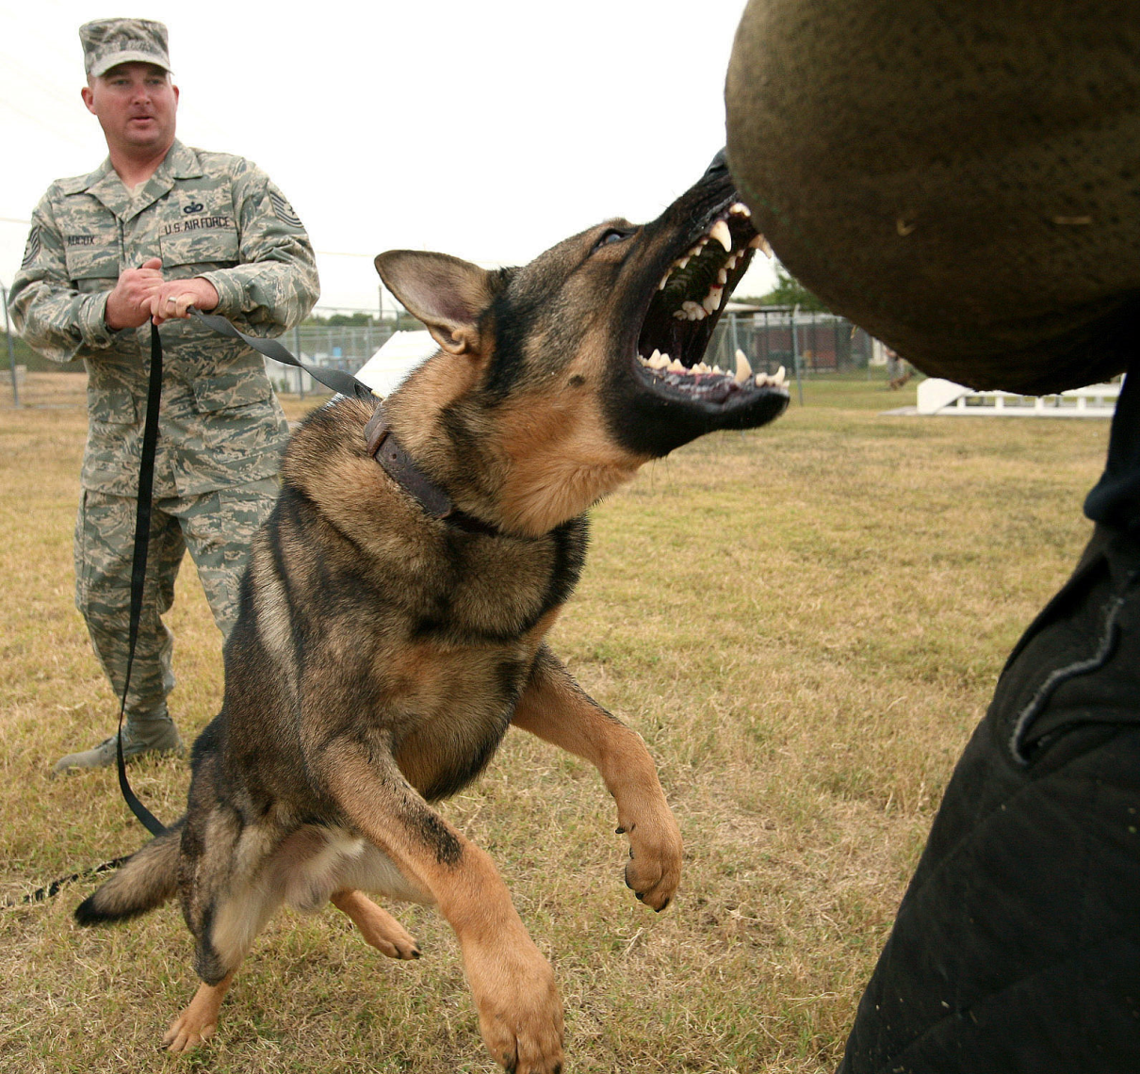

Slide 7
What do we want to know about this object?

Slide 8
What do we want to know about this object?
Object recognition expert:
“Dog”

Slide 9
What do we want to know about this object?
Object recognition expert:
“Dog”
Person in the Scene:
“Big pointy teeth”, “Can move fast”, “Looks angry”

Slide 10

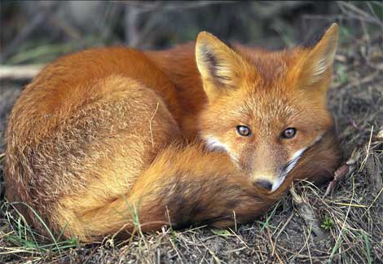
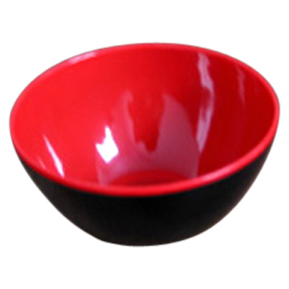
Our Goal: Infer Object Properties
Can I poke with it?
Can I put stuff in it?
Is it alive?
What shape is it?
Is it soft?
Does it have a tail?
Will it blend?

Slide 11
Why Infer Properties
We want detailed information about objects
“Dog”
vs.
“Large, angry animal with pointy teeth”

Slide 12
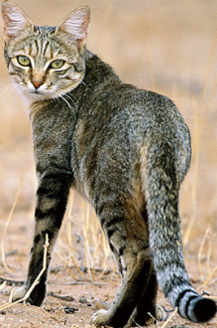
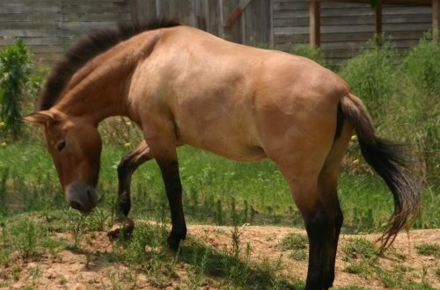
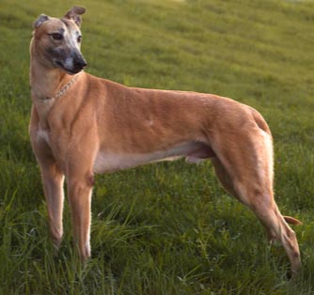
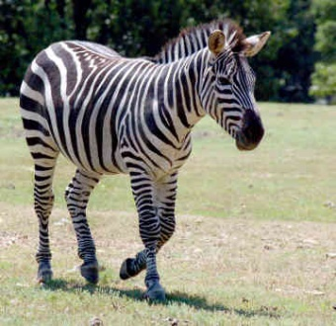
Why Infer Properties
2. We want to be able to infer something about unfamiliar objects
Familiar Objects
New Object

Slide 13
Why Infer Properties
2. We want to be able to infer something about unfamiliar objects
If we can infer category names…
Familiar Objects
New Object
Cat
Horse
Dog
???

Slide 14
Why Infer Properties
2. We want to be able to infer something about unfamiliar objects
If we can infer properties…
Familiar Objects
New Object
Has Stripes
Has Ears
Has Eyes
….
Has Four Legs
Has Mane
Has Tail
Has Snout
….
Brown
Muscular
Has Snout
….
Has Stripes (like cat)
Has Mane and Tail (like horse)
Has Snout (like horse and dog)

Slide 15
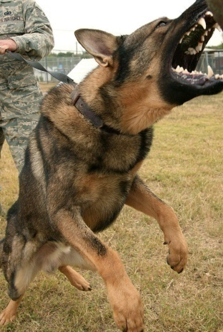


Why Infer Properties
3. We want to make comparisons between objects or categories
What is unusual about this dog?
What is the difference between horses and zebras?

Slide 16
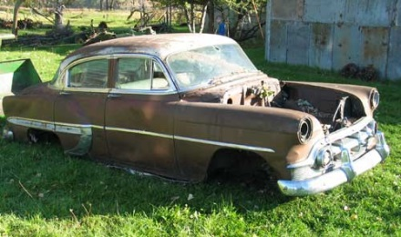
Strategy 1: Category Recognition
Object Image
Category
associated properties
Has Wheels
Used for Transport
Made of Metal
Has Windows
…
classifier
“Car”
Category Recognition: PASCAL 2008
Category → Attributes: ??
Notes:
Note that much work on recognition, but little on inferring attributes

Slide 17
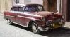
Strategy 2: Exemplar Matching
Object Image
Similar Image
similarity function
associated properties
Has Wheels
Used for Transport Made of Metal
Old
…
Malisiewicz Efros 2008
Hays Efros 2008
Efros et al. 2003
Notes:
Note that much work on recognition, but little on inferring attributes

Slide 18

Strategy 3: Infer Properties Directly
Object Image
No Wheels
Old
Brown
Made of Metal
…
classifier for each attribute
See also Lampert et al. 2009
Gibson’s affordances
Notes:
Note that much work on recognition, but little on inferring attributes

Slide 19
The Three Strategies
Category
associated properties
classifier
“Car”
Has Wheels
Used for Transport
Made of Metal
Has Windows
Old
No Wheels
Brown
…
Object Image
Similar Image
similarity function
associated properties
Direct
classifier for each attribute

Slide 20
Our attributes
Visible parts: “has wheels”, “has snout”, “has eyes”
Visible materials or material properties: “made of metal”, “shiny”, “clear”, “made of plastic”
Shape: “3D boxy”, “round”

Slide 21
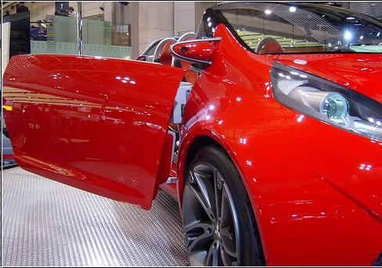
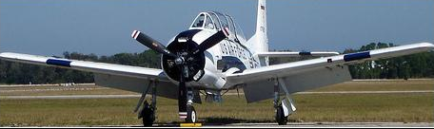
Attribute Examples
Shape: Horizontal Cylinder
Part: Wing, Propeller, Window, Wheel
Material: Metal, Glass
Shape:
Part: Window, Wheel, Door, Headlight, Side Mirror
Material: Metal, Shiny

Slide 22
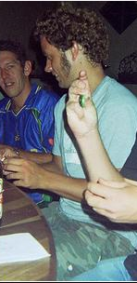
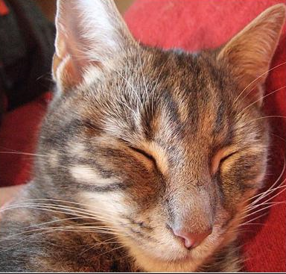
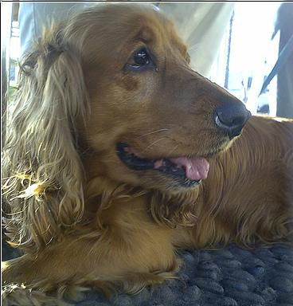
Attribute Examples
Shape:
Part: Head, Ear, Nose, Mouth, Hair, Face, Torso, Hand, Arm
Material: Skin, Cloth
Shape:
Part: Head, Ear, Snout, Eye
Material: Furry
Shape:
Part: Head, Ear, Snout, Eye, Torso, Leg
Material: Furry

Slide 23
Datasets
a-Pascal
  20 categories from PASCAL 2008 trainval dataset (10K object images)
    airplane, bicycle, bird, boat, bottle, bus, car, cat, chair, cow, dining table, dog, horse, motorbike, person, potted plant, sheep, sofa, train, tv monitor
  Ground truth for 64 attributes
  Annotation via Amazon’s Mechanical Turk
a-Yahoo
  12 new categories from Yahoo image search
    bag, building, carriage, centaur, donkey, goat, jet ski, mug, monkey, statue of person, wolf, zebra
  Categories chosen to share attributes with those in Pascal
Attribute labels are somewhat ambiguous
  Agreement among “experts” 84.3
  Between experts and Turk labelers 81.4
  Among Turk labelers 84.1

Slide 24
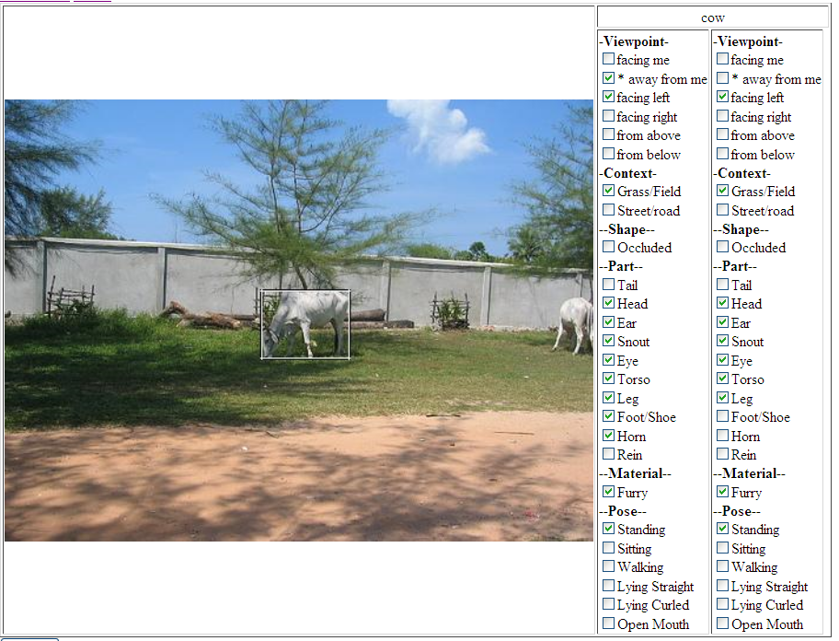
Annotation on Amazon Turk

Slide 25
Our approach

Slide 26
Features
Strategy: cover our bases
Spatial pyramid histograms of quantized
  Color and texture for materials
  Histograms of gradients (HOG) for parts
  Canny edges for shape

Slide 27
Our approach

Slide 28
Learning Attributes
Learn to distinguish between things that have an attribute and things that do not
Train one classifier (linear SVM) per attribute

Slide 29
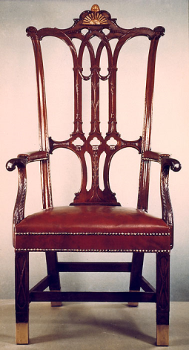
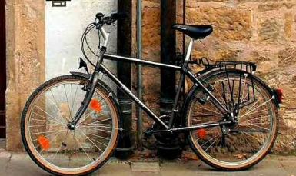
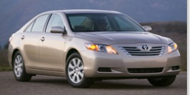

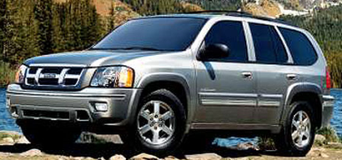
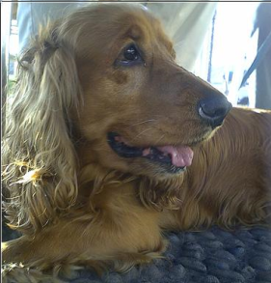
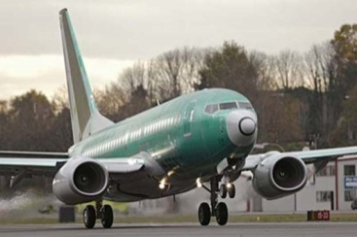
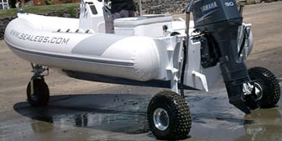
Learning Attributes
Simplest approach: Train classifier using all features for each attribute independently
“Has Wheels”
“No Wheels Visible”

Slide 30
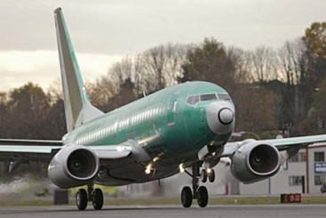
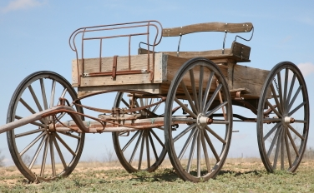
Dealing with Correlated Attributes
Big Problem: Many attributes are strongly correlated through the object category
Most things that “have wheels” are “made of metal”
When we try to learn “has wheels”, we may accidentally learn “made of metal”
Has Wheels, Made of Metal?

Slide 31
Decorrelating attributes
Solution:
Select features that can distinguish between two classes
  Things that have the attribute (e.g., wheels)
  Things that do not, but have similar attributes to those that do
Then, train attribute classifier on all positive and negative examples using the selected features

Slide 32
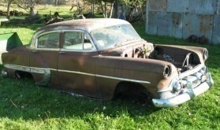
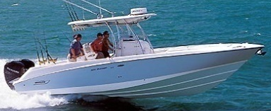

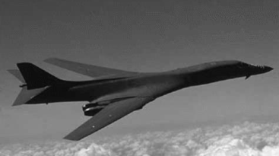
Feature Selection
Do feature selection (L1 logistic regression) for each class separately and pool features
vs.
Car Wheel Features
vs.
Boat Wheel Features
Plane Wheel Features
vs.
“Has Wheels”
“No Wheels”
All Wheel Features

Slide 33
Feature selection
“Has Wheel” vs. “Made of Metal” Correlation
Ground truth
  a-Pascal: 0.71 (cars, airplanes, boats, etc.)
  a-Yahoo: 0.17 (carriages)
a-Yahoo, predicted with whole features: 0.56
a-Yahoo, predicted with selected features: 0.28

Slide 34
Experiments
Predict attributes for unfamiliar objects
Identify what is unusual about an object

Slide 35
Results: Predicting attributes
Train on 20 object classes from a-Pascal train set
  Feature selection for each attribute
  Train a linear SVM classifier
Test on 12 object classes from Yahoo image search (cross-category) or on a-Pascal test set (within-category)
  Apply learned classifiers to predict each attribute

Slide 36
Describing Objects by their Attributes
No examples from these object categories were seen during training

Slide 37
Describing Objects by their Attributes
No examples from these object categories were seen during training

Slide 38
Attribute Prediction: Quantitative Analysis
Area Under the ROC for Familiar (PASCAL) vs. Unfamiliar (Yahoo) Object Classes
Worst
Wing
Handlebars
Leather
Clear
Cloth
Best
Eye
Side Mirror
Torso
Head
Ear

Slide 39
Average ROC Area
Trained on a-PASCAL objects
Test Objects | Parts | Materials | Shape
a-PASCAL | 0.794 | 0.739 | 0.739
a-Yahoo | 0.726 | 0.645 | 0.677

Slide 40
Describing Objects by their Attributes
No examples from these object categories were seen during training

Slide 41
Our approach

Slide 42
Category Recognition
Semantic attributes not enough
  74% accuracy even with ground truth attributes
Introduce discriminative attributes
  Trained by selecting subset of classes and features
    Dogs vs. sheep using color
    Cars and buses vs. motorbikes and bicycles using edges
  Train 10,000 and select 1,000 most reliable, according to a validation set

Slide 43
Attributes not big help when sufficient data
Use attribute predictions as features
Train linear SVM to categorize objects
PASCAL 2008 | Base Features | Semantic Attributes | All Attributes
Classification Accuracy | 58.5% | 54.6% | 59.4%
Class-normalized Accuracy | 35.5% | 28.4% | 37.7%

Slide 44
Learning New Categories
From limited examples
  nearest neighbor of attribute predictions
From verbal description
  nearest neighbor to verbally specified attributes
    Goat: “has legs, horns, head, torso, feet”, “is furry”
    Building: “has windows, rows of windows”, “made of glass, metal”, “is 3D boxy”

Slide 45
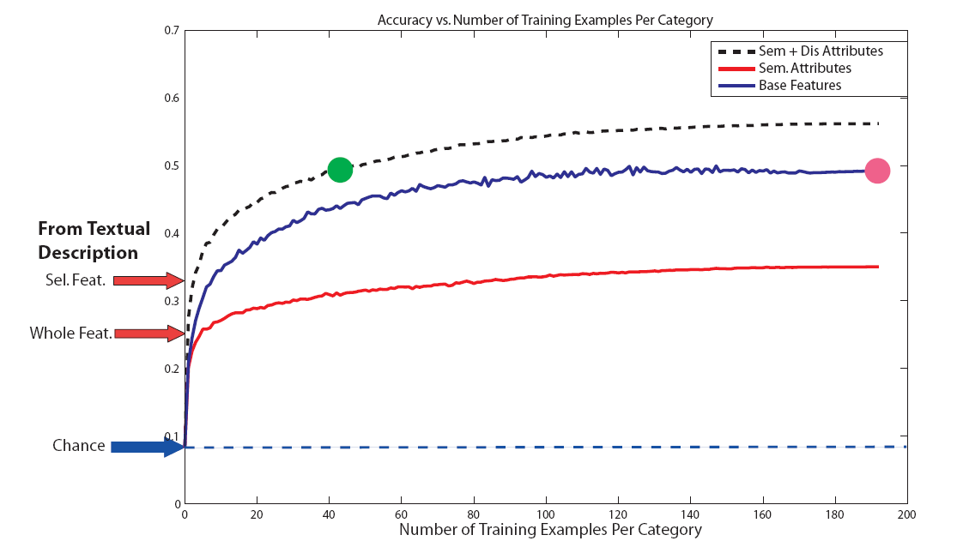
Recognition of New Categories

Slide 46
Identifying Unusual Attributes
Look at predicted attributes that are not expected given class label

Slide 47
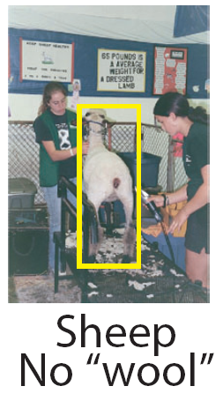
Absence of typical attributes
752 reports
68% are correct

Slide 48
Absence of typical attributes
752 reports
68% are correct

Slide 49
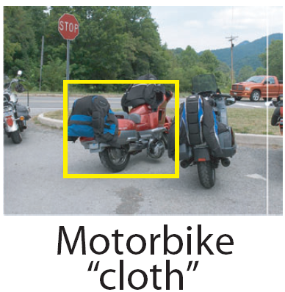
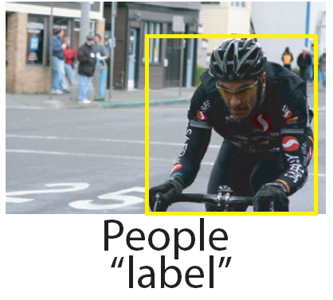
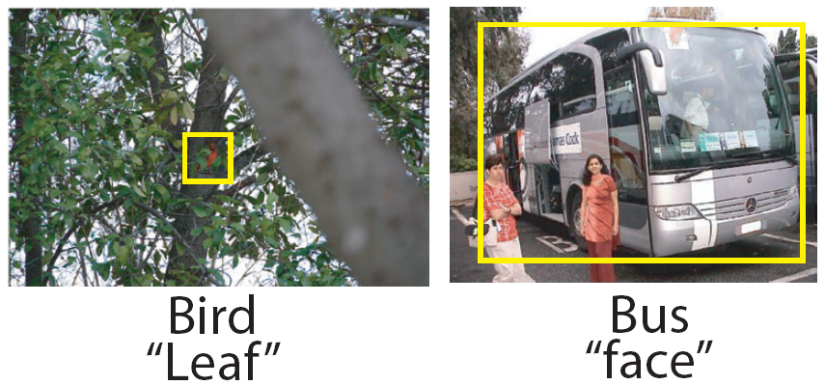
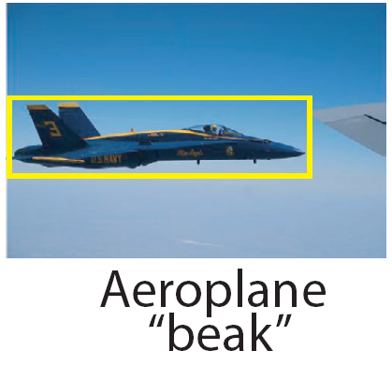
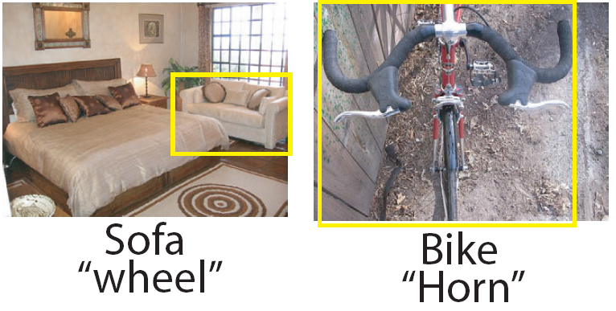
Presence of atypical attributes
951 reports
47% are correct

Slide 50
Presence of atypical attributes
951 reports
47% are correct

Slide 51
How do we know if we learn what we intend?
Dataset biases and natural correlations can create an illusion of a well-learned model.

Slide 52
Feature selection improves classifier semantics
Learning from textual description:
  Selected features: 32.5%
  Whole features: 25.2%
Absence of typical attributes:
  Selected features: 68.2%
  Whole features: 54.8%
Presence of atypical attributes:
  Selected features: 47.3%
  Whole features: 24.5%

Slide 53
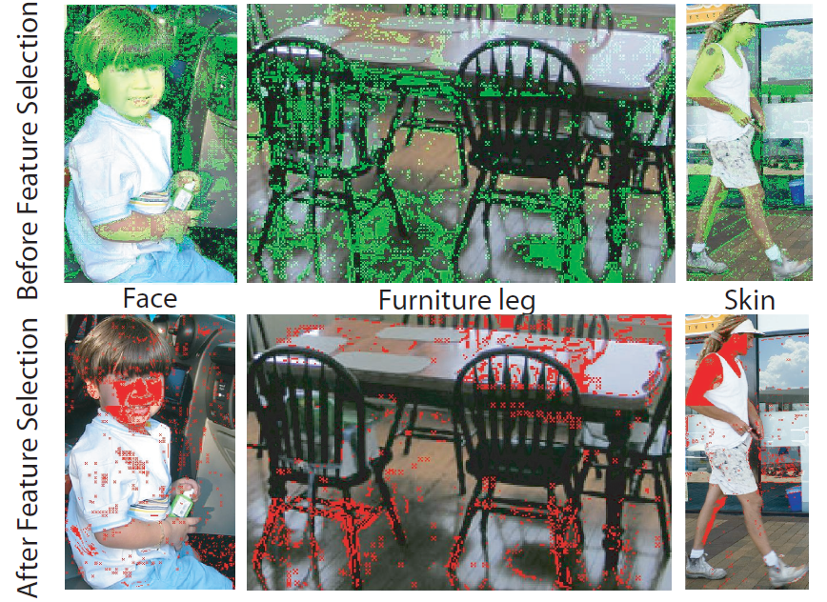
Attribute Localization

Slide 54
Unusual attribute localization

Slide 55
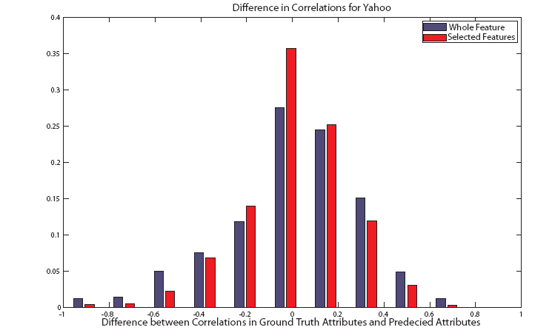
Correlation of Attributes

Slide 56
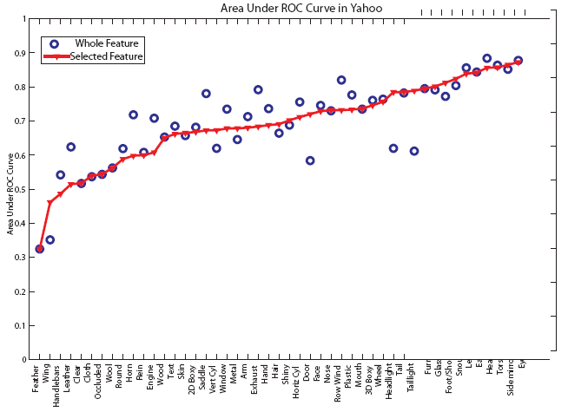
Better semantics does not necessarily lead to higher overall accuracy
Train on 20 PASCAL classes
Test on 12 different Yahoo classes

Slide 57
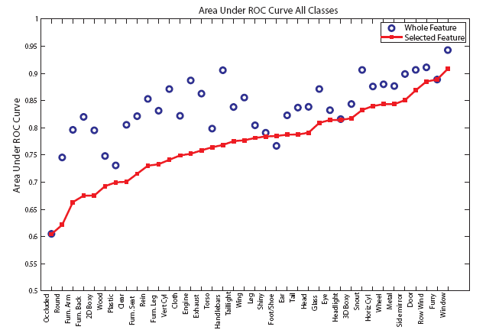
Learning the wrong thing sometimes gives much better numbers
Train and Test on Same Classes from PASCAL

Slide 58
Attribute localization

Slide 59
How to tell if we learn what we intend
Test out of sample
  Train on PASCAL, test on different categories from a different source
Evaluate on an “implied” ability that is not directly learned
  If we really learn an attribute, we should be able to
    localize it
    detect unusual cases of absence/presence
    learn from description
See if it makes reasonable mistakes
  E.g., context increases confusion between similar classes and decreases confusion with background (Divaala et al. 2009)

Slide 60
Future efforts
New dataset
  Many object classes
  More careful and comprehensive set of attributes
  Higher quality training images, some additional supervision
Apply multiple strategies for predicting attributes
Learn by reading and other non-visual sources

Slide 61
Conclusion
Inferring object properties is the central goal of object recognition
  Categorization is a means, not an end
We have shown that a special form of feature selection allows better learning of intended attributes
We have shown that learning properties directly enables several new abilities
  Predict properties of new types of objects
  Specify what is unusual about a familiar object
  Learn from verbal description
Much more to be done

Slide 62
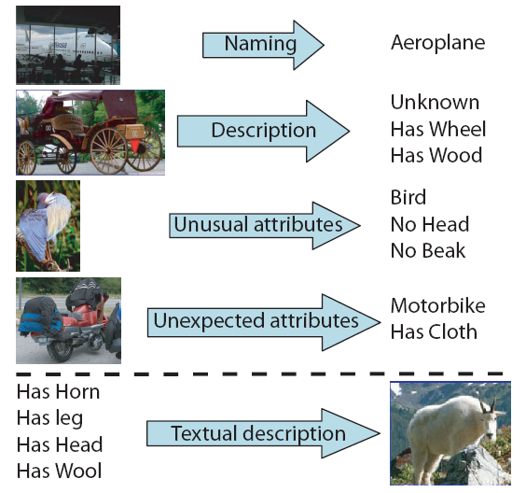
Thank you
A. Farhadi, I. Endres, D. Hoiem, D.A. Forsyth, “Describing Objects by their Attributes”, CVPR 2009

Slide 63
Today – Crowd enabled recognition
Recognizing Object Attributes
Recognizing Scene Attributes

Slide 64
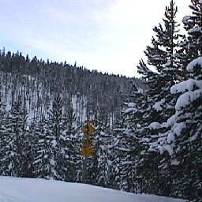
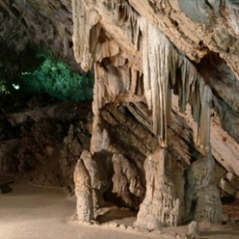
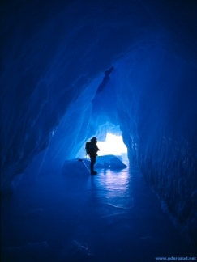
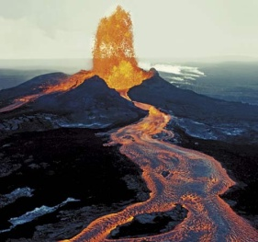
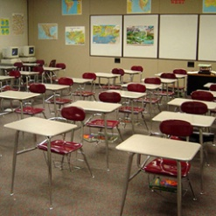
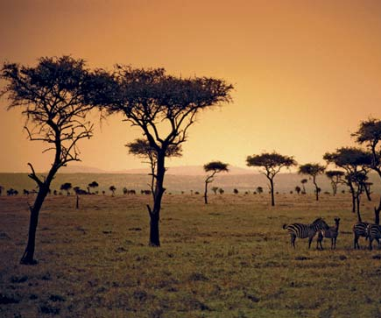
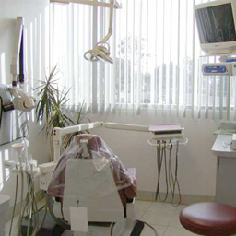
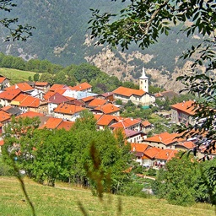

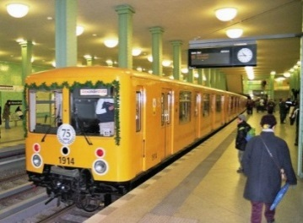
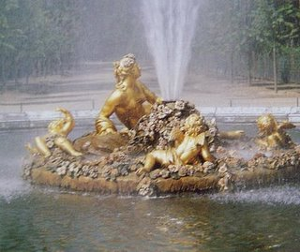





Space of Scenes
Genevieve Patterson and James Hays. CVPR 2012
Notes:
scenes are all photos that aren’t of objects and aren’t abstract.

Slide 65

Space of Scenes
Notes:
We’ve come up with various categories of scenes in this space. Sun database has about 900 categories, so this is just a tiny, random sample

Slide 66




Space of Scenes
Notes:
And you hope that these categories cover the space of scenes, and that for any new photo you can say, oh yes this belongs in category Y.
But it’s actually hard to assign some photos to categories.
Transition between savanna and forest is continuous, based on canopy coverage. True of many, many groups of categories

Slide 67



Space of Scenes
Notes:
Even for scene categories that are completely distinct, that do not lie on a continuum, a single image can depict multiple scene categories. They’re spatially distinct, they’re somewhat independent. But it’s hard to put this image into our categorical taxonomy.

Slide 68

Space of Scenes
?
Notes:
Our taxonomy isn’t necessarily exhaustive, so some scenes (this is a “rehearsal room”) we can’t say anything about.

Slide 69




Space of Scenes
Notes:
and even if we agree that these are all “villages” (and they are in SUN), there is a huge, interesting intra-class variation and it seems unsatisfying to just say “village”

Slide 70
Big Picture
Scenes don’t fit neatly into categories.
  Objects often do!
Categories aren’t expressive enough.
We should reason about scene attributes instead of (or in addition to) scene categories.

Slide 71

Attribute-based Visual Understanding
Learning To Detect Unseen Object Classes by Between-Class Attribute Transfer. Lampert, Nickisch, and Harmeling. CVPR 2009.
Describing Objects by their Attributes.
Farhadi, Endres, Hoiem, Forsyth. CVPR 2009.
Attribute and Simile Classifiers for Face Verification.
Kumar, Berg, Belhumeur, Nayar. ICCV 2009.
Numerous more recent works on activity, texture, 3d models, etc.
Notes:
and I think this type of understanding is even more appropriate for scenes

Slide 72

Spatial layout: large, enclosed
Affordances / functions: can fly, park, walk
Materials: shiny, black, hard
Object presence: has people, ships
Simile: looks like Star Trek
Emotion: scary, intimidating
Notes:
So what would interesting scene attributes be? Here’s some possible examples of how we could describe a scene by attributes
In this case all global properties. Spatial envelope considered by Antonio, but there are a lot of other important attributes that define a scene.
What makes a good / interesting attribute, though?

Slide 73
Space of Scenes
Notes:
emphasize: even though I’ve said scenes don’t fit neatly in to categories, huge categorical databases like the SUN db definitely give us a great diversity of scenes, a great sampling of the space. I think one measure of a good attribute is whether it divides this space.

Slide 74

Space of Scenes
Notes:
good attributes are discriminative

Slide 75

Space of Scenes
Notes:
emphasize: not a strict hierarchy / tree.

Slide 76

Space of Scenes
Notes:
affordance / function attribute.

Slide 77


Space of Scenes
Notes:
material attribute.
emphasize: goal is not to recover categories. Maybe you could, but probably best to directly classify in to categories if that’s your goal.
emphasize: there can, of course, be a lot of variance for certain attributes within a category. Maybe half of canyons are dry and maybe half have water.
emphasize: while for any given query, some attributes can be ambiguous, (just like scene boundaries were), most of them won’t be. It may be unclear if an enclosed restaurant patio is indoors our outdoors, but we can say it is a place for eating. Fails more gracefully.

Slide 78

Which Scene Attributes are Relevant?
Inspired by the “splitting” task of Oliva and Torralba and “ESP game” by von Ahn and Blum.

Slide 79

102 Scene Attributes

Slide 80

Notes:
Describe setting up DB
Describe design of interface, improvements planned
80

Slide 81

SUN Attributes: A Large-Scale
Database of Scene Attributes
http://www.cs.brown.edu/~gen/sunattributes.html
Global, binary attributes describing:
Affordances / Functions (e.g. farming, eating)
Materials (e.g. carpet, running water)
Surface Properties (e.g. aged, sterile)
Spatial Envelope (e.g. enclosed, symmetrical)
Statistics of database:
14,340 images from 717 scene categories
102 attributes
4 million+ labels
good workers ~92% accurate
pre-trained classifiers for download
Space of Scenes
Organized by Attributes
Notes:
key point – we’re augmenting the recent, categorical SUN database with attributes.
Larger scale than most (all?) attribute databases. Crowdsourced. Variety of types of attributes.

Slide 82


Slide 83

102 dimensional attribute space reduced to 2d with t-SNE

Slide 84

Enclosed Area

Slide 85

Open Area

Slide 86

Transport

Slide 87



Sailing

Slide 88

Instances of the “15 Scene” Categories

Slide 89

Average Precision of Attribute Classifiers

Slide 90

Average Precision of Attribute Classifiers
Notes:
Redo this

Slide 91

Attribute Recognition

Slide 92

Most Confident Classifications

Slide 93
Most Confident Classifications

Slide 94
Recap: Attributes and Crowdsourcing
If you can only get one label per instance, maybe a categorical label is the most informative.
But now that crowdsourcing exists, we can get enough training data to simultaneously reason about a multitude of object / scene properties (e.g. attributes).
In general, there is a broadening of interesting recognition tasks.
Zero-shot learning: model category with an attribute distribution only.

