Slide 1
Project 5 steps
Train a face-like classifier
  How to sample negative training data?
Test classifier at a single scale
Add non-maximum suppression
Test classifier at multiple scales
  One call to non maximum suppression per image.

Slide 2
Data Sets and Crowdsourcing
Or: My grad students are starting to hate me, but it looks like we need more training data.
Computer Vision
James Hays

Slide 3
Outline
Data collection with experts – PASCAL VOC
Annotation with non-experts
  ESP Game
  Mechanical Turk
Human-in-the-loop Recognition
  Visipedia

Slide 4
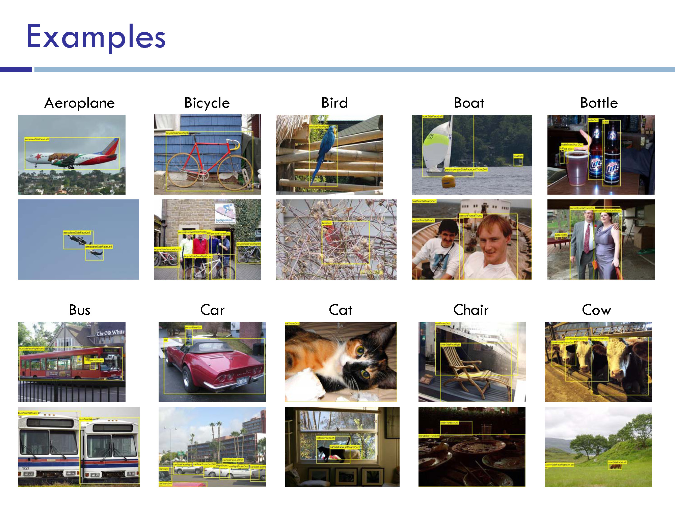

Slide 5
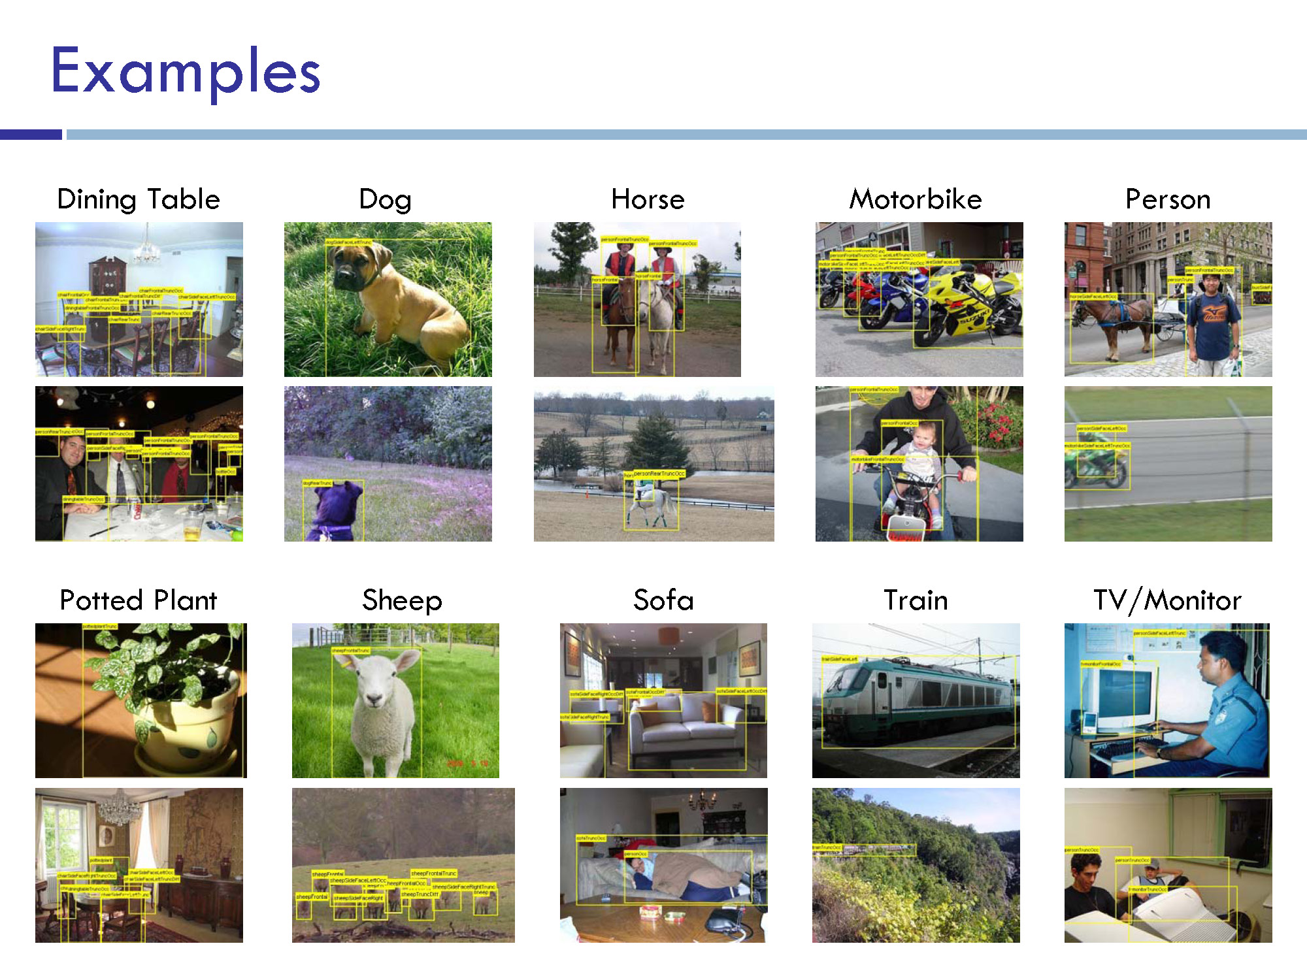

Slide 6
Outline
Data collection with experts – PASCAL VOC
Annotation with non-experts
  LabelMe – no incentive (altruism, perhaps)
  ESP Game – fun incentive (not fun enough?)
  Mechanical Turk – financial incentive
Human-in-the-loop Recognition
  Visipedia

Slide 7
LabelMe
http://labelme.csail.mit.edu
“Open world” database annotated by the community*
Notes on Image Annotation, Barriuso and Torralba 2012. http://arxiv.org/abs/1210.3448

Slide 8
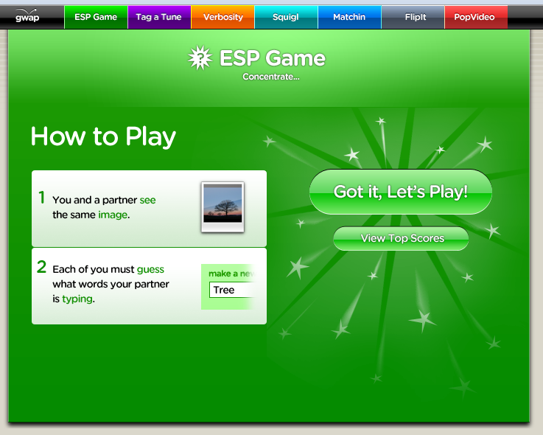
Luis von Ahn and Laura Dabbish. Labeling Images with a Computer Game. ACM Conf. on Human Factors in Computing Systems, CHI 2004

Slide 9
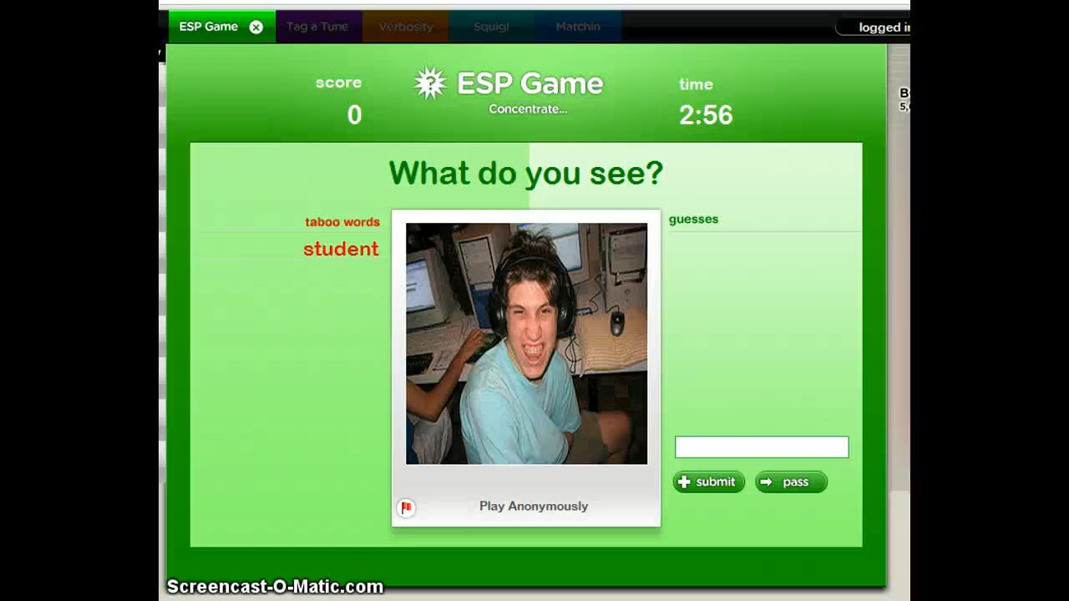

Slide 10
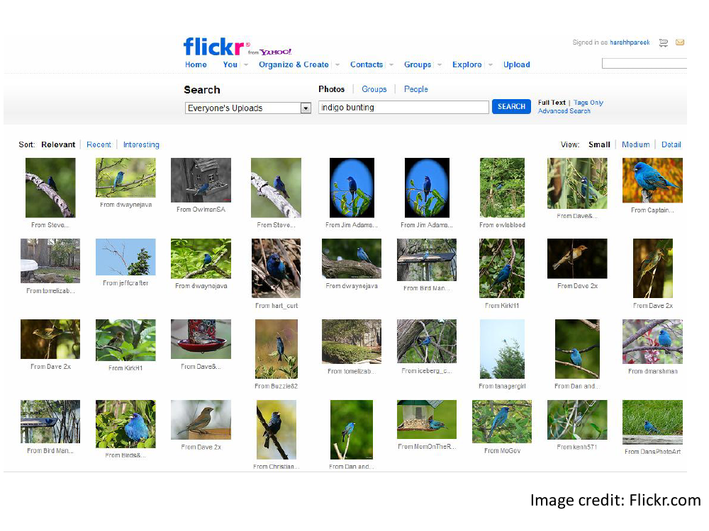

Slide 11
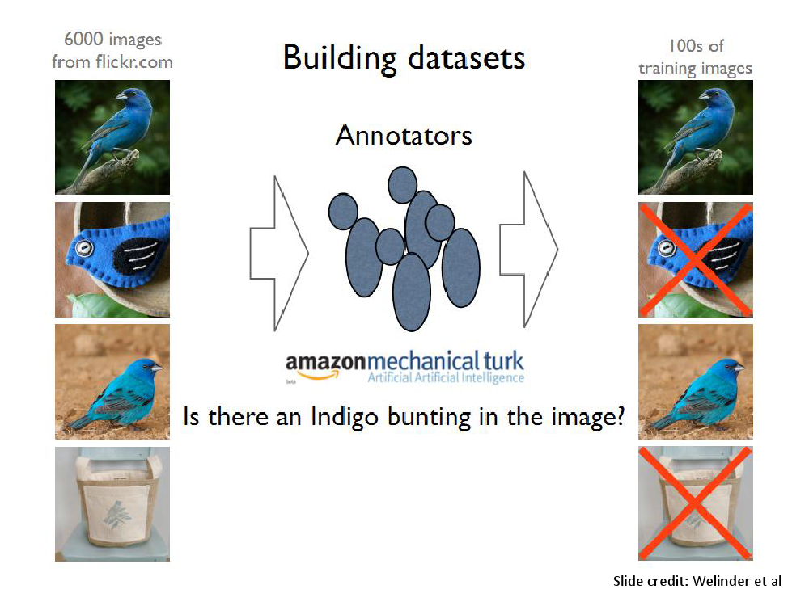

Slide 12
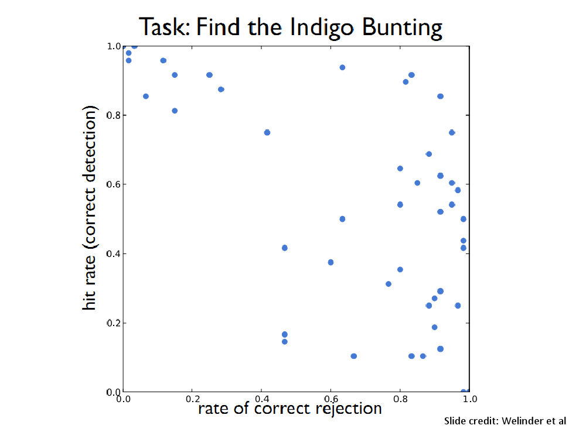

Slide 13
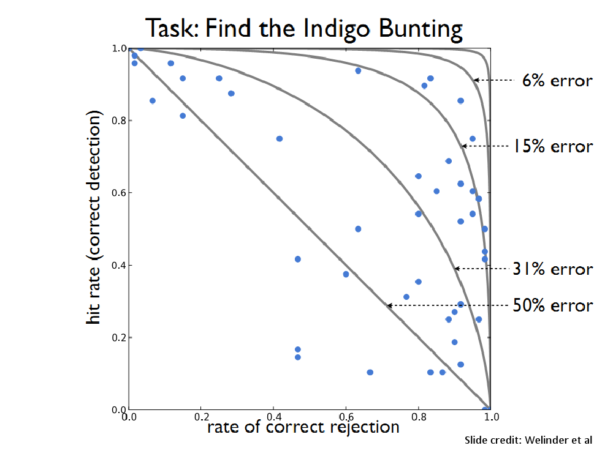

Slide 14
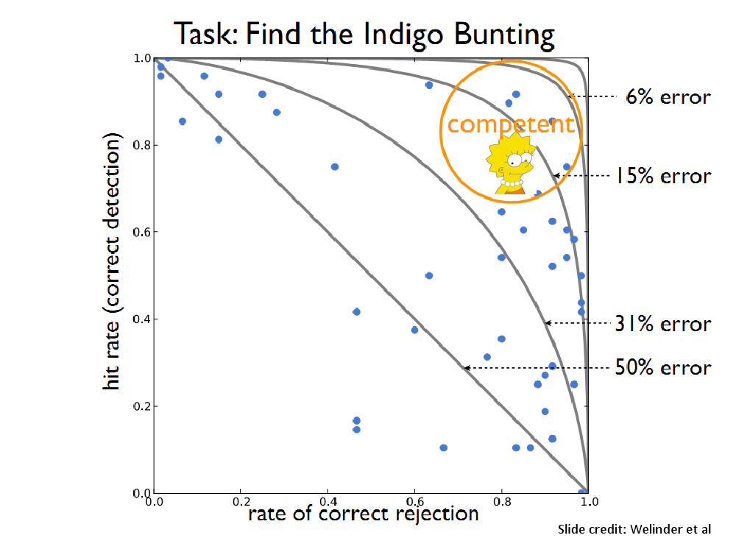

Slide 15
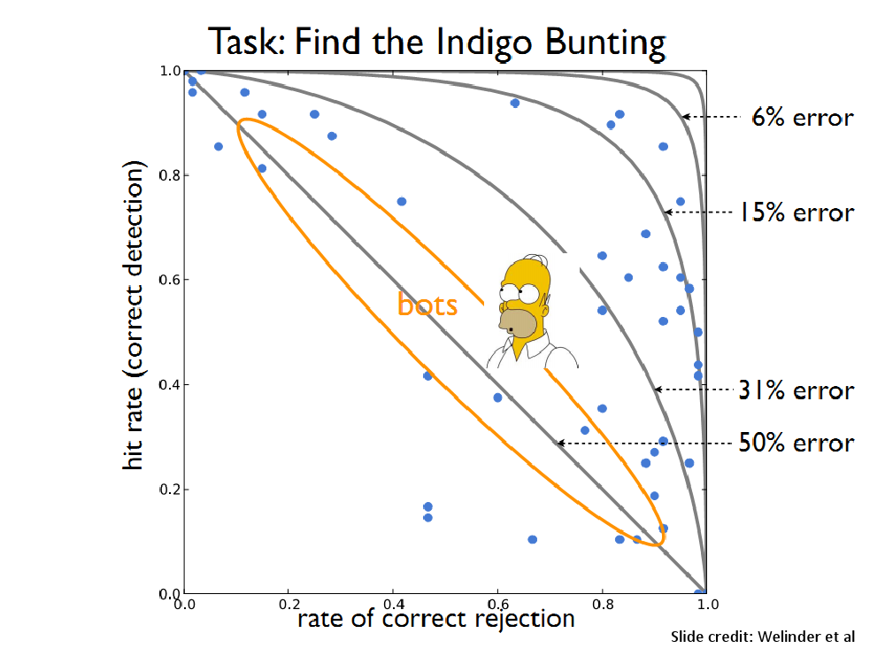

Slide 16
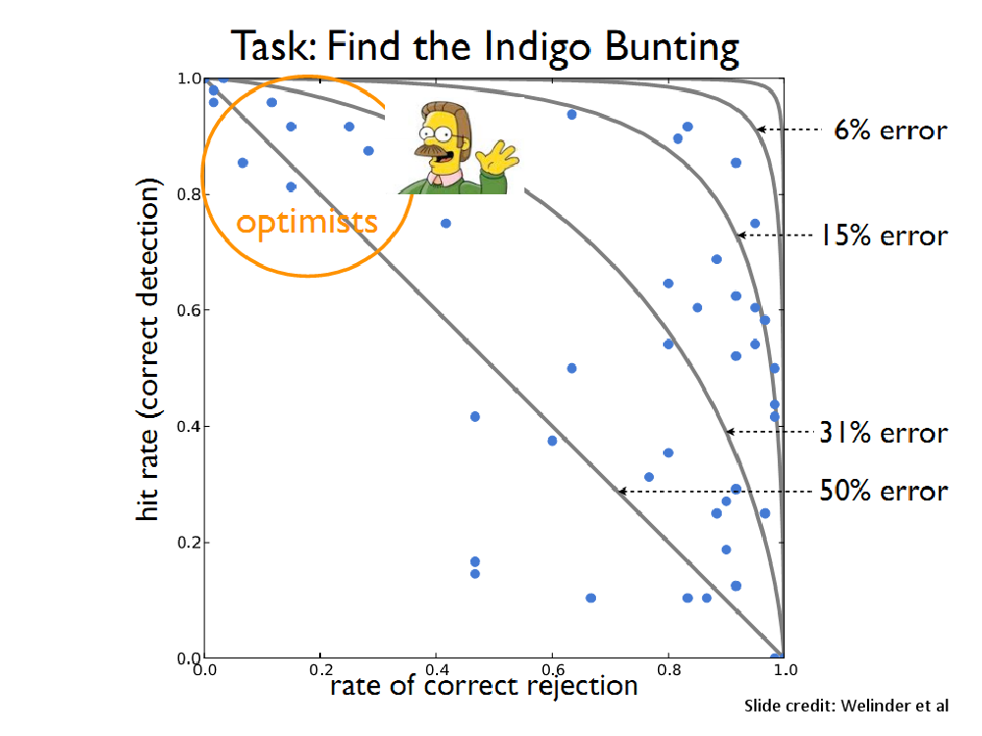

Slide 17
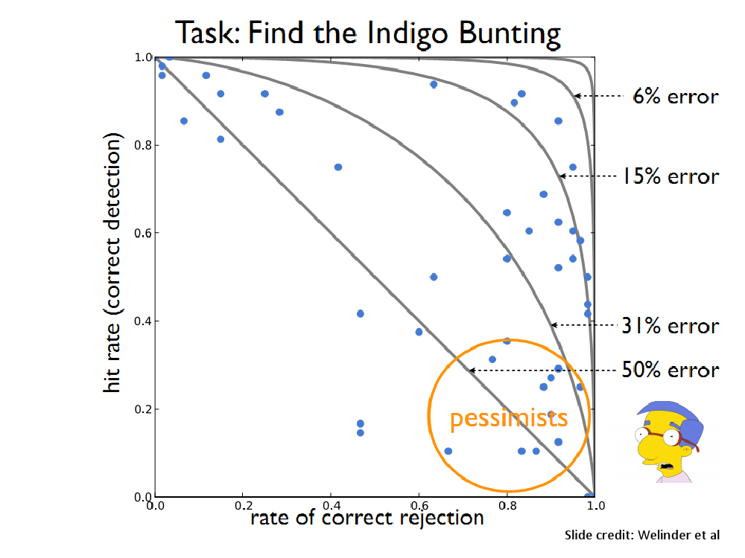

Slide 18
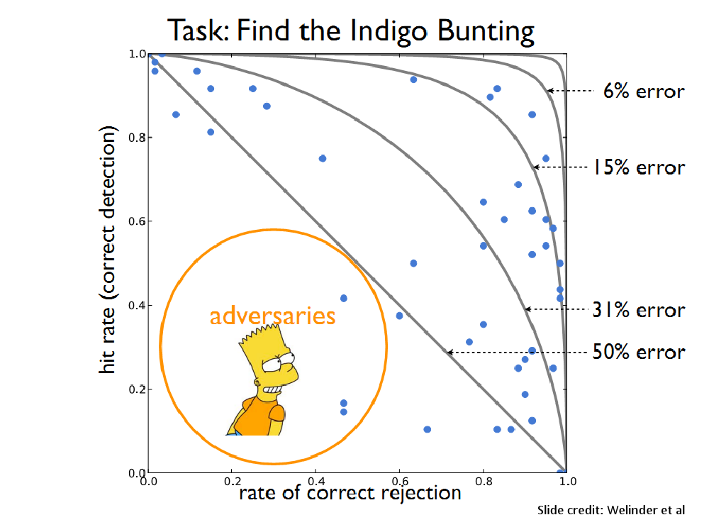

Slide 19
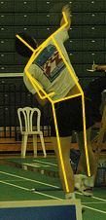
Utility data annotation via Amazon Mechanical Turk
X 100 000 = $5000
Alexander Sorokin
David Forsyth
CVPR Workshops 2008
Slides by Alexander Sorokin

Slide 20
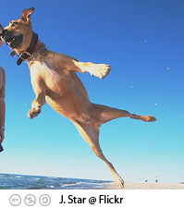
Amazon Mechanical Turk
Workers
Task
Task: Dog?
Broker
Answer: Yes
Pay: $0.01
Is this a dog?
o Yes
o No
www.mturk.com
$0.01

Slide 21
Annotation protocols
Type keywords
Select relevant images
Click on landmarks
Outline something
Detect features
  ……….. anything else ………

Slide 22
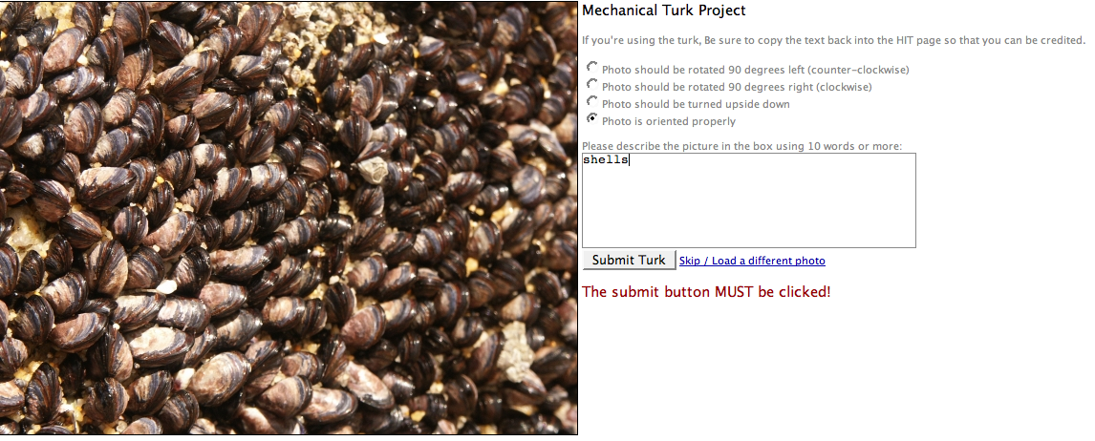
Type keywords
$0.01
http://austinsmoke.com/turk/.

Slide 23
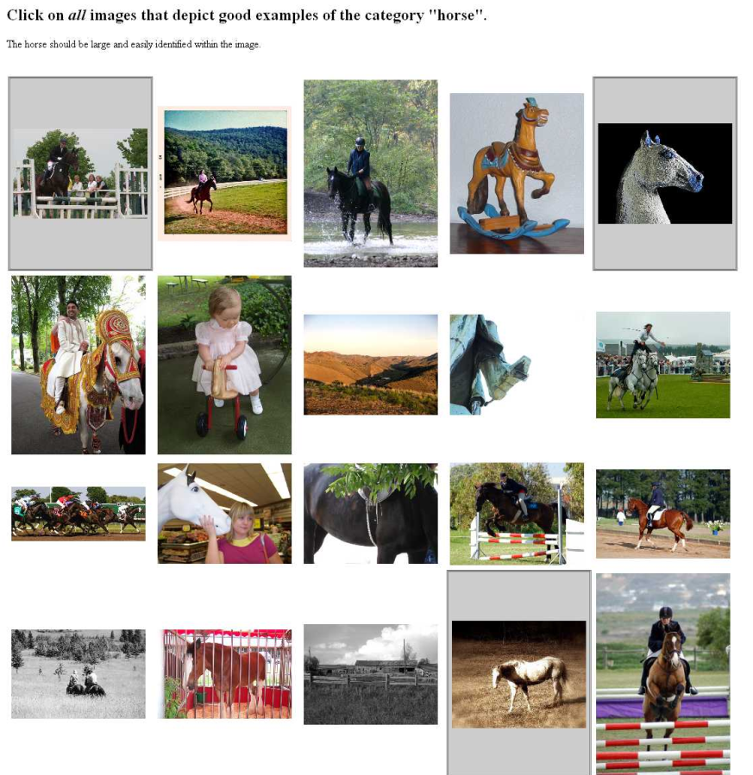
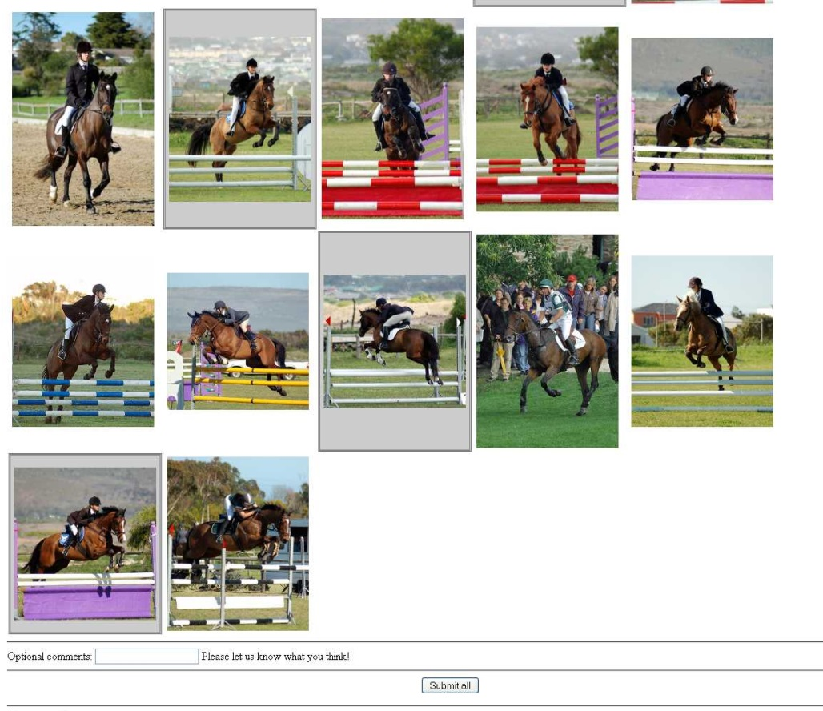
Select examples
Joint work with Tamara and Alex Berg
http://visionpc.cs.uiuc.edu/~largescale/data/simpleevaluation/html/horse.html
Notes:
Select relevant examples
Joint work with
The user clicks on relevant images.

Slide 24
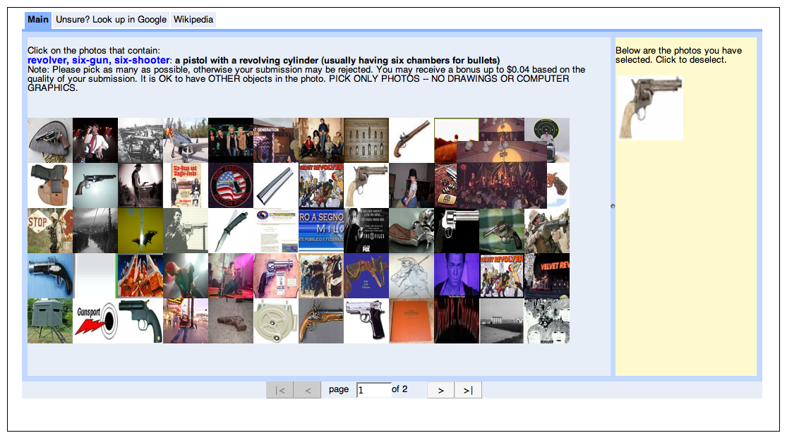
Select examples
$0.02
requester mtlabel

Slide 25
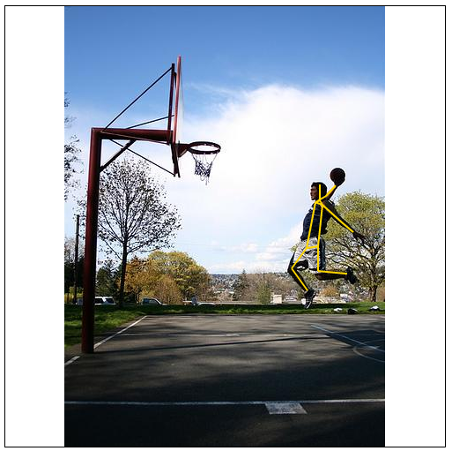
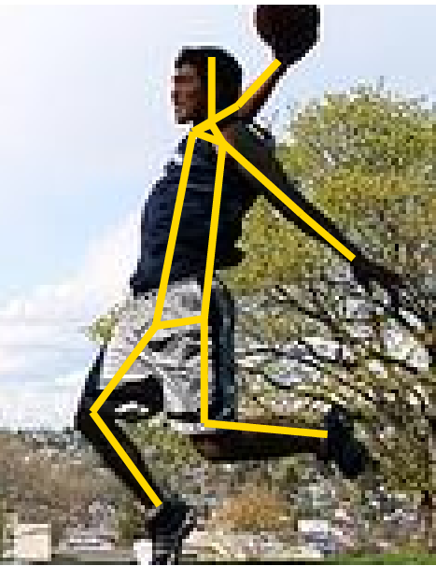
Click on landmarks
$0.01
http://vision-app1.cs.uiuc.edu/mt/results/people14-batch11/p7/

Slide 26
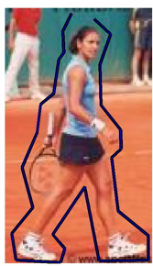
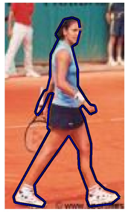
Outline something
$0.01
http://visionpc.cs.uiuc.edu/~largescale/results/production-3-2/results_page_013.html
Data from Ramanan NIPS06

Slide 27
Motivation
X 100 000 = $5000
Custom
annotations
Large scale
Low price

Slide 28
Issues
Quality?
  How good is it?
  How to be sure?
Price?
  How to price it?

Slide 29
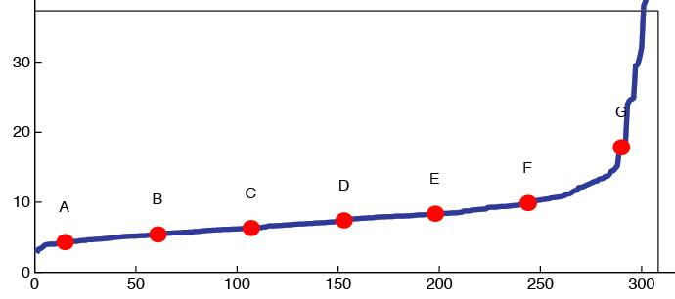
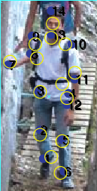
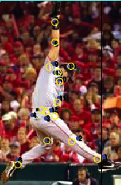
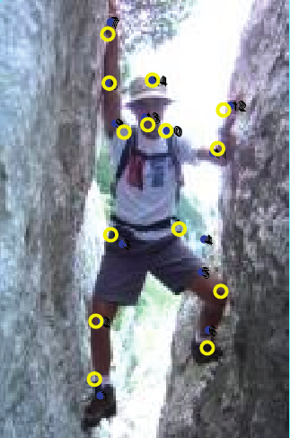
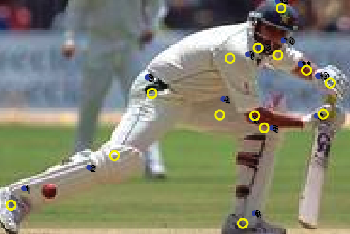
Annotation quality
Agree within 5-10 pixels
on 500x500 screen
There are bad ones.
A
C
E
G
Notes:
Tense - present

Slide 30
How do we get quality annotations?

Slide 31

Ensuring Annotation Quality
Consensus / Multiple Annotation /
“Wisdom of the Crowds”
Gold Standard / Sentinel
  Special case: qualification exam
Grading Tasks
  A second tier of workers who grade others
Not enough on its own, but widely used
Widely used and most important. Find good annotators and keep them honest.
Not widely used

Slide 32
Pricing
Trade off between throughput and cost
  NOT as much of a trade off with quality
Higher pay can actually attract scammers

Slide 33
Outline
Data collection with experts – PASCAL VOC
Annotation with non-experts
  LabelMe
  ESP Game
  Mechanical Turk
Human-in-the-loop Recognition
  Visipedia

Slide 34
Visual Recognition with Humans in the Loop
Steve Branson, Catherine Wah, Florian Schroff, Boris Babenko, Peter Welinder, Pietro Perona, Serge Belongie
Part of the Visipedia project
Slides from Brian O’Neil

Slide 35
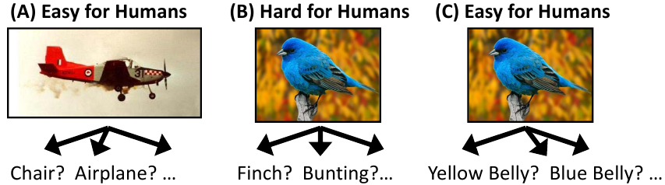
Introduction:
Computers starting to get good at this.
If it’s hard for humans, it’s probably too hard for computers.
Semantic feature extraction difficult for computers.
Combine strengths to solve this problem.
Notes:
Visual recognition approaches typically tackle (A): Fully autonomous recognition on relatively easy datsets.
(B) Is hard for non-expert humans. Also difficult for computers: State of the art 28-45% on fine-scale data.
(C) Human capacity to extract salient visual features is amazing and natural.

Slide 36
The Approach: What is progress?
Supplement visual recognition with the human capacity for visual feature extraction to tackle difficult (fine-grained) recognition problems.
Typical progress is viewed as increasing data difficulty while maintaining full autonomy
Here, the authors view progress as reduction in human effort on difficult data.

Slide 37
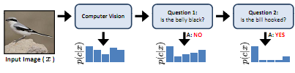
The Approach: 20 Questions
Ask the user a series of discriminative visual questions to make the classification.

Slide 38
Which 20 questions?
At each step, exploit the image itself and the user response history to select the most informative question to ask next.
No
Image x
Ask user a question
Stop?
Yes

Slide 39
Which question to ask?
The question that will reduce entropy the most, taking into consideration the computer vision classifier confidences for each category.

Slide 40
Some definitions:
Set of possible questions
Possible answers to question i
Possible confidence in answer i (Guessing, Probably, Definitely)
User response
History of user responses at time t

Slide 41
Question selection
Seek the question that gives the maximum information gain (entropy reduction) given the image and the set of previous user responses.
Probability of obtaining
Response u_{i} given the image
And response history
Entropy when response is
Added to history
Entropy before response
is added.
where

Slide 42
Incorporating vision
Bayes Rule
A visual recognition algorithm outputs a probability distribution across all classes that is used as the prior.
A posterior probability is then computed based on the probability of obtaining a particular response history given each class.

Slide 43
Modeling user responses
Assume that the questions are answered independently.
Required for posterior computation
Required for information gain
computation

Slide 44
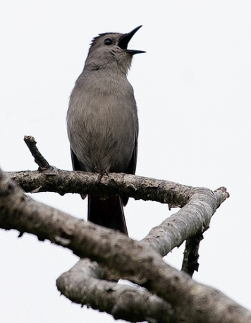
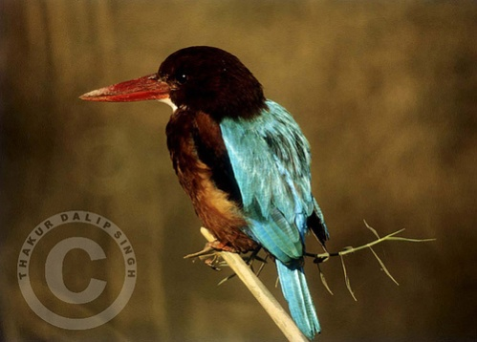
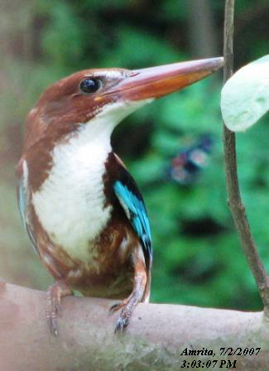
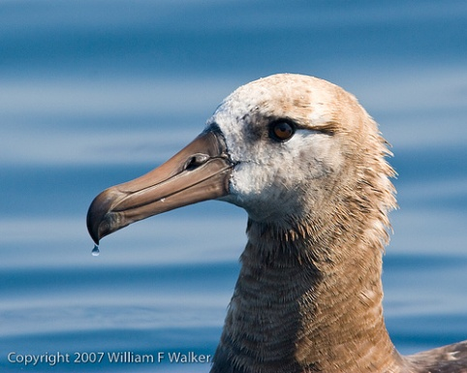
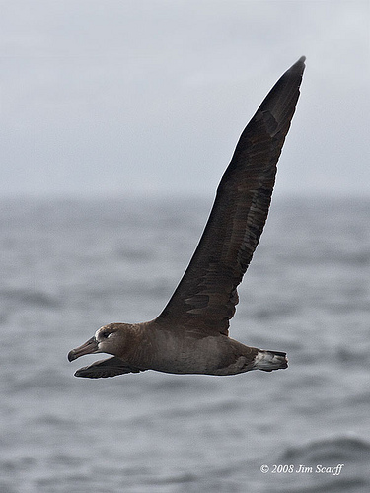
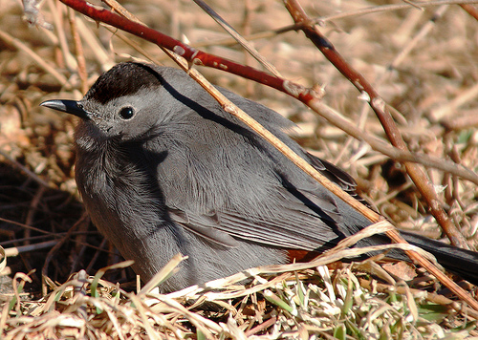
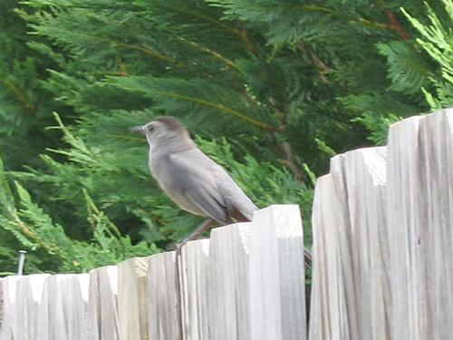
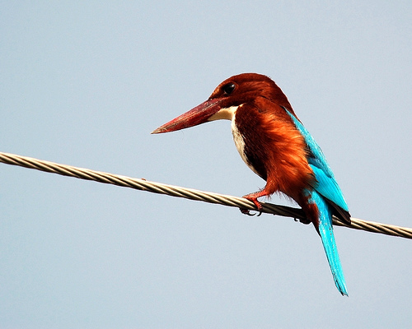
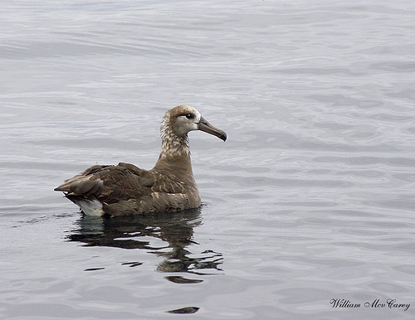
The Dataset: Birds-200
6033 images of 200 species

Slide 45

Implementation
Assembled 25 visual questions encompassing 288 visual attributes extracted from www.whatbird.com
Mechanical Turk users asked to answer questions and provide confidence scores.

Slide 46
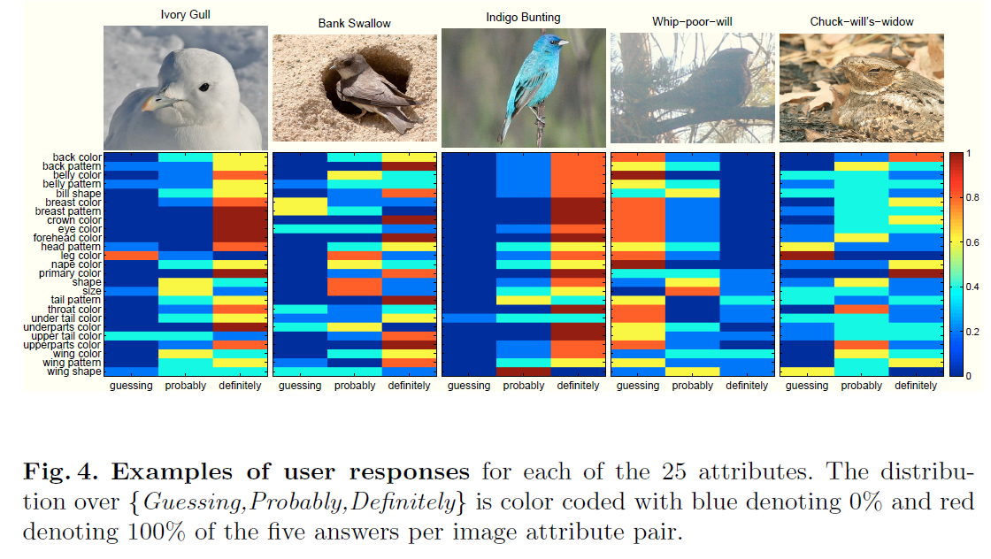
User Responses.

Slide 47
Visual recognition
Any vision system that can output a probability distribution across classes will work.
Authors used Andrea Vedaldis’s code.
  Color/gray SIFT
  VQ geometric blur
  1 v All SVM
Authors added full image color histograms and VQ color histograms

Slide 48
Experiments
No
Image x
Ask user a question
Stop?
Yes
2 Stop criteria:
  Fixed number of questions – evaluate accuacy
  User stops when bird identified – measure number of questions required.
Notes:
Assume people are perfect verifiers

Slide 49
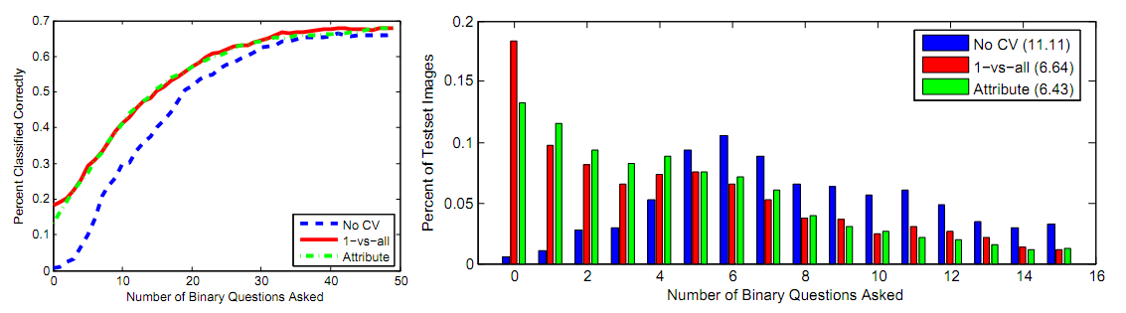
Results
Average number of questions to make ID reduced from 11.11 to 6.43
Method allows CV to handle the easy cases, consulting with users only on the more difficult cases.

Slide 50
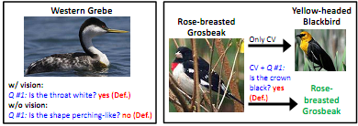
Results
Vision allows the questions to be salient right away.
User input can correct gross errors from CV

Slide 51
Key Observations
Visual recognition reduces labor over a pure “20 Q” approach.
Visual recognition improves performance over a pure “20 Q” approach. (69% vs 66%)
User input dramatically improves recognition results. (66% vs 19%)

Slide 52
Strengths and weaknesses
Handles very difficult data and yields excellent results.
Plug-and-play with many recognition algorithms.
Requires significant user assistance
Reported results assume humans are perfect verifiers
Is the reduction from 11 questions to 6 really that significant?

Slide 53
Next lecture(s)
Human-in-the-loop
Attributes
More crowdsourcing (ImageNet, MS COCO)

