Slide 1
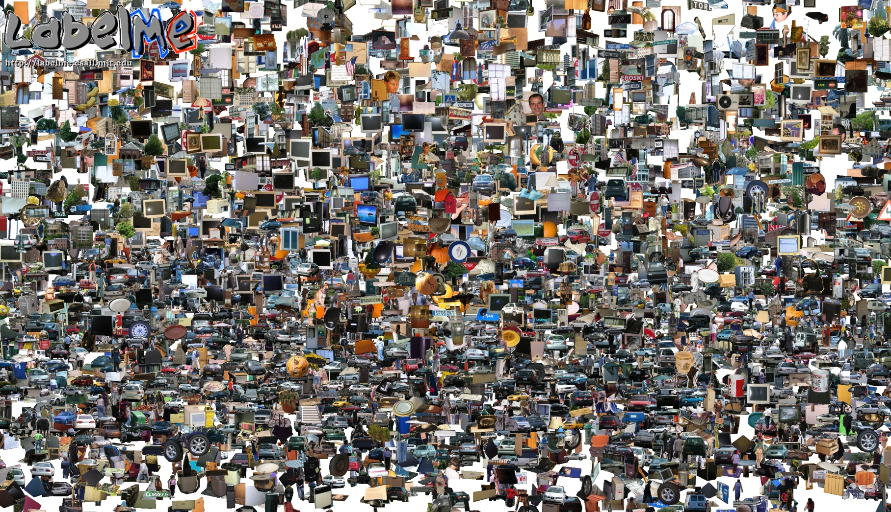
Opportunities of Scale, Part 2
Computer Vision
James Hays
Many slides from James Hays, Alyosha Efros, and Derek Hoiem
Graphic from Antonio Torralba

Slide 2
Recap
Opportunities of Scale: Data-driven methods
Previous Lecture
  The unreasonable effectiveness of data
  Scene completion
Today
  Im2gps
  Recognition via Tiny Images
Project 5 Intro

Slide 3
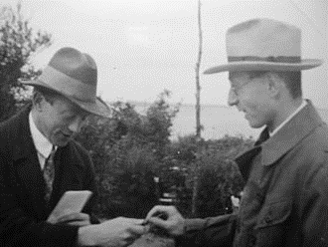
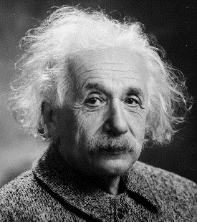
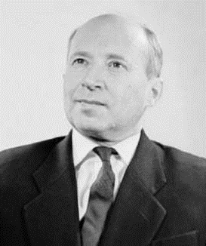
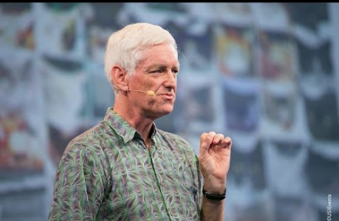
The Unreasonable Effectiveness of Math
“The miracle of the appropriateness of the language of mathematics…” Eugene Wigner
“The most incomprehensible thing about the universe is that it is comprehensible.” Albert Einstein
“There is only one thing which is more unreasonable than the unreasonable effectiveness of mathematics in physics, and this is the unreasonable ineffectiveness of mathematics in biology.” Israel Gelfand
“We should stop acting as if our goal is to author extremely elegant theories, and instead embrace complexity and make use of the best ally we have: the unreasonable effectiveness of data.” Peter Norvig

Slide 4
General Principal
Huge Dataset
Images
image
matching
Info from Most Similar Images
Input Image
Associated Info
Hopefully, If you have enough images, the dataset will contain very similar images that you can find with simple matching methods.

Slide 5
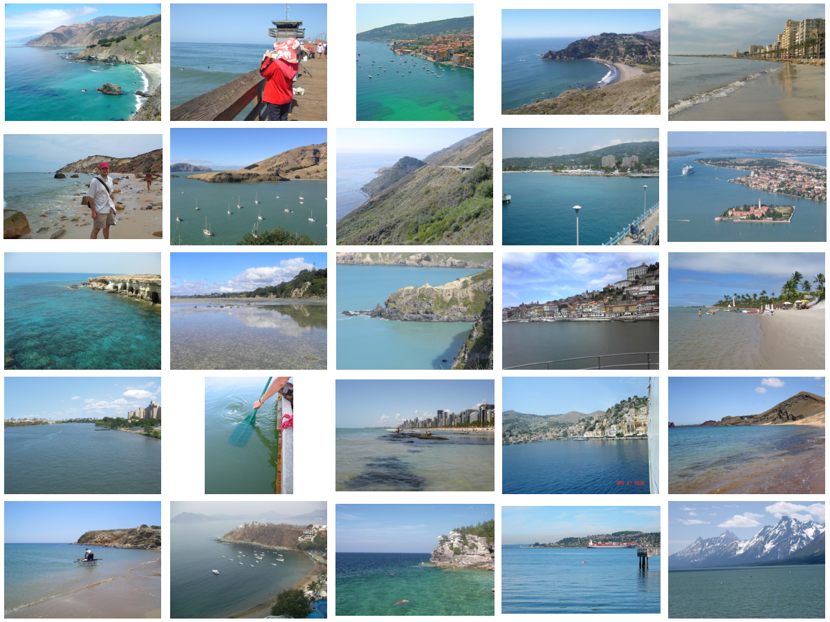
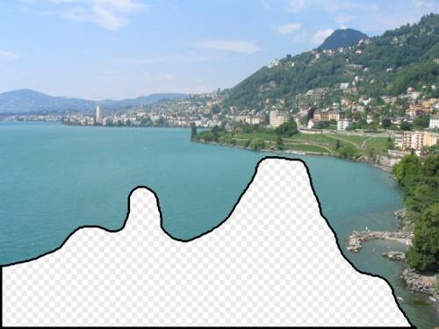
… 200 total
Notes:
5

Slide 6
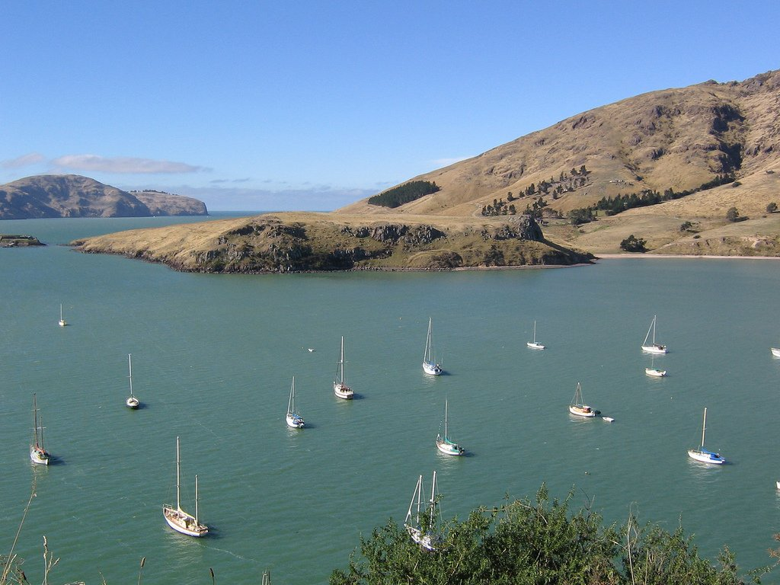
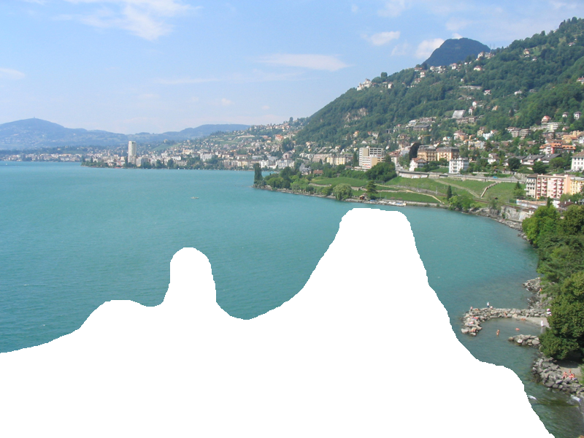
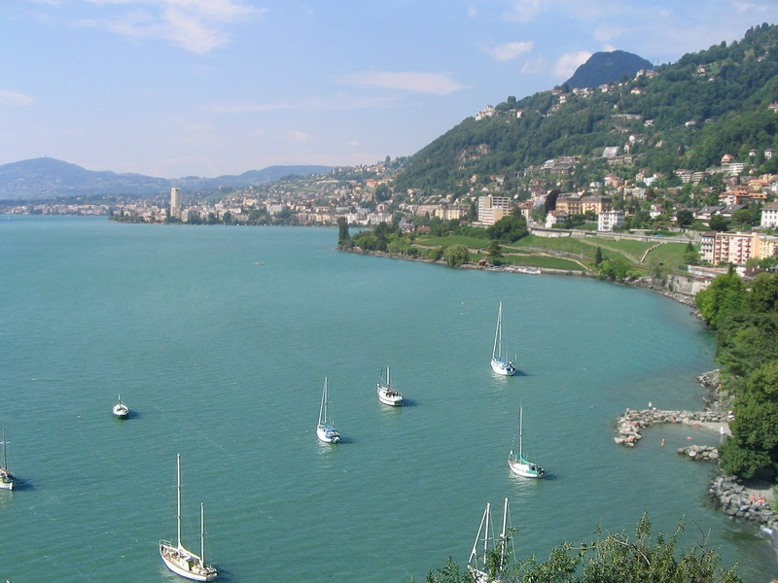
Graph cut + Poisson blending

Slide 7
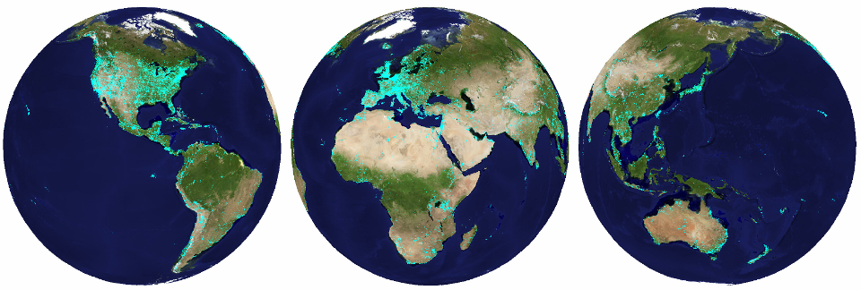
im2gps (Hays & Efros, CVPR 2008)
6 million geo-tagged Flickr images
http://graphics.cs.cmu.edu/projects/im2gps/

Slide 8
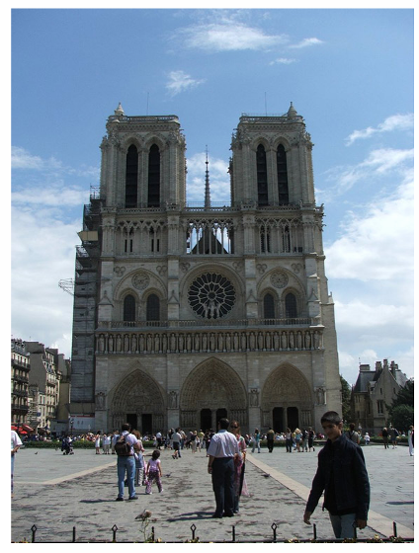
How much can an image tell about its geographic location?

Slide 9
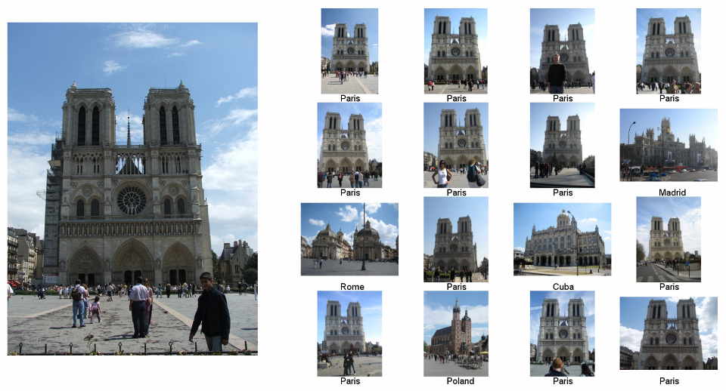
Nearest Neighbors according to gist + bag of SIFT + color histogram + a few others

Slide 10
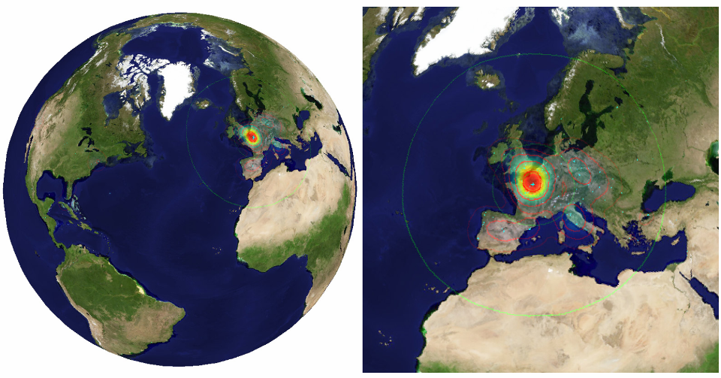

Slide 11
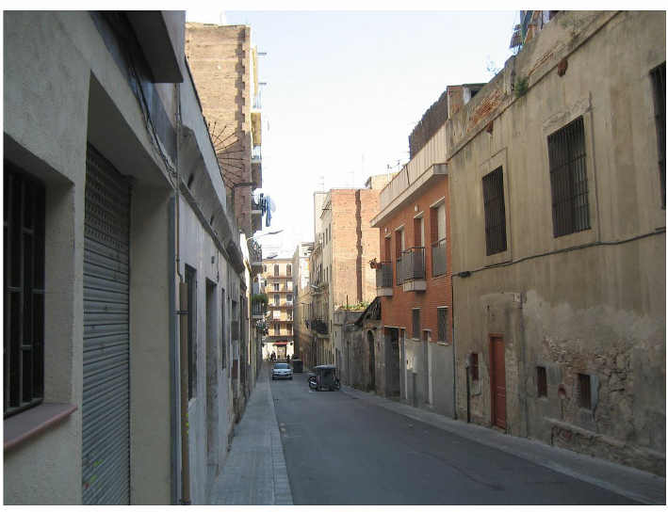
Im2gps

Slide 12
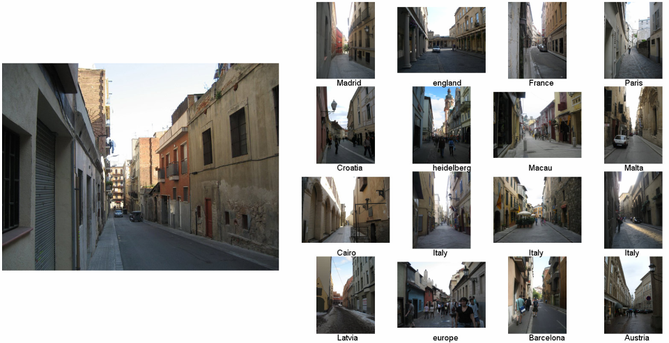
Example Scene Matches

Slide 13
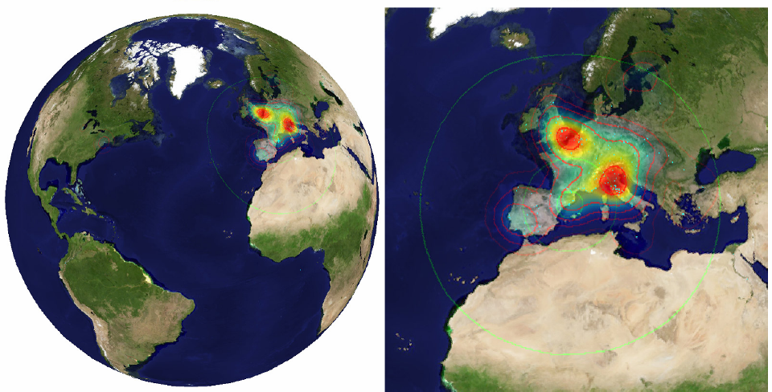
Voting Scheme
Notes:
Probability map for that same image
Explain the green circles and how they relate to evaluation
13

Slide 14
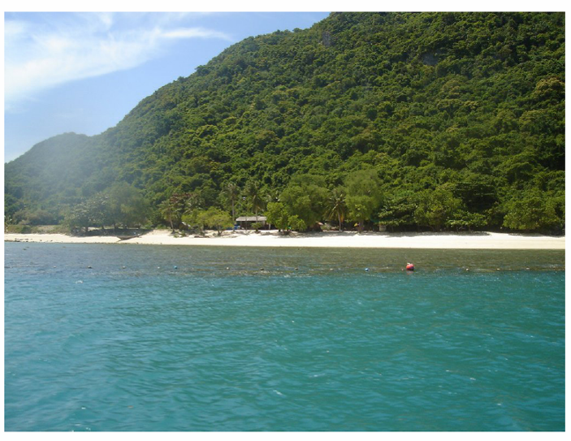
im2gps

Slide 15
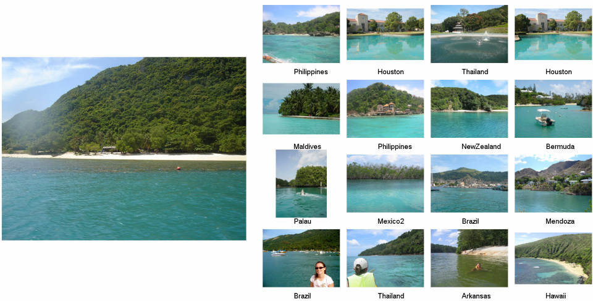

Slide 16
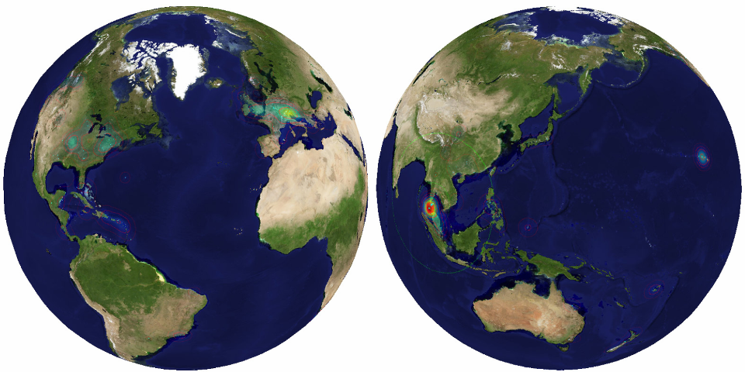

Slide 17
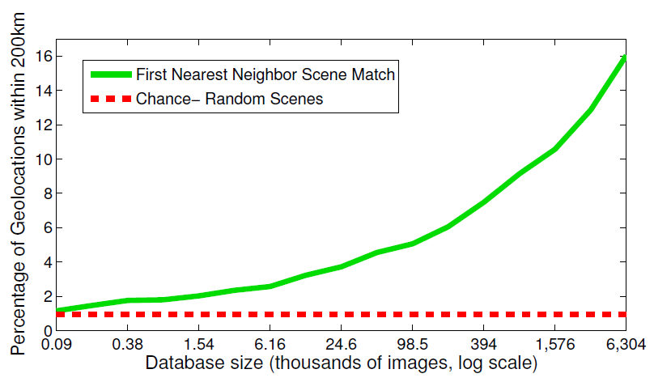
Effect of Dataset Size

Slide 18
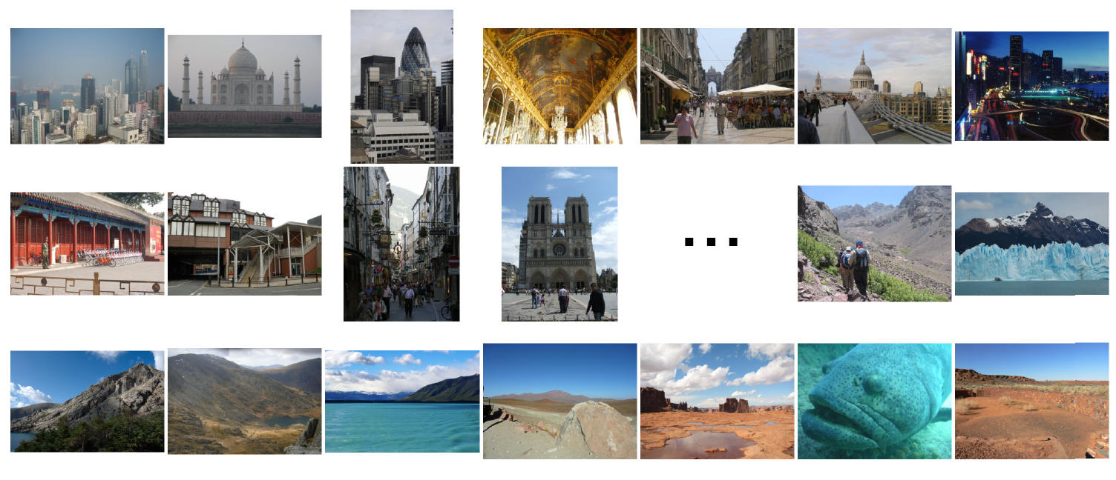
Population density ranking
High Predicted Density
Low Predicted Density

Slide 19
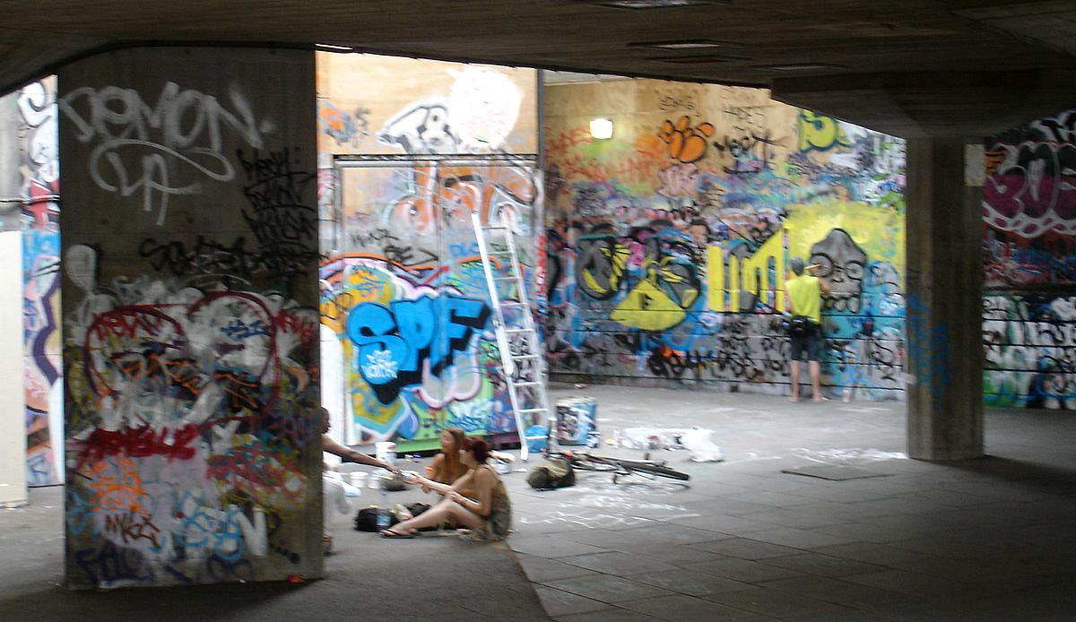
Where is This?
[Olga Vesselova, Vangelis Kalogerakis, Aaron Hertzmann, James Hays, Alexei A. Efros. Image Sequence Geolocation. ICCV’09]
Notes:
19

Slide 20
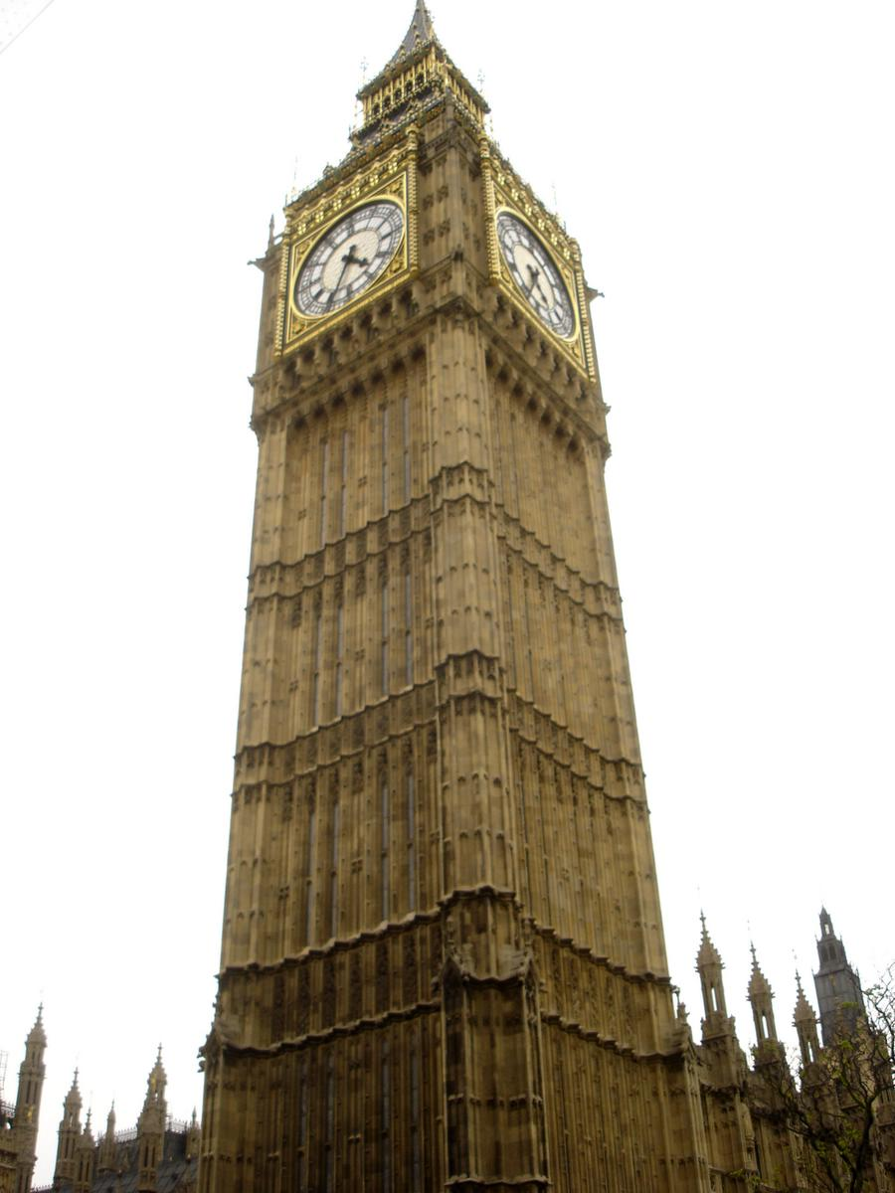
Where is This?

Slide 21


Where are These?
15:14,
June 18th, 2006
16:31,
June 18th, 2006
Notes:
Individually each photograph is 16%, but together they reinforce each other well
21

Slide 22
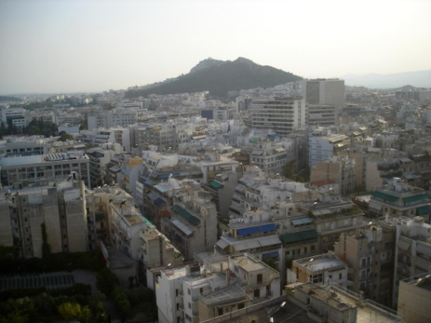
Where are These?
15:14,
June 18th, 2006
16:31,
June 18th, 2006
17:24,
June 19th, 2006
Notes:
If you know that brits love to vacation in greece…
22

Slide 23
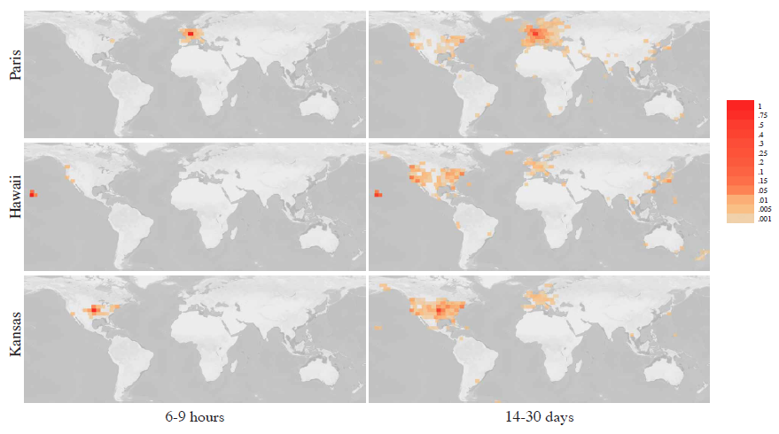
Results
im2gps – 10% (geo-loc within 400 km)
temporal im2gps – 56%

Slide 24
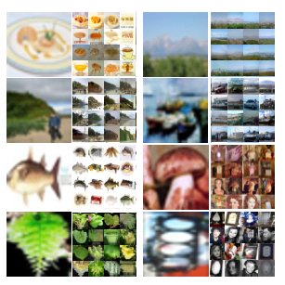
Tiny Images
80 million tiny images: a large dataset for non-parametric object and scene recognition Antonio Torralba, Rob Fergus and William T. Freeman. PAMI 2008.
http://groups.csail.mit.edu/vision/TinyImages/

Slide 25
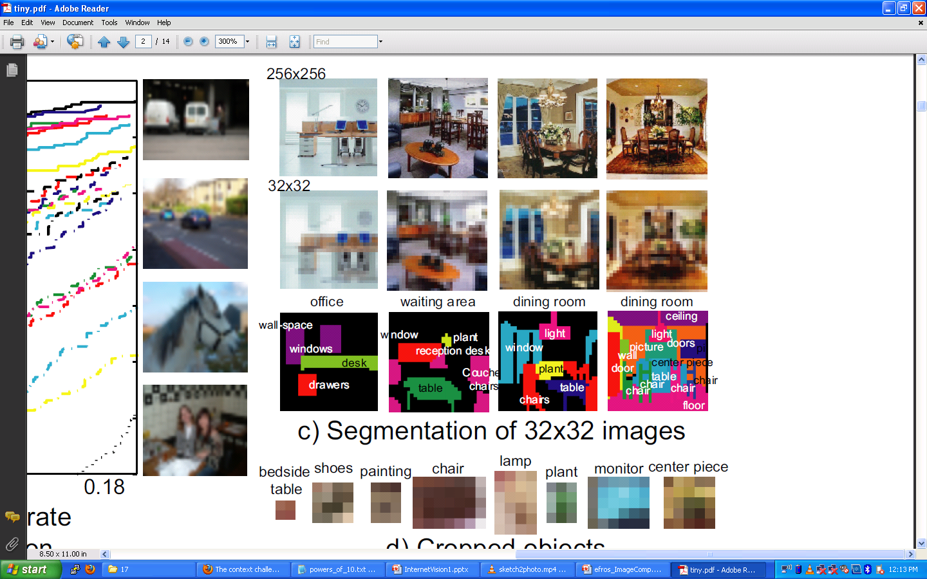

Slide 26
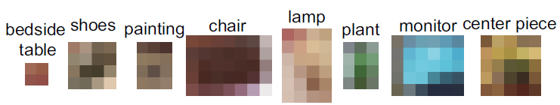

Slide 27
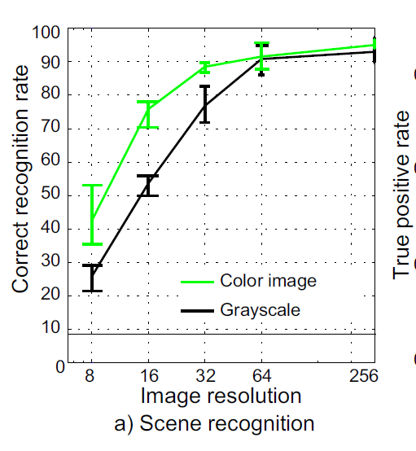
Human Scene Recognition

Slide 28
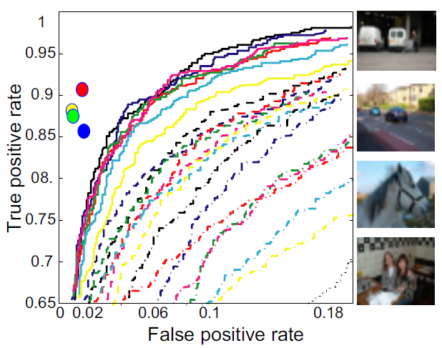
Humans vs. Computers:
Car-Image Classification
Various computer vision algorithms for full resolution images
Humans for 32 pixel tall images

Slide 29
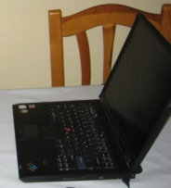
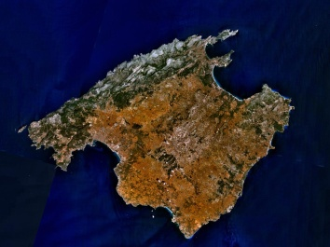
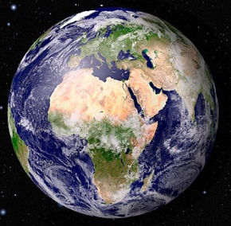
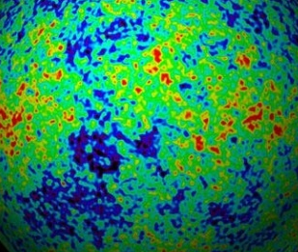
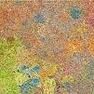
Powers of 10
Number of images on my hard drive: 10⁴
Number of images seen during my first 10 years: 10⁸
(3 images/second * 60 * 60 * 16 * 365 * 10 = 630720000)
Number of images seen by all humanity: 10²⁰
106,456,367,669 humans¹ * 60 years * 3 images/second * 60 * 60 * 16 * 365 =
1 from http://www.prb.org/Articles/2002/HowManyPeopleHaveEverLivedonEarth.aspx
Number of photons in the universe: 10⁸⁸
Number of all 32x32 images: 10⁷³⁷³
256 ^{32*32*3} ~ 10⁷³⁷³
Notes:
so don’t listen to anyone claiming to brute force image space
But most of image space is empty, never observed. If you were to run the rand() command in Matlab, how often would it generate a plausible image?

Slide 30
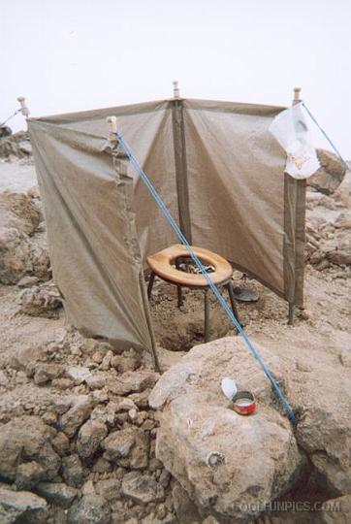
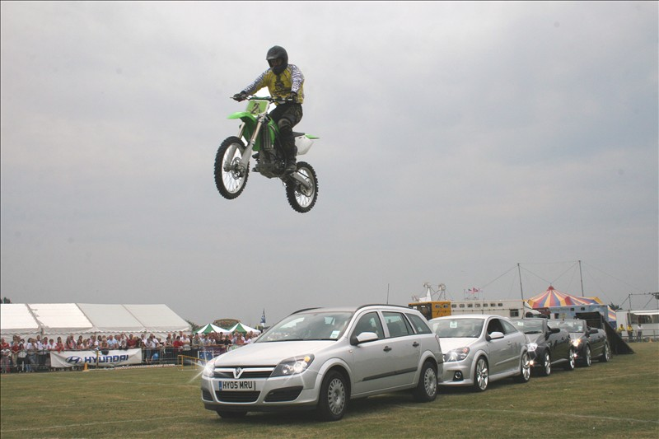
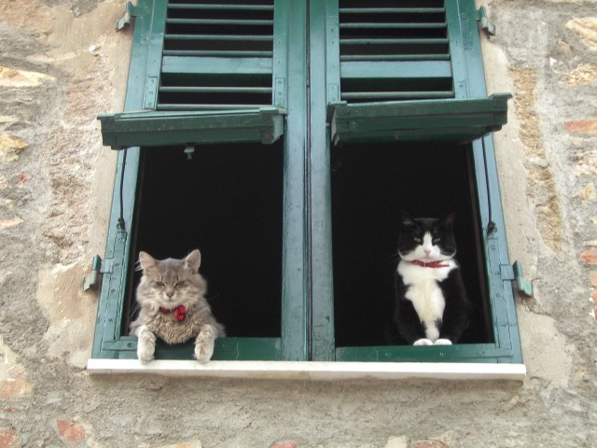
Scenes are unique
Notes:
Scene and object recognition at human performance is very hard because we are able to deal with so many different kinds of scenes…
Scenes are so unique.

Slide 31
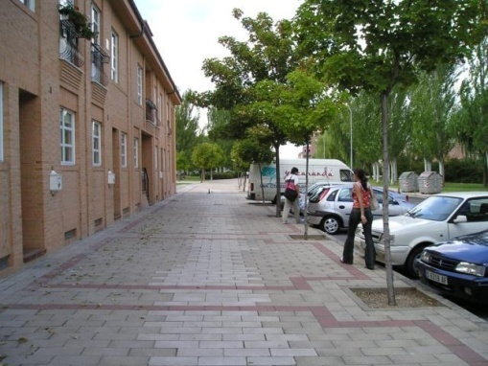
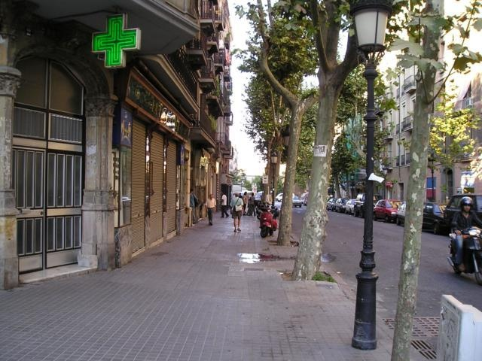
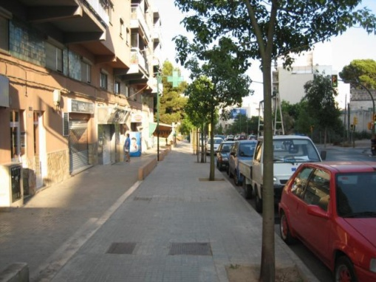
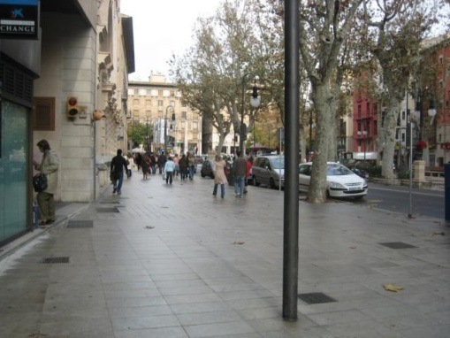
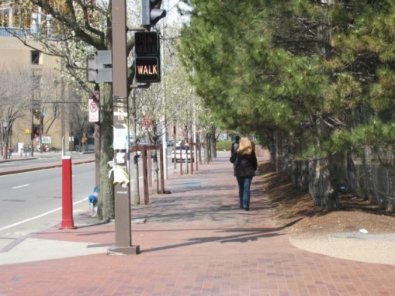
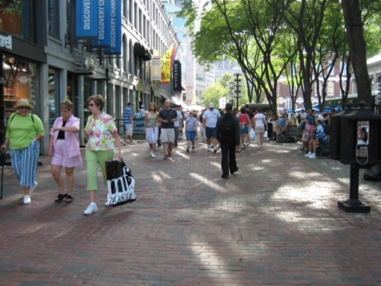
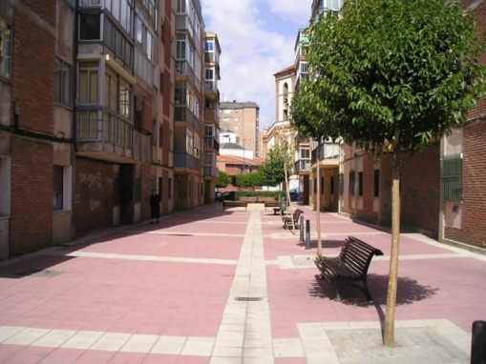
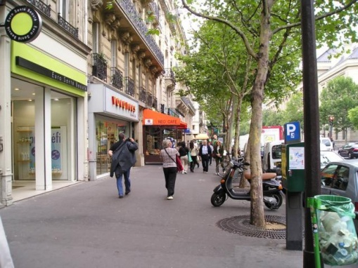
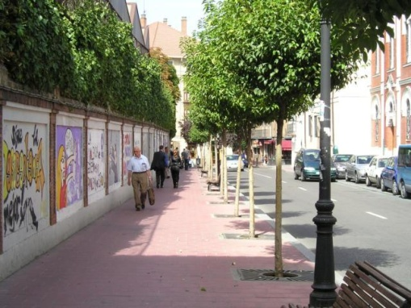
But not all scenes are so original
Notes:
But most scenes are not really like that. Most of the time, scenes are boring places in which nothing really surprising happens. For instance, this street… there is nothing really special about it. In fact, I can easily find thousands of other street pictures that look just like this. Of course, these scenes are different in the details, just as two faces are different, but at a coarser level they are form by similar objects arranged in a similar spatial configuration.

Slide 32
Lots
Of
Images
A. Torralba, R. Fergus, W.T.Freeman. PAMI 2008

Slide 33
Lots
Of
Images
A. Torralba, R. Fergus, W.T.Freeman. PAMI 2008

Slide 34
Lots
Of
Images

Slide 35
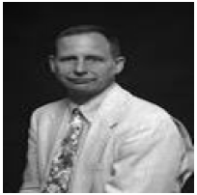
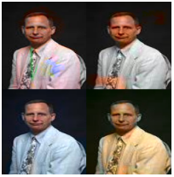




Application: Automatic Colorization
Input
Color Transfer
Color Transfer
Matches (gray)
Matches (w/ color)
Avg Color of Match

Slide 36






Application: Automatic Colorization
Input
Color Transfer
Color Transfer
Matches (gray)
Matches (w/ color)
Avg Color of Match

Slide 37

Application: Person Detection
80 million “tiny images” downloaded by keyword search.
80 nearest neighbors vote for image category.

Slide 38

Re-ranking Altavista search for “person”

Slide 39

Automatic Orientation Examples
A. Torralba, R. Fergus, W.T.Freeman. 2008
Notes:
Based on average correlation to the top 50 nearest neighbors. Note that this doesn’t really beat just assuming that the image is upright.
39

Slide 40

Summary
With billions of images on the web, it’s often possible to find a close nearest neighbor
In such cases, we can shortcut hard problems by “looking up” the answer, stealing the labels from our nearest neighbor
For example, simple (or learned) associations can be used to synthesize background regions, colorize, or recognize objects

Slide 41

Project 5
http://www.cc.gatech.edu/~hays/compvision/proj5/

