Slide 1
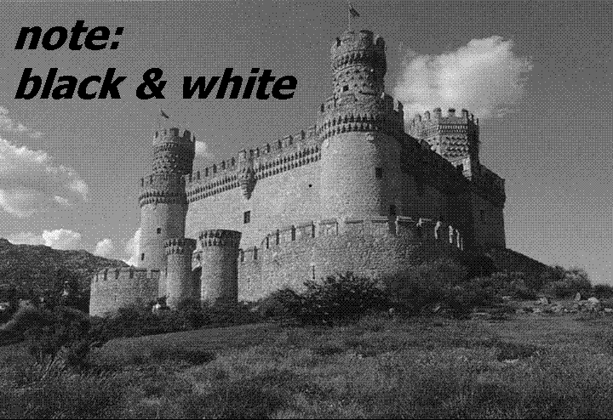

Slide 2
Recap – Image Classification with Bags of Local Features
Bag of Feature models were the state of the art for image classification for a decade
BoF may still be the state of the art for instance retrieval
We saw numerous strategies to fight back against lost spatial information (spatial pyramid) and lost feature detail due to quantization.
Food for thought, doesn’t the spatial pyramid seem kind of recursive / hierarchical? Like a SIFT feature on top of SIFT features?

Slide 3
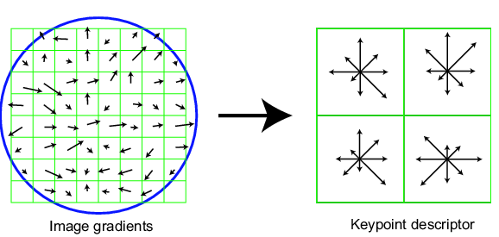
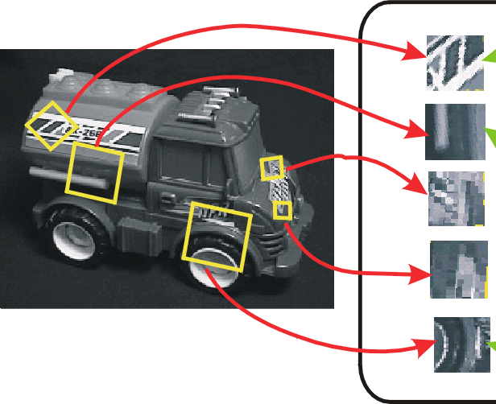
SIFT vector formation
4x4 array of gradient orientation histogram weighted by magnitude
8 orientations x 4x4 array = 128 dimensions
Motivation: some sensitivity to spatial layout, but not too much.
showing only 2x2 here but is 4x4

Slide 4

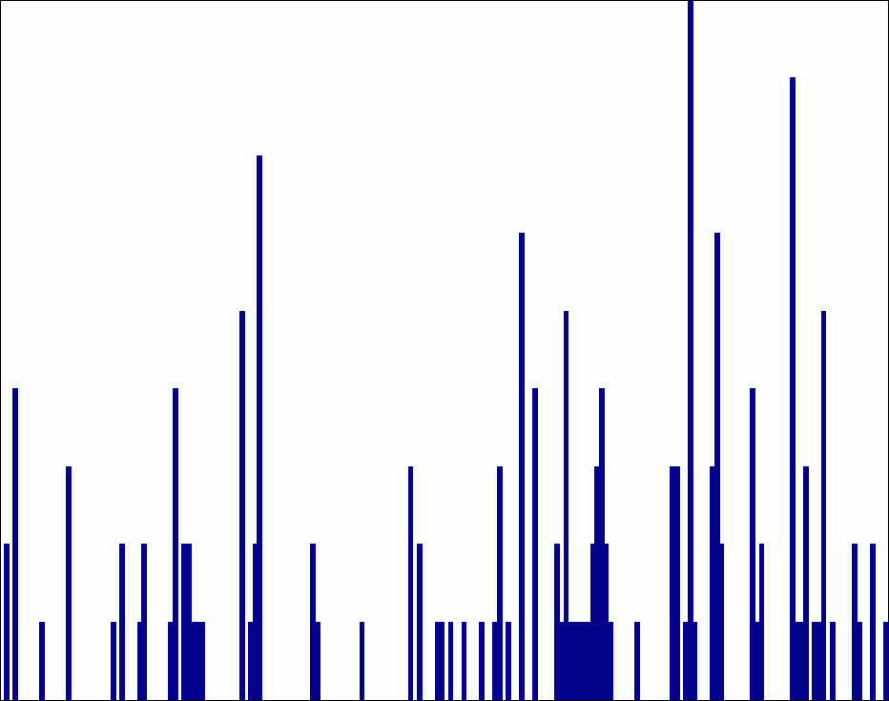











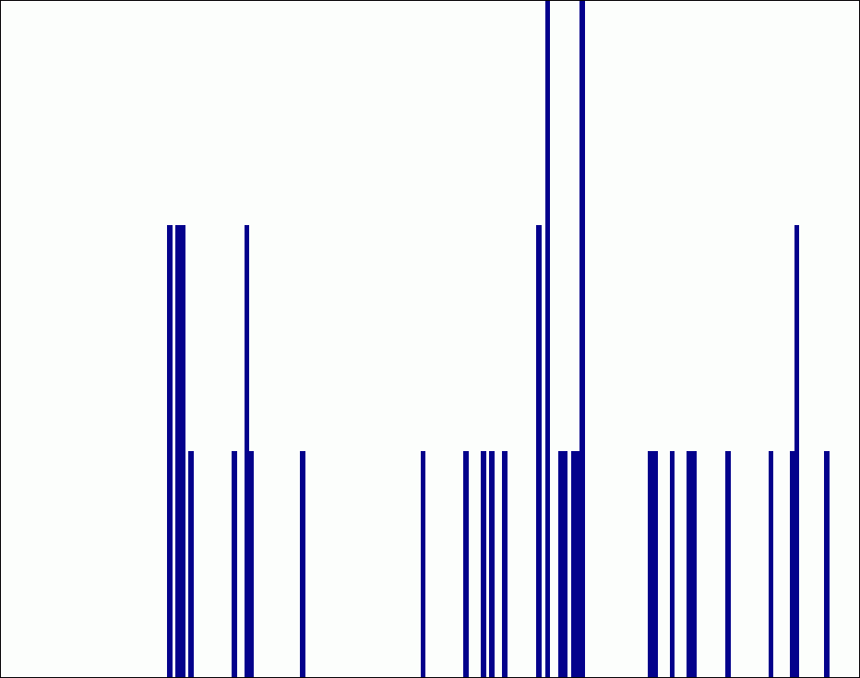






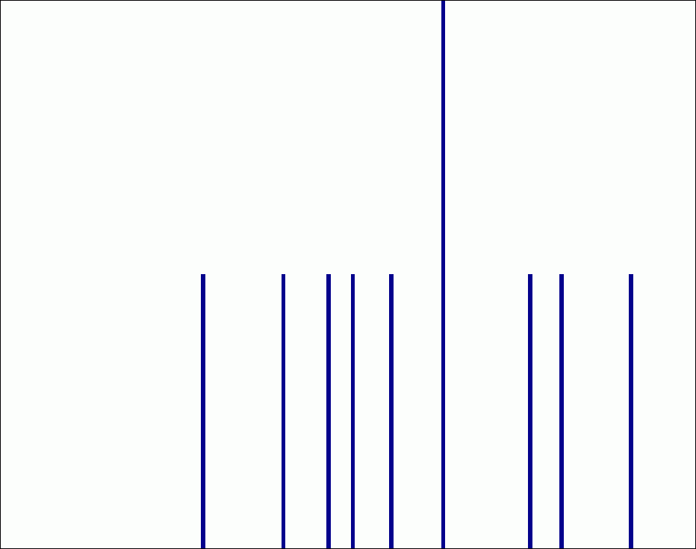

Spatial pyramid representation
Extension of a bag of features
Locally orderless representation at several levels of resolution
level 0
level 1
level 2
Lazebnik, Schmid & Ponce (CVPR 2006)

Slide 5
Recap – Image Classification with Bags of Local Features
Food for thought, doesn’t the spatial pyramid seem kind of recursive / hierarchical? Like a SIFT feature on top of SIFT features?
Seems like there is a tendency for features to involve convolution, spatial pooling, and non-linearities.

Slide 6
Object Detection
Overview
Viola-Jones
Dalal-Triggs
Later classes:
  Deformable models
  Deep learning

Slide 7
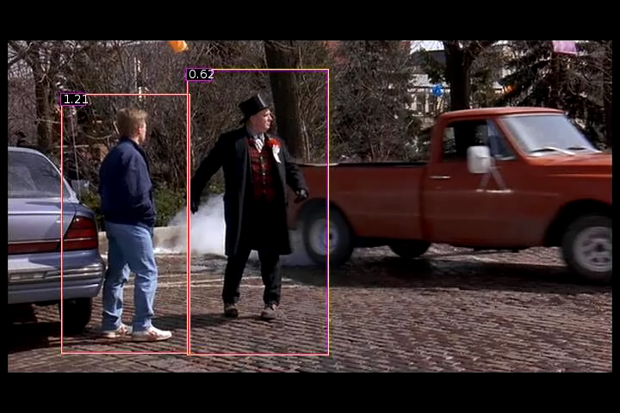
Person detection with HoG’s & linear SVM’s
Histograms of Oriented Gradients for Human Detection, Navneet Dalal, Bill Triggs, International Conference on Computer Vision & Pattern Recognition - June 2005
http://lear.inrialpes.fr/pubs/2005/DT05/

Slide 8
Object detection vs Scene Recognition
What’s the difference?
Objects (even if deformable and articulated) probably have more consistent shapes than scenes.
Scenes can be defined by distribution of “stuff” – materials and surfaces with arbitrary shape.
Objects are “things” that own their boundaries
Bag of words models are less popular for object detection because they throw away shape info.

Slide 9
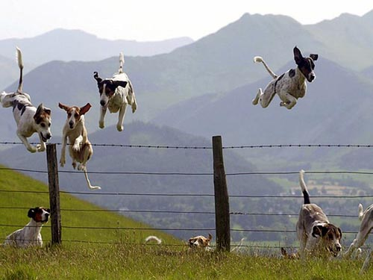
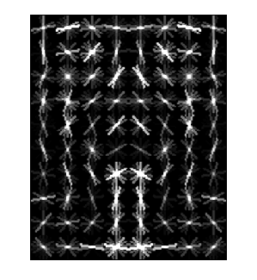
Object Category Detection
Focus on object search: “Where is it?”
Build templates that quickly differentiate object patch from background patch
Dog Model
…
Object or
Non-Object?

Slide 10
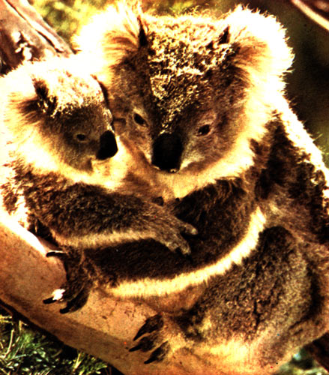
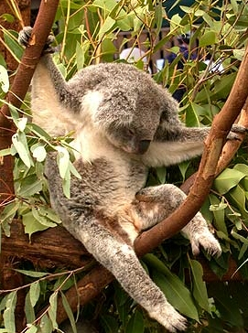
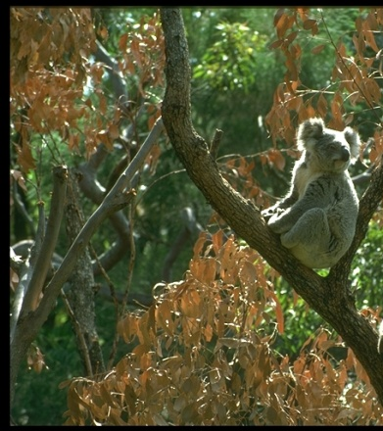


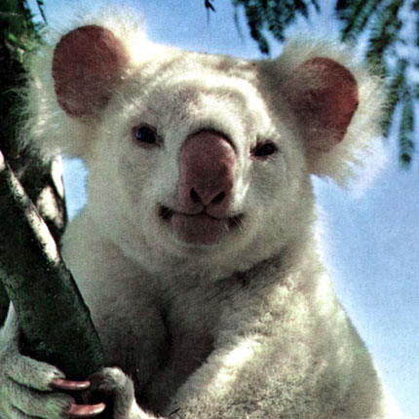
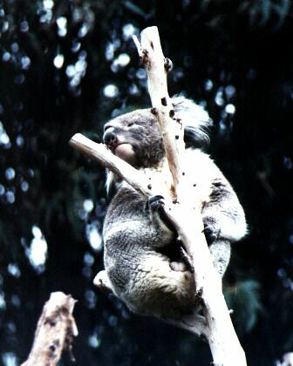
Challenges in modeling the object class
Illumination
Object pose
Clutter
Occlusions
Intra-class appearance
Viewpoint
Slide from K. Grauman, B. Leibe

Slide 11
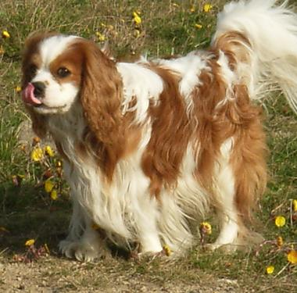
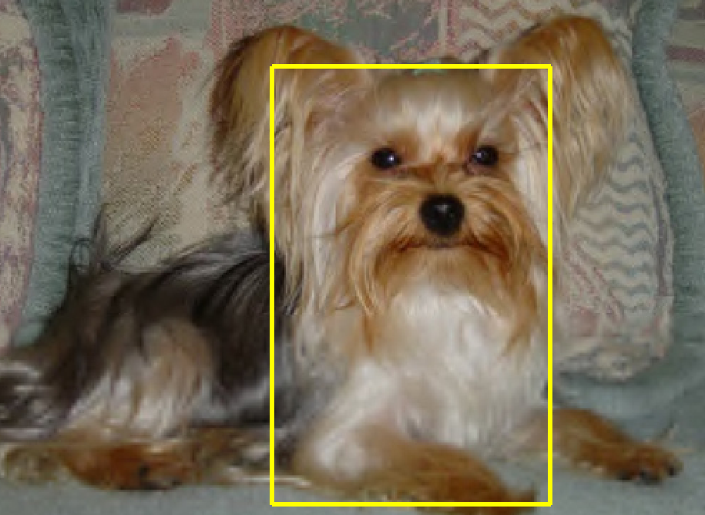
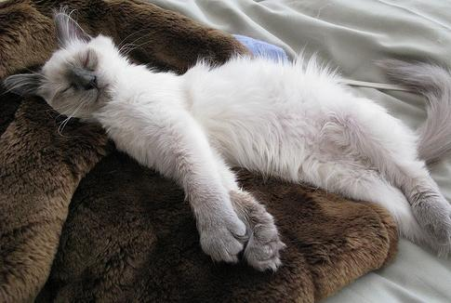
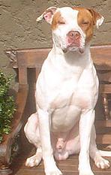
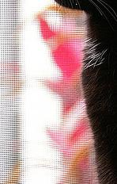

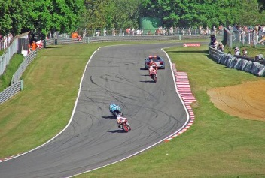

Challenges in modeling the non-object class
True Detections
Bad Localization
Confused with Similar Object
Confused with Dissimilar Objects
Misc. Background

Slide 12
General Process of Object Recognition
Specify Object Model
What are the object parameters?
Generate Hypotheses
Score Hypotheses
Resolve Detections

Slide 13
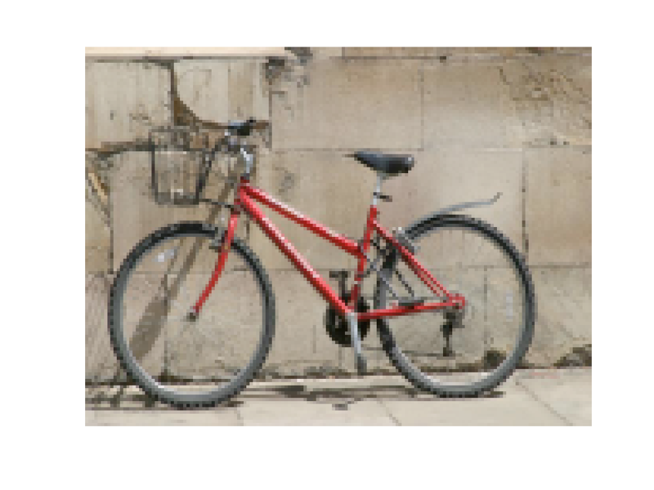
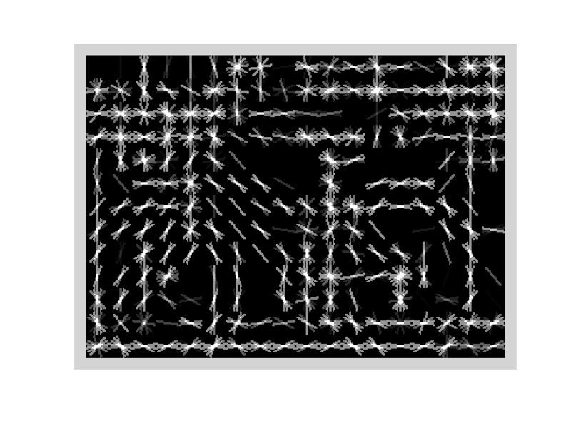
Specifying an object model
Statistical Template in Bounding Box
  Object is some (x,y,w,h) in image
  Features defined wrt bounding box coordinates
Image
Template Visualization
Images from Felzenszwalb

Slide 14
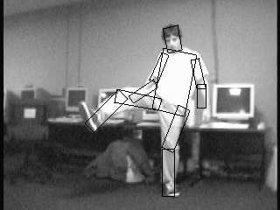
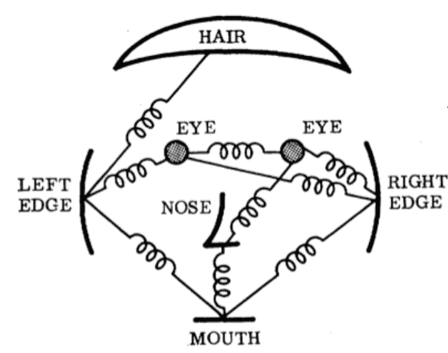
Specifying an object model
2. Articulated parts model
  Object is configuration of parts
  Each part is detectable
Images from Felzenszwalb

Slide 15
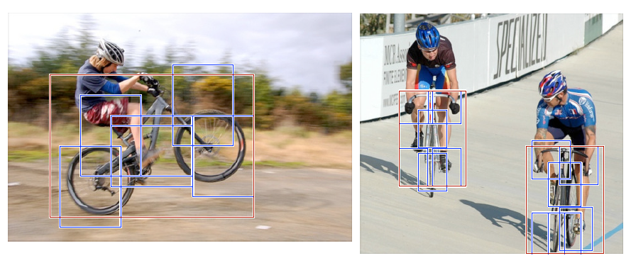
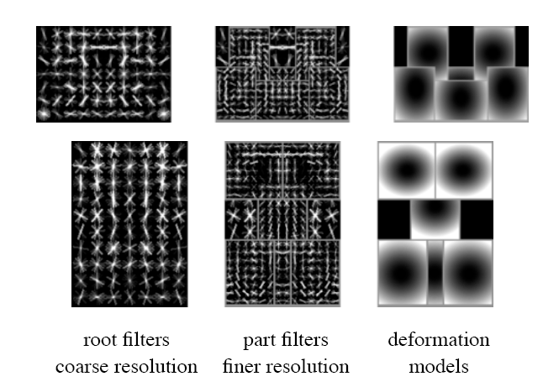
Specifying an object model
3. Hybrid template/parts model
Detections
Template Visualization
Felzenszwalb et al. 2008

Slide 16
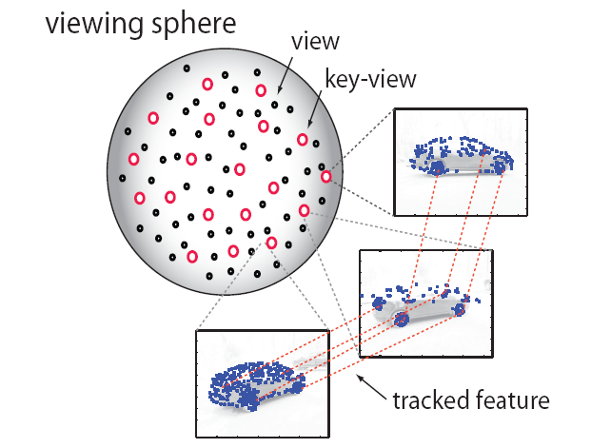
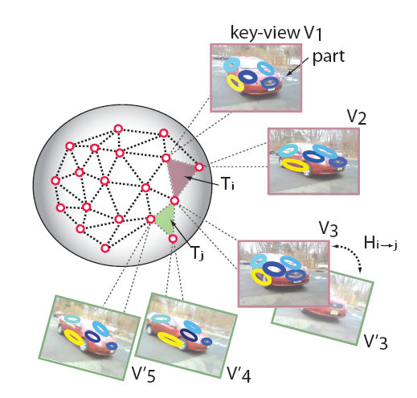
Specifying an object model
3D-ish model
Object is collection of 3D planar patches under affine transformation

Slide 17
General Process of Object Recognition
Specify Object Model
Generate Hypotheses
Propose an alignment of the model to the image
Score Hypotheses
Resolve Detections

Slide 18
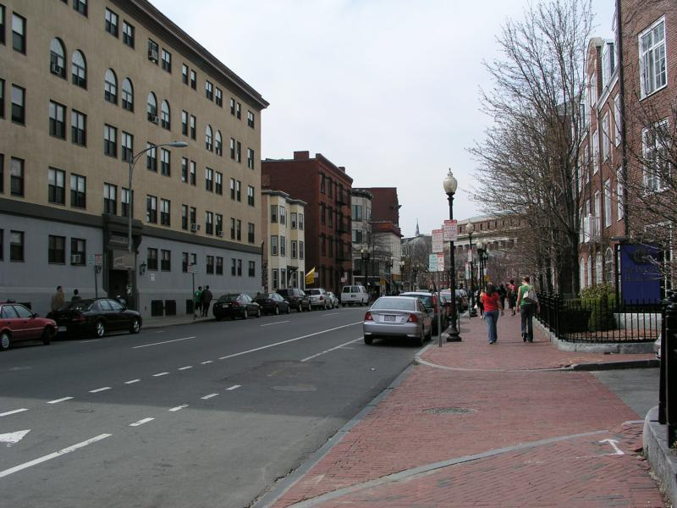
Generating hypotheses
Sliding window
  Test patch at each location and scale

Slide 19
Generating hypotheses
Sliding window
  Test patch at each location and scale
Note – Template did not change size

Slide 20
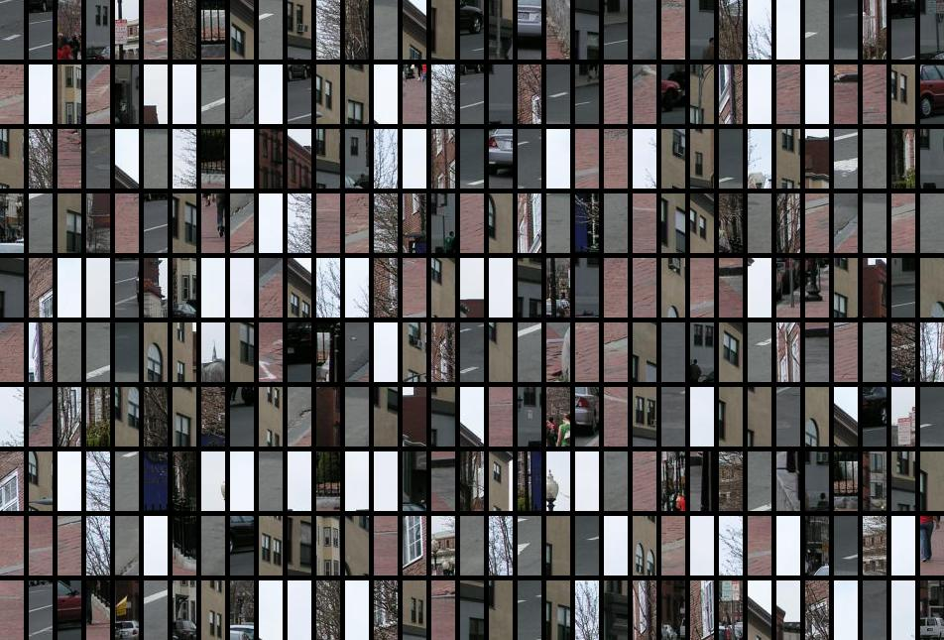
Each window is separately classified

Slide 21
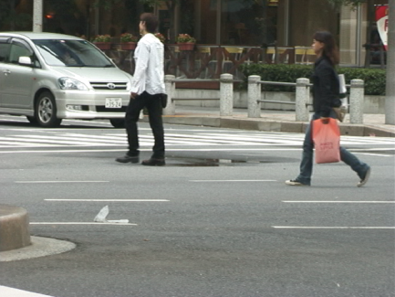
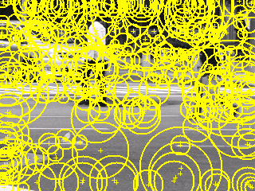
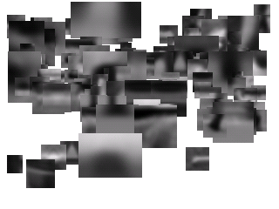
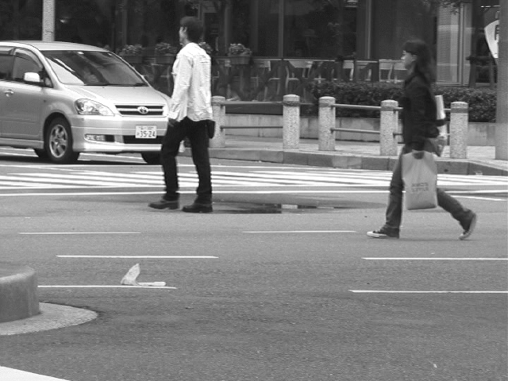
Generating hypotheses
2. Voting from patches/keypoints
Matched Codebook
Entries
Probabilistic
Voting
Interest Points
y
s
3D Voting Space
(continuous)
x
ISM model by Leibe et al.

Slide 22
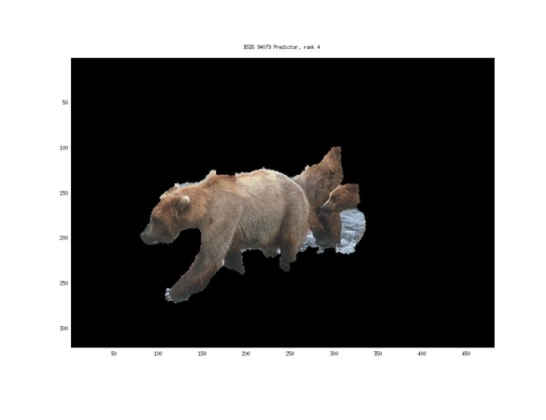
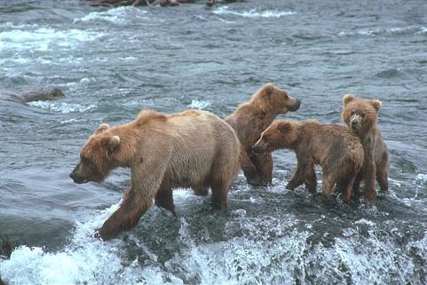
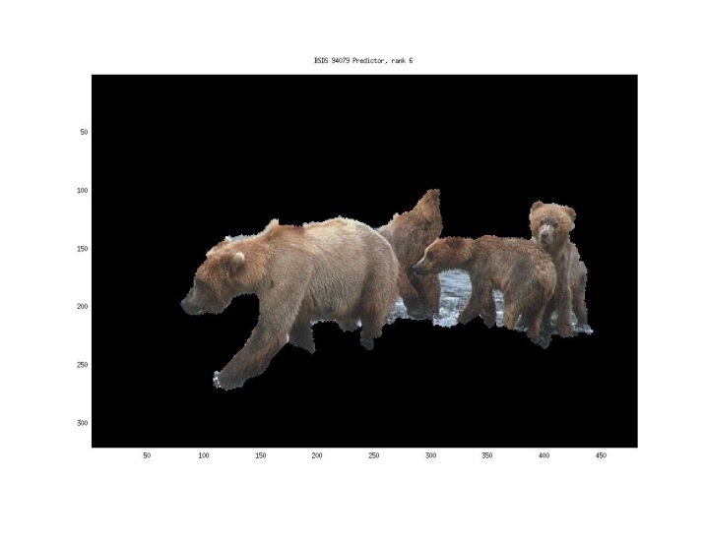
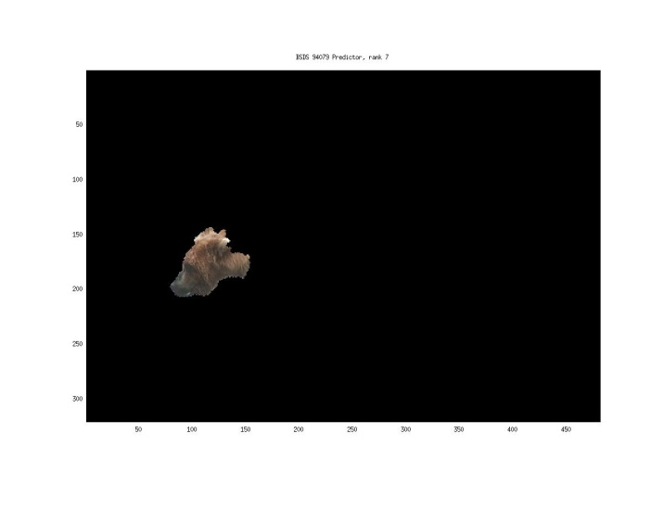
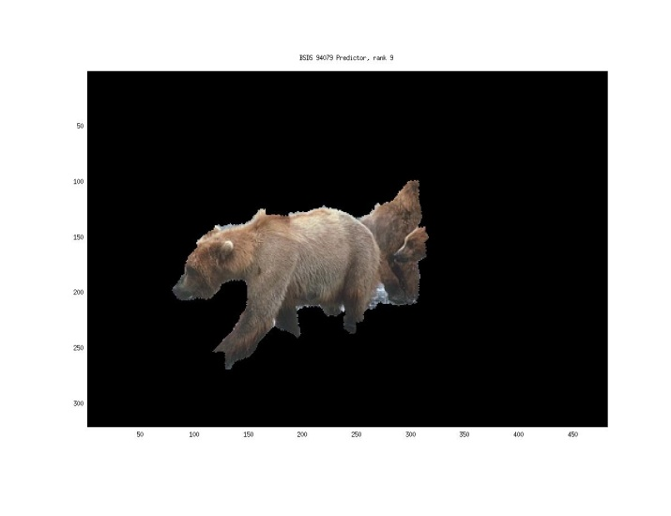
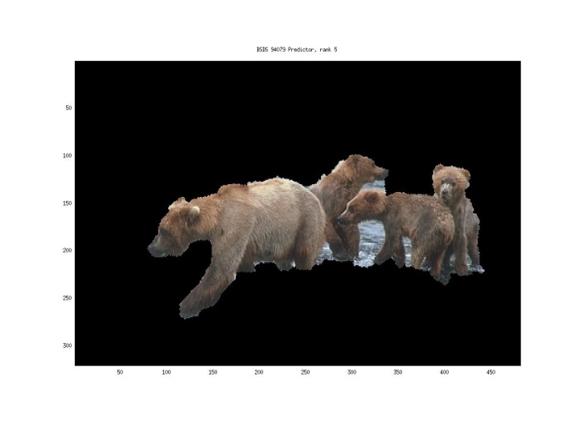
Generating hypotheses
3. Region-based proposal
Endres Hoiem 2010

Slide 23
General Process of Object Recognition
Specify Object Model
Generate Hypotheses
Mainly-gradient based features, usually based on summary representation, many classifiers
Score Hypotheses
Resolve Detections

Slide 24
General Process of Object Recognition
Specify Object Model
Generate Hypotheses
Score Hypotheses
Resolve Detections
Rescore each proposed object based on whole set

Slide 25
Resolving detection scores
Non-max suppression
Score = 0.8
Score = 0.8
Score = 0.1

Slide 26
Resolving detection scores
Non-max suppression
Score = 0.8
Score = 0.8
Score = 0.1
Score = 0.1
“Overlap” score is below some threshold

Slide 27
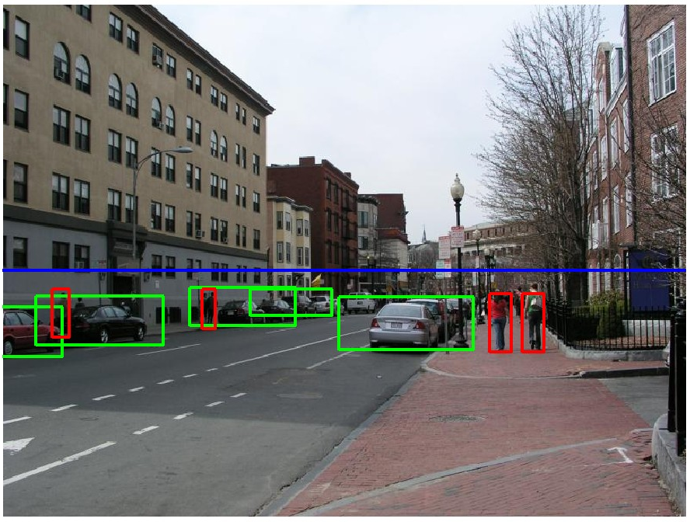
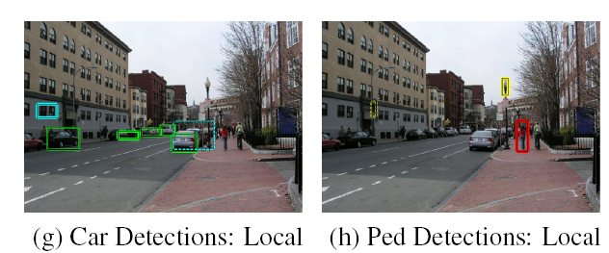
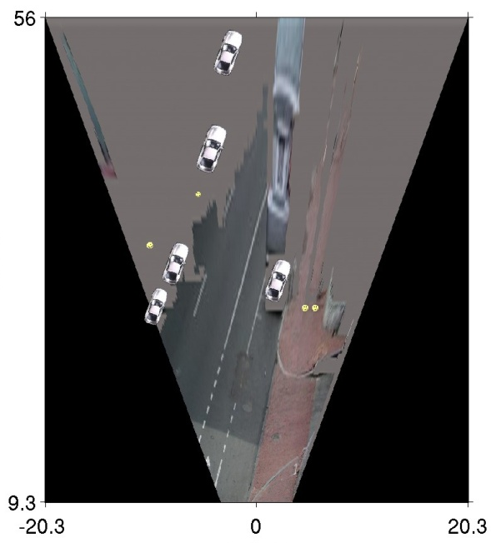
Resolving detection scores
2. Context/reasoning
meters
Hoiem et al. 2006
meters

Slide 28
Object category detection in computer vision
Goal: detect all pedestrians, cars, monkeys, etc in image

Slide 29
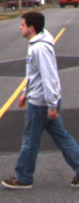
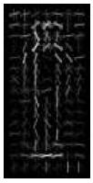
Basic Steps of Category Detection
Align
  E.g., choose position, scale orientation
  How to make this tractable?
Compare
  Compute similarity to an example object or to a summary representation
  Which differences in appearance are important?
Aligned
Possible Objects
Exemplar
Summary

Slide 30
Sliding window: a simple alignment solution
…
…

Slide 31
Influential Works in Detection
Sung-Poggio (1994, 1998) : ~2000 citations
  Basic idea of statistical template detection, bootstrapping to get “face-like” negative examples, multiple whole-face prototypes (in 1994)
Rowley-Baluja-Kanade (1996-1998) : ~3600
  “Parts” at fixed position, non-maxima suppression, simple cascade, rotation, pretty good accuracy, fast
Schneiderman-Kanade (1998-2000,2004) : ~1700
  Careful feature engineering, excellent results, cascade
Viola-Jones (2001, 2004) : ~13,000
  Haar-like features, Adaboost as feature selection, hyper-cascade, very fast
Dalal-Triggs (2005) : ~16,000 citations
  Careful feature engineering, excellent results, HOG feature, online code
Felzenszwalb-McAllester-Ramanan (2008): ~4,600 citations
  Template/parts-based blend
Girshick et al. (2013): ~2000 citations
  R-CNN / Fast R-CNN / Faster R-CNN. Deep learned models on object proposals.

Slide 32
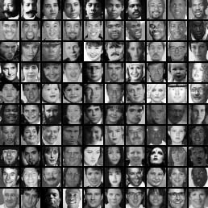
Sliding Window Face Detection with Viola-Jones
Many Slides from Lana Lazebnik

Slide 33
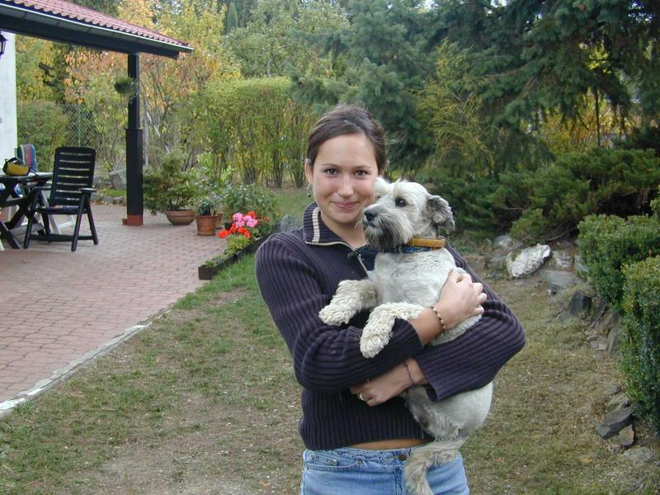

Face detection and recognition
Detection
Recognition
“Sally”

Slide 34
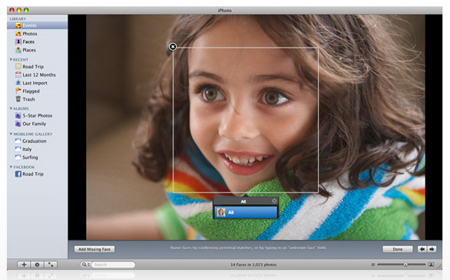
Consumer application: Apple iPhoto
http://www.apple.com/ilife/iphoto/

Slide 35
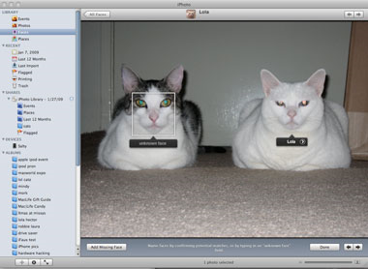
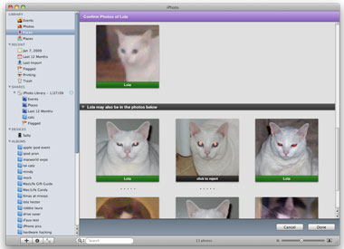
Consumer application: Apple iPhoto
Can be trained to recognize pets!
http://www.maclife.com/article/news/iphotos_faces_recognizes_cats

Slide 36

Consumer application: Apple iPhoto
Things iPhoto thinks are faces

Slide 37

Funny Nikon ads
"The Nikon S60 detects up to 12 faces."

Slide 38

Funny Nikon ads
"The Nikon S60 detects up to 12 faces."

Slide 39
Challenges of face detection
Sliding window detector must evaluate tens of thousands of location/scale combinations
Faces are rare: 0–10 per image
  For computational efficiency, we should try to spend as little time as possible on the non-face windows
  A megapixel image has ~10⁶ pixels and a comparable number of candidate face locations
  To avoid having a false positive in every image image, our false positive rate has to be less than 10⁻⁶

Slide 40
The Viola/Jones Face Detector
A seminal approach to real-time object detection
Training is slow, but detection is very fast
Key ideas
  Integral images for fast feature evaluation
  Boosting for feature selection
  Attentional cascade for fast rejection of non-face windows
P. Viola and M. Jones. Rapid object detection using a boosted cascade of simple features. CVPR 2001.
P. Viola and M. Jones. Robust real-time face detection. IJCV 57(2), 2004.

Slide 41

Image Features
“Rectangle filters”
Value =
∑ (pixels in white area) –
∑ (pixels in black area)
Notes:
For real problems results are only as good as the features used...
This is the main piece of ad-hoc (or domain) knowledge
Rather than the pixels, we have selected a very large set of simple functions
Sensitive to edges and other critcal features of the image
** At multiple scales
Since the final classifier is a perceptron it is important that the features be non-linear… otherwise the final classifier will be a simple perceptron.
We introduce a threshold to yield binary features

Slide 42




Example
Source
Result

Slide 43
Fast computation with integral images
The integral image computes a value at each pixel (x,y) that is the sum of the pixel values above and to the left of (x,y), inclusive
This can quickly be computed in one pass through the image
(x,y)

Slide 44
Computing the integral image

Slide 45
Computing the integral image
ii(x, y-1)
s(x-1, y)
i(x, y)
Cumulative row sum: s(x, y) = s(x–1, y) + i(x, y)
Integral image: ii(x, y) = ii(x, y−1) + s(x, y)
MATLAB: ii = cumsum(cumsum(double(i)), 2);

Slide 46
Computing sum within a rectangle
Let A,B,C,D be the values of the integral image at the corners of a rectangle
Then the sum of original image values within the rectangle can be computed as:
  sum = A – B – C + D
Only 3 additions are required for any size of rectangle!
D
B
C
A

Slide 47

Computing a rectangle feature
Integral Image
-1
+1
+2
-2
-1
+1

Slide 48

Feature selection
For a 24x24 detection region, the number of possible rectangle features is ~160,000!

Slide 49
Feature selection
For a 24x24 detection region, the number of possible rectangle features is ~160,000!
At test time, it is impractical to evaluate the entire feature set
Can we create a good classifier using just a small subset of all possible features?
How to select such a subset?

Slide 50
Boosting
Boosting is a learning scheme that combines weak learners into a more accurate ensemble classifier
Weak learners based on rectangle filters:
Ensemble classification function:
value of rectangle feature
parity
threshold
window
learned weights

Slide 51
Training procedure
Initially, weight each training example equally
In each boosting round:
  Find the weak learner that achieves the lowest weighted training error
  Raise the weights of training examples misclassified by current weak learner
Compute final classifier as linear combination of all weak learners (weight of each learner is directly proportional to its accuracy)
  Exact formulas for re-weighting and combining weak learners depend on the particular boosting scheme (e.g., AdaBoost)
Y. Freund and R. Schapire, A short introduction to boosting, Journal of Japanese Society for Artificial Intelligence, 14(5):771-780, September, 1999.

Slide 52
Boosting intuition
Weak
Classifier 1
Slide credit: Paul Viola

Slide 53
Boosting illustration
Weights
Increased

Slide 54
Boosting illustration
Weak
Classifier 2

Slide 55
Boosting illustration
Weights
Increased

Slide 56
Boosting illustration
Weak
Classifier 3

Slide 57
Boosting illustration
Final classifier is
a combination of weak classifiers

Slide 58

Boosting for face detection
First two features selected by boosting:
This feature combination can yield 100% recall and 50% false positive rate

Slide 59
Boosting vs. SVM
Advantages of boosting
  Integrates classifier training with feature selection
  Complexity of training is linear instead of quadratic in the number of training examples
  Flexibility in the choice of weak learners, boosting scheme
  Testing is fast
Disadvantages
  Needs many training examples
  Training is slow
  Often doesn’t work as well as SVM (especially for many-class problems)

Slide 60

Boosting for face detection
A 200-feature classifier can yield 95% detection rate and a false positive rate of 1 in 14084
Not good enough!
Receiver operating characteristic (ROC) curve

Slide 61
Attentional cascade
We start with simple classifiers which reject many of the negative sub-windows while detecting almost all positive sub-windows
Positive response from the first classifier triggers the evaluation of a second (more complex) classifier, and so on
A negative outcome at any point leads to the immediate rejection of the sub-window
T
T
T
IMAGE
SUB-WINDOW
T
FACE
Classifier 1
Classifier 2
Classifier 3
F
F
F
NON-FACE
NON-FACE
NON-FACE

Slide 62
Attentional cascade
Chain classifiers that are progressively more complex and have lower false positive rates:
Receiver operating characteristic
% False Pos
0
50
vs
false
neg
determined by
0 100
% Detection
T
T
T
IMAGE
SUB-WINDOW
T
FACE
Classifier 1
Classifier 2
Classifier 3
F
F
F
NON-FACE
NON-FACE
NON-FACE
Notes:
In general simple classifiers, while they are more efficient, they are also weaker.
We could define a computational risk hierarchy (in analogy with structural risk minimization)…
A nested set of classifier classes
The training process is reminiscent of boosting…
- previous classifiers reweight the examples used to train subsequent classifiers
The goal of the training process is different
- instead of minimizing errors minimize false positives

Slide 63
Attentional cascade
The detection rate and the false positive rate of the cascade are found by multiplying the respective rates of the individual stages
A detection rate of 0.9 and a false positive rate on the order of 10⁻⁶ can be achieved by a
10-stage cascade if each stage has a detection rate of 0.99 (0.99¹⁰ ≈ 0.9) and a false positive rate of about 0.30 (0.3¹⁰ ≈ 6×10⁻⁶)
T
T
T
IMAGE
SUB-WINDOW
T
FACE
Classifier 1
Classifier 2
Classifier 3
F
F
F
NON-FACE
NON-FACE
NON-FACE

Slide 64
Training the cascade
Set target detection and false positive rates for each stage
Keep adding features to the current stage until its target rates have been met
  Need to lower AdaBoost threshold to maximize detection
  (as opposed to minimizing total classification error)
  Test on a validation set
If the overall false positive rate is not low enough, then add another stage
Use false positives from current stage as the negative training examples for the next stage

Slide 65

The implemented system
Training Data
  5000 faces
    All frontal, rescaled to
    24x24 pixels
  300 million non-faces
    9500 non-face images
  Faces are normalized
    Scale, translation
Many variations
  Across individuals
  Illumination
  Pose
Notes:
This situation with negative examples is actually quite common… where negative examples are free.

Slide 66
System performance
Training time: “weeks” on 466 MHz Sun workstation
38 layers, total of 6061 features
Average of 10 features evaluated per window on test set
“On a 700 Mhz Pentium III processor, the face detector can process a 384 by 288 pixel image in about .067 seconds”
  15 Hz
  15 times faster than previous detector of comparable accuracy (Rowley et al., 1998)

Slide 67





Output of Face Detector on Test Images

Slide 68



Other detection tasks
Facial Feature Localization
Profile Detection
Male vs.
female

Slide 69




Profile Detection

Slide 70

Profile Features

Slide 71
Summary: Viola/Jones detector
Rectangle features
Integral images for fast computation
Boosting for feature selection
Attentional cascade for fast rejection of negative windows

