Slide 1
Highlighted Project 2 Implementations

Slide 2
Vocabulary trees: complexity
Number of words given tree parameters: branching factor and number of levels
branching_factor^^{number_of_levels}
Word assignment cost vs. flat vocabulary
O(k) for flat
O(log_{branching_factor}(k) * branching_factor)
Is this like a kd-tree?
Yes, but with better partitioning and defeatist search.
This hierarchical data structure is lossy – you might not find your true nearest cluster.
Notes:
Number of words = (branching_factor)^(number_of_levels)
Assignment cost for flat hierarchy O(k), for tree O(log(base branching_factor)(k) * branching_factor)

Slide 3
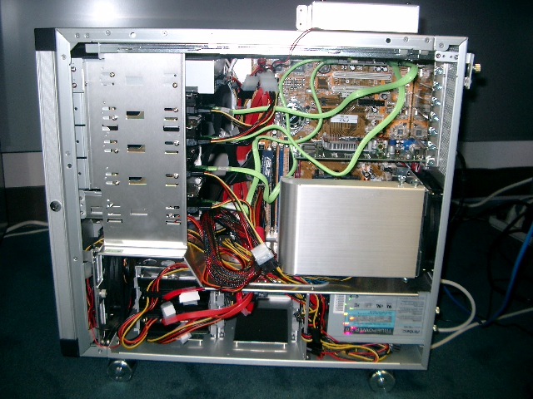
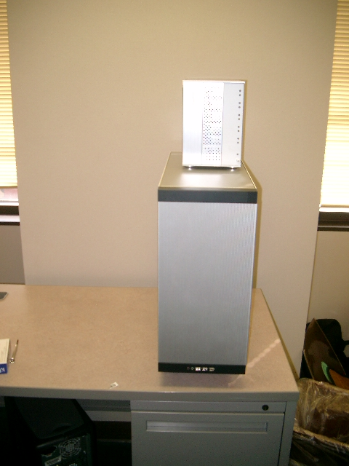
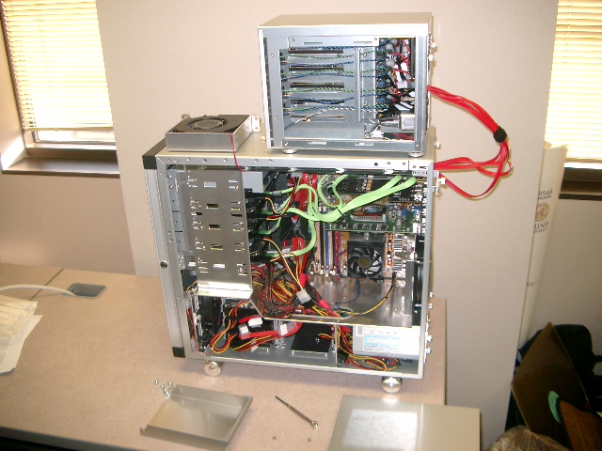
110,000,000
Images in
5.8 Seconds
Slide
Slide Credit: Nister
Notes:
Very recently, we have scaled the system even further.
The system we just demo’d searches a 50 thousand image index in the RAM of this laptop at real-time rates.
We have built and programmed a desktop system at home in which we currently have 12 hard drives. We bypass the operating system and
read and write the disk surfaces directly.
Last week this system clocked in on 110 Million images in 5.8 seconds, so roughly 20Million images per second and machine.
The images consist of around 10 days of four TV channels, so more than a month of TV.
Soon we don’t have to watch TV, because we’ll have machines doing it for us.

Slide 4
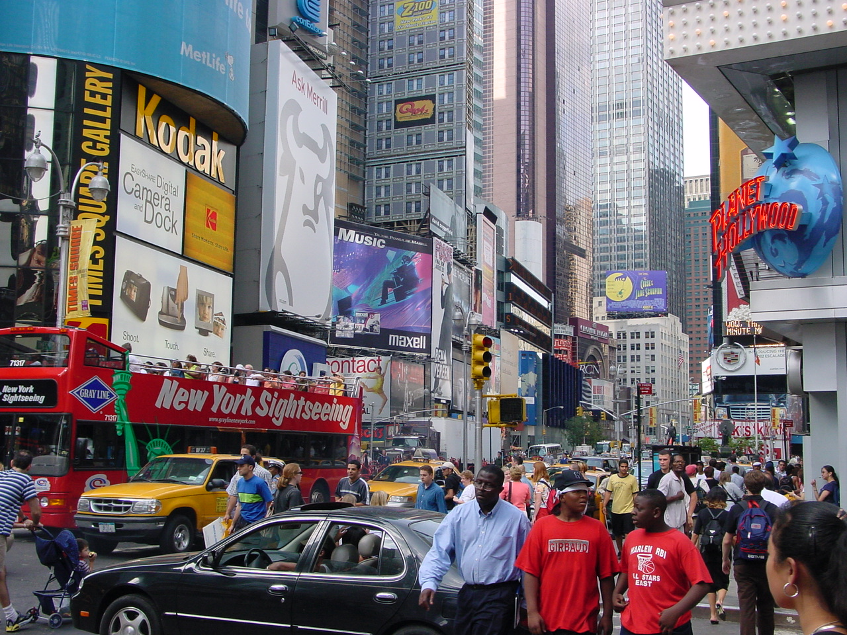


Slide
Slide Credit: Nister
Notes:
To continue the analogy, if we printed all these images on paper, and stacked them,

Slide 5
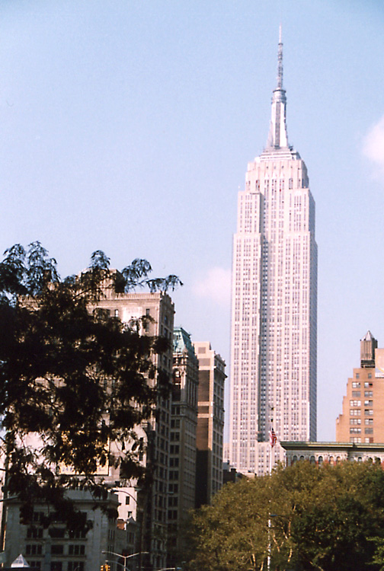
Slide
Slide Credit: Nister
Notes:
The pile would stack, as high as

Slide 6
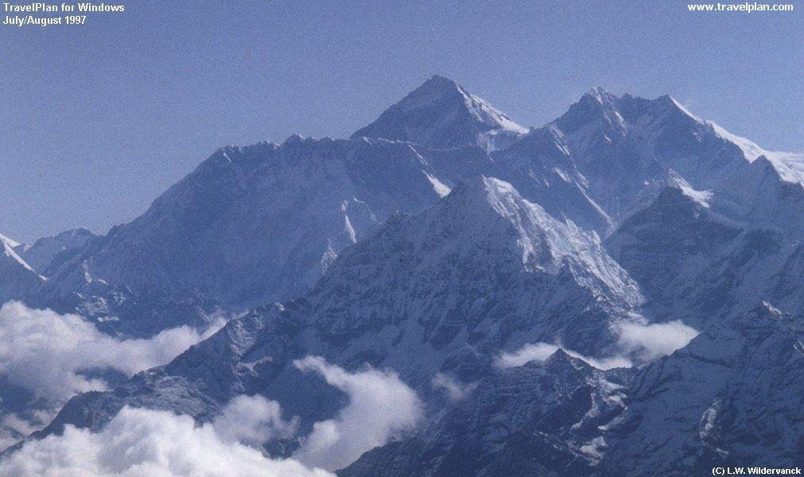
Slide
Slide Credit: Nister
Notes:
Mount Everest.
Another way to put perspective on this is, Google image search not too long ago claimed to index 2 billion images,
although based on meta-data, while we do it based on image content.
So, with about 20 desktop systems like the one I just showed, it seems that it may be possible to build a web-scale content-based image search engine,
and we are sort of hoping that this paper will fuel the race for the first such search engine.
So, that is some motivation.
Let me now move to the contribution of the paper.
As you can guess by now, it is about scalability of recognition and retrieval.

Slide 7
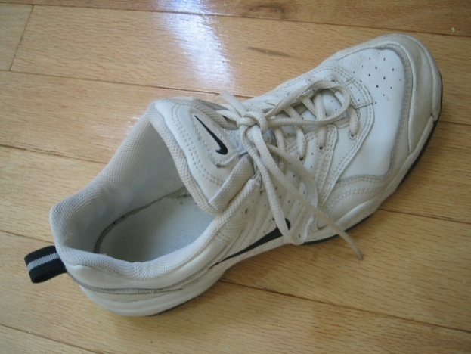
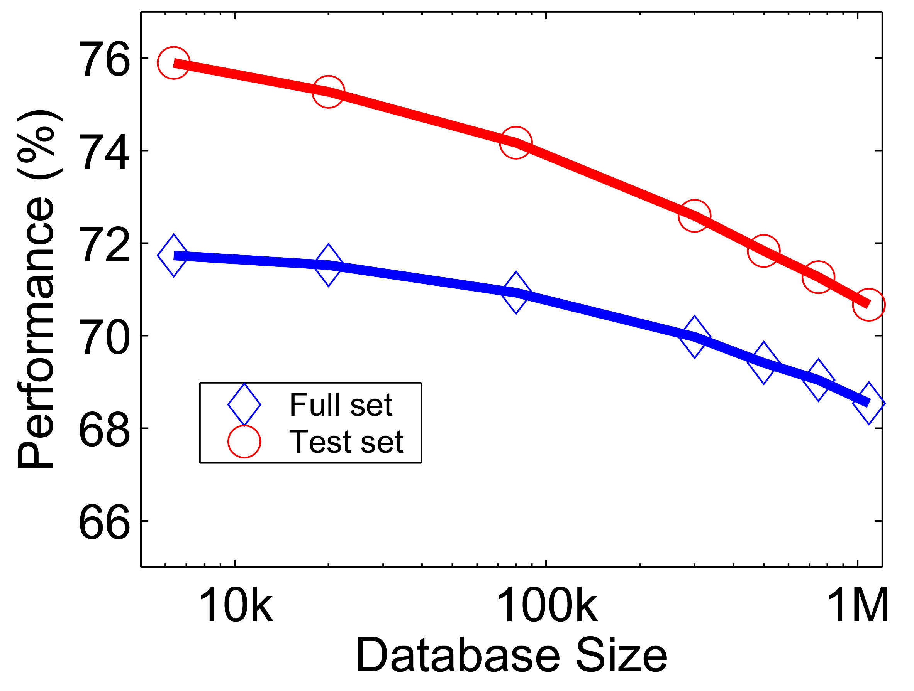








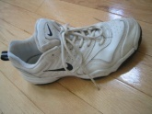
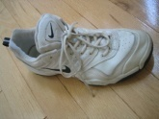
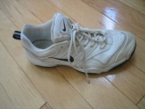
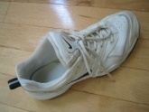
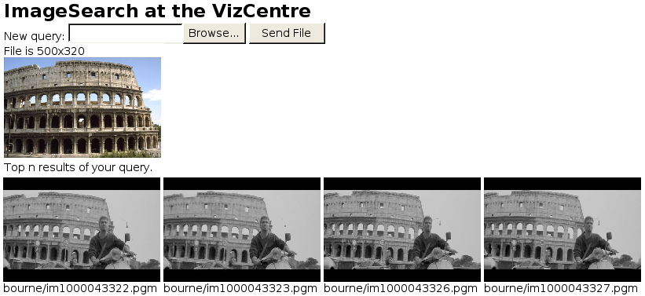





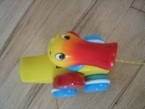






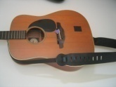
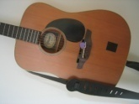
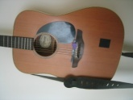
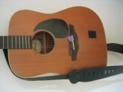
Performance
Notes:
One of the reasons we managed to take the system this far is that we have worked with rigorous performance testing against a database with ground truth.
We now have a benchmark database with over 10000 images grouped in sets of four images of the same object. We query on one of the images in the group and see how many of the other images in the group make it to the top of the query.
In the paper, we have tested this up to a million images, by embedding the ground truth database into a database encompassing all the frames of 10 feature length movies.

Slide 8
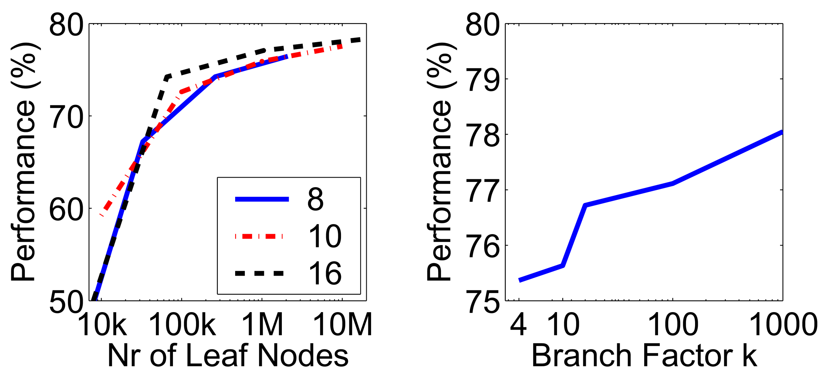
Higher branch factor works better (but slower)
Notes:
We also find that performance improves with the branch factor.
This improvement is not dramatic, but it is interesting to note that very low branch factors are somewhat weak, and a branch factor of two results in partitioning the space with planes.

Slide 9
Visual words/bags of words
+ flexible to geometry / deformations / viewpoint
+ compact summary of image content
+ provides fixed dimensional vector representation for sets
+ very good results in practice
background and foreground mixed when bag covers whole image
optimal vocabulary formation remains unclear
basic model ignores geometry – must verify afterwards, or encode via features
Kristen Grauman
Notes:
9

Slide 10
Instance recognition: remaining issues
How to summarize the content of an entire image? And gauge overall similarity?
How large should the vocabulary be? How to perform quantization efficiently?
Is having the same set of visual words enough to identify the object/scene? How to verify spatial agreement?
How to score the retrieval results?
Kristen Grauman

Slide 11
Can we be more accurate?
So far, we treat each image as containing a “bag of words”, with no spatial information
Which matches better?
e
h
a
f
e
e
z
a
f
e
h
a
f
e
e

Slide 12
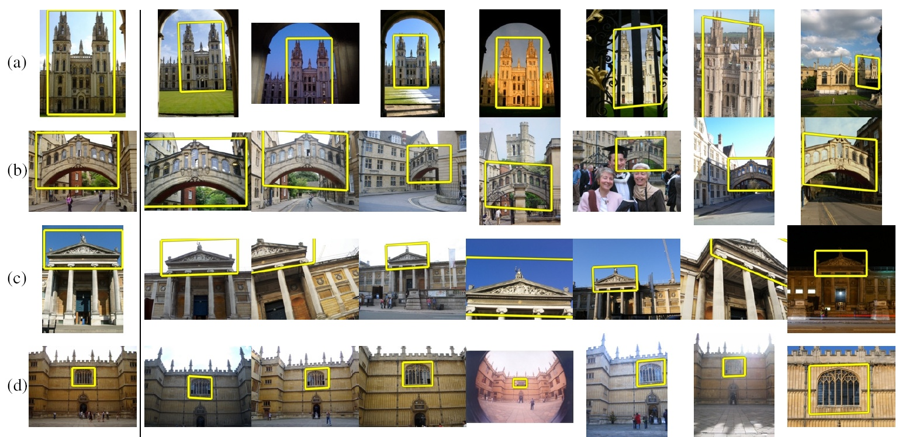
Can we be more accurate?
So far, we treat each image as containing a “bag of words”, with no spatial information
Real objects have consistent geometry

Slide 13
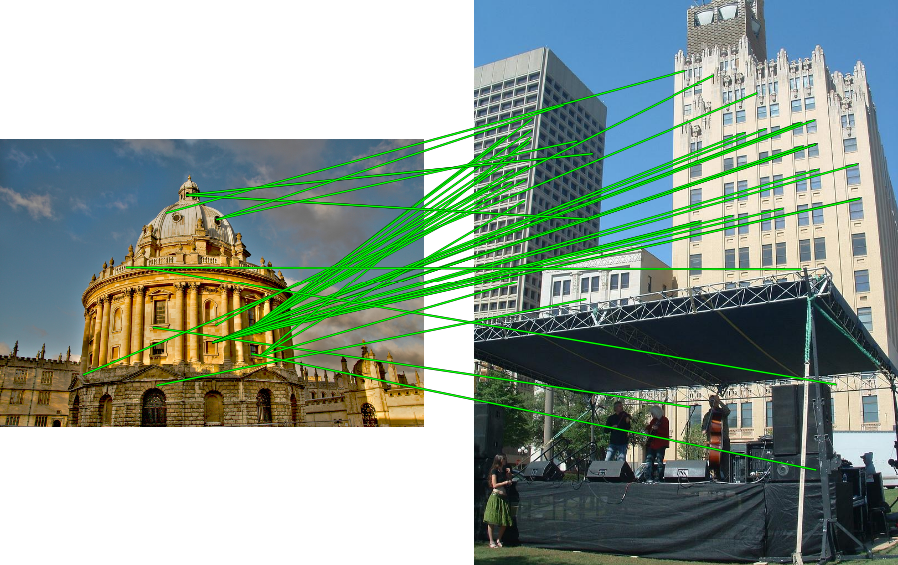
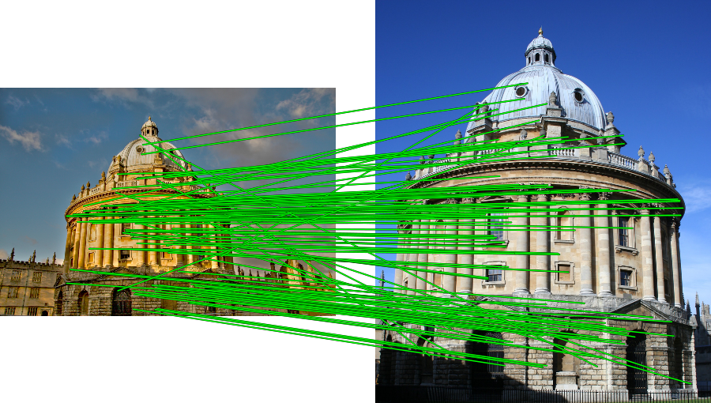
Spatial Verification
Query
Query
DB image with high BoW similarity
DB image with high BoW similarity
Both image pairs have many visual words in common.
Slide credit: Ondrej Chum

Slide 14
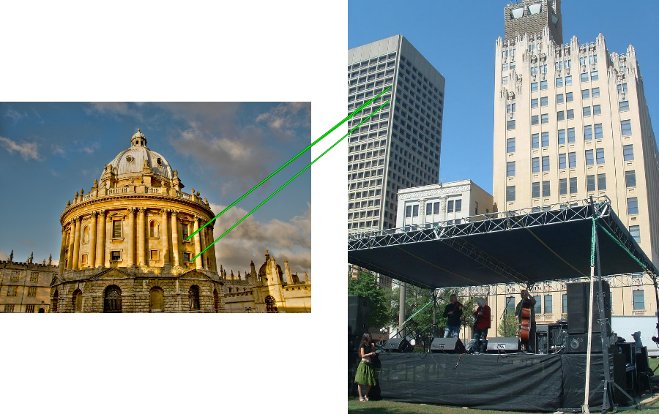
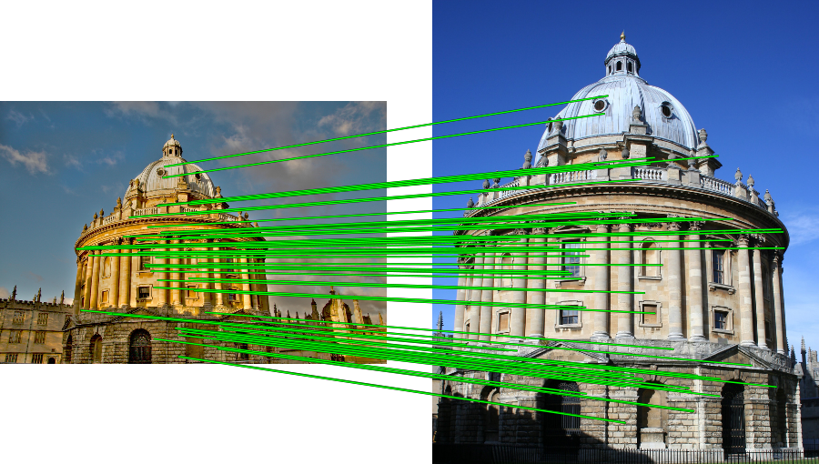
Spatial Verification
Query
Query
DB image with high BoW similarity
DB image with high BoW similarity
Only some of the matches are mutually consistent
Slide credit: Ondrej Chum

Slide 15
Spatial Verification: two basic strategies
RANSAC
  Typically sort by BoW similarity as initial filter
  Verify by checking support (inliers) for possible transformations
    e.g., “success” if find a transformation with > N inlier correspondences
Generalized Hough Transform
  Let each matched feature cast a vote on location, scale, orientation of the model object
  Verify parameters with enough votes
Kristen Grauman

Slide 16
RANSAC verification

Slide 17
Recall: Fitting an affine transformation
Approximates viewpoint changes for roughly planar objects and roughly orthographic cameras.

Slide 18
RANSAC verification

Slide 19
Instance recognition: remaining issues
How to summarize the content of an entire image? And gauge overall similarity?
How large should the vocabulary be? How to perform quantization efficiently?
Is having the same set of visual words enough to identify the object/scene? How to verify spatial agreement?
How to score the retrieval results?
Kristen Grauman

Slide 20
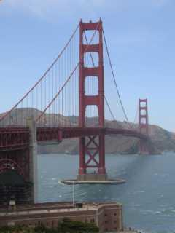
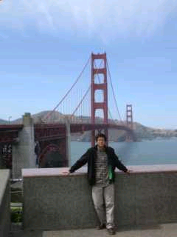
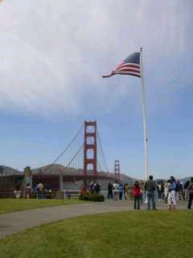
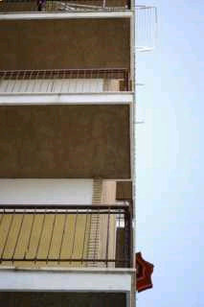
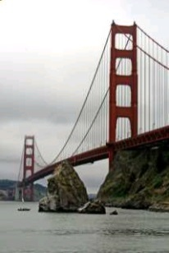
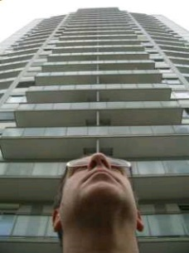
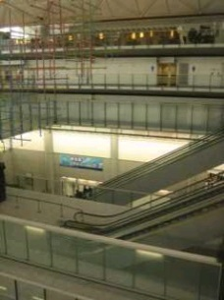
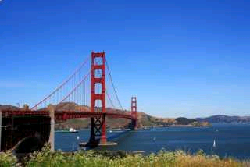
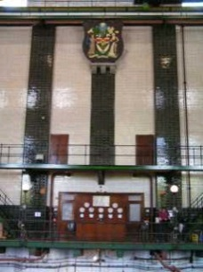
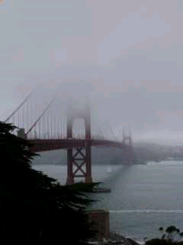
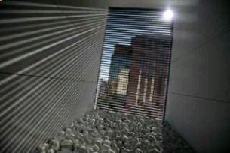
Scoring retrieval quality
Results (ordered):
Database size: 10 images
Relevant (total): 5 images
Query
precision = #relevant / #returned
recall = #relevant / #total relevant
1
0.8
0.6
precision
0.4
0.2
0
0
0.2
0.4
0.6
0.8
1
recall
Slide credit: Ondrej Chum

Slide 21
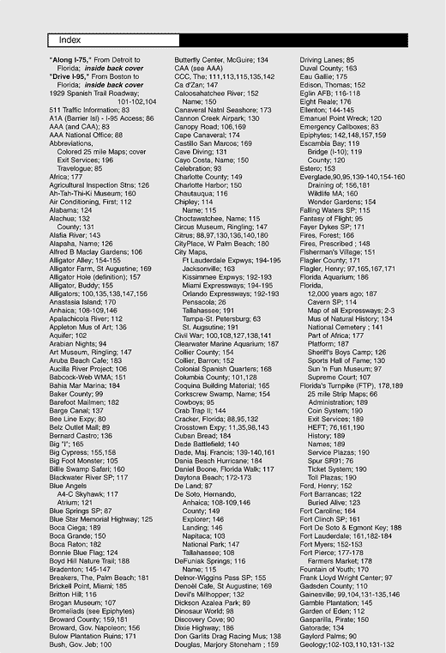

What else can we borrow from text retrieval?
China is forecasting a trade surplus of $90bn (£51bn) to $100bn this year, a threefold increase on 2004's $32bn. The Commerce Ministry said the surplus would be created by a predicted 30% jump in exports to $750bn, compared with a 18% rise in imports to $660bn. The figures are likely to further annoy the US, which has long argued that China's exports are unfairly helped by a deliberately undervalued yuan. Beijing agrees the surplus is too high, but says the yuan is only one factor. Bank of China governor Zhou Xiaochuan said the country also needed to do more to boost domestic demand so more goods stayed within the country. China increased the value of the yuan against the dollar by 2.1% in July and permitted it to trade within a narrow band, but the US wants the yuan to be allowed to trade freely. However, Beijing has made it clear that it will take its time and tread carefully before allowing the yuan to rise further in value.
China, trade,
surplus, commerce,
exports, imports, US,
yuan, bank, domestic,
foreign, increase,
trade, value

Slide 22
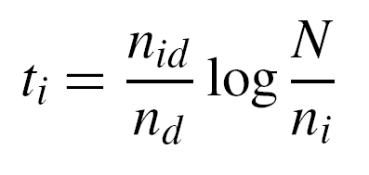
tf-idf weighting
Term frequency – inverse document frequency
Describe frame by frequency of each word within it, downweight words that appear often in the database
(Standard weighting for text retrieval)
Number of occurrences of word i in document d
Total number of documents in database
Number of documents word i occurs in, in whole database
Number of words in document d
Kristen Grauman

Slide 23
Query expansion
Query: golf green
Results:
- How can the grass on the greens at a golf course be so perfect?
For example, a skilled golfer expects to reach the green on a par-four hole in ...
- Manufactures and sells synthetic golf putting greens and mats.
Irrelevant result can cause a `topic drift’:
Volkswagen Golf, 1999, Green, 2000cc, petrol, manual, , hatchback, 94000miles, 2.0 GTi, 2 Registered Keepers, HPI Checked, Air-Conditioning, Front and Rear Parking Sensors, ABS, Alarm, Alloy
Slide credit: Ondrej Chum
Notes:
Query expansion is a technique to increase recall, possibly at the expense of precision.

Slide 24
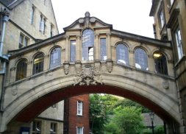
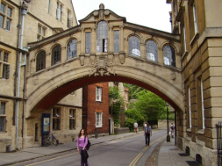
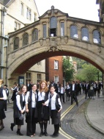
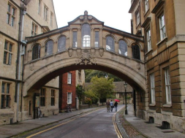
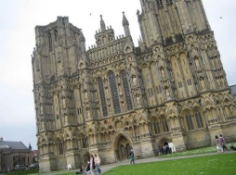
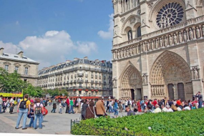
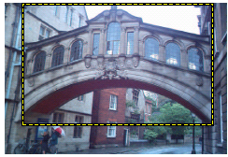
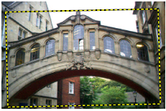
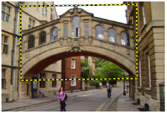
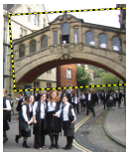
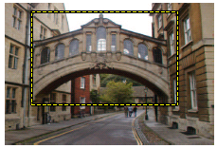
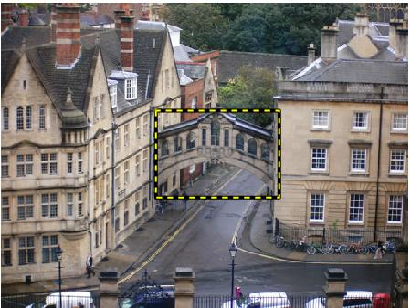
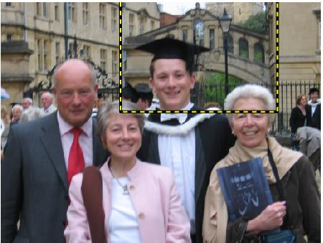


Query Expansion
Results
…
Spatial verification
Query image
New results
New query
Chum, Philbin, Sivic, Isard, Zisserman: Total Recall…, ICCV 2007
Slide credit: Ondrej Chum

Slide 25
Recognition via alignment
  Pros:
    Effective when we are able to find reliable features within clutter
    Great results for matching specific instances
  Cons:
    Spatial verification as post-processing – not seamless, expensive for large-scale problems
    Not suited for category recognition.
Kristen Grauman

Slide 26
Summary
Matching local invariant features
  Useful not only to provide matches for multi-view geometry, but also to find objects and scenes.
Bag of words representation: quantize feature space to make discrete set of visual words
  Summarize image by distribution of words
  Index individual words
Inverted index: pre-compute index to enable faster search at query time
Recognition of instances via alignment: matching local features followed by spatial verification
  Robust fitting : RANSAC, GHT
Kristen Grauman

Slide 27
Lessons from a Decade Later
For Category recognition (project 4)
  Bag of Feature models remained the state of the art until Deep Learning.
  Spatial layout either isn't that important or its too difficult to encode.
  Quantization error is, in fact, the bigger problem. Advanced feature encoding methods address this.
  Bag of feature models are nearly obsolete. At best they seem to be inspiring tweaks to deep models e.g. NetVLAD.
James Hays

Slide 28
Lessons from a Decade Later
For instance retrieval (this lecture)
  deep learning is taking over.
  learn better local features (replace SIFT) e.g. MatchNet
  or learn better image embeddings (replace the histograms of visual features) e.g. Vo and Hays 2016.
  or learn to do spatial verification e.g. DeTone, Malisiewicz, and Rabinovich 2016.
  or learn a monolithic deep network to recognition all locations e.g. Google’s PlaNet 2016.
James Hays

Slide 29






Things to remember
Object instance recognition
  Find keypoints, compute descriptors
  Match descriptors
  Vote for / fit affine parameters
  Return object if # inliers > T
Keys to efficiency
  Visual words
    Used for many applications
  Inverse document file
    Used for web-scale search

