Slide 1
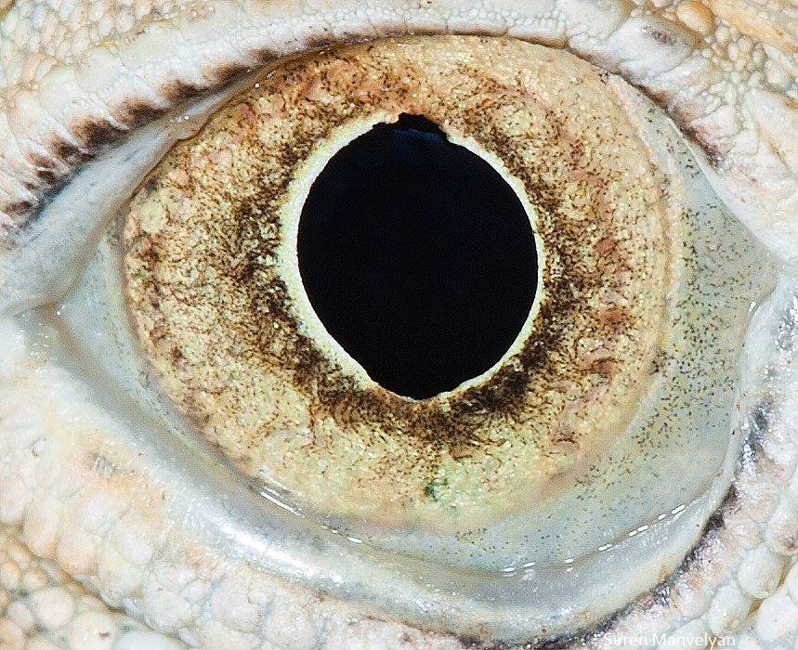
By Suren Manvelyan, http://www.surenmanvelyan.com/gallery/7116
Notes:
http://www.surenmanvelyan.com/gallery/7116
iguana

Slide 2
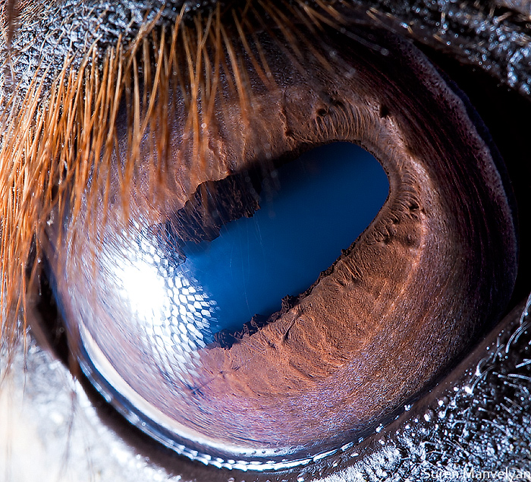
By Suren Manvelyan, http://www.surenmanvelyan.com/gallery/7116
Notes:
http://www.surenmanvelyan.com/gallery/7116
horse

Slide 3
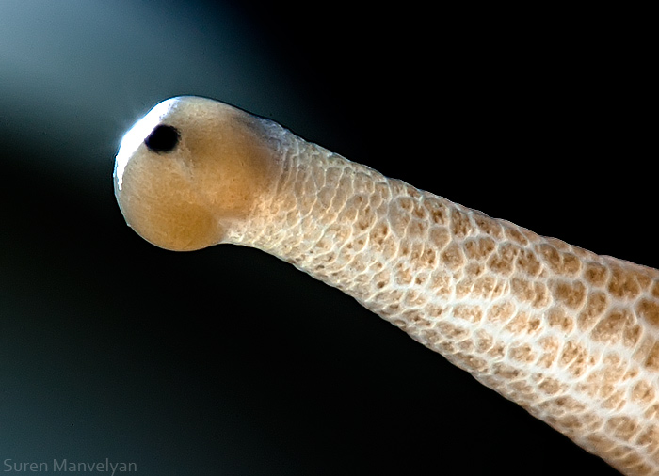
By Suren Manvelyan, http://www.surenmanvelyan.com/gallery/7116
Notes:
http://www.surenmanvelyan.com/gallery/7116
snail

Slide 4
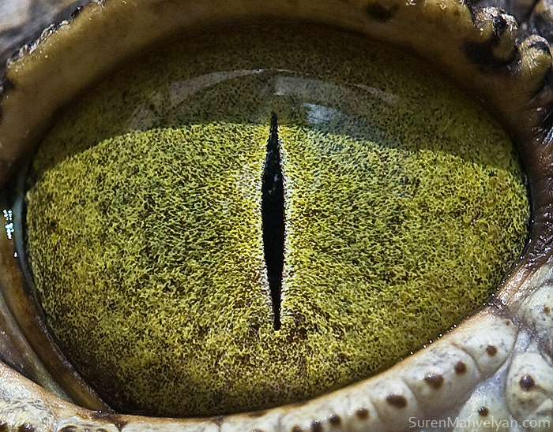
By Suren Manvelyan, http://www.surenmanvelyan.com/gallery/7116
Notes:
http://www.surenmanvelyan.com/gallery/7116
Crocodile (nile crocodile?)

Slide 5
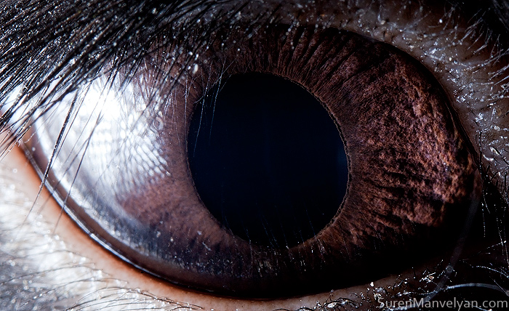
By Suren Manvelyan, http://www.surenmanvelyan.com/gallery/7116
Notes:
http://www.surenmanvelyan.com/gallery/7116
rabbit

Slide 6
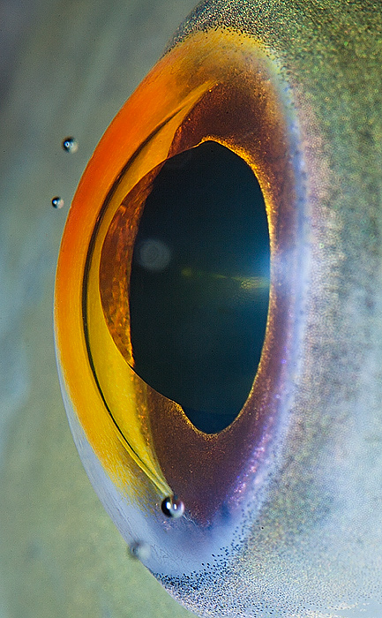
By Suren Manvelyan, http://www.surenmanvelyan.com/gallery/7116
Notes:
http://www.surenmanvelyan.com/gallery/7116
fish

Slide 7
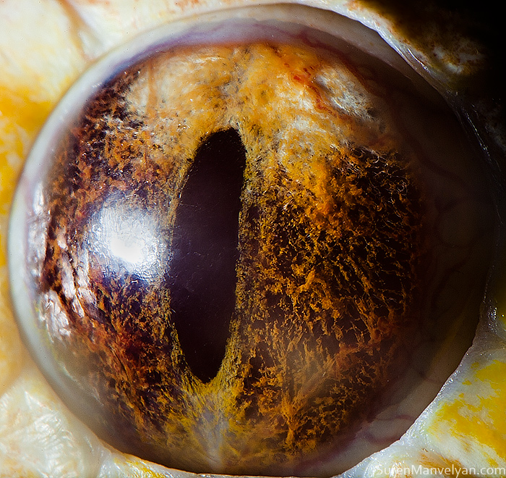
By Suren Manvelyan, http://www.surenmanvelyan.com/gallery/7116
Notes:
http://www.surenmanvelyan.com/gallery/7116
Tiger python

Slide 8
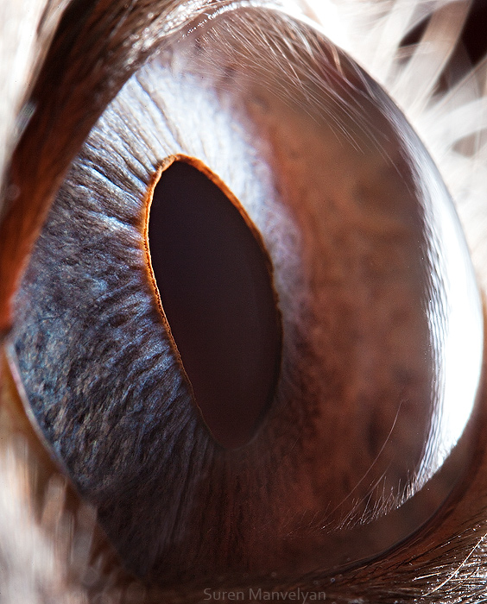
By Suren Manvelyan, http://www.surenmanvelyan.com/gallery/7116
Notes:
http://www.surenmanvelyan.com/gallery/7116
Siam cat

Slide 9
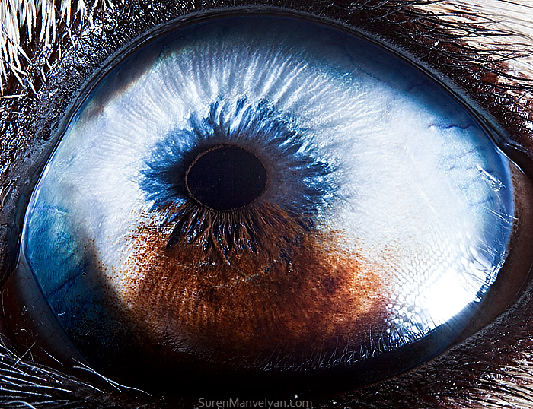
By Suren Manvelyan, http://www.surenmanvelyan.com/gallery/7116
Notes:
http://www.surenmanvelyan.com/gallery/7116
Husky with heterochromia

Slide 10
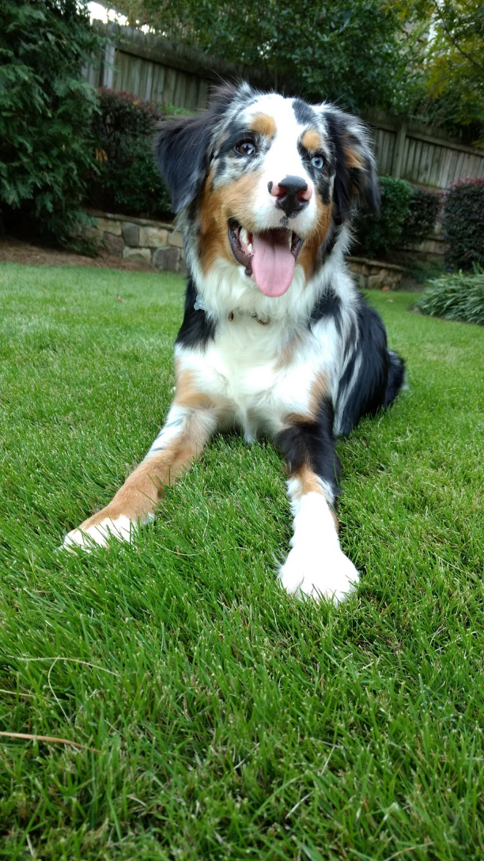
Indy
Notes:
http://www.surenmanvelyan.com/gallery/7116
Crocodile (nile crocodile?)

Slide 11

Indy
Notes:
http://www.surenmanvelyan.com/gallery/7116
Crocodile (nile crocodile?)

Slide 12
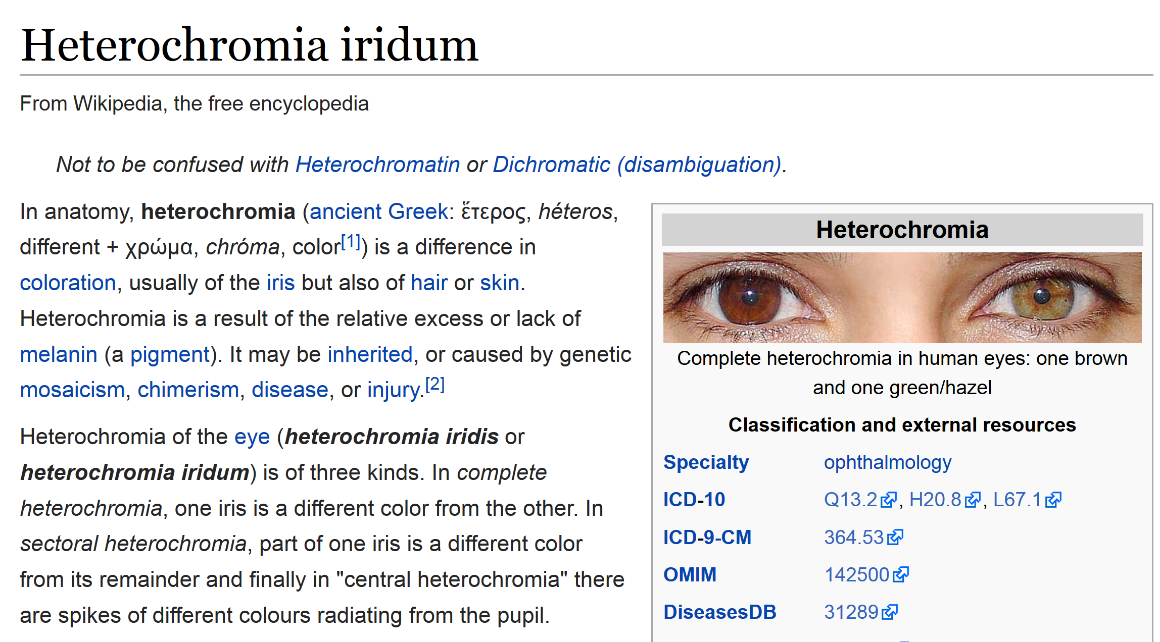

Slide 13
Recap
Bag of Features for Image Classification

Slide 14


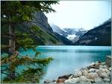

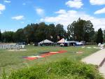
Image Categorization
Training
Training Labels
Training Images
Image Features
Classifier Training
Trained Classifier
Testing
Image Features
Trained Classifier
Prediction
Outdoor
Test Image

Slide 15

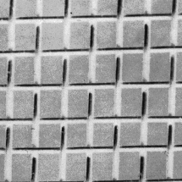
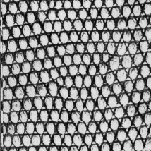



Origin 1: Texture recognition
Texture is characterized by the repetition of basic elements or textons
For stochastic textures, it is the identity of the textons, not their spatial arrangement, that matters
Julesz, 1981; Cula & Dana, 2001; Leung & Malik 2001; Mori, Belongie & Malik, 2001; Schmid 2001; Varma & Zisserman, 2002, 2003; Lazebnik, Schmid & Ponce, 2003

Slide 16




Origin 1: Texture recognition
histogram
Universal texton dictionary
Julesz, 1981; Cula & Dana, 2001; Leung & Malik 2001; Mori, Belongie & Malik, 2001; Schmid 2001; Varma & Zisserman, 2002, 2003; Lazebnik, Schmid & Ponce, 2003

Slide 17
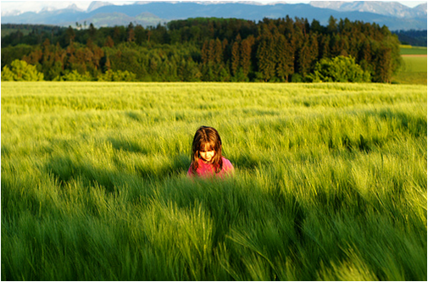
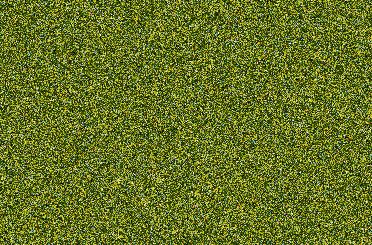
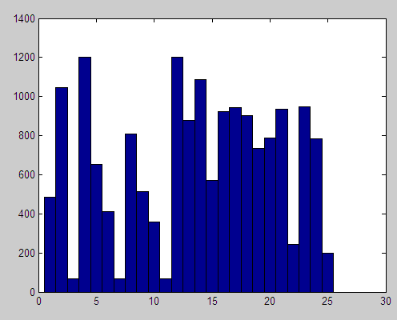
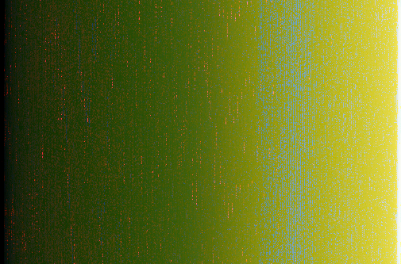
But what about layout?
All of these images have the same color histogram

Slide 18
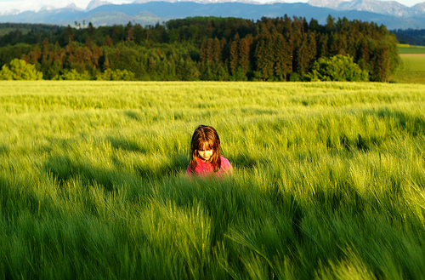
Spatial pyramid
Compute histogram in each spatial bin

Slide 19
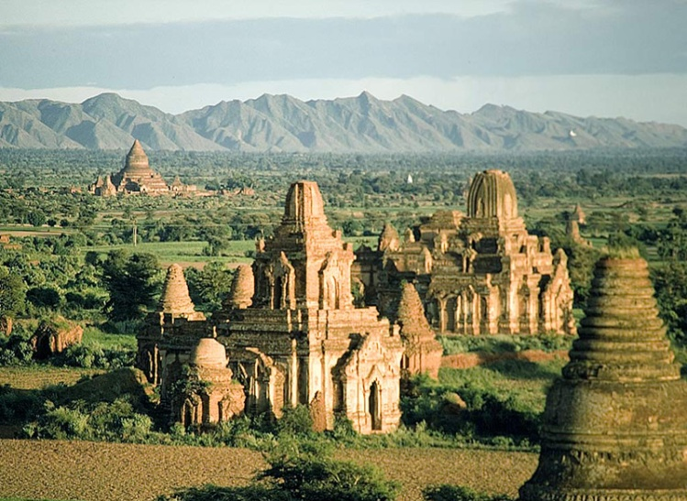
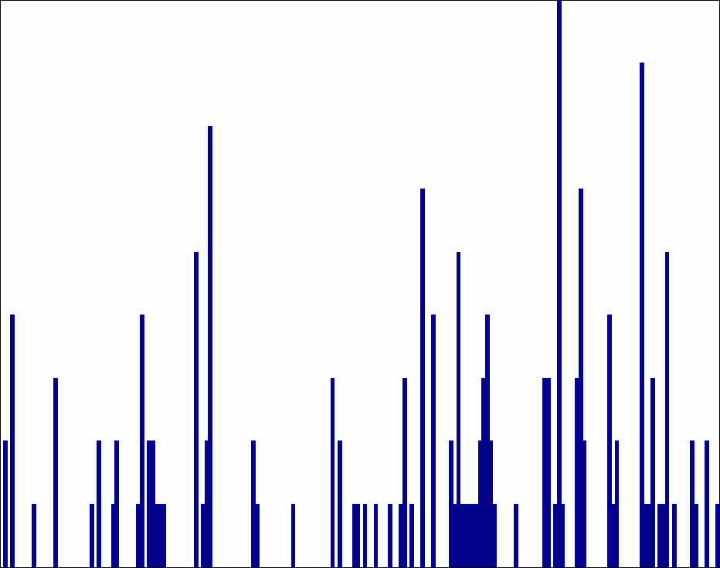
Spatial pyramid representation
Extension of a bag of features
Locally orderless representation at several levels of resolution
level 0
Lazebnik, Schmid & Ponce (CVPR 2006)

Slide 20


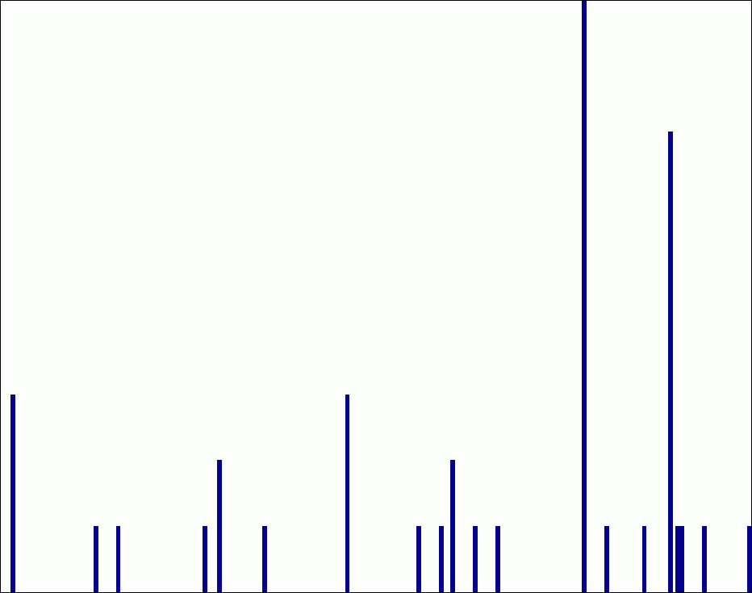
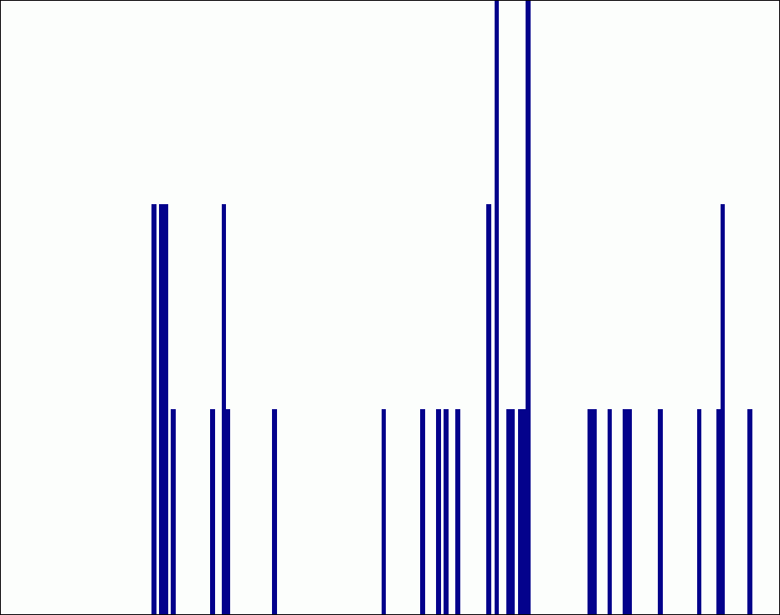
Spatial pyramid representation
Extension of a bag of features
Locally orderless representation at several levels of resolution
level 0
level 1
Lazebnik, Schmid & Ponce (CVPR 2006)

Slide 21
















Spatial pyramid representation
Extension of a bag of features
Locally orderless representation at several levels of resolution
level 0
level 1
level 2
Lazebnik, Schmid & Ponce (CVPR 2006)

Slide 22
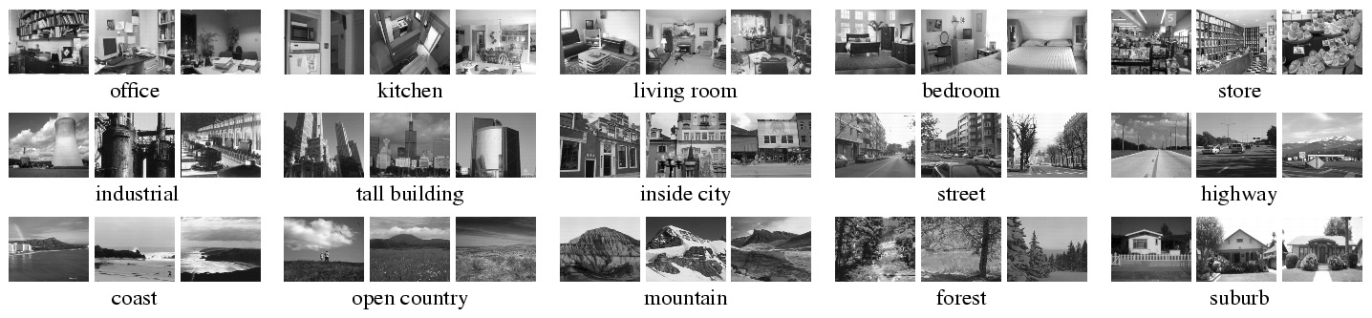
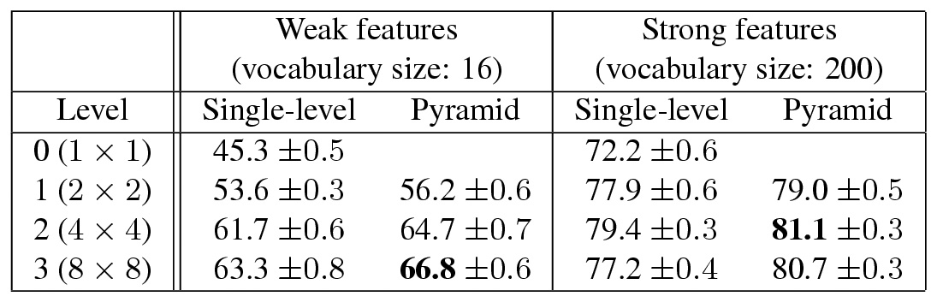
Scene category dataset
Multi-class classification results
(100 training images per class)

Slide 23
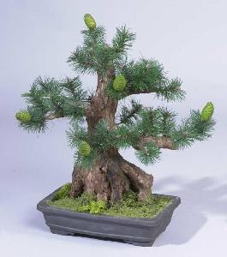
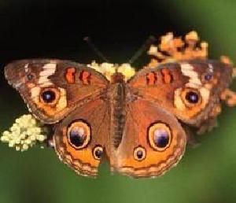
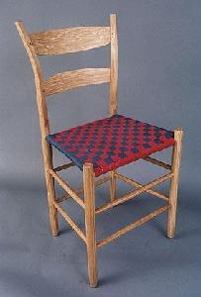
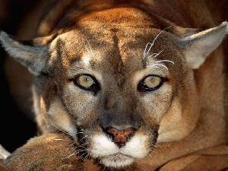

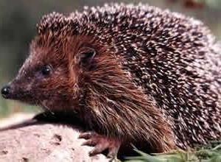
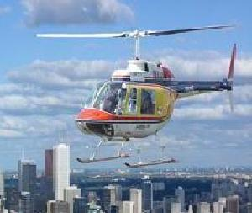
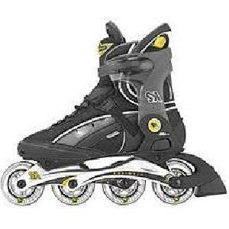
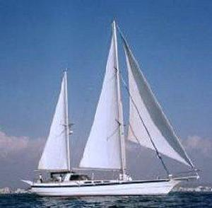

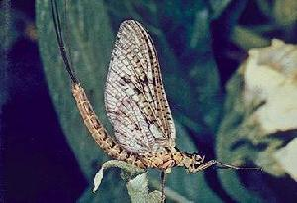
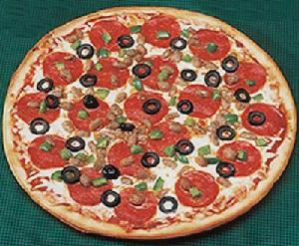
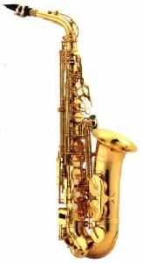
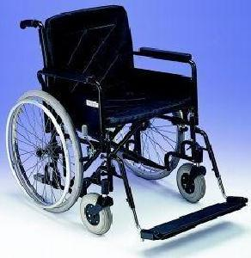
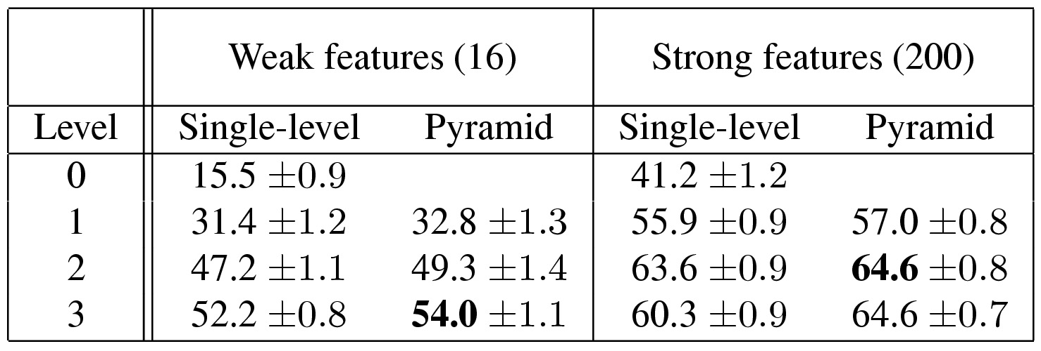
Caltech101 dataset
http://www.vision.caltech.edu/Image_Datasets/Caltech101/Caltech101.html
Multi-class classification results (30 training images per class)

Slide 24
Large-scale Instance Retrieval
Computer Vision
James Hays
Many slides from Derek Hoiem and Kristen Grauman

Slide 25
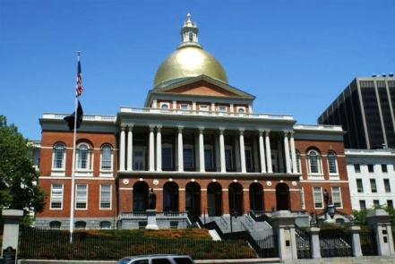
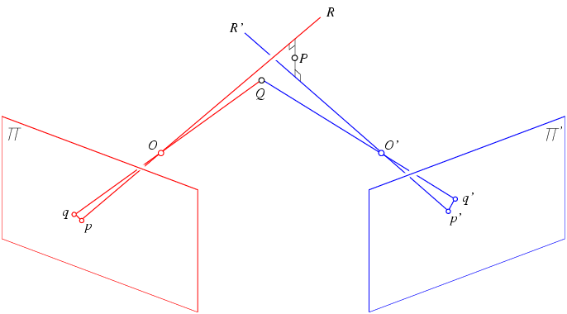
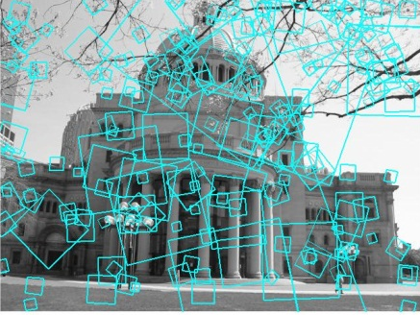
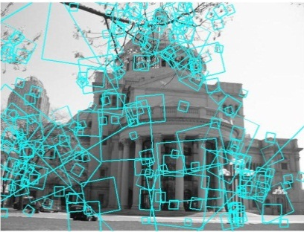

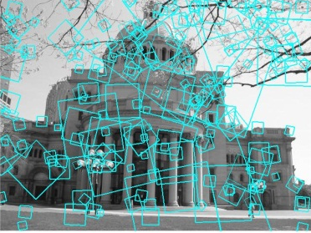
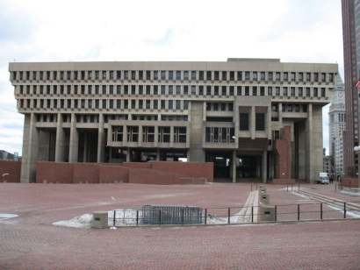
Multi-view matching
?
vs
…
Matching two given views for depth
Search for a matching view for recognition
Kristen Grauman

Slide 26
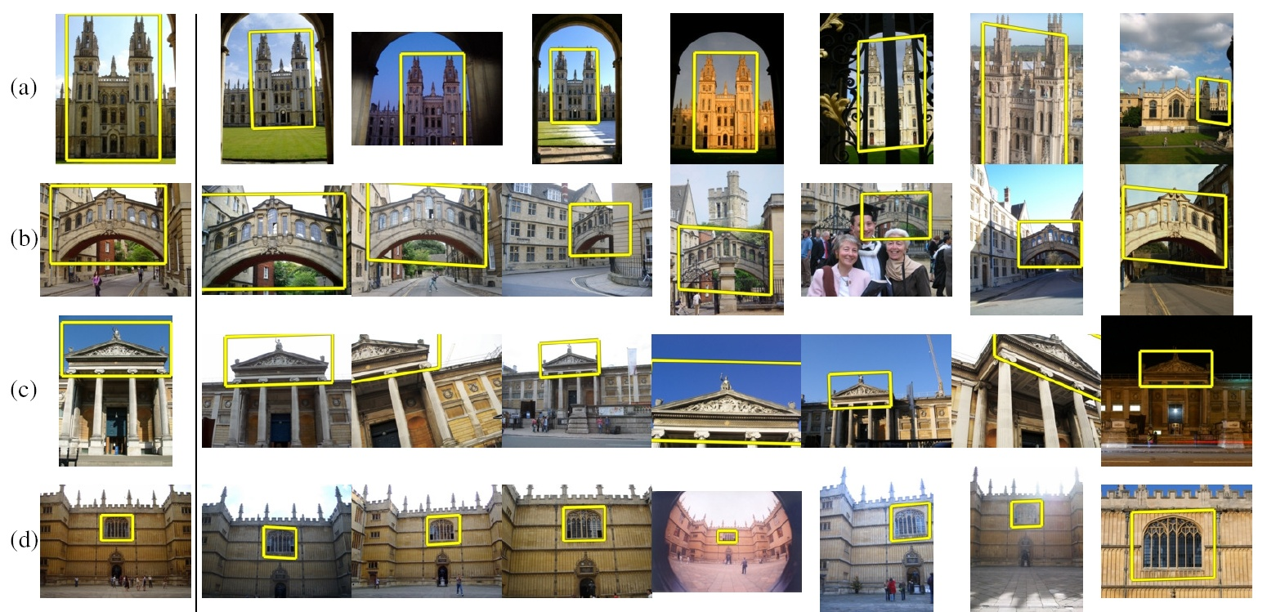
How to quickly find images in a large database that match a given image region?

Slide 27
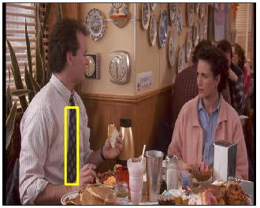
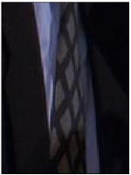
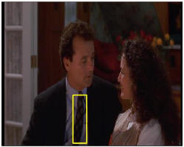
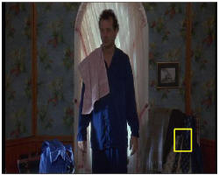






Video Google System
Query region
Collect all words within query region
Inverted file index to find relevant frames
Compare word counts
Spatial verification
Sivic & Zisserman, ICCV 2003
Demo online at : http://www.robots.ox.ac.uk/~vgg/research/vgoogle/index.html
Retrieved frames
Kristen Grauman
Notes:
27

Slide 28


Example Applications
Aachen Cathedral
Mobile tourist guide
Self-localization
Object/building recognition
Photo/video augmentation
[Quack, Leibe, Van Gool, CIVR’08]

Slide 29

Application: Large-Scale Retrieval
Query
Results from 5k Flickr images (demo available for 100k set)
[Philbin CVPR’07]

Slide 30

Web Demo: Movie Poster Recognition
50’000 movie
posters indexed
Query-by-image
from mobile phone
available in Switzer-
land
http://www.kooaba.com/en/products_engine.html#

Slide 31





Application: Image Auto-Annotation
Moulin Rouge
Old Town Square (Prague)
Tour Montparnasse
Colosseum
Viktualienmarkt
Maypole
Left: Wikipedia image
Right: closest match from Flickr
[Quack CIVR’08]

Slide 32


Notes:
http://www.google.com/mobile/goggles

Slide 33


Simple idea
See how many keypoints are close to keypoints in each other image
Lots of Matches
Few or No Matches
But this will be really, really slow!

Slide 34
Indexing local features
Each patch / region has a descriptor, which is a point in some high-dimensional feature space (e.g., SIFT)
Descriptor’s feature space
Kristen Grauman
Notes:
34

Slide 35
Indexing local features
When we see close points in feature space, we have similar descriptors, which indicates similar local content.
Query image
Descriptor’s feature space
Database images
Easily can have millions of features to search!
Kristen Grauman

Slide 36

Indexing local features: inverted file index
For text documents, an efficient way to find all pages on which a word occurs is to use an index…
We want to find all images in which a feature occurs.
To use this idea, we’ll need to map our features to “visual words”.
Kristen Grauman

Slide 37
Visual words
Map high-dimensional descriptors to tokens/words by quantizing the feature space
Quantize via clustering, let cluster centers be the prototype “words”
Word #2
Determine which word to assign to each new image region by finding the closest cluster center.
Descriptor’s feature space
Kristen Grauman

Slide 38

Visual words
Example: each group of patches belongs to the same visual word
Figure from Sivic & Zisserman, ICCV 2003
Kristen Grauman

Slide 39
Visual vocabulary formation
Issues:
Vocabulary size, number of words
Sampling strategy: where to extract features?
Clustering / quantization algorithm
Unsupervised vs. supervised
What corpus provides features (universal vocabulary?)
Kristen Grauman

Slide 40



Sampling strategies
Sparse, at interest points
Dense, uniformly
Randomly
To find specific, textured objects, sparse sampling from interest points often more reliable.
Multiple complementary interest operators offer more image coverage.
For object categorization, dense sampling offers better coverage.
[See Nowak, Jurie & Triggs, ECCV 2006]
Multiple interest operators
Image credits: F-F. Li, E. Nowak, J. Sivic

Slide 41

Inverted file index
Database images are loaded into the index mapping words to image numbers
Kristen Grauman

Slide 42

Inverted file index
New query image is mapped to indices of database images that share a word.
Kristen Grauman

Slide 43
Inverted file index
Key requirement for inverted file index to be efficient: sparsity
If most pages/images contain most words then you’re not better off than exhaustive search.
  Exhaustive search would mean comparing the word distribution of a query versus every page.

Slide 44
Instance recognition: remaining issues
How to summarize the content of an entire image? And gauge overall similarity?
How large should the vocabulary be? How to perform quantization efficiently?
Is having the same set of visual words enough to identify the object/scene? How to verify spatial agreement?
How to score the retrieval results?
Kristen Grauman

Slide 45

Analogy to documents
Of all the sensory impressions proceeding to the brain, the visual experiences are the dominant ones. Our perception of the world around us is based essentially on the messages that reach the brain from our eyes. For a long time it was thought that the retinal image was transmitted point by point to visual centers in the brain; the cerebral cortex was a movie screen, so to speak, upon which the image in the eye was projected. Through the discoveries of Hubel and Wiesel we now know that behind the origin of the visual perception in the brain there is a considerably more complicated course of events. By following the visual impulses along their path to the various cell layers of the optical cortex, Hubel and Wiesel have been able to demonstrate that the message about the image falling on the retina undergoes a step-wise analysis in a system of nerve cells stored in columns. In this system each cell has its specific function and is responsible for a specific detail in the pattern of the retinal image.
China is forecasting a trade surplus of $90bn (£51bn) to $100bn this year, a threefold increase on 2004's $32bn. The Commerce Ministry said the surplus would be created by a predicted 30% jump in exports to $750bn, compared with a 18% rise in imports to $660bn. The figures are likely to further annoy the US, which has long argued that China's exports are unfairly helped by a deliberately undervalued yuan. Beijing agrees the surplus is too high, but says the yuan is only one factor. Bank of China governor Zhou Xiaochuan said the country also needed to do more to boost domestic demand so more goods stayed within the country. China increased the value of the yuan against the dollar by 2.1% in July and permitted it to trade within a narrow band, but the US wants the yuan to be allowed to trade freely. However, Beijing has made it clear that it will take its time and tread carefully before allowing the yuan to rise further in value.
sensory, brain,
visual, perception,
retinal, cerebral cortex,
eye, cell, optical
nerve, image
Hubel, Wiesel
China, trade,
surplus, commerce,
exports, imports, US,
yuan, bank, domestic,
foreign, increase,
trade, value
ICCV 2005 short course, L. Fei-Fei

Slide 46





Slide 47







Bags of visual words
Summarize entire image based on its distribution (histogram) of word occurrences.
Analogous to bag of words representation commonly used for documents.
Notes:
47

Slide 48








Comparing bags of words
Rank frames by normalized scalar product between their (possibly weighted) occurrence counts---nearest neighbor search for similar images.
[1 8 1 4]
[5 1 1 0]
for vocabulary of V words
Kristen Grauman

Slide 49

Inverted file index and
bags of words similarity
w₉₁
Extract words in query
Inverted file index to find relevant frames
Compare word counts
Kristen Grauman

Slide 50
Instance recognition: remaining issues
How to summarize the content of an entire image? And gauge overall similarity?
How large should the vocabulary be? How to perform quantization efficiently?
Is having the same set of visual words enough to identify the object/scene? How to verify spatial agreement?
How to score the retrieval results?
Kristen Grauman

Slide 51


Vocabulary size
Results for recognition task with 6347 images
Branching factors
Influence on performance, sparsity
Nister & Stewenius, CVPR 2006
Kristen Grauman

Slide 52
Recognition with K-tree
Following slides by David Nister (CVPR 2006)

Slide 53

Notes:
I will now try to describe the approach with an animation.
The first, offline phase, is to train the vocabulary tree.
We use Maximally Stable Extremal Regions by Matas et al. and then we extract SIFT descriptors from the MSER regions.
Regarding the feature extraction, we are not really claiming anything other than down-in-the-trenches nose-to-the-grindstone hard work to get good implementations of the state-of-the-art, and since we are all obsessed with novelty I will not spend any time talking about the feature extraction.
We believe that the vocabulary tree approach will work well on any of your favorite descriptors.

Slide 54

Notes:
All the descriptor vectors are thrown into a common space.
This is done for many images, the goal being to acquire enough statistics on how natural images distribute points in the descriptor space.

Slide 55


Slide 56


Slide 57


Slide 58


Slide 60
Notes:
We then run k-means on the descriptor space. In this setting, k defines what we call the branch-factor of the tree, which indicates how fast the tree branches.
In this illustration, k is three. We then run k-means again, recursively on each of the resulting quantization cells.
This defines the vocabulary tree, which is essentially a hierarchical set of cluster centers and their corresponding Voronoi regions.
We typically use a branch-factor of 10 and six levels, resulting in a million leaf nodes. We lovingly call this the Mega-Voc.

Slide 70
Notes:
We now have the vocabulary tree, and the online phase can begin.
In order to add an image to the database, we perform feature extraction. Each descriptor vector is now dropped down from the root of the tree and quantized very efficiently into a path down the tree, encoded by a single integer.
Each node in the vocabulary tree has an associated inverted file index.
Indecies back to the new image are then added to the relevant inverted files.
This is a very efficient operation that is carried out whenever we want to add an image.

Slide 71



Slide 72



Slide 73



Slide 74



Slide 75

Notes:
When we then wish to query on an input image, we quantize the descriptor vectors of the input image in a similar way, and accumulate scores for the images in the database with so called term frequency inverse document frequency (tf-idf). This is effectively an entropy weighting of the information. The winner is the image in the database with the most common information with the input image.

Slide 76
Vocabulary trees: complexity
Number of words given tree parameters: branching factor and number of levels
branching_factor^^{number_of_levels}
Word assignment cost vs. flat vocabulary
O(k) for flat
O(log_{branching_factor}(k) * branching_factor)
Is this like a kd-tree?
Yes, but with better partitioning and defeatist search.
This hierarchical data structure is lossy – you might not find your true nearest cluster.
Notes:
Number of words = (branching_factor)^(number_of_levels)
Assignment cost for flat hierarchy O(k), for tree O(log(base branching_factor)(k) * branching_factor)

Slide 77
To be continued…

