Slide 1
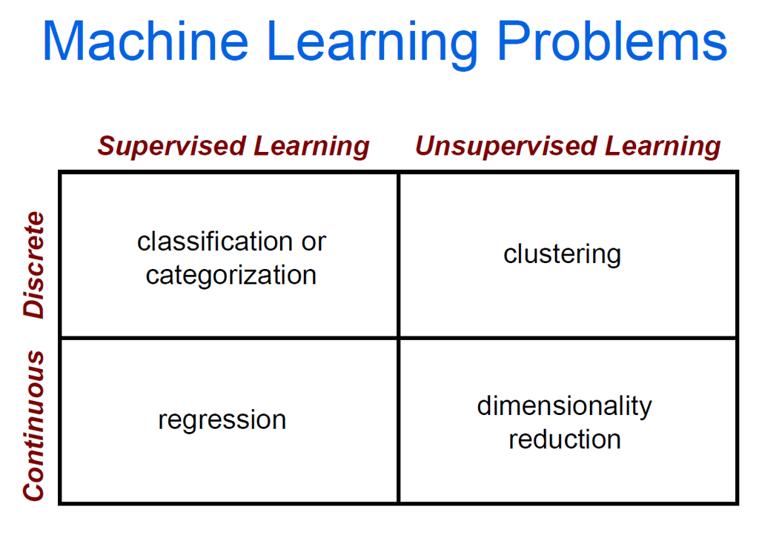

Slide 2
Supervised learning
y = f(x)
Training: given a training set of labeled examples {(x₁,y₁), …, (x_{N},y_{N})}, estimate the prediction function f by minimizing the prediction error on the training set
Testing: apply f to a never before seen test example x and output the predicted value y = f(x)
output
prediction function
Image feature
Slide credit: L. Lazebnik

Slide 3




Image Categorization
Training
Training Labels
Training Images
Image Features
Classifier Training
Trained Classifier

Slide 4
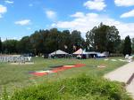
Image Categorization
Training
Training Labels
Training Images
Image Features
Classifier Training
Trained Classifier
Testing
Image Features
Trained Classifier
Prediction
Outdoor
Test Image

Slide 5
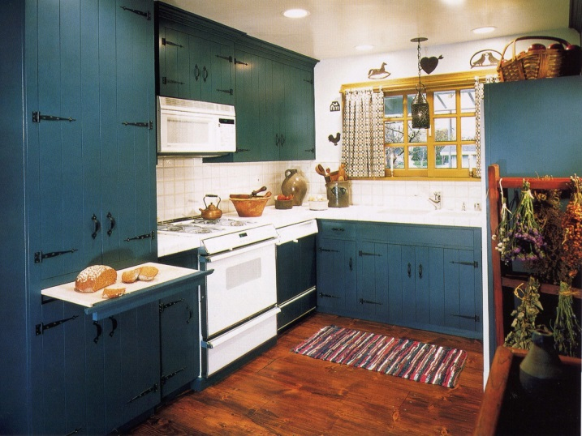

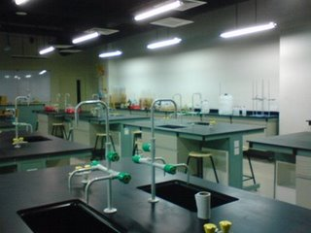
Example: Scene Categorization
Is this a kitchen?

Slide 6
Image features
Training
Training Labels
Training Images
Image Features
Classifier Training
Trained Classifier

Slide 7
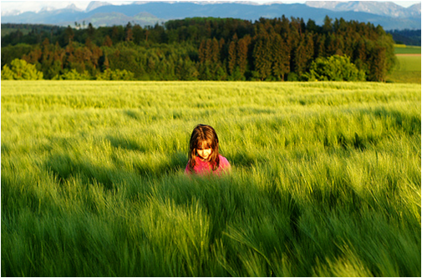
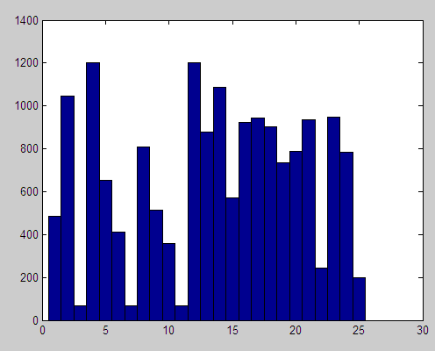
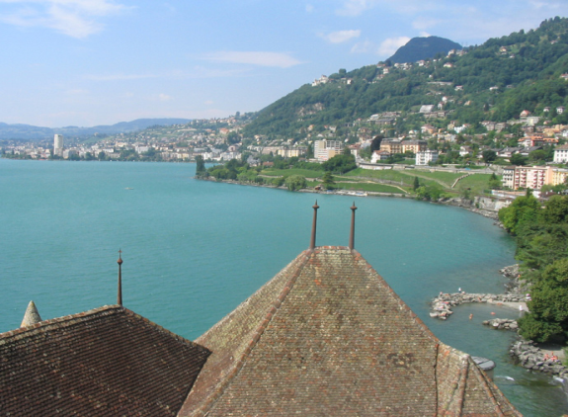
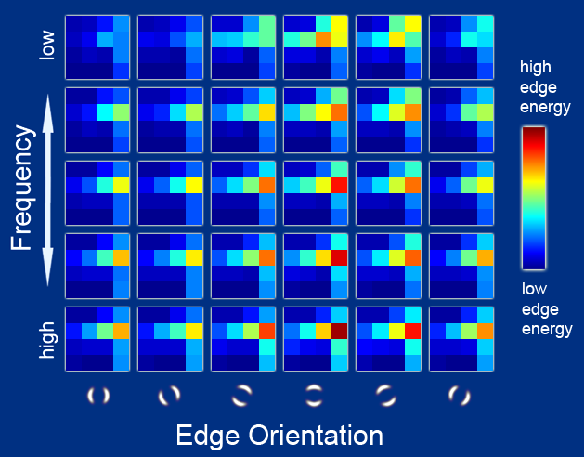
Features
Raw pixels
Histograms
GIST descriptors
…
Slide credit: L. Lazebnik

Slide 8
Classifiers
Training
Training Labels
Training Images
Image Features
Classifier Training
Trained Classifier

Slide 9
Learning a classifier
Given some set of features with corresponding labels, learn a function to predict the labels from the features
x
x
x
x
x
x
o
x
x
o
o
o
o
x2
x1

Slide 10
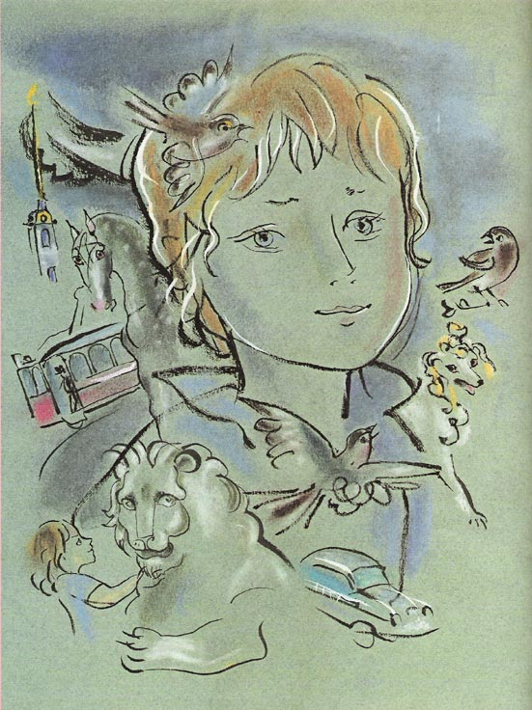
Recognition: Overview and History
Slides from Lana Lazebnik, Fei-Fei Li, Rob Fergus, Antonio Torralba, and Jean Ponce

Slide 11
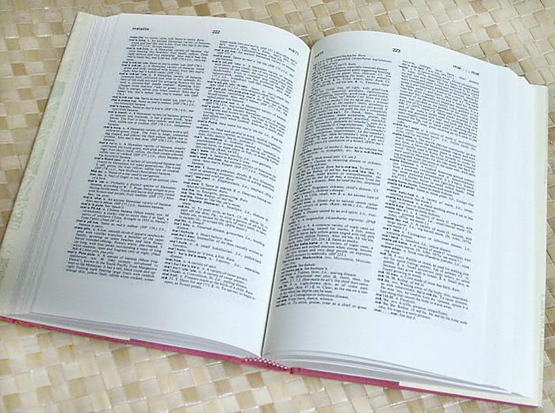

How many visual object categories are there?
~10,000 to 30,000
Biederman 1987
Notes:
1500-3000 basic-level nouns, ~10 types per basic-level category
Alternative explanation (Perona): ~1000 names per domain (broad scene category), 20-30 domains

Slide 12
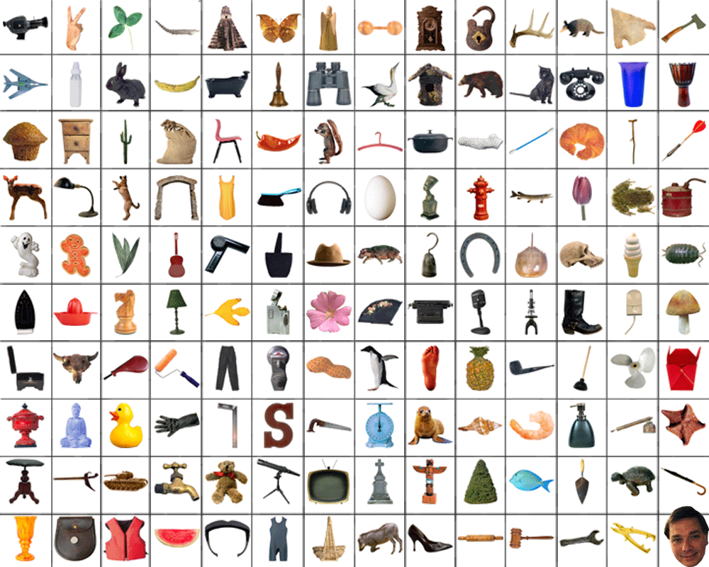
~10,000 to 30,000

Slide 13
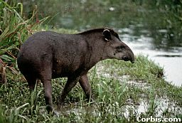

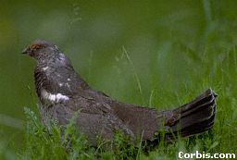
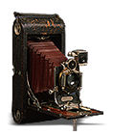
OBJECTS
ANIMALS
PLANTS
INANIMATE
NATURAL
MAN-MADE
…..
VERTEBRATE
MAMMALS
BIRDS
TAPIR
BOAR
GROUSE
CAMERA

Slide 14
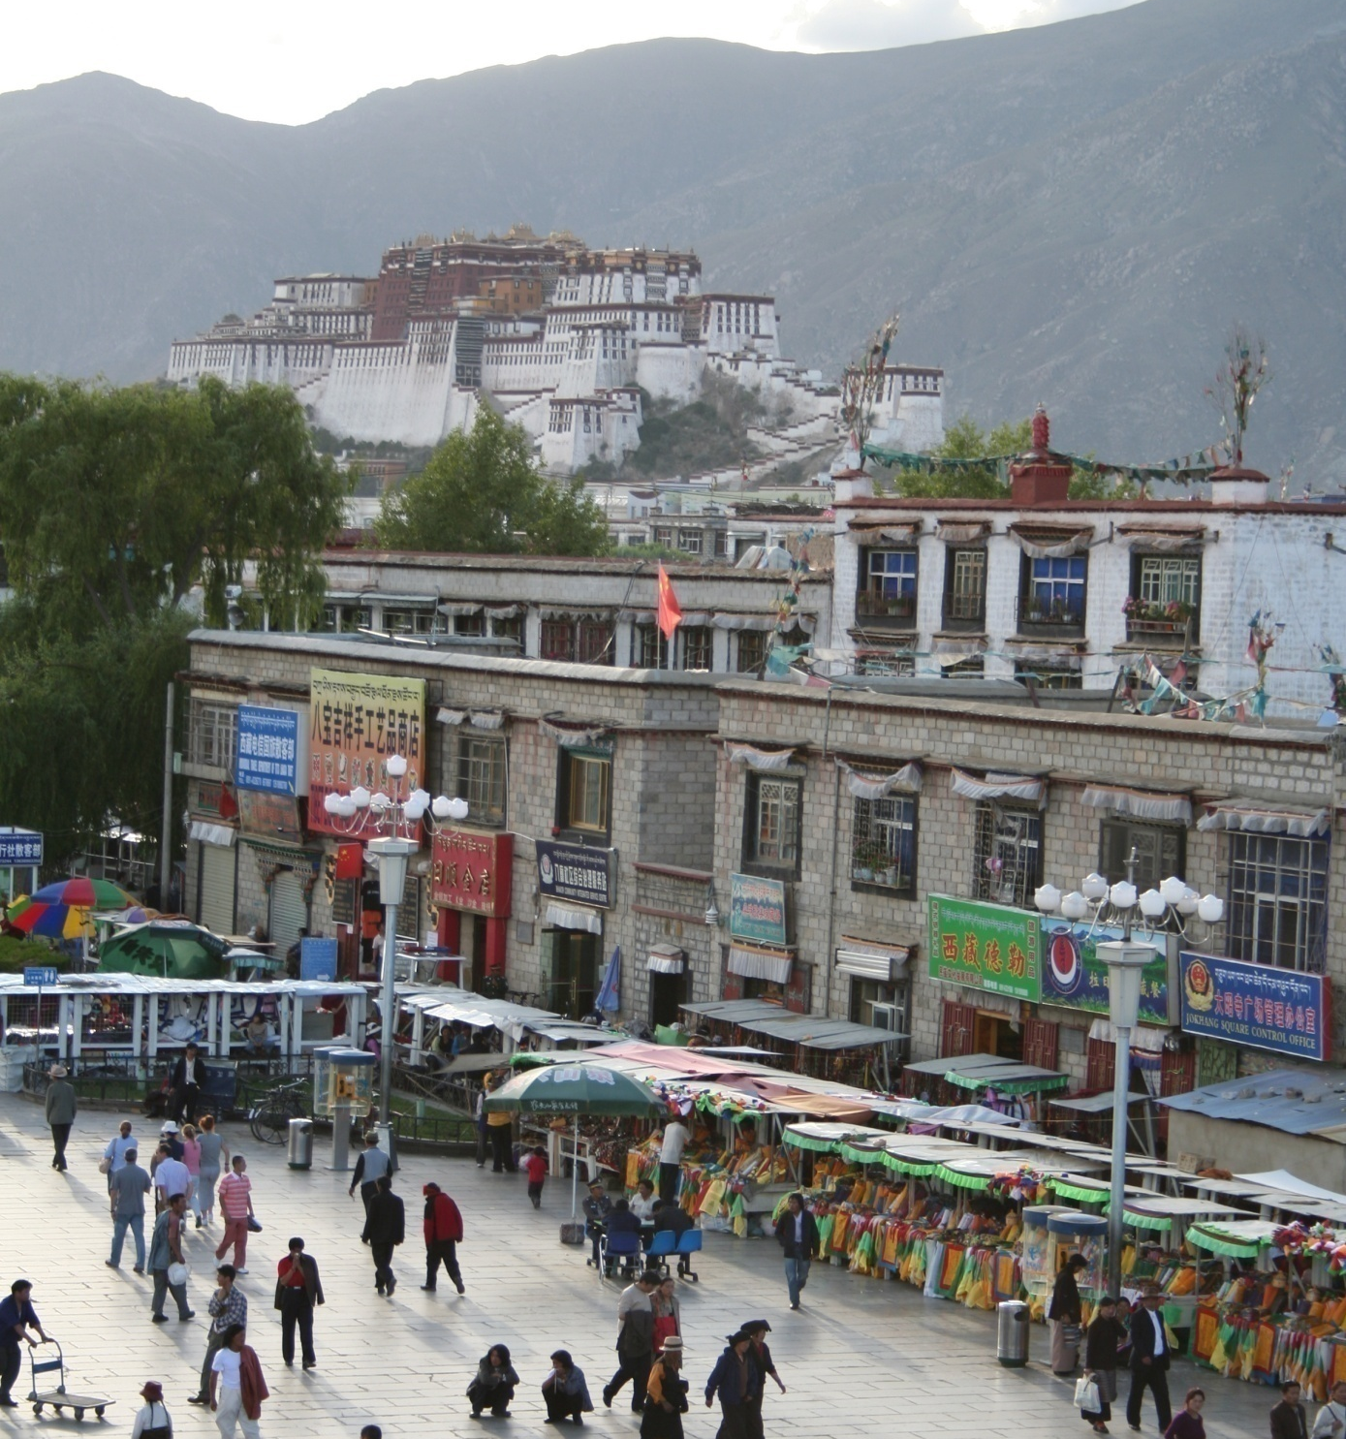
Specific recognition tasks
Svetlana Lazebnik

Slide 15
Scene categorization or classification
outdoor/indoor
city/forest/factory/etc.
Svetlana Lazebnik

Slide 16
Image annotation / tagging / attributes
street
people
building
mountain
tourism
cloudy
brick
…
Svetlana Lazebnik

Slide 17
Object detection
find pedestrians
Svetlana Lazebnik

Slide 18
Image parsing / semantic segmentation
sky
mountain
building
tree
building
banner
street lamp
market
people
Svetlana Lazebnik

Slide 19
Scene understanding?
Svetlana Lazebnik

Slide 20
Recognition is all about modeling variability
Variability:
Camera position
Illumination
Shape parameters
Within-class variations?
Svetlana Lazebnik
Notes:
One could argue that invariance is the key challenge to computer vision. But is this still true with big data?

Slide 21
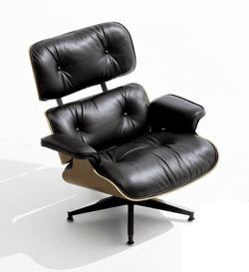
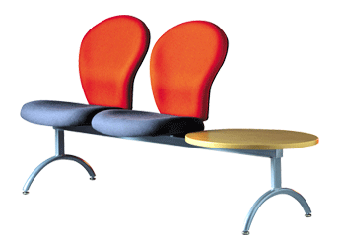
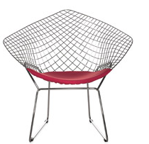
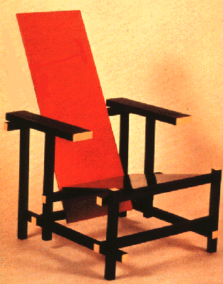
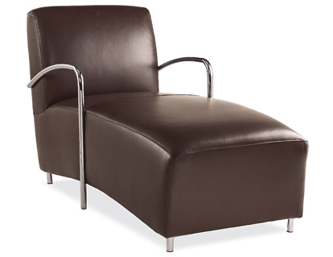
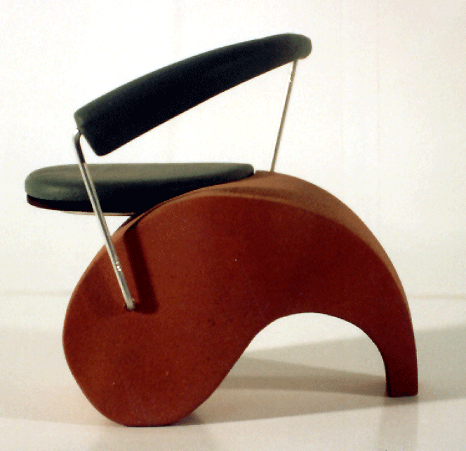
Within-class variations
Svetlana Lazebnik
Notes:
Note English language issues. Try to not let language confound things.

Slide 22
History of ideas in recognition
1960s – early 1990s: the geometric era
Svetlana Lazebnik

Slide 23
θ
Variability:
Camera position
Illumination
Alignment
Shape: assumed known
Roberts (1965); Lowe (1987); Faugeras & Hebert (1986); Grimson & Lozano-Perez (1986); Huttenlocher & Ullman (1987)
Svetlana Lazebnik

Slide 24
Recall: Alignment
Alignment: fitting a model to a transformation between pairs of features (matches) in two images
x_{i}
x_{i}
Find transformation T
that minimizes
'
T
Svetlana Lazebnik

Slide 25
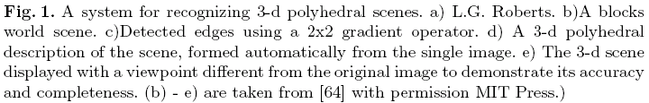
Recognition as an alignment problem:
Block world
L. G. Roberts, Machine Perception of Three Dimensional Solids, Ph.D. thesis, MIT Department of Electrical Engineering, 1963.
J. Mundy, Object Recognition in the Geometric Era: a Retrospective, 2006

Slide 26
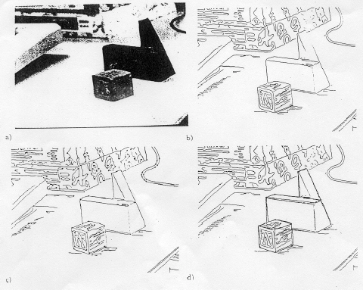
Alignment: Huttenlocher & Ullman (1987)

Slide 27
Variability
Invariance to:
Camera position
Illumination
Internal parameters
Duda & Hart ( 1972); Weiss (1987); Mundy et al. (1992-94);
Rothwell et al. (1992); Burns et al. (1993)
Svetlana Lazebnik

Slide 28
Example: invariant to similarity transformations computed from four points
B
C
D
A
Projective invariants (Rothwell et al., 1992):
General 3D objects do not admit monocular viewpoint
invariants (Burns et al., 1993)

Slide 29






Representing and recognizing object categories
is harder...
ACRONYM (Brooks and Binford, 1981)
Binford (1971), Nevatia & Binford (1972), Marr & Nishihara (1978)

Slide 30
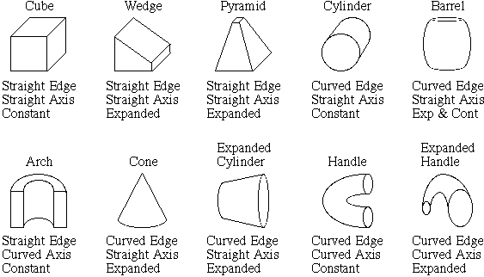
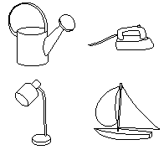
Recognition by components
Biederman (1987)
Primitives (geons)
Objects
http://en.wikipedia.org/wiki/Recognition_by_Components_Theory
Svetlana Lazebnik

Slide 31
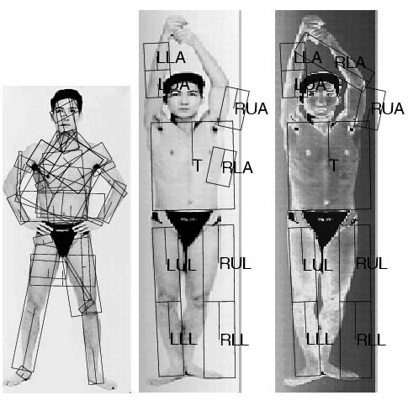
General shape primitives?
Generalized cylinders
Ponce et al. (1989)
Forsyth (2000)
Zisserman et al. (1995)
Svetlana Lazebnik

Slide 32
History of ideas in recognition
1960s – early 1990s: the geometric era
1990s: appearance-based models
Svetlana Lazebnik

Slide 33
Empirical models of image variability
Appearance-based techniques
Turk & Pentland (1991); Murase & Nayar (1995); etc.
Svetlana Lazebnik

Slide 34
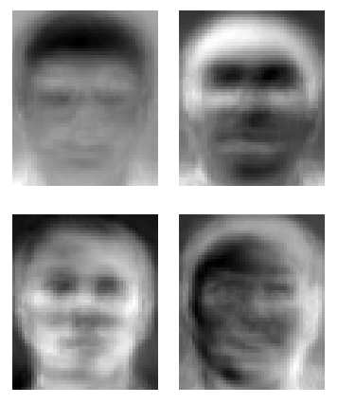
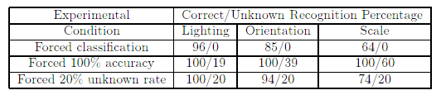
Eigenfaces (Turk & Pentland, 1991)
Svetlana Lazebnik

Slide 35
Color Histograms
Swain and Ballard, Color Indexing, IJCV 1991.
Svetlana Lazebnik

Slide 36
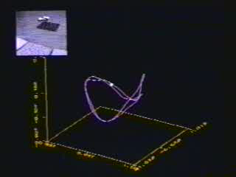
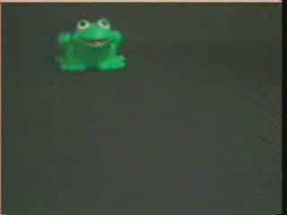
Appearance manifolds
H. Murase and S. Nayar, Visual learning and recognition of 3-d objects from appearance, IJCV 1995

Slide 37
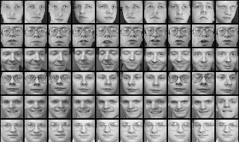
Limitations of global appearance models
Requires global registration of patterns
Not robust to clutter, occlusion, geometric transformations
Svetlana Lazebnik

Slide 38
History of ideas in recognition
1960s – early 1990s: the geometric era
1990s: appearance-based models
1990s – present: sliding window approaches
Svetlana Lazebnik

Slide 39
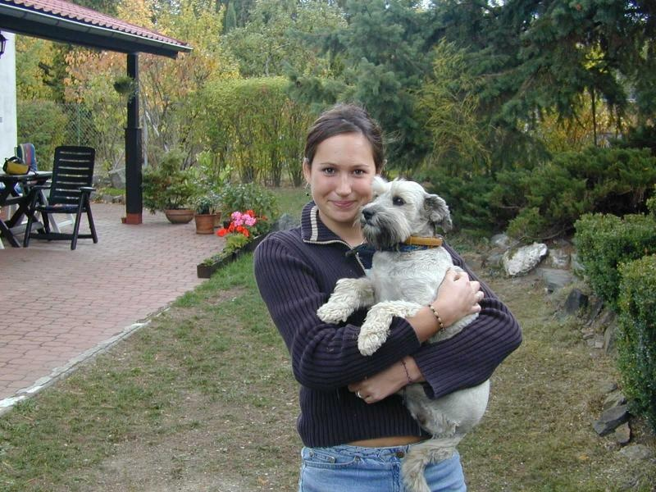
Sliding window approaches

Slide 40
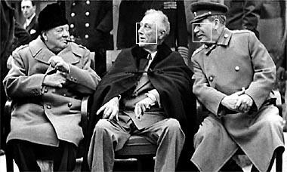
Sliding window approaches
Turk and Pentland, 1991
Belhumeur, Hespanha, & Kriegman, 1997
Schneiderman & Kanade 2004
Viola and Jones, 2000
Schneiderman & Kanade, 2004
Argawal and Roth, 2002
Poggio et al. 1993

Slide 41
History of ideas in recognition
1960s – early 1990s: the geometric era
1990s: appearance-based models
Mid-1990s: sliding window approaches
Late 1990s: local features
Svetlana Lazebnik

Slide 42
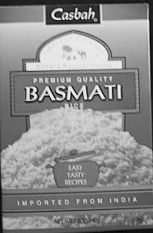
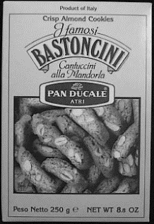

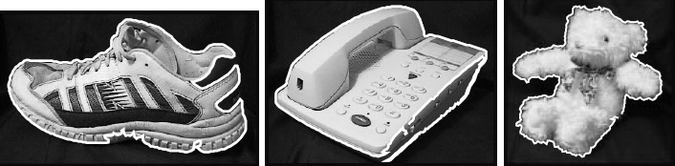
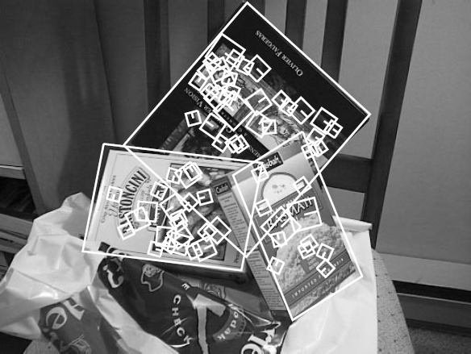
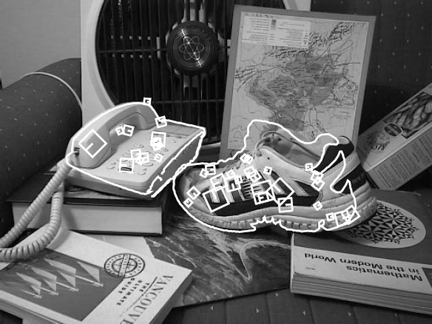
Local features for object instance recognition
D. Lowe (1999, 2004)

Slide 43
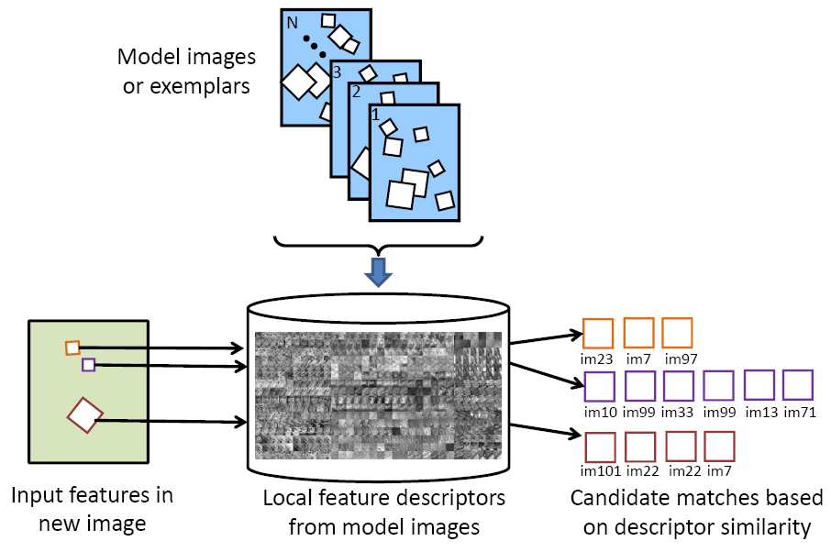
Large-scale image search
Combining local features, indexing, and spatial constraints
Image credit: K. Grauman and B. Leibe

Slide 44
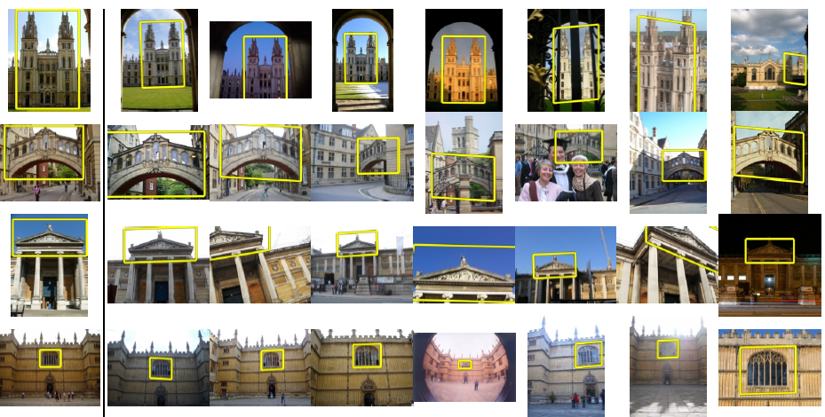
Large-scale image search
Combining local features, indexing, and spatial constraints
Philbin et al. ‘07

Slide 45
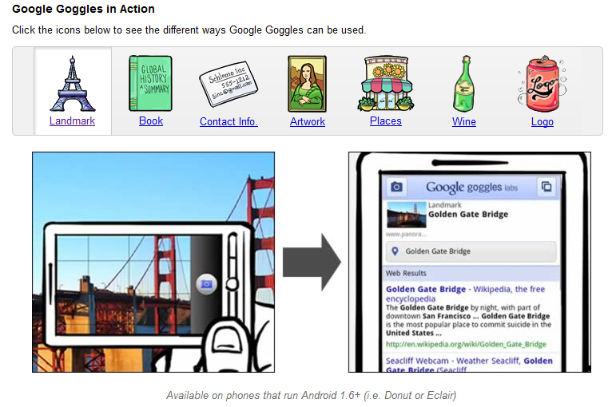
Large-scale image search
Combining local features, indexing, and spatial constraints
Svetlana Lazebnik

Slide 46
History of ideas in recognition
1960s – early 1990s: the geometric era
1990s: appearance-based models
Mid-1990s: sliding window approaches
Late 1990s: local features
Early 2000s: parts-and-shape models

Slide 47
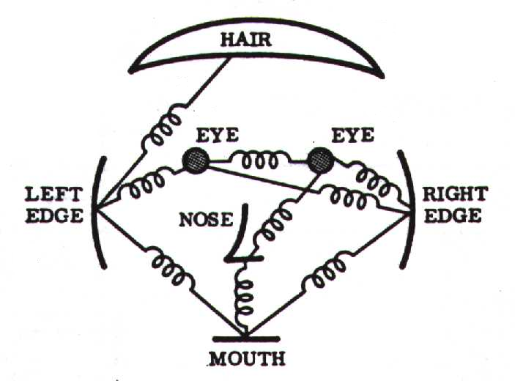
Parts-and-shape models
Model:
  Object as a set of parts
  Relative locations between parts
  Appearance of part
Figure from [Fischler & Elschlager 73]

Slide 48
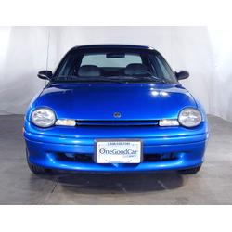
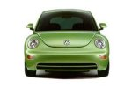
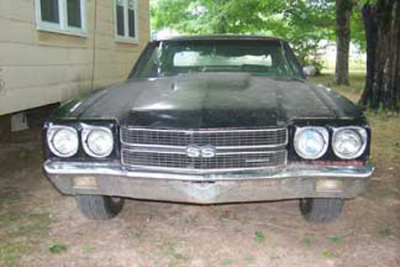
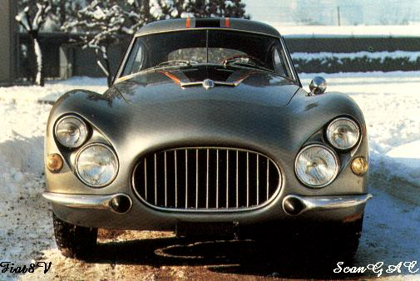
Constellation models
Weber, Welling & Perona (2000), Fergus, Perona & Zisserman (2003)
Notes:
Globally different, but have portions in common

Slide 49
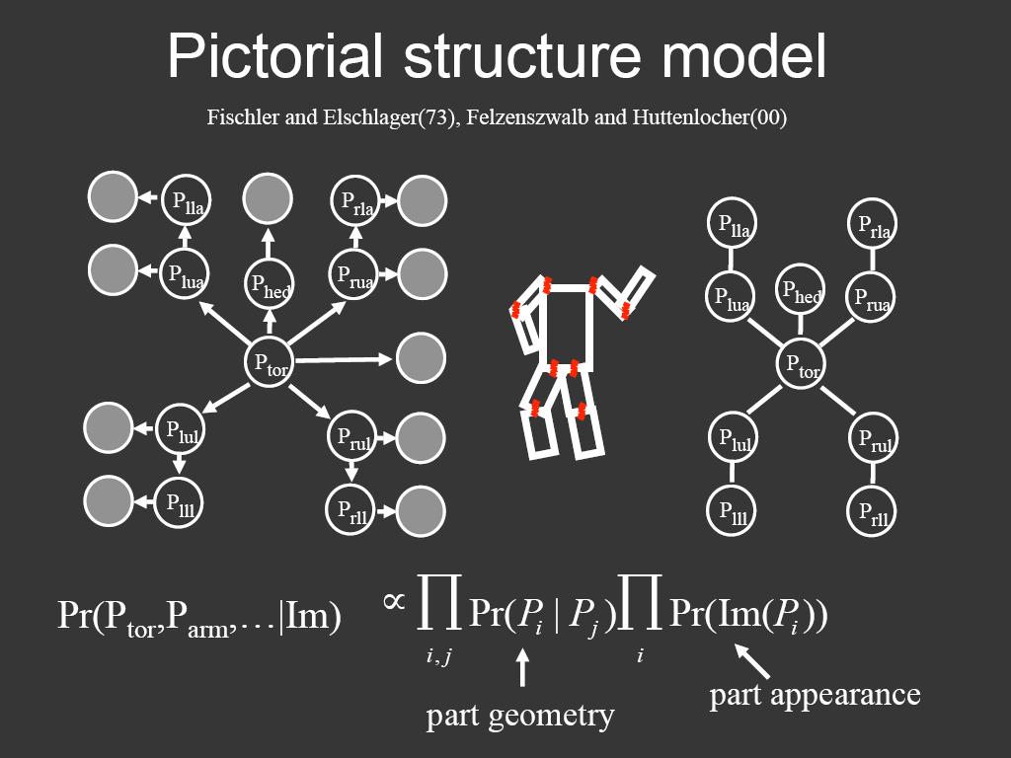
Representing people

Slide 50
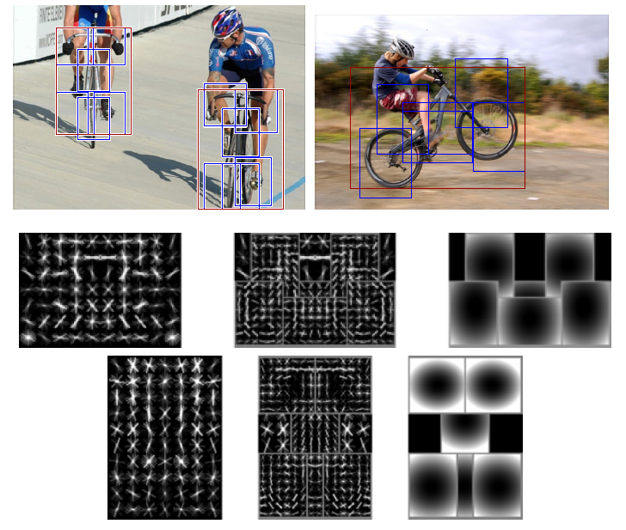
Discriminatively trained part-based models
P. Felzenszwalb, R. Girshick, D. McAllester, D. Ramanan, "Object Detection with Discriminatively Trained Part-Based Models," PAMI 2009

Slide 51
History of ideas in recognition
1960s – early 1990s: the geometric era
1990s: appearance-based models
Mid-1990s: sliding window approaches
Late 1990s: local features
Early 2000s: parts-and-shape models
Mid-2000s: bags of features
Svetlana Lazebnik

Slide 52
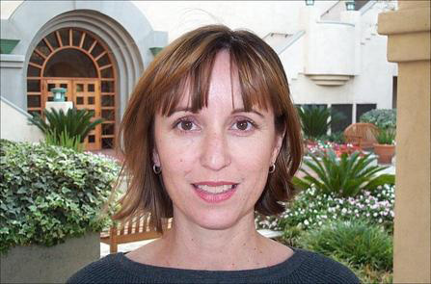
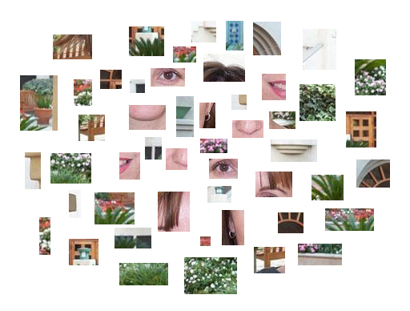
Bag-of-features models
Svetlana Lazebnik

Slide 53



Bag-of-features models
Bag of ‘words’
Object
Svetlana Lazebnik

Slide 54








Objects as texture
All of these are treated as being the same
No distinction between foreground and background: scene recognition?
Svetlana Lazebnik
Notes:
Motivation slide. Clearly location has to help, but bag-of-words doesn’t have it…

Slide 55






Origin 1: Texture recognition
Texture is characterized by the repetition of basic elements or textons
For stochastic textures, it is the identity of the textons, not their spatial arrangement, that matters
Julesz, 1981; Cula & Dana, 2001; Leung & Malik 2001; Mori, Belongie & Malik, 2001; Schmid 2001; Varma & Zisserman, 2002, 2003; Lazebnik, Schmid & Ponce, 2003

Slide 56




Origin 1: Texture recognition
histogram
Universal texton dictionary
Julesz, 1981; Cula & Dana, 2001; Leung & Malik 2001; Mori, Belongie & Malik, 2001; Schmid 2001; Varma & Zisserman, 2002, 2003; Lazebnik, Schmid & Ponce, 2003

Slide 57
Origin 2: Bag-of-words models
Orderless document representation: frequencies of words from a dictionary Salton & McGill (1983)

Slide 58

Origin 2: Bag-of-words models
Orderless document representation: frequencies of words from a dictionary Salton & McGill (1983)
US Presidential Speeches Tag Cloud
http://chir.ag/phernalia/preztags/

Slide 59

Origin 2: Bag-of-words models
Orderless document representation: frequencies of words from a dictionary Salton & McGill (1983)
US Presidential Speeches Tag Cloud
http://chir.ag/phernalia/preztags/

Slide 60

Origin 2: Bag-of-words models
Orderless document representation: frequencies of words from a dictionary Salton & McGill (1983)
US Presidential Speeches Tag Cloud
http://chir.ag/phernalia/preztags/

Slide 61



Bag-of-features steps
Extract features
Learn “visual vocabulary”
Quantize features using visual vocabulary
Represent images by frequencies of “visual words”

Slide 62


1. Feature extraction
Regular grid or interest regions

Slide 63


1. Feature extraction
Compute descriptor
Normalize patch
Detect patches
Slide credit: Josef Sivic

Slide 64
1. Feature extraction
…
Slide credit: Josef Sivic

Slide 65
2. Learning the visual vocabulary
…
Slide credit: Josef Sivic

Slide 66
2. Learning the visual vocabulary
…
Clustering
Slide credit: Josef Sivic

Slide 67
2. Learning the visual vocabulary
Visual vocabulary
…
Clustering
Slide credit: Josef Sivic

Slide 68
K-means clustering
Want to minimize sum of squared Euclidean distances between points x_{i} and their nearest cluster centers m_{k}
Algorithm:
Randomly initialize K cluster centers
Iterate until convergence:
  Assign each data point to the nearest center
  Recompute each cluster center as the mean of all points assigned to it

Slide 69
Clustering and vector quantization
Clustering is a common method for learning a visual vocabulary or codebook
  Unsupervised learning process
  Each cluster center produced by k-means becomes a codevector
  Codebook can be learned on separate training set
  Provided the training set is sufficiently representative, the codebook will be “universal”
The codebook is used for quantizing features
  A vector quantizer takes a feature vector and maps it to the index of the nearest codevector in a codebook
  Codebook = visual vocabulary
  Codevector = visual word

Slide 70

















Example codebook
…
Appearance codebook
Source: B. Leibe

Slide 71

Another codebook
…
…
…
…
…
Appearance codebook
Source: B. Leibe

Slide 72
Visual vocabularies: Issues
How to choose vocabulary size?
  Too small: visual words not representative of all patches
  Too large: quantization artifacts, overfitting
Computational efficiency
  Vocabulary trees
  (Nister & Stewenius, 2006)

Slide 73


But what about layout?
All of these images have the same color histogram

Slide 74

Spatial pyramid
Compute histogram in each spatial bin

Slide 75


Spatial pyramid representation
Extension of a bag of features
Locally orderless representation at several levels of resolution
level 0
Lazebnik, Schmid & Ponce (CVPR 2006)

Slide 76




Spatial pyramid representation
Extension of a bag of features
Locally orderless representation at several levels of resolution
level 0
level 1
Lazebnik, Schmid & Ponce (CVPR 2006)

Slide 77
















Spatial pyramid representation
Extension of a bag of features
Locally orderless representation at several levels of resolution
level 0
level 1
level 2
Lazebnik, Schmid & Ponce (CVPR 2006)

Slide 78


Scene category dataset
Multi-class classification results
(100 training images per class)

Slide 79















Caltech101 dataset
http://www.vision.caltech.edu/Image_Datasets/Caltech101/Caltech101.html
Multi-class classification results (30 training images per class)

Slide 80

Bags of features for action recognition
Space-time interest points
Juan Carlos Niebles, Hongcheng Wang and Li Fei-Fei, Unsupervised Learning of Human Action Categories Using Spatial-Temporal Words, IJCV 2008.

Slide 81
History of ideas in recognition
1960s – early 1990s: the geometric era
1990s: appearance-based models
Mid-1990s: sliding window approaches
Late 1990s: local features
Early 2000s: parts-and-shape models
Mid-2000s: bags of features
Present trends: combination of local and global methods, data-driven methods, context, deep learning
Svetlana Lazebnik

