Slide 1
Outline
Recap camera calibration
Epipolar Geometry

Slide 2
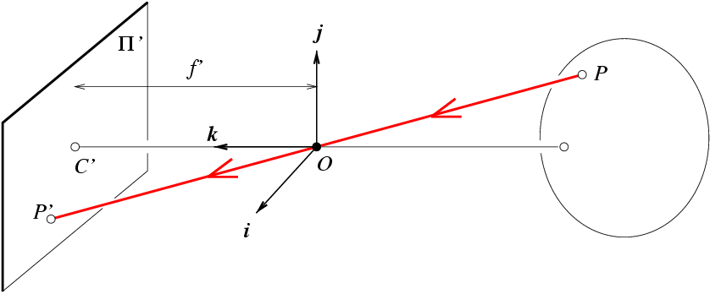
Oriented and Translated Camera
R
j_{w}
t
k_{w}
O_{w}
i_{w}

Slide 3
Degrees of freedom
5
6
Notes:
How many known points are needed to estimate this?

Slide 4
How to calibrate the camera?

Slide 5
How do we calibrate a camera?
880 214
43 203
270 197
886 347
745 302
943 128
476 590
419 214
317 335
783 521
235 427
665 429
655 362
427 333
412 415
746 351
434 415
525 234
716 308
602 187
312.747 309.140 30.086
305.796 311.649 30.356
307.694 312.358 30.418
310.149 307.186 29.298
311.937 310.105 29.216
311.202 307.572 30.682
307.106 306.876 28.660
309.317 312.490 30.230
307.435 310.151 29.318
308.253 306.300 28.881
306.650 309.301 28.905
308.069 306.831 29.189
309.671 308.834 29.029
308.255 309.955 29.267
307.546 308.613 28.963
311.036 309.206 28.913
307.518 308.175 29.069
309.950 311.262 29.990
312.160 310.772 29.080
311.988 312.709 30.514

Slide 6
Method 1 – homogeneous linear system
Solve for m’s entries using linear least squares
Ax=0 form
[U, S, V] = svd(A);
M = V(:,end);
M = reshape(M,[],3)';

Slide 7
For project 3, we want the camera center

Slide 8
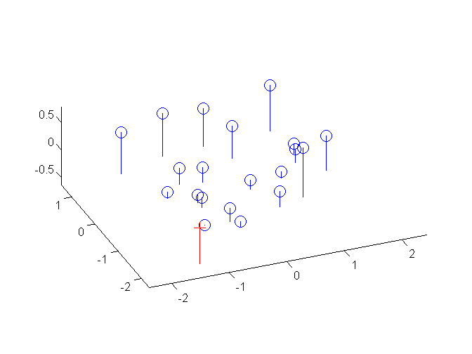
Estimate of camera center
1.0486 -0.3645
-1.6851 -0.4004
-0.9437 -0.4200
1.0682 0.0699
0.6077 -0.0771
1.2543 -0.6454
-0.2709 0.8635
-0.4571 -0.3645
-0.7902 0.0307
0.7318 0.6382
-1.0580 0.3312
0.3464 0.3377
0.3137 0.1189
-0.4310 0.0242
-0.4799 0.2920
0.6109 0.0830
-0.4081 0.2920
-0.1109 -0.2992
0.5129 -0.0575
0.1406 -0.4527
1.5706 -0.1490 0.2598
-1.5282 0.9695 0.3802
-0.6821 1.2856 0.4078
0.4124 -1.0201 -0.0915
1.2095 0.2812 -0.1280
0.8819 -0.8481 0.5255
-0.9442 -1.1583 -0.3759
0.0415 1.3445 0.3240
-0.7975 0.3017 -0.0826
-0.4329 -1.4151 -0.2774
-1.1475 -0.0772 -0.2667
-0.5149 -1.1784 -0.1401
0.1993 -0.2854 -0.2114
-0.4320 0.2143 -0.1053
-0.7481 -0.3840 -0.2408
0.8078 -0.1196 -0.2631
-0.7605 -0.5792 -0.1936
0.3237 0.7970 0.2170
1.3089 0.5786 -0.1887
1.2323 1.4421 0.4506

Slide 9
Oriented and Translated Camera
R
j_{w}
t
k_{w}
O_{w}
i_{w}

Slide 10
Recovering the camera center
This is not the camera center C. It is –RC
(because a point will be rotated before t_{x}, t_{y}, and t_{z} are added)
So we need -R⁻¹ K⁻¹ m₄ to get C
This is t * K
So K⁻¹ m₄ is t
Q is K * R. So we just need -Q⁻¹ m₄
Q

Slide 11
Estimate of camera center
1.0486 -0.3645
-1.6851 -0.4004
-0.9437 -0.4200
1.0682 0.0699
0.6077 -0.0771
1.2543 -0.6454
-0.2709 0.8635
-0.4571 -0.3645
-0.7902 0.0307
0.7318 0.6382
-1.0580 0.3312
0.3464 0.3377
0.3137 0.1189
-0.4310 0.0242
-0.4799 0.2920
0.6109 0.0830
-0.4081 0.2920
-0.1109 -0.2992
0.5129 -0.0575
0.1406 -0.4527
1.5706 -0.1490 0.2598
-1.5282 0.9695 0.3802
-0.6821 1.2856 0.4078
0.4124 -1.0201 -0.0915
1.2095 0.2812 -0.1280
0.8819 -0.8481 0.5255
-0.9442 -1.1583 -0.3759
0.0415 1.3445 0.3240
-0.7975 0.3017 -0.0826
-0.4329 -1.4151 -0.2774
-1.1475 -0.0772 -0.2667
-0.5149 -1.1784 -0.1401
0.1993 -0.2854 -0.2114
-0.4320 0.2143 -0.1053
-0.7481 -0.3840 -0.2408
0.8078 -0.1196 -0.2631
-0.7605 -0.5792 -0.1936
0.3237 0.7970 0.2170
1.3089 0.5786 -0.1887
1.2323 1.4421 0.4506

Slide 12
Epipolar Geometry and Stereo Vision
Many slides adapted from Derek Hoiem, Lana Lazebnik, Silvio Saverese, Steve Seitz, many figures from Hartley & Zisserman

Slide 13
Epipolar geometry
Relates cameras from two positions

Slide 14
Depth from Stereo
Goal: recover depth by finding image coordinate x’ that corresponds to x
X
X
x
z
x
x’
x'
f
f
C
Baseline B
C’

Slide 15
Depth from Stereo
Goal: recover depth by finding image coordinate x’ that corresponds to x
Sub-Problems
Calibration: How do we recover the relation of the cameras (if not already known)?
Correspondence: How do we search for the matching point x’?
X
x
x'

Slide 16
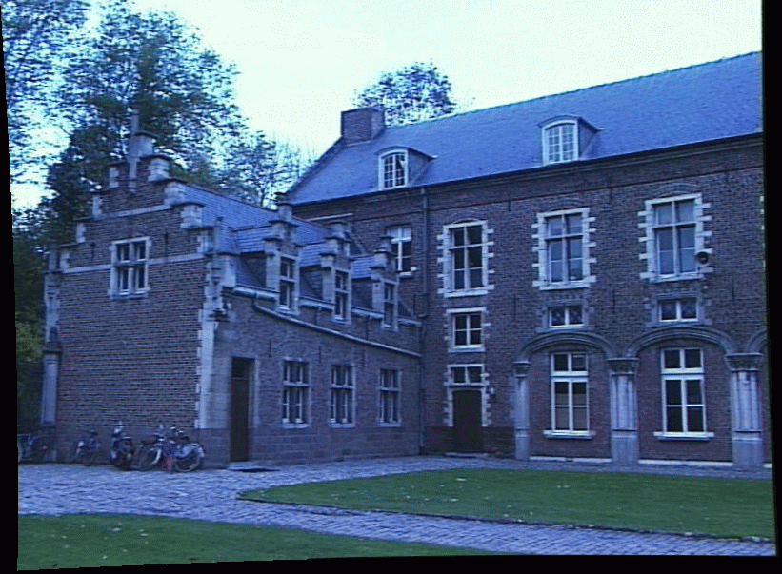
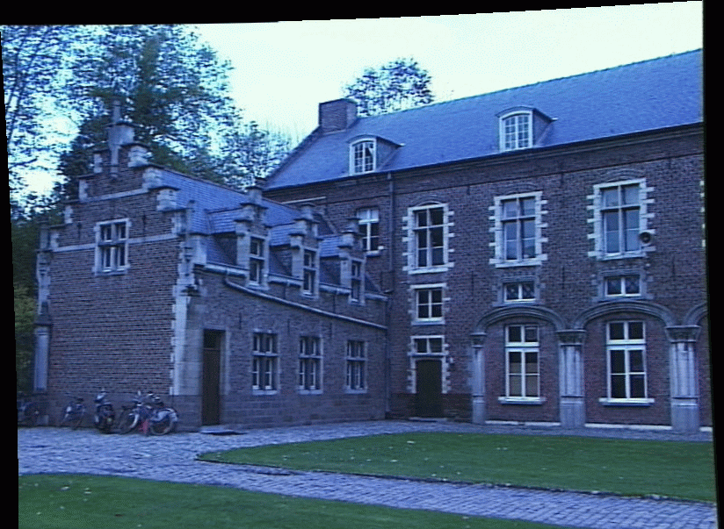
Correspondence Problem
x
?
We have two images taken from cameras with different intrinsic and extrinsic parameters
How do we match a point in the first image to a point in the second? How can we constrain our search?

Slide 17
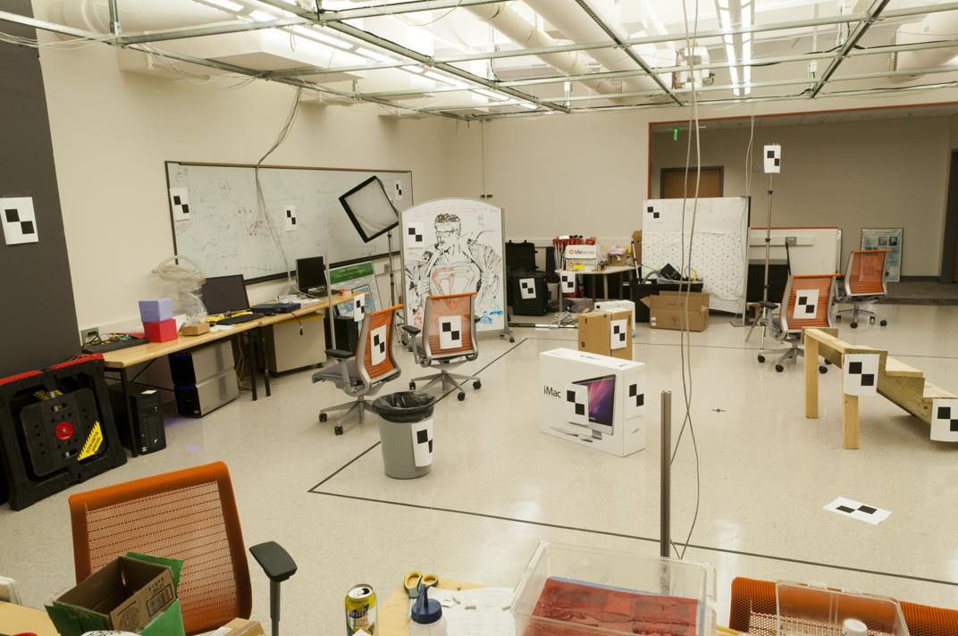
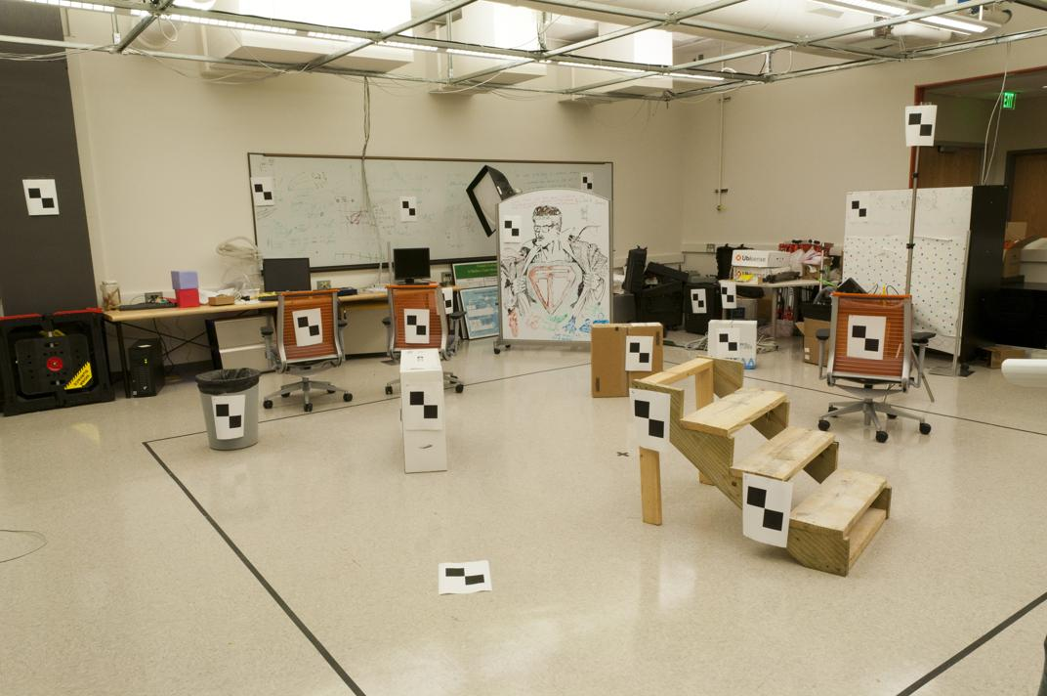
Where do we need to search?

Slide 18
Key idea: Epipolar constraint

Slide 19
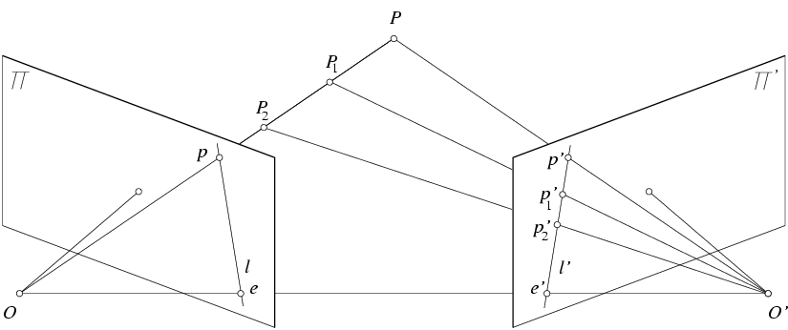
Key idea: Epipolar constraint
X
X
X
x
x’
x’
x’
Potential matches for x have to lie on the corresponding line l’.
Potential matches for x’ have to lie on the corresponding line l.

Slide 20
Wouldn’t it be nice to know where matches can live? To constrain our 2d search to 1d.

Slide 21
VLFeat’s 800 most confident matches among 10,000+ local features.

Slide 22
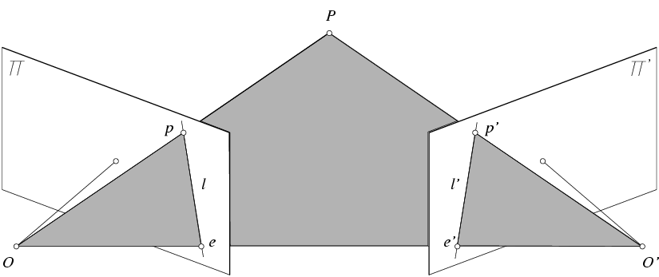
Epipolar geometry: notation
X
x
x’
Baseline – line connecting the two camera centers
Epipoles
= intersections of baseline with image planes
= projections of the other camera center
Epipolar Plane – plane containing baseline (1D family)

Slide 23
Epipolar geometry: notation
X
x
x’
Baseline – line connecting the two camera centers
Epipoles
= intersections of baseline with image planes
= projections of the other camera center
Epipolar Plane – plane containing baseline (1D family)
Epipolar Lines - intersections of epipolar plane with image planes (always come in corresponding pairs)

Slide 24
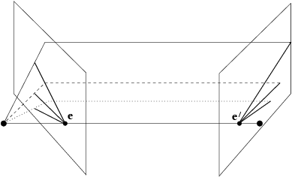
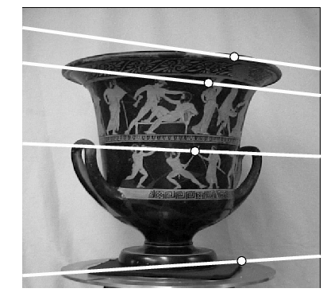
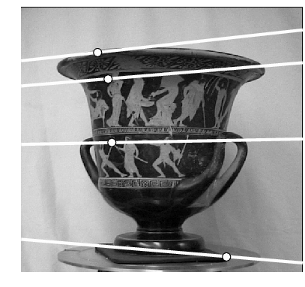
Example: Converging cameras

Slide 25
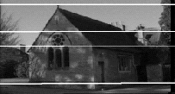
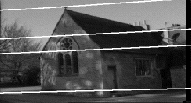
Example: Motion parallel to image plane

Slide 26
Example: Forward motion
What would the epipolar lines look like if the camera moves directly forward?

Slide 27
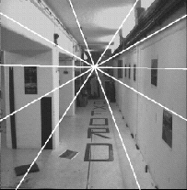
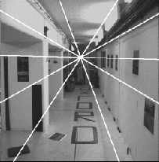
Example: Forward motion
e’
e
Epipole has same coordinates in both images.
Points move along lines radiating from e: “Focus of expansion”

Slide 28
Epipolar constraint: Calibrated case
X
x
x’
Given the intrinsic parameters of the cameras:
Convert to normalized coordinates by pre-multiplying all points with the inverse of the calibration matrix; set first camera’s coordinate system to world coordinates
3D scene point
Homogeneous 2d point (3D ray towards X)
2D pixel coordinate (homogeneous)
3D scene point in 2nd camera’s 3D coordinates

Slide 29
Epipolar constraint: Calibrated case
X
x
x’
Given the intrinsic parameters of the cameras:
Convert to normalized coordinates by pre-multiplying all points with the inverse of the calibration matrix; set first camera’s coordinate system to world coordinates
Define some R and t that relate X to X’ as below
for some scale factor

Slide 30
Epipolar constraint: Calibrated case
X
x
x’
$$\hat{x}$$
$${\hat{x}}^{′}$$
(because $\hat{x}, R{\hat{x}}^{′},$ and $t$ are co-planar)
Notes:
X’ is X in the second camera’s coordinate system
We can identify the non-homogeneous 3D vectors X and X’ with the homogeneous coordinate vectors x and x’ of the projections of the two points into the two respective images

Slide 31
Epipolar constraint: Calibrated case
X
x
x’
$$\hat{x}$$
$${\hat{x}}^{′}$$
(because $\hat{x}, R{\hat{x}}^{′},$ and $t$ are co-planar)
Notes:
X’ is X in the second camera’s coordinate system
We can identify the non-homogeneous 3D vectors X and X’ with the homogeneous coordinate vectors x and x’ of the projections of the two points into the two respective images

Slide 32
Essential matrix
X
x
x’
Essential Matrix
(Longuet-Higgins, 1981)
Notes:
[t]_{x} is the skew symmetric matrix of t

Slide 33
Properties of the Essential matrix
X
x
x’
Drop ^ below to simplify notation
Skew-symmetric matrix
E x’ is the epipolar line associated with x’ (l = E x’)
E^{T}x is the epipolar line associated with x (l’ = E^{T}x)
E e’ = 0 and E^{T}e = 0
E is singular (rank two)
E has five degrees of freedom
(3 for R, 2 for t because it’s up to a scale)

Slide 34
Epipolar constraint: Uncalibrated case
X
x
x’
If we don’t know K and K’, then we can write the epipolar constraint in terms of unknown normalized coordinates:

Slide 35
The Fundamental Matrix
Without knowing K and K’, we can define a similar relation using unknown normalized coordinates
Fundamental Matrix
(Faugeras and Luong, 1992)

Slide 36
Properties of the Fundamental matrix
X
x
x’
F x’ = 0 is the epipolar line associated with x’
F^{T}x = 0 is the epipolar line associated with x
F e’ = 0 and F^{T}e = 0
F is singular (rank two): det(F)=0
F has seven degrees of freedom: 9 entries but defined up to scale, det(F)=0

Slide 37
Estimating the Fundamental Matrix
8-point algorithm
Least squares solution using SVD on equations from 8 pairs of correspondences
Enforce det(F)=0 constraint using SVD on F
7-point algorithm
Use least squares to solve for null space (two vectors) using SVD and 7 pairs of correspondences
Solve for linear combination of null space vectors that satisfies det(F)=0
Minimize reprojection error
Non-linear least squares
Note: estimation of F (or E) is degenerate for a planar scene.

Slide 38
8-point algorithm
Solve a system of homogeneous linear equations
Write down the system of equations
$$uu^{′}f_{11}+uv^{′}f_{12}+uf_{13}+vu^{′}f_{21}+vv^{′}f_{22}+vf_{23}+u^{′}f_{31}+v^{′}f_{32}+f_{33}=0$$
$Af=\left[\begin{matrix}u_{1}u_{1}′ & u_{1}v_{1}′ & \begin{matrix}u_{1} & v_{1}u_{1}′ & \begin{matrix}v_{1}v_{1}′ & v_{1} & \begin{matrix}u_{1}′ & v_{1}′ & 1\end{matrix}\end{matrix}\end{matrix} \\ \begin{matrix}⋮ \\ u_{n}u_{v}^{′}\end{matrix} & \begin{matrix}⋮ \\ u_{n}v_{n}′\end{matrix} & \begin{matrix}\begin{matrix}⋮ \\ u_{n}\end{matrix} & \begin{matrix}⋮ \\ v_{n}u_{n}′\end{matrix} & \begin{matrix}\begin{matrix}⋮ \\ v_{n}v_{n}′\end{matrix} & \begin{matrix}⋮ \\ v_{n}\end{matrix} & \begin{matrix}\begin{matrix}⋮ \\ u_{n}′\end{matrix} & \begin{matrix}⋮ \\ v_{n}′\end{matrix} & \begin{matrix}⋮ \\ 1\end{matrix}\end{matrix}\end{matrix}\end{matrix}\end{matrix}\right]\left[\begin{matrix}f_{11} \\ f_{12} \\ \begin{aligned}f_{13} \\ f_{21} \\ ⋮ \\ f_{33}\end{aligned}\end{matrix}\right]$=0

Slide 39
8-point algorithm
Solve a system of homogeneous linear equations
Write down the system of equations
Solve f from Af=0 using SVD
Matlab:
[U, S, V] = svd(A);
f = V(:, end);
F = reshape(f, [3 3])’;

Slide 40
Need to enforce singularity constraint

Slide 41
8-point algorithm
Solve a system of homogeneous linear equations
Write down the system of equations
Solve f from Af=0 using SVD
Resolve det(F) = 0 constraint using SVD
Matlab:
[U, S, V] = svd(A);
f = V(:, end);
F = reshape(f, [3 3])’;
Matlab:
[U, S, V] = svd(F);
S(3,3) = 0;
F = U*S*V’;

Slide 42
8-point algorithm
Solve a system of homogeneous linear equations
Write down the system of equations
Solve f from Af=0 using SVD
Resolve det(F) = 0 constraint by SVD
Notes:
Use RANSAC to deal with outliers (sample 8 points)
How to test for outliers?
Notes:
Test for outliers by computing distance from epipolar line to corresponding point (NOT by taking square of x^{T}Fx’)

Slide 43
Problem with eight-point algorithm

Slide 44
Problem with eight-point algorithm
Poor numerical conditioning
Can be fixed by rescaling the data

Slide 45
The normalized eight-point algorithm
(Hartley, 1995)
Center the image data at the origin, and scale it so the mean squared distance between the origin and the data points is 2 pixels
Use the eight-point algorithm to compute F from the normalized points
Enforce the rank-2 constraint (for example, take SVD of F and throw out the smallest singular value)
Transform fundamental matrix back to original units: if T and T’ are the normalizing transformations in the two images, than the fundamental matrix in original coordinates is T’^{T} F T

Slide 46
VLFeat’s 800 most confident matches among 10,000+ local features.

Slide 47
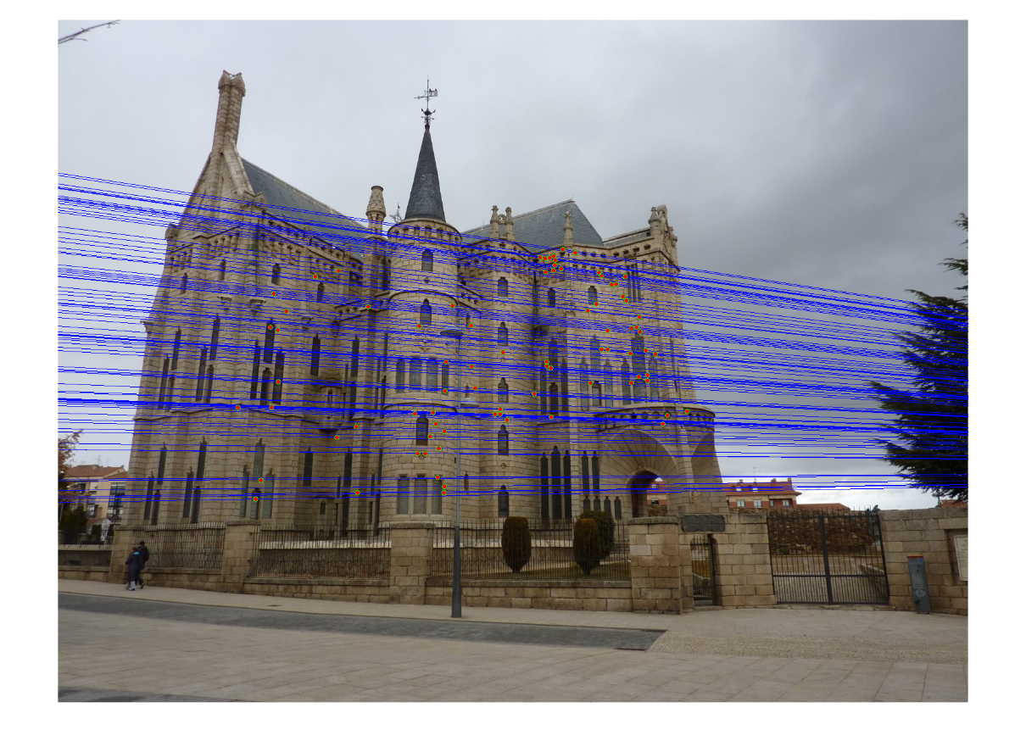
Epipolar lines

Slide 48
Keep only the matches at are “inliers” with respect to the “best” fundamental matrix

Slide 49
7-point algorithm
Faster (need fewer points) and could be more robust (fewer points), but also need to check for degenerate cases

Slide 50
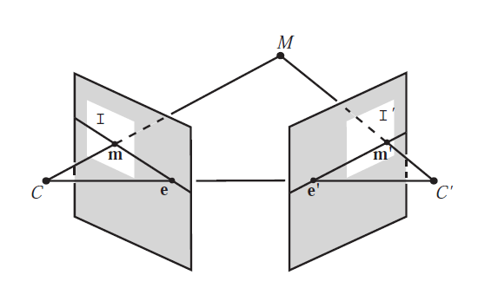
“Gold standard” algorithm
Use 8-point algorithm to get initial value of F
Use F to solve for P and P’ (discussed later)
Jointly solve for 3d points X and F that minimize the squared re-projection error
X
x
x'
See Algorithm 11.2 and Algorithm 11.3 in HZ (pages 284-285) for details

Slide 51
Comparison of estimation algorithms
 | 8-point | Normalized 8-point | Nonlinear least squares
Av. Dist. 1 | 2.33 pixels | 0.92 pixel | 0.86 pixel
Av. Dist. 2 | 2.18 pixels | 0.85 pixel | 0.80 pixel

Slide 52
We can get projection matrices P and P’ up to a projective ambiguity
Code:
function P = vgg_P_from_F(F)
[U,S,V] = svd(F);
e = U(:,3);
P = [-vgg_contreps(e)*F e];
K’*rotation
K’*translation
See HZ p. 255-256
If we know the intrinsic matrices (K and K’), we can resolve the ambiguity

Slide 53
From epipolar geometry to camera calibration
Estimating the fundamental matrix is known as “weak calibration”
We cIf we know the calibration matrices of the two cameras, we can estimate the essential matrix: E = K^{T}FK’
The essential matrix gives us the relative rotation and translation between the cameras, or their extrinsic parameters

Slide 54
Let’s recap…
Fundamental matrix song

