Slide 1
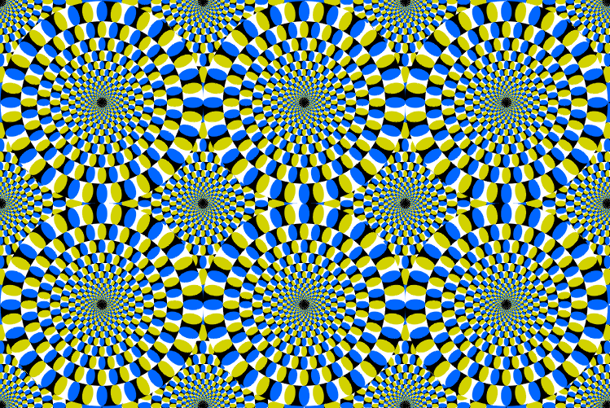
Does the peripheral drift illusion work on other organisms?

Slide 2
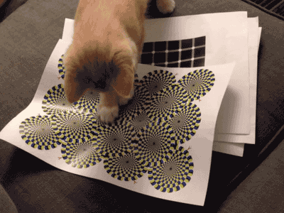
Yes!

Slide 3
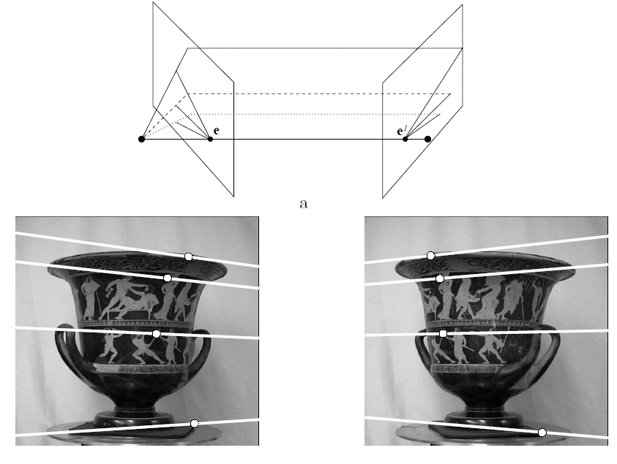
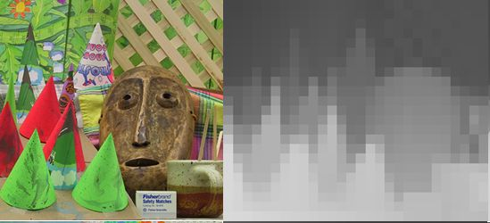
Multiple views
stereo vision
structure from motion
optical flow
Lowe
Hartley and Zisserman

Slide 4
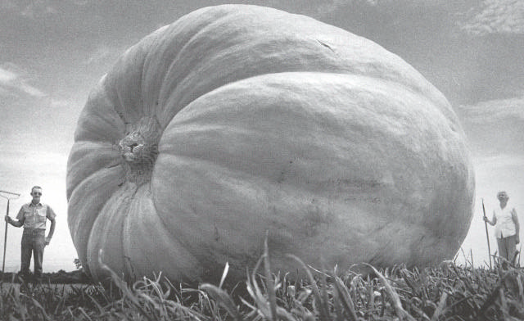
Why multiple views?
Structure and depth are inherently ambiguous from single views.
Images from Lana Lazebnik

Slide 5
Why multiple views?
Structure and depth are inherently ambiguous from single views.
P1
P2
P1’=P2’
Optical center

Slide 6
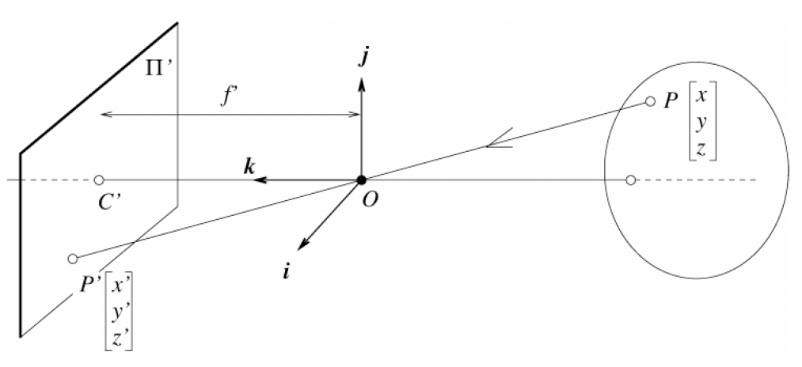
Camera parameters
Camera frame 2
Extrinsic parameters:
Camera frame 1 ←→ Camera frame 2
Intrinsic parameters:
Image coordinates relative to camera ←→ Pixel coordinates
Camera frame 1
Extrinsic params: rotation matrix and translation vector
Intrinsic params: focal length, pixel sizes (mm), image center point, radial distortion parameters
We’ll assume for now that these parameters are given and fixed.
Notes:
6

Slide 7
Geometry for a simple stereo system
First, assuming parallel optical axes, known camera parameters (i.e., calibrated cameras):

Slide 8
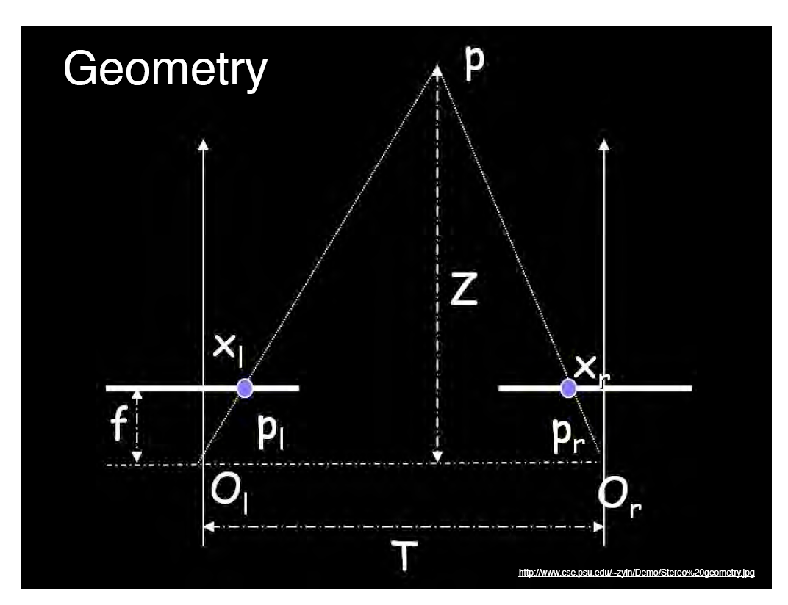
World point
Depth of p
image point (left)
image point (right)
Focal length
optical center (right)
optical center (left)
baseline
Notes:
8

Slide 9
Geometry for a simple stereo system
Assume parallel optical axes, known camera parameters (i.e., calibrated cameras). What is expression for Z?
Similar triangles (p_{l}, P, p_{r}) and (O_{l}, P, O_{r}):
disparity
Notes:
9

Slide 10
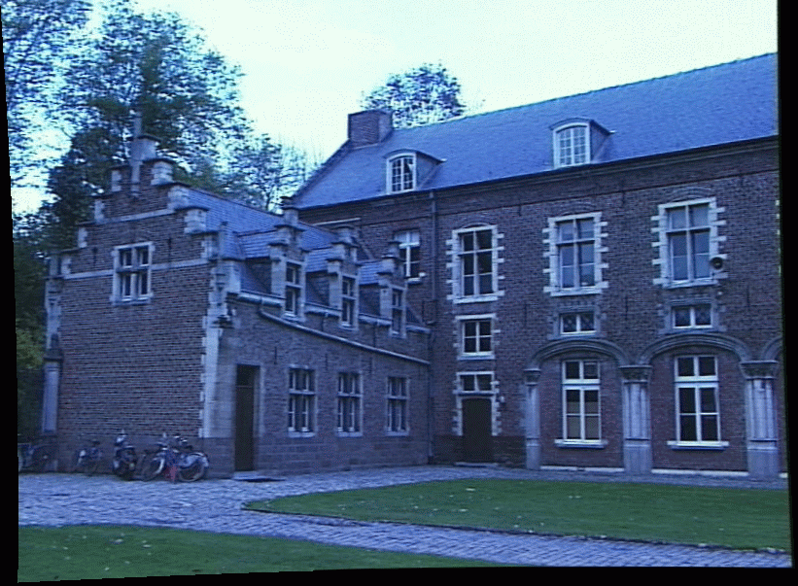
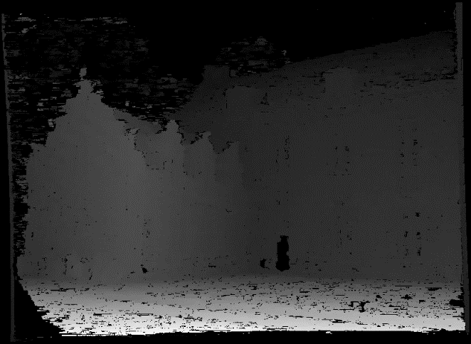
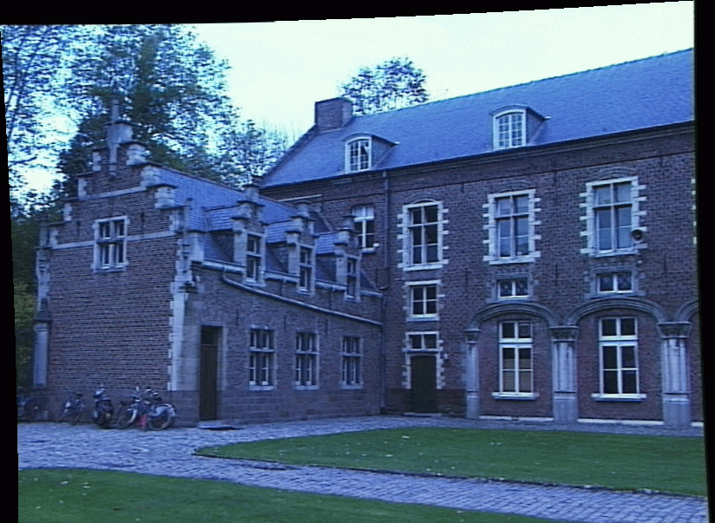
Depth from disparity
image I(x,y)
Disparity map D(x,y)
image I´(x´,y´)
(x´,y´)=(x+D(x,y), y)
So if we could find the corresponding points in two images, we could estimate relative depth…

Slide 11
What did we need to know?
Correspondence for every pixel. Sort of like project 2, but project 2 is “sparse” and we need “dense” correspondence.
Calibration for the cameras.

Slide 12
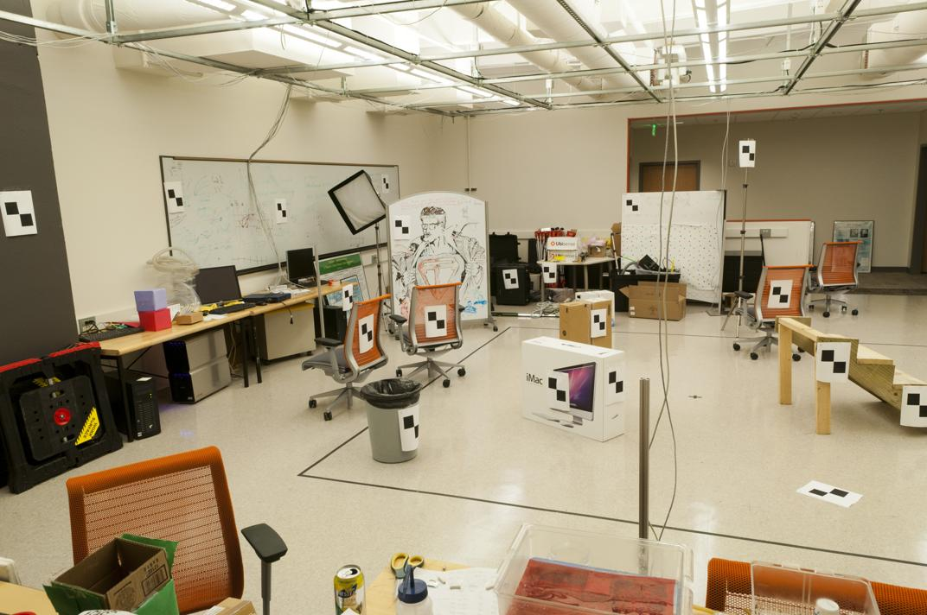
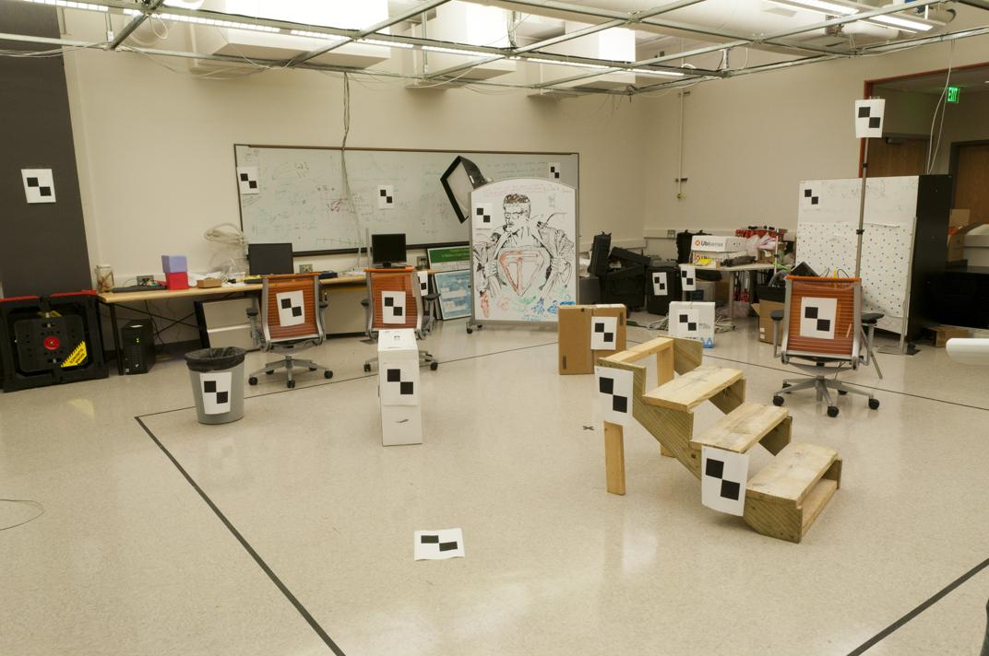
Where do we need to search?

Slide 13
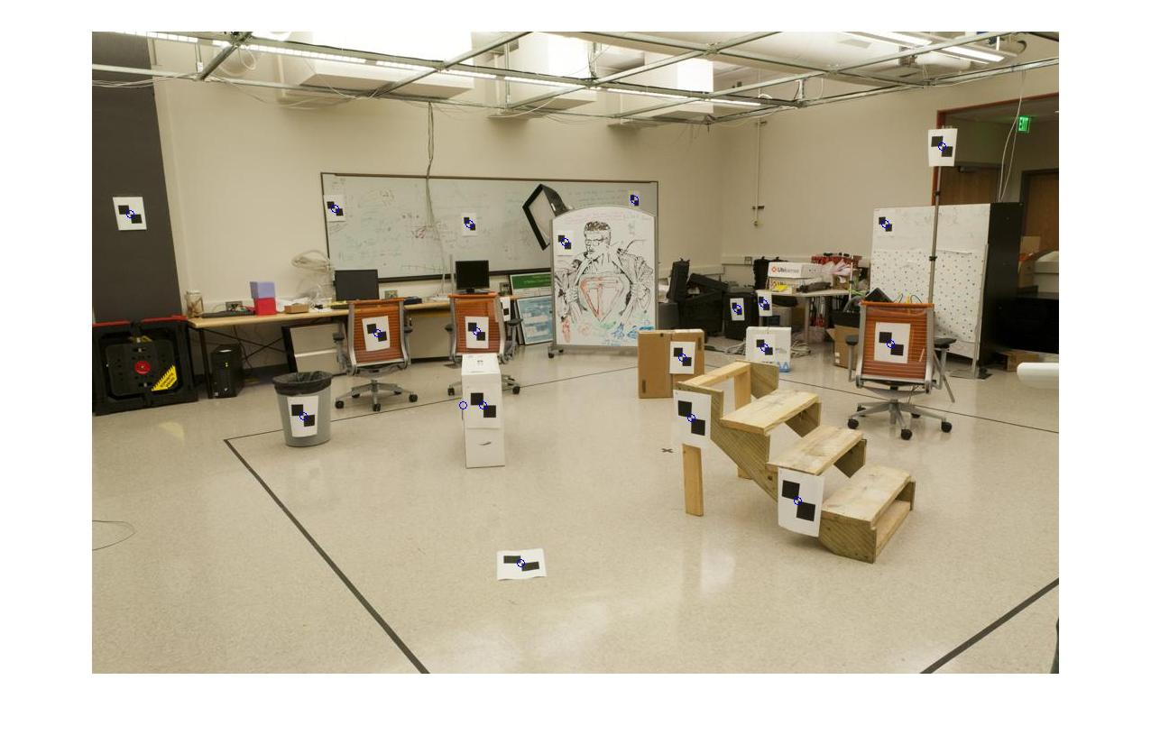
How do we calibrate a camera?
880 214
43 203
270 197
886 347
745 302
943 128
476 590
419 214
317 335
783 521
235 427
665 429
655 362
427 333
412 415
746 351
434 415
525 234
716 308
602 187
312.747 309.140 30.086
305.796 311.649 30.356
307.694 312.358 30.418
310.149 307.186 29.298
311.937 310.105 29.216
311.202 307.572 30.682
307.106 306.876 28.660
309.317 312.490 30.230
307.435 310.151 29.318
308.253 306.300 28.881
306.650 309.301 28.905
308.069 306.831 29.189
309.671 308.834 29.029
308.255 309.955 29.267
307.546 308.613 28.963
311.036 309.206 28.913
307.518 308.175 29.069
309.950 311.262 29.990
312.160 310.772 29.080
311.988 312.709 30.514

Slide 14
World vs Camera coordinates

Slide 15
Image formation
Let’s design a camera
  Idea 1: put a piece of film in front of an object
  Do we get a reasonable image?
Slide source: Seitz

Slide 16
Pinhole camera
Idea 2: add a barrier to block off most of the rays
  This reduces blurring
  The opening known as the aperture
Slide source: Seitz
Notes:
Q: How does this transform the image? A: It gets inverted

Slide 17
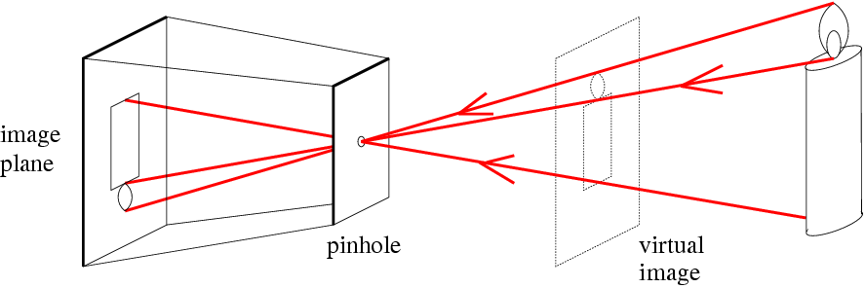
Pinhole camera
f
c
f = focal length
c = center of the camera
Figure from Forsyth

Slide 18
Projection: world coordinates→image coordinates
.
Optical Center (u₀, v₀)
.
.
Y
f
Z
X
.
v
Camera Center (t_{x}, t_{y}, t_{z})
u

Slide 19
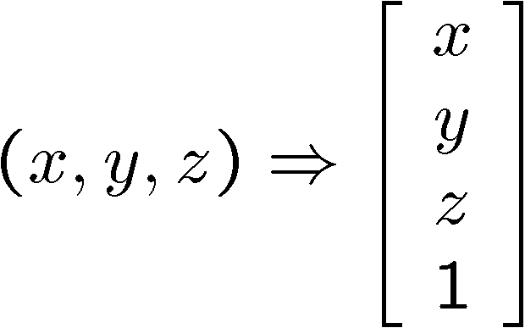
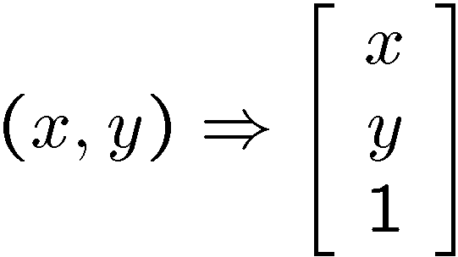
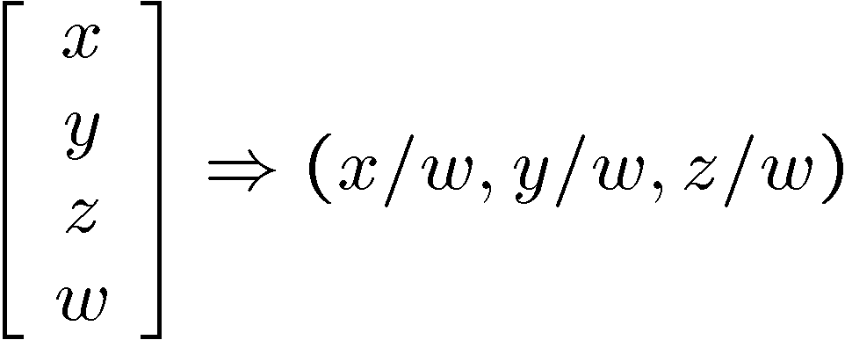
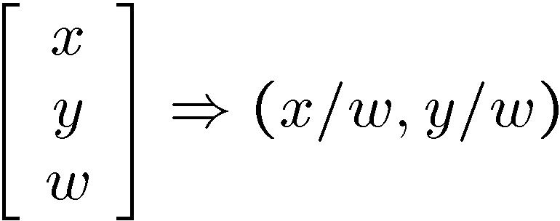
Homogeneous coordinates
Conversion
Converting to homogeneous coordinates
homogeneous image
coordinates
homogeneous scene
coordinates
Converting from homogeneous coordinates
Notes:
Append coordinate with value 1; proportional coordinate system

Slide 20
World vs Camera coordinates

Slide 21
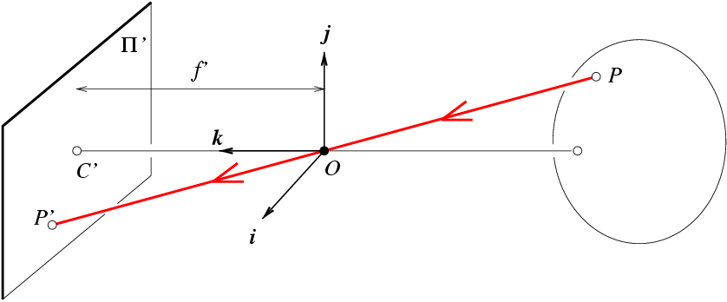
Projection matrix
Slide Credit: Saverese
R,T
j_{w}
k_{w}
O_{w}
i_{w}
x: Image Coordinates: (u,v,1)
K: Intrinsic Matrix (3x3)
R: Rotation (3x3)
t: Translation (3x1)
X: World Coordinates: (X,Y,Z,1)
Notes:
We can use homogeneous coordinates to write camera matrix in linear form.

Slide 22
Pinhole Camera Model
x: Image Coordinates: (u,v,1)
K: Intrinsic Matrix (3x3)
R: Rotation (3x3)
t: Translation (3x1)
X: World Coordinates: (X,Y,Z,1)

Slide 23
Projection matrix
Intrinsic Assumptions
Unit aspect ratio
Optical center at (0,0)
No skew
Extrinsic Assumptions
No rotation
Camera at (0,0,0)
K
Slide Credit: Saverese
Notes:
Work through equations for u and v on board

Slide 24
Remove assumption: known optical center
Intrinsic Assumptions
Unit aspect ratio
No skew
Extrinsic Assumptions
No rotation
Camera at (0,0,0)

Slide 25
Remove assumption: square pixels
Intrinsic Assumptions
No skew
Extrinsic Assumptions
No rotation
Camera at (0,0,0)

Slide 26
Remove assumption: non-skewed pixels
Intrinsic Assumptions
Extrinsic Assumptions
No rotation
Camera at (0,0,0)
Note: different books use different notation for parameters

Slide 27
Oriented and Translated Camera
R
j_{w}
t
k_{w}
O_{w}
i_{w}

Slide 28
Allow camera translation
Intrinsic Assumptions
Extrinsic Assumptions
No rotation

Slide 29
3D Rotation of Points
Slide Credit: Saverese
Rotation around the coordinate axes, counter-clockwise:
p’
γ
y
p
z

Slide 30
Allow camera rotation

Slide 31
Degrees of freedom
5
6
Notes:
How many known points are needed to estimate this?

Slide 32
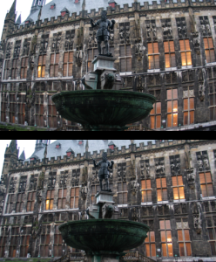
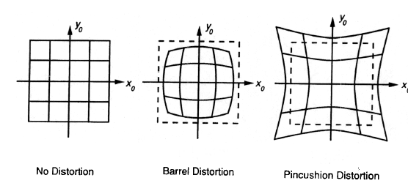
Beyond Pinholes: Radial Distortion
Common in wide-angle lenses or for special applications (e.g., security)
Creates non-linear terms in projection
Usually handled by through solving for non-linear terms and then correcting image
Corrected Barrel Distortion
Image from Martin Habbecke

Slide 33
How to calibrate the camera?
(also called “camera resectioning”)

Slide 34
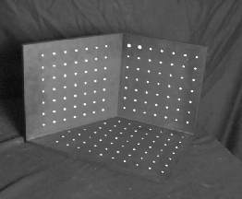
Calibrating the Camera
Use an scene with known geometry
  Correspond image points to 3d points
  Get least squares solution (or non-linear solution)
Known 2d image coords
Known 3d locations
Unknown Camera Parameters

Slide 35
How do we calibrate a camera?
Known 2d image coords
Known 3d locations
880 214
43 203
270 197
886 347
745 302
943 128
476 590
419 214
317 335
783 521
235 427
665 429
655 362
427 333
412 415
746 351
434 415
525 234
716 308
602 187
312.747 309.140 30.086
305.796 311.649 30.356
307.694 312.358 30.418
310.149 307.186 29.298
311.937 310.105 29.216
311.202 307.572 30.682
307.106 306.876 28.660
309.317 312.490 30.230
307.435 310.151 29.318
308.253 306.300 28.881
306.650 309.301 28.905
308.069 306.831 29.189
309.671 308.834 29.029
308.255 309.955 29.267
307.546 308.613 28.963
311.036 309.206 28.913
307.518 308.175 29.069
309.950 311.262 29.990
312.160 310.772 29.080
311.988 312.709 30.514

Slide 36
Unknown Camera Parameters
Known 2d image coords
Known 3d locations

Slide 37
Unknown Camera Parameters
Known 2d image coords
Known 3d locations

Slide 38
Unknown Camera Parameters
Known 2d image coords
Known 3d locations

Slide 39
Unknown Camera Parameters
Known 2d image coords
Known 3d locations
Method 1 – homogeneous linear system. Solve for m’s entries using linear least squares
[U, S, V] = svd(A);
M = V(:,end);
M = reshape(M,[],3)';

Slide 40
Unknown Camera Parameters
Known 2d image coords
Known 3d locations
Method 2 – nonhomogeneous linear system. Solve for m’s entries using linear least squares
Ax=b form
M = A\Y;
M = [M;1];
M = reshape(M,[],3)';

Slide 41
Calibration with linear method
Advantages
  Easy to formulate and solve
  Provides initialization for non-linear methods
Disadvantages
  Doesn’t directly give you camera parameters
  Doesn’t model radial distortion
  Can’t impose constraints, such as known focal length
Non-linear methods are preferred
  Define error as difference between projected points and measured points
  Minimize error using Newton’s method or other non-linear optimization

Slide 42
Can we factorize M back to K [R | T]?
Yes!
You can use RQ factorization (note – not the more familiar QR factorization). R (right diagonal) is K, and Q (orthogonal basis) is R. T, the last column of [R | T], is inv(K) * last column of M.
  But you need to do a bit of post-processing to make sure that the matrices are valid. See http://ksimek.github.io/2012/08/14/decompose/

Slide 43
Can we factorize M back to K [R | T]?
Yes!
Alternatively, you can more directly solve for the individual entries of K [R | T].

Slide 44
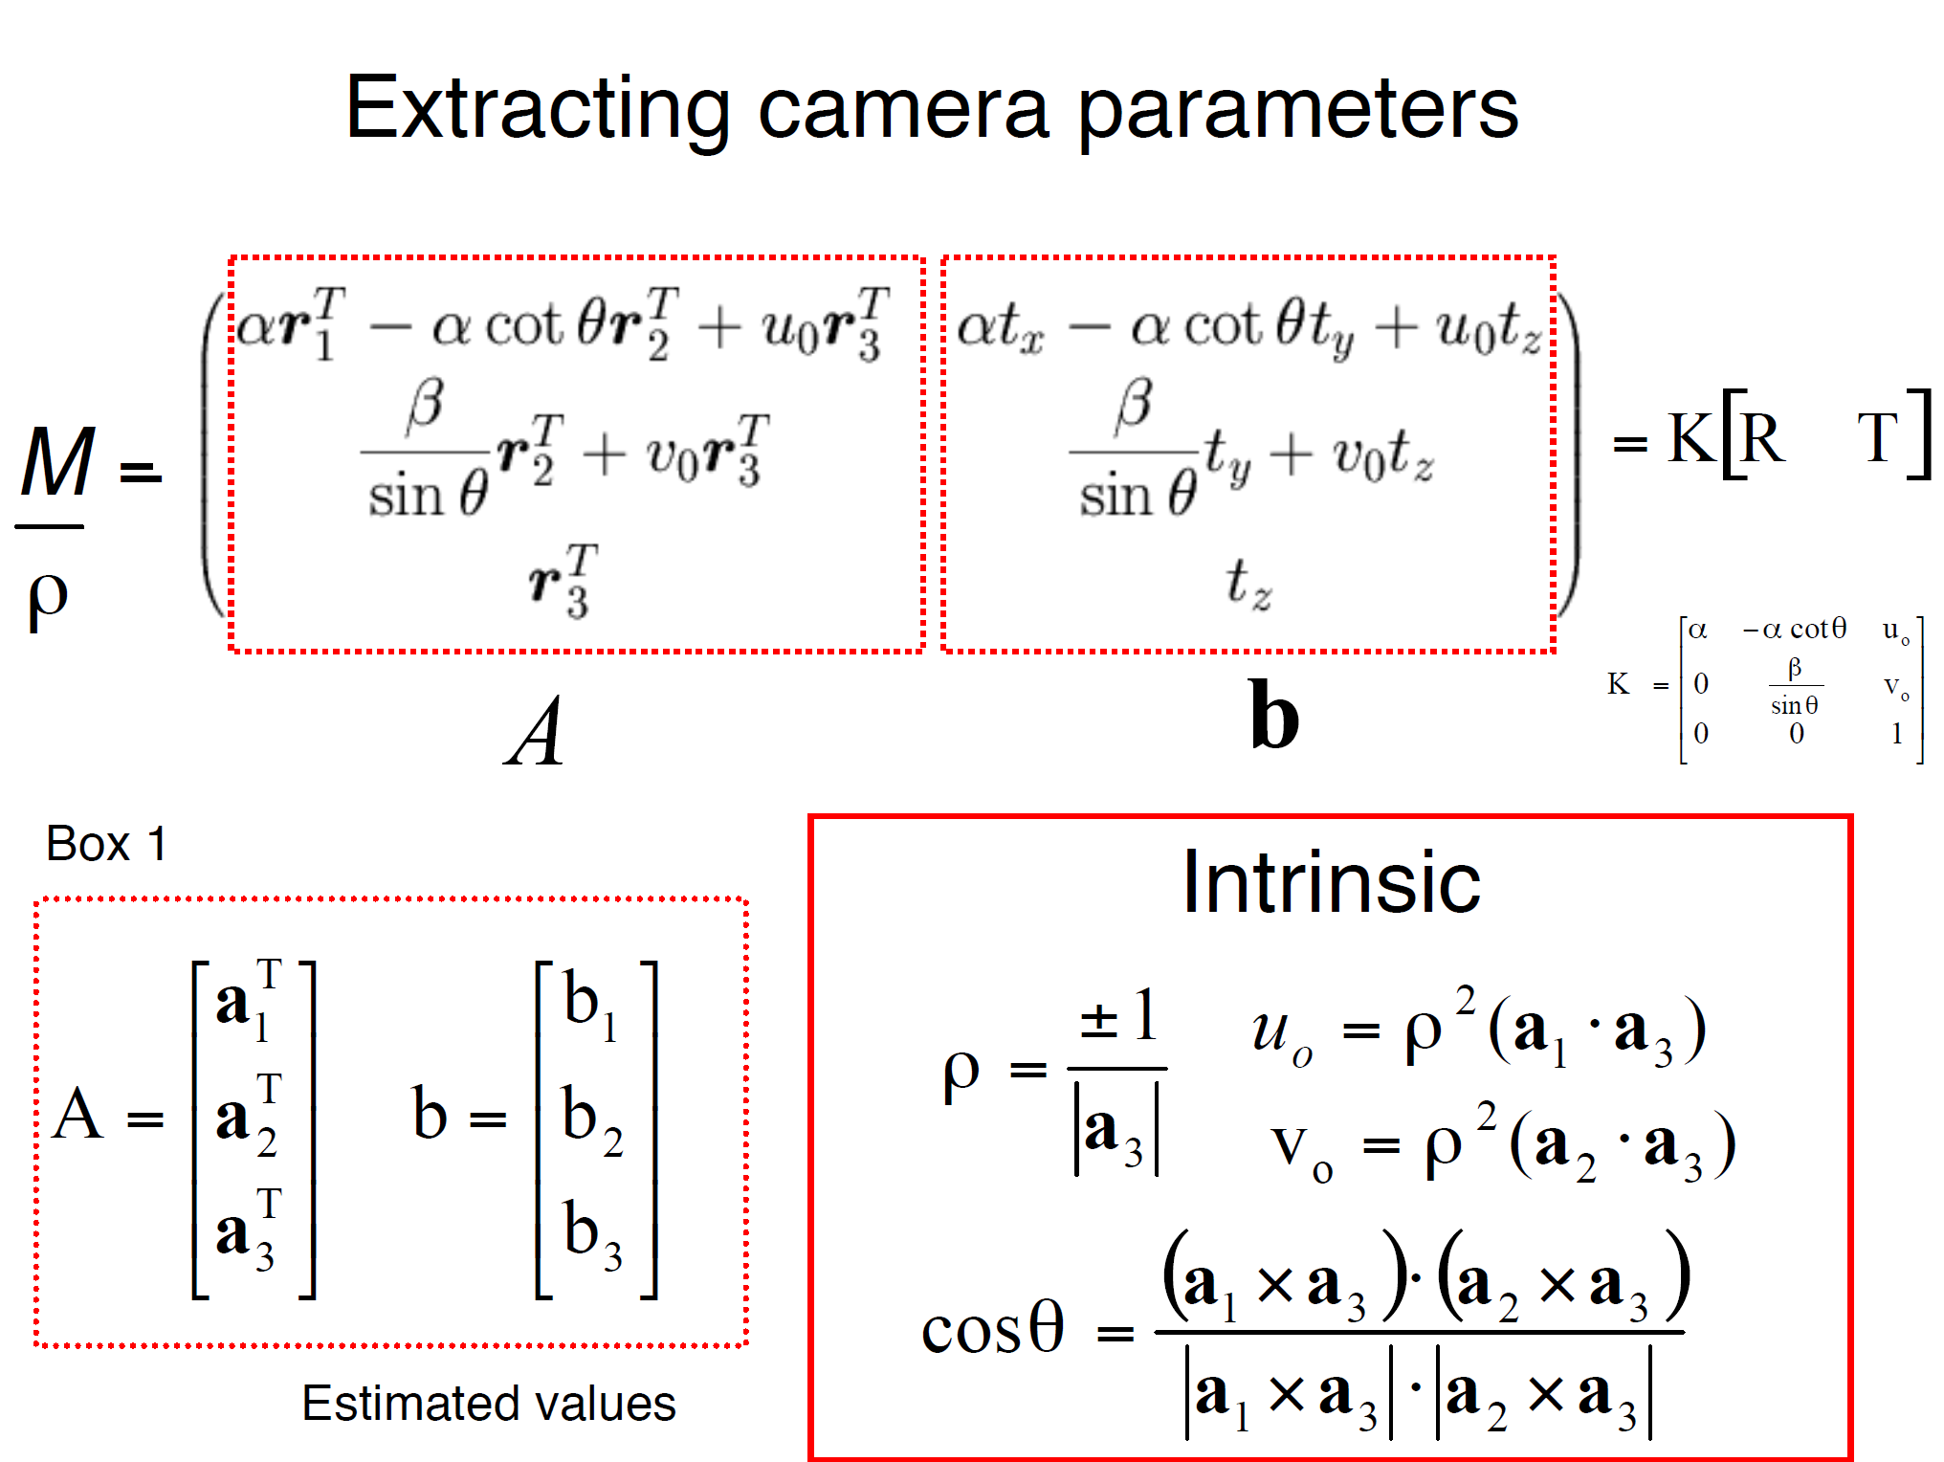

Slide 45
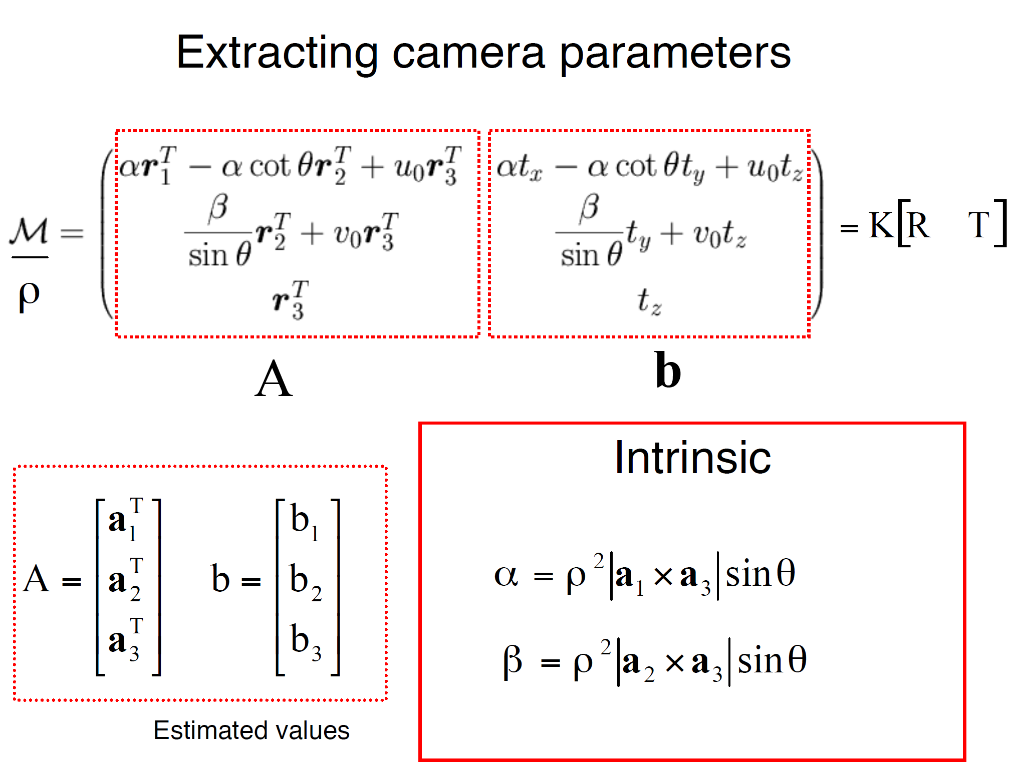

Slide 46
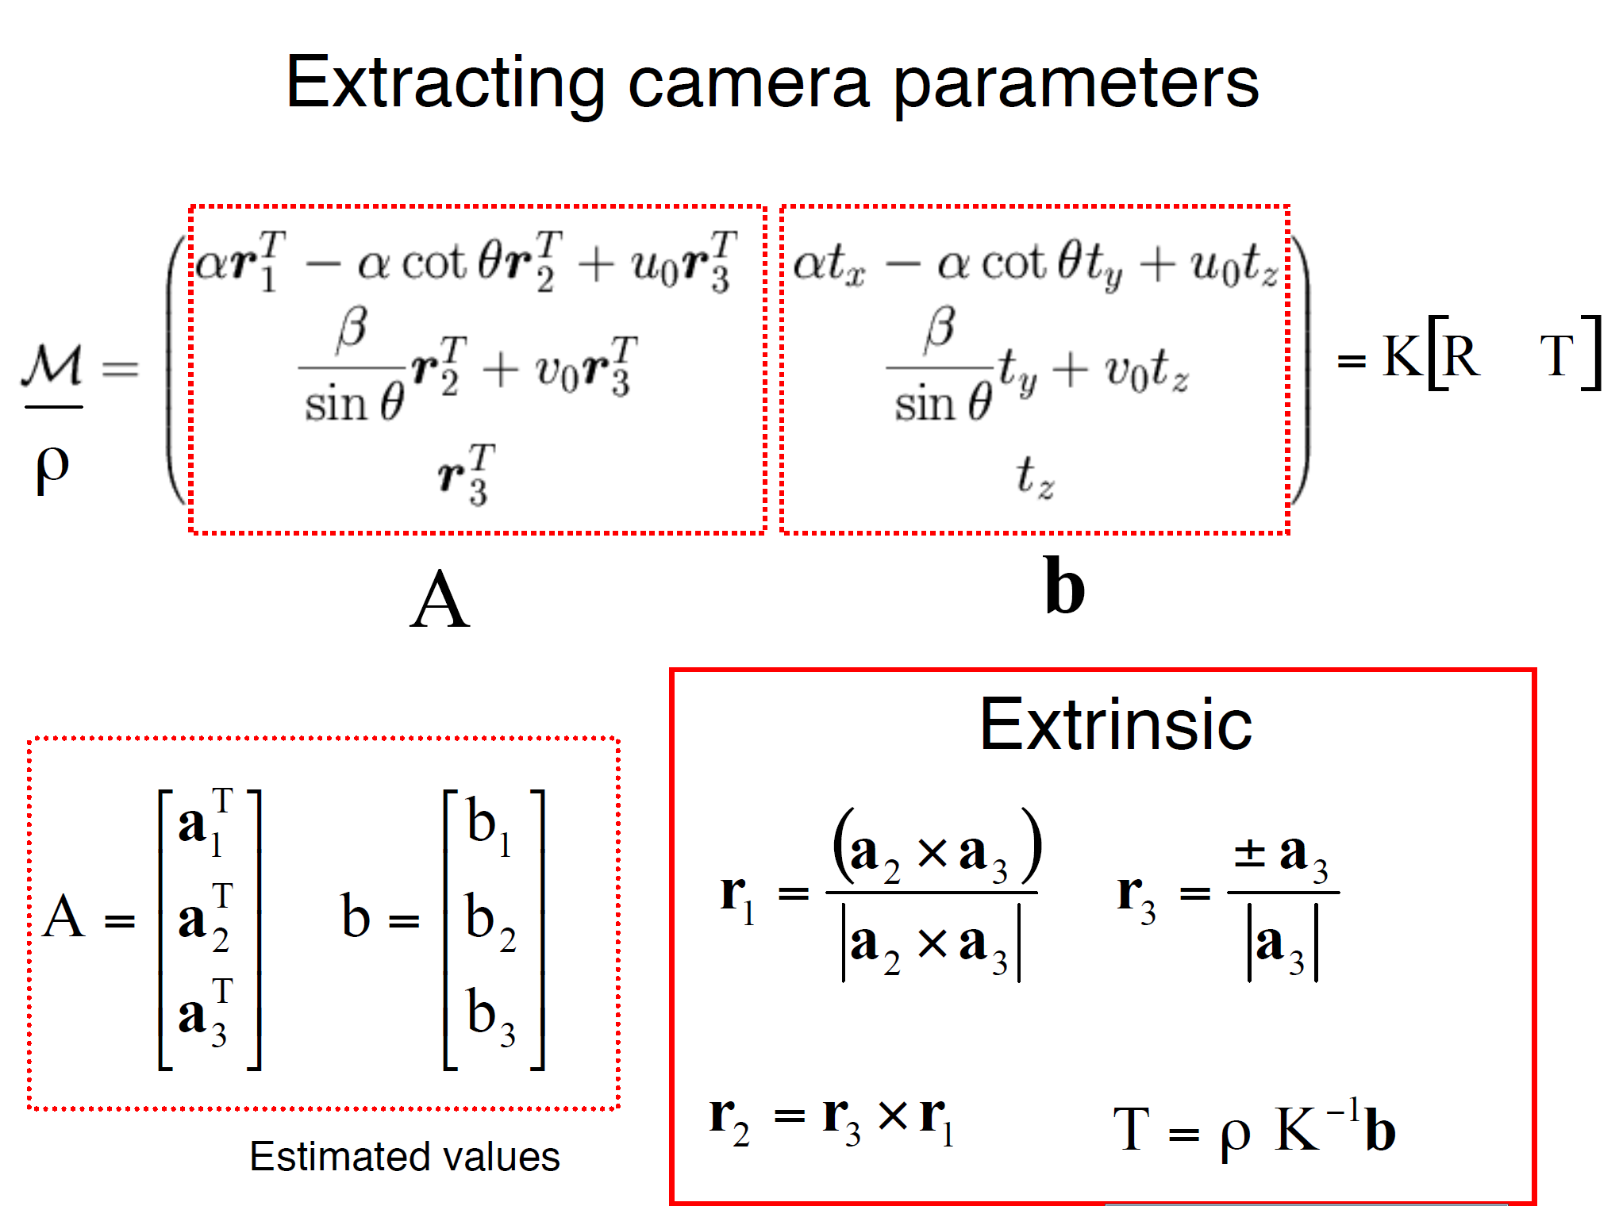

Slide 47
For project 3, we want the camera center

Slide 48
Recovering the camera center
This is not the camera center C. It is –RC
(because a point will be rotated before t_{x}, t_{y}, and t_{z} are added)
So we need
-R⁻¹ K⁻¹ m₄ to get C
This is t * K
So K⁻¹ m₄ is t
Q is K * R. So we just need -Q⁻¹ m₄
Q

