Slide 1
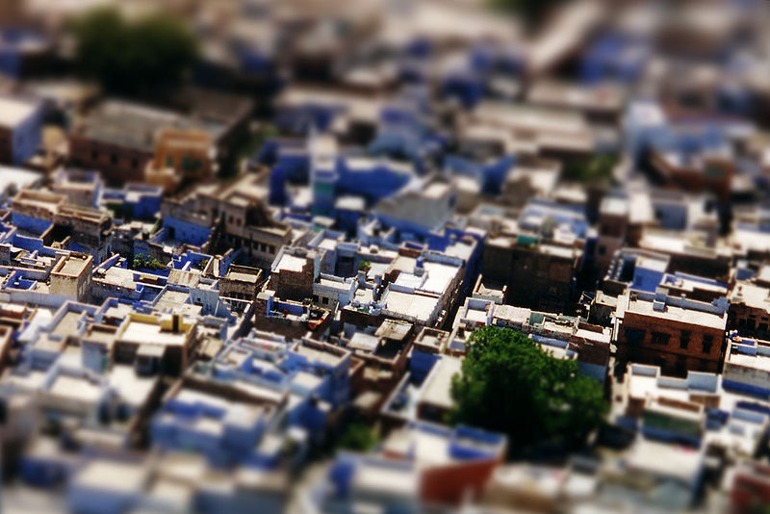
Miniature faking
In close-up photo, the depth of field is limited.
http://en.wikipedia.org/wiki/File:Jodhpur_tilt_shift.jpg

Slide 2
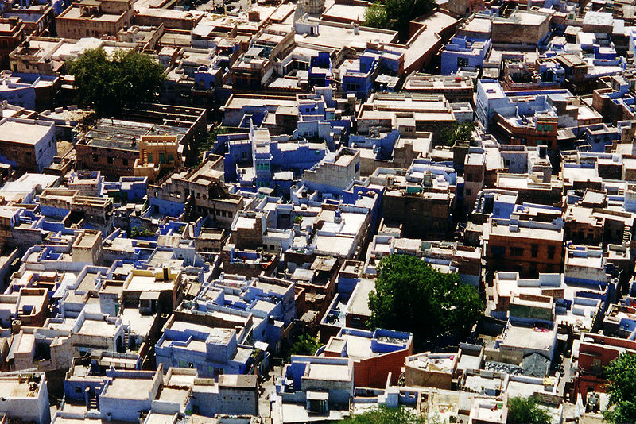
Miniature faking

Slide 3
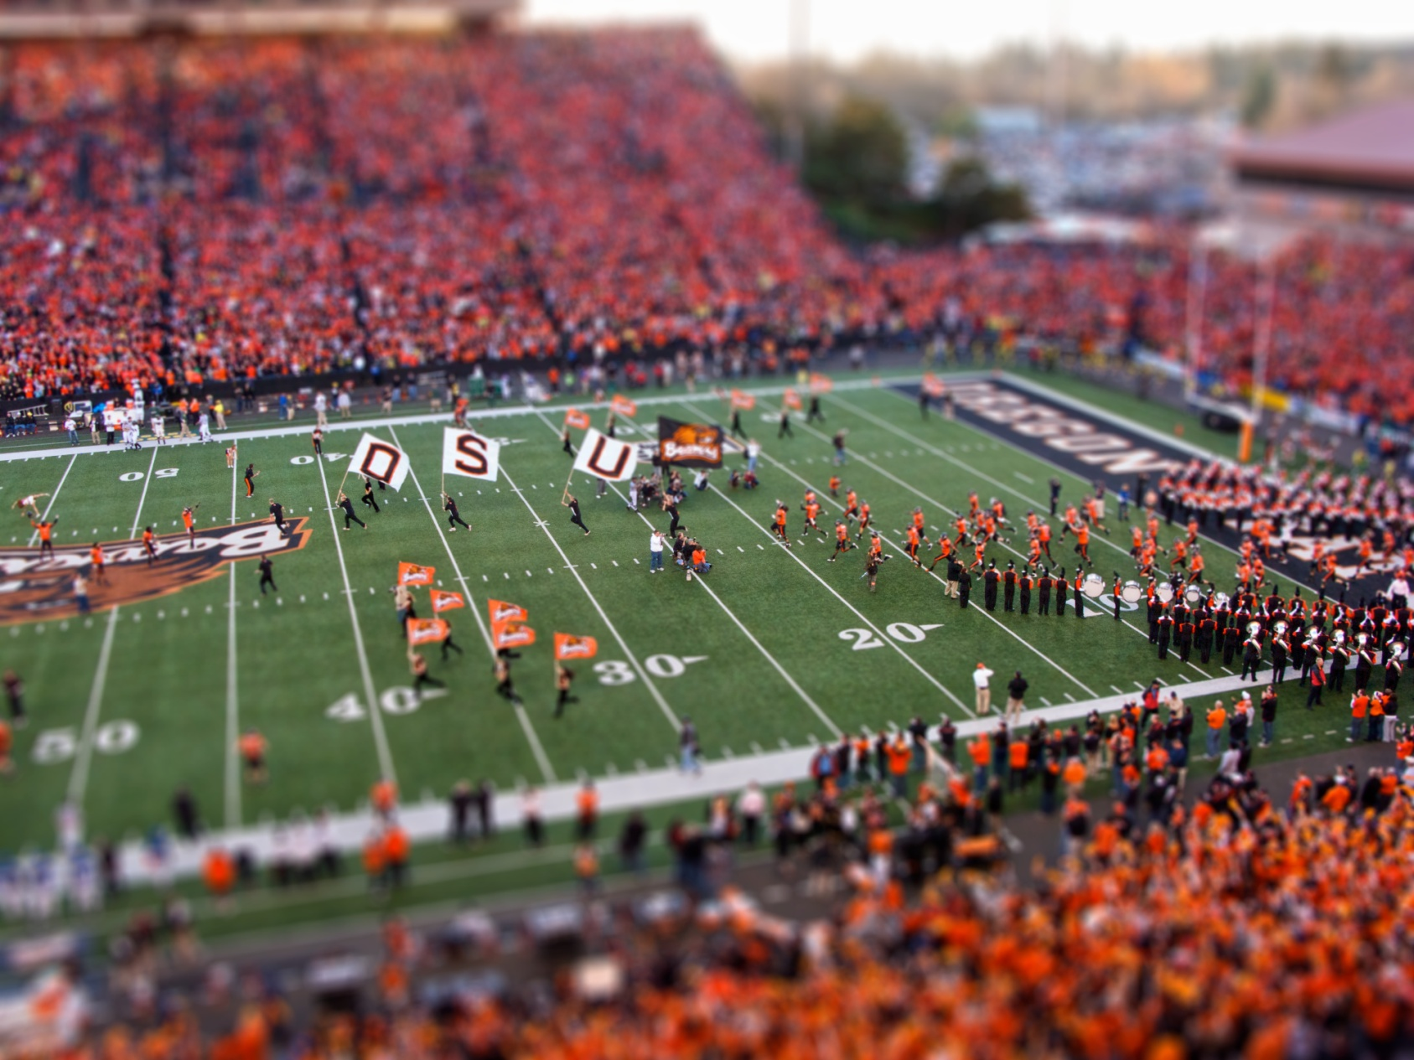
Miniature faking
http://en.wikipedia.org/wiki/File:Oregon_State_Beavers_Tilt-Shift_Miniature_Greg_Keene.jpg

Slide 4
Review
Previous section:
  Feature detection and matching
  Model fitting and outlier rejection

Slide 5
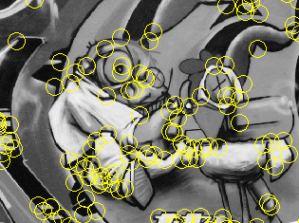
Review: Interest points
Keypoint detection: repeatable and distinctive
  Corners, blobs, stable regions
  Harris, DoG, MSER

Slide 6
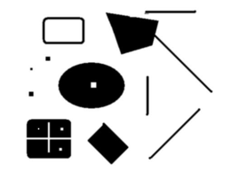
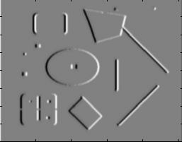
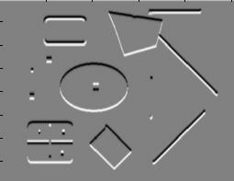
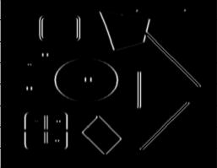
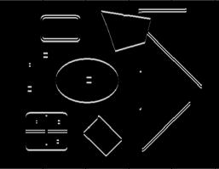
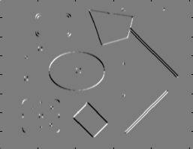
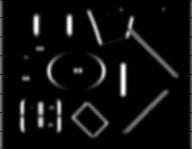
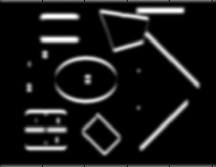
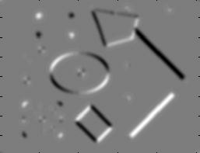
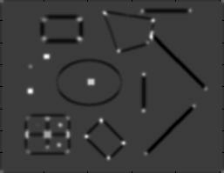
Harris Detector [Harris88]
Second moment matrix
1. Image derivatives
I_{x}
I_{y}
(optionally, blur first)
I_{x}²
I_{y}²
I_{x}I_{y}
2. Square of derivatives
3. Gaussian
filter g(σ_{I})
g(I_{x}²)
g(I_{y}²)
g(I_{x}I_{y})
4. Cornerness function – both eigenvalues are strong
5. Non-maxima suppression
har

Slide 7
Review: Local Descriptors
Most features can be thought of as templates, histograms (counts), or combinations
Most available descriptors focus on edge/gradient information
  Capture texture information
  Color rarely used

Slide 8
Review: Hough transform
y
m
x
b
y
m
3
5
3
3
2
2
3
7
11
10
4
3
2
3
1
4
5
2
2
1
0
1
3
3
x
b
Slide from S. Savarese
Notes:
􀁑 Basic ideas
• A line is represented as . Every line in the image corresponds
to a point in the parameter space
• Every point in the image domain corresponds to a line in the parameter
space (why ? Fix (x,y), (m,n) can change on the line . In other
words, for all the lines passing through (x,y) in the image space, their
parameters form a line in the parameter space)
• Points along a line in the space correspond to lines passing through the
same point in the parameter space (why ?)

Slide 9
Review: RANSAC
Algorithm:
Sample (randomly) the number of points required to fit the model (#=2)
Solve for model parameters using samples
Score by the fraction of inliers within a preset threshold of the model
Repeat 1-3 until the best model is found with high confidence
Notes:
Let me give you an intuition of what is going on. Suppose we have the standard line fitting problem in presence of outliers.
We can formulate this problem as follows: want to find the best partition of points in inlier set and outlier set such that…
The objective consists of adjusting the parameters of a model function so as to best fit a data set.
"best" is defined by a function f that needs to be minimized.
Such that the best parameter of fitting the line give rise to a residual error lower that delta
as when the sum, S, of squared residuals

Slide 10
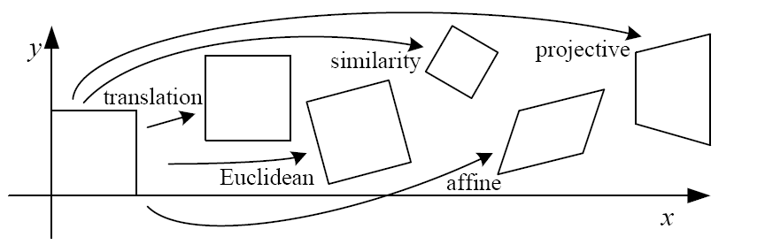
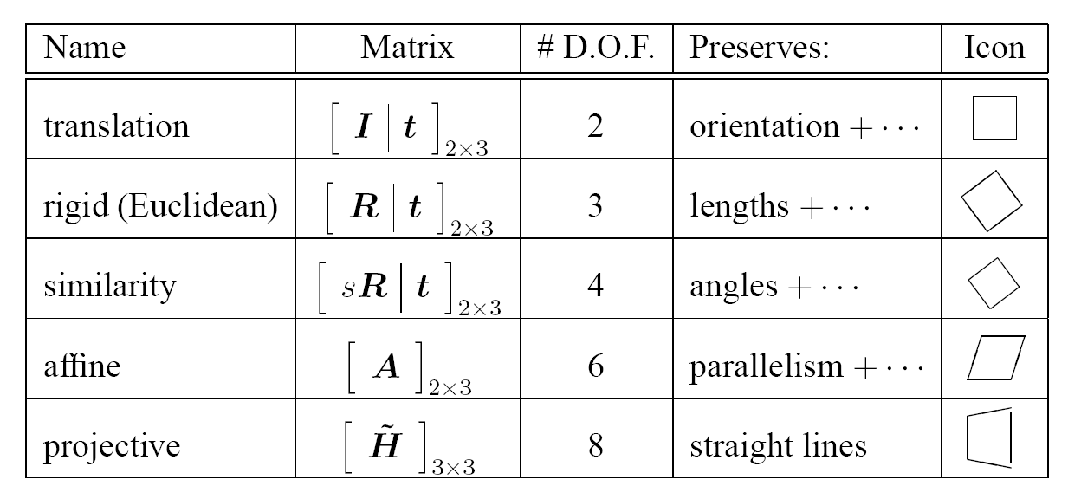
Review: 2D image transformations
Szeliski 2.1

Slide 11
This section – multiple views
Today – Intro to multiple views and Stereo
Wednesday – Camera calibration
Friday – Fundamental Matrix
Monday – Optical Flow
Wednesday – Multiview wrapup

Slide 12
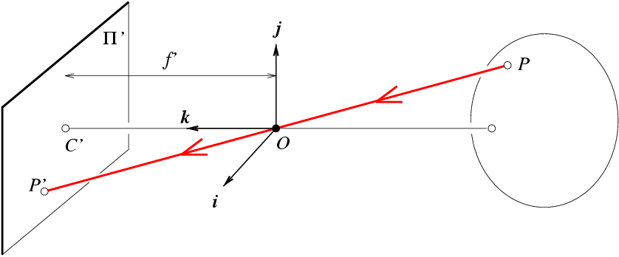
Oriented and Translated Camera
R
j_{w}
t
k_{w}
O_{w}
i_{w}

Slide 13
Degrees of freedom
5
6
Notes:
How many known points are needed to estimate this?

Slide 14
How to calibrate the camera?

Slide 15
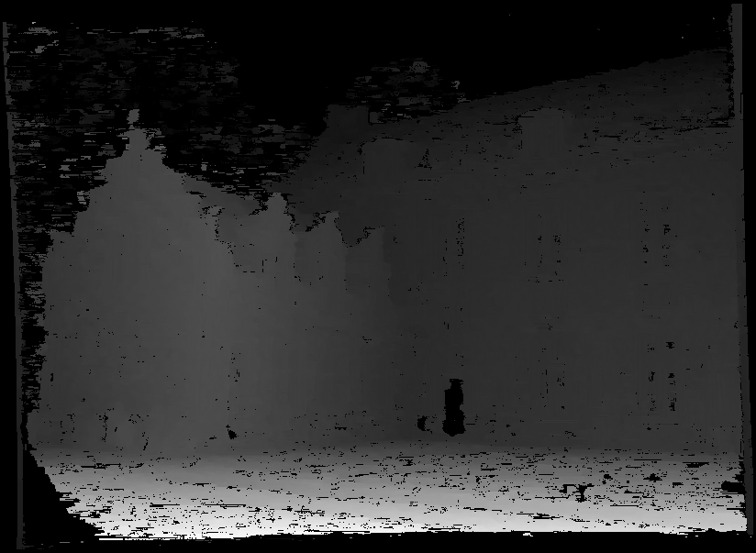
Stereo:
Intro
Computer Vision
James Hays
Slides by
Kristen Grauman

Slide 16
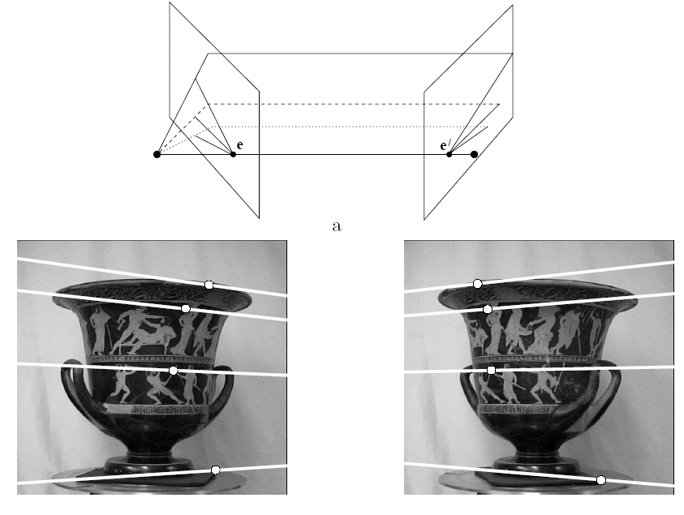
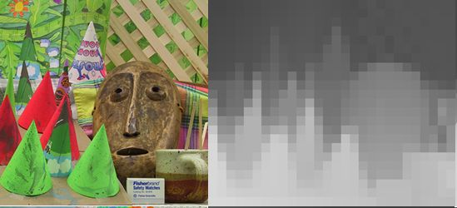
Multiple views
stereo vision
structure from motion
optical flow
Lowe
Hartley and Zisserman

Slide 17
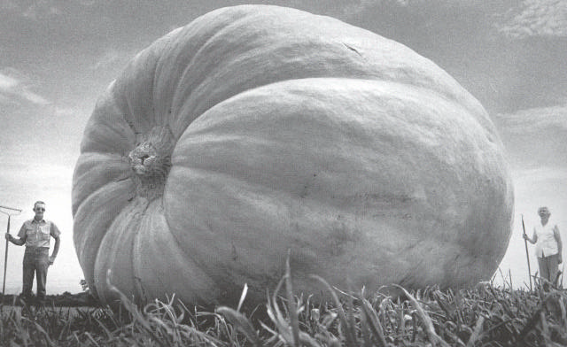
Why multiple views?
Structure and depth are inherently ambiguous from single views.
Images from Lana Lazebnik

Slide 18
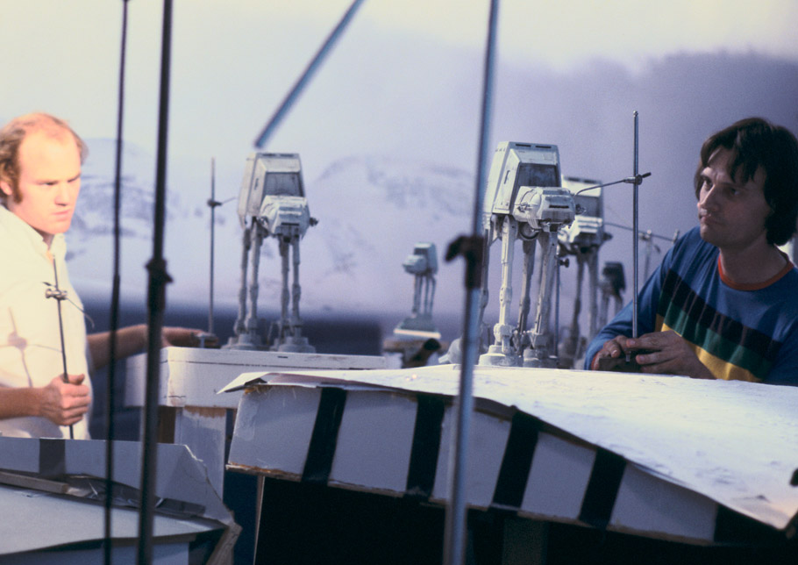
Notes:
Phil Tippett and Jon Berg stop-motion animate a shot with all three walkers (the background walkers are cutouts). Originally the plan had been to photograph the walkers against four-by-five Ektachrome transparencies shot in Norway; when these didn’t work as planned, matte artist Mike Pangrazio copied select Ektachromes onto large scenic backings.

Slide 19
Why multiple views?
Structure and depth are inherently ambiguous from single views.
P1
P2
P1’=P2’
Optical center

Slide 20
What cues help us to perceive 3d shape and depth?

Slide 21
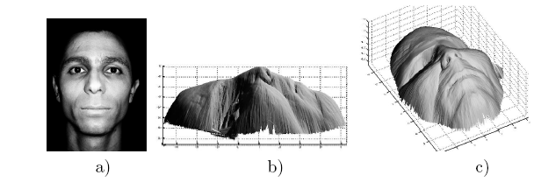
Shading
[Figure from Prados & Faugeras 2006]
Notes:
21

Slide 22
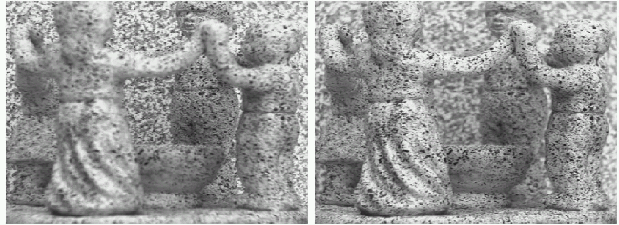
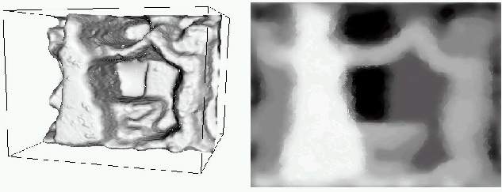
Focus/defocus
Images from same point of view, different camera parameters
3d shape / depth estimates
[figs from H. Jin and P. Favaro, 2002]

Slide 23
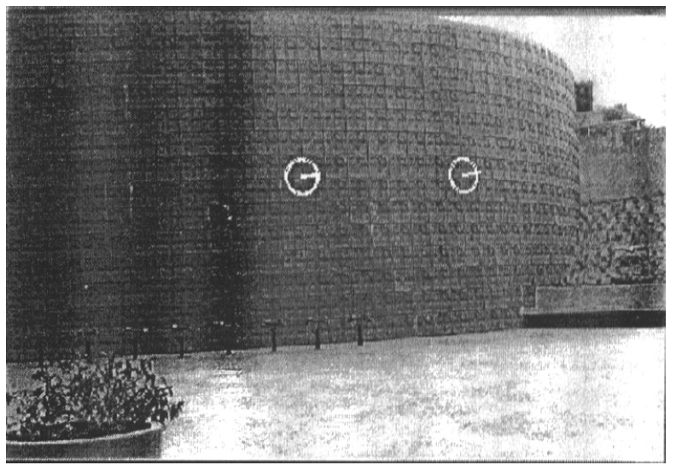
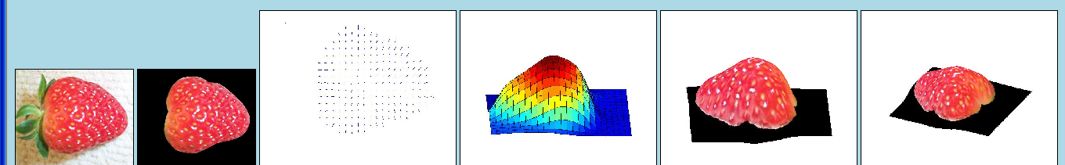
Texture
[From A.M. Loh. The recovery of 3-D structure using visual texture patterns. PhD thesis]
Notes:
23

Slide 24
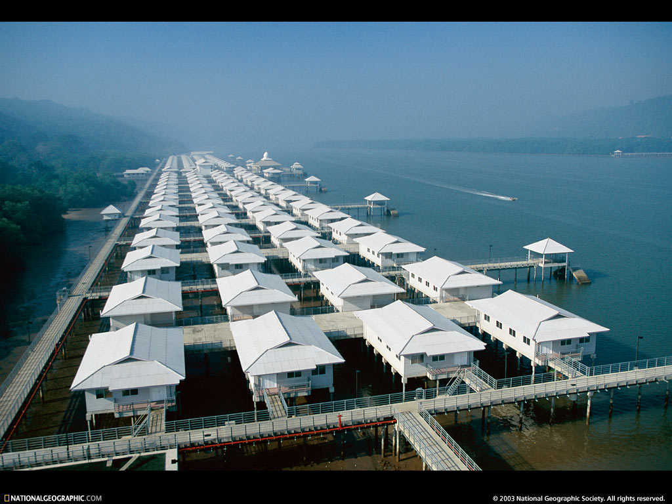
Perspective effects
Image credit: S. Seitz

Slide 25
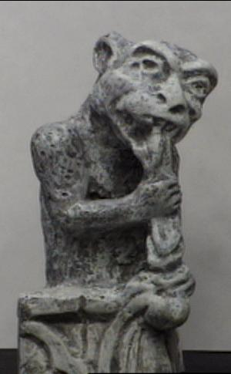
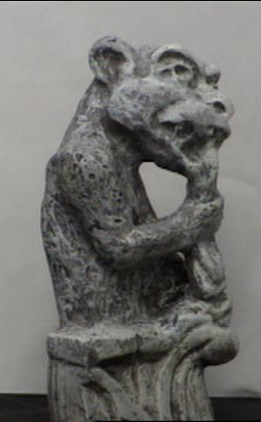
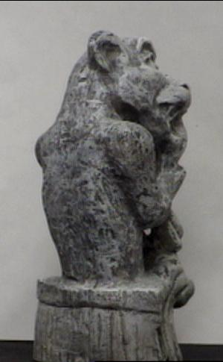
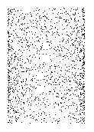
Motion
Figures from L. Zhang
http://www.brainconnection.com/teasers/?main=illusion/motion-shape

Slide 26
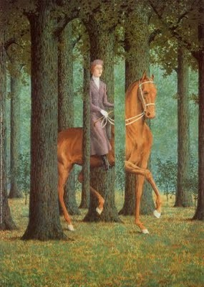
Occlusion
Rene Magritt'e famous painting Le Blanc-Seing (literal translation: "The Blank Signature") roughly translates as "free hand" or "free rein".
Notes:
http://rene-magritte-paintings.blogspot.com/2009/11/le-blanc-seing.html

Slide 27
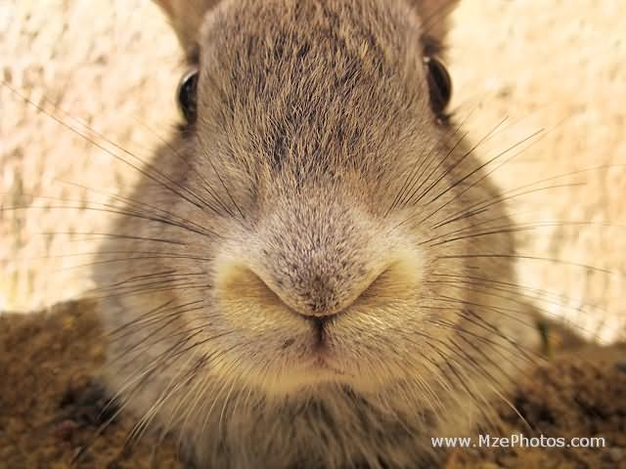
If stereo were critical for depth perception, navigation, recognition, etc., then this would be a problem

Slide 28
Multi-view geometry problems
Structure: Given projections of the same 3D point in two or more images, compute the 3D coordinates of that point
?
Camera 1
Camera 3
R₁,t₁
Camera 2
R₃,t₃
R₂,t₂
Slide credit: Noah Snavely
Notes:
Structure from motion solves the following problem:
Given a set of images of a static scene with 2D points in correspondence, shown here as color-coded points, find…
a set of 3D points P and
a rotation R and position t of the cameras that explain the observed correspondences. In other words, when we project a point into any of the cameras, the reprojection error between the projected and observed 2D points is low.
This problem can be formulated as an optimization problem where we want to find the rotations R, positions t, and 3D point locations P that minimize sum of squared reprojection errors f. This is a non-linear least squares problem and can be solved with algorithms such as Levenberg-Marquart. However, because the problem is non-linear, it can be susceptible to local minima. Therefore, it’s important to initialize the parameters of the system carefully. In addition, we need to be able to deal with erroneous correspondences.

Slide 29
Multi-view geometry problems
Stereo correspondence: Given a point in one of the images, where could its corresponding points be in the other images?
Camera 1
Camera 3
R₁,t₁
Camera 2
R₃,t₃
R₂,t₂
Slide credit: Noah Snavely
Notes:
Structure from motion solves the following problem:
Given a set of images of a static scene with 2D points in correspondence, shown here as color-coded points, find…
a set of 3D points P and
a rotation R and position t of the cameras that explain the observed correspondences. In other words, when we project a point into any of the cameras, the reprojection error between the projected and observed 2D points is low.
This problem can be formulated as an optimization problem where we want to find the rotations R, positions t, and 3D point locations P that minimize sum of squared reprojection errors f. This is a non-linear least squares problem and can be solved with algorithms such as Levenberg-Marquart. However, because the problem is non-linear, it can be susceptible to local minima. Therefore, it’s important to initialize the parameters of the system carefully. In addition, we need to be able to deal with erroneous correspondences.

Slide 30
Multi-view geometry problems
Motion: Given a set of corresponding points in two or more images, compute the camera parameters
Camera 1
?
Camera 2
?
?
Camera 3
R₁,t₁
R₃,t₃
R₂,t₂
Slide credit: Noah Snavely
Notes:
Structure from motion solves the following problem:
Given a set of images of a static scene with 2D points in correspondence, shown here as color-coded points, find…
a set of 3D points P and
a rotation R and position t of the cameras that explain the observed correspondences. In other words, when we project a point into any of the cameras, the reprojection error between the projected and observed 2D points is low.
This problem can be formulated as an optimization problem where we want to find the rotations R, positions t, and 3D point locations P that minimize sum of squared reprojection errors f. This is a non-linear least squares problem and can be solved with algorithms such as Levenberg-Marquart. However, because the problem is non-linear, it can be susceptible to local minima. Therefore, it’s important to initialize the parameters of the system carefully. In addition, we need to be able to deal with erroneous correspondences.

Slide 31
Estimating scene shape
“Shape from X”: Shading, Texture, Focus, Motion…
Stereo:
  shape from “motion” between two views
  infer 3d shape of scene from two (multiple) images from different viewpoints
Main idea:
scene point
image plane
optical center
Notes:
31

Slide 32
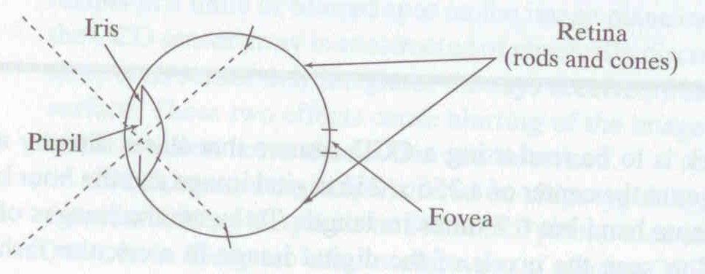
Human eye
Rough analogy with human visual system:
Pupil/Iris – control amount of light passing through lens
Retina - contains sensor cells, where image is formed
Fovea – highest concentration of cones
Fig from Shapiro and Stockman

Slide 33
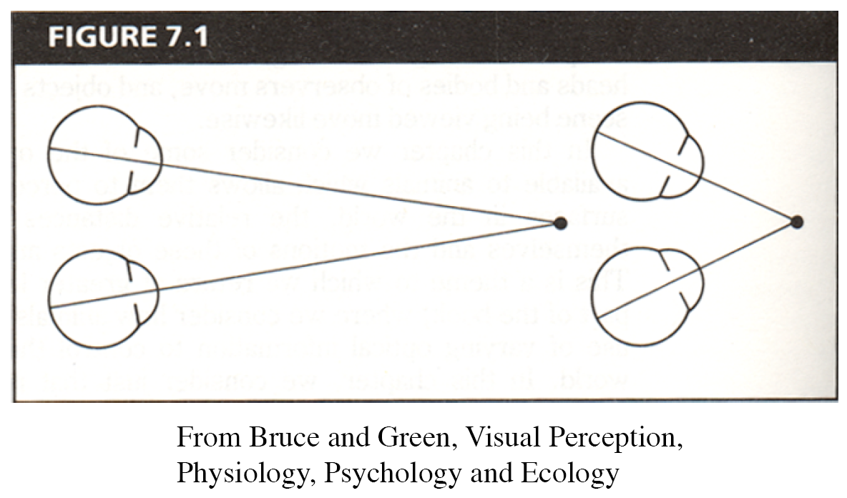
Human eyes fixate on point in space – rotate so that corresponding images form in centers of fovea.
Human stereopsis: disparity
Notes:
33

Slide 34
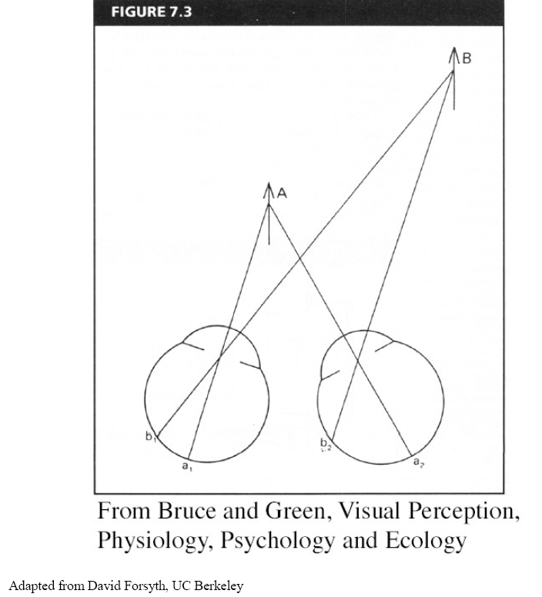
Human stereopsis: disparity
Disparity occurs when eyes fixate on one object; others appear at different visual angles
Notes:
34

Slide 35
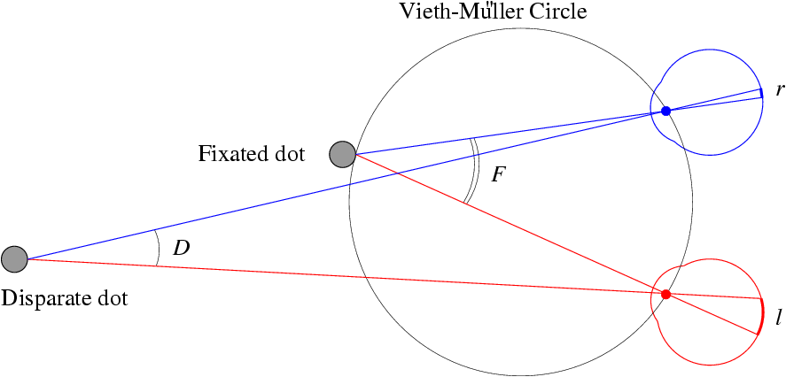
Human stereopsis: disparity
Disparity: d = r-l = D-F.
Forsyth & Ponce
Notes:
35

Slide 36
Random dot stereograms
Julesz 1960: Do we identify local brightness patterns before fusion (monocular process) or after (binocular)?
To test: pair of synthetic images obtained by randomly spraying black dots on white objects
Notes:
36

Slide 37
Random dot stereograms
Forsyth & Ponce
Notes:
37

Slide 38
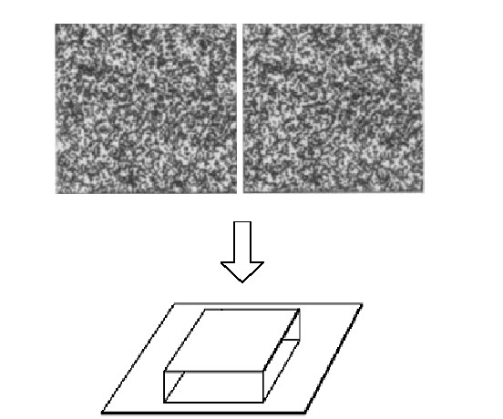
Random dot stereograms
Notes:
38

Slide 39
Random dot stereograms
When viewed monocularly, they appear random; when viewed stereoscopically, see 3d structure.
Human binocular fusion not directly associated with the physical retinas; must involve the central nervous system (V2, for instance).
Imaginary “cyclopean retina” that combines the left and right image stimuli as a single unit
High level scene understanding not required for Stereo
But, high level scene understanding is arguably better than stereo
Notes:
39
According to Ralph Siegel, Dr. Julesz had "unambiguously demonstrated that stereoscopic depth could be computed in the absence of any identifiable objects, in the absence of any perspective, in the absence of any cues available to either eye alone."
Artists are more often stereo blind than average people. Being stereo blind may train you to be better at recognizing and thus depicting other monocular depth cues.

Slide 40
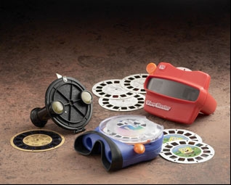
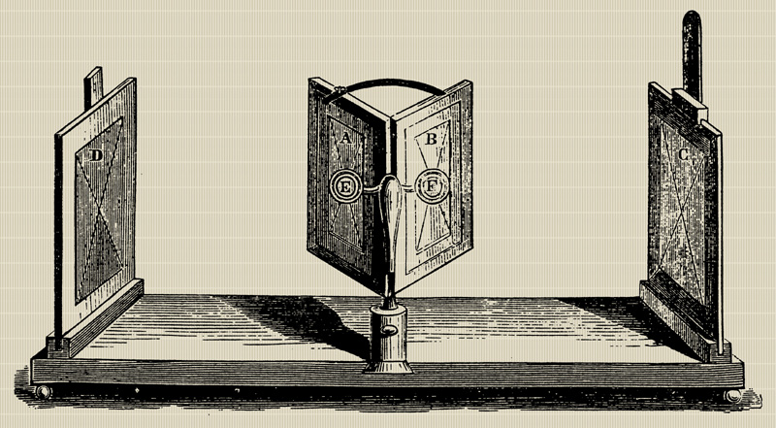
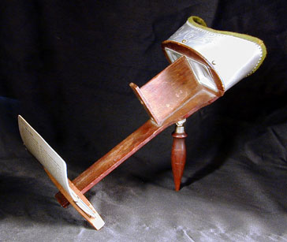
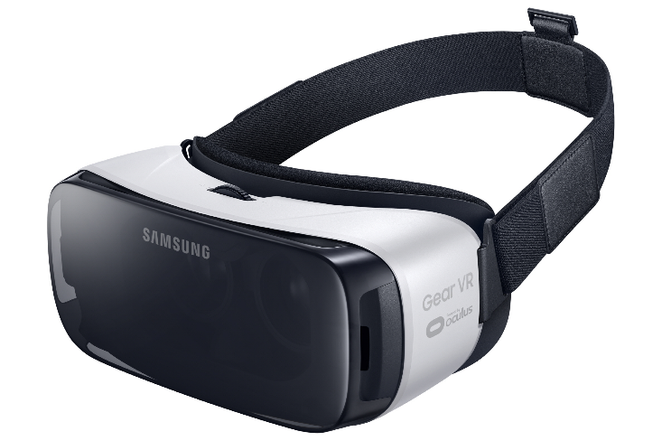
Stereo photography and stereo viewers
Take two pictures of the same subject from two slightly different viewpoints and display so that each eye sees only one of the images.
Image from fisher-price.com
Invented by Sir Charles Wheatstone, 1838

Slide 41
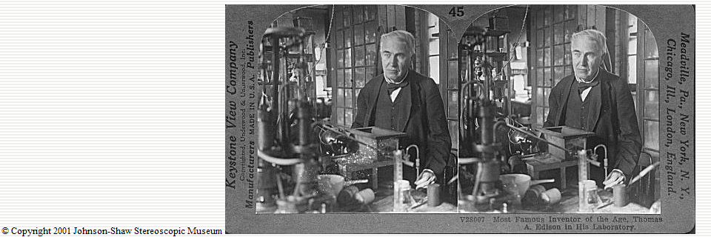
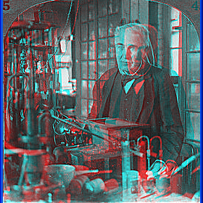
http://www.johnsonshawmuseum.org
Notes:
41

Slide 42
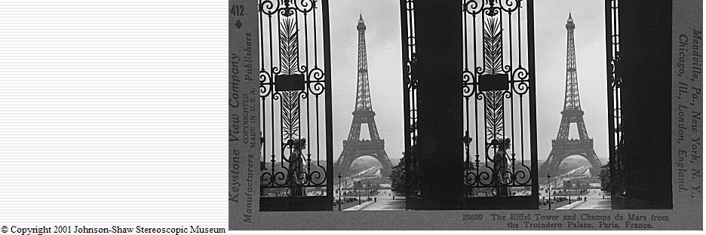
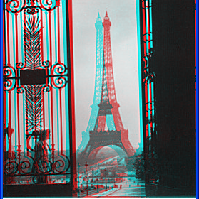
http://www.johnsonshawmuseum.org
Notes:
42

Slide 43
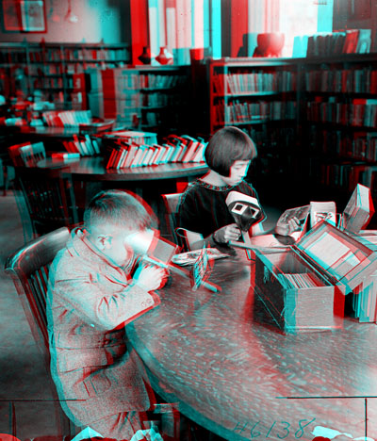

Public Library, Stereoscopic Looking Room, Chicago, by Phillips, 1923
Notes:
43

Slide 44
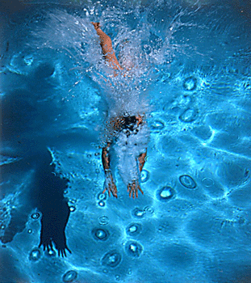
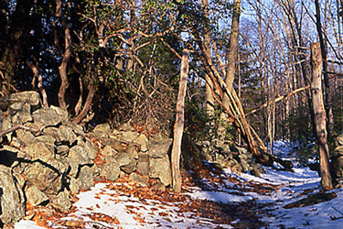
http://www.well.com/~jimg/stereo/stereo_list.html
Notes:
44

Slide 45

Autostereograms
Exploit disparity as depth cue using single image.
(Single image random dot stereogram, Single image stereogram)
Images from magiceye.com
Notes:
45

Slide 46

Autostereograms
Images from magiceye.com
Notes:
46

Slide 47

Estimating depth with stereo
Stereo: shape from “motion” between two views
We’ll need to consider:
Info on camera pose (“calibration”)
Image point correspondences
scene point
image plane
optical center
Notes:
47

Slide 48


Stereo vision
Two cameras, simultaneous views
Single moving camera and static scene

Slide 49

Camera parameters
Camera frame 2
Extrinsic parameters:
Camera frame 1 ←→ Camera frame 2
Intrinsic parameters:
Image coordinates relative to camera ←→ Pixel coordinates
Camera frame 1
Extrinsic params: rotation matrix and translation vector
Intrinsic params: focal length, pixel sizes (mm), image center point, radial distortion parameters
We’ll assume for now that these parameters are given and fixed.
Notes:
49

Slide 50
Geometry for a simple stereo system
First, assuming parallel optical axes, known camera parameters (i.e., calibrated cameras):

Slide 51

World point
Depth of p
image point (left)
image point (right)
Focal length
optical center (right)
optical center (left)
baseline
Notes:
51

Slide 52
Geometry for a simple stereo system
Assume parallel optical axes, known camera parameters (i.e., calibrated cameras). What is expression for Z?
Similar triangles (p_{l}, P, p_{r}) and (O_{l}, P, O_{r}):
disparity
Notes:
52

Slide 53



Depth from disparity
image I(x,y)
Disparity map D(x,y)
image I´(x´,y´)
(x´,y´)=(x+D(x,y), y)
So if we could find the corresponding points in two images, we could estimate relative depth…

Slide 54


Where do we need to search?
To be continued…

Slide 55

Break
Feel free to leave if you’ve got Project 2 mostly working

Slide 56
proj2 Common Problems
Interest point detection
Feature description
Matching

Slide 57
Interest Point Detection
Suppress corners on the edge of the image which might have appeared from padding artifacts
You probably shouldn’t have too few (50) or too many (5000) interest points.
Colfilt() approach to non-max suppression may be more reliable.
  But I’ve seen people using it incorrectly.

Slide 58
Feature Description
You can start with something very simple, e.g. cutting out raw image patches.
  My implementation gets 74/100 matches correct with this, versus 93/100 with a more SIFT-like feature.
You can use imagesc(image1_features) to check that the features aren’t degenerate in some way.
Free parameters (e.g. size of Gaussians) can matter

