Slide 2
Compression
How is it that a 4MP image can be compressed to a few hundred KB without a noticeable change?

Slide 3
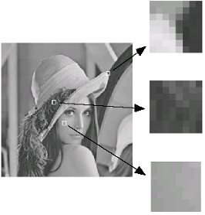
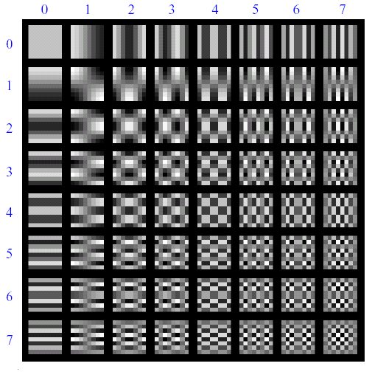
Lossy Image Compression (JPEG)
Block-based Discrete Cosine Transform (DCT)
Slides: Efros

Slide 4
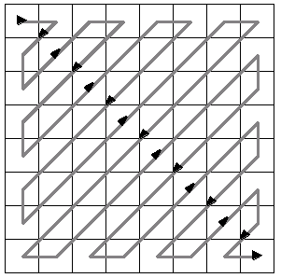
Using DCT in JPEG
The first coefficient B(0,0) is the DC component, the average intensity
The top-left coeffs represent low frequencies, the bottom right – high frequencies

Slide 5
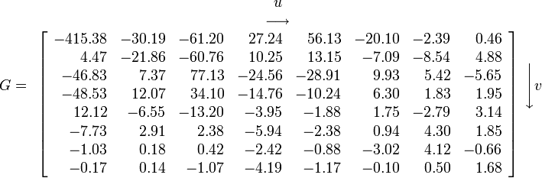
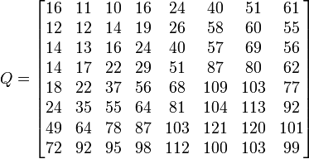
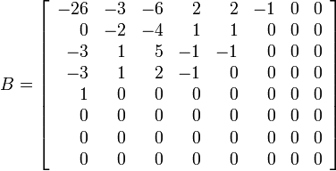
Image compression using DCT
Quantize
  More coarsely for high frequencies (which also tend to have smaller values)
  Many quantized high frequency values will be zero
Encode
  Can decode with inverse dct
Filter responses
Quantization table
Quantized values

Slide 6
JPEG Compression Summary
Convert image to YCrCb
Subsample color by factor of 2
  People have bad resolution for color
Split into blocks (8x8, typically), subtract 128
For each block
  Compute DCT coefficients
  Coarsely quantize
    Many high frequency components will become zero
  Encode (with run length encoding and then Huffman coding for leftovers)
http://en.wikipedia.org/wiki/YCbCr
http://en.wikipedia.org/wiki/JPEG

Slide 7
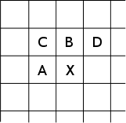
Lossless compression (PNG)
Predict that a pixel’s value based on its upper-left neighborhood
Store difference of predicted and actual value
Pkzip it (DEFLATE algorithm)

Slide 8
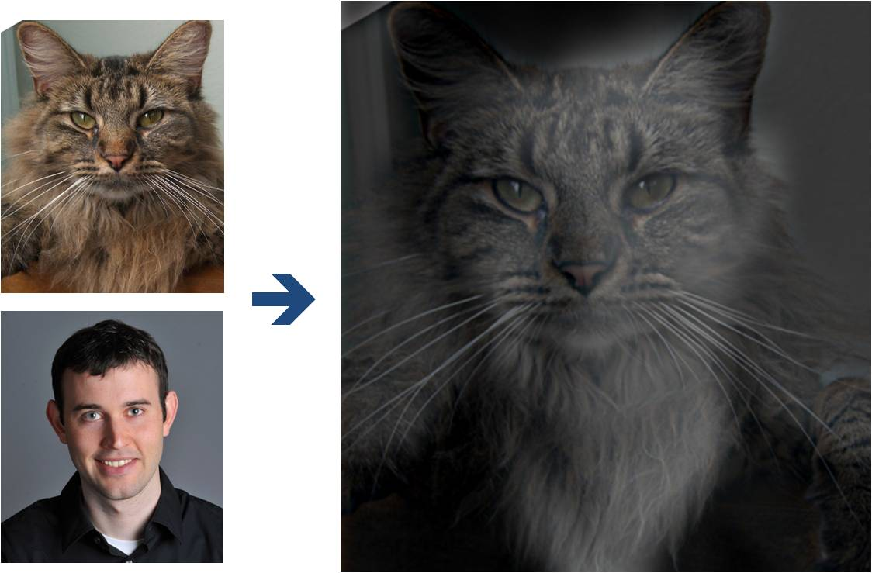
Why do we get different, distance-dependent interpretations of hybrid images?
?

Slide 9
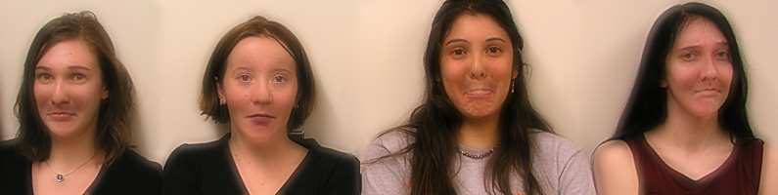
Application: Hybrid Images
A. Oliva, A. Torralba, P.G. Schyns,
“Hybrid Images,” SIGGRAPH 2006

Slide 10
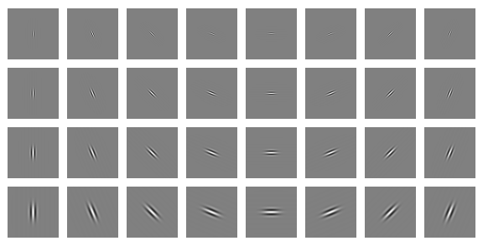
Clues from Human Perception
Early processing in humans filters for various orientations and scales of frequency
Perceptual cues in the mid-high frequencies dominate perception
When we see an image from far away, we are effectively subsampling it
Early Visual Processing: Multi-scale edge and blob filters

Slide 11

Campbell-Robson contrast sensitivity curve

Slide 12
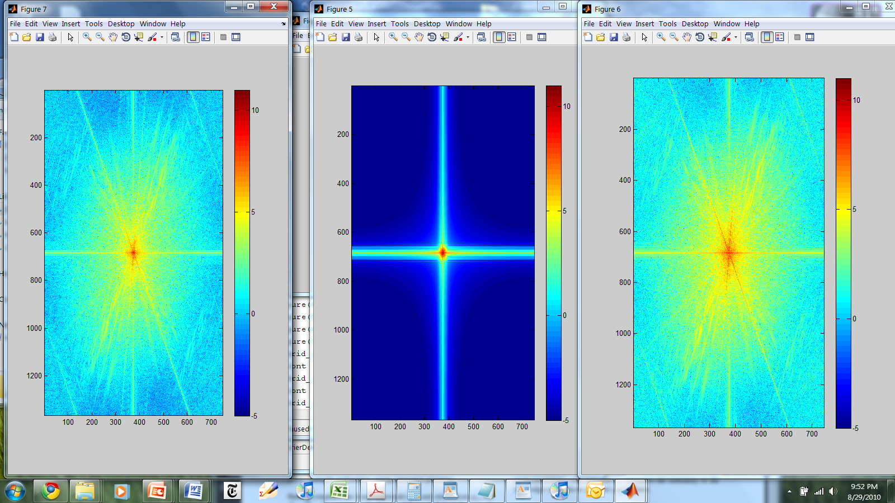
Hybrid Image in FFT
Hybrid Image
Low-passed Image
High-passed Image

Slide 13

Review: Image filtering
1
1
1
1
1
1
1
1
1
0 | 0 | 0 | 0 | 0 | 0 | 0 | 0 | 0 | 0
0 | 0 | 0 | 0 | 0 | 0 | 0 | 0 | 0 | 0
0 | 0 | 0 | 90 | 90 | 90 | 90 | 90 | 0 | 0
0 | 0 | 0 | 90 | 90 | 90 | 90 | 90 | 0 | 0
0 | 0 | 0 | 90 | 90 | 90 | 90 | 90 | 0 | 0
0 | 0 | 0 | 90 | 0 | 90 | 90 | 90 | 0 | 0
0 | 0 | 0 | 90 | 90 | 90 | 90 | 90 | 0 | 0
0 | 0 | 0 | 0 | 0 | 0 | 0 | 0 | 0 | 0
0 | 0 | 90 | 0 | 0 | 0 | 0 | 0 | 0 | 0
0 | 0 | 0 | 0 | 0 | 0 | 0 | 0 | 0 | 0
 | 0
0 | 0 | 0 | 0 | 0 | 0 | 0 | 0 | 0 | 0
0 | 0 | 0 | 0 | 0 | 0 | 0 | 0 | 0 | 0
0 | 0 | 0 | 90 | 90 | 90 | 90 | 90 | 0 | 0
0 | 0 | 0 | 90 | 90 | 90 | 90 | 90 | 0 | 0
0 | 0 | 0 | 90 | 90 | 90 | 90 | 90 | 0 | 0
0 | 0 | 0 | 90 | 0 | 90 | 90 | 90 | 0 | 0
0 | 0 | 0 | 90 | 90 | 90 | 90 | 90 | 0 | 0
0 | 0 | 0 | 0 | 0 | 0 | 0 | 0 | 0 | 0
0 | 0 | 90 | 0 | 0 | 0 | 0 | 0 | 0 | 0
0 | 0 | 0 | 0 | 0 | 0 | 0 | 0 | 0 | 0
Credit: S. Seitz
Notes:
ones, divide by 9

Slide 14
Image filtering
1
1
1
1
1
1
1
1
1
0 | 0 | 0 | 0 | 0 | 0 | 0 | 0 | 0 | 0
0 | 0 | 0 | 0 | 0 | 0 | 0 | 0 | 0 | 0
0 | 0 | 0 | 90 | 90 | 90 | 90 | 90 | 0 | 0
0 | 0 | 0 | 90 | 90 | 90 | 90 | 90 | 0 | 0
0 | 0 | 0 | 90 | 90 | 90 | 90 | 90 | 0 | 0
0 | 0 | 0 | 90 | 0 | 90 | 90 | 90 | 0 | 0
0 | 0 | 0 | 90 | 90 | 90 | 90 | 90 | 0 | 0
0 | 0 | 0 | 0 | 0 | 0 | 0 | 0 | 0 | 0
0 | 0 | 90 | 0 | 0 | 0 | 0 | 0 | 0 | 0
0 | 0 | 0 | 0 | 0 | 0 | 0 | 0 | 0 | 0
 | 0 | 10
0 | 0 | 0 | 0 | 0 | 0 | 0 | 0 | 0 | 0
0 | 0 | 0 | 0 | 0 | 0 | 0 | 0 | 0 | 0
0 | 0 | 0 | 90 | 90 | 90 | 90 | 90 | 0 | 0
0 | 0 | 0 | 90 | 90 | 90 | 90 | 90 | 0 | 0
0 | 0 | 0 | 90 | 90 | 90 | 90 | 90 | 0 | 0
0 | 0 | 0 | 90 | 0 | 90 | 90 | 90 | 0 | 0
0 | 0 | 0 | 90 | 90 | 90 | 90 | 90 | 0 | 0
0 | 0 | 0 | 0 | 0 | 0 | 0 | 0 | 0 | 0
0 | 0 | 90 | 0 | 0 | 0 | 0 | 0 | 0 | 0
0 | 0 | 0 | 0 | 0 | 0 | 0 | 0 | 0 | 0
Credit: S. Seitz
Notes:
ones, divide by 9

Slide 15
Image filtering
1
1
1
1
1
1
1
1
1
0 | 0 | 0 | 0 | 0 | 0 | 0 | 0 | 0 | 0
0 | 0 | 0 | 0 | 0 | 0 | 0 | 0 | 0 | 0
0 | 0 | 0 | 90 | 90 | 90 | 90 | 90 | 0 | 0
0 | 0 | 0 | 90 | 90 | 90 | 90 | 90 | 0 | 0
0 | 0 | 0 | 90 | 90 | 90 | 90 | 90 | 0 | 0
0 | 0 | 0 | 90 | 0 | 90 | 90 | 90 | 0 | 0
0 | 0 | 0 | 90 | 90 | 90 | 90 | 90 | 0 | 0
0 | 0 | 0 | 0 | 0 | 0 | 0 | 0 | 0 | 0
0 | 0 | 90 | 0 | 0 | 0 | 0 | 0 | 0 | 0
0 | 0 | 0 | 0 | 0 | 0 | 0 | 0 | 0 | 0
 | 0 | 10 | 20
0 | 0 | 0 | 0 | 0 | 0 | 0 | 0 | 0 | 0
0 | 0 | 0 | 0 | 0 | 0 | 0 | 0 | 0 | 0
0 | 0 | 0 | 90 | 90 | 90 | 90 | 90 | 0 | 0
0 | 0 | 0 | 90 | 90 | 90 | 90 | 90 | 0 | 0
0 | 0 | 0 | 90 | 90 | 90 | 90 | 90 | 0 | 0
0 | 0 | 0 | 90 | 0 | 90 | 90 | 90 | 0 | 0
0 | 0 | 0 | 90 | 90 | 90 | 90 | 90 | 0 | 0
0 | 0 | 0 | 0 | 0 | 0 | 0 | 0 | 0 | 0
0 | 0 | 90 | 0 | 0 | 0 | 0 | 0 | 0 | 0
0 | 0 | 0 | 0 | 0 | 0 | 0 | 0 | 0 | 0
Credit: S. Seitz
Notes:
ones, divide by 9

Slide 16
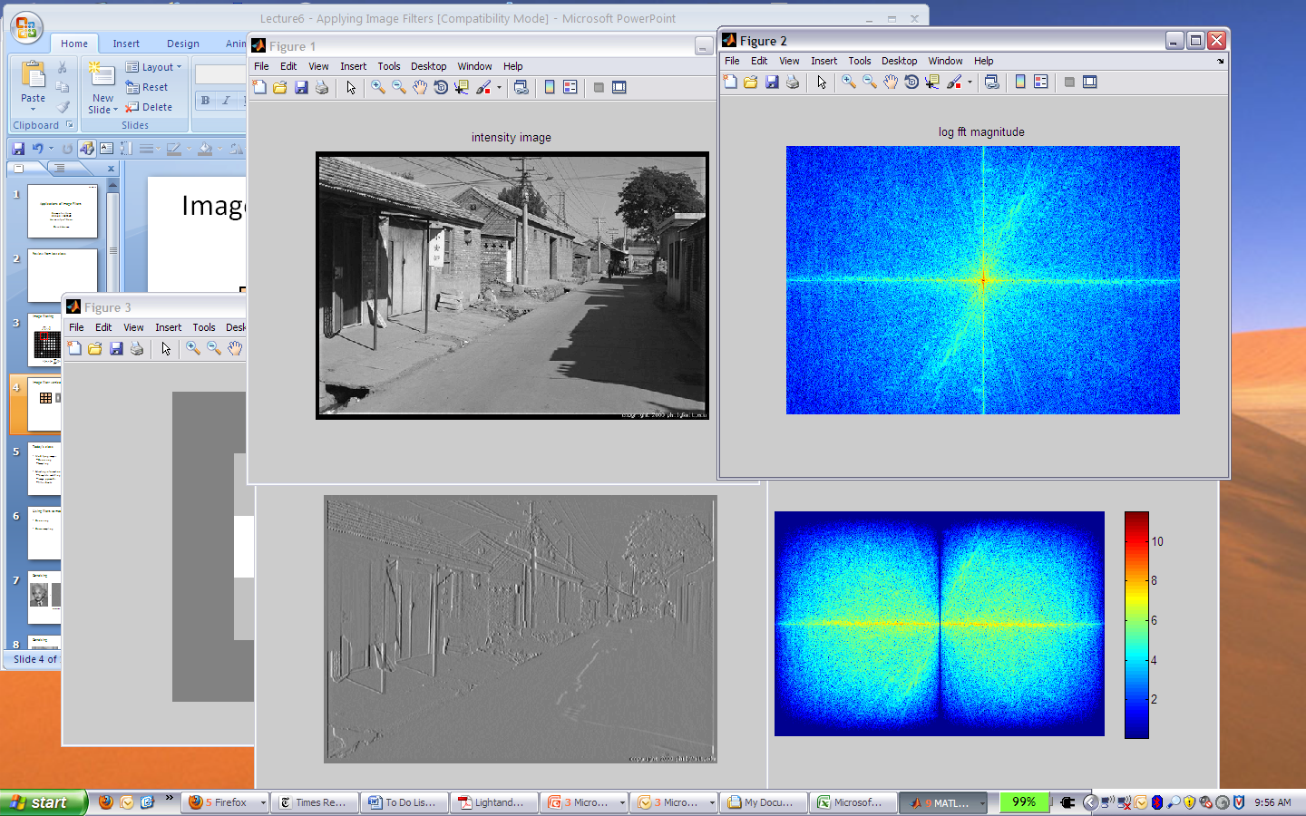
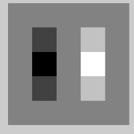
Filtering in spatial domain
1
0
-1
2
0
-2
1
0
-1
*
=

Slide 17
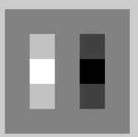

Filtering in frequency domain
FFT
FFT
=
Inverse FFT

Slide 18
Review of Filtering
Filtering in spatial domain
  Slide filter over image and take dot product at each position
  Remember linearity (for linear filters)
  Examples
    1D: [-1 0 1], [0 0 0 0 0.5 1 1 1 0.5 0 0 0]
    1D: [0.25 0.5 0.25], [0 0 0 0 0.5 1 1 1 0.5 0 0 0]
    2D: [1 0 0 ; 0 2 0 ; 0 0 1]/4

Slide 19
Review of Filtering
Filtering in frequency domain
  Can be faster than filtering in spatial domain (for large filters)
  Can help understand effect of filter
  Algorithm:
    Convert image and filter to fft (fft2 in matlab)
    Pointwise-multiply ffts
    Convert result to spatial domain with ifft2

Slide 20
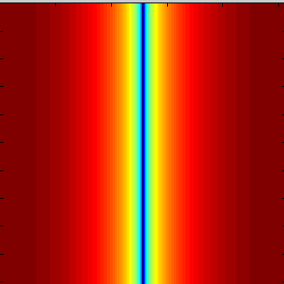
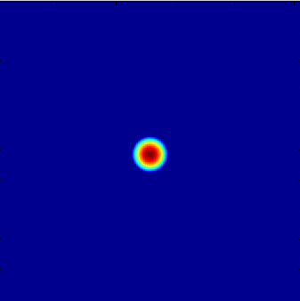
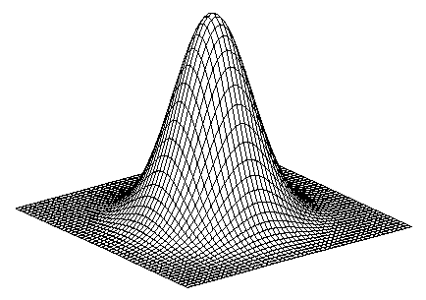
Review of Filtering
Linear filters for basic processing
  Edge filter (high-pass)
  Gaussian filter (low-pass)
[-1 1]
Gaussian
FFT of Gradient Filter
FFT of Gaussian

Slide 21
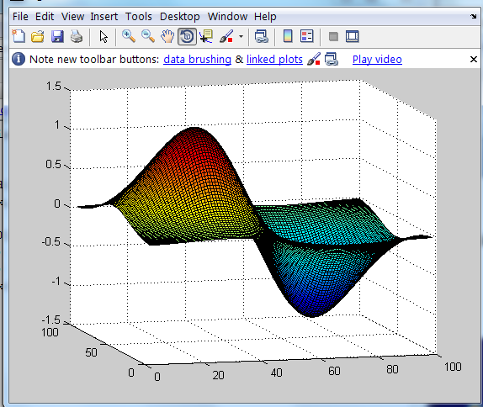
Review of Filtering
Derivative of Gaussian

Slide 22
Review of Last 3 Days
Applications of filters
  Template matching (SSD or Normxcorr2)
    SSD can be done with linear filters, is sensitive to overall intensity
  Gaussian pyramid
    Coarse-to-fine search, multi-scale detection
  Laplacian pyramid
    Teases apart different frequency bands while keeping spatial information
    Can be used for compositing in graphics
  Downsampling
    Need to sufficiently low-pass before downsampling

Slide 23
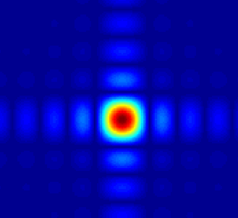
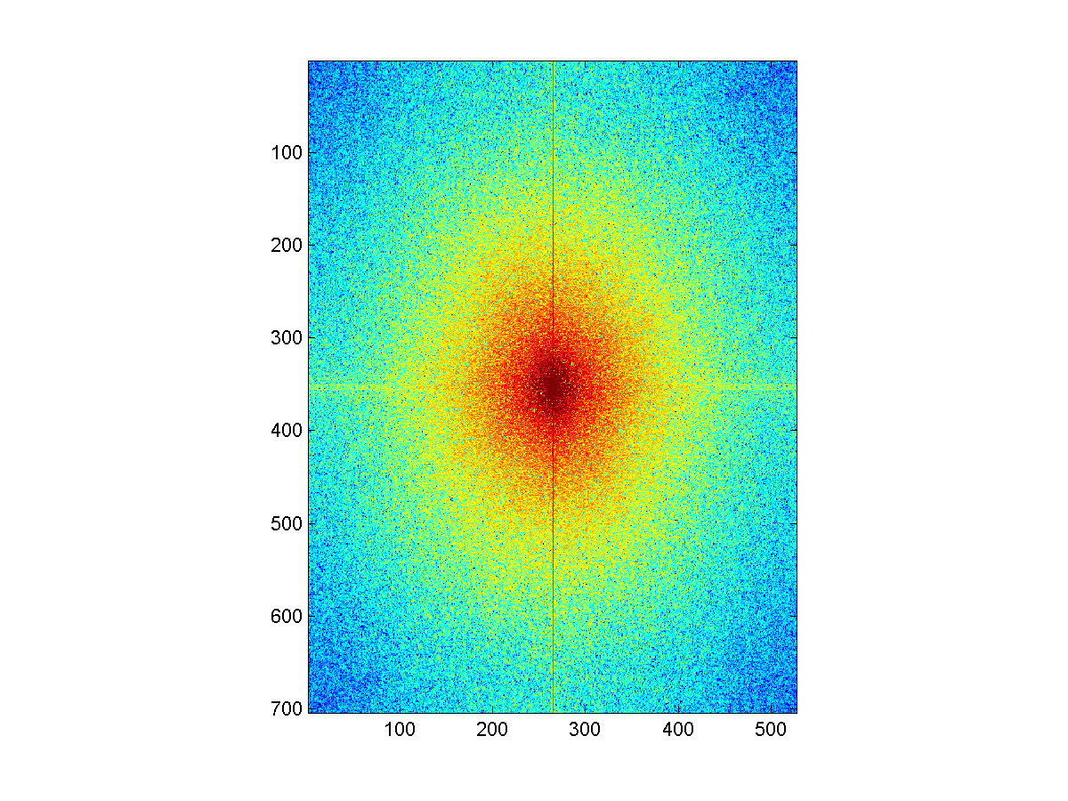
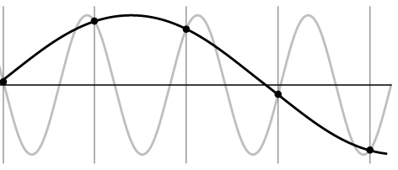
Things to Remember
Sometimes it makes sense to think of images and filtering in the frequency domain
  Fourier analysis
Can be faster to filter using FFT for large images (N logN vs. N² for auto-correlation)
Images are mostly smooth
  Basis for compression
Remember to low-pass before sampling

Slide 24

The blue and green colors are actually the same

Slide 25
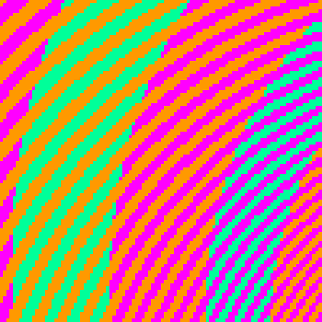
http://blogs.discovermagazine.com/badastronomy/2009/06/24/the-blue-and-the-green/

Slide 26
Previous Lectures
We’ve now touched on the first three chapters of Szeliski.
  1. Introduction
  2. Image Formation
  3. Image Processing
Now we’re moving on to
  4. Feature Detection and Matching
  Multiple views and motion (7, 8, 11)

Slide 27
Edge / Boundary Detection
Szeliski 4.2
Computer Vision
James Hays
Many slides from Lana Lazebnik, Steve Seitz, David Forsyth, David Lowe, Fei-Fei Li, and Derek Hoiem

Slide 28
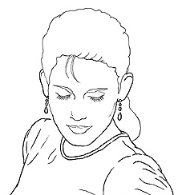
Edge detection
Goal: Identify sudden changes (discontinuities) in an image
  Intuitively, most semantic and shape information from the image can be encoded in the edges
  More compact than pixels
Ideal: artist’s line drawing (but artist is also using object-level knowledge)
Source: D. Lowe

Slide 29
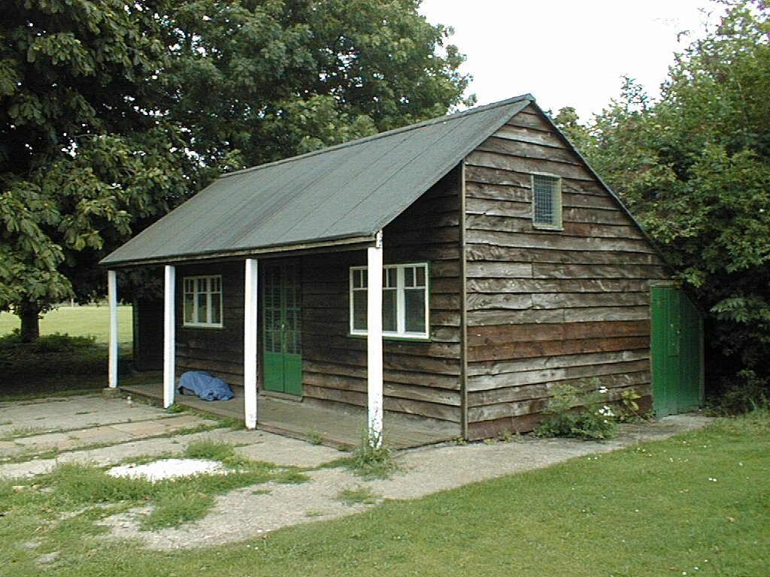
Why do we care about edges?
Extract information, recognize objects
Recover geometry and viewpoint
Vertical vanishing
point
(at infinity)
Vanishing
line
Vanishing
point
Vanishing
point

Slide 30
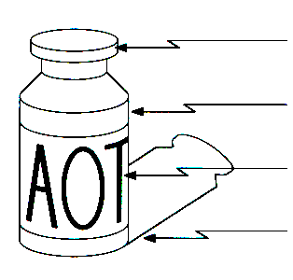
Origin of Edges
surface normal discontinuity
depth discontinuity
surface color discontinuity
illumination discontinuity
Edges are caused by a variety of factors
Source: Steve Seitz

Slide 31
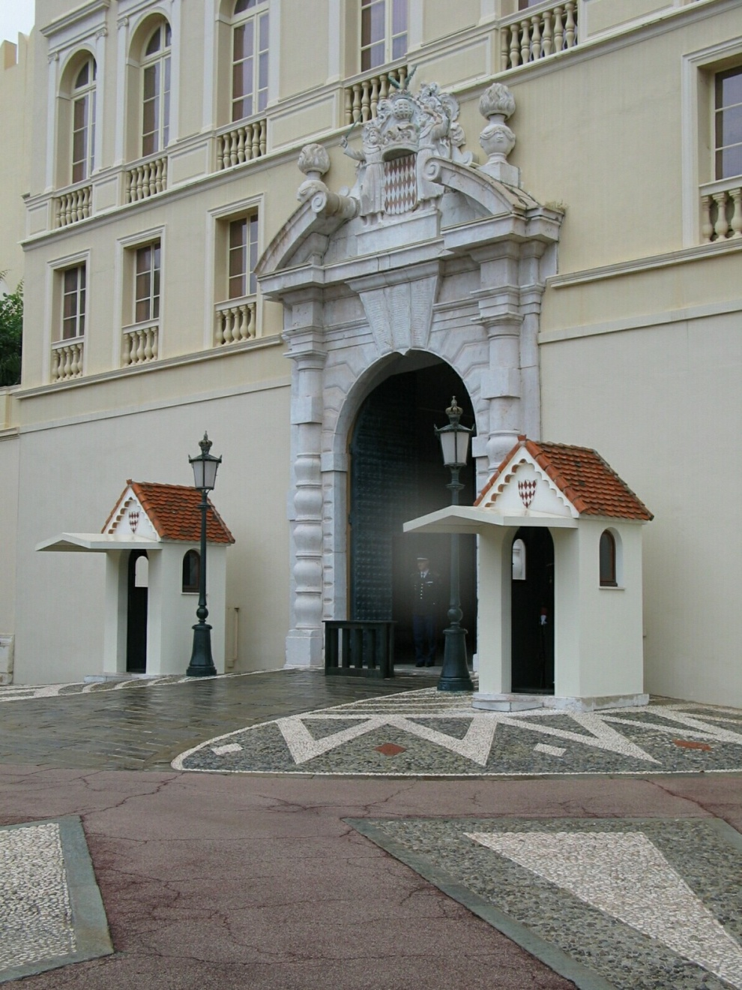
Closeup of edges
Source: D. Hoiem

Slide 32
Closeup of edges
Source: D. Hoiem

Slide 33
Closeup of edges
Source: D. Hoiem

Slide 34
Closeup of edges
Source: D. Hoiem

Slide 35

Characterizing edges
An edge is a place of rapid change in the image intensity function
intensity function
(along horizontal scanline)
image
first derivative
edges correspond to
extrema of derivative

Slide 36
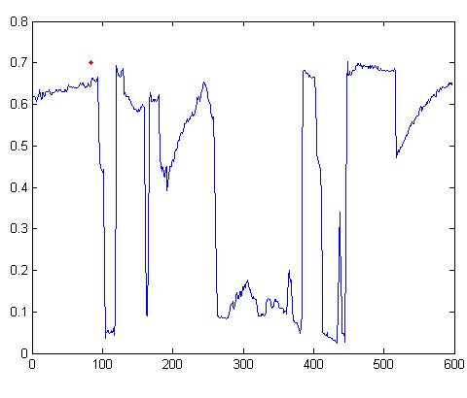

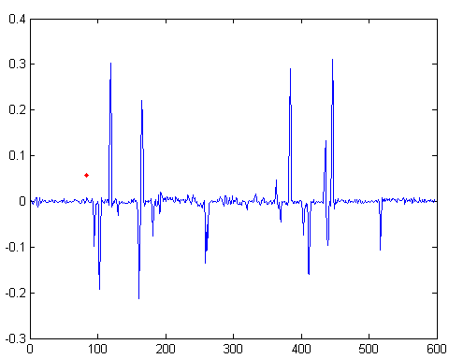
Intensity profile
Source: D. Hoiem

Slide 37
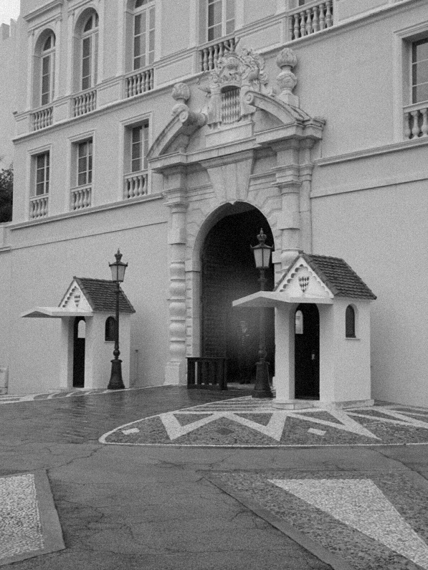
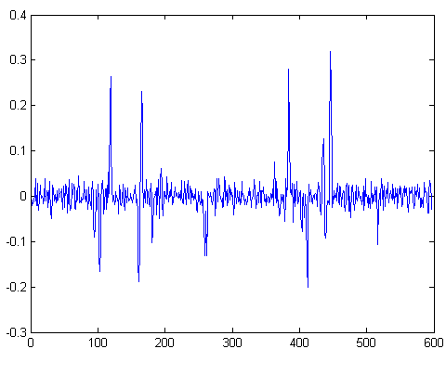
With a little Gaussian noise
Gradient
Source: D. Hoiem

Slide 38

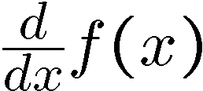
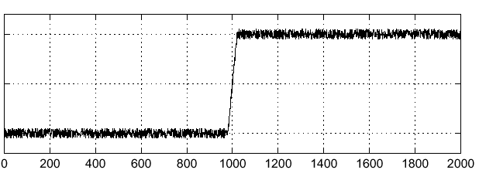
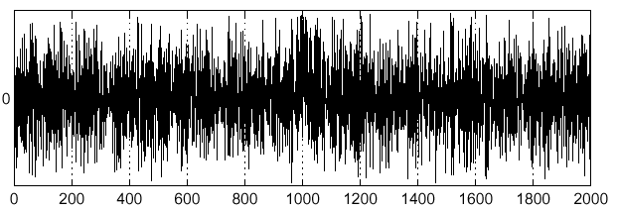
Effects of noise
Consider a single row or column of the image
  Plotting intensity as a function of position gives a signal
Where is the edge?
Source: S. Seitz
Notes:
How to fix?

Slide 39
Effects of noise
Difference filters respond strongly to noise
  Image noise results in pixels that look very different from their neighbors
  Generally, the larger the noise the stronger the response
What can we do about it?
Source: D. Forsyth

Slide 40
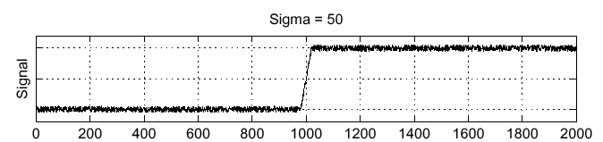
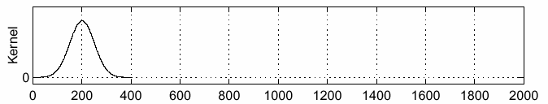
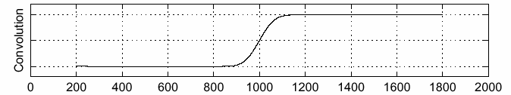
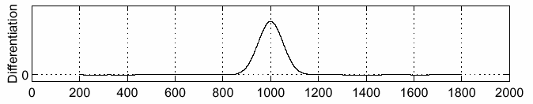
Solution: smooth first
f
g
f * g
To find edges, look for peaks in
Source: S. Seitz

Slide 41
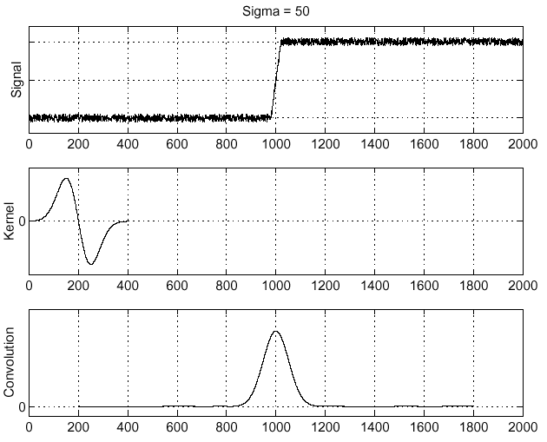
Derivative theorem of convolution
Differentiation is convolution, and convolution is associative:
This saves us one operation:
f
Source: S. Seitz

Slide 42
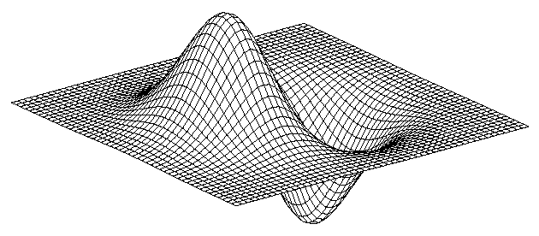
Derivative of Gaussian filter
* [1 -1] =
Notes:
Is this filter separable?

Slide 43
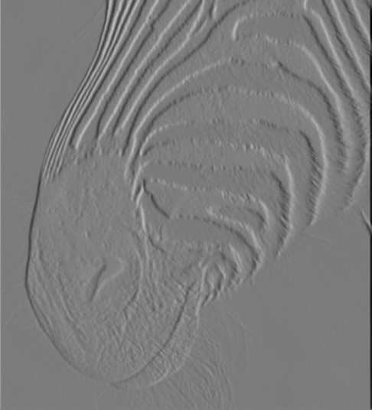
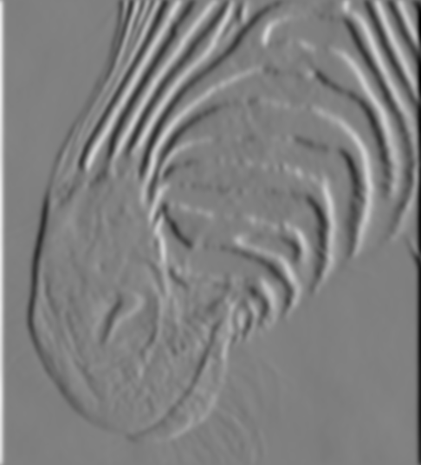
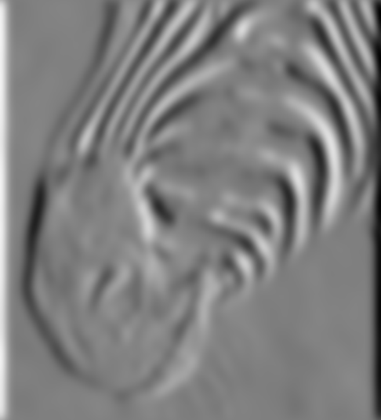
Tradeoff between smoothing and localization
1 pixel
3 pixels
7 pixels
Smoothed derivative removes noise, but blurs edge. Also finds edges at different “scales”.
Source: D. Forsyth

Slide 44
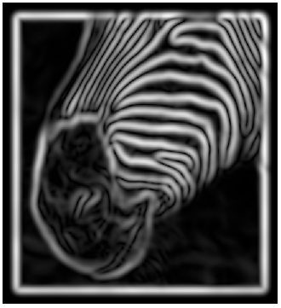
Implementation issues
The gradient magnitude is large along a thick “trail” or “ridge,” so how do we identify the actual edge points?
How do we link the edge points to form curves?
Source: D. Forsyth
Notes:
Figures show gradient magnitude of zebra at two different scales

Slide 45
Designing an edge detector
Criteria for a good edge detector:
  Good detection: the optimal detector should find all real edges, ignoring noise or other artifacts
  Good localization
    the edges detected must be as close as possible to the true edges
    the detector must return one point only for each true edge point
Cues of edge detection
  Differences in color, intensity, or texture across the boundary
  Continuity and closure
  High-level knowledge
Source: L. Fei-Fei

Slide 46
Canny edge detector
This is probably the most widely used edge detector in computer vision
Theoretical model: step-edges corrupted by additive Gaussian noise
Canny has shown that the first derivative of the Gaussian closely approximates the operator that optimizes the product of signal-to-noise ratio and localization
J. Canny, A Computational Approach To Edge Detection, IEEE Trans. Pattern Analysis and Machine Intelligence, 8:679-714, 1986.
22,000 citations!
Source: L. Fei-Fei

Slide 47
Note about Matlab’s Canny detector
Small errors in implementation
  Gaussian function not properly normalized
  First filters with a Gaussian, then a difference of Gaussian (equivalent to filtering with a larger Gaussian and taking difference)

Slide 48

Example
original image (Lena)

Slide 49
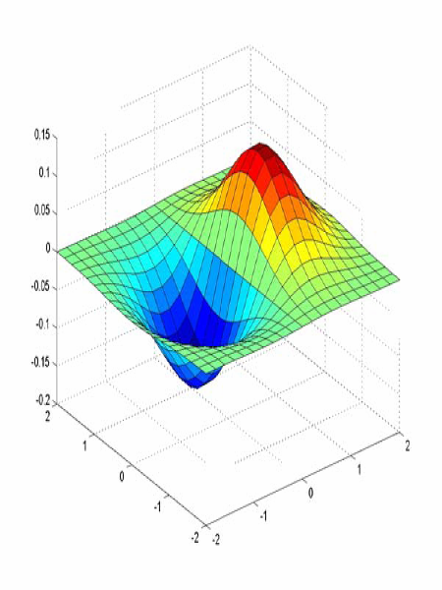
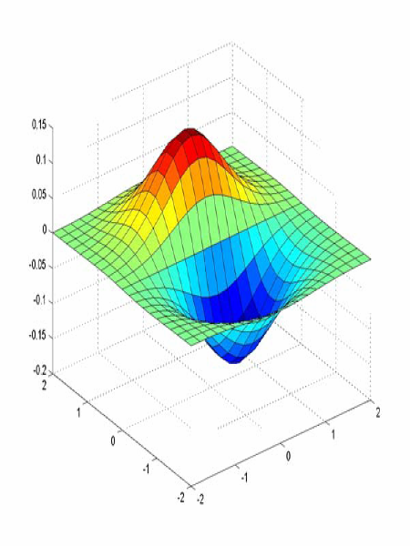
Derivative of Gaussian filter
x-direction
y-direction

Slide 50
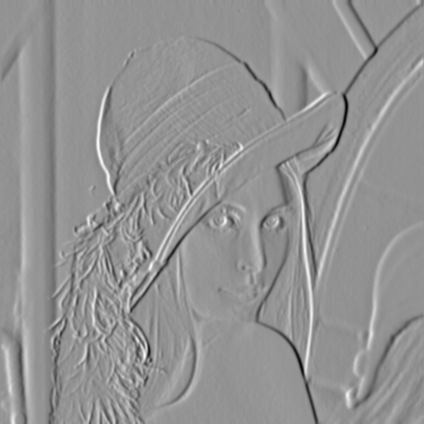
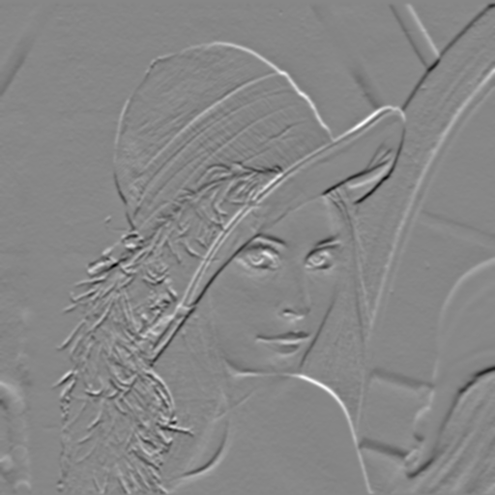
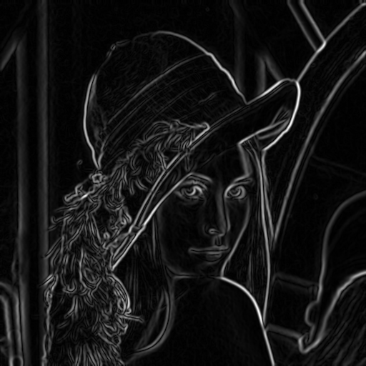
Compute Gradients (DoG)
X-Derivative of Gaussian
Y-Derivative of Gaussian
Gradient Magnitude

Slide 51
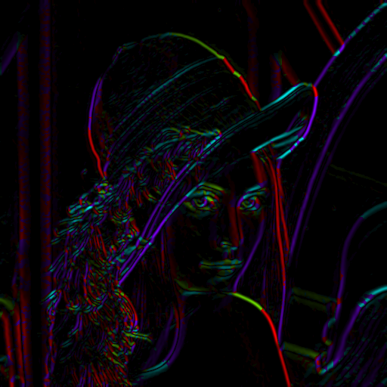
Get Orientation at Each Pixel
Threshold at minimum level
Get orientation
theta = atan2(gy, gx)

Slide 52


Non-maximum suppression for each orientation
At q, we have a maximum if the value is larger than those at both p and at r. Interpolate to get these values.
Source: D. Forsyth

Slide 53
Edge linking
Assume the marked point is an edge point. Then we construct the tangent to the edge curve (which is normal to the gradient at that point) and use this to predict the next points (here either r or s).
Source: D. Forsyth

Slide 54

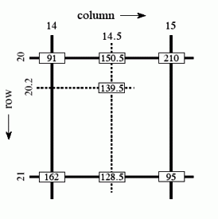

Sidebar: Bilinear Interpolation
http://en.wikipedia.org/wiki/Bilinear_interpolation

Slide 55



Sidebar: Interpolation options
imx2 = imresize(im, 2, interpolation_type)
‘nearest’
  Copy value from nearest known
  Very fast but creates blocky edges
‘bilinear’
  Weighted average from four nearest known pixels
  Fast and reasonable results
‘bicubic’ (default)
  Non-linear smoothing over larger area (4x4)
  Slower, visually appealing, may create negative pixel values
Examples from http://en.wikipedia.org/wiki/Bicubic_interpolation

Slide 56
Before Non-max Suppression

Slide 57

After non-max suppression

Slide 58
Before Non-max Suppression

Slide 59

After non-max suppression

Slide 60

Hysteresis thresholding
Threshold at low/high levels to get weak/strong edge pixels
Do connected components, starting from strong edge pixels

Slide 61
Hysteresis thresholding
Check that maximum value of gradient value is sufficiently large
  drop-outs? use hysteresis
    use a high threshold to start edge curves and a low threshold to continue them.
Source: S. Seitz

Slide 62

Final Canny Edges

Slide 63
Canny edge detector
Filter image with x, y derivatives of Gaussian
Find magnitude and orientation of gradient
Non-maximum suppression:
  Thin multi-pixel wide “ridges” down to single pixel width
Thresholding and linking (hysteresis):
  Define two thresholds: low and high
  Use the high threshold to start edge curves and the low threshold to continue them
MATLAB: edge(image, ‘canny’)
Source: D. Lowe, L. Fei-Fei

Slide 64





Effect of σ (Gaussian kernel spread/size)
original
Canny with
Canny with
The choice of σ depends on desired behavior
  large σ detects large scale edges
  small σ detects fine features
Source: S. Seitz

Slide 65






Where do humans see boundaries?
image
human segmentation
gradient magnitude
Berkeley segmentation database:
http://www.eecs.berkeley.edu/Research/Projects/CS/vision/grouping/segbench/

Slide 66

Building Visual Dictionaries
Sample patches from a database
  E.g., 128 dimensional SIFT vectors
Cluster the patches
  Cluster centers are the dictionary
Assign a codeword (number) to each new patch, according to the nearest cluster

Slide 67

pB boundary detector
Martin, Fowlkes, Malik 2004: Learning to Detect Natural Boundaries…
http://www.eecs.berkeley.edu/Research/Projects/CS/vision/grouping/papers/mfm-pami-boundary.pdf
Figure from Fowlkes

Slide 68

pB Boundary Detector
Figure from Fowlkes

Slide 69

Brightness
Color
Texture
Combined
Human

Slide 70



Results
Pb (0.88)
Human (0.95)

Slide 71



Results
Pb
Pb (0.88)
Global Pb
Human
Human (0.96)

Slide 72



Pb (0.63)
Human (0.95)

Slide 73



Pb (0.35)
Human (0.90)
For more: http://www.eecs.berkeley.edu/Research/Projects/CS/vision/bsds/bench/html/108082-color.html

Slide 74

Global pB boundary detector
Figure from Fowlkes

Slide 75

45 years of boundary detection
Source: Arbelaez, Maire, Fowlkes, and Malik. TPAMI 2011 (pdf)

Slide 76
State of edge detection
Local edge detection works well
  But many false positives from illumination and texture edges
Some methods to take into account longer contours, but could probably do better
Modern methods that actually “learn” from data.
Poor use of object and high-level information

Slide 77


Style and abstraction in portrait sketching, Berger et al. SIGGRAPH 2013
Learn from artist’s strokes so that edges are more likely in certain parts of the face.

