Slide 1
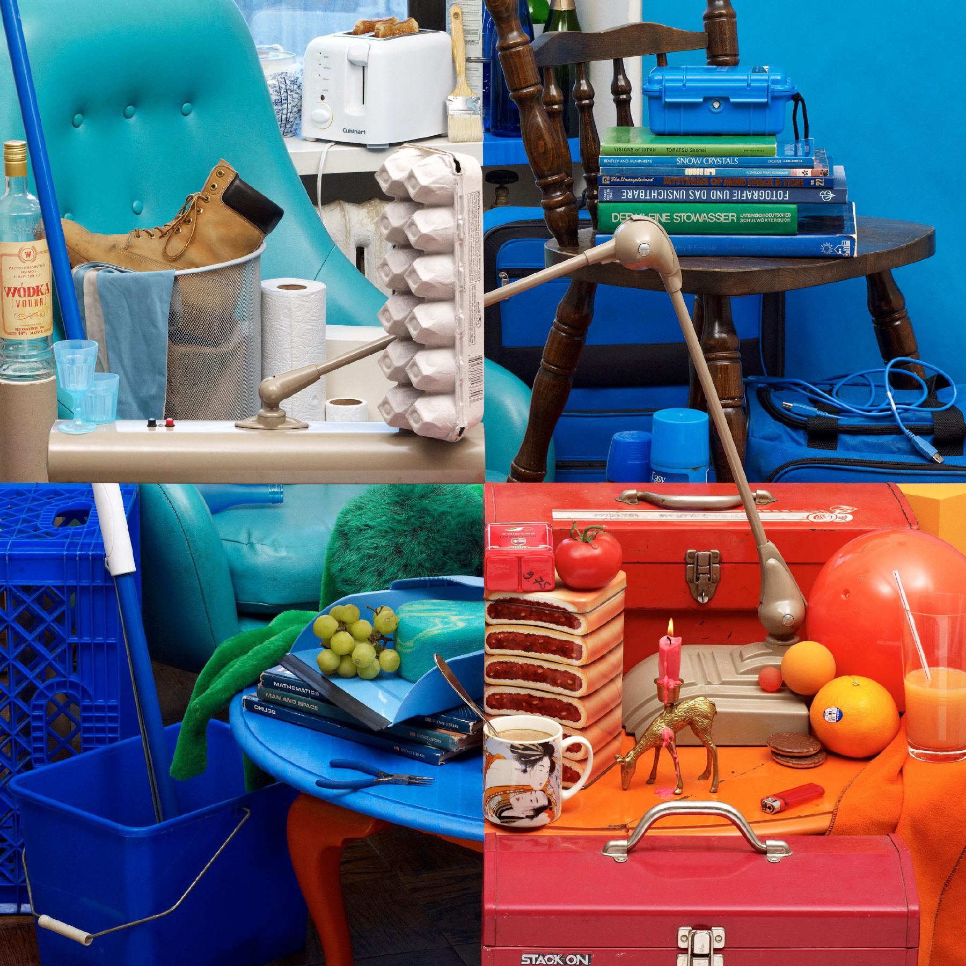

Slide 2
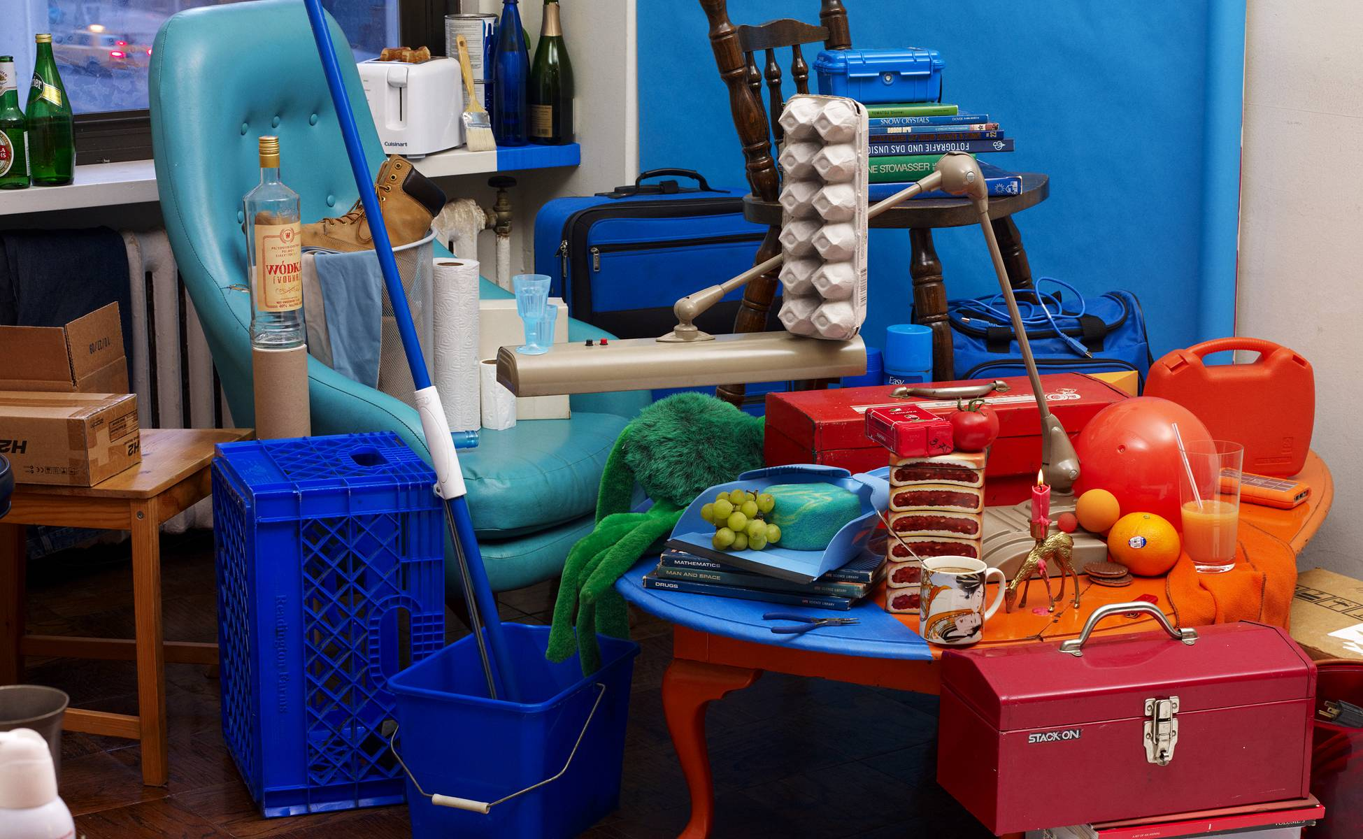

Slide 3
Light
Computer Vision
James Hays

Slide 4
Projection: world coordinates→image coordinates
.
.
.
3
f
5
y
-2
z
v’
?
.
Camera Center (0, 0, 0)
u’
If X = 2, Y = 3,
Z = 5, and f = 2
What are U and V?
Notes:
Being a little loose about coordinates vs lengths
u and v prime because they are in the same coordinate system as x, y, and z but in later slides u and v will be –u’ and –v’ because they are in their own coordinate system which is mirrored

Slide 5
Interlude: why does this matter?

Slide 6
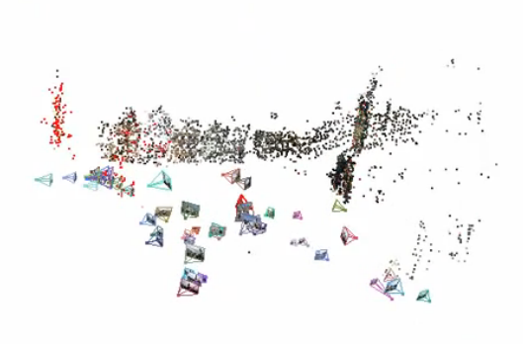
Relating multiple views

Slide 7
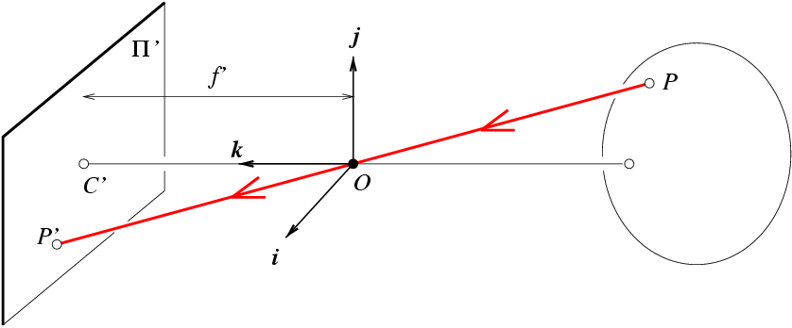
Projection matrix
X
x
Intrinsic Assumptions
Unit aspect ratio
Optical center at (0,0)
No skew
Extrinsic Assumptions
No rotation
Camera at (0,0,0)
K
Slide Credit: Savarese
Notes:
Work through equations for u and v on board

Slide 8
Remove assumption: optical center at origin
Intrinsic Assumptions
Unit aspect ratio
No skew
Extrinsic Assumptions
No rotation
Camera at (0,0,0)

Slide 9
Remove assumption: square pixels
Intrinsic Assumptions
No skew
Extrinsic Assumptions
No rotation
Camera at (0,0,0)

Slide 10
Remove assumption: non-skewed pixels
Intrinsic Assumptions
Extrinsic Assumptions
No rotation
Camera at (0,0,0)
Note: different books use different notation for parameters

Slide 11
Oriented and Translated Camera
R
j_{w}
X
t
k_{w}
O_{w}
x
i_{w}

Slide 12
Allow camera translation
Intrinsic Assumptions
Extrinsic Assumptions
No rotation

Slide 13
3D Rotation of Points
Slide Credit: Saverese
Rotation around the coordinate axes, counter-clockwise:
p’
γ
y
p
z

Slide 14
Allow camera rotation

Slide 15
Degrees of freedom
5
6
Notes:
How many known points are needed to estimate this?

Slide 16
Reminder: read your book
Lectures have assigned readings
Szeliski 2.1 and especially 2.1.5 cover the geometry of image formation

Slide 17
Field of View (Zoom, focal length)

Slide 18
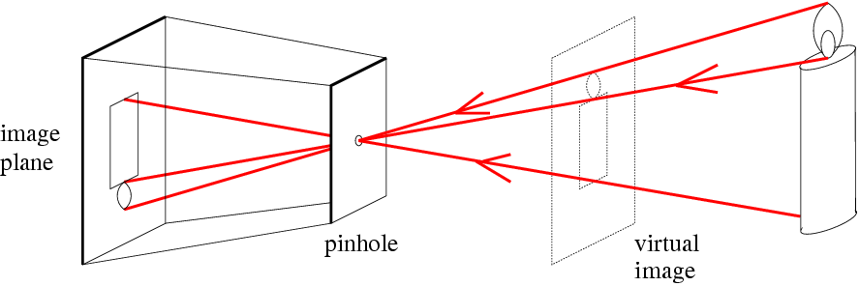
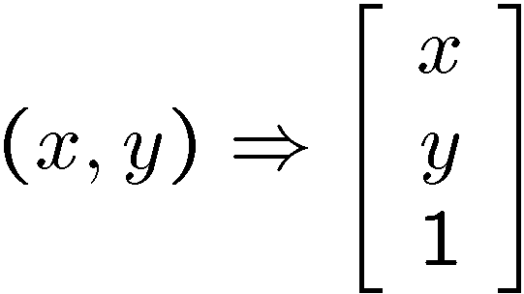
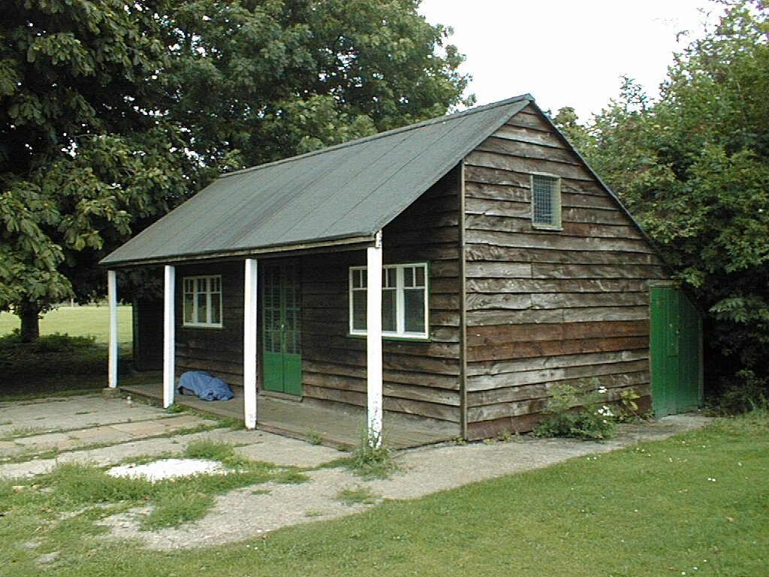
Things to remember
Vertical vanishing
point
(at infinity)
Vanishing points and vanishing lines
Pinhole camera model and camera projection matrix
Homogeneous coordinates
Vanishing
line
Vanishing
point
Vanishing
point

Slide 19
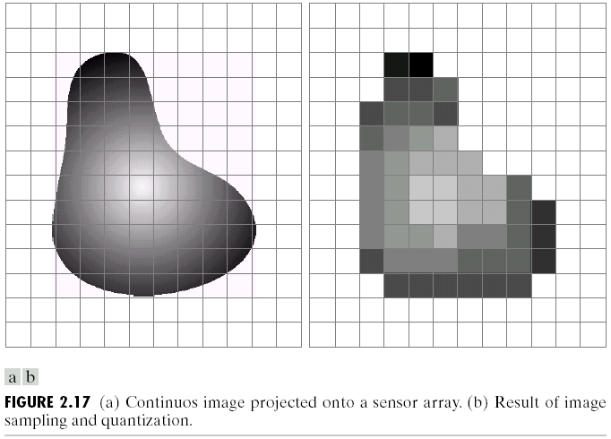
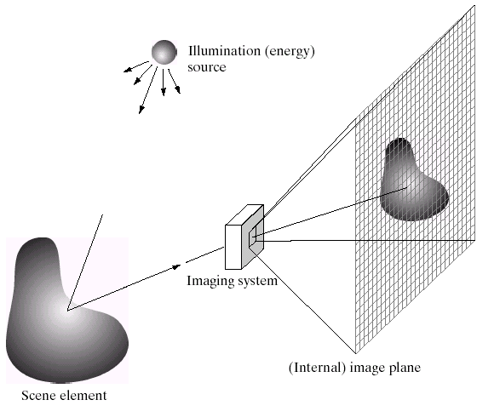
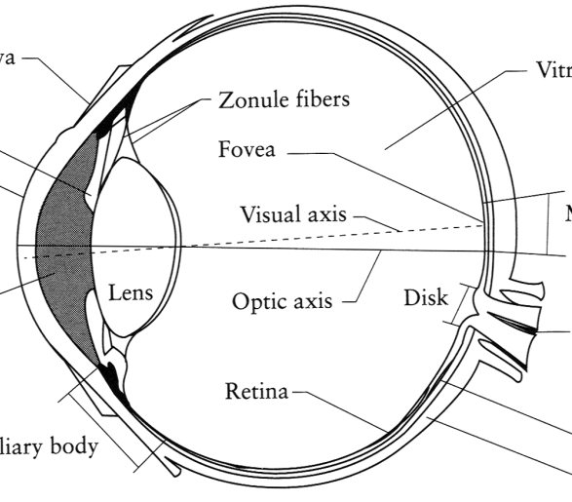
Image Formation
Digital Camera
Film
The Eye

Slide 20
A photon’s life choices
Absorption
Diffusion
Reflection
Transparency
Refraction
Fluorescence
Subsurface scattering
Phosphorescence
Interreflection
light source
λ
?

Slide 21
A photon’s life choices
Absorption
Diffusion
Reflection
Transparency
Refraction
Fluorescence
Subsurface scattering
Phosphorescence
Interreflection
light source
λ

Slide 22
A photon’s life choices
Absorption
Diffuse Reflection
Reflection
Transparency
Refraction
Fluorescence
Subsurface scattering
Phosphorescence
Interreflection
light source
λ

Slide 23
A photon’s life choices
Absorption
Diffusion
Specular Reflection
Transparency
Refraction
Fluorescence
Subsurface scattering
Phosphorescence
Interreflection
light source
λ

Slide 24
A photon’s life choices
Absorption
Diffusion
Reflection
Transparency
Refraction
Fluorescence
Subsurface scattering
Phosphorescence
Interreflection
light source
λ

Slide 25
A photon’s life choices
Absorption
Diffusion
Reflection
Transparency
Refraction
Fluorescence
Subsurface scattering
Phosphorescence
Interreflection
light source
λ

Slide 26
A photon’s life choices
Absorption
Diffusion
Reflection
Transparency
Refraction
Fluorescence
Subsurface scattering
Phosphorescence
Interreflection
light source
λ₁
λ₂

Slide 27
A photon’s life choices
Absorption
Diffusion
Reflection
Transparency
Refraction
Fluorescence
Subsurface scattering
Phosphorescence
Interreflection
light source
λ

Slide 28
A photon’s life choices
Absorption
Diffusion
Reflection
Transparency
Refraction
Fluorescence
Subsurface scattering
Phosphorescence
Interreflection
light source
t=1
t=n

Slide 29
A photon’s life choices
Absorption
Diffusion
Reflection
Transparency
Refraction
Fluorescence
Subsurface scattering
Phosphorescence
Interreflection
light source
λ
(Specular Interreflection)

Slide 30
Lambertian Reflectance
In computer vision, surfaces are often assumed to be ideal diffuse reflectors with no dependence on viewing direction.

Slide 31
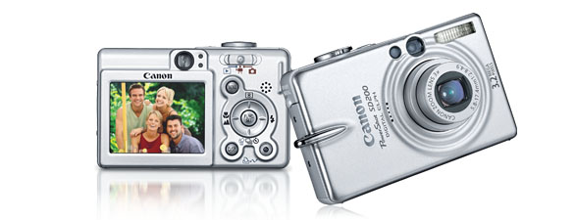
Digital camera
A digital camera replaces film with a sensor array
  Each cell in the array is light-sensitive diode that converts photons to electrons
  Two common types
    Charge Coupled Device (CCD)
    CMOS
  http://electronics.howstuffworks.com/digital-camera.htm
Slide by Steve Seitz

Slide 32
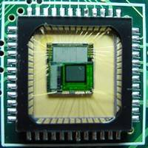
Sensor Array
CMOS sensor

Slide 33
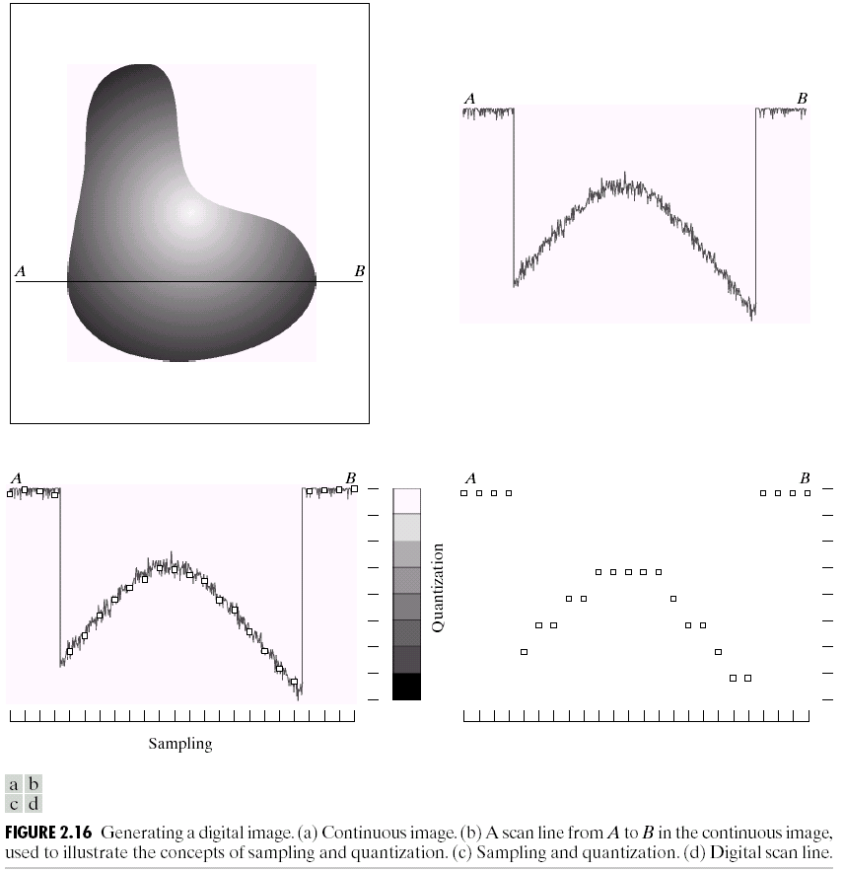
Sampling and Quantization

Slide 34
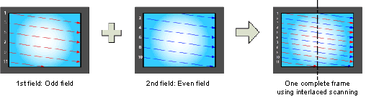
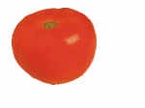
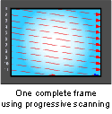
Interlace vs. progressive scan
http://www.axis.com/products/video/camera/progressive_scan.htm
Slide by Steve Seitz

Slide 35
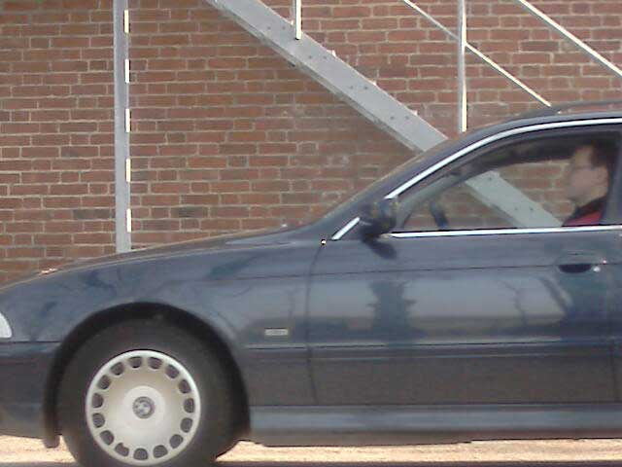
Progressive scan
http://www.axis.com/products/video/camera/progressive_scan.htm
Slide by Steve Seitz

Slide 36
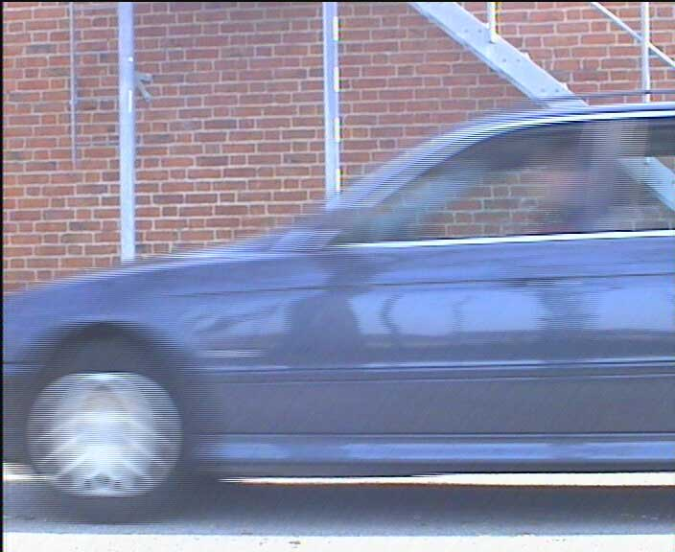
Interlace
http://www.axis.com/products/video/camera/progressive_scan.htm
Slide by Steve Seitz

Slide 37
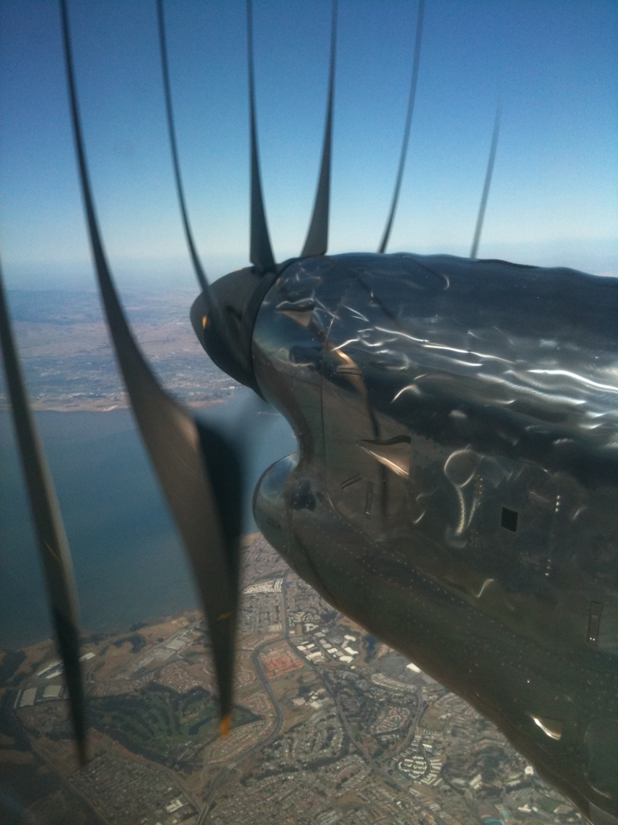
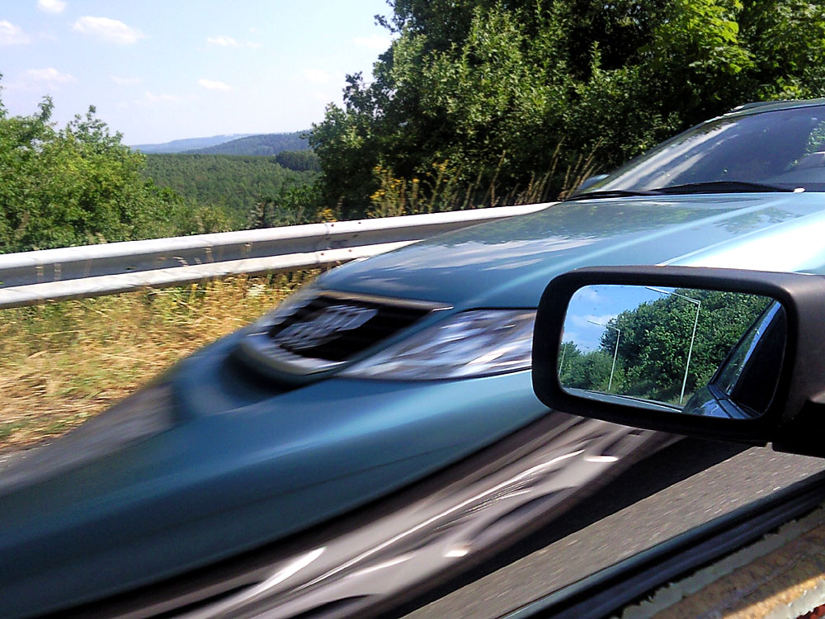
Rolling Shutter
Notes:
http://en.wikipedia.org/wiki/Rolling_shutter
Even DSLRs have this problem.

Slide 38

The Eye
The human eye is a camera!
  Iris - colored annulus with radial muscles
  Pupil - the hole (aperture) whose size is controlled by the iris
  What’s the “film”?
    photoreceptor cells (rods and cones) in the retina
Slide by Steve Seitz

Slide 39
Aside: why do we care about human vision in this class?
We don’t, necessarily.

Slide 40
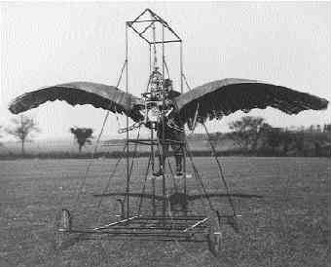
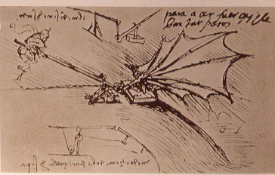
Ornithopters

Slide 41
Why do we care about human vision?
We don’t, necessarily.
But cameras necessarily imitate the frequency response of the human eye, so we should know that much.
Also, computer vision probably wouldn’t get as much scrutiny if biological vision (especially human vision) hadn’t proved that it was possible to make important judgements from 2d images.

Slide 42
Does computer vision “understand” images?
"Can machines fly?" The answer is yes, because airplanes fly.
"Can machines swim?" The answer is no, because submarines don't swim.
"Can machines think?" Is this question like the first, or like the second?
Source: Norvig

Slide 43
The Retina

Slide 44
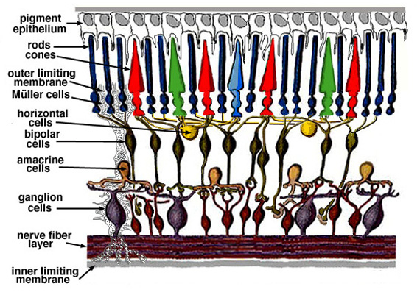
Retina up-close
Light
Notes:
Tapetum lucidum

Slide 45
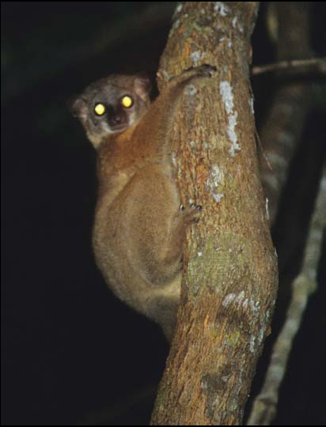
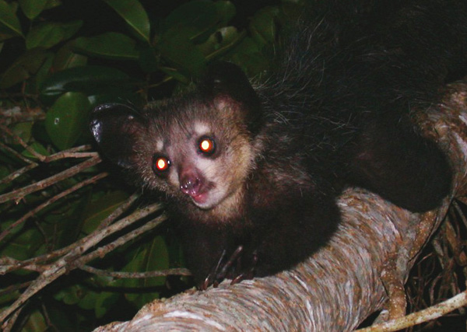
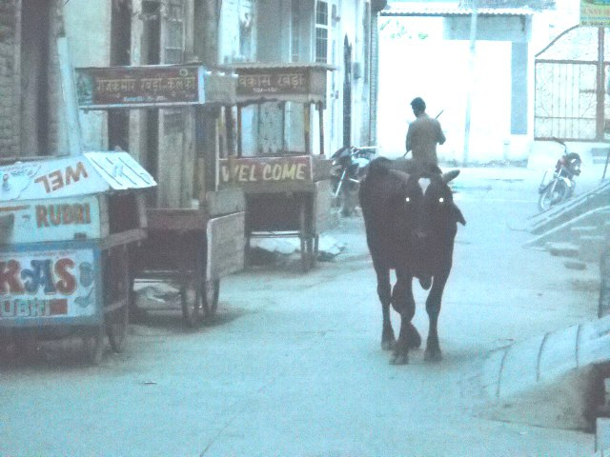
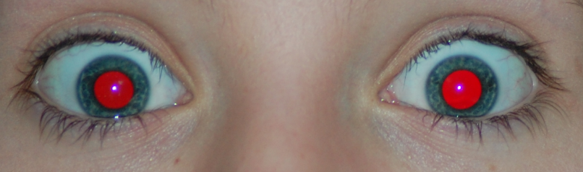
What humans don’t have: tapetum lucidum
Human eyes can reflect a tiny bit and blood in the retina makes this reflection red.
Notes:
Animals with Tapetum Lucidum also have RPE, just not in the same part of the eye.

Slide 46
Two types of light-sensitive receptors
Cones
cone-shaped
less sensitive
operate in high light
color vision
Rods
rod-shaped
highly sensitive
operate at night
gray-scale vision
© Stephen E. Palmer, 2002

Slide 47
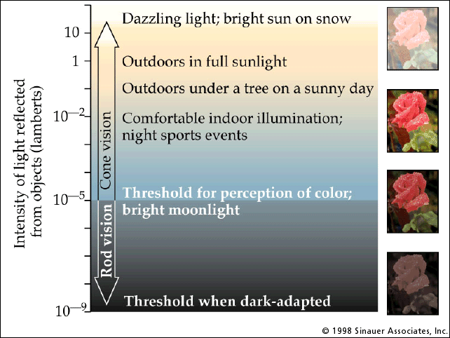
Rod / Cone sensitivity

Slide 48
Distribution of Rods and Cones
Night Sky: why are there more stars off-center?
Averted vision: http://en.wikipedia.org/wiki/Averted_vision
© Stephen E. Palmer, 2002

Slide 49
Wait, the blood vessels are in front of the photoreceptors??
https://www.youtube.com/watch?v=L_W-IXqoxHA
Notes:
Yes, and you can see them!

Slide 51
Eye Movements
Saccades
Can be consciously controlled. Related to perceptual attention.
200ms to initiation, 20 to 200ms to carry out. Large amplitude.
Microsaccades
Involuntary. Smaller amplitude. Especially evident during prolonged fixation. Function debated.
Ocular microtremor (OMT)
involuntary. high frequency (up to 80Hz), small amplitude.
Smooth pursuit – tracking an object

Slide 52
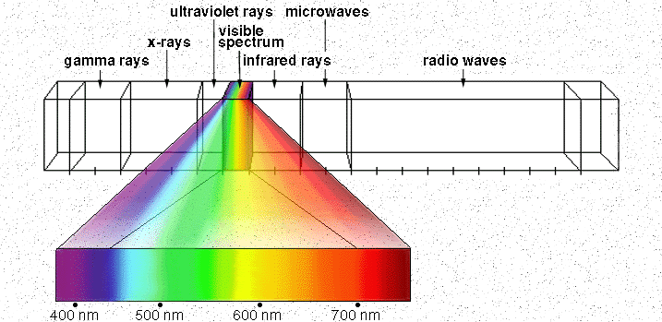
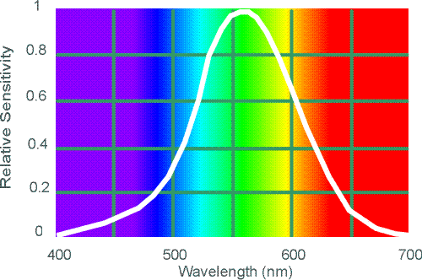
Electromagnetic Spectrum
Human Luminance Sensitivity Function
http://www.yorku.ca/eye/photopik.htm
Notes:
At least 3 spectral bands required (e.g. R,G,B)

Slide 53
Visible Light
Why do we see light of these wavelengths?
…because that’s where the
Sun radiates EM energy
© Stephen E. Palmer, 2002
Notes:
Because that’s where the Sun’s peak radiation was
Because the atmosphere is fairly transparent in that range
Because biology has many important markers in that range (but that’s because of the previous two reasons)

Slide 54
The Physics of Light
Any patch of light can be completely described
physically by its spectrum: the number of photons
(per time unit) at each wavelength 400 - 700 nm.
© Stephen E. Palmer, 2002

Slide 55
The Physics of Light
Some examples of the spectra of light sources
© Stephen E. Palmer, 2002

Slide 56
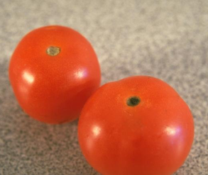
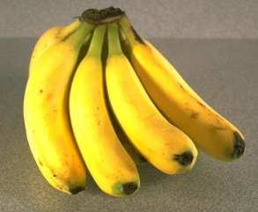
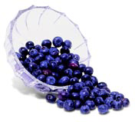
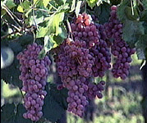
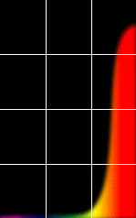
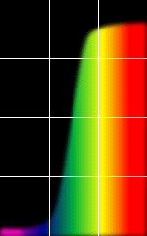
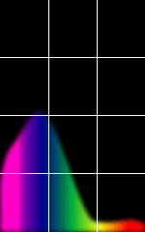
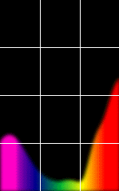
The Physics of Light
Some examples of the reflectance spectra of surfaces
Red
Yellow
Blue
Purple
% Photons Reflected
400 700
400 700
400 700
400 700
Wavelength (nm)
© Stephen E. Palmer, 2002

Slide 57
The Psychophysical Correspondence
There is no simple functional description for the perceived
color of all lights under all viewing conditions, but …...
A helpful constraint:
Consider only physical spectra with normal distributions
mean
area
variance
© Stephen E. Palmer, 2002

Slide 58
The Psychophysical Correspondence
Mean
Hue
# Photons
Wavelength
© Stephen E. Palmer, 2002

Slide 59
The Psychophysical Correspondence
Variance
Saturation
# Photons
Wavelength
© Stephen E. Palmer, 2002

Slide 60
The Psychophysical Correspondence
Area
Brightness
# Photons
Wavelength
© Stephen E. Palmer, 2002

Slide 61
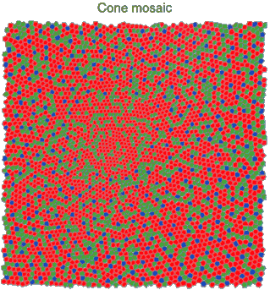
Physiology of Color Vision
Three kinds of cones:
Why are M and L cones so close?
Why are there 3?
© Stephen E. Palmer, 2002

Slide 62


Impossible Colors
Can you make the cones respond in ways that typical light spectra never would?
http://en.wikipedia.org/wiki/Impossible_colors

Slide 63
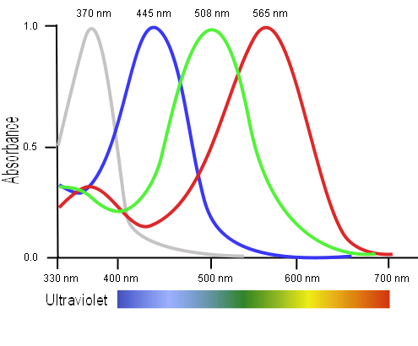
Tetrachromatism
Bird cone responses
Most birds, and many other animals, have cones for ultraviolet light.
Some humans, mostly female, seem to have slight tetrachromatism.

Slide 64
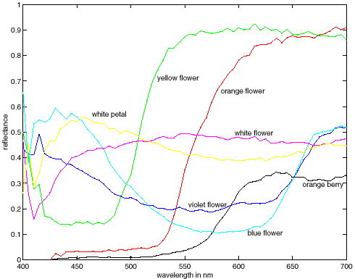
More Spectra
metamers
Notes:
Metamerism can be illuminant based or observer based. Color blindness produced well known instances of metamerism.

Slide 65
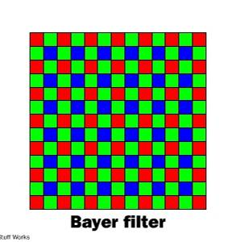
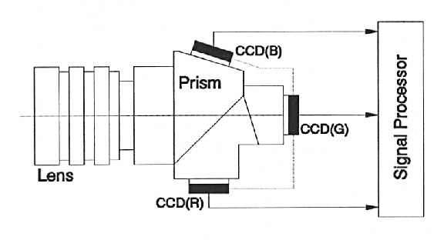
Color Sensing in Camera (RGB)
3-chip vs. 1-chip: quality vs. cost
Why more green?
Why 3 colors?
http://www.cooldictionary.com/words/Bayer-filter.wikipedia
Slide by Steve Seitz

Slide 66
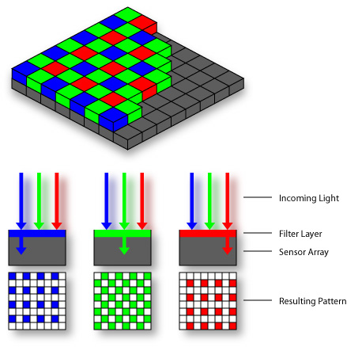

Practical Color Sensing: Bayer Grid
Estimate RGB
at ‘G’ cells from neighboring values
Slide by Steve Seitz

Slide 67
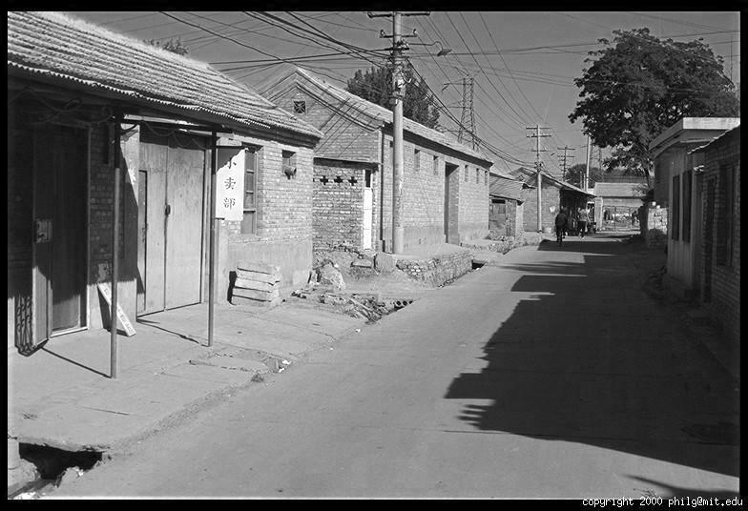
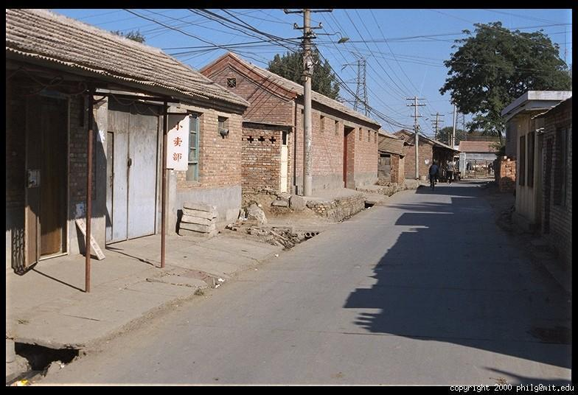
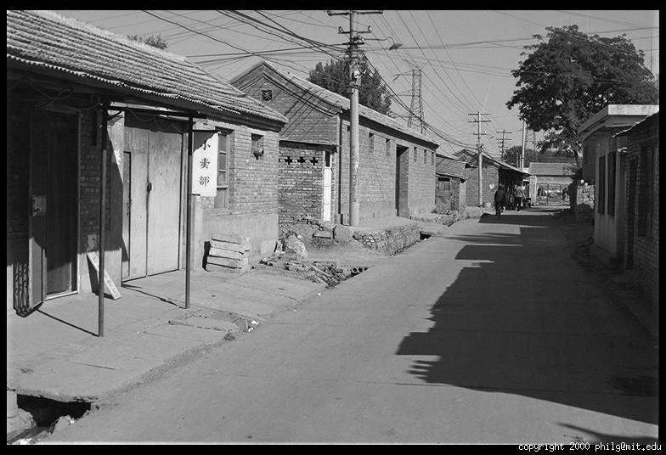
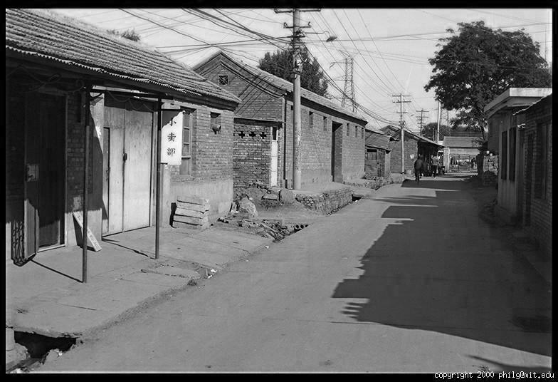
Color Image
R
G
B

Slide 68
Images in Matlab
Images represented as a matrix
Suppose we have a NxM RGB image called “im”
  im(1,1,1) = top-left pixel value in R-channel
  im(y, x, b) = y pixels down, x pixels to right in the b^{th} channel
  im(N, M, 3) = bottom-right pixel in B-channel
imread(filename) returns a uint8 image (values 0 to 255)
  Convert to double format (values 0 to 1) with im2double
column
row
R
0.92 | 0.93 | 0.94 | 0.97 | 0.62 | 0.37 | 0.85 | 0.97 | 0.93 | 0.92 | 0.99
0.95 | 0.89 | 0.82 | 0.89 | 0.56 | 0.31 | 0.75 | 0.92 | 0.81 | 0.95 | 0.91
0.89 | 0.72 | 0.51 | 0.55 | 0.51 | 0.42 | 0.57 | 0.41 | 0.49 | 0.91 | 0.92
0.96 | 0.95 | 0.88 | 0.94 | 0.56 | 0.46 | 0.91 | 0.87 | 0.90 | 0.97 | 0.95
0.71 | 0.81 | 0.81 | 0.87 | 0.57 | 0.37 | 0.80 | 0.88 | 0.89 | 0.79 | 0.85
0.49 | 0.62 | 0.60 | 0.58 | 0.50 | 0.60 | 0.58 | 0.50 | 0.61 | 0.45 | 0.33
0.86 | 0.84 | 0.74 | 0.58 | 0.51 | 0.39 | 0.73 | 0.92 | 0.91 | 0.49 | 0.74
0.96 | 0.67 | 0.54 | 0.85 | 0.48 | 0.37 | 0.88 | 0.90 | 0.94 | 0.82 | 0.93
0.69 | 0.49 | 0.56 | 0.66 | 0.43 | 0.42 | 0.77 | 0.73 | 0.71 | 0.90 | 0.99
0.79 | 0.73 | 0.90 | 0.67 | 0.33 | 0.61 | 0.69 | 0.79 | 0.73 | 0.93 | 0.97
0.91 | 0.94 | 0.89 | 0.49 | 0.41 | 0.78 | 0.78 | 0.77 | 0.89 | 0.99 | 0.93
G
0.92 | 0.93 | 0.94 | 0.97 | 0.62 | 0.37 | 0.85 | 0.97 | 0.93 | 0.92 | 0.99
0.95 | 0.89 | 0.82 | 0.89 | 0.56 | 0.31 | 0.75 | 0.92 | 0.81 | 0.95 | 0.91
0.89 | 0.72 | 0.51 | 0.55 | 0.51 | 0.42 | 0.57 | 0.41 | 0.49 | 0.91 | 0.92
0.96 | 0.95 | 0.88 | 0.94 | 0.56 | 0.46 | 0.91 | 0.87 | 0.90 | 0.97 | 0.95
0.71 | 0.81 | 0.81 | 0.87 | 0.57 | 0.37 | 0.80 | 0.88 | 0.89 | 0.79 | 0.85
0.49 | 0.62 | 0.60 | 0.58 | 0.50 | 0.60 | 0.58 | 0.50 | 0.61 | 0.45 | 0.33
0.86 | 0.84 | 0.74 | 0.58 | 0.51 | 0.39 | 0.73 | 0.92 | 0.91 | 0.49 | 0.74
0.96 | 0.67 | 0.54 | 0.85 | 0.48 | 0.37 | 0.88 | 0.90 | 0.94 | 0.82 | 0.93
0.69 | 0.49 | 0.56 | 0.66 | 0.43 | 0.42 | 0.77 | 0.73 | 0.71 | 0.90 | 0.99
0.79 | 0.73 | 0.90 | 0.67 | 0.33 | 0.61 | 0.69 | 0.79 | 0.73 | 0.93 | 0.97
0.91 | 0.94 | 0.89 | 0.49 | 0.41 | 0.78 | 0.78 | 0.77 | 0.89 | 0.99 | 0.93
B
0.92 | 0.93 | 0.94 | 0.97 | 0.62 | 0.37 | 0.85 | 0.97 | 0.93 | 0.92 | 0.99
0.95 | 0.89 | 0.82 | 0.89 | 0.56 | 0.31 | 0.75 | 0.92 | 0.81 | 0.95 | 0.91
0.89 | 0.72 | 0.51 | 0.55 | 0.51 | 0.42 | 0.57 | 0.41 | 0.49 | 0.91 | 0.92
0.96 | 0.95 | 0.88 | 0.94 | 0.56 | 0.46 | 0.91 | 0.87 | 0.90 | 0.97 | 0.95
0.71 | 0.81 | 0.81 | 0.87 | 0.57 | 0.37 | 0.80 | 0.88 | 0.89 | 0.79 | 0.85
0.49 | 0.62 | 0.60 | 0.58 | 0.50 | 0.60 | 0.58 | 0.50 | 0.61 | 0.45 | 0.33
0.86 | 0.84 | 0.74 | 0.58 | 0.51 | 0.39 | 0.73 | 0.92 | 0.91 | 0.49 | 0.74
0.96 | 0.67 | 0.54 | 0.85 | 0.48 | 0.37 | 0.88 | 0.90 | 0.94 | 0.82 | 0.93
0.69 | 0.49 | 0.56 | 0.66 | 0.43 | 0.42 | 0.77 | 0.73 | 0.71 | 0.90 | 0.99
0.79 | 0.73 | 0.90 | 0.67 | 0.33 | 0.61 | 0.69 | 0.79 | 0.73 | 0.93 | 0.97
0.91 | 0.94 | 0.89 | 0.49 | 0.41 | 0.78 | 0.78 | 0.77 | 0.89 | 0.99 | 0.93

Slide 69
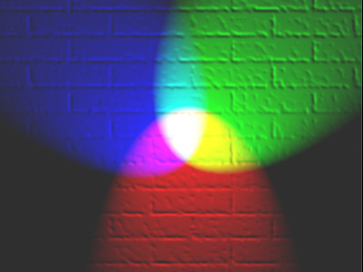
Color spaces
How can we represent color?
http://en.wikipedia.org/wiki/File:RGB_illumination.jpg

Slide 70

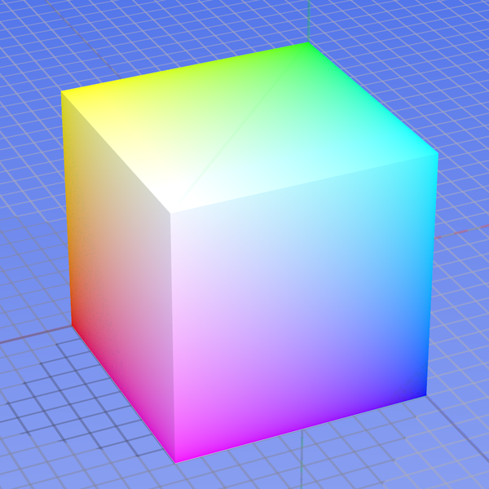



Color spaces: RGB
Default color space
0,1,0
R
(G=0,B=0)
1,0,0
G
(R=0,B=0)
0,0,1
B
(R=0,G=0)
Some drawbacks
Strongly correlated channels
Non-perceptual
Image from: http://en.wikipedia.org/wiki/File:RGB_color_solid_cube.png

Slide 71




Color spaces: HSV
Intuitive color space
H
(S=1,V=1)
S
(H=1,V=1)
V
(H=1,S=0)

Slide 72






Color spaces: YCbCr
Fast to compute, good for compression, used by TV
Y=0
Y=0.5
Y
(Cb=0.5,Cr=0.5)
Cr
Cb
(Y=0.5,Cr=0.5)
Cb
Y=1
Cr
(Y=0.5,Cb=05)

Slide 73




Color spaces: L*a*b*
“Perceptually uniform”* color space
L
(a=0,b=0)
a
(L=65,b=0)
b
(L=65,a=0)

Slide 74
If you had to choose, would you rather go without luminance or chrominance?

Slide 75
If you had to choose, would you rather go without luminance or chrominance?

Slide 76

Most information in intensity
Only color shown – constant intensity

Slide 77

Most information in intensity
Only intensity shown – constant color

Slide 78
Most information in intensity
Original image

Slide 79

Back to grayscale intensity
0.92 | 0.93 | 0.94 | 0.97 | 0.62 | 0.37 | 0.85 | 0.97 | 0.93 | 0.92 | 0.99
0.95 | 0.89 | 0.82 | 0.89 | 0.56 | 0.31 | 0.75 | 0.92 | 0.81 | 0.95 | 0.91
0.89 | 0.72 | 0.51 | 0.55 | 0.51 | 0.42 | 0.57 | 0.41 | 0.49 | 0.91 | 0.92
0.96 | 0.95 | 0.88 | 0.94 | 0.56 | 0.46 | 0.91 | 0.87 | 0.90 | 0.97 | 0.95
0.71 | 0.81 | 0.81 | 0.87 | 0.57 | 0.37 | 0.80 | 0.88 | 0.89 | 0.79 | 0.85
0.49 | 0.62 | 0.60 | 0.58 | 0.50 | 0.60 | 0.58 | 0.50 | 0.61 | 0.45 | 0.33
0.86 | 0.84 | 0.74 | 0.58 | 0.51 | 0.39 | 0.73 | 0.92 | 0.91 | 0.49 | 0.74
0.96 | 0.67 | 0.54 | 0.85 | 0.48 | 0.37 | 0.88 | 0.90 | 0.94 | 0.82 | 0.93
0.69 | 0.49 | 0.56 | 0.66 | 0.43 | 0.42 | 0.77 | 0.73 | 0.71 | 0.90 | 0.99
0.79 | 0.73 | 0.90 | 0.67 | 0.33 | 0.61 | 0.69 | 0.79 | 0.73 | 0.93 | 0.97
0.91 | 0.94 | 0.89 | 0.49 | 0.41 | 0.78 | 0.78 | 0.77 | 0.89 | 0.99 | 0.93

Slide 80
Next week
Convolution, Filtering, Image Pyramids, Frequencies, Project 1

