Slide 1
Overview of part 1
Historical perspective
  From reductionism to systems and networks
Examples of complex networks
Structural/topological metrics
  Average path length
  Degree distribution
  Clustering
Topological models
  Regular, random, small-world, scale-free networks
  An evolutionary model of network growth: Preferential attachment
Implications of scale-free property in:
  Robustness/fragility
  Epidemics/diffusion processes
Focusing on the “small scale”: network motifs
  Networks as functioning circuits

Slide 2
References
I used many slides from other talks:
  S.Maslov, “Statistical physics of complex networks”
    http://www.cmth.bnl.gov/~maslov/3ieme_cycle_Maslov_lectures_1_and_2.ppt
  I.Yanai, “Evolution of networks”
    http://bioportal.weizmann.ac.il/course/evogen/Networks/12.NetworkEvolution.ppt
  D.Bonchev, “Networks basics”
    http://www.ims.nus.edu.sg/Programs/biomolecular07/files/Danail_tut1.ppt
  Eileen Kraemer, “Topology and dynamics of complex networks”
    http://www.cs.uga.edu/~eileen/fres1010/Notes/DynamicNetworks.ppt

Slide 3
Historical perspective
In the beginning.. there was REDUCTIONISM
  All we need to know is the behavior of the system elements
  Particles in physics, molecules or proteins in biology, communication links in the Internet
  Complex systems are nothing but the result of many interactions between the system’s elements
  No new phenomena will emerge when we consider the entire system
  A centuries-old very flawed scientific tradition..

Slide 4
Historical perspective
During the 80’s and early 90’s, several parallel approaches departed from reductionism
Consider the entire SYSTEM attempting to understand/explain its COMPLEXITY
  B. Mandelbrot and others: Chaos and non-linear dynamical systems (the math of complexity)
  P. Bak: Self-Organized Criticality – The edge of chaos
  S. Wolfram: Cellular Automata
  S. Kauffman: Random Boolean Networks
  I. Prigogine: Dissipative Structures
  J. Holland: Emergence
  H. Maturana, F. Varela: Autopoiesis networks & cognition
  Systems Biology

Slide 5
Historical perspective
Systems approach: thinking about Networks
  The focus moves from the elements (network nodes) to their interactions (network links)
  To a certain degree, the structural details of each element become less important than the network of interactions
  Some system properties, such as Robustness, Fragility, Modularity, Hierarchy, Evolvability, Redundancy (and others) can be better understood through the Networks approach
Some milestones:
  1998: Small-World Networks (D.Watts and S.Strogatz)
  1999: Scale-Free Networks (R.Albert & A.L.Barabasi)
  2002: Network Motifs (U.Alon)

Slide 6
Some relevant Zen:
Things derive their being and nature by mutual dependence and are nothing in themselves.
-Nagarjuna, second century Buddhist philosopher
An elementary particle is not an independently existing, unanalyzable entity. It is, in essence, a set of relationships that reach outward to other things.
-H.P. Stapp, twentieth century physicist
See slides by Itay Yanai

Slide 7
Overview of part 1
Historical perspective
  From reductionism to systems and networks
Examples of complex networks
Structural/topological metrics
  Average path length
  Degree distribution
  Clustering
Topological models
  Regular, random, small-world, scale-free networks
  An evolutionary model of network growth: Preferential attachment
Implications of scale-free property in:
  Robustness/fragility
  Epidemics/diffusion processes
Focusing on the “small scale”: network motifs
  Networks as functioning circuits

Slide 8
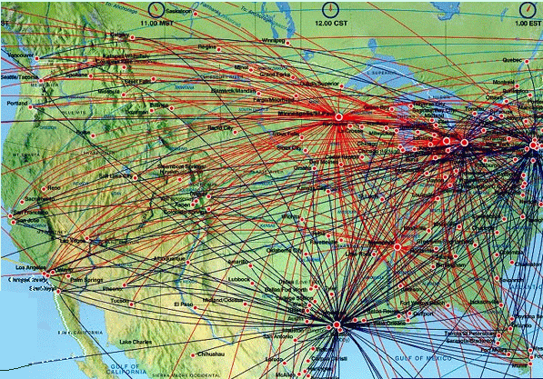
Air Transportation Network

Slide 9
Actors’ web
Kraemer

Slide 10
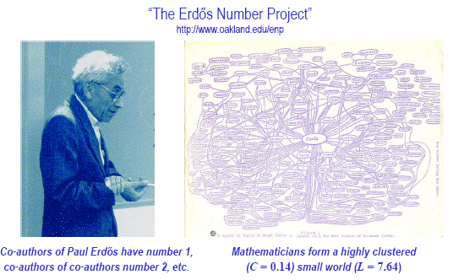
Mathematicians &
Computer Scientists
Kraemer

Slide 11
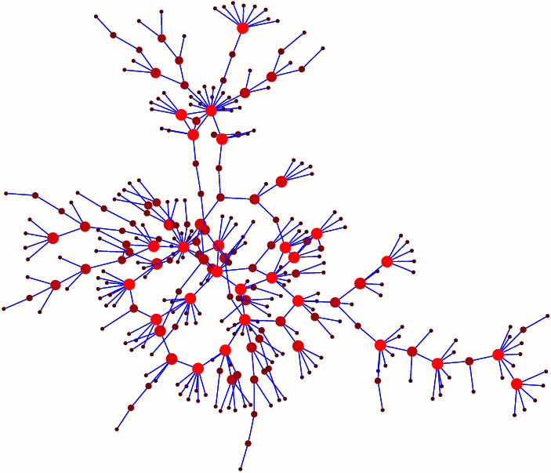
Sexual contacts: M. E. J. Newman, The structure and function of complex networks, SIAM Review 45, 167-256 (2003).

Slide 12
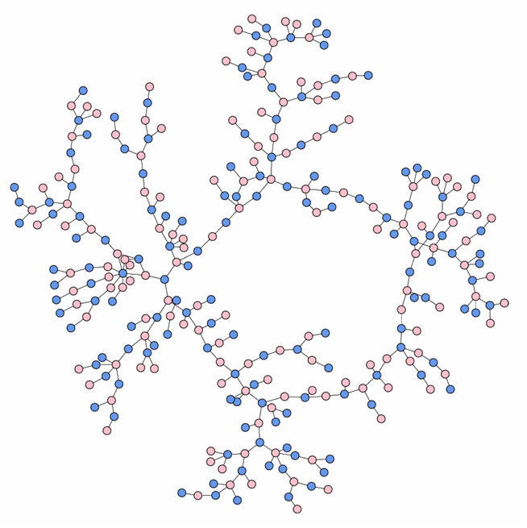
High school dating: Data drawn from Peter S. Bearman, James Moody, and Katherine Stovel visualized by Mark Newman

Slide 13
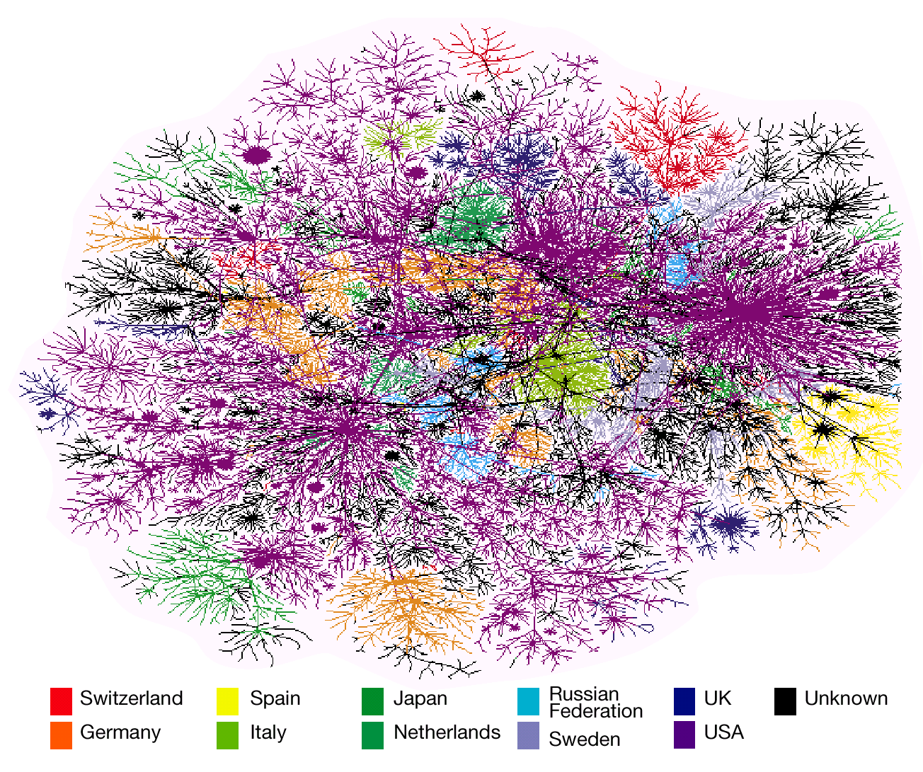
Internet as measured by Hal Burch and Bill Cheswick's Internet Mapping Project.

Slide 14
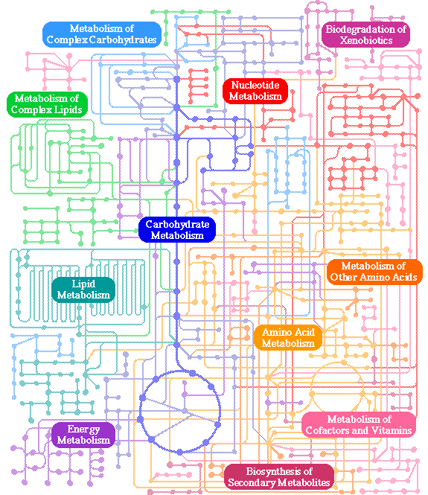
Metabolic networks
KEGG database: http://www.genome.ad.jp/kegg/kegg2.html

Slide 15
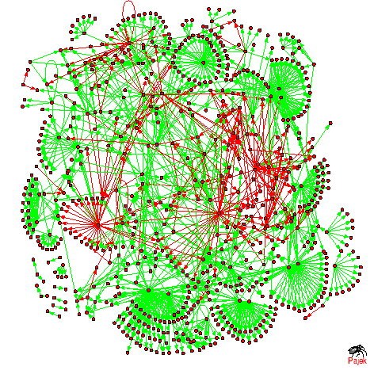
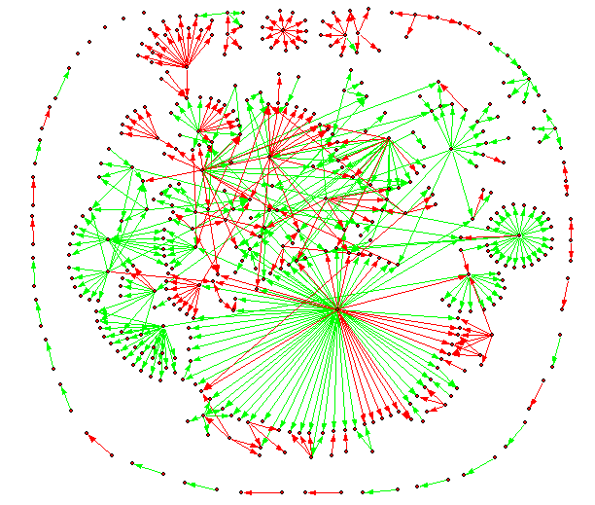

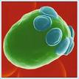
Transcription regulatory networks
Single-celled eukaryote:
S. cerevisiae
Bacterium: E. coli

Slide 16
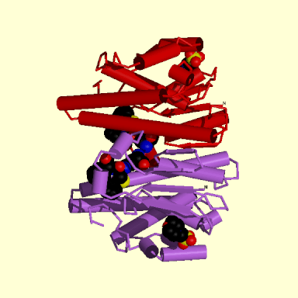
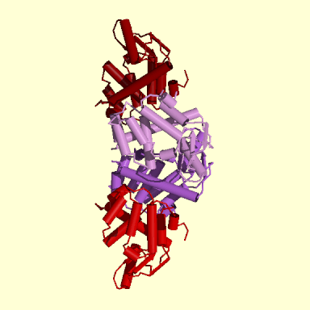
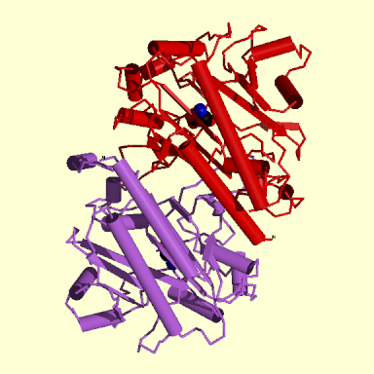
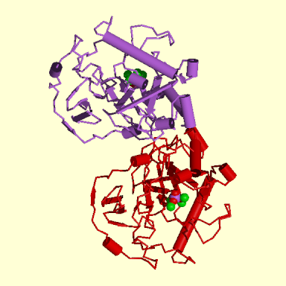
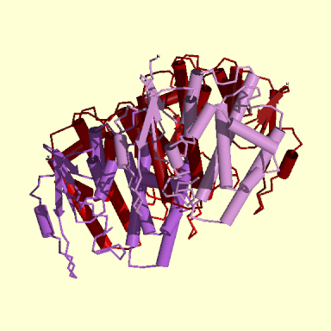
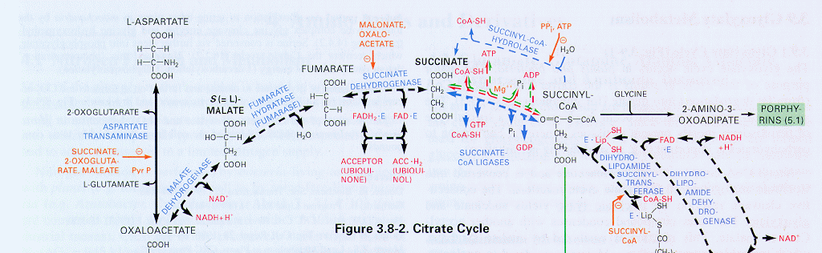
Bio-Map
L-A Barabasi
GENOME
miRNA
regulation?
_ _ _ _ _ _ _ _ _ _ _ _ _ _ _ _ _ _ _ _ _
- -
protein-gene interactions
PROTEOME
protein-protein interactions
METABOLISM
Bio-chemical reactions
Citrate Cycle

Slide 17
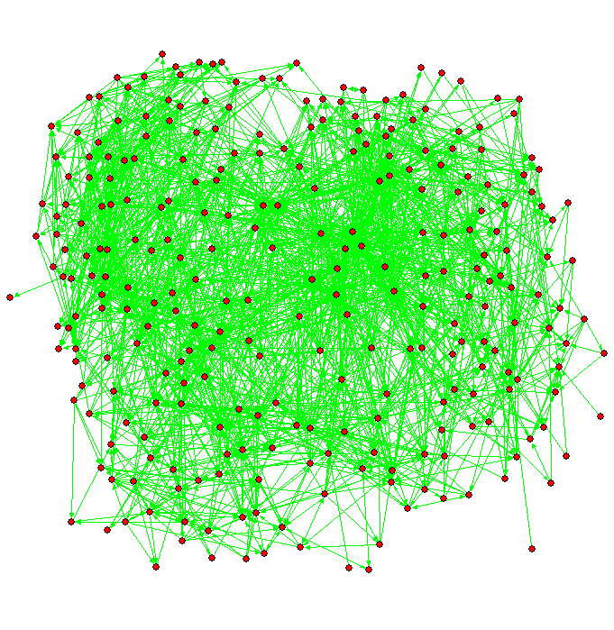

C. elegans neuronal
net

Slide 18
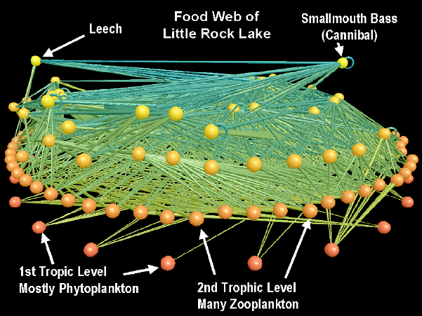
Freshwater food web by Neo Martinez and Richard Williams

Slide 19
Overview of part 1
Historical perspective
  From reductionism to systems and networks
Examples of complex networks
Structural/topological metrics
  Average path length
  Degree distribution
  Clustering
Topological models
  Regular, random, small-world, scale-free networks
  An evolutionary model of network growth: Preferential attachment
Implications of scale-free property in:
  Robustness/fragility
  Epidemics/diffusion processes
Focusing on the “small scale”: network motifs
  Networks as functioning circuits

Slide 20
Networks As Graphs
Networks can be undirected or directed, depending on whether
the interaction between two neighboring nodes proceeds in both
directions or in only one of them, respectively.
⇔
1
2
3
4
5
6
The specificity of network nodes and links can be quantitatively
characterized by weights
2.5
7.3
3.3
12.7
5.4
8.1
2.5
Bonchev
Vertex-Weighted
Edge-Weighted

Slide 21
Networks As Graphs - 2
A network can be connected (presented by a single component) or
disconnected (presented by several disjoint components).
connected
disconnected
Networks having no cycles are termed trees. The more cycles the
network has, the more complex it is.
trees
cyclic graphs
Bonchev

Slide 22
Networks As Graphs - 3
Some Basic Types of Graphs
Paths
Stars
Cycles
Complete Graphs
Bipartite Graphs
Bonchev

Slide 23
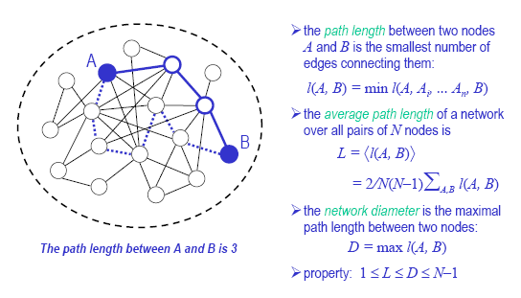
Structural metrics:
Average path length
Slides by Kraemer &
Barabasi, Bonabeau (SciAm’03)

Slide 24
Structural Metrics:
Degree distribution(connectivity)

Slide 25
Structural Metrics:
Clustering coefficient

Slide 26
Several other graph metrics exist
We will study them as needed
  Centrality
  Betweenness
  Assortativity
  Modularity
  …

Slide 27
Network Evolution
Slide by Kraemer

Slide 28
Overview of part 1
Historical perspective
  From reductionism to systems and networks
Examples of complex networks
Structural/topological metrics
  Average path length
  Degree distribution
  Clustering
Topological models
  Regular, random, small-world, scale-free networks
  An evolutionary model of network growth: Preferential attachment
Implications of scale-free property in:
  Robustness/fragility
  Epidemics/diffusion processes
Focusing on the “small scale”: network motifs
  Networks as functioning circuits

Slide 29
Regular networks

Slide 30
Regular networks – fully connected
Slides by Kraemer &
Barabasi, Bonabeau (SciAm’03)

Slide 31
Regular networks –Lattice

Slide 32
Regular networks –Lattice: ring world

Slide 33
Random networks

Slide 34
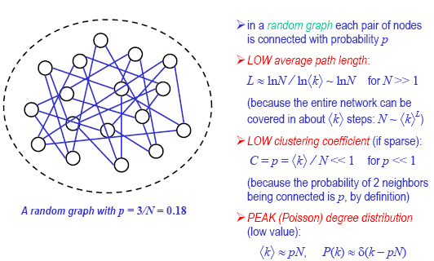
Random networks (Erdos-Renyi, ‘60)

Slide 35
Random Networks

Slide 36
Small-world networks

Slide 37
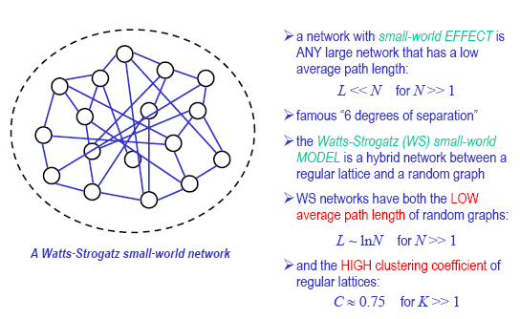
Small-world networks (Watts-Strogatz, ‘98)

Slide 38
Small-world networks

Slide 39
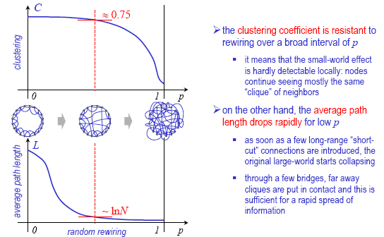
Small-world networks

Slide 40
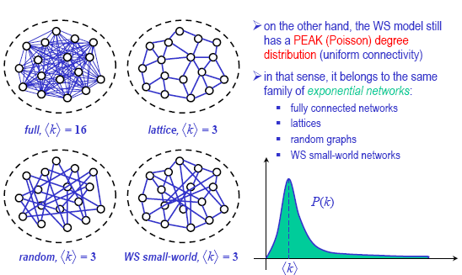
Small-world networks

Slide 41
Scale-free networks

Slide 42
Scale-free networks

Slide 43
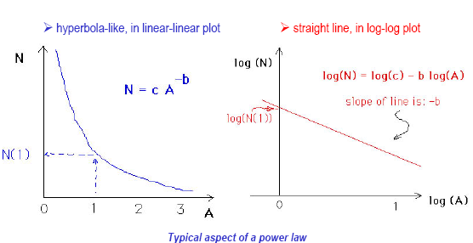
Scale-free networks

Slide 44
Scale-free networks

Slide 45
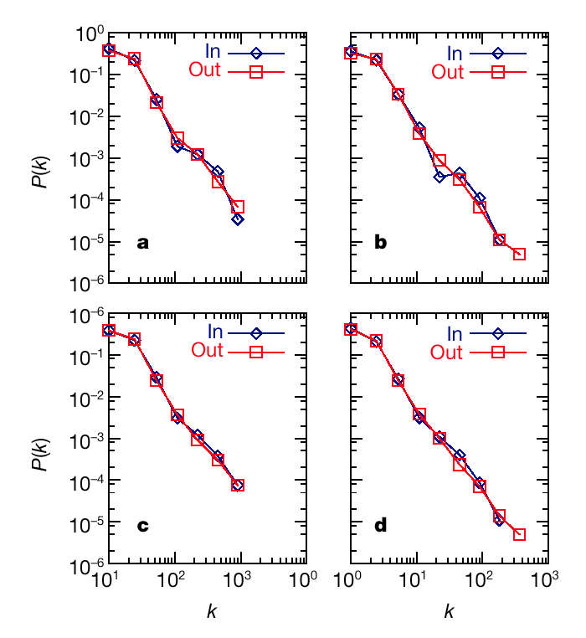
Connectivity distributions for metabolic networks
A. fulgidus (archaea)
E. coli
(bacterium)
averaged over 43 organisms
C. elegans
(eukaryote)
Jeong et al. Nature (2000) 407 651-654

Slide 46
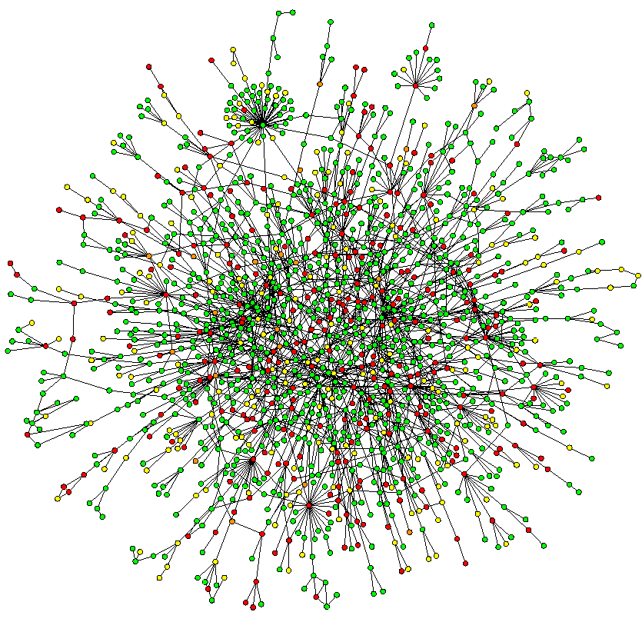
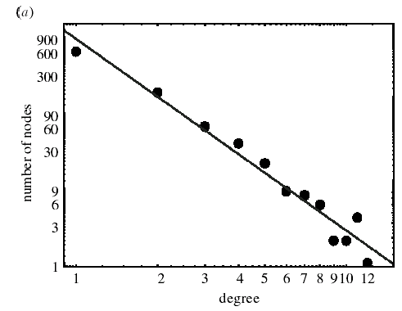
Protein-protein interaction networks
Jeong et al. Nature 411, 41 - 42 (2001)
Wagner. RSL (2003) 270 457-466

Slide 47
Preferential attachment model

Slide 48
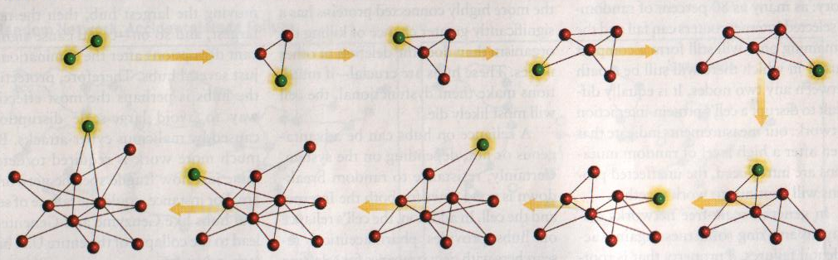
A simple model for generating “scale-free” networks
Evolution : networks expand continuously by the addition of new vertices, and
Preferential-attachment (rich get richer) : new vertices attach preferentially to sites that are already well connected.
Barabasi & Bonabeau Sci. Am. May 2003 60-69
Barabasi and Albert. Science (1999) 286 509-512

Slide 49
Scale-free network model
To incorporate the growing character of the network, starting with a small number (m₀) of vertices, at every time step we add a new vertex with m (< m₀ ) edges that link the new vertex to m different vertices already present in the system.
Barabasi and Albert. Science (1999) 286 509-512

Slide 50
Scale-free network model
To incorporate preferential attachment, we assume that the probability P that a new vertex will be connected to vertex i depends on the connectivity k _{i} of that vertex, so that
Π(k _{i} ) = k _{i} /Σ _{j} k _{j} .
Barabasi and Albert. Science (1999) 286 509-512

Slide 51
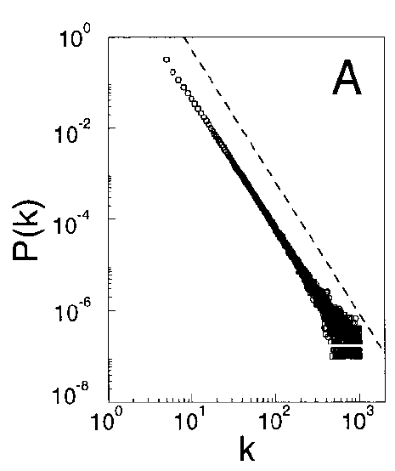
Scale-free network model
This network evolves into a scale-invariant state with the probability that a vertex has k edges, following a power law with an exponent = 2.9 +/- 0.1
After t time steps, the model leads to a random network with t + m₀ vertices and mt edges.
Barabasi and Albert. Science (1999) 286 509-512

Slide 52
Overview of part 1
Historical perspective
  From reductionism to systems and networks
Examples of complex networks
Structural/topological metrics
  Average path length
  Degree distribution
  Clustering
Topological models
  Regular, random, small-world, scale-free networks
  An evolutionary model of network growth: Preferential attachment
Implications of scale-free property in:
  Robustness/fragility
  Epidemics/diffusion processes
Focusing on the “small scale”: network motifs
  Networks as functioning circuits

Slide 53
Robustness/fragility of scale-free networks

Slide 54
Robustness/fragility

Slide 55
Robustness/fragility

Slide 56
Yeast protein-protein interaction networks
the phenotypic effect of removing the corresponding protein:
Lethal
Slow-growth
Non-lethal
Unknown
Jeong et al. Nature 411, 41 - 42 (2001)

Slide 57
Epidemics & other diffusion processes in scale-free networks

Slide 58
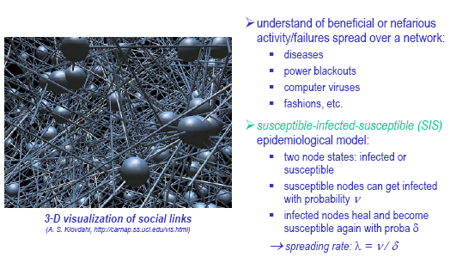
Epidemics in complex networks

Slide 59
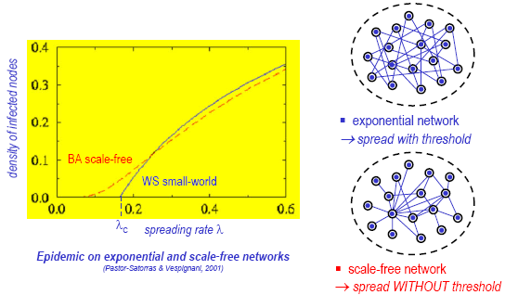
Node dynamics and self-organization:
Epidemics in complex networks

Slide 60
Results can be generalized to generic
scale-free connectivity distributions P(k)~ k^{-γ}
If 2 < γ ≤ 3 we have absence of an epidemic threshold.
If 3 < γ ≤ 4 an epidemic threshold appears, but
it is approached with vanishing slope.
If γ > 4 the usual MF behavior is recovered.
SF networks are equal to random graph.
Pastor-Satorras & Vespignani (2001, 2002), Boguna, Pastor-Satorras, Vespignani (2003),
Dezso & Barabasi (2001), Havlin et al. (2002), Barthélemy, Barrat, Pastor-Satorras, Vespignani (2004)

Slide 61
Overview of part 1
Historical perspective
  From reductionism to systems and networks
Examples of complex networks
Structural/topological metrics
  Average path length
  Degree distribution
  Clustering
Topological models
  Regular, random, small-world, scale-free networks
  An evolutionary model of network growth: Preferential attachment
Implications of scale-free property in:
  Robustness/fragility
  Epidemics/diffusion processes
Focusing on the “small scale”: network motifs
  Networks as functioning circuits

Slide 62
Reference
Uri Alon, “An Introduction to Systems Biology: Design Principles of Biological Circuits”, Chapman & Hall, 2007

Slide 63
Definition of motifs
Network motifs are subgraphs that occur significantly more often in a real network than in the corresponding randomized network.

Slide 64
Network motifs
Original network
Random version of original network

Slide 65
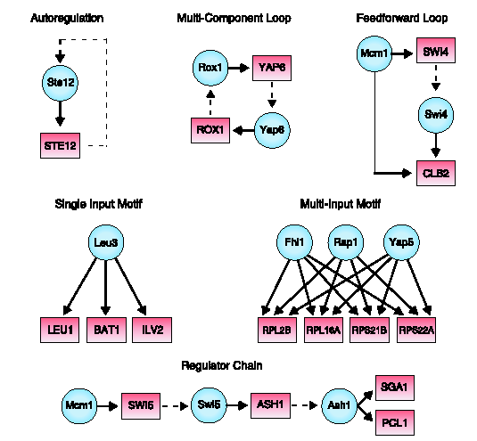
Motifs in genetic network of yeast

Slide 66
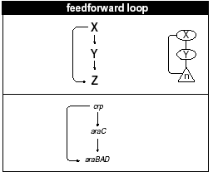
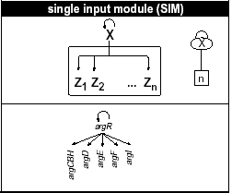
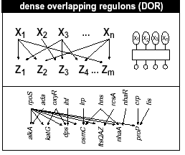
Motifs in genetic network of E. coli

Slide 67
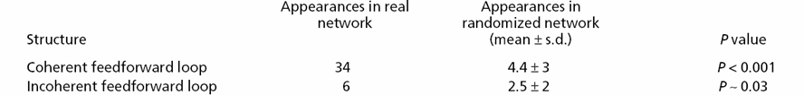
Examples of network motifs
(3 nodes)
Feed forward loop
  Found in many transcriptional
  regulatory networks
X Y Z
coherent
incoherent
X Y Z
X Y Z
X Y Z
X Y Z

Slide 68
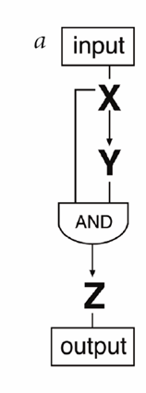
Possible functional role of a coherent feed-forward loop
Noise filtering: short pulses in input do not result in turning on Z

Slide 69
Conservation of network motif constituents
Drosophila melanogaster
Homo Sapiens
Mus musculus
Orthologs
Four nodes motif
Saccharomyces cerevisiae
C. elegans
Arabidopsis thaliana

