Slide 1
Voice over the Internet
(the basics)
CS 7270
Networked Applications & Services
Lecture-2

Slide 2
Outline
Basics about voice encoding
Packetization trade-offs
Architecture of basic VoIP tool
Playback buffer (jitter buffer)
  Adaptive playback buffers?
How to deal with packet losses and late packets?

Slide 3
Voice over the Internet
Includes computer2computer voice applications (like Skype, VoIPBuster, etc)
+ VoIP services
+ Telephony Routing over IP (TRIP)
Includes “off-net” calls (calls to PSTN phones)

Slide 4
Reading-1
“Voice over Internet Protocol (VoIP)” by Bur Goode, published at IEEE Proceedings, Sep’02

Slide 5
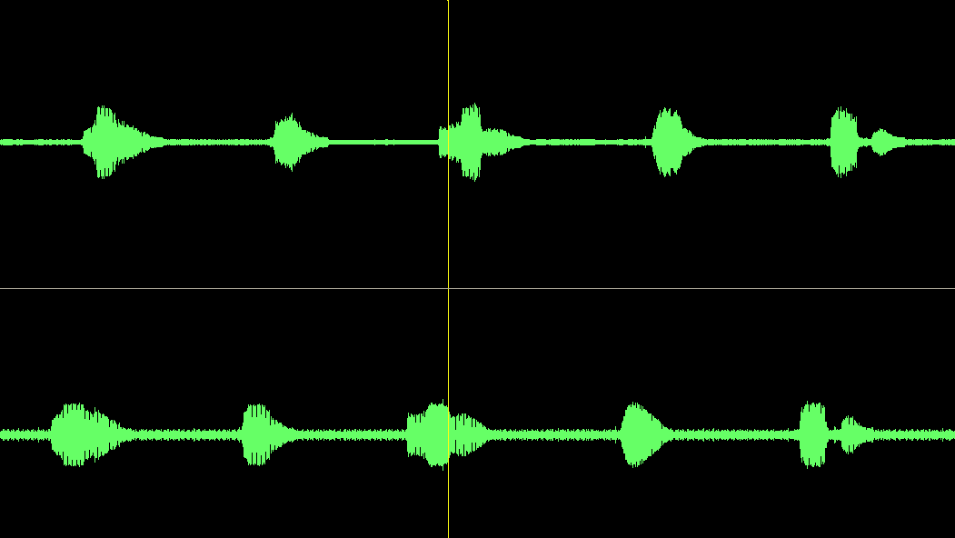
It all starts from an analog signal

Slide 6
Codecs

Slide 7
How does PCM work?
Voice spectrum extends to about 3-4KHz
According to Nyquist’s rate, a sampling frequency of 8KHz should be enough to completely reconstruct the original voice signal from the sampled signal
PCM uses 8 bits per sample (64kbps)
Frame size?
  G.711 uses 125msec (too large for packet voice)
  G.729 uses 10msec

Slide 8
Listen to the various codecs and judge for yourself
http://www.data-compression.com/speech.shtml
(look at bottom of this page)

Slide 9
Popular recent codecs for VoIP
See GlobalIPSound
(http://www.gipscorp.com/products/demos.php)
  Wide band codecs (50-8,000 Hz)
  iLBC (packetization: 20 and 30 msec, bitrate: 15.2 kbps and 13.3 kbps)
    Free, open-source
    No error propagation when lost frame (problem with LPC)
  iSAC (proprietary – best codec currently?)
    PACKET SIZE Adaptive, 30 - 60 ms
    BIT RATE Adaptive and variable, range 10 - 32 kbps
    SAMPLING RATE 16 kHz
    AUDIO BANDWIDTH 8 kHz

Slide 10
MOS scores
Also look at the effect of “codec concatenation” (e.g., G.729*3)

Slide 11
Effects of transcoding

Slide 12
Packetization tradeoffs
R: encoding rate (bps)
H: header size per packet (bits)
  E.g., 40B for RTP/UDP/IP packet
S: packetization period or sample duration (sec)
BW: voice transmission requirement
  BW = R + H/S
  How can you decrease BW?
  Lower R means more complex codec, more correlations across successive packets
  Higher S means more delay at sender and larger sensitivity to packet losses

Slide 13
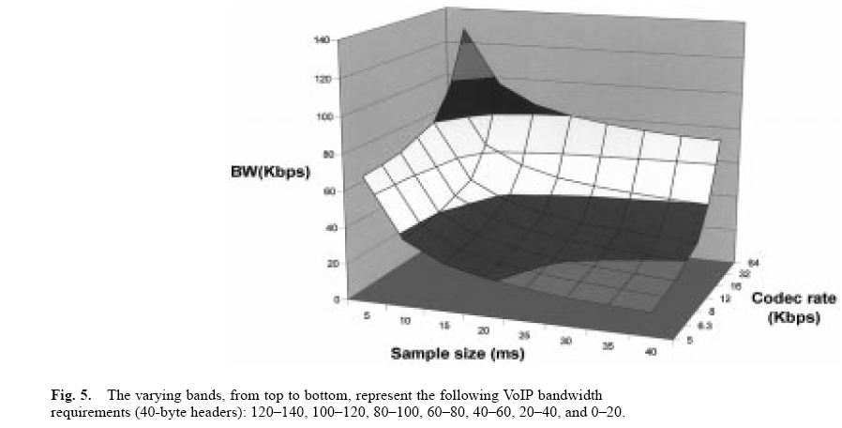

Slide 14
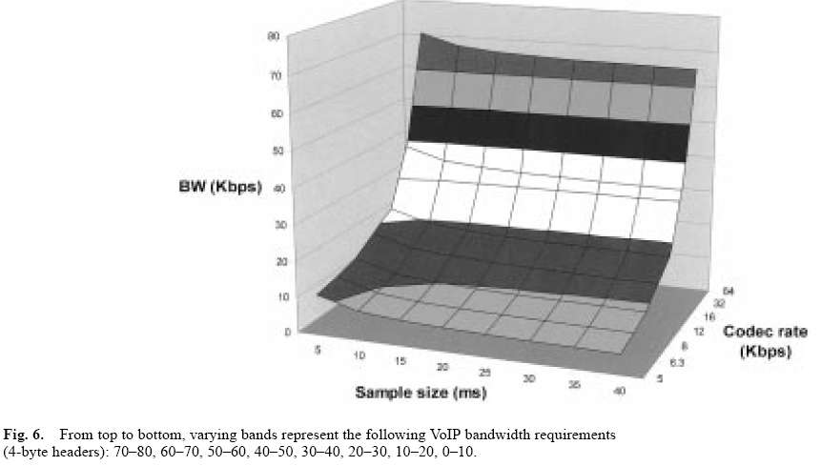

Slide 15
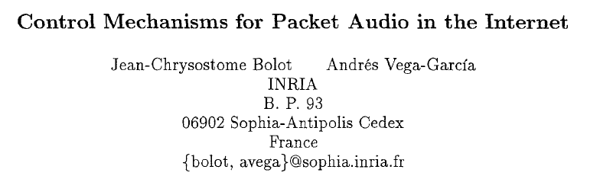

Slide 16
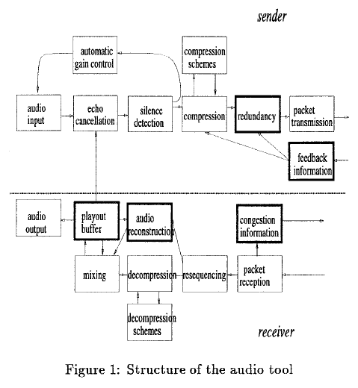

Slide 17
Network effects
One-way delay between sender/receiver
  Includes encoding, packetization, transmission, propagation, queueing, jitter compensation, decoding
  Typically, acceptable if < 150msec for domestic calls and < 400msec for international
    Depends on call’s interactivity
  What can we do to reduce packet delay?

Slide 18
Network effects (cont’)
Packet losses
  Low-bitrate codecs are very sensitive to packet losses (why?)
  Should we do retransmissions?
  Should we do Forward-Error-Correction?
  Or just, packet loss concealment? How?
Delay variation or jitter
  Jitter compensation buffer at receiver
  How large should this buffer be?
  Losing vs discarding packets
  Delay budget calculations
Insufficient network capacity
  Rate adaptation (use multiple codecs)

Slide 19
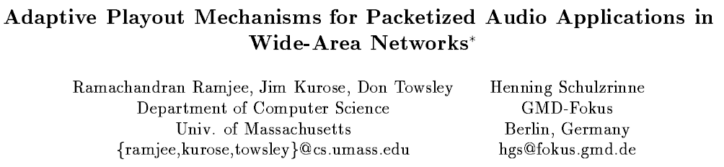

Slide 20
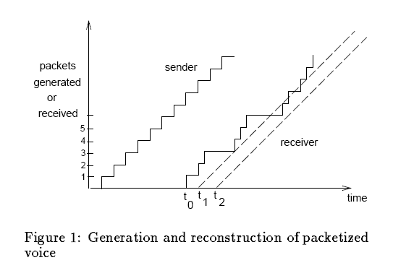

Slide 21
Delay budget

Slide 22
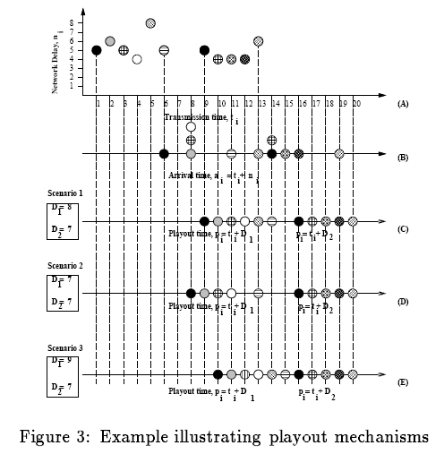

Slide 23


Slide 24
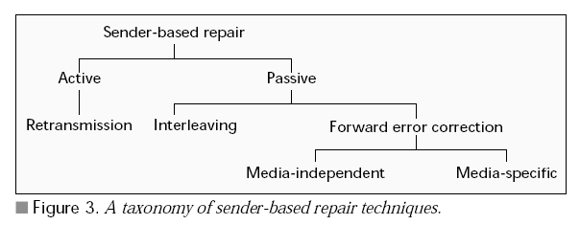

Slide 25
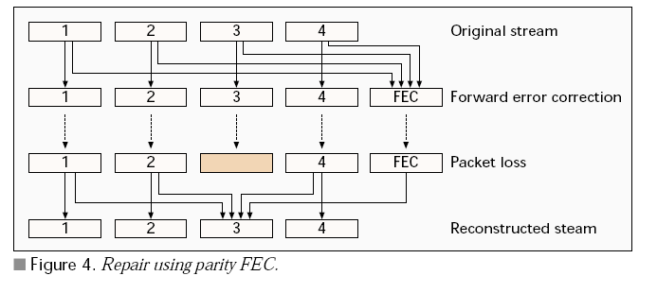

Slide 26
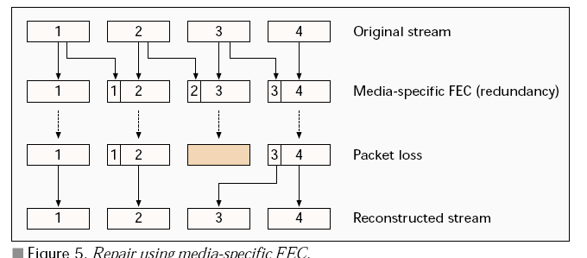

Slide 27
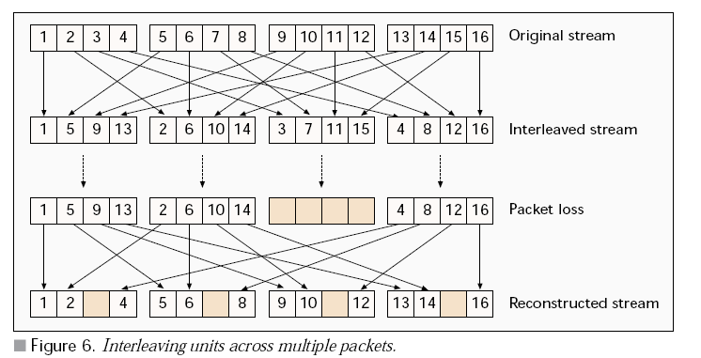

Slide 28
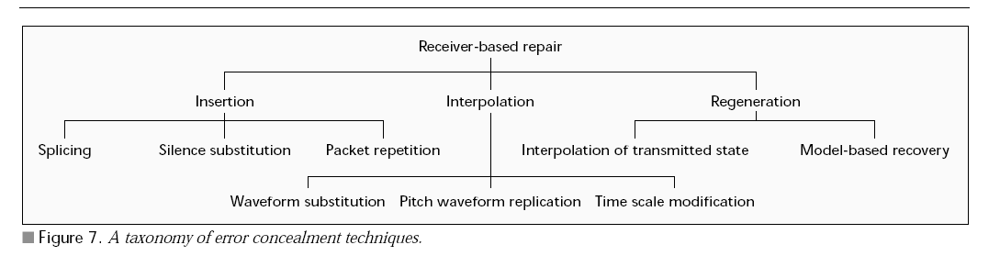

Slide 29
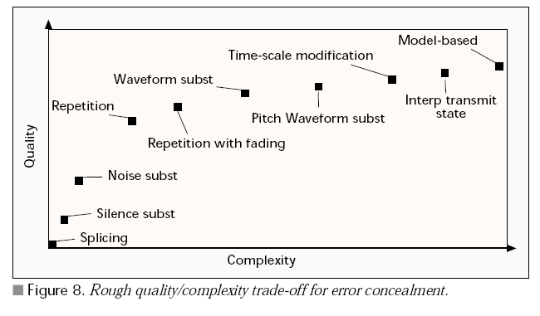

Slide 30
