Slide 1
Video over the Internet
CS 7270
Networked Applications & Services

Slide 2
Reading
“Video Streaming: Concepts, Algorithms,and Systems”, John G. Apostolopoulos, Wai- tian Tan, Susie J. Wee, HP Laboratories Palo Alto
Very nicely written tutorial
But written in 2002

Slide 3
Classification of video apps
Point2point vs multicast vs broadcast
Is there a “reverse channel”?
Pros and cons of reverse channel
Real-time vs pre-recorded video
What about “almost real-time”?
Interactive vs non-interactive video
Static vs dynamic channels
CBR vs VBR channels
Do not confuse with CBR/VBR encoding
Packet-switched vs circuit-switched channels
QoS support?

Slide 4
Overview of video compression
Distinguish between standards (e.g., MPEG-2) and particular codecs (e.g., WMV)
Spatial redundancy in images/video
Temporal redundancy in video
Perceptual redundancy (much less understood and exploited)

Slide 5
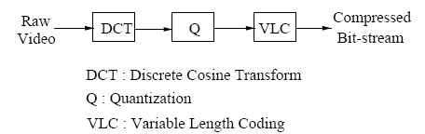
JPEG image compression
Convert RGB image to luminance (intensity) and chrominance components
Partition image in 8x8 blocks
Compute 2-D Discrete-Cosine Transform (DCT) coefficients of each block
Natural images have mostly low-frequency content
Quantization of most important coefficients
Variable-length encoding (remember Huffman coding?) of quantized coefficients to produce compressed bitstream

Slide 6
Video compression
Apply image compression for each frame?
Does not exploit temporal redundancy
Motion estimation
Partition frame in 16x16 blocks
Identify closest block in previous frame, and compute motion vector
Encode the prediction error, as well as the motion vector for each block

Slide 7
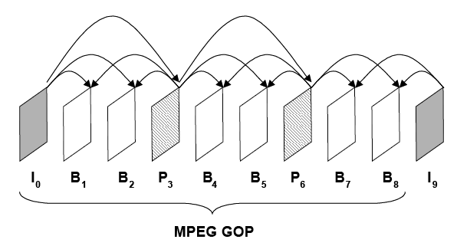
Prediction dependences between frames
Intracoded frames (I), predicted frames (P), and interpolated frames (B)
Inherently VBR encoding
The GOP and its significance

Slide 8
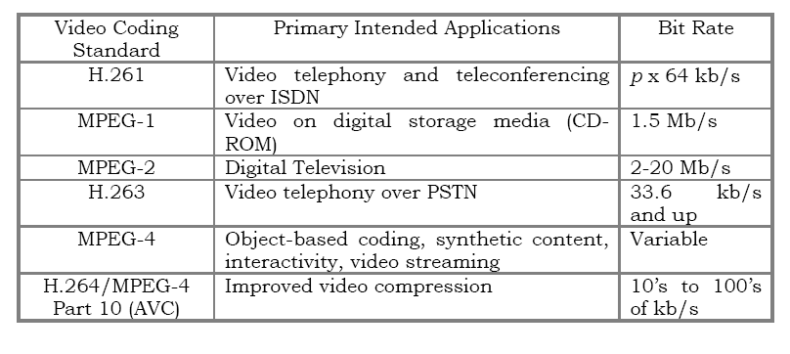
Video standards
What do the standards specify?
Encode and decoder implementations?
Bit syntax?
Decoding process?

Slide 9
Video streaming challenges
Video download or video streaming?
Let’s define carefully each option
Consider the standard “navigation” requirements (pause, fast-forward, rewind, scene selection, etc)
Which option is better?
Time-varying bandwidth
Delay jitter
Packet losses

Slide 10
Time-varying bandwidth and rate control
What does rate control mean?
How would you do rate control?
Available bandwidth estimation and its application in rate control
Video streaming over TCP
TCP is a window (not rate) based transport protocol
TCP adjusts the window size based on AIMD congestion-control algorithm
Nevertheless, TCP is often used in video streaming, especially when receiver window is appropriately sized
How would you calculate the receiver window size to set the streaming rate at a certain value?
Video streaming over UDP
Congestion control?
TCP friendlyness

Slide 11
Rate control techniques
Transcoding
Requires application-layer gateways
Multiple encodings of same file
Burden for the server (and potentially the user)
Scalable compression (or layered coding)

Slide 12
Jitter (delay variations)
Why is this a problem?
Solution: Playback buffering
Key question: how long should the playback buffer (or playback delay) be?
Several research proposals for Adaptive Playback Buffer schemes
Playback buffers have additional advantages:
Allow retransmissions of lost packets
Smooth throughput variations (e.g., due to TCP)
Loss resilience through interleaving

Slide 13
Effect of playout buffering

Slide 14
Packet losses
Common in Internet paths due to congestion or short-term outages
Key characteristic: losses take place in bursts
Solutions?
Retransmissions
Commonly used, but constrained by delay budget and playback delay
Forward Error Correction
Introduce bandwidth overhead (and potentially delay)
Loss/error concealment
Less effective in highly compressed video, but also commonly used
Loss resilient video coding

Slide 15
Need for loss-resilient codecs
Some video codecs are not resilient to losses
Loss of bitstream synchronization
Need for Resync markers (placed where?)
Place most important data just after markers
Error propagation across frames
How can reverse channel help?

Slide 16
Error-resilient video coding methods
Scalable (layered) video coding
Base layer plus several enhancement layers
Useful if network provides several classes of service or priorities
Multiple description coding (MDC) video
Several “descriptions” of the same video
The more descriptions you receive, the better
Significant redundancy among descriptions
What if all descriptions are subject to simultaneous losses?
MDC video with path diversity

Slide 17
Multiple description video and path diversity

Slide 18
Adaptive video streaming over HTTP
Read:
“Watching Video over the Web, Part 1 (streaming protocols”, by Ali Begen et al.

Slide 19
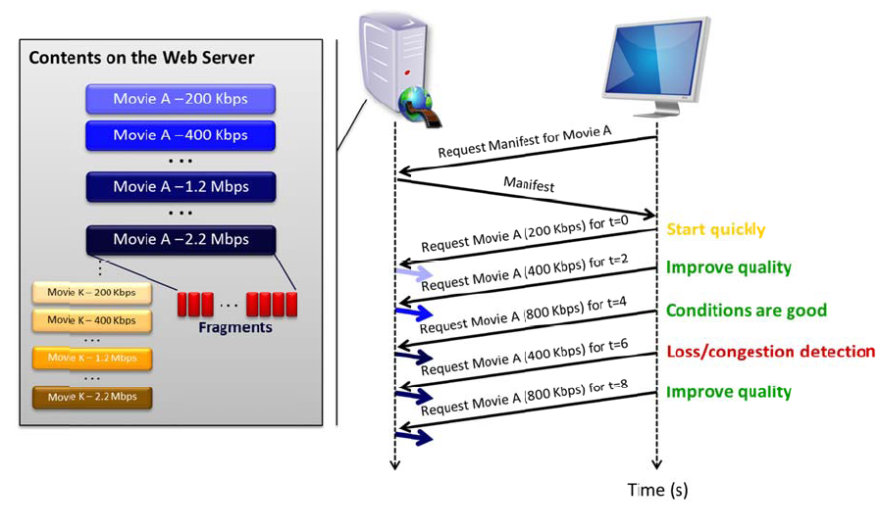

Slide 20
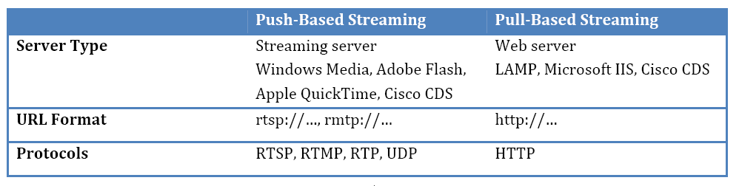
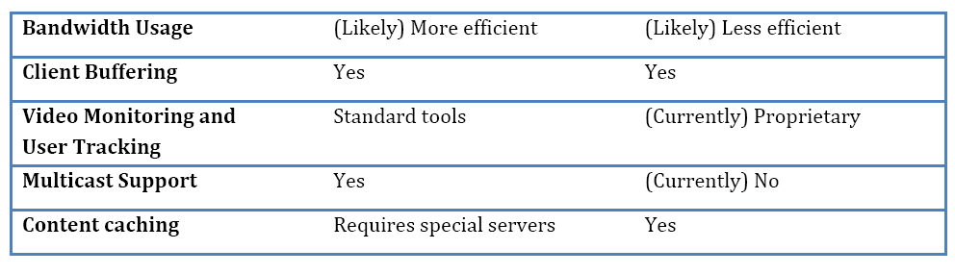

Slide 21
Reading
“I Tube, You Tube, Everybody Tubes: Analyzing the World’s Largest User Generated Content Video System”, by M.Cha et al.
Appeared at IMC’07

Slide 22
YouTube basics
How can we crawl all posted videos?
Metadata for each video?
# of views
# of ratings
Average rating (stars)
# comments -> user interaction
Links from other sites
Director
Several categories of videos
The paper focuses on ENTertainment and “How to & DIY” (SCI) categories

Slide 23
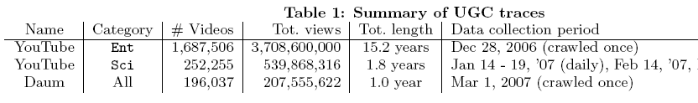
UGC vs non-UGC traces

Slide 24
Pareto principle in video popularity
Also known as the “80-20” (or 90-10) rule
Associated with highly skewed distributions
Caused by positive-feedback effects (“the rich get richer”)
Does non-UGC content (say movies from NetFlix) follow a similar pattern?
A practical implication of this skewness: caching works!

Slide 25
Video popularity: power-law?
Definition of power-law: Prob[X>x] ~ c*x^{-a} for large x
How would you check if a random variable X follows a power-law?
The popularity of YouTube videos appears to be a power-law with an exponential cutoff in very large values (truncated tail)

Slide 26
What causes the “truncated-tails”?
Authors’ conjecture: truncated tails can result from “fetch-only-once” effect?
As opposed to “fetch-again”, every time we access a popular Web page such as CNN.com

Slide 27
Analysis of “long tail” phenomemon
What can prevent/reduce the “long tail” effect for unpopular videos?
Natural reasons: some video clips were not meant to be seen by many people (e.g., family or friend videos)
Sampling filters: Uploaders do not post their less interesting videos
Information filters: Search engines return most popular/linked content (older videos are more affected by such filtering)

Slide 28
Do users mostly see new content?
Very recent videos (about a month old) get more requests
But overall, the popularity does not seem to depend on the video’s age

Slide 29
Content duplication/aliases
What does this mean?
Why is it important?
How to detect aliases, say in YouTube?

Slide 30
Illegal uploads of video content
Mostly due to copyrighted material
Major issue for all UGC applications
How to detect/measure?
The paper reports that only 5% of the deleted videos were marked by YouTube as “copyright violations”

