Slide 1
Some recent work on P2P content distribution
Based on joint work with Yan Huang (PPLive), YP Zhou, Tom Fu, John Lui (CUHK)
August 2008
Dah Ming Chiu
Chinese University of Hong Kong

Slide 2
The case for P2P VoD
Client-server VoD is expensive, even with CDN support
The case for peer-assisted VoD (Sigcomm 2007)
The Key challenges
  P2P live streaming, already very successful, relies on peers watching video at the same time
  For P2P VoD, much less synchrony in time
    Peers watching different movies
    Peers watching different parts of the same movie
Notes:
The Sigcomm 2007 paper, “Can Internet Video-on-Demand be Profitable?” makes a good case for P2P VoD.
They give cost models of client-server, and CDN based VoD, and show peer-assisted VoD let content providers provide video of much higher quality; and the server bandwidth costs can be reduced down to less than 10 percent (of client server VoD). But how to build a P2P VoD system?

Slide 3
The PPLive VoD System
Deployed in the fall of 2007
100K+ subscribers
1000s simultaneous users at a time
100s of movies at resolution of 350-500Kb/s
Server loading around 11 percent at busy time
Reasonable user satisfaction
  Objective measurements
  Subjective survey
Notes:
Apparently, what was suggested by the Sigcomm 2007 paper was not much of a secret, as a number of P2P VoD systems were already being developed in 2007. PPLive, a popular P2P streaming software company, developed a P2P VoD system in the early part of 2007, and deployed it in the fall of 2007.

Slide 4

Contrast with P2P Streaming
Both make use of peers uplink bandwidth
For P2P streaming
  Peers are viewing the same video simultaneously
For P2P VoD
  Peers are viewing different videos
  Peers are viewing different parts of the same movie
time
time

Slide 5
What is the secret?
Make users contribute storage!
  Each peer contributes 0.5 to 1GB of hard disk
  The key problem of VoD: content replication!
    Peers periodically report replication state to tracker
    Replication algorithm to decide what to keep
Less autonomy, less free riding
  Peers have little control in upload BW, cache
Other less technical factors
  Working with ISPs
  Get good content to draw eyeballs
  Get Ads to finance operation
Notes:
P2P VoD is different than P2P life streaming. A peer cannot bank on the video content it wants to watch already existing in other peers streaming buffers. The Sigcomm 2007 paper discuss this issue. In fact they created a stochastic model to analyze this problem. They suggest that each peer must do pre-fetching to reduce server load. Here, perhaps a more direct way, is for peers to replicate some server content in its hard disk (cache). In the PPlive system, each peer contributes 0.5 to 1 GB storage. The software is downloaded by users as binary, and is free. There is relatively less control by the users, in terms of limiting upload bandwidth usage and storage contribution. Each peer regularly sends heartbeat to the server, and video play only continues if there is heartbeat. This heartbeat mechanism lets the peers report all kinds of information to the server; perhaps the most important piece of information from the system design point of view, is the replication state of the peer. This allows the server to tally the overall replication “health” for different movies, and this information is in turn used to optimize replication. We will explain this more later on.
Aside:
The uplink sharing model gives the relationship between available uplink bandwidth of peers and the video resolution (playback rate).
For P2P VoD, there needs a model that gives the relationship of the needed cache size and number of movies in the VoD system, perhaps relating to other parameters such as (a) size of a movie, and (b) the steady-state on-line population size. This analysis is beyond the scope of this paper.
Other than these technical factors, there are many other, perhaps even more important factors to ensure the success of the P2P VoD system. For example, PPLive works closely with ISPs in China. The way I understand it, it is a collaboration. Clearly how to get good content and ads are also important, to attract eyeballs. These are factors beyond the scope of this paper.

Slide 6
Content replication
Multiple video replication
  Tracker system to map movies to on-line peers
    “Holding a movie” means holding at least some chunks of a movie, in memory or disk
  Bring movies from disk to memory when requested
Replication at chunk level (same as p2p streaming)
  Peers gossip to get bitmap
  Size of chunk = 2MB
  Size of bitmap ~ 100 bits
Notes:
The Sigcomm 2007 paper is mostly based on single video replication. In single video replication case, the only thing you can do is to increase the streaming buffer to allow pre-fetch.
Given hard-disk cache at each peer, PPLive’s VoD adopts multiple video replication. At the 400Kb/s resolution, a one-hour plus movie is 200-300MB. So the 1G storage can hold about 4 complete movies.
To support Multiple Video Replication, the tracker is more complicated. It must efficiently provide a mapping between the movies and those online peers replicating a given movie. A peer is considered replicating a movie if it holds at least a chunk of that movie, usually it holds many chunks if not all chunks. The size of chunk is a basic unit for storage. If you have less than a chunk, then you don’t even tell others that you have the chunk. To be more helpful to others, you want the chunk size to be not too big. But the peers learn about what chunks each other has via gossip, using a bitmap. If the chunk size is too small, then the gossip overhead would be large. In PPLive’s VoD, the chunk size is 2MB. So the bitmap for a typical movie is around 100 bits.
In order to provide good uploading service, the I/O system must also be optimized in how it fetch parts of a chunk from disk cache into memory, in anticipation of downloading requests.

Slide 7
Segment sizes
Chunk
  Unit advertised in bitmap
Piece
  minimum viewable unit
Subpiece
  Transmission unit
  May request different subpiece from different peers
chunk
piece
16KB
1KB
subpiece
Notes:
Other than the unit of “chunk”, which is used to describe “who has what”, the other important unit is “piece”. Piece is the unit suitable for playback. The size is 16KB. It is important to collect a whole piece, before it can be passed to the player. For transmission, a piece is too big. It is divided to 16 1KB subpieces. A peer can get different subpieces from different neighbors.

Slide 8
Important algorithms
There are several important algorithms:
Piece selection algorithm
Replication algorithm
Transmission scheduling algorithm
These are interesting algorithms worthy of further studies
Notes:
In p2p systems, there are already quite a few papers studying the theoretical limits of p2p systems. Usually, we look at the system asymptotically, as the size of a piece goes to zero. In reality, p2p systems are implemented by many discrete, distributed algorithms, which work surprisingly well. I believe there will be tremendous interests in studying these algorithms, trying to generalize them and standardize them.
Here we look at some of these algorithms as they are implemented in PPLIve’s VoD system.

Slide 9
Piece selection
A mixture of strategies used for pulling data:
Sequential
  Closest to playback first
Rarest first
  Equivalent to Newest first, helps propagate content
Anchor-based
  Sequential at different anchor points
  Randomly select anchor-point, with some probability
playback
1 2 3 4 5 6 7 8
X X X X
Rarest First
Sequential
Neighbor buffer map
Local buffer map
AnchorPoints
Notes:
The consideration here is the same as that for p2p life streaming. It helps to implement a mixture of “sequential” and “rarest first”, as a trade-off between local playback and peer sharing. The anchor-based strategy is interesting for VoD. If the anchors are close to where users are skipping to, delay can be minimized.

Slide 10
Replication algorithm
No pre-fetch; rely on what peer already has in its disk cache
Cache replacement
  Many possibilities: LRU, LFU
  Weigh-based approach
    How complete is the movie cached?
      Favors those more complete movies
      Once a movie is marked for discard, discard all chunks
    What is the Availability To Demand (ATD) ratio?
      This information is obtained from tracker
Notes:
In the Sigcomm 2007 paper, pre-fetching was suggested.
In PPLive’s system, no pre-fetching is used; since it is complicated and can potentially use up precious uplink bandwidth. Instead, the previously viewed movies are retained in a peer’s disk cache. The key is to select the right movies to cache. The obvious cache management algorithm (LRU and FLU) don’t seem to work as well. Since online peers report their bitmap of movies to the tracker, a tracker can summarize that information and let peers known the Availability-to-Demand ratio of a movie. Based on that (global) info, a peer can decide whether to keep a movie. Of course, it is also important the kept movie is one that the peer has downloaded a significant portion already.
We believe how to do replication well is key to the performance and server load savings of a p2p vod system. In PPLive’s case, continuing optimization efforts have reduced the server load from around 20% to around 11%, using the strategy described above.
We believe this is a very interesting research problem for further studies.

Slide 11
Transmission strategy
When pulling a piece, or chunk:
Request (different) subpieces from different neighbors at the same time
The number of neighbors to try decided experimentally. For 500Kb/s, 8-20 can be tried simultaneously
Overly aggressive -> duplicate replies, higher system overheads
Overly conservative -> under-performance
Requesting peer
Neighbors holding piece
Notes:
There are two conflicting goals:
Minimize duplicate requests and replies, hence overhead
Maximize downloading rate for local peer
The transmission strategy can be very aggressive, e.g. try requesting the same piece from multiple peers. This obviously leads to more duplicates. The strategy can also be conservation: e.g. request one neighbor at a time. PPLive’s algorithm is to request different (sub)pieces from different neighbors, at the same time. Many experiments were tried to determine the best number of simultaneous requests. Also the local peer must adjust the request rate to different peers depending on the response time from the neighbors, and handle timeouts.
The current algorithm is an ad hoc algorithm. This seems an interesting, well-defined problem for further studies.

Slide 12
Measurement study
User behavior
Replication: demand and supply
User satisfaction
Other network conditions

Slide 13
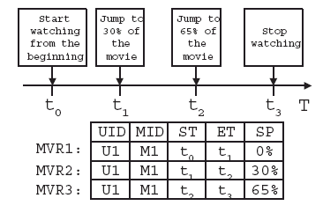
Viewing traces
MVR = Movie View Records
UID = user’s unique ID
MID = movie ID
ST = start time
ET = end time
SP = start position

Slide 14
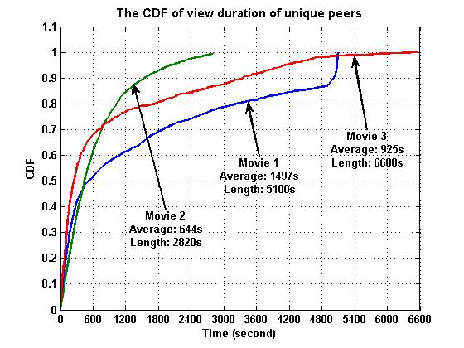
Typical movies
Note:
Some users viewed entire movie, e.g. 5K watched entire movie 1
But large number of users are browsing…
Notes:
We first take a look at some typical movies in this VoD system. We collected a one-week trace of ten movies from the P2P-VoD log server, from Dec. 23 to Dec. 29, 2007. Here we select three “typical” movies to illustrate the results.
MVR = Movie viewing record
From the table, we could observe that:
Movie 2 is the most popular movie with 95005 unique viewers while Movie 3 is the least popular but the longest (almost 2 hours).
Average of jumps is computed from number of MVRs divided by unique viewers. The number of jumps is relatively small. This had impact on the design of piece selection. Anchor-based piece selection is currently not implemented.
Average viewing duration is small. This can be due to either content, and the browsing effect, or due to poor quality of experience. The right figure indicates the distribution of viewing duration. There is certainly a lot of browsing – people watching for just a short duration to survey the content. We can see that more than 10% of the people (~4K) viewing movie 2 did complete the whole movie. This gives me confidence that the quality of experience must be good enough for this to happen.

Slide 15
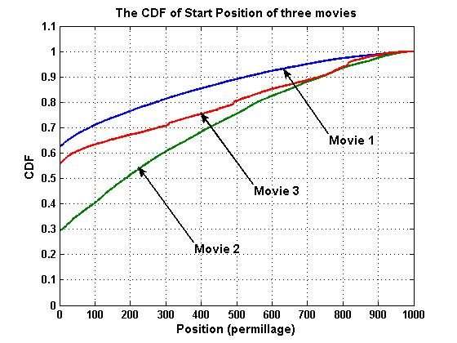
Starting position of viewing
Notes:
This figure shows the distribution of the start position (X axis). A large proportion of viewing started from position 0. The rest of MVR starting positions are uniformed distributed. So there is no propelling reason for using any particular position as anchor points (for anchor-based piece selection).

Slide 16
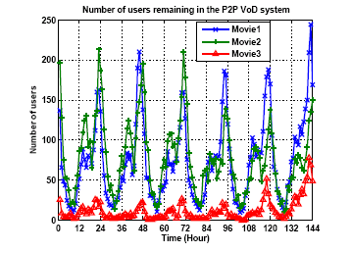
Peer residence time distribution
70% users staying more than 15 min
Prime times of the day
Notes:
The left figure shows the residence time distribution of users. There is a high proportion of users (> 70%) who stays in the system over 15 minutes. During the residence time, peers are able to provide upload services to the community.
The right figure shows the variation of the number of users in the system over the time of day. As we can see, there is “rush hours” or “prime time”, I believe during lunch breaks and evenings. The knowledge of the prime time is use to measure server efficiency, as we will explain later.

Slide 17
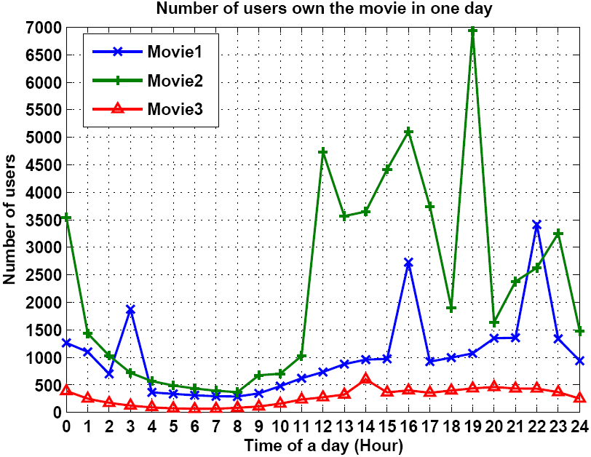
Replication: supply
Movie level supply
Chunk-level supply
= % time a chunk is held
Notes:
The figures illustrates the movie-level and chunk-level supply condition of the three movies in a one day trace.
The left figure illustrates the number of peers that own the movie. To be counted, the peer must be in the system and has at least one chunk of the movie. From the figure we can observe that the supply fluctuates with the viewership; the lowest level of supply is during the time between 5:00 am to 9:00 am. This corresponds to the period during which the number of viewers are low.
The right figure shows the percentage of time a chunk is held by a peer that holds the movie. The right figure shows the average chunk-level supply over a 24-hour period. From the figure we can observe that the supply level for chunks in the beginning of the movie is higher; but is general good across the movie (more than 30% of users holding the movie),

Slide 18
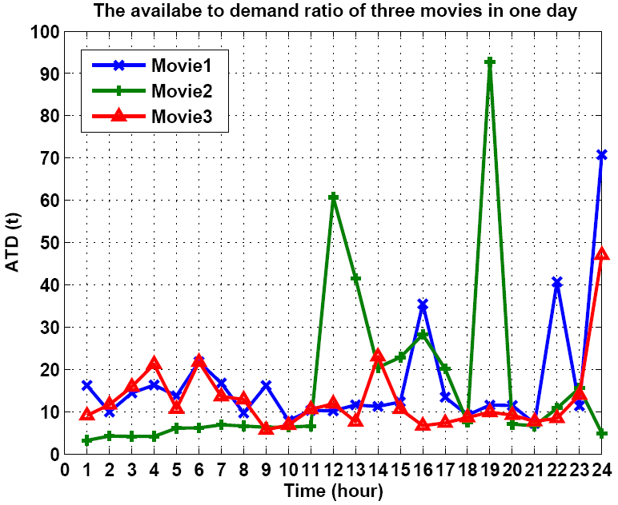
Replication: supply and demand
ATD = availability to demand ratio
Notes:
The availability to demand ratio (ATD) shows the amount of supply per demand demand (number of peers viewing)
We can see that the ATD varies over time. In steady state, since each peer watches a movie, and holds 4-5 movies in its disk cache, then the average ATD should be around 5-6.
In reality, the ATD can be quite a bit higher, specially during the time of heavy viewing. This implies each peer may hold a large number of movies (only smaller fragments) sometimes.
By the way, the chunk-level demand is figured out based the starting viewing time (ST) and ending viewing time (ET) and starting position (Sp) of MVRs.

Slide 19
User satisfaction
Fluency = viewing time / total time (including buffering, freezes)
Notes:
User satisfaction is very important to a content provider. It is measured by peers reporting a fluency index to the log server in periodic heartbeat messages (or at the end of viewing???). The left figure shows the number of fluency records reported to the log server at different times during a one-day period. It more or less follows the daily viewing pattern.
The right figure shows the distribution of fluency index of the three movies in a one-day period. The fluency takes value from 0 to 1. We divide the interval [0, 1] into ten sub-intervals: [0, 01.1), [0.1, 0.2), … [0.9, 1.0]. We can observe that there is a high percentage of fluency indexes whose values are greater than 0.7. However around 25% of the fluency indexes are less than 0.2. One possible explanation of this is that there is a high buffering time which causes long start-up latency. Once people passed the initial hump, they tend to stay. This represents an area worthy of further study and improvements.

Slide 20
Servers
Some information about a typical server
48-hour Measurement
Dell Power Edge server
CPU: Intel DueCore1.6GHz
RAM: 4GB
Gigabit Ethernet Card
Provide 100 movies.
Notes:
In the figure, the pattern of upload rate and CPU usage vary with time and this pattern is very similar with that of number of users in Figure of the paper. The server upload rate and CPU usage are correlated with the number of users viewing the movies.
Comparing to the statistics in the Sigcomm’07 paper (which is client/server architecture), we could find that the P2P technology helps to reduce the server’s burden.

Slide 21
Other network conditions
Uplink and downlink bandwidth distribution
Recent one-day measuring result on May 12, 2008
Average peer contributed upload rate: 368Kbps
Average download rate from other peers: 352Kbps
Average download rate from server: 32Kbps
Average server loading ratio: 8.3%

Slide 22
How to measure server loading
Server loading ratio = actual server uploading / server uploading w/o p2p
During non-prime time
  server loading ratio may be high
  absolute loading is not
Server loading ratio is defined as average over prime time
Achieved server loading ratio by PPLive
  For P2P streaming, very low (e.g. 1-2%)
  For P2P VoD, it was around 20% when the paper was written; after some optimization, the ratio was reduced to around 10-11%.

Slide 23
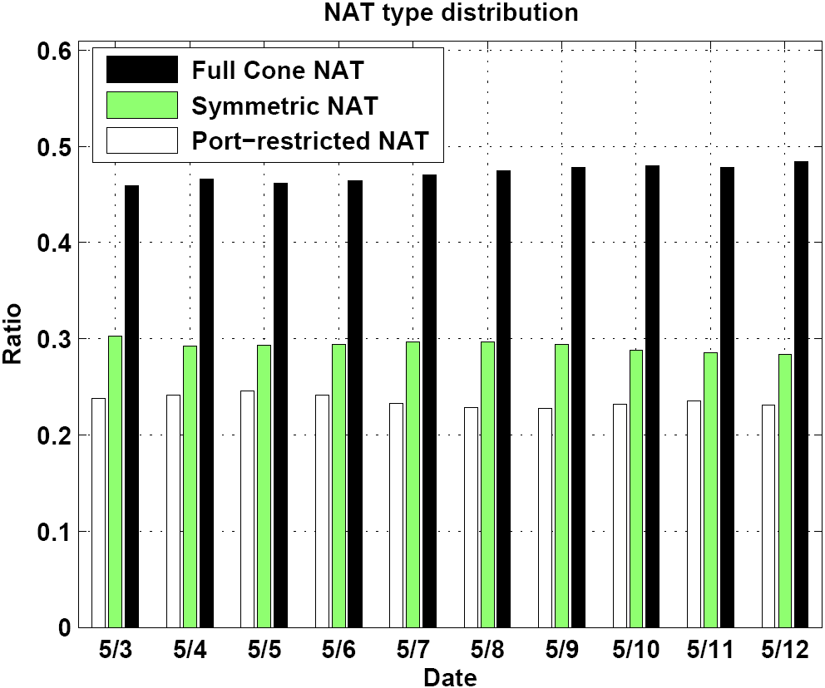
NAT
NAT Traverse
Notes:
The left figure illustrates the ratio of peers behind NAT boxes. We can observe that the ratio remains stable (around 80%) during the 10-day measurement from May 3 to May 12, 2008.
This is a rather high percentage of peers behind NAT boxes.
A STUN-like mechanism is used to detect what NAT boxes are used.
The right figure shows the distribution of different types of NATs. The full cone NAT has the largest proportion (around 47%). There is no Restricted Cone NAT for some reason.

Slide 24
Concluding remarks
Main messages of this paper
  Large scale P2P VoD can be realized
  Design rationales and insights from the PPLive case
  Some key research problems to take home
  How to measure a P2P VoD system, and some insights from measurement
  How to monitor a P2P VoD system, to optimize its operation
Notes:
This is a “systems paper”. We are describing the experiences and insights from a real P2P VoD system implementation and deployment. This is the first paper on a relatively large P2P VoD system. The important points to take away is the design considerations and metrics, and the description of some key algorithms that we worthy of further research and study. The analysis of measurement data also provides a peek into user behavior, network conditions, and performance of the PPLive system. These are all very valuable for people designing such P2P VoD systems.

