Slide 1
The State of the Art of P2P Video Streaming
Slide courtesy:
Dr. Sumi Helal & Dr. Choonhwa Lee at University of Florida, USA
Prof. Darshan Purandare at University of Central Florida, USA
Dr. Meng ZHANG, Dyyno Inc., USA
Jan David Mol, Delft University of Technology, Netherlands

Slide 2
Outline
Introduction
Video Streaming Approaches
  IP Multicast
  Content Distribution Network
  Application Layer Multicast
  Mesh-Pull P2P Streaming
    CoolStreaming
    PPLive
Mesh-Push-Pull Mechanism
Mobile P2P Streaming

Slide 3
P2P Is More Than File Download
P2P Protocols:
1999: Napster, End System Multicast (ESM)
2000: Gnutella, eDonkey
2001: Kazaa
2002: eMule, BitTorrent
2003: Skype
2004: Coolstreaming, GridMedia, PPLive
2005~: TVKoo, TVAnts, PPStream, SopCast, …
Next: VoD, IPTV, Gaming

Slide 4
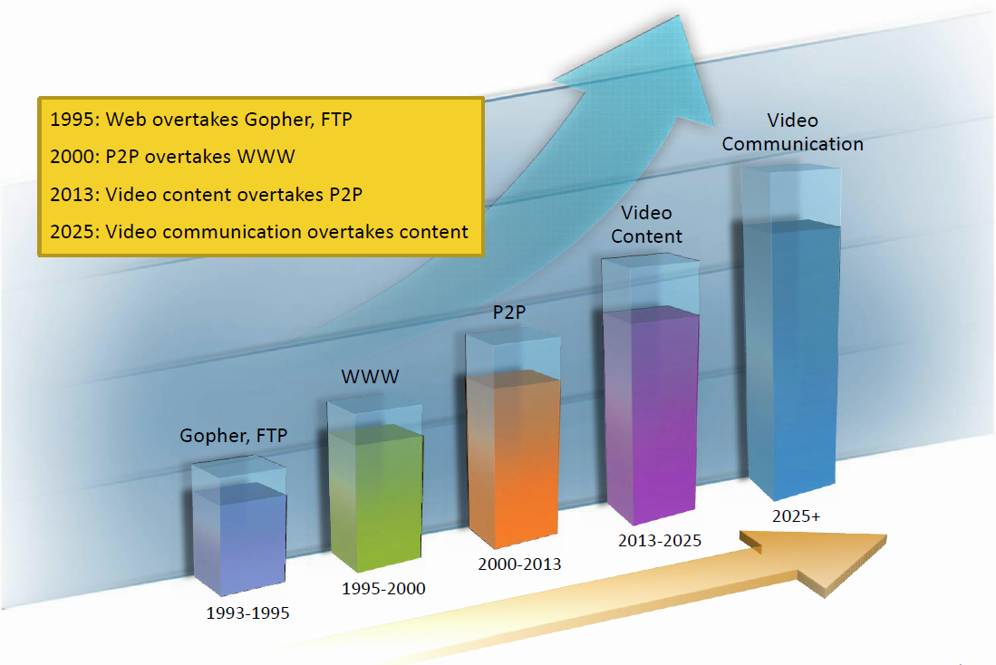
Internet Traffic

Slide 5
Internet Video Streaming
Large-scale video broadcast over Internet
  Real-time video streaming
  Large numbers of viewers
    AOL Live 8 broadcast peaked at 175,000 (July 2005)
    CBS NCAA broadcast peaked at 268,000 (March 2006)
    NFL Superbowl 2007 had 93 million viewers in the U.S. (Nielsen Media Research)
  Very high data rate
    TV quality video encoded with MPEG-4 would require 1.5 Tbps aggregate capacity for 100 million viewers

Slide 6
Video Streaming Approaches
IP Multicast
Content Distribution Networks
  Expensive
  Akamai, Limelight, etc
Application Layer Multicast
  Synonyms
    Peer-to-Peer multicast, Overlay multicast
  Alternative to IP Multicast
  Scalable
  No setup cost
  Taxonomy
    Overlay Structure: Tree / Mesh
    Fetching Mechanism: Push / Pull

Slide 7
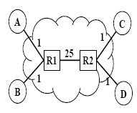
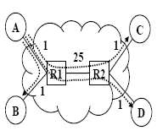
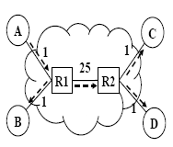
IP Multicast
Network layer solution
Internet routers responsible for multicasting
  Group membership: remember group members for each multicast session
  Multicast routing: route data to members
Efficient bandwidth usage
  Network topology is best known in network layer

Slide 8
IP Multicast
Per-group state in routers
  High complexity, especially in core routers
  Scalability concern
  Violation of the end-to-end design principle: ‘stateless’
Slow deployment
  Changes at infrastructural level
  IP multicast is often disabled in routers
Difficult to support higher layer functionality
  E.g., error control, flow control, and congestion control

Slide 9
Content Distribution Networks (CDNs)
CDN nodes deployed at strategic locations
These nodes cooperate with each other to satisfy an end user’s request
User request is forwarded to a nearest CDN node, which has a cached copy
QoS improves, as end user receives best possible connection
Akamai, Limelight, etc

Slide 10
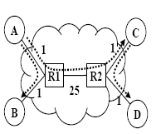
Application Layer Multicast
Application layer solution
  Multicast functionality in end hosts
  End systems participate in multicast via an overlay structure
  Overlay consists of application-layer links
  Application-layer link is a logical link consisting of one or more links in underlying network
Initial approaches adopt tree topology
  Tree-Push
  Tree construction & maintenance
  Disruption in the event of churn and node failures

Slide 11
Application Layer Multicast
Easy to deploy
  No change to network infrastructure
Programmable end hosts
  Overlay construction algorithms at end hosts can be easily applied
  Application-specific customizations

Slide 12
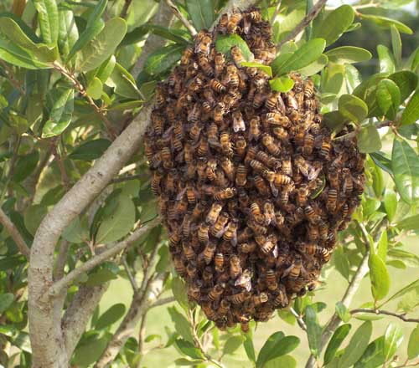
Mesh-Pull P2P streaming
Data-driven/swarming protocol
  Media content is broken down in small pieces and disseminated in a swarm
  Neighbor nodes use a gossip protocol to exchange their buffer map
  Nodes trade unavailable pieces
BitTorrent
CoolStreaming
  PPLive, SopCast, Fiedian, and TVAnts are derivates of CoolStreaming
  Proprietary and working philosophy not published
  Reverse engineered and measurement studies released

Slide 13
Why Is P2P Streaming Hard?
Real-time constraints
  Pieces needed in a sequential order and on time
Bandwidth constraints
  Download speed >= video speed
High user expectations
  Users spoiled with low start-up time and no/little loss
High churn rate
  Robust network topology to minimize churn impact
Fairness difficult to achieve
  High bandwidth peers have no incentive to contribute

Slide 14
CoolStreaming
Video file is chopped and disseminated in a swarm
Node upon arrival obtains a list of 40 peers from the server
Node contacts these peers to join the swarm
Every node has typically 4-8 neighbors, periodically sharing its buffer map with them
Node exchanges missing chunks with its neighbors
Deployed in the Internet and highly successful

Slide 15
CoolStreaming
Membership Manager
  Maintains a list of members in the group
  Periodically generates membership messages
  Distributes it using Scalable Gossip Membership Protocol (SGAM)
Partnership Manager
  Partners are members that have expected data segments
  Exchanges Buffer Map (BM) with partners
  Buffer Map contains availability information of segments
Scheduler
  Determines which segment should be obtained from which partner
  Downloads segments from partners and uploads their wanted segments

Slide 16
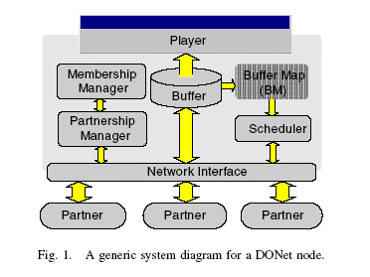
Diagram of CoolStreaming System

Slide 17
PPLive
Data-driven P2P streaming
Gossip-based protocols
  Peer management
  Channel discovery
Very popular P2P IPTV application
  Over 100,000 simultaneous viewers and 40,000 viewers daily
  Over 200+ channels
  Windows Media Video and Real Video format

Slide 18
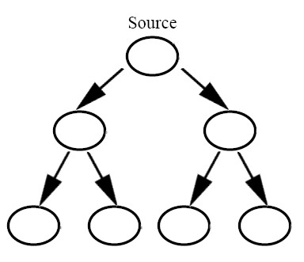
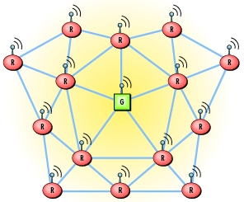
Tree-Push vs. Mesh-Pull

Slide 19
Tree-Push vs. Mesh-Pull
Tree-Push Based
  Content flows from root to children along the tree
  Node failures affect a complete sub-tree
  Long recovery time
Mesh-Pull Based
  Nodes exchanges data availability information with neighbor nodes
  Resilient to node failure
  High control overhead
    Meta-data exchange consumes bandwidth
  Longer delay for downloading each chunk
    Request-Response

Slide 20

Hybrid Pull-Push Protocol
Pull-based protocol has trade-off between control overhead and delay
  To minimize the delay
    Node notifies its neighbors of packet arrivals immediately
    Neighbors also request the packet immediately
    large control overhead
  To decrease the overhead
    Node waits until a group of packets arrive before informing its neighbors
    Neighbors can also request a batch of packets at a time
    considerable delay
Notes:
20

Slide 21
Pull-Push Streaming Mechanism
  Pull mechanism as startup
  Successful pulls trigger packet pushes by the neighbors
  Every node subscribes to pushing packets from the neighbors
  Lost packets during the push interval are recovered by pull mechanism

Slide 22
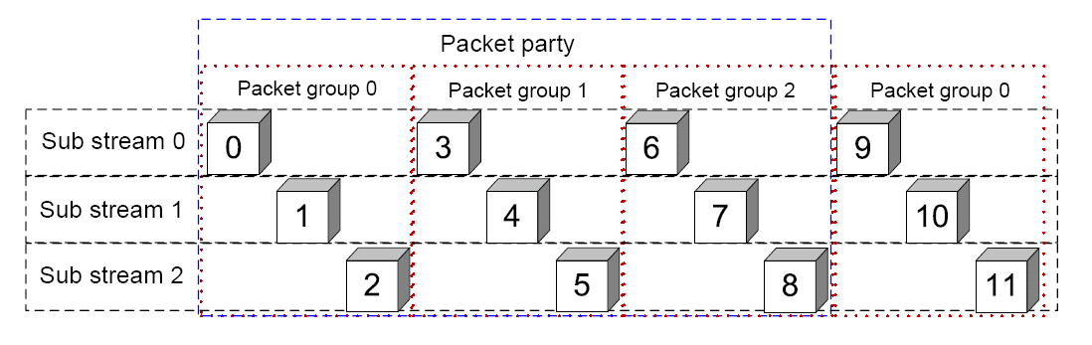
Pull-Push Streaming Mechanism
n-sub streams: packets with sequence number s % n
Loop avoidance
  For n-sub streams, there are n packets in a packet group
  Packet party is composed of multiple packet groups.
  Push switching is determined by the pull results of the first packet group in a packet party

Slide 23
Mobile P2P Streaming
Mobile video streaming
  Rapid growth of mobile P2P communication
  Video streaming expected to rise to as high as 91% of the Internet traffic in 2014
Mobile environment
  Increase of mobile and wireless peers
  Unsteady network connections
  Battery power
  Various video coding for mobile devices
  Frequent node churn
  Security

Slide 24
Mobile P2P Streaming
Mobile node issues
  Uplink vs. downlink bandwidth
  Battery power
  Multiple interfaces
  Geo-targeting
Other mobility considerations
  Processing power
  Link layer mobility
  Mobile IP & proxy mobile IP
  Tracker mobility

Slide 25
Pioneering Approaches
Video proxy located at the edge of networks
  Adaptive video transcoding considering the network conditions and constraints of mobile users
Distributed transcoding by fixed nodes
  Sub-streams from multiple parents are assembled
  Resilient to peer churns

Slide 26
Pioneering Approaches
Hierarchical overlay
  Multiple network interfaces – access link vs. sharing link
  Peer fetches a video thru cellular networks (WAN) to share it with others over local networks (LAN)
Cooperative video streaming
  P2P-based application layer channel bonding in resource-constrained mobile environments
  Similar, in spirit, to channel/link bundling technology at link layer to efficiently leverage the combined capacity of all access links

Slide 27
Questions?

