Slide 1
One-Click Hosting Services: A File-Sharing Hideout
Demetris Antoniades
danton@ics.forth.gr
Evangelos P. Markatos
markatos@ics.forth.gr
ICS-FORTH
Heraklion, Crete, Hellas
Constantine Dovrolis
dovrolis@cc.gatech.edu
College of Computing
Georgia Tech

Slide 2





File Sharing
One of the most popular Internet user activities
60-70% of total traffic volume
Recent studies show increase in Web traffic
  Mainly attributed to Web-based file sharing

Slide 3





What’s new?
Since 2006, a large number of One-Click Hosting (OCH) services have made their appearance
  Mainly used for file-sharing
Large number of web sites indexing content to OCH
  Indication of a large number of users

Slide 4
OCH-Services
Provide file hosting services at no cost
Provide unique URLs to the uploader that she can share with her friends & communities
Provide no indexing for the hosted files
  So, legally speaking, they cannot be blamed for participating in file sharing
  Users find content through web searches and dedicated blogs/forums

Slide 5
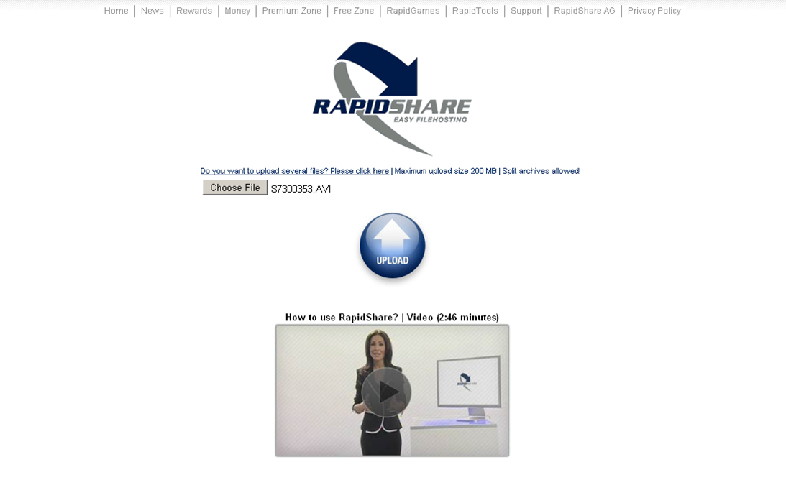
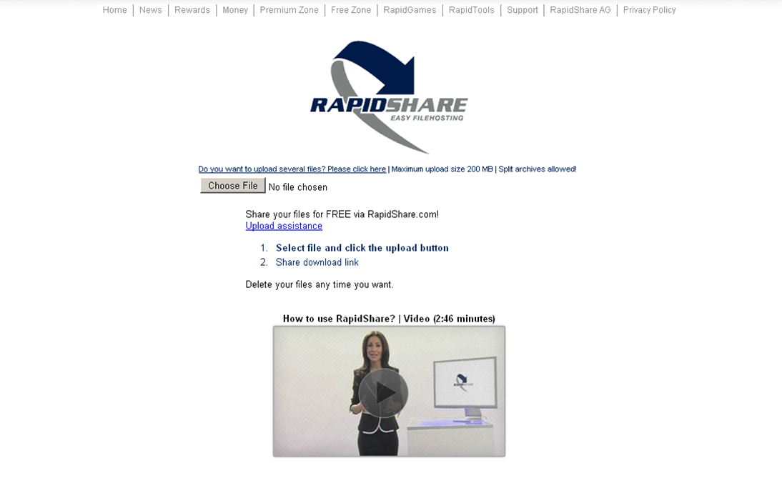
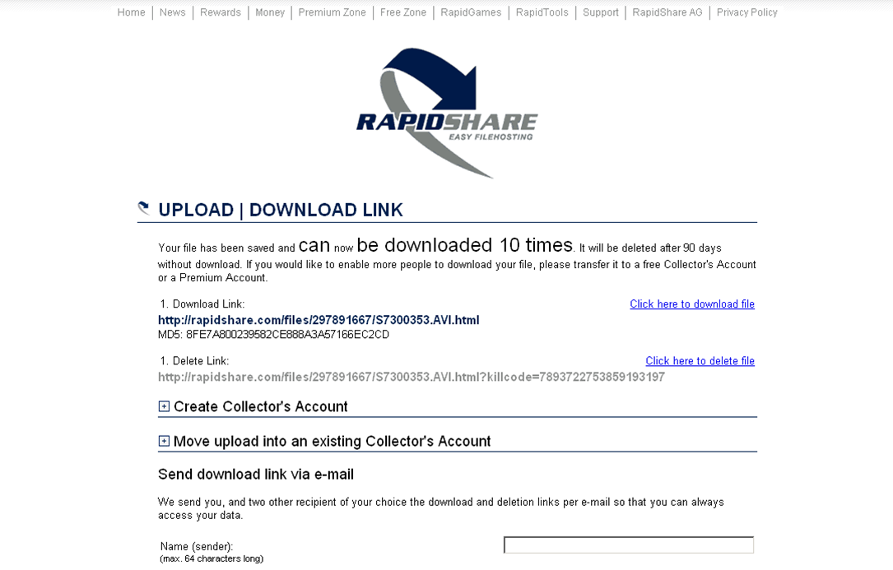

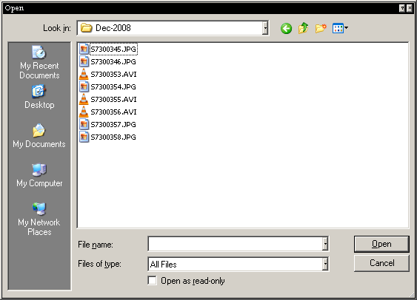


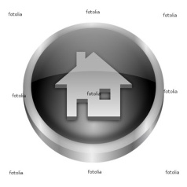


Upload Phase

Slide 6
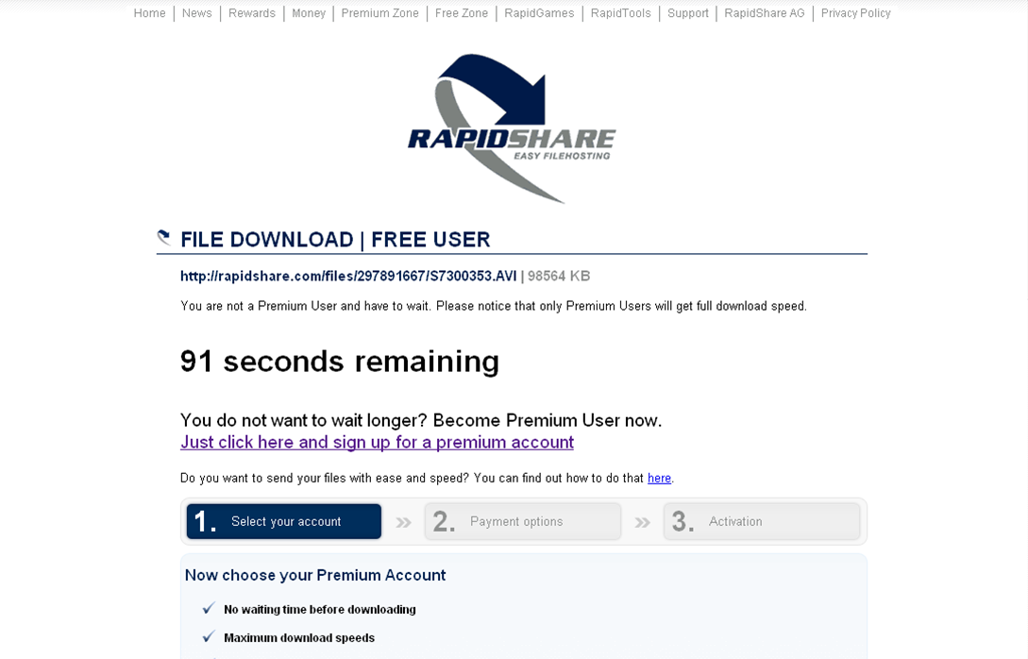
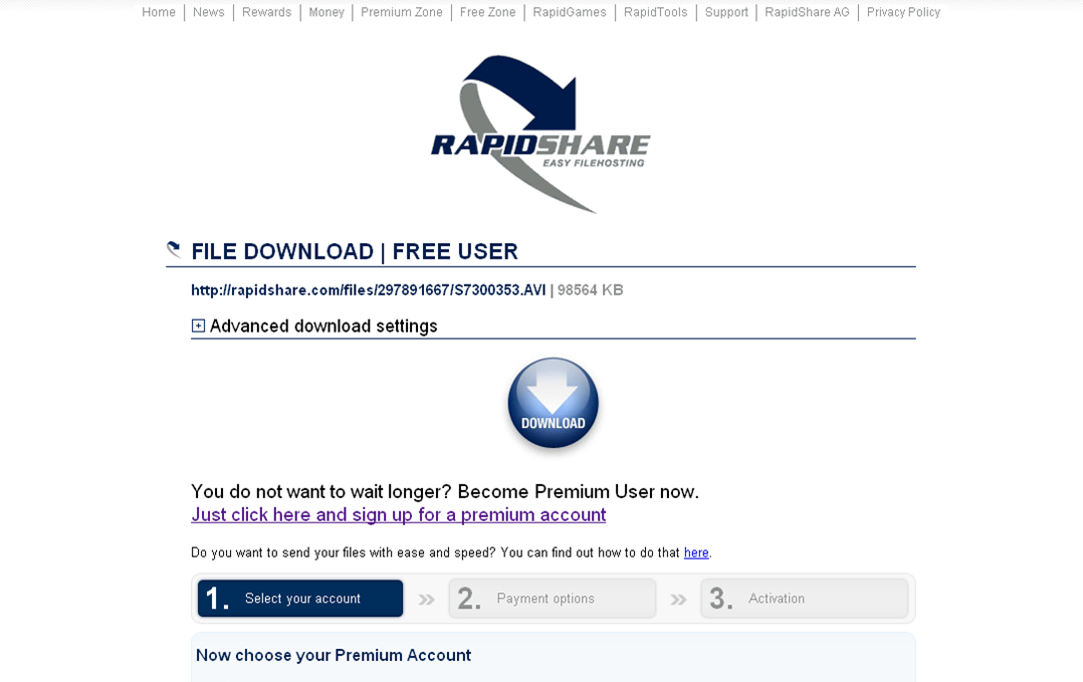
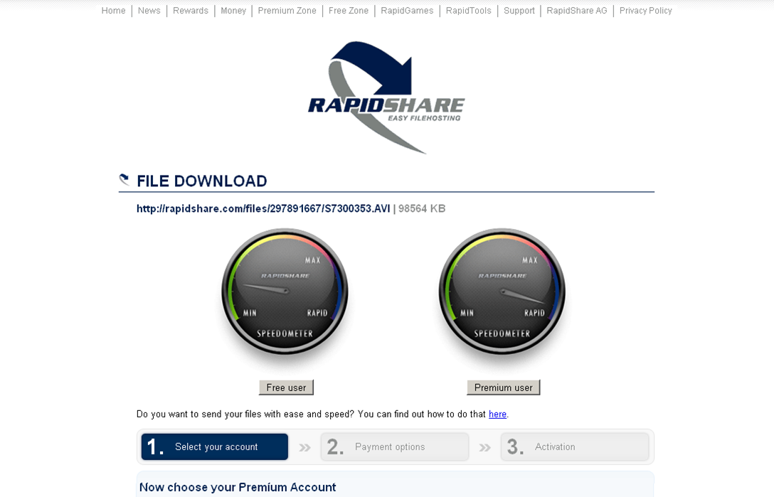
Download Phase

Slide 7
This study
Investigates how One-Click Hosting services work and how they are used
Traffic load
Client characteristics
Infrastructure
Content

Slide 8
Collected Data
Name | Collection period | Total Bytes | Total Flows
Monitor1 | Jun 6 – Oct 23’08 | 60.8TB | 2.2B
Monitor2 | Aug 10 – Dec 2’08 | 214.8TB | 1.4B
Two monitoring points
  Monitor1: NREN, ~10K total users (~750 RS)
  Monitor2: University, ~1K total users (~450 RS)
Identify Web Services by the 2 last domain levels of HTTP requests

Slide 9
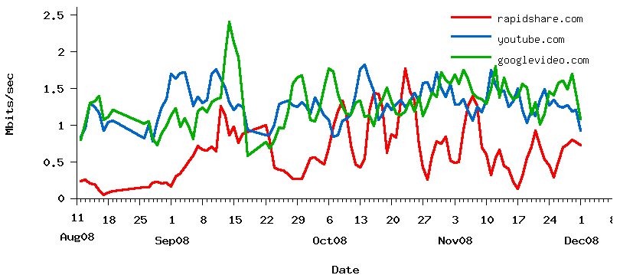
Why rapidshare.com?
rapidshare.com is currently the largest and most popular such service.
  12th most visited site
  2.5M unique users in December 2008
  It is the largest traffic producing OCH service in both our monitoring points.
  Traffic volume similar to YouTube and Google-Video

Slide 10
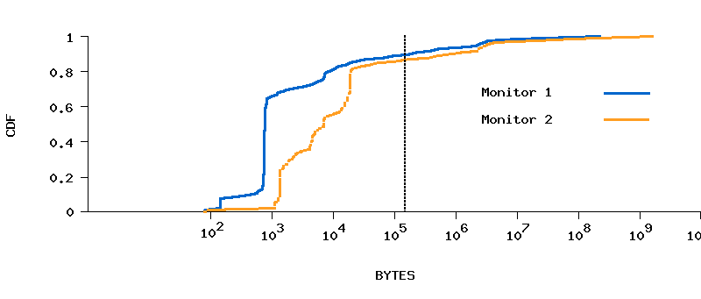
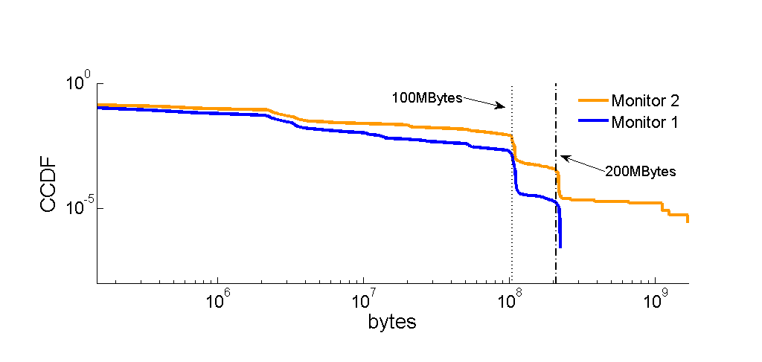
Flow Sizes
90% of the flows < 150KBytes
  Probably page access flows
Download flows range from several MB to 2GB
Daily user activity varies in number of download files

Slide 11
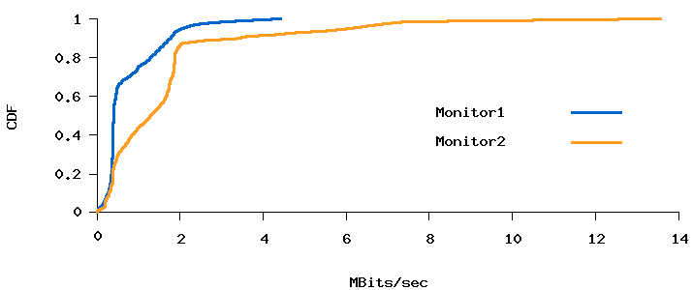
Free Vs. Paying Clients
Rapidshare.com rate-limits free user downloads to 0.2Mbits/sec – 2.0Mbits/sec
Only 20% of the users experience greater download throughputs ➔ Subscribers

Slide 12
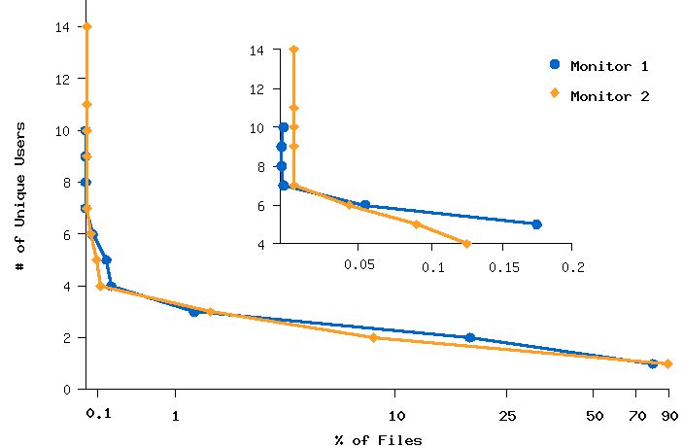
Downloaded Content
File popularity: Unique downloaders per file
75% of the files downloaded only once
Only 0.05% downloaded by more than 5 users

Slide 13
Service Architecture
Try to infer the architecture of the RapidShare service by answering:
  What is the total number of servers used by RapidShare?
    Single-Homing Vs. Multi-Homing
  Where are these servers located?
    Single Vs. Multiple Datacenters
  Is the content located at all the servers?
  Are all the servers serving download requests?
How is this architecture different from traditional content distribution networks?

Slide 14
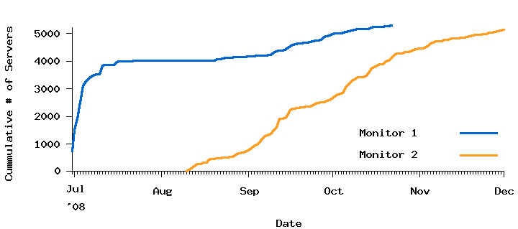
Total Number of Servers Used
5,291 distinct server IP addresses
36 /24 subnets
8 different ISPs
Large increase in number of servers during Sep’08
Infrastructure Update

Slide 15
Server Location
Discover the geographical location of the server infrastructure
Single-datacenter Vs. Multiple geographically distributed datacenters
Performed a number of traceroutes from different planetlab locations
Used minimum RTT to infer distance from landmarks

Slide 16
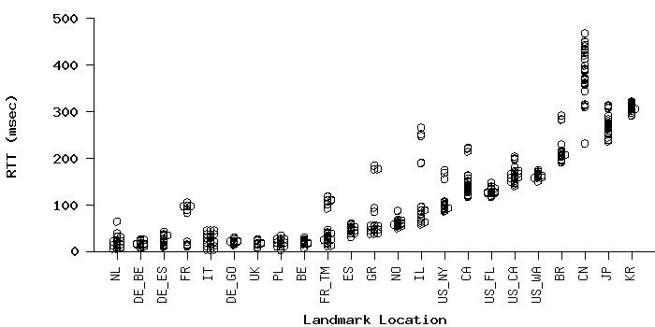
Server Location cont.
Close min-RTT values show a single central datacenter
Datacenter closest to central-European countries

Slide 17
Content Replication
What is the number of servers that store each file?
Used TOR as a geographically distributed downloader
  421 different exit nodes
Requested 20,000 RapidShare file URLs
Each file served by exactly 12 servers (group)
Each file indexed by exactly 1 server

Slide 18
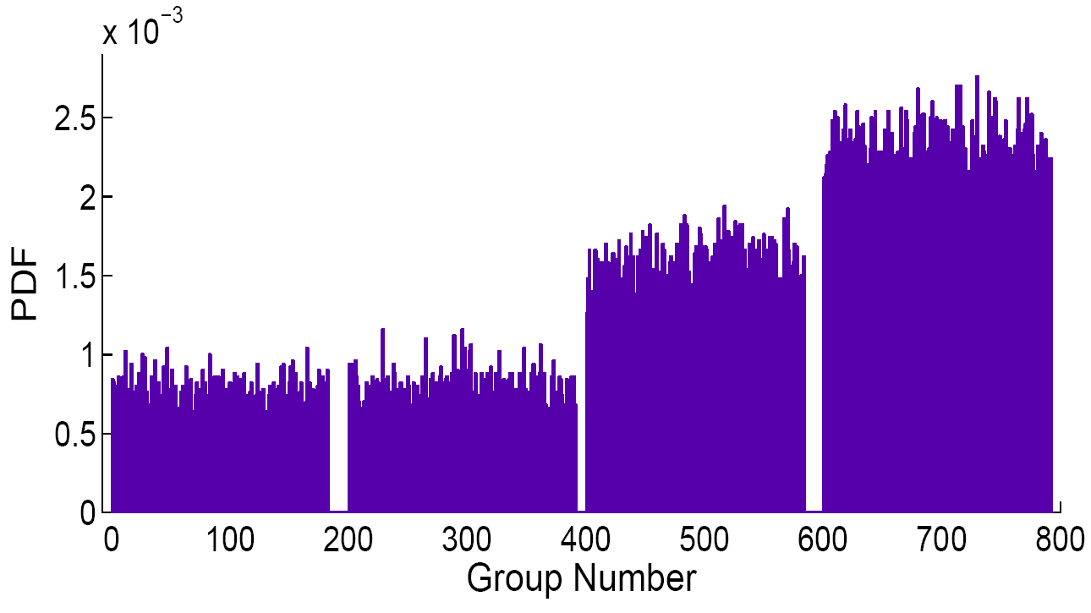
Server Load Balancing
Which server group will host a newly uploaded file?
50000 file upload requests
Log upload group-id
Recently added groups have a higher likelihood of being selected as the upload group

Slide 19
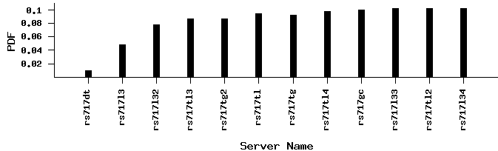
Server Load Balancing (cont)
Which download server of that group will be used upon a download request?
1000 back-to-back file download requests
Log download server
Indexing servers are less likely to be selected as download server

Slide 20
OCH services vs. CDNs
One-Click Hosting services
  Data-center in a single location
  Use multi-homing to:
    Increase reliability
    Decrease cost for the content provider
    Selectively redirect users to least loaded servers
  Content replicated on multiple servers
Content Distribution Networks
  Multiple geographically distributed servers so as to minimize delay observed by client
  Client redirected to the closest (in terms of RTT) server group
  Content replicated on multiple servers
Notes:
Omoiotites, diafores or both?? Ee danton??

Slide 21
Challenging the P2P Paradigm
P2P has been (and continues to be) the most popular File-Sharing mechanism
Can OCH services replace P2P?
BitTorrent Vs. RapidShare.com
  Download Throughput

Slide 22
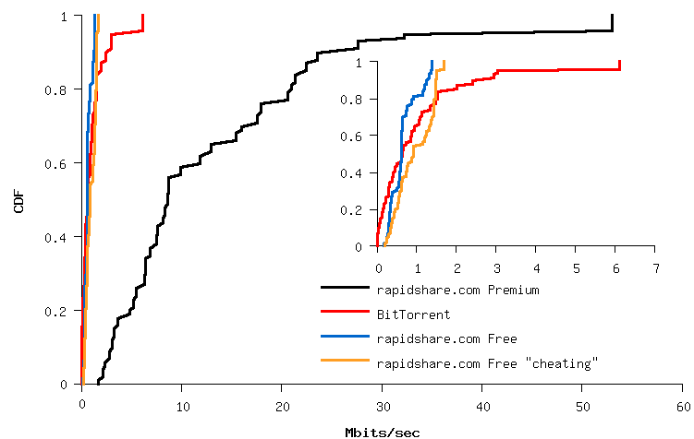
BT Vs. RS: Download Throughput
Download a list of objects from both networks
  Objects of different size
  Objects of different kind
3 types of RS users
  Subscribers
  Free Users
  “Free-Cheating” Users
RS subscribers outperforms open BitTorrent trackers in terms of throughput
Free users experience comparable download experience

Slide 23
Content Indexing Websites
Form an important component for the emergence of OCH services
Crawled 4 different Indexing Websites
Identify the contributors of the traffic
Identify the size of the shared object
Identify the types of shared object

Slide 24
Indexing WebSites
Name | # Indexed Objects | RS Hosted Objects | # of Stale Files | # of Uploaders
egydown.com | 972 | 787 | 134 (17%) | N/A
rapidmega.info | 942 | 893 | 116 (13%) | 9
rslinks.org | 12124 | 11841 | 64 (0.5%) | 21
rapidshareindex.com | 54327 | 36522 | 7052 (19.3%) | 18
Less than 20% of the files are not available
Only a small number of users upload content
Users share mostly videos and applications
Different communities observed in different websites

Slide 25
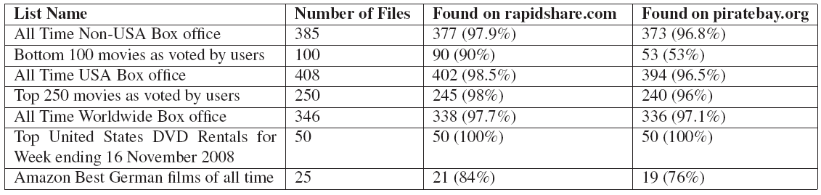
BT Vs. RS: Content Availability
Searched for a number of different files in both network
Rapidshare.com holds at least as much objects as BitTorrent

Slide 26
Content Contributors
A small number of the users is responsible for most of the content uploaded

Slide 27
Shared Objects
Users share mostly Videos and Applications
Different communities can be observed in different WebSites

Slide 28
Copyrighted Material
Manually observed 100 most recent objects uploaded in each WebSite.
In all cases more than 84% of the Objects are copyrighted.

Slide 29
Conclusions
Currently responsible for 10% of the daily traffic in our traces
  60% of daily Web traffic
Most files are downloaded only once
All servers at multihomed single datacenter
  Very different than CDN architecture
OCH services are a promising alternative to P2P for file-sharing
Free users experience similar performance with BitTorrent Open tracker users
  Subscribers (~20%) experience better performance
Most users do not contribute on sharing files (only download)

Slide 30
Backup slides

Slide 31
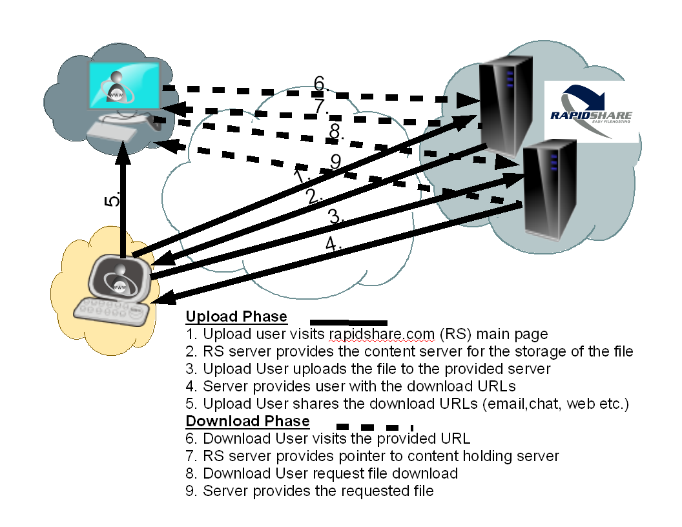
How do OCH Services Work

Slide 32
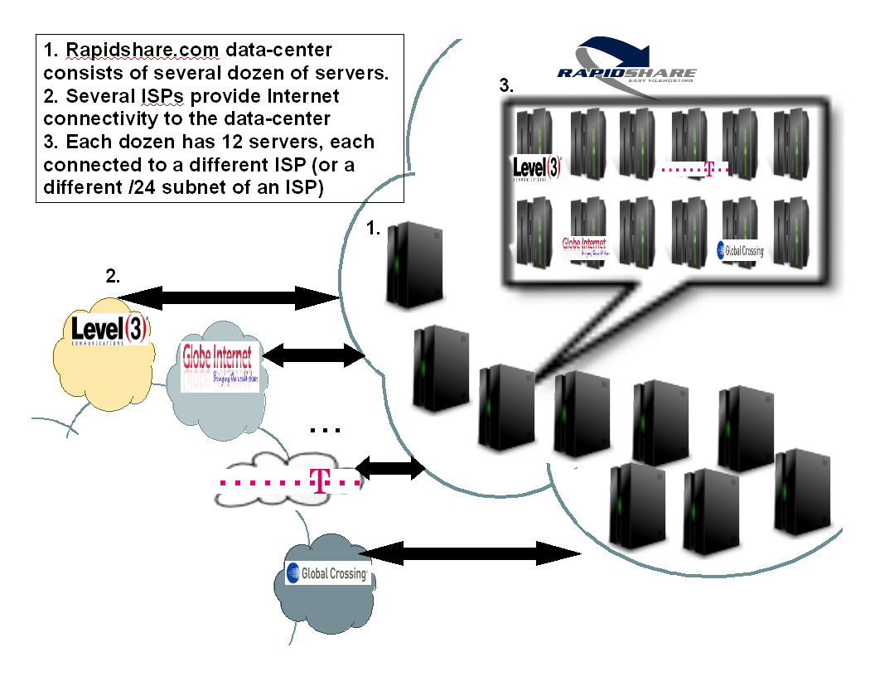
Derived Architecture

