Slide 1
Understanding KaZaA
Jian Liang
Rakesh Kumar
Keith Ross
Polytechnic University
Brooklyn, N.Y.

Slide 2
Purpose of Measurement Study
Try to understand highly successful file-sharing system
Overlay topology and dynamics
Peer selection
Index management

Slide 3
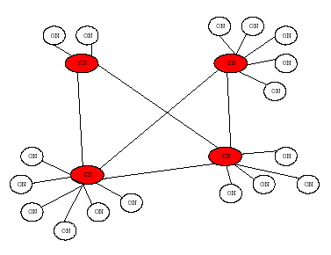
Big Picture of Overlay
Two layer hierarchy
Ordinary Node (ON)
Super Node (SN)
SNs are generally more powerful machines (CPU, network bw) and they are NOT behind NATs

Slide 4
FastTrack architecture
Each ON has a parent SN node
For each shared file, ON uploads to parent SN:
Filename, ContentHash, file descriptors (metadata)
Parent SN provides ON with “SN refresh list”
Up to 200 alive SNs, then stored at ON cache
For each SN, the list includes: IP address, port number, SN workload (defined as ?), freshness, and timestamp
SNs also exchange SN refresh lists
Each SN maintains local index for all children ONs
Each SN maintains TCP connections with other SNs
Overlay net
If an SN cannot answer a query, it forwards query to other SN peers
TTL-limited flooding
Actual file transfer is directly between peers (not through overlay) using HTTP
All signaling traffic is encrypted

Slide 5
Measurement Apparatus
KaZaA Sniffing Platform
KaZaA Probing Tool

Slide 6
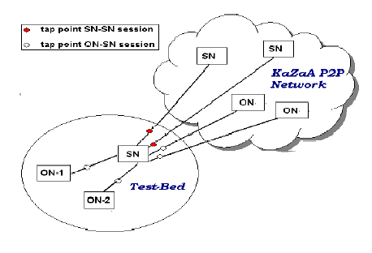
KaZaA Sniffing Platform
Poly (Ethernet)
Home (cable modem)

Slide 7
KaZaA Probing Tool
Campus & home based probing
Probe arbitrary SNs
Retrieve their SN refresh lists
Obtain workload of probed SN

Slide 8
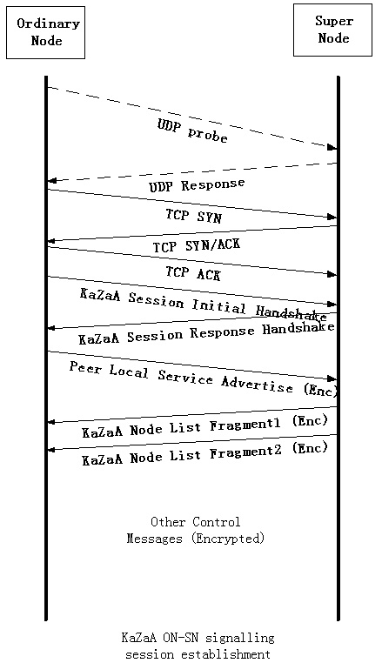
Signaling Protocol
ON-SN session initial
(repeat for 5 SNs)
SN-SN session initial

Slide 9
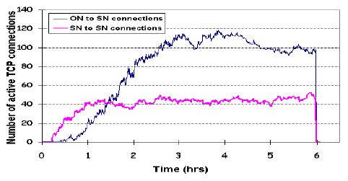
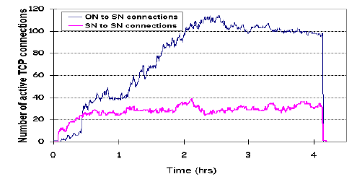
TCP Connections Evolution at instrumented SN node
Poly campus 4 – 6 hour measurement
Cable modem 7-11 hour measurement

Slide 10
Some basic calculations
Estimate total number of SNs, assuming about 3M users (typical in 2004)
About 25000-40000 SNs
Estimate probability of SN-SN link
About 0.1%

Slide 11
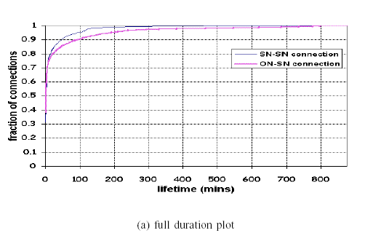
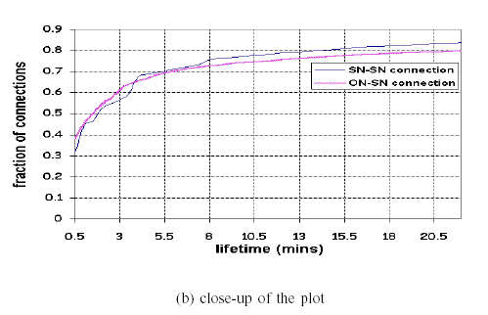
Signaling Sessions Lifetime
Measured over a period of 12 hours
Avg duration: 34mins (ON-SN) and 11mins (SN-SN)
30-40% of connections (both types) last for less than 30 seconds!
What causes short-lived ON-SN connections?
What causes short-lived SN-SN connections?

Slide 12
Parent selection
Recall that ON receives a list of 200 SNs from its parent SN
Then, it can select a new parent
How would you select the parent SN?

Slide 13
SN workload vs # of connections
7 - 11 hours TCP connections evolution
7 - 11 hours workload values evolution

Slide 14
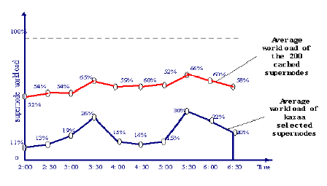
Peer Selection: the workload of the SN clearly matters

Slide 15
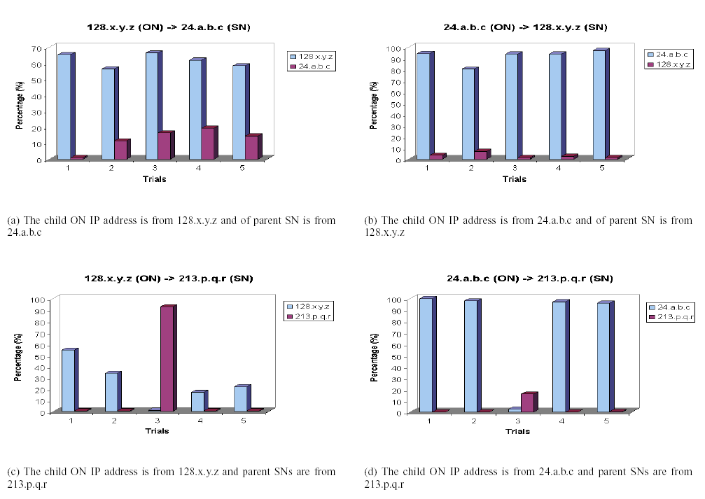
Locality in Peer Selection: (graphs show percentage of SNs in the SN list having common prefix with child ON and parent SN)

Slide 16
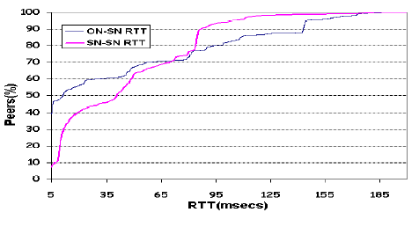
Peer Selection: it appears that RTT also matters: 40% of ON-SN connections have RTT<5ms 60% of SN-SN connections have RTT<50ms

Slide 17
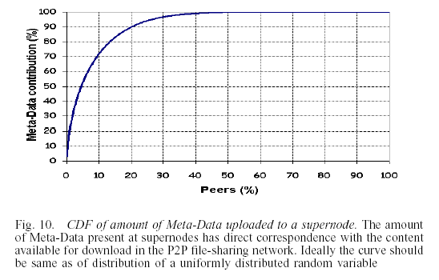
Index Management: 1) No index exchange between SNs 2) SN purges metadata of ON as soon as that child disconnects from parent 3) Highly skewed contribution of metadata by different peers

Slide 18
Summary of Results
20,000 ~ 40,000 active supernodes
Each SN connects to approx. 0.1% of other SNs
Highly dynamic connections: over 35% SN-SN durations are less than 30 sec.

Slide 19
Summary of results
Peer selection uses IP prefix match, workload, RTT and freshness
No index exchange between SNs, but query forwarding
Skewed content distribution: 20% peers provide 70% metadata for sharing

