Slide 1
A Confidence-Based Approach to Multi-Robot Demonstration Learning
Sonia Chernova Manuela Veloso
Carnegie Mellon University
Computer Science Department

Slide 2
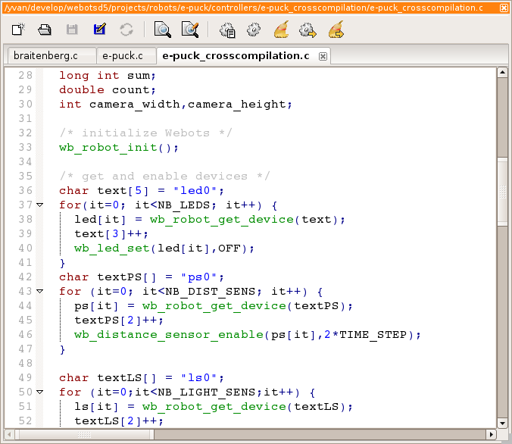
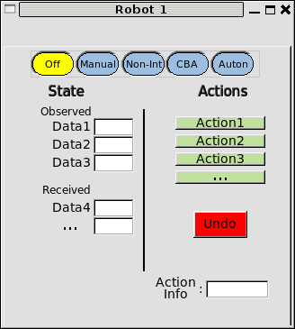


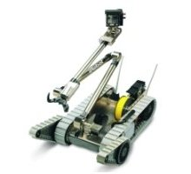
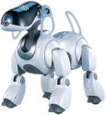
Policy Development
Traditional Policy Development:
Access/select sensor data
Develop actions
Code the policy (C++, Python, …)
Learning from Demonstration:
Access/select sensor data
Develop actions
Provide demonstrations

Slide 3
Research Questions
How can we teach a single robot through demonstration by enabling both the robot and the teacher to select demonstration examples?
How can we teach collaborative multi-robot tasks through demonstration?

Slide 4





Single Robot Learning
  Confidence-Based Autonomy (CBA) algorithm
    Confident Execution
    Corrective Demonstration
Environment
state
Policy
action
[Sonia Chernova and Manuela Veloso. Interactive Policy Learning through Confidence-Based Autonomy. Journal of Artificial Intelligence Research. Vol. 34, 2009.]
demonstration request
demonstration
demonstration
Teacher

Slide 5
Task Representation
sensor data
Robot state
Robot actions
Training dataset:
Policy represented by classifier
  (e.g. Gaussian Mixture Model, Support Vector Machine, etc)
  policy action
  decision boundary with greatest confidence for the query
  classification confidence w.r.t. decision boundary
f₂
f₁

Slide 6
Assumptions
Teacher understands and can demonstrate the task
High-level task learning
  Discrete actions
  Non-negligible action duration
State space contains all information necessary to learn the task policy
Robot is able to stop to request demonstration
  … however, the environment may continue to change

Slide 7

Confidence-Based Autonomy
Policy
Request
Demonstration
?
s_{i}
Current
State
No
Yes
Request
Demonstration
a_{d}
s₁
s₂
s₃
s₄
…
s_{i}
…
s_{t}
Add Training
Point (s_{i}, a_{d})
Execute
Action
a_{p}
Time
Relearn Classifier
Execute
Action a_{d}

Slide 8
Confidence-Based Autonomy
Confident
Execution
s_{i}
Policy
Request
Demonstration
?
No
Yes
Corrective
Demonstration
Request
Demonstration
a_{d}
a_{c}
Execute
Action
a_{p}
Add Training
Point (s_{i}, a_{d})
Add Training
Point (s_{i}, a_{c})
Relearn
Classifier
Teacher
Relearn Classifier
Execute
Action a_{d}

Slide 9
Research Questions
How can we teach a single robot through demonstration by enabling both the robot and the teacher to select demonstration examples?
How can we teach collaborative multi-robot tasks through demonstration?

Slide 10


Multi-Robot Learning from Demonstration
Challenges
  Limited human attention
  Human-robot interaction
  Teaching collaborative behavior

Slide 11
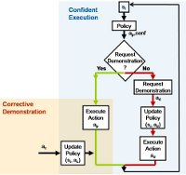

flexMLfD Multi-Robot Learning from Demonstration
CBA
CBA
CBA
demonstrations
demonstrations
demonstrations
Teacher

Slide 12
Teaching Collaborative Behavior
Robots perform complementary actions based on individual policies
Without Communication
Implicit Coordination
With Communication
Coordination through Shared State – communication occurs automatically
Coordination through Active Communication – demonstration of communication actions

Slide 13
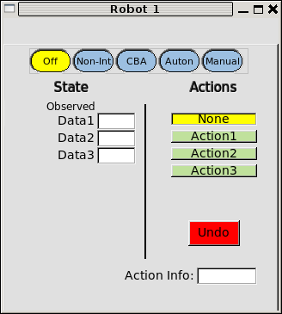
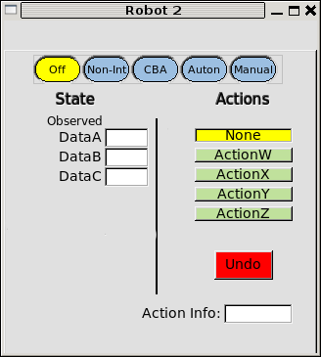
Implicit Coordination
  Coordination without communication
  Observed state and environmental effects of physical actions enable complementary behaviors
2.3
4.9
2.0
128.9
0.01
13.1

Slide 14
Coordination through Shared State
Coordination based on state features that are automatically communicated to teammates each time their value changes.
2.3
4.9
2.0
128.9
0.01
13.1

Slide 15
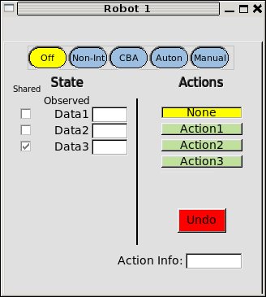
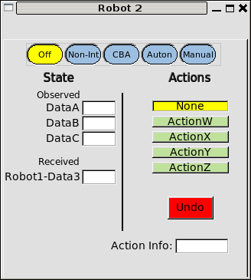
Coordination through Shared State
2.3
4.9
2.0
128.9
0.01
13.1
2.0

Slide 16
Coordination through Shared State
From: Robot1
Label: Data3
Value: 3.0
2.3
4.9
3.0
128.9
0.01
13.1
2.0
3.0

Slide 17
Coordination through Active Communication
Coordination based on demonstrated communication actions that are incorporated directly into the robot's policy
2.3
4.9
2.0
128.9
0.01
13.1

Slide 18
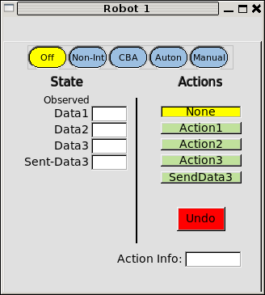
Coordination through Active Communication
2.3
4.9
2.0
128.9
0.01
13.1
2.0
2.0

Slide 19
Coordination through Active Communication
2.3
4.9
128.9
0.01
13.1
3.0
1.0
9.0
7.5
2.0
2.0

Slide 20
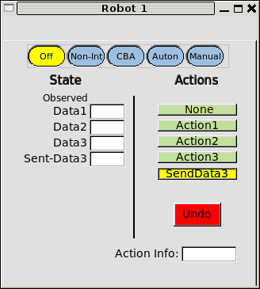
Coordination through Active Communication
From: Robot1
Label: Data3
Value: 3.0
2.3
4.9
3.0
128.9
0.01
13.1
3.0
3.0

Slide 21
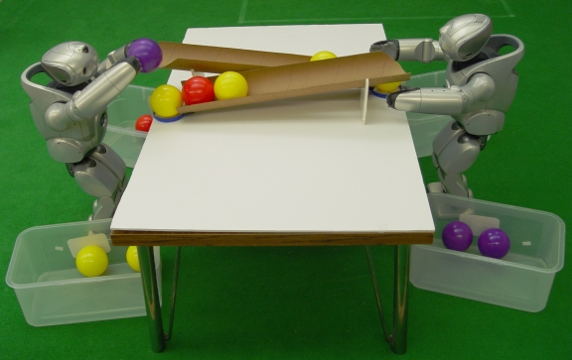
QRIO Ball Sorting Domain
state
actions
Red
Yellow
Blue
Empty
Domain objectives:
  Sort balls into bins by color
  Distribute balls between robots
    Share balls if teammate runs out
    Communication required for collaboration
Drop left, drop right,
pass ramp, wait

Slide 22
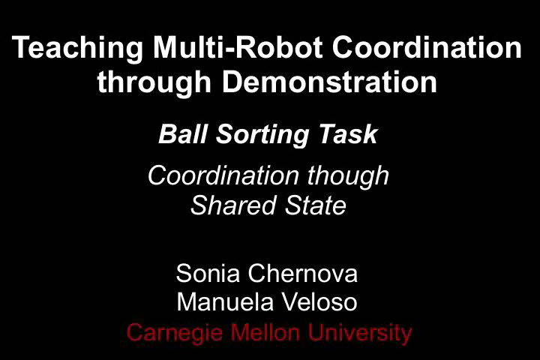
Shared State Video

Slide 23
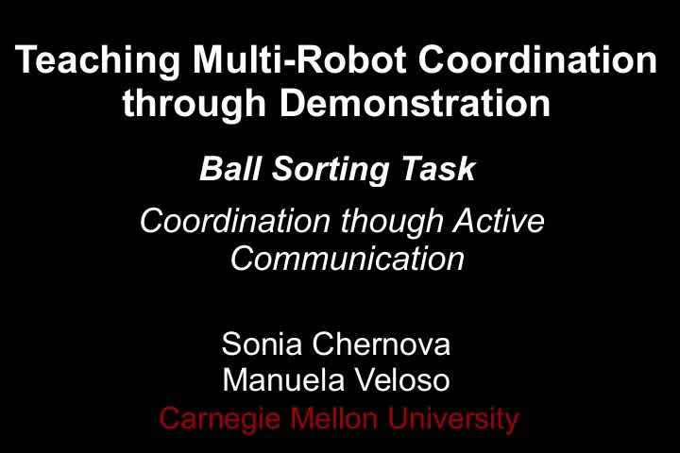
Active Communication Video

Slide 24
Algorithm Comparison
Ball Sorting Task
 | Average Number of Demonstrations
Active Communication | 17.3 ± 2
Shared State | 13.2 ± 2

Slide 25
Algorithm Comparison
Ordered Ball Sorting Task
  Sort balls in order by color (all red first, then blue, then yellow)
 | Avg. Number of Demonstrations | Avg. Number of Communication Messages
Active Communication | 135.0 ± 5.9 | 5.8 ± 1.1
Shared State | 52.6 ±6.6 | 37.7 ± 2.6
Combined | 92.2 ± 4.8 | 5.8 ± 1.1

Slide 26

Playground Domain

Slide 27
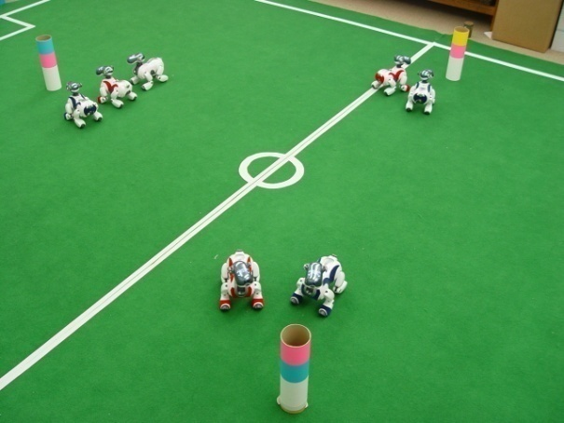
Scalability of Teaching Collaborative Multi-Robot Behaviors
Scalability evaluation with up to 7 AIBO robots
  Synchronous learning start times
  Offset learning start times
  Common policy learning
Conclusions:
  Linear trend for training time, number of demonstrations, etc
  No absolute upper bound on number of robots
  Approach likely to be limited by domain-specific factors
    training time
    acceptable demonstration delay

Slide 28
Summary
  flexMLfD multi-robot learning framework
    Each robot learns individual policy using Confidence-Based Autonomy
  Three techniques for teaching collaborative
  multi-robot behavior
    Implicit coordination
    Coordination through active communication
    Coordination through shared state
  Scalability analysis using up to 7 robots

Slide 29
Questions?

Slide 30
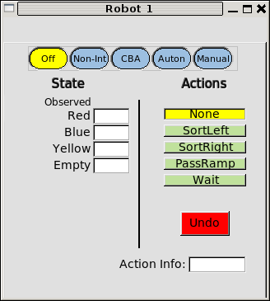
State and Action Selection
Robot Sensors
Robot Actions
Camera Microphone
Forward Left Right TurnLeft TurnRight DropLeft DropRight PassRamp Gesture Sit Wait Wave Search WalkToOpenSpace …
Buttons Network
DropLeft DropRight
PassRamp
Wait
State Features
R G B NumAIBOsNear HearBell Q1_{dist} Q2_{dist} Q1_{angle} Q2_{angle} Q1_{near} Q2_{near} InOpenSpace Empty Button1 Button2 …
RedBall YellowBall BlueBall
RedBall YellowBall BlueBall
Empty
Task
Configuration
Communication Data
Identify task-relevant state features and actions
Communication actions
Internal state
Shared state

Slide 31
Autonomous Ball Sorting Video

Slide 32
Types of Communication Data
Each state feature that must be communicated for coordination may be:
  Relevant over its full range of values
    Communicated each time its value changes
  Relevant over a reduced range of values
    Communicated only when relevant

